Slide 1
EMPLOYEE DATA ANALYSIS USING EXCEL
STUDENT NAME: SHARMILA.P
REGISTER NO : 312204626,C181E80E4FF719F83D74E4D6EEAC0083
DEPARTMENT : COMMERCE
COLLEGE : K.C.S. KASI NADAR COLLEGE OF ARTS & SCIENCE

Slide 2
PROJECT TITLE
EMPLOYEE RATING CARD ANALYSIS

Slide 3

AGENDA
Problem Statement
Project Overview
End Users
Our Solution and Proposition
Dataset Description
Modelling Approach
Results and Discussion
Conclusion
3/21/2024 Annual Review

Slide 4

PROBLEM STATEMENT
To identify employee rating with employee database

Slide 5

PROJECT OVERVIEW
In this analysis, I aim to streamline the process of identifying employee ratings based on their department, gender, and technical knowledge using excel, with the help of below stated tools in excel
Table
Slicers
Pivot chart (line chart & pie chart)
Pivot formula

Slide 6

WHO ARE THE END USERS?
Civil engineering
Computer engineering
Electrical engineering
Electronics engineering

Slide 7

OUR SOLUTION AND ITS VALUE PROPOSITION
Visual Representation
Chart and graphics
2. User- Friendly interface
Accessibility
Ease of Use
Scenario Analysis
Used to analyse different situations
Comprehensive Data Management
Data Organisation
Data Integration
Advanced Analytical Tools
Formulas and Function
Pivot table

Slide 8
DATASET DESCRIPTION
DATA OVERVIEW
The dataset contains information about employees within the organization, including their scores on Punctuality and Teamwork. This data is used to calculate the total score for each employee.
DATA FIELDS
Problem Solving
Punctuality
Communication
Technical knowledge
Team work
Meeting headline

Slide 9
MODELLING
Data Cleaning
Creating Table
Creating pivot chart
Creating dashboard
Inserting pivot chart in dashboard
Inserting formula in dashboard to make interaction
Creating interactive dashboard by putting all together elements
9

Slide 10
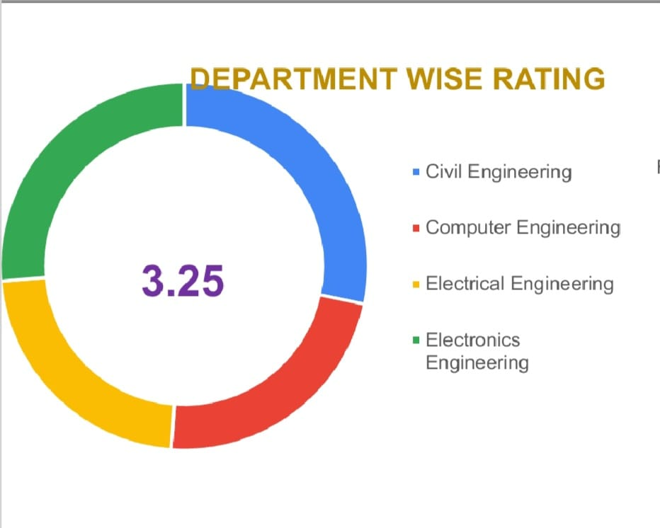
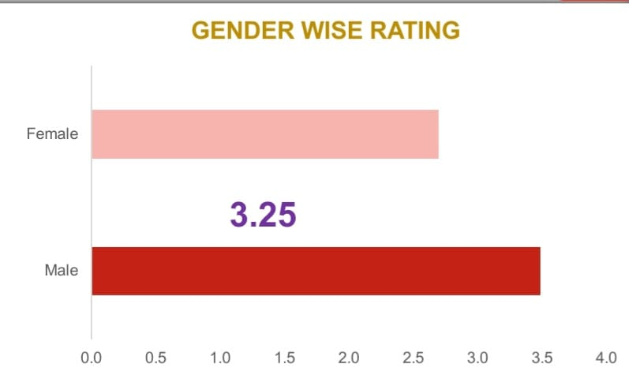
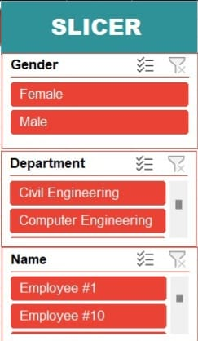
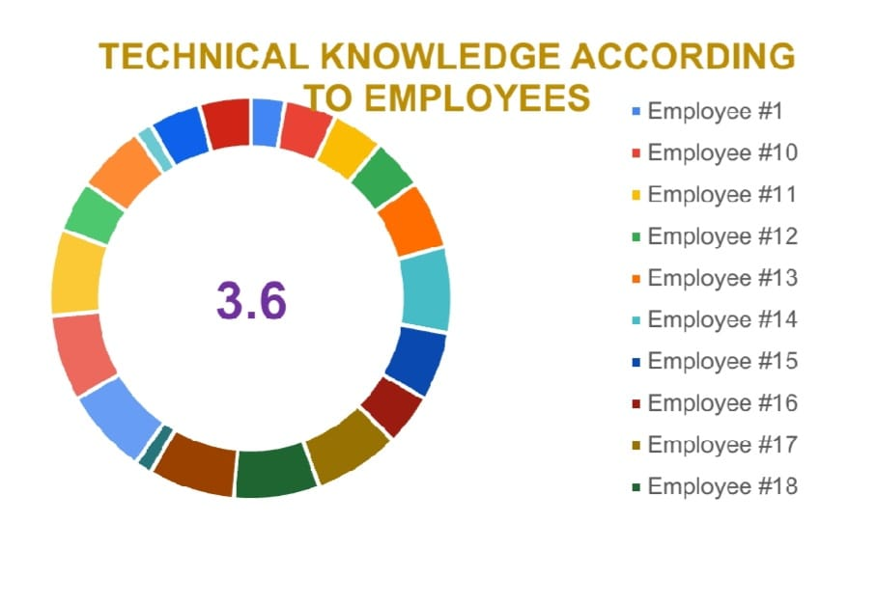
RESULTS
(Click to open file)
10

Slide 11
CONCLUSION
Employee Rating Analysis using Excel helps optimize future employee performance, leading to improved outcomes for both team members and the organization. It enables organizations to identify top performers for talent planning purposes and provides supporting evidence when addressing poor performance, such as in dismissal cases. Additionally, it allows employees to understand how they compare to their peers.

