Slide 1
NO POVERTY

Slide 2
agenda
INTRODUCTION 3
PROBLEM STATEMENT 4
SOLUTION 5
ADVANTAGES 6
FLOW GRAPH 11

Slide 3
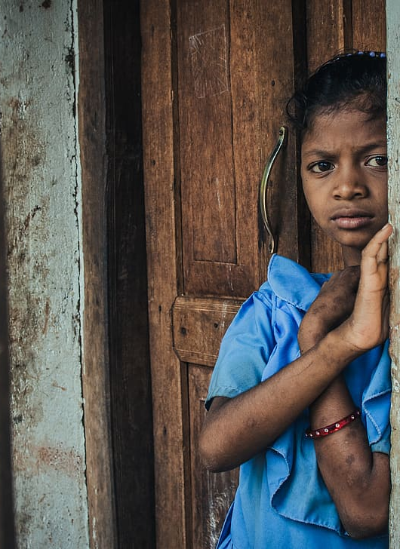
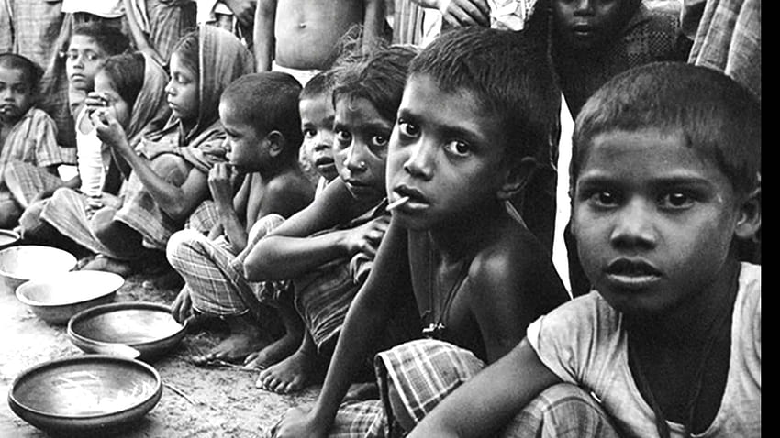
What is poverty?

Slide 4
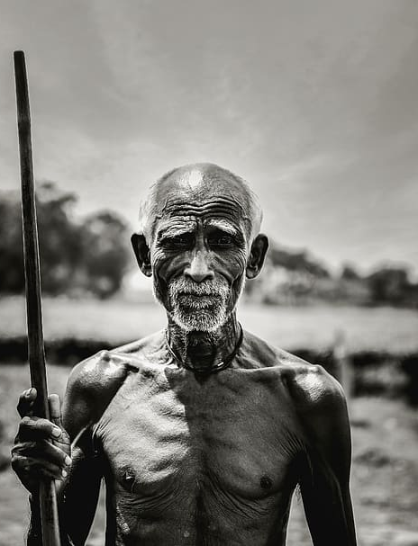
Why poverty especially in farmers?
The Reality of the world

Slide 5
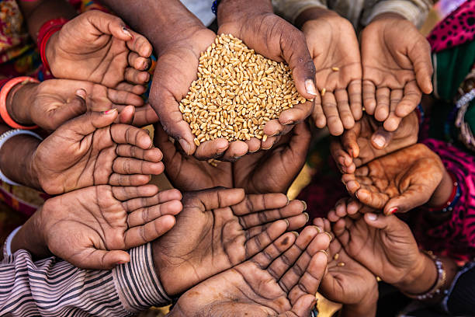
Problem Statement
“Despite being the backbone of the economy, farmers across the globe, particularly in developing nations, continue to grapple with pervasive poverty. This enduring issue stems from a multitude of interconnected challenges, including but not limited to limited access to financial resources, inadequate infrastructure, unpredictable weather patterns exacerbated by climate change, lack of technological advancements, poor market access, and exploitative trade practices.”

Slide 6
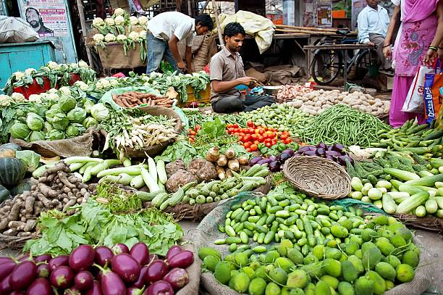
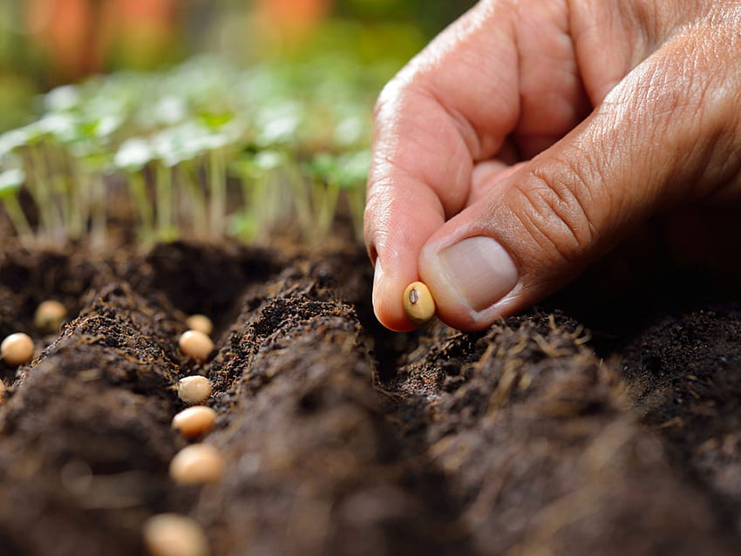
When does the problem occur & its root cause:
Low agricultural productivity
No market accessibility and price volatility
Lack of Crop disaster management
Poor quality of seeds and fertilizers
Adverse weather conditions
Lack of information about the market opportunities.

Slide 7
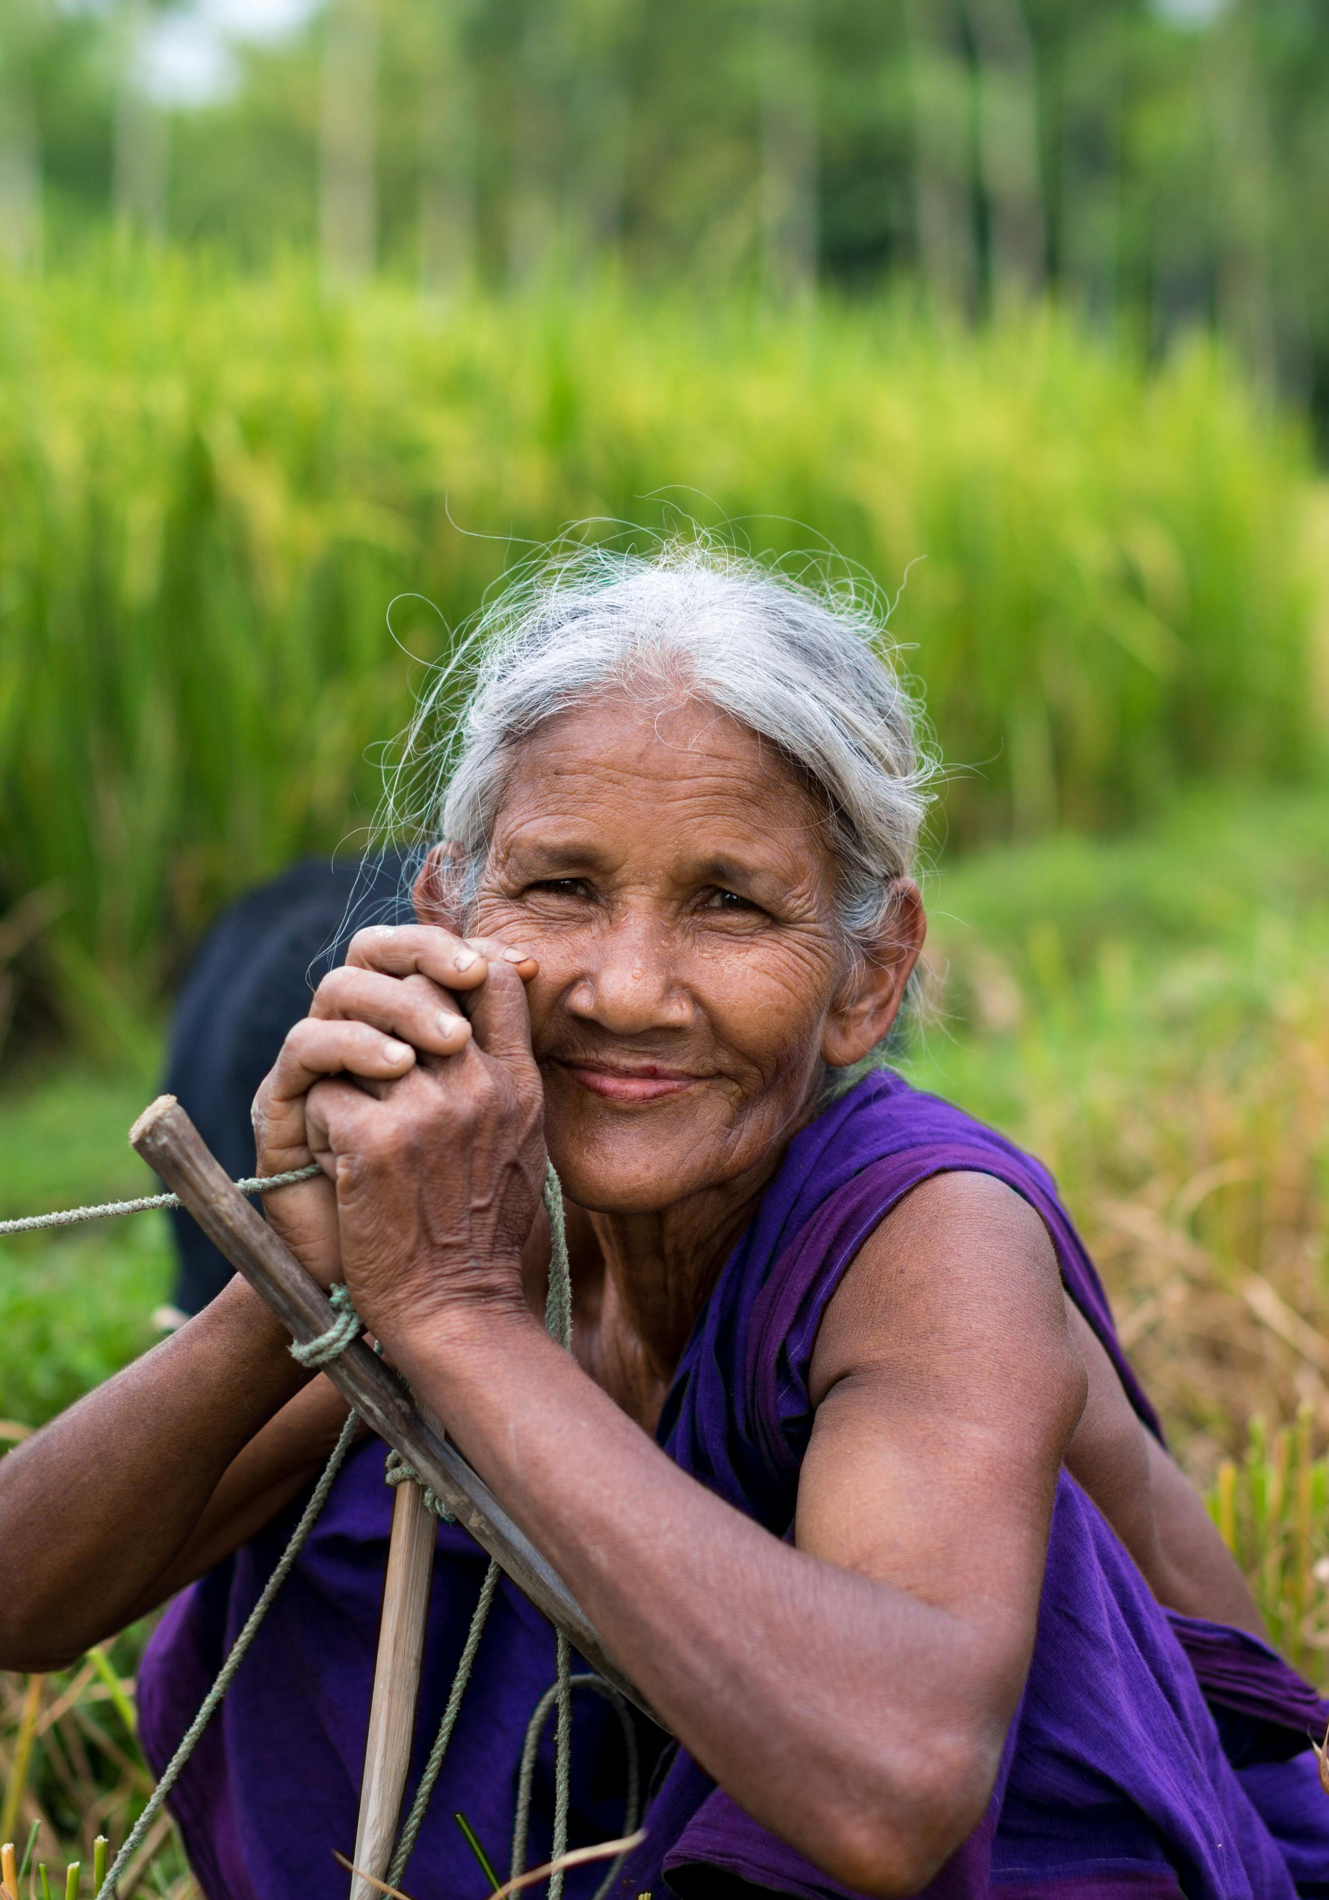
Solution
A website exclusively for the farmers to sell their crops and products online to the consumers.
Increased selling prices thereby being beneficial.
Educating farmers about various policies and schemes that are implemented by the government.
Availing high quality seeds and crops being available for the farmers.
Intimate about the price fluctuation in the crops within the market.

Slide 8
FLOWGRAPH:
Choose your role
Customer
Farmer
Choose the required items and add them in the cart
Verify you are farmer
Purchase the required items directly from the farmers
Add all the items of your harvest
Logout

Slide 9
ADVANTAGES:
Awareness and Education
Resource Hub
Advocacy and Mobilization
Networking and Collaboration
Impact Measurement and Reporting

Slide 10
thank you
NIKITHAA M
SHARMILA R
PRASANNA DEVI M
Team Name: The Deciders

