Slide 1
Noodles Crypto Analytics Platform
End-to-end analytics with Python, MySQL and Power BI
Prepared by
Sharmila Arockiyasamy
Noodles Crypto Analytics • Task 9

Slide 2
Executive Summary
• Combines source JSON, Python preparation, a MySQL warehouse and Power BI
• Supports currency and social-engagement analysis
• Interactive reports provide filtering, comparison and drill-through
• Verify scale/performance claims before presenting
Noodles Crypto Analytics • Task 9

Slide 3
Business Problem
• Manual analysis across source files is hard to repeat
• Different schemas require normalization and validation
• Stakeholders need consistent metrics and clear filtering
• Goal: documented, repeatable reporting
Noodles Crypto Analytics • Task 9

Slide 4
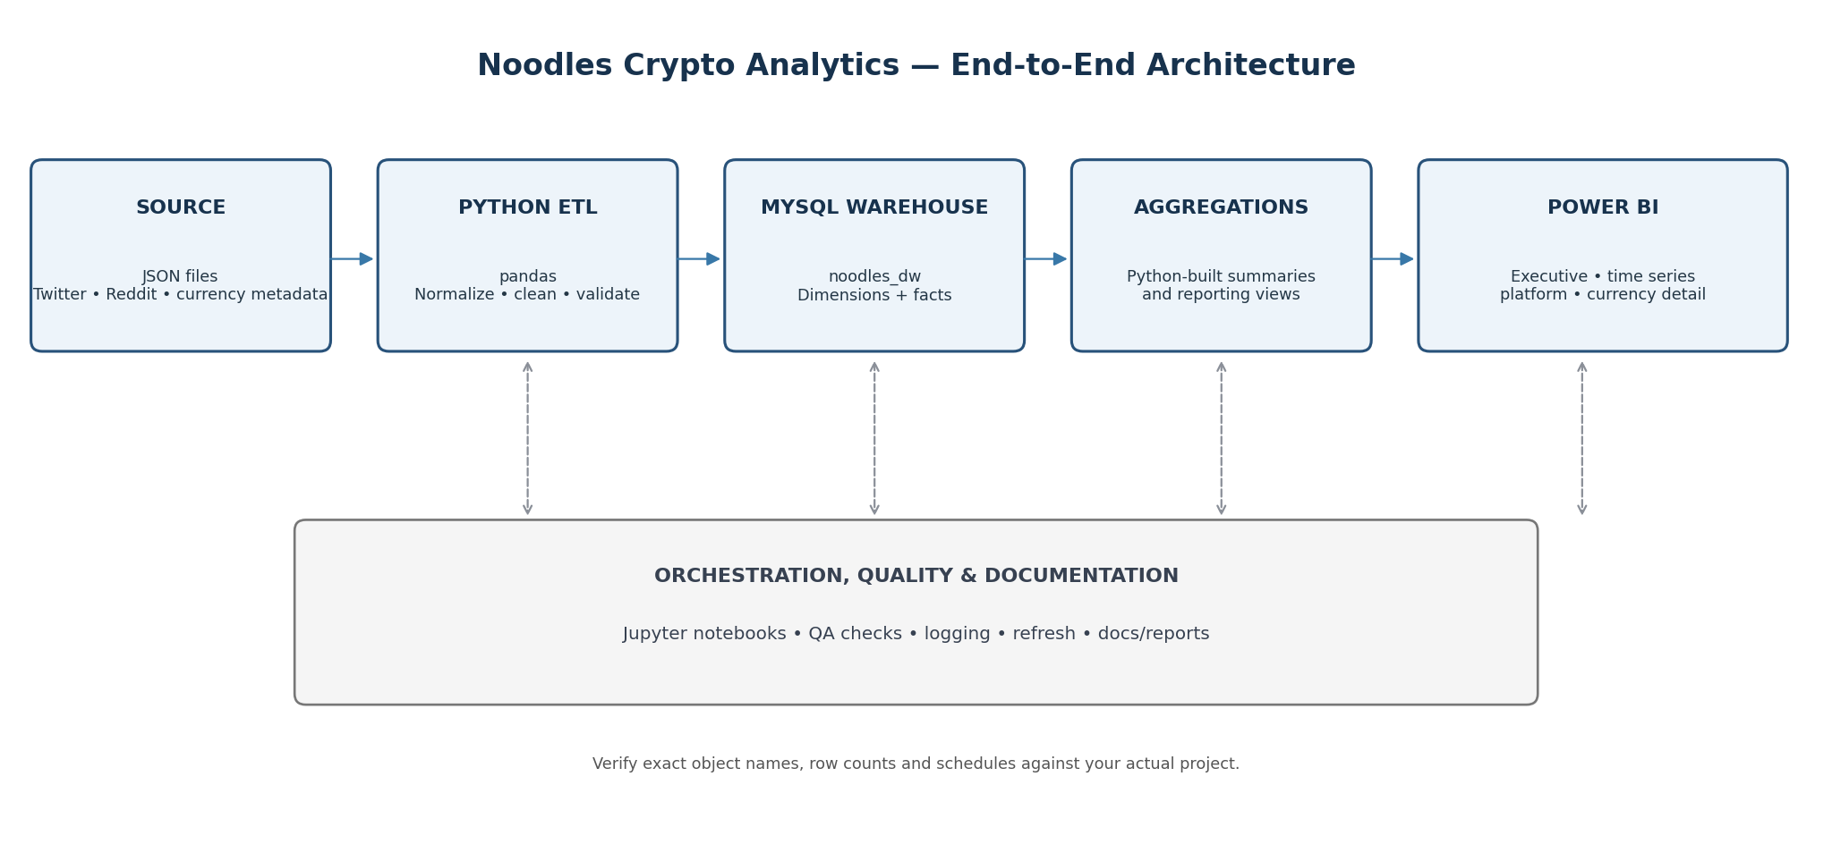
Technical Architecture
JSON → Python/pandas → MySQL noodles_dw → aggregation views → Power BI
Noodles Crypto Analytics • Task 9

Slide 5
Data Model
• Dimensions: DimCurrency, DimDate, DimPlatform
• Fact: FactSocialEngagement
• Aggregation and reporting views support BI
• Verify exact keys, grain and row counts locally
Noodles Crypto Analytics • Task 9

Slide 6
Python ETL
• Read JSON into data frames
• Normalize schema, symbols and data types
• Handle missing values and validate records
• Load prepared data into the warehouse
• Demonstrate actual notebook output
Noodles Crypto Analytics • Task 9

Slide 7
Data Quality
• Check nulls and required fields
• Check duplicates and key uniqueness
• Validate relationships and orphan records
• Compare source, staging and warehouse counts
• Use actual QA screenshots; do not invent quality percentages
Noodles Crypto Analytics • Task 9

Slide 8
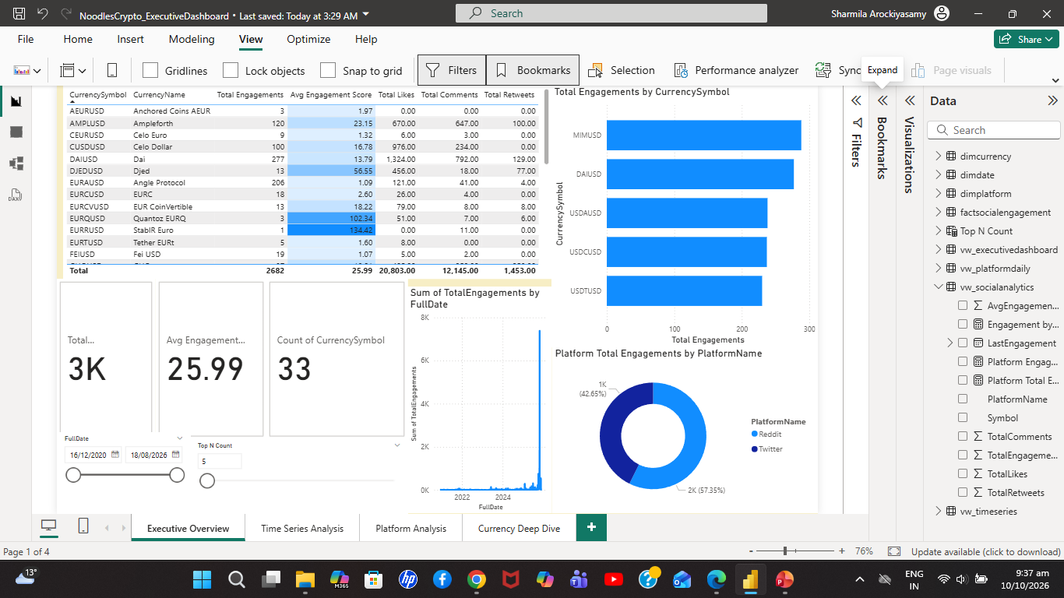
Executive Dashboard
• KPI cards summarize the current filter context
• Currency table and Top N selector support ranking
• Date slicer controls analysis period
• Tooltips and platform breakdown add context
Noodles Crypto Analytics • Task 9

Slide 9
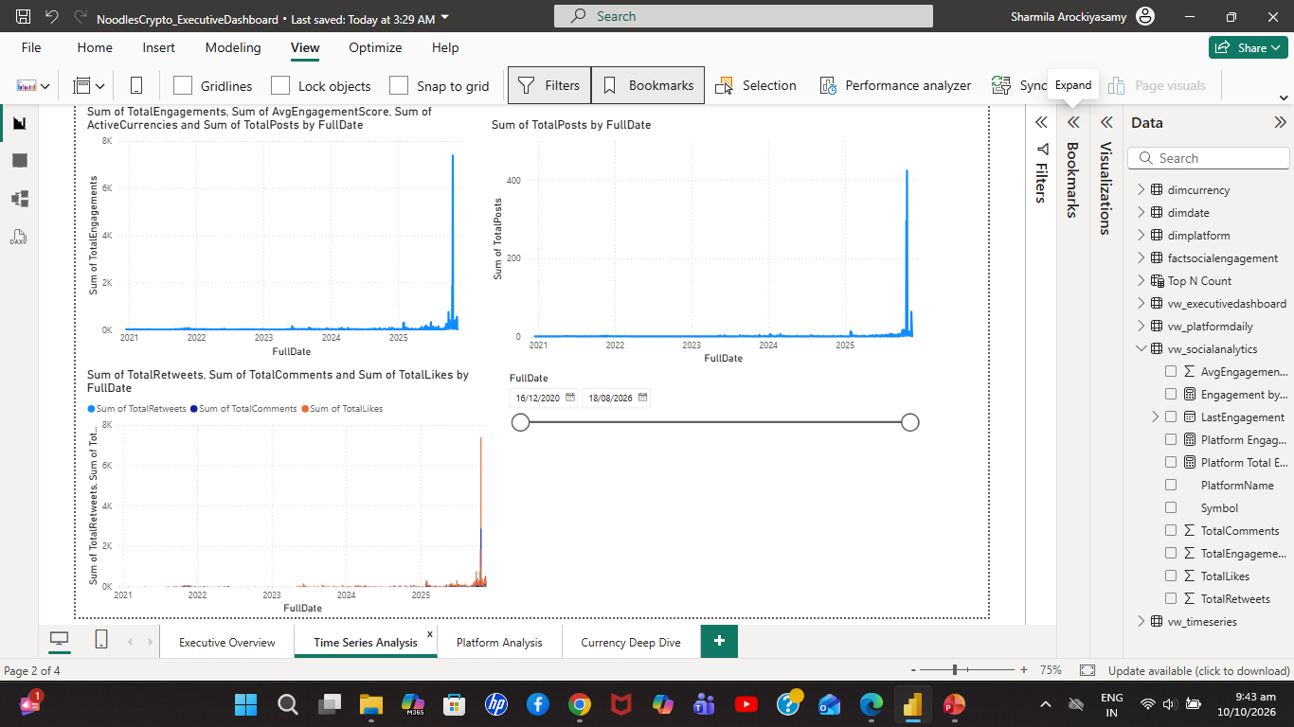
Time Series and Platforms
• Explore engagement over time
• Compare total engagement and average score by platform
• Use filters to focus analysis
• Check unusual spikes against source data
Noodles Crypto Analytics • Task 9

Slide 10
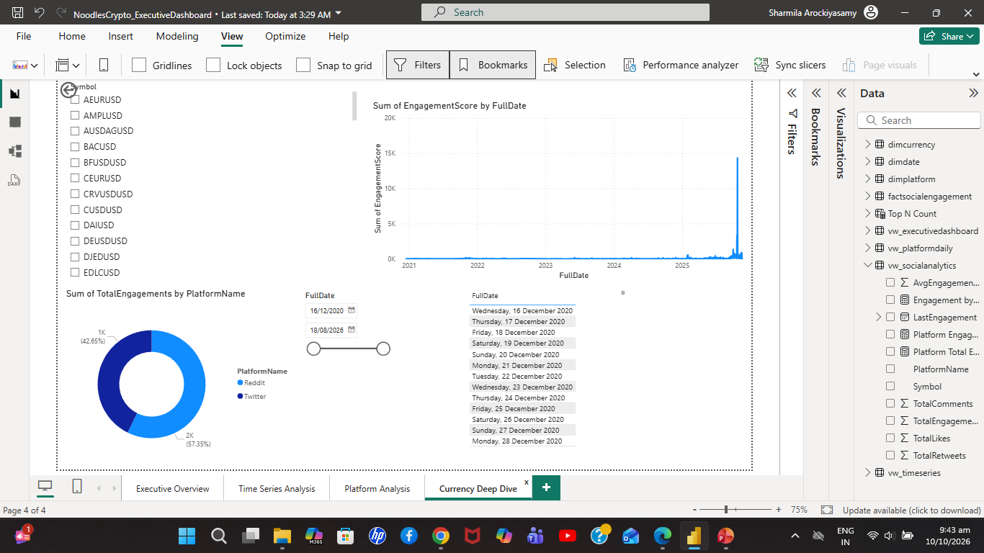
Currency Deep Dive
• Drill through from a selected currency
• Review engagement-score trend and platform split
• Bookmarks switch saved report states
• Tooltips reveal additional values
Noodles Crypto Analytics • Task 9

Slide 11
Operations and User Guide
• Runbook covers refresh, validation and troubleshooting
• User guide explains pages and interactions
• Keep credentials secure
• Record schedule only after verifying it
Noodles Crypto Analytics • Task 9

Slide 12
Conclusion and Q&A
• Connects data preparation, warehousing and visualization
• Documentation supports repeatable operations
• Next: validate metrics, record live demo, publish portfolio links
Thank you — Questions?
Noodles Crypto Analytics • Task 9

