Slide 1
Employee Data Analysis using Excel
STUDENT NAME:SHARMILA.S
REGISTER NO:122203102
DEPARTMENT:B.COM CORPORATE SECRETARYSHIP
COLLEGE: MAHALASHMI WOMEN'S COLLEGE OF ARTS AND SCIENCE

Slide 2
PROJECT TITLE
Employee Performance Analysis using Excel

Slide 3


AGENDA
Problem Statement
Project Overview
End Users
Our Solution and Proposition
Dataset Description
Modelling Approach
Results and Discussion
Conclusion
3/21/2024 Annual Review

Slide 4

PROBLEM STATEMENT
1.A concise summary of a problem that needs to be addressed. It should be specific, evidence-based, and real-life
2.problem statement can look different depending on whether it's dealing with a practical, real-world problem or a theoretical issue.
3.Businesses and other organizations write problem statements to understand problems, better gain support for new ideas, and collaborate on solutions.
.

Slide 5

PROJECT OVERVIEW
1.A project overview is a detailed description of a project's goals and objectives, the steps to achieve these goals
2.problem statement can look different depending on whether it's dealing with a practical, real-world problem or a theoretical issue.
3.brief summary of a project's goals, value, and potential challenges,

Slide 6

WHO ARE THE END USERS?
1.An end user, also known as the end consumer, is the person who makes the final purchase or use of a product.
2people who receive a gift from friends or individuals who buy shoes to wear. I
3.In contrast, a customer is any person or business that buys products or services

Slide 7

OUR SOLUTION AND ITS VALUE PROPOSITION
1.A short statement that communicates why buyers should choose your products or services
2.It's more than just a product or service description — it's the specific
3.business provides and the promise of value that a customer can expect you to deliver.

Slide 8
Dataset Description
1.A set or collection of data. This set is normally presented in a tabular patter
2.Every column describes a particular variable. And each row corresponds to a given member of the data set
3.as per the given question. This is a part of data management.

Slide 9

THE "WOW" IN OUR SOLUTION
1.When someone makes us feel appreciated, respected and heard, we are impressed
2.That personal touch is a 'WOW' moment that can turn a casual coffee drinker into a loyal, repeat customer.
3.Every time I travel to Boston, I stay in the same hotel. It's not fancy and the location isn't great, but they know how to wow a customer.
3/21/2024 Annual Review
9

Slide 10
MODELLING
1.Modeling involves making a representation of something. Creating a tiny, functioning volcano is an example of modeling
2.modeling when they have a class election that represents a larger one, like a presidential election.
3.Modeling is anything that represents something else, usually on a smaller scale.
10

Slide 11
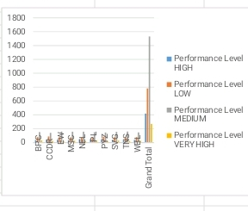
RESULTS
11

Slide 12
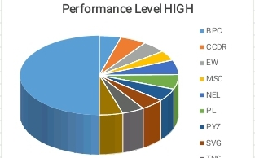
RESULT

Slide 13
conclusion
1.an employee performance analysis conclusion, you can summarize the employee's performance during the review period,
2.These systems can be a good way to measure employee performance and productivity.
3.These evaluations can help identify areas of strength and improvement, which can lead to a growth plan for the employee.

