Slide 1

Employee Data Analysis using Excel
STUDENT NAME :
REGISTER NO :
DEPARTMENT :
COLLEGE :
SHARMILA. S
122203182/asunm1455122203182
3rd B.COM (CORPORATE SECRETARYSHIP)
TAGORE COLLEGE OF ARTS AND SCIENCE
1
Notes:
1

Slide 2
PROJECT TITLE
Employee Performance Analysis using Excel
2

Slide 3
AGENDA
Problem Statement
Project Overview
End Users
Our Solution and Proposition
Dataset Description
Modelling Approach
Results and Discussion
Conclusion
3/21/2024 Annual Review
3

Slide 4
PROBLEM STATEMENT
Acknowledge and reward employees for their achievements and hard work
This can boost morale and motivation.Providing consistent feedback allows employees to understand their strengths and areas for improvement
4

Slide 5
PROJECT OVERVIEW
Provide an overview of the employee dataset. Include details such as the number of records (employees), the variables included (e.g., employee ID, name, age, department, salary, etc.), and any unique identifiers.
Outline the specific objectives of the analysis. This could involve identifying trends, patterns, correlations, or anomalies within the data. State what you aim to achieve through the analysis.
Based on the analysis, suggest recommendations or actions that can be taken to improve employee performance, retention, or any other relevant aspect identified in the dataset.
5

Slide 6
WHO ARE THE END USERS?
Employees
Employer
Managers
Supervisor
Human resource management
6

Slide 7
OUR SOLUTION AND ITS VALUE PROPOSITION
Conditional formatting - missing
Filter - Remove
Formula - performance
Pivot - summary
Graph - data visualization
7

Slide 8
DATASET DESCRIPTION
Employee - kaggle
Total - 26 features
Taken - 9 features
Employee I'd - numerical
Name - text
Performance level
Gender - male, female
﻿Employer Rating - numerical

Slide 9
THE "WOW" IN OUR SOLUTION
Performance = IFS(Z8>=5, "VERY HIGH", Z8>=4, "HIGH", Z8>=3, "MED",TRUE, "LOW")
9

Slide 10
MODELLING
Data collection
Performance level collection
Features collection
1. Edunet
1.Quality of work
2.Quantity of work
1.Employee id
3.Needs improvement
2. Name
3. Performance
4. Punctuality
Pivot table collection
1. Summarize large datasets
2. Analyze performance trends
3. Identify top performers
Data cleaning collection
1.Remove unnecessary columns/rows
2. Validate data consistency
10

Slide 11
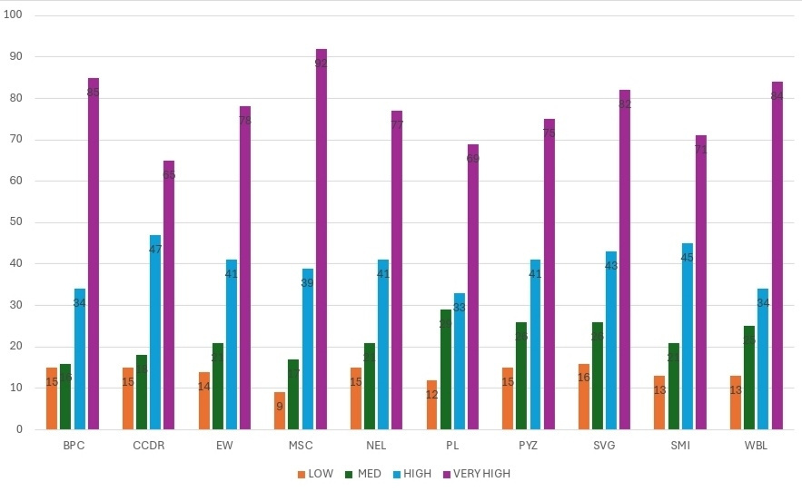
RESULT
11

Slide 12
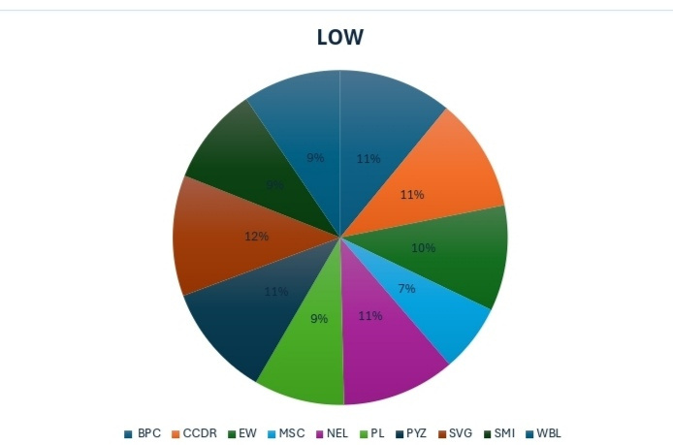
CONCLUSION

