Slide 1
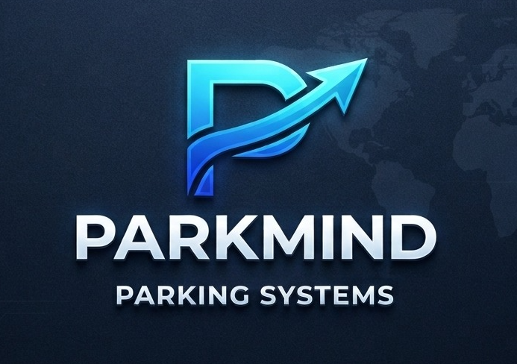
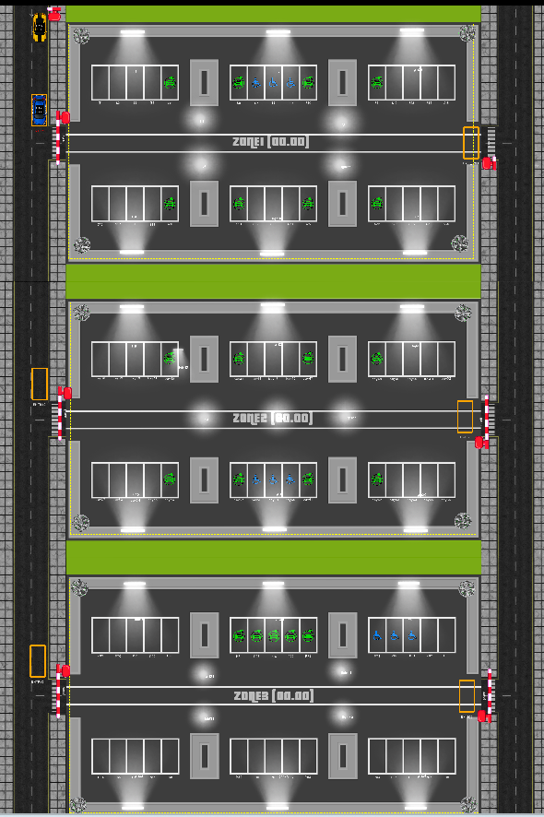
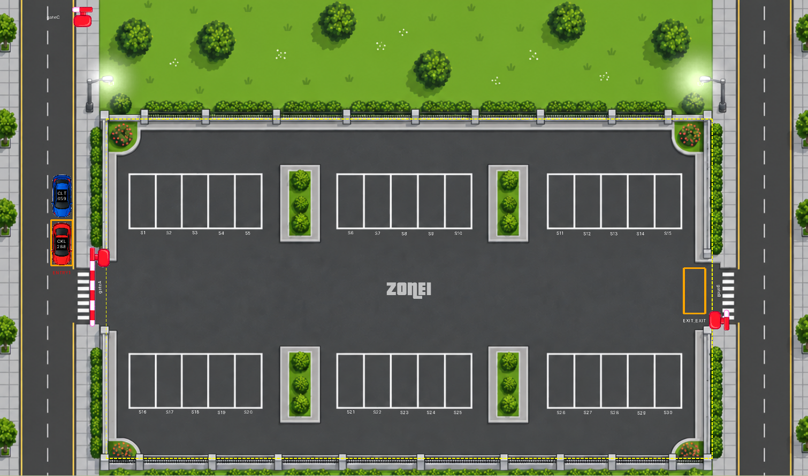
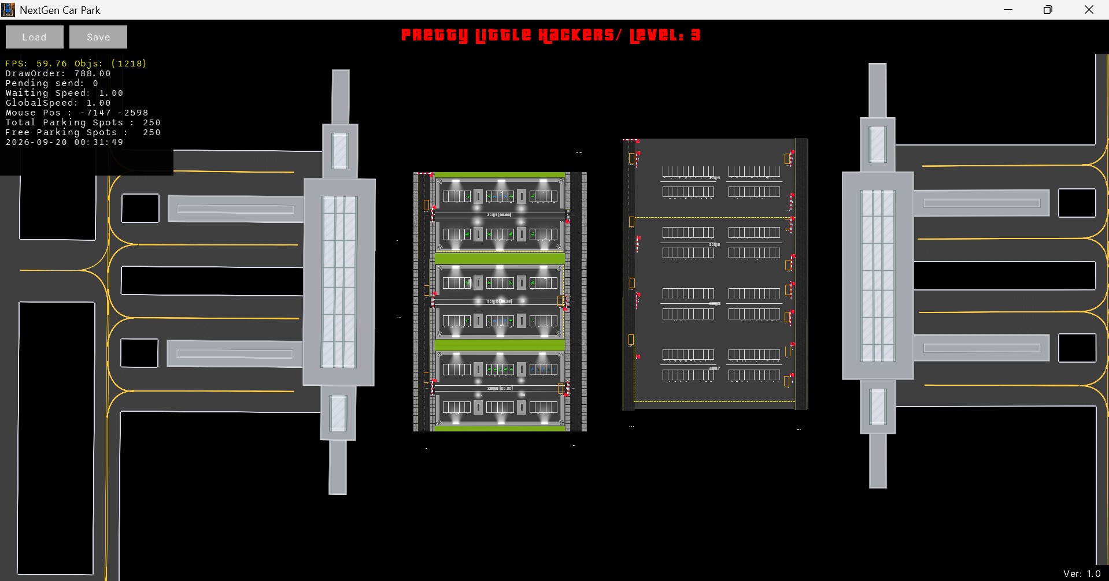
PRETTY LITTLE HACKERS
HACKATHON 2026
ONE ENGINE / THREE OPERATING ENVIRONMENTS
PARKMIND
Autonomous Parking
at Airport Scale
We don’t just park cars.
We keep the whole facility moving.
30 SPACES
3 ZONES
250+ BAYS
Sharmila • Jushita • Pravir • Ram
30
3
250+
THE DIFFERENCE
Built for the moments
when parking stops behaving perfectly.
Traffic
Failures
LEVEL 1
ZONES
AIRPORT BAYS
Wrong spots
Payments
Security
AUTONOMOUS OPERATIONS
Notes:
“PARKMIND is our autonomous parking operations engine. It is designed for real-world pressure: growing facilities, traffic bottlenecks, equipment failures, wrong parking, payment risk and security issues. Our goal is simple: keep the entire facility moving, even when the environment changes.”

Slide 2
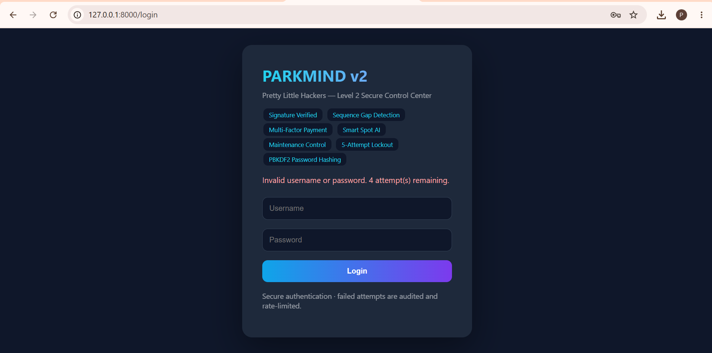
ADMIN

Slide 3
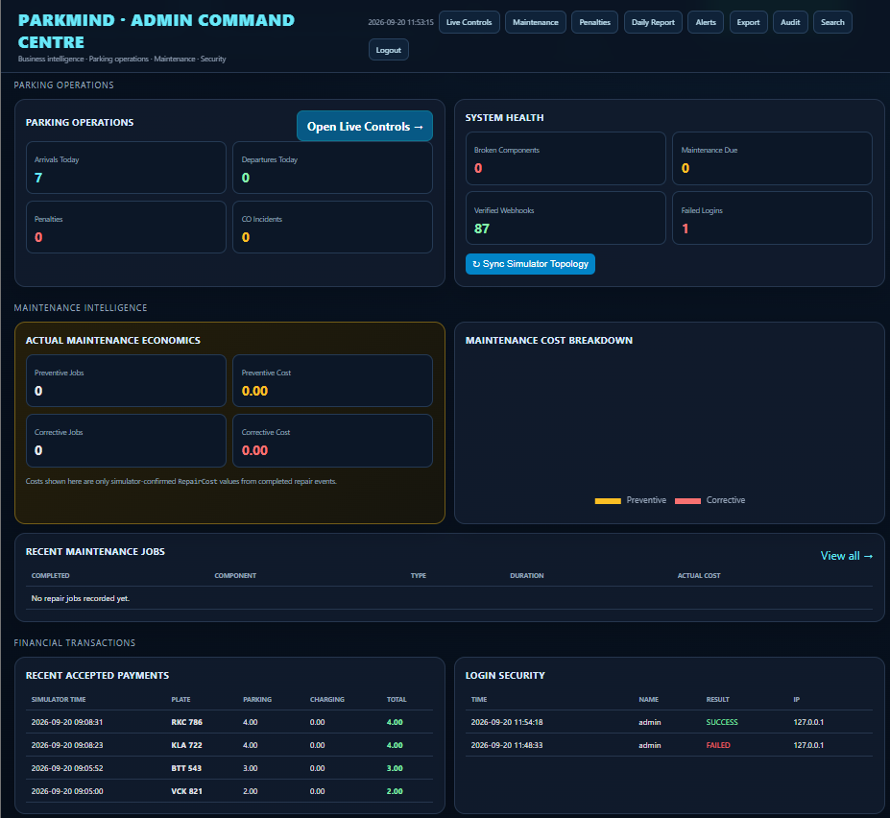
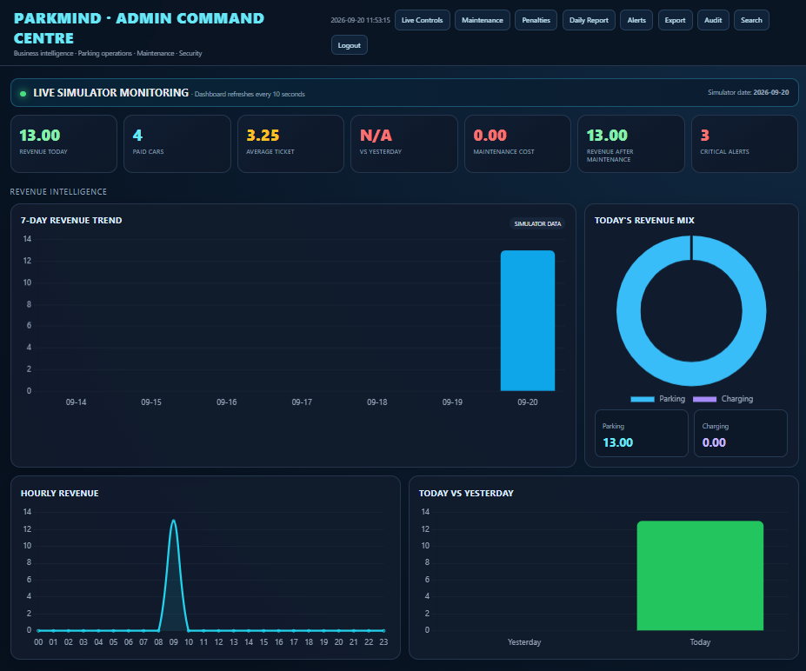

Slide 4
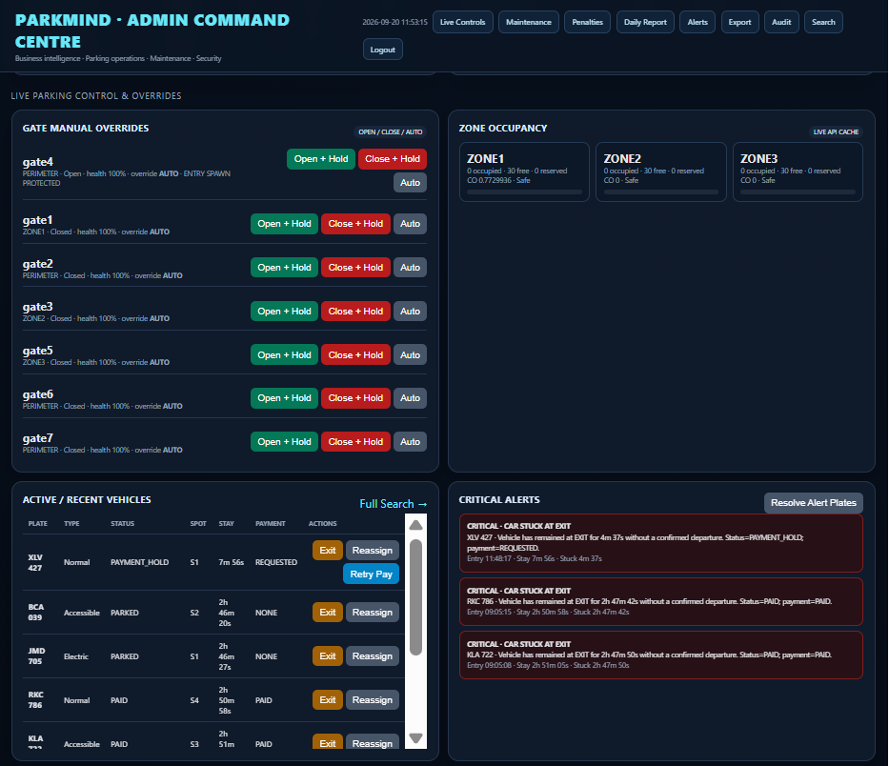
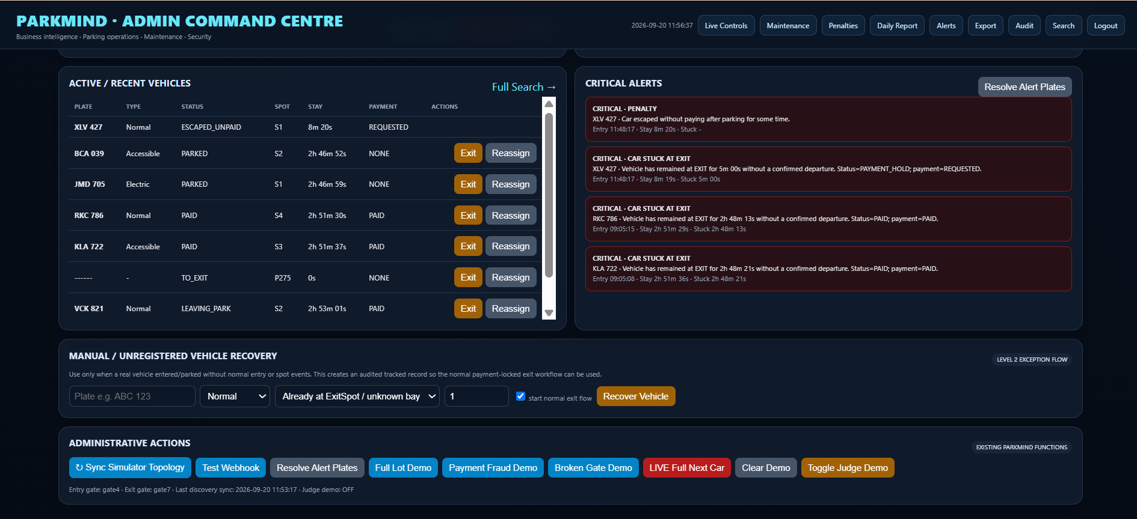

Slide 5
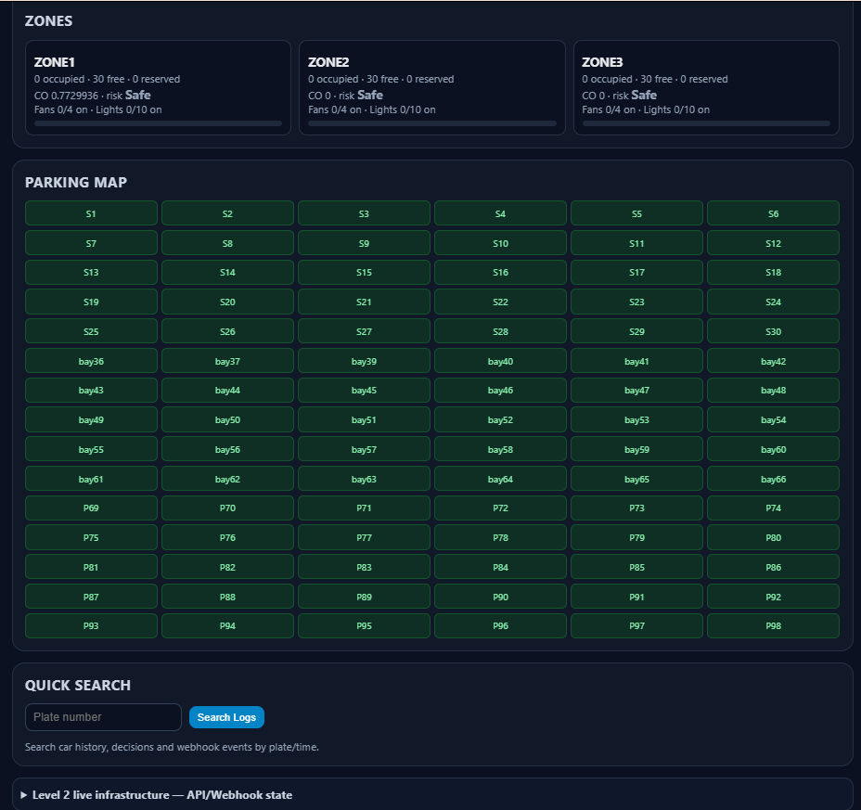
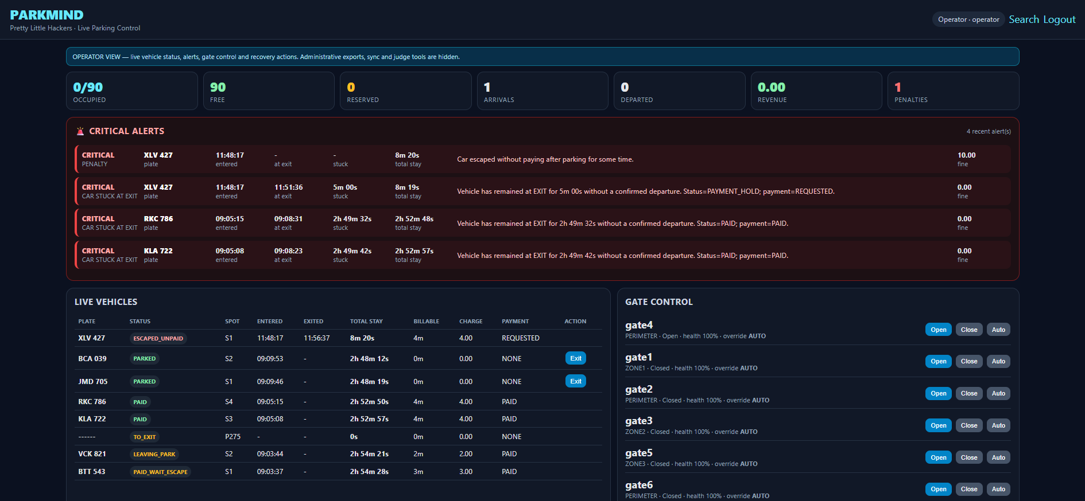
OPERATOR

Slide 6
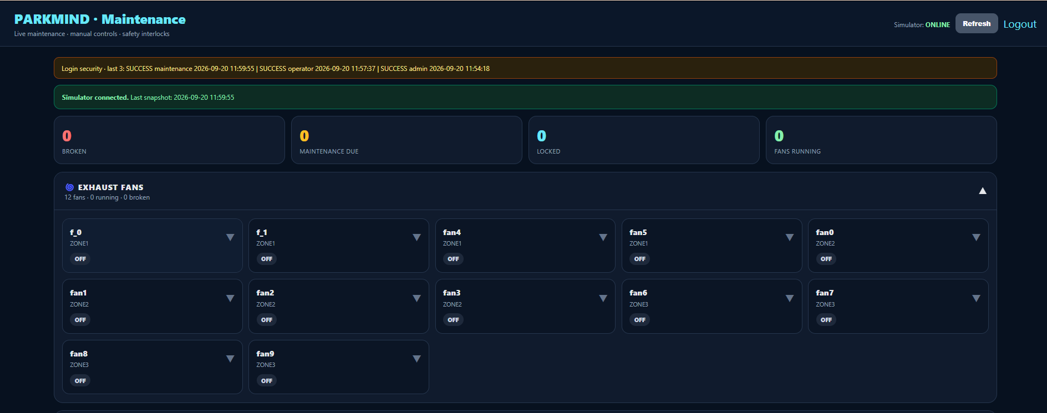
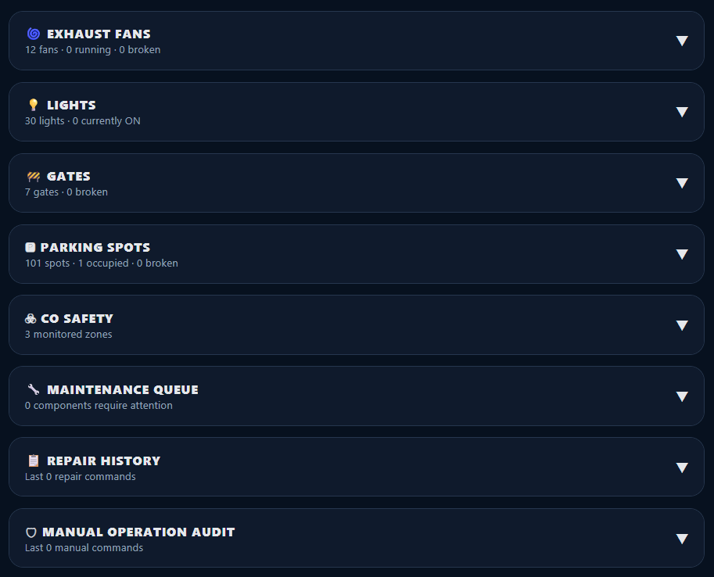
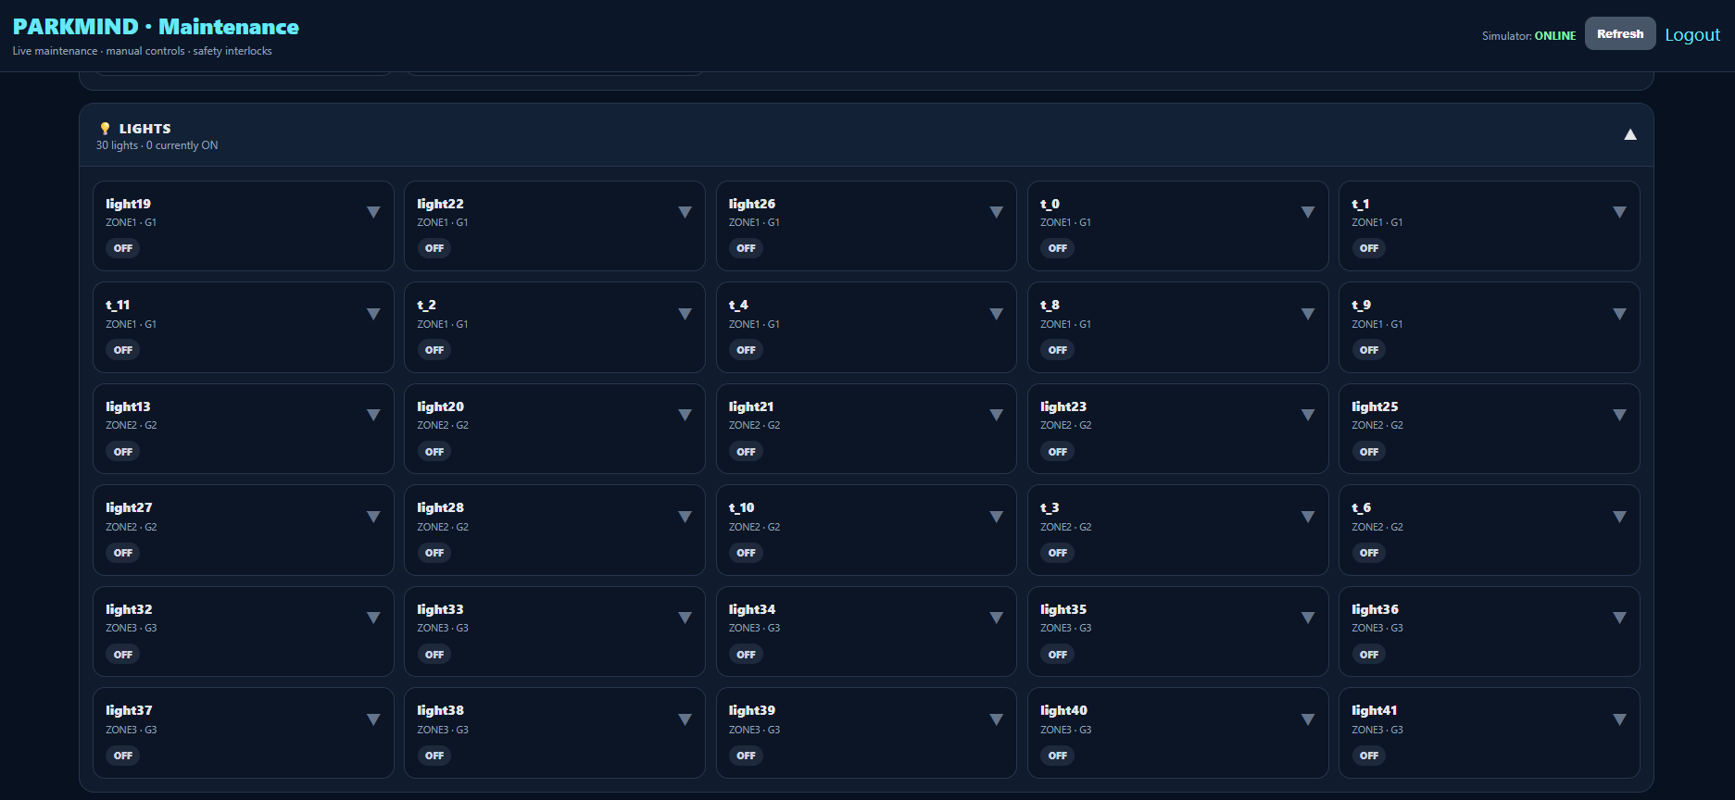
MAINTENANCE

Slide 7
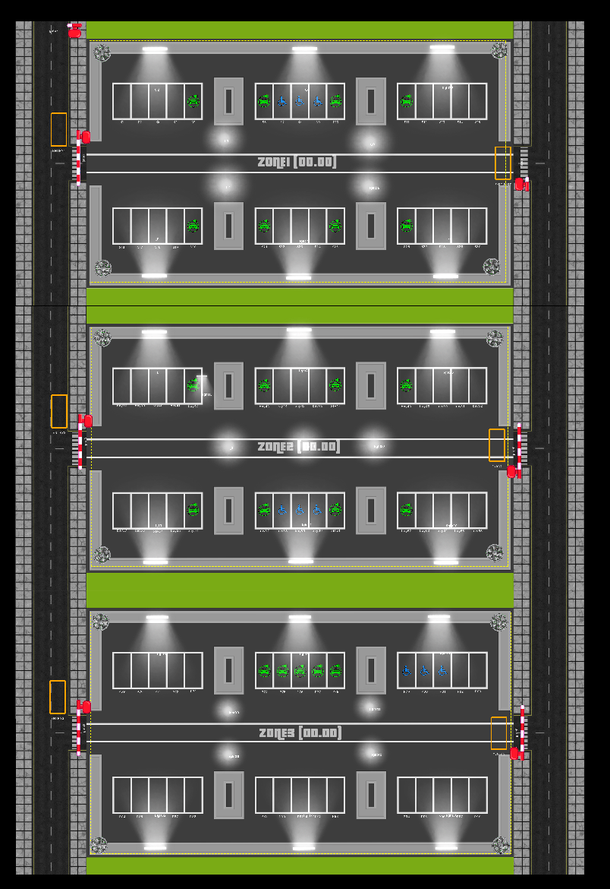
01 · PROBLEM
Multi-scale Carpark
More capacity and more automation means more things to coordinate — and more ways a small fault can become an operational incident.
→
FLOW
⚙
COMPONENTS
Cars can arrive, move, park, queue, pay and leave across multiple routes.
Spots, gates, lights and fans have state, usage and failure modes.
!
SAFETY
◆
CONTROL
CO levels can turn a normal zone into a ventilation incident.
Operators, maintenance and admins need different powers.
✓
TRUST
◷
TRACEABILITY
Only verified events should be allowed to change system state.
Repairs, penalties, logins and system changes must remain auditable.
WHY THIS DESIGN
The system separates operational truth (simulator events) from control policy (what PARKMIND is allowed to do).
Notes:
Use the parking layout to show why Level 2 is fundamentally a coordination problem. We have more zones, more entry/exit paths, component failures, safety automation and role-specific actions. The design answer is to make the controller explicit: verify event -> update state -> apply a rule -> issue a command -> wait for confirmation.

Slide 8
02 / RESILIENCE
Gate fail-over
One failed barrier should not become a failed parking facility.
LIVE TRAFFIC MAP
WHEN A GATE BREAKS
GATE A
GATE B
GATE C
DETECT
failure is visible immediately
OPEN
BROKEN
OPEN
REROUTE
healthy nearby gate becomes the path
PROTECT
drivers keep moving; the failed gate is isolated
BUSINESS RESULT
TRAFFIC CONTINUES
No facility-wide shutdown
for a single failed barrier.
KEEP OPERATIONS LIVE
Notes:
“A failed gate should be a localized problem, not a facility-wide shutdown. PARKMIND detects the failure, removes that path from active routing, and sends traffic to a healthy alternative so the operation continues while maintenance catches up.”

Slide 9
03 / ASSET PROTECTION
Predictive maintenance — service before failure
Turn maintenance from an emergency into a scheduled operating decision.
PREVENTIVE MAINTENANCE QUEUE
COMPONENT HEALTH
BARRIER GATE
87%
LOW RISK
EXHAUST FAN 03
SERVICE TONIGHT
2.1h window
PARKING SPOT
72%
WATCH
GATE B
CHECK NEXT WINDOW
1.4h window
EXHAUST FAN
55%
SERVICE SOON
LIGHT GROUP 2
DAYLIGHT ONLY
0.7h window
LIGHTING
39%
PLAN SERVICE
QUIET-HOUR LOGIC
Move service work away from peak traffic.
USE CYCLE → HEALTH → ACTION
PROTECT THE ASSET
Notes:
“We do not want maintenance to start after something breaks during peak demand. PARKMIND tracks component use and health, surfaces what needs attention, and helps schedule service in safer, quieter operating windows.”

Slide 10
04 / REVENUE ASSURANCE
Pay, verify, then exit
Protect revenue without slowing down legitimate customers.
RECENT ACCEPTED PAYMENTS
EXIT CONTROL
PLATE
PARKING
CHARGING
STATUS
NO PAYMENT
= NO RELEASE
ABC 1234
RM 12
RM 0
VERIFIED
WXY 808
RM 20
RM 8
VERIFIED
01
MATCH THE VEHICLE
EV 2026
RM 14
RM 11
VERIFIED
02
MATCH THE AMOUNT
JHK 77
RM 8
RM 0
VERIFIED
03
CHECK PAYMENT STATE
04
BLOCK DUPLICATES
GHOST PAYMENTS → BLOCKED
REVENUE + TRUST
Notes:
“Revenue assurance is about more than calculating a price. PARKMIND verifies that the right vehicle is paying the right amount, avoids duplicate charging, and keeps the exit release tied to a successful payment state. That protects both revenue and customer trust.”

Slide 11
06 · SAFETY + ENERGY AUTOMATION
Safety rules are policies, not suggestions.
CO events trigger ventilation automatically; light control follows simulator time and activity, with manual interlocks preventing unsafe actions.
CO RESPONSE LADDER
LIGHT POLICY
SAFE
No ventilation action; resolve old alert
DAY
NIGHT
MID
Healthy fans ON
HIGH
Critical alert + fans ON
06:00–18:00 default day window
Night + active zone → lights ON
Day → lights OFF
Manual ON during daytime → BLOCKED
CRITICAL
Critical alert + preserve ventilation capacity
No healthy fan available → raise a separate critical “NO HEALTHY EXHAUST FAN” alert.
INTERLOCK
Broken / under-maintenance components are skipped by policy actions.
Notes:
Safety is implemented as an interlock. CO events are authoritative and can immediately turn on healthy exhaust fans; turning them off during danger is blocked. Lighting follows simulator time and activity, with a default configurable day window of 06:00–18:00.

Slide 12
07 · PREVENTIVE MAINTENANCE
Use what the simulator tells us. Repair only when it is safe.
The maintenance flow separates “predictive signal” from “safe to repair now,” then records command and completion as a lifecycle.
01
02
03
04
05
Observe
Predict
Gate
Repair
Verify
cycles · runtime · API life
simulator maintenance alarm
safety interlock
send one command
component_fixed
SAFETY INTERLOCKS BEFORE REPAIR
MAINTENANCE QUEUE VIEW
Parking spot
must be free + unreserved
URGENT
G-07
Gate
Repair pending
Gate
must be idle + closed unless already broken
PREVENTIVE
FAN-12
Fan
Wait for safe ventilation window
Fan
must be off + zone not in CO danger
SAFE TO REPAIR
B-42
Spot
Interlock passed
Light
no documented repair endpoint in simulator
CONTROL ONLY
L-03
Light
No repair endpoint
A completed component_fixed event closes the repair lock and resolves the maintenance alert.
Notes:
The important distinction is between a maintenance signal and a repair decision. The implementation only uses simulator-backed life, usage, runtime or alarm information; it does not manufacture its own health percentage. Before a command is sent, the system checks whether the component can safely be taken offline.

Slide 13
What makes us unique?

Slide 14
THANK YOU

