Slide 1
Energy Efficient Dynamic Routing Mechanism(EEDRM) with Obstacles for WSN
SSOID : 15EUIT128
Team Name : Crafters

Slide 2
Agenda
Introduction
Traditional Procedure
Proposed Prototype Model
Model Explanation
Experimental analysis
Real time Applications
Advantages
Conclusion

Slide 3
Introduction
Wireless sensor networks find some important real time applications say, Military surveillance, Health care monitoring, Natural disaster prevention etc.,
But, the major factors say Energy, Throughput, Time and Memory complexities should be properly maintained in-order to get optimised data transfer.
When Mobile sensor node/cluster head is collecting the data from other nodes, if there comes an obstacle there exists a problem that no further movement is possible in already computed path.
So, Data Loss happens.

Slide 4
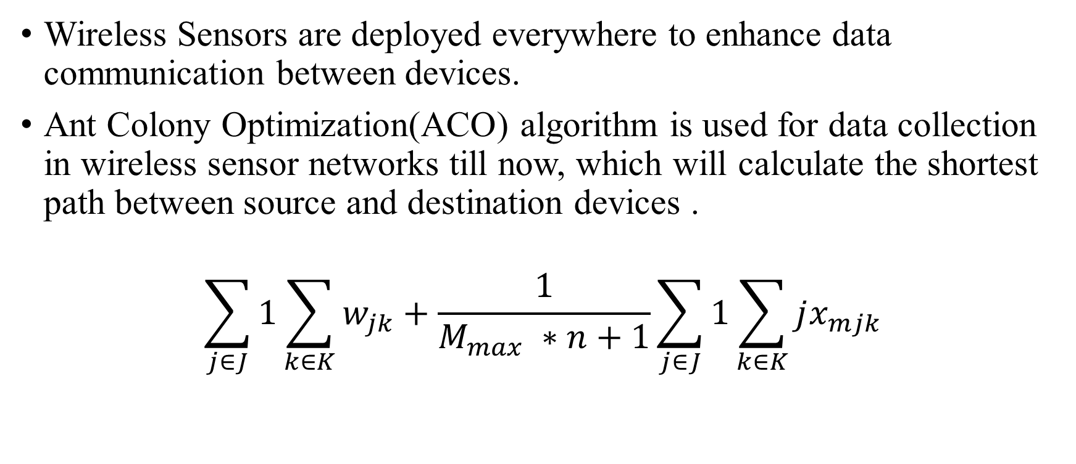
Traditional Procedure
Wireless Sensors are deployed everywhere to enhance data communication between devices.
Ant Colony Optimization(ACO) algorithm is used for data collection in wireless sensor networks till now, which will calculate the shortest path between source and destination devices .
$$\sum_{j∈J}{1}\sum_{k∈K}{w_{jk}+\frac{1}{M_{max} ∗n+1}}\sum_{j∈J}{1}\sum_{k∈K}{jx_{mjk}}$$

Slide 5
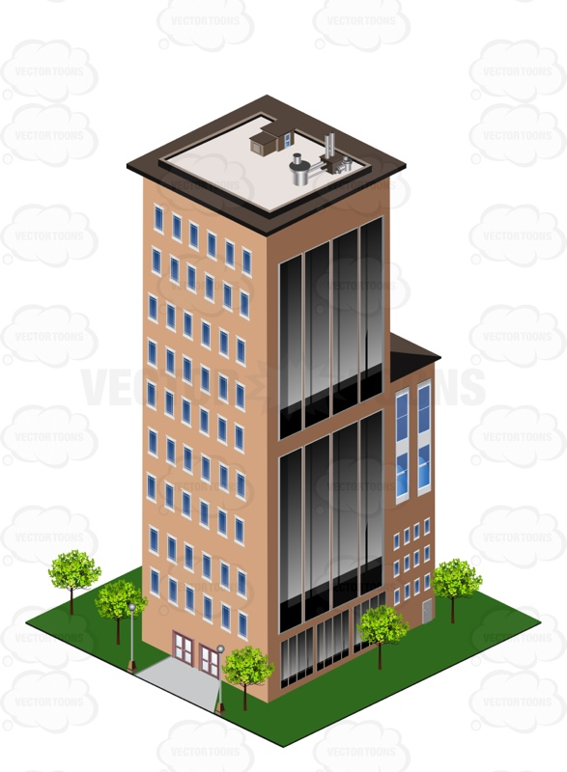
Existing Model
Mobile sink

Slide 6
Proposed Prototype Model
In the Proposed Methodology, the sensor networks is divided into clusters and the sink which stores data will be Static and elected mobile cluster heads will find the shortest route among the cluster members for data collection.
Each node delivers the data to the mobile sink and the sink carries the data to the base station

Slide 7
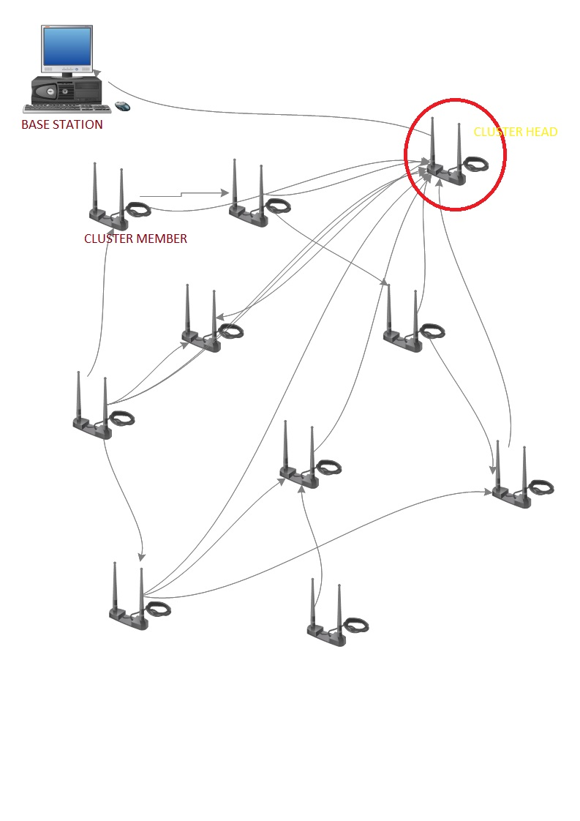
Model Explanation
Cluster Formation

Slide 8
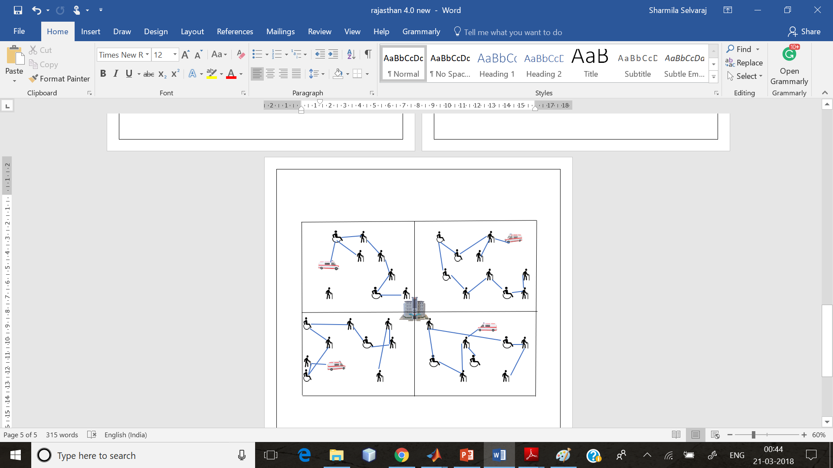
Model Explanation
Mode of Communication

Slide 9
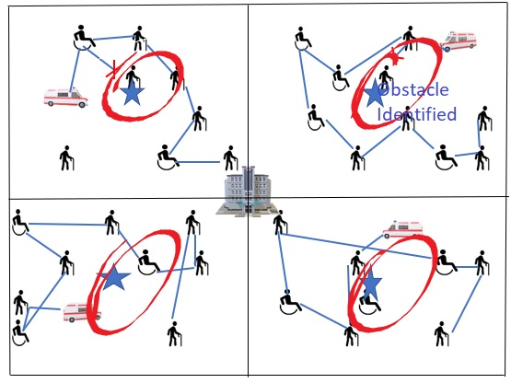
Model Explanation
Obstacle Observation

Slide 10
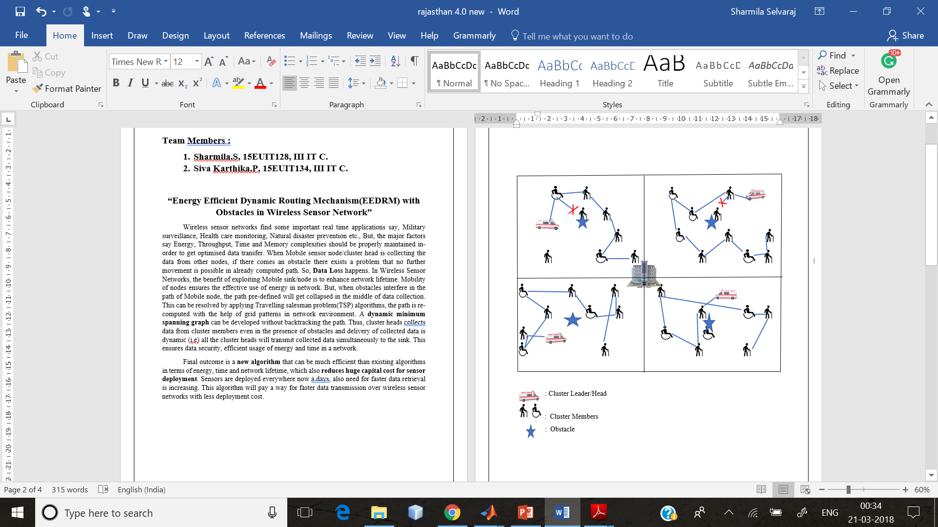
Model Explanation
Data Transmission

Slide 11
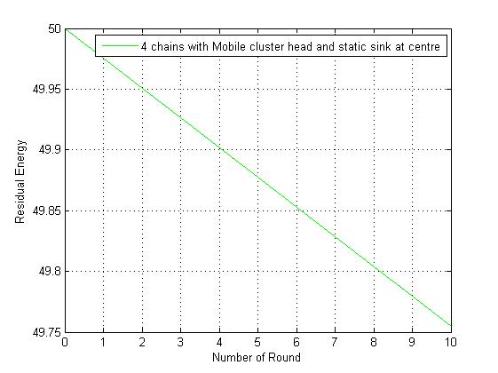
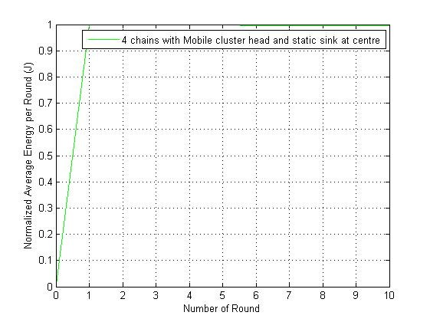
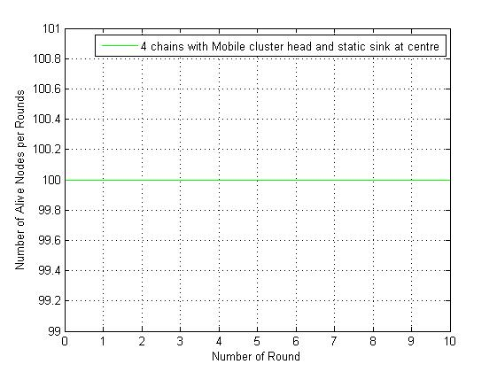
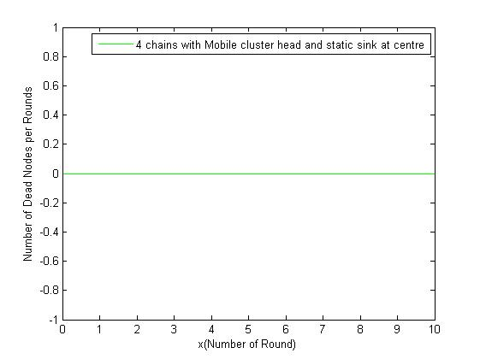
Experimental analysis using MATLAB

Slide 12
Real Time Applications
Health Care Monitoring
Natural Disaster Prevention
Military Surveillance

Slide 13
Advantages
The major advantages of EEDRM are as follows:
Increases Network Lifetime ,which will reduces Huge Capital cost that the Government invests on Sensor network deployment and maintenance.
Less Delay
Low Energy Consumption
Increases Throughput and QoS.

Slide 14
Conclusion
Thus, an Energy Efficient Framework/Prototype is developed to determine a prominent resource management scheme in digital transmission.

