Slide 1
Energy Efficient Dynamic Routing Mechanism(EEDRM) for WSN

Slide 2
Agenda
Introduction
Traditional Procedure
Proposed Prototype Model
Model Explanation
Efficiency analysis
Real time Applications
Advantages
Conclusion

Slide 3
Introduction
Wireless sensor networks find some important real time applications say, Military surveillance, Health care monitoring, Natural disaster prevention etc.,
But, the major factors say Energy, Throughput, Time and Memory complexities should be properly maintained in-order to get optimised data transfer.
When Mobile sensor node/cluster head is collecting the data from other nodes, if there comes an obstacle there exists a problem that no further movement is possible in already computed path.
So, Data Loss happens.

Slide 4
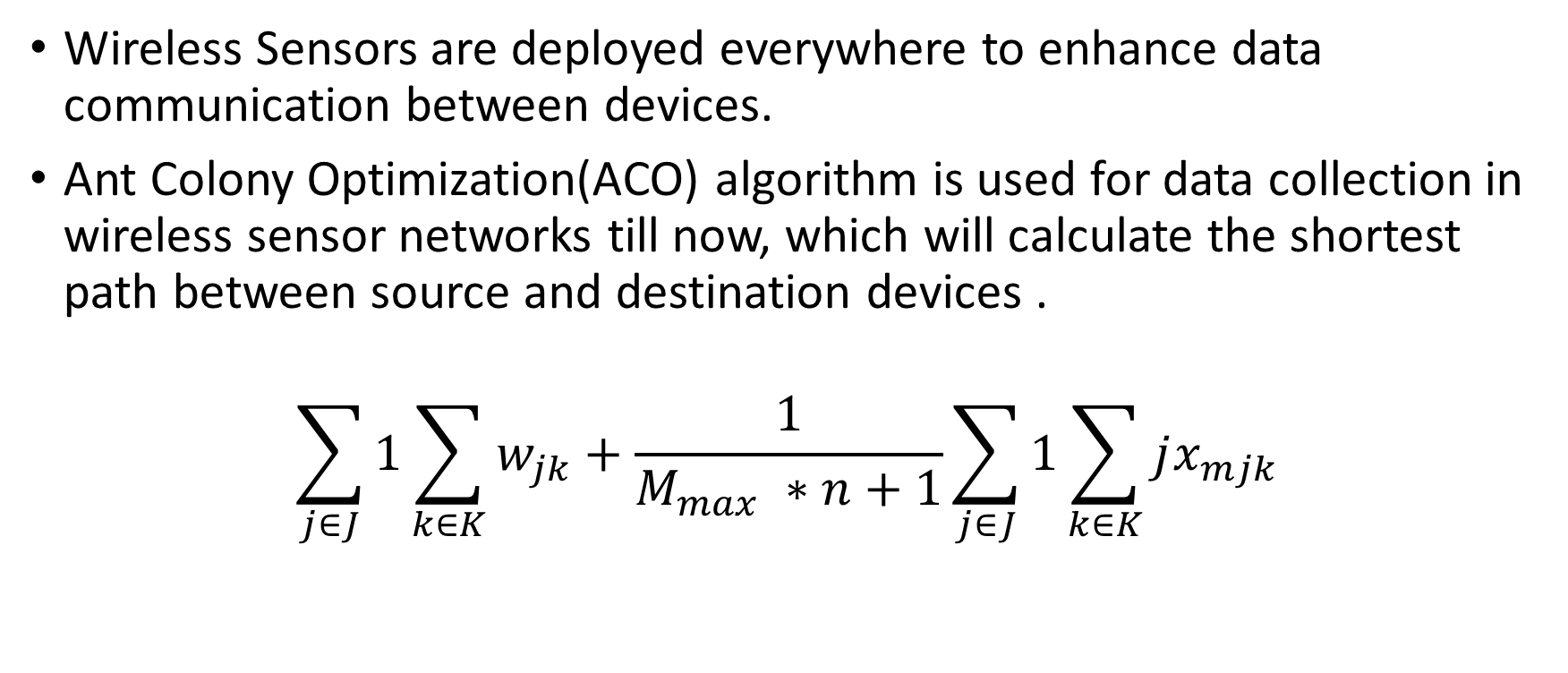
Traditional Procedure
Wireless Sensors are deployed everywhere to enhance data communication between devices.
Ant Colony Optimization(ACO) algorithm is used for data collection in wireless sensor networks till now, which will calculate the shortest path between source and destination devices .
$$\sum_{j∈J}{1}\sum_{k∈K}{w_{jk}+\frac{1}{M_{max} ∗n+1}}\sum_{j∈J}{1}\sum_{k∈K}{jx_{mjk}}$$

Slide 5

Existing Model
Mobile sink

Slide 6
Proposed Prototype Model
In the Proposed Methodology, the sensor networks is divided into clusters and the sink which stores data will be Static and elected mobile cluster heads will find the shortest route among the cluster members for data collection.
Each node delivers the data to the mobile sink and the sink carries the data to the base station

Slide 7
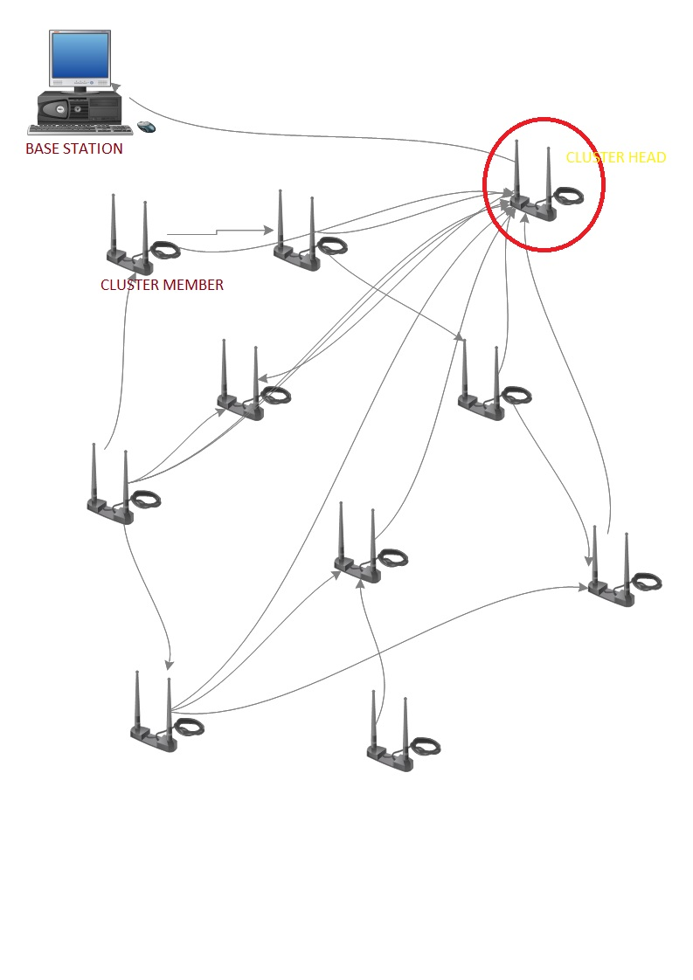
Model Explanation
Cluster Formation

Slide 8
CLUSTER FORMATION

Slide 9
Model Explanation
Environmental coverage

Slide 10
Model Explanation
Environmental Coverage
<picture>

Slide 11
Model Explanation
Mode of Communication

Slide 12
Model Explanation
Obstacle Observation

Slide 13
Model Explanation
Data Transmission

