Slide 1
Employee Data Analysis using Excel
STUDENT NAME: SHARMILA.M
REGISTER NO: 312205070
NM NO:12CC84BE6965711A8D74DA7A67292DBB
DEPARTMENT: COMMERCE
COLLEGE: NAZARETH COLLEGE OF ARTS AND SCIENCE

Slide 2
PROJECT TITLE
Employee Performance Analysis using Excel

Slide 3


AGENDA
Problem Statement
Project Overview
End Users
Our Solution and Proposition
Dataset Description
Modelling Approach
Results and Discussion
Conclusion
3/21/2024 Annual Review

Slide 4

PROBLEM STATEMENT
Employee data analysis involves assessing performance metrics to drive company growth, motivate employees, and allocate appreciation, promotions, and salary increments based on objective data.

Slide 5

PROJECT OVERVIEW
Our objective is to assess employee performance by analyzing factors such as gender, performance scores, ratings, and achievements. This analysis will inform decisions related to recognition, growth opportunities, promotions, and salary adjustments.

Slide 6
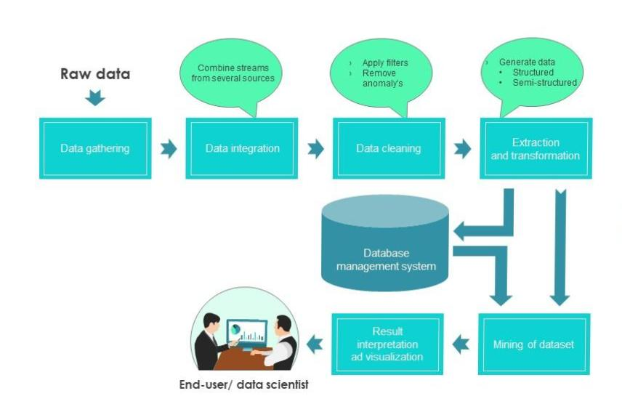

WHO ARE THE END USERS?

Slide 7

OUR SOLUTION AND ITS VALUE PROPOSITION
1.Automated Data Collection
2.Performance Categorization
3.Trend and Pattern Identification
4.Visual Dashboards
5.Customized Recommendations
6.Continuous Feedback Loop

Slide 8
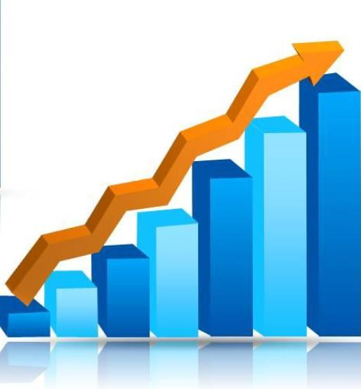
Dataset Description
Employee data = kaggle
26= features
9= features
Employee ID= number
Name=text
Employee type
Performance level
Gender-male, female
Employee rating -Number
Notes:
It appears you’ve provided a list of employee-related features. Let’s break it down: 1. Imp ID**: A unique identifier for each employee. 2. Name: The name of the employee. 3. Emp Type**: The type of employment (e.g., full-time, part-time, contract). 4. Performance Level: An indicator of an employee’s performance (e.g., high, medium, low). 5. Gender: Male or female. 6. Employee Rating: A numerical rating representing an employee’s performance

Slide 9

THE "WOW" IN OUR SOLUTION
•Performance level =IFS(Z8>=5,”VERY
HIGH”,Z8>=4,”HIGH”,Z8>=3,”MED”,TRUE,”LOW”)
3/21/2024 Annual Review
9

Slide 10
MODELLING
Data Collection:
Kaggle , Website, edunetDashboard
Feature Collection:
Identifying & Highlighting
Data Cleaning:
Conditional Formatting & Filtering
Performance Level:
Performance Analysis by systematic order as High,Medium
Low,from the departments of Employees
Summary:
Pivot Table,Overall performance of the employees
Visualization:
Trend Lines Exponentioal Lines & Graphs ,Pie Charts
10

Slide 11
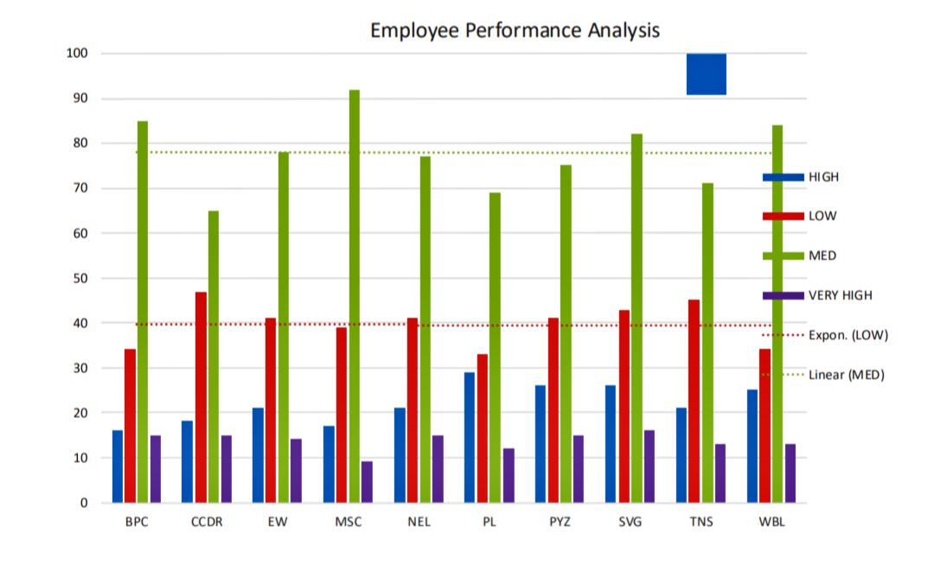
RESULTS
11

Slide 12
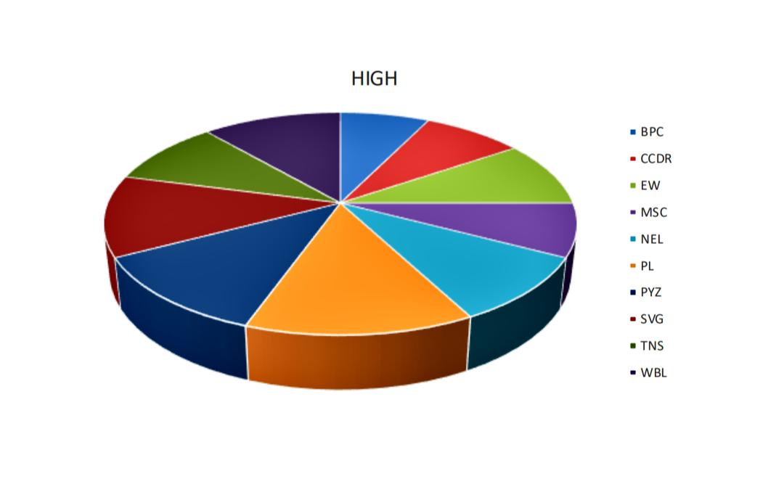
RESULTS

Slide 13

conclusion
From the overall analysis,In the organization averagely performing
employees are more in numbers,So every employee have their own
talents and skills based on that you can give the tasks and motivate
them for the organization growth.
PL Sector is the highest percentage than the other departments
PYZ and NEL are nearly closest to the PL sector.

