Slide 1



Donation Management System
Every donation tells a story. We help you tell it.

Slide 2
CONSULTANT. Md. Moshaidul Islam wdpf.idb-bisew it scholarship Email: moshaidul@gmail.com
Instructor.
Farhana Akter Lucky
wdpf idb-bisew it scholarship
Email: farhanawdpf@gmail.com
Developed By.
Name: Sharmin Akter
Trainee ID:1288188
Batch: WDPF/NCLC-M/65/01
Email: sharminakter13092000@gmail.com

Slide 3
Md. Moshaidul Islam,
Consultant
WDPF-IDB-BISEW
IDB Bhaban Sher-e-Bangla Nagar, Dhaka
Subject: Project Proposal for a Donation Management System Web Application
Dear Sir,
Thank you for providing me with the opportunity to develop a real-world project based on the core curriculum of our course, Web Development with PHP and Framework (PWAD).
In this regard, I have chosen to propose a project on a Donation Management System, which is of great value to non-profit organizations and charities. I have conducted a thorough analysis of the requirements for such a system and have prepared a comprehensive proposal, which is enclosed for your review and consideration.
I believe this project will be an excellent opportunity to apply the skills I have acquired and will allow me to utilize my full potential. I am confident that with your final approval and guidance, I can successfully complete this project.
Sincerely,
Sharmin Akter
ID: 1288188

Slide 4
ABSTRACT
Charity is a selfless deed in which those in good financial standing assist those in need. It was hard to find a sponsor, and dealing with sponsors was a major difficulty. This charity management system makes it simple to locate sponsors. However, waste as increased to an all-time high as a result of this nation's growing population and growth. Many people want to donate, but they are unsure of how to go about doing so. By bringing together donors and those in need, our app solves the problem of aiding the less fortunate. Our application seeks to improve the contribution process's speed, charity, and transparency.

Slide 5
TABLE OF CONTENTS
Sl No | Name | Page Number
01 | Introduction | 01
02 | Objective | 01
03 | Description | 02
04 | Analysis of Requirements | 02
05 | Scope | 03
06 | Software Advantages | 04
07 | Softwarer Features – key features | 05
08 | Softwarer Features – future additional features | 06
09 | Key Functionality | 07

Slide 6
Sl No | Name | Page Number
10 | Target User | 08
11 | Techonology Used | 09
12 | Gantt Chart | 10
13 | Software workflow | 11
14 | ER-Diagram | 12
15 | Demo Registration and login forms | 13
16 | Demo Dashboard | 14
17 | Demo Homepage | 15
18 | Demo Payment Method | 16
19 | Conclusion | 17
20 | Thank you | 18

Slide 7
Introduction
A Donation Management System is designed to streamline the process of collecting, tracking, and managing donations from individuals or organizations. It serves as the backbone for non-profits, charities, or fundraising platforms by maintaining accurate records of donors, donations, and related activities.
Objective
The Donation Management System aims to provide a centralized platform for managing donors, campaigns, and donation transactions efficiently. It is designed to support non-profit organizations, charities, and fundraising teams in tracking contributions, engaging donors, and ensuring transparency and accountability.

Slide 8
Description
This system is a web-based application that automates the entire lifecycle of donation handling — from donor registration to donation processing, campaign management, and reporting. It offers role-based access for administrators, volunteers, campaign managers, and donors, ensuring each user accesses only the relevant functionalities.
Analysis of Requirements
Compiling the web application's requirements is the initial stage in the implementation process. To determine the essential features and functionalities needed in the web application, a requirements assessment including possible funders, school administrators, and other stakeholders will be carried out.

Slide 9

Scope
Admin Panel
Donor Portal
Beneficiary Records
Campaign Management
Payment Integration
Reports & Analytics

Slide 10

Software Advantages
Centralized donation data for easier access and updates
Improved donor engagement and retention
Enhanced transparency and audit readiness
Efficient campaign and event tracking
Automated receipt and report generation

Slide 11
Software Features
Key Features
Donor Management
Donation Tracking
Campaign Management
User Role Access
Acknowledgment & Receipts
Reports & Analytics
Security & Data Integrity
Volunteer Management
SMS and Email Notifications
Donor Dashboard
Online Payment Integration

Slide 12

Software Features
Future Additional Features
Recurring Donations
Mobile App Integration
AI-Based Donation Suggestions
Social Media Sharing
Donation Certificate Generator
Multi-Organization Support
QR Code for Campaign
Block-chain Integration
Tax Report Automation
Multilingual Support

Slide 13

Key Functionalities:
Add and manage donors and donations
Create and monitor donation campaigns
Role-based login and permissions
Export reports in Excel/PDF formats
Secure and user-friendly interface
Search and filter records easily

Slide 14
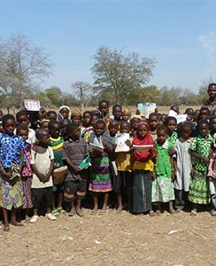
Target Users
Nonprofit organizations
NGO administrators
Individual donors
Campaign managers

Slide 15
Technologies Used
Frontend: HTML, CSS, JavaScript,Bootstrap5,JQuery
Backend: PHP
Database: MySQL / MariaDB
Server: Apache / XAMPP
Web Browser: Google Chrome, Firefox, Safari
Payment Gateways:PayPal, Stripe, Payoneer

Slide 16
Gantt Chart
Task | Week-1 | Week-1 | Week-1 | Week-1 | Week-1 | Week-1
Requirement Analysis
System Design
Implementation
Testing
Deployment
Maintenance
Documentation

Slide 17
start
homepage
login
Admin
Donor
Volunteer
Campaign Manager
Beneficiary
Check request
Select donation category
Make campaign
Sent request
Check donation request
Communicate with donor & volunteer
Enter item details
Collect fund
Get admin approval
Send the details to admin approval
Manage donation
Request Admin
Ensure donation
Distribute fund to different campaign
Get donation
Maintain records
Make donation
End
Software Workflow

Slide 18
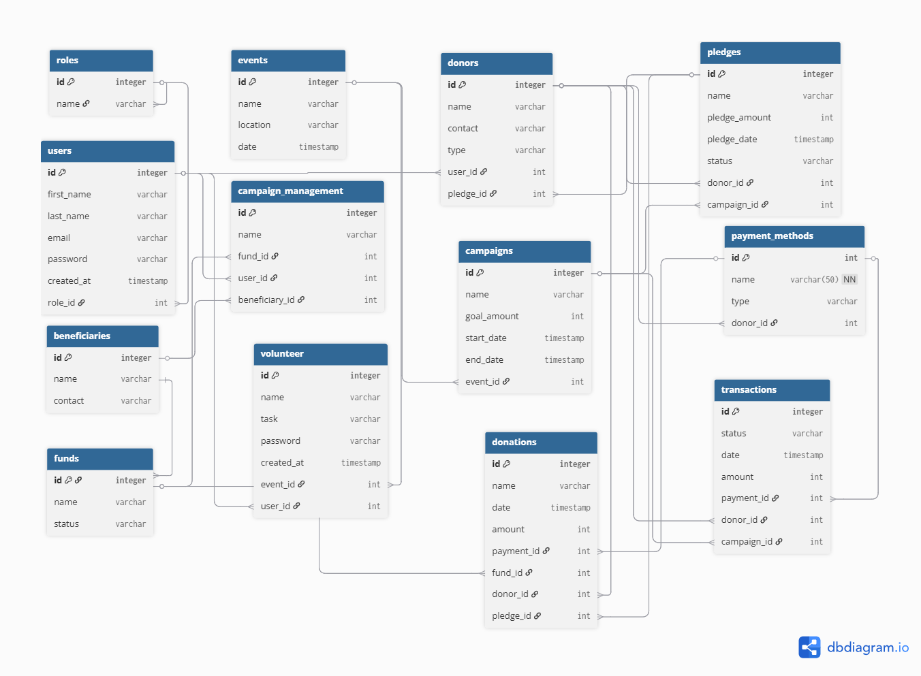
ER-Diagram

Slide 19
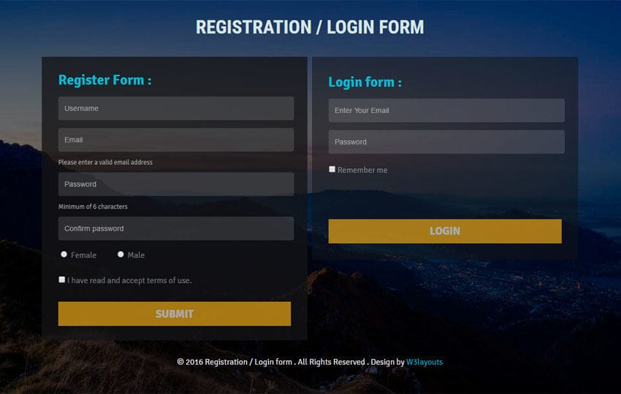
Registration and Login Form

Slide 20
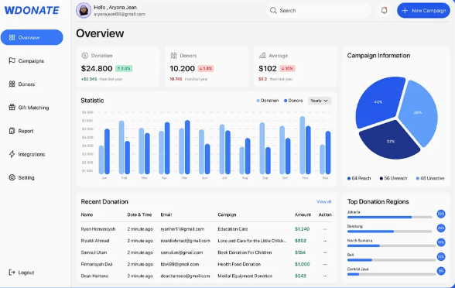
Admin Dashboard

Slide 21
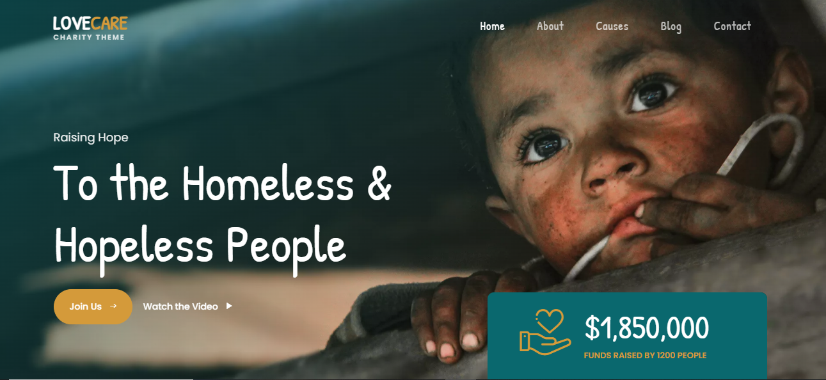
Home Page

Slide 22
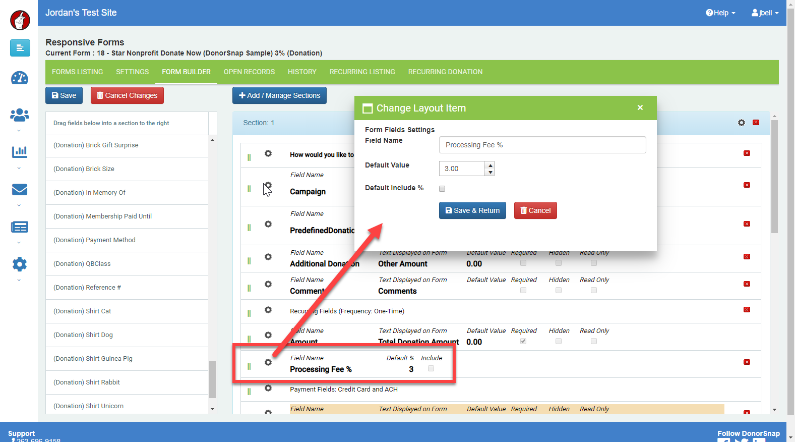
Donation Payment Method

Slide 23
Conclusion
To sum up, the Donation Management System offers a simplified, open, and effective platform for handling contributions and communications with donors. By automating essential procedures such as donor registration, fund tracking, and receipt production, the system not only minimizes administrative overhead but also promotes trust and accountability. It helps organizations to focus more on their main mission—helping those in need—while offering donors a secure and user-friendly way to contribute. Any organization hoping to leave a lasting impression must have a strong and scalable contribution management system in place as the significance of charity giving only increases.

Slide 24
Thank You.

