Slide 1
Benchmarking Machine Learning Approaches for Causal Inference Study to Predict Infant Cognitive Capacity
Sharmin Sultana ID: 01339552 sharmin_sultana@student.uml.edu | Atqiya Munawara Mahi ID: 01941220 atqiyamunawara_mahi@student.uml.edu

Slide 2
Objective
Predict the Causal effect of specialized therapeutical treatments on premature infants by using state-of-art machine learning models and also study cause-effect relationship.
Compare the performance among the algorithms using accuracy measure and confusion matrix.
Study the findings from the results and compare the outcome on infants who were given the specialized treatment vs who were not.

Slide 3
Causal Effect
A field of statistics and data analysis.
Aims to draw conclusions about causality and the relationship between cause and effect .
It is the process of determining whether a specific factor or intervention caused a certain outcome or effect, given other possible factors that could have contributed to that effect.
Goal: To identify the causal effect of an intervention, treatment, or exposure on an outcome of interest while controlling for the effects of other confounding factors.

Slide 4
Dataset
We use Infant Health and Development Program (IHDP) to carry out our project objectives.
https://www.kaggle.com/code/konradb/get-ihdp-data
It has 29 independent attributes and 1 target attribute.
”outcome" (target) is a 0/1 variable that denotes whether or not each child is receiving specialist care.
The "y factual" and "y cfactual" feature evaluates the child's advancements in cognitive development.

Slide 5
Data Pre-Processing

Slide 6
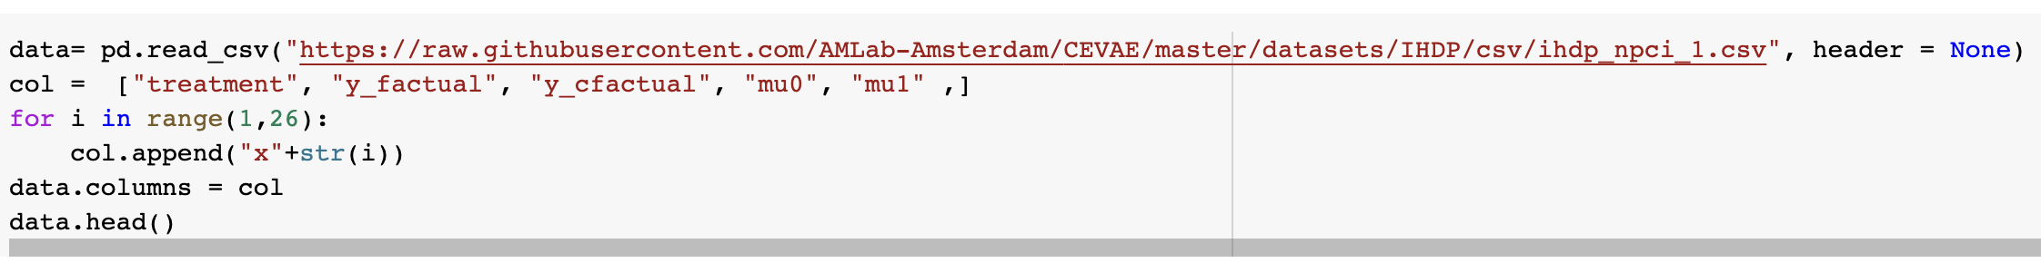
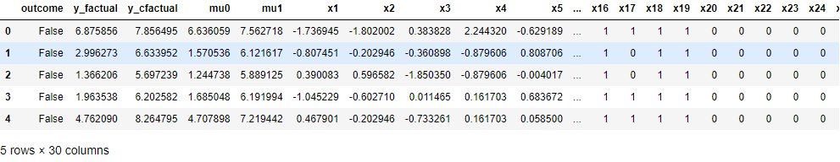
Load the Dataset

Slide 7
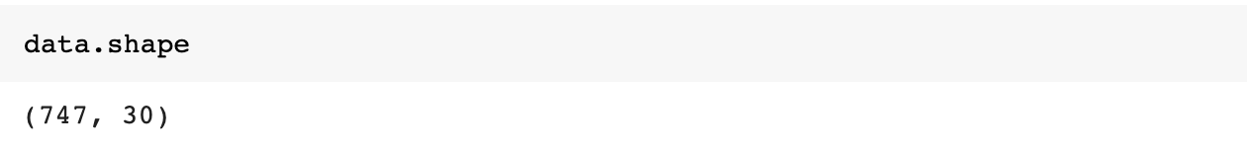
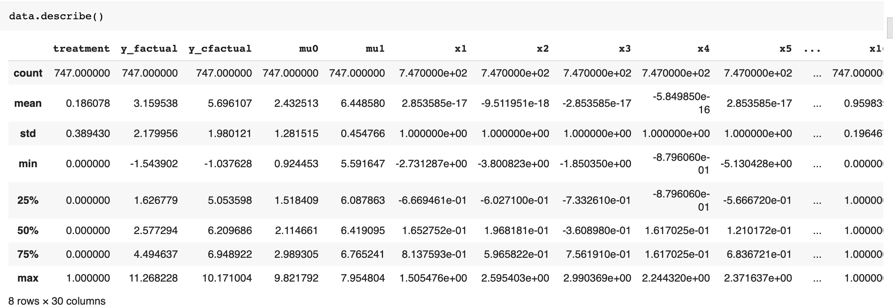
Dataset Description

Slide 8
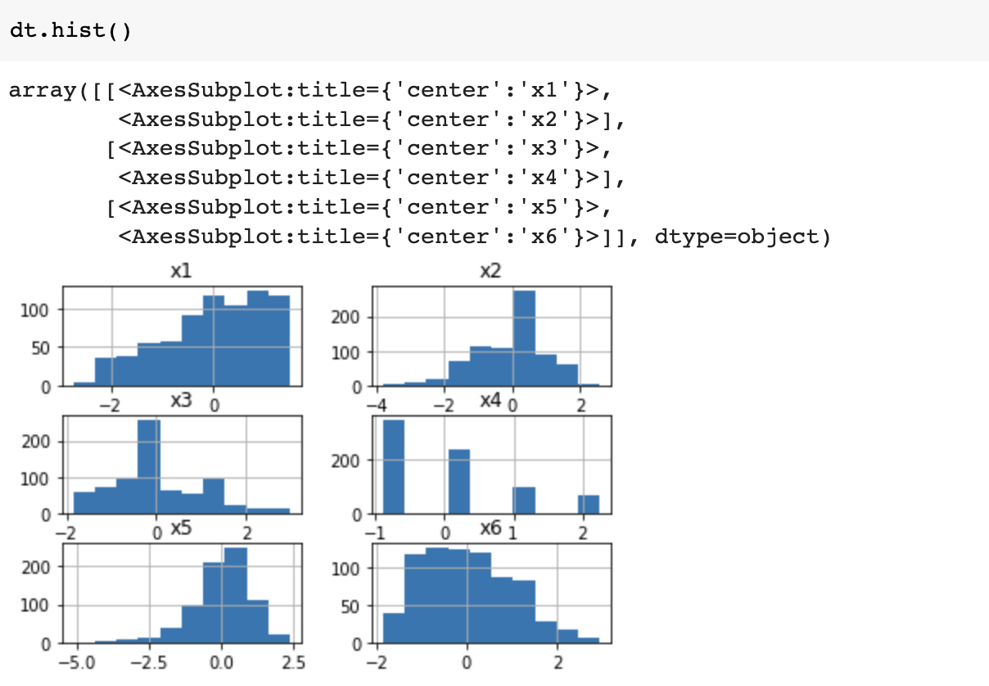
Outlier Identification
Extreme values for 'x2' and 'x3' variable.

Slide 9
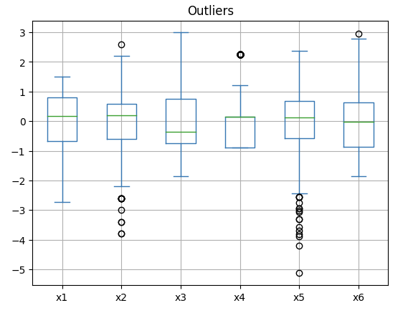
BoxPlot
boxplot for variables x2, x4, x5 & x6, are present outliers

Slide 10
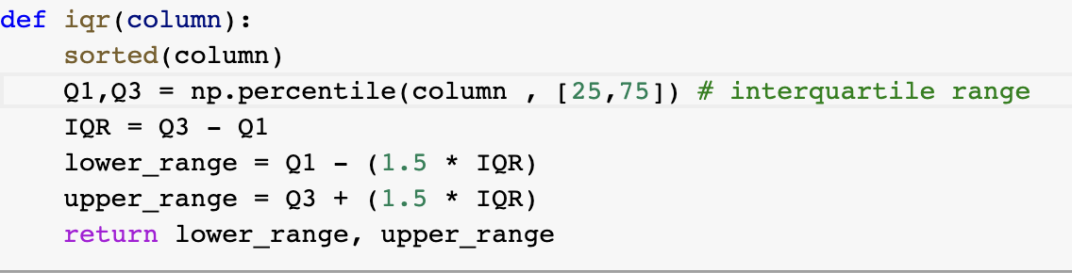
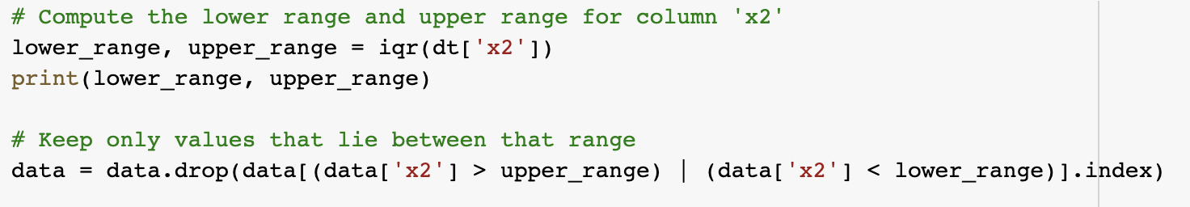
Outlier Removal
Inner Quartile Range (IQR) is the distance between the upper and lower quartiles.
We used IQR * 1.5 rules to remove the outliers.

Slide 11
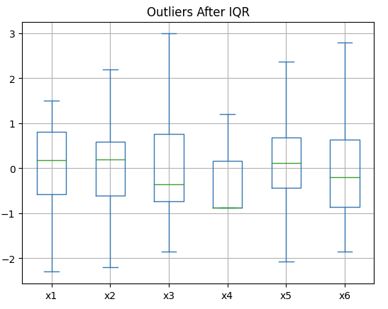
Boxplot after Removing outlier
We noticed that x2, x4, x5 & x6 [Slide 7] has outliers. After increasing the range by using IQR we were able to remove outliers.

Slide 12
Modelling using ML algorithms
We have implemented ML algorithms including:
1. Linear Regression
2. Decision Tree
3. Random Forest
4. Gradient Boosting
5. XGboost

Slide 13
Modelling using Neural Network
Implemented a small-scale novel neural network
Includes 1 hidden layer with input size 29
Params: batch size = 50
epochs =16
Loss = binary crossentropy
Optimizer = adam

Slide 14
Performance Evaluation Metrices
Used four metrices:
R-squared (Rˆ2)
Mean Absolute Error (MAE)
Mean Squared Error (MSE)
Root Mean Squared Error(RMSE).

Slide 15
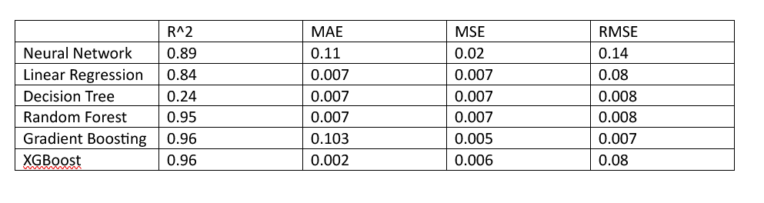
Results

Slide 16
Modelling using Causal Inference Package(DoWhy)
Used DoWhy package to generate ATE
The ATE can be represented as follows:
AT E = E[Y (1) − Y (0)]
Difference between y_factual and yc_factual
Average Treatment Effect = 4.15
Causal Estimand using Backdoor Propensity Weighting = None

Slide 17
Performance Analysis (ML and DL)
Overall Neural network gives the most significant performance among all 6 models.
Largest R-squared value and lowest RMSE value
Random forest, Gradient Boosting and Xgboost has R-squared value above 95%, hence these models are prone to overfit.

Slide 18
Performance Analysis (Causal model)
The causal model provides an ATE of 4.15 which is the difference between y_factual and yc_factual.
The result of Causal estimand using backdoor propensity weighting is ‘None’.
This is because of lack of data.

Slide 19
Conclusion
The study hypothesized that ML algorithms, combined with causal inference analysis, could accurately predict infant cognitive capacity and identify factors that influence cognitive development.
Six different ML algorithms were implemented along with a simple Neural Network
The Neural Network model's perfomance is significant than others based on the evaluation metrics.
The causal model provides a more precise understanding of the effect of the treatment on the outcome of interest

Slide 20

Thank You Appreciate Your Patience!

