Slide 1
Electricity Demand Forecasting Using Machine Learning Models
CSE-400(Thesis & Project)
Presented By
Sharmin Ara
ID: 1604044
Supervised by:
Dr. Md. Mokammel Haque
Professor
Dept. of CSE, CUET

Slide 2
Contents
Introduction
Motivation
Challenges
Related Work
Objectives with specific aims
Methodology
Implementation
Experimental Evaluation
Contributions
Conclusion
Future Work
References

Slide 3
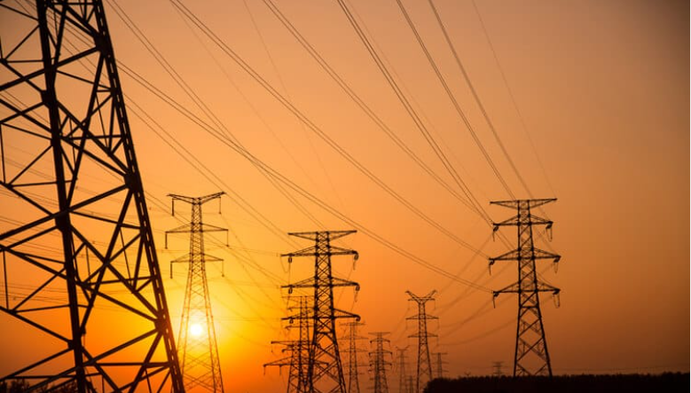
Introduction
Electricity has become the vital part
of everyday life in this modern world.
Electricity demand forecasting is a very difficult task.
Accurate electricity demand forecasting helps to run the power system efficiently and effectively.

Slide 4
Introduction(Cont.)
Electricity demand forecasting offers a useful duty in
decision making for power system companies.
Global electricity demand is predicted to increase by 85% in 2040 due to the
increasing population and
their convenient life style.

Slide 5
Motivation
Electricity demand forecasting is an effective way to balance the
requirement and distribution of electricity.
Based on the features, the model will be able to predict the electricity demand in future.
This will prevent the waste of electricity as we are ensuring the proper distribution of electricity.
We can be prepared for future by using the estimation.

Slide 6
Challenges
Most challenging part was preparing our dataset.
Had to consider a variety of features to build a competent dataset.
All the features were not available in a single source.

Slide 7
Related Work
Comparison of Machine Learning Based Methods for Residential Load Forecasting [1](N. Shabbir et al.,2019)
Work Done:
1.Compared machine learning algorithms named: linear regression, tree
based regression and Support Vector Machine (SVM) based regression.
2. SVM is the best technique among them.
Limitation:
1. Root Mean Square Error (RMSE) rate is comparatively high.

Slide 8
Related Work(Cont.)
Electricity Consumption & Prediction using Machine Learning
Models[2](Z. Çamurdan et al.,2017)
Work done:
1.Analyzed Machine Learning algorithms effectiveness, after being
applied to the electricity consumption prediction.
2. Reviewed about the Conventional Machine Learning Models as well
as the recent models.
Limitation:
1.Didn’t analyze the related features to predict electricity demand.
2. No real case implementation is shown .

Slide 9
Related Work(Cont.)
Machine Learning Based Electricity Demand Forecasting[3]
(R. Jena et al., 2020)
Work done:
1.Developed machine learning models that are evaluated using different evaluation metrics.
2.Random forest gives the highest(98%) accuracy among them.
Limitation:
1.Used small dataset.

Slide 10
Objectives
To build our own dataset combining energy data, weather data and
population density data.
To predict the electricity demand accurately using well defined
machine learning methods.
To find the most satisfactory approach supporting the dataset with
good prediction accuracy.

Slide 11
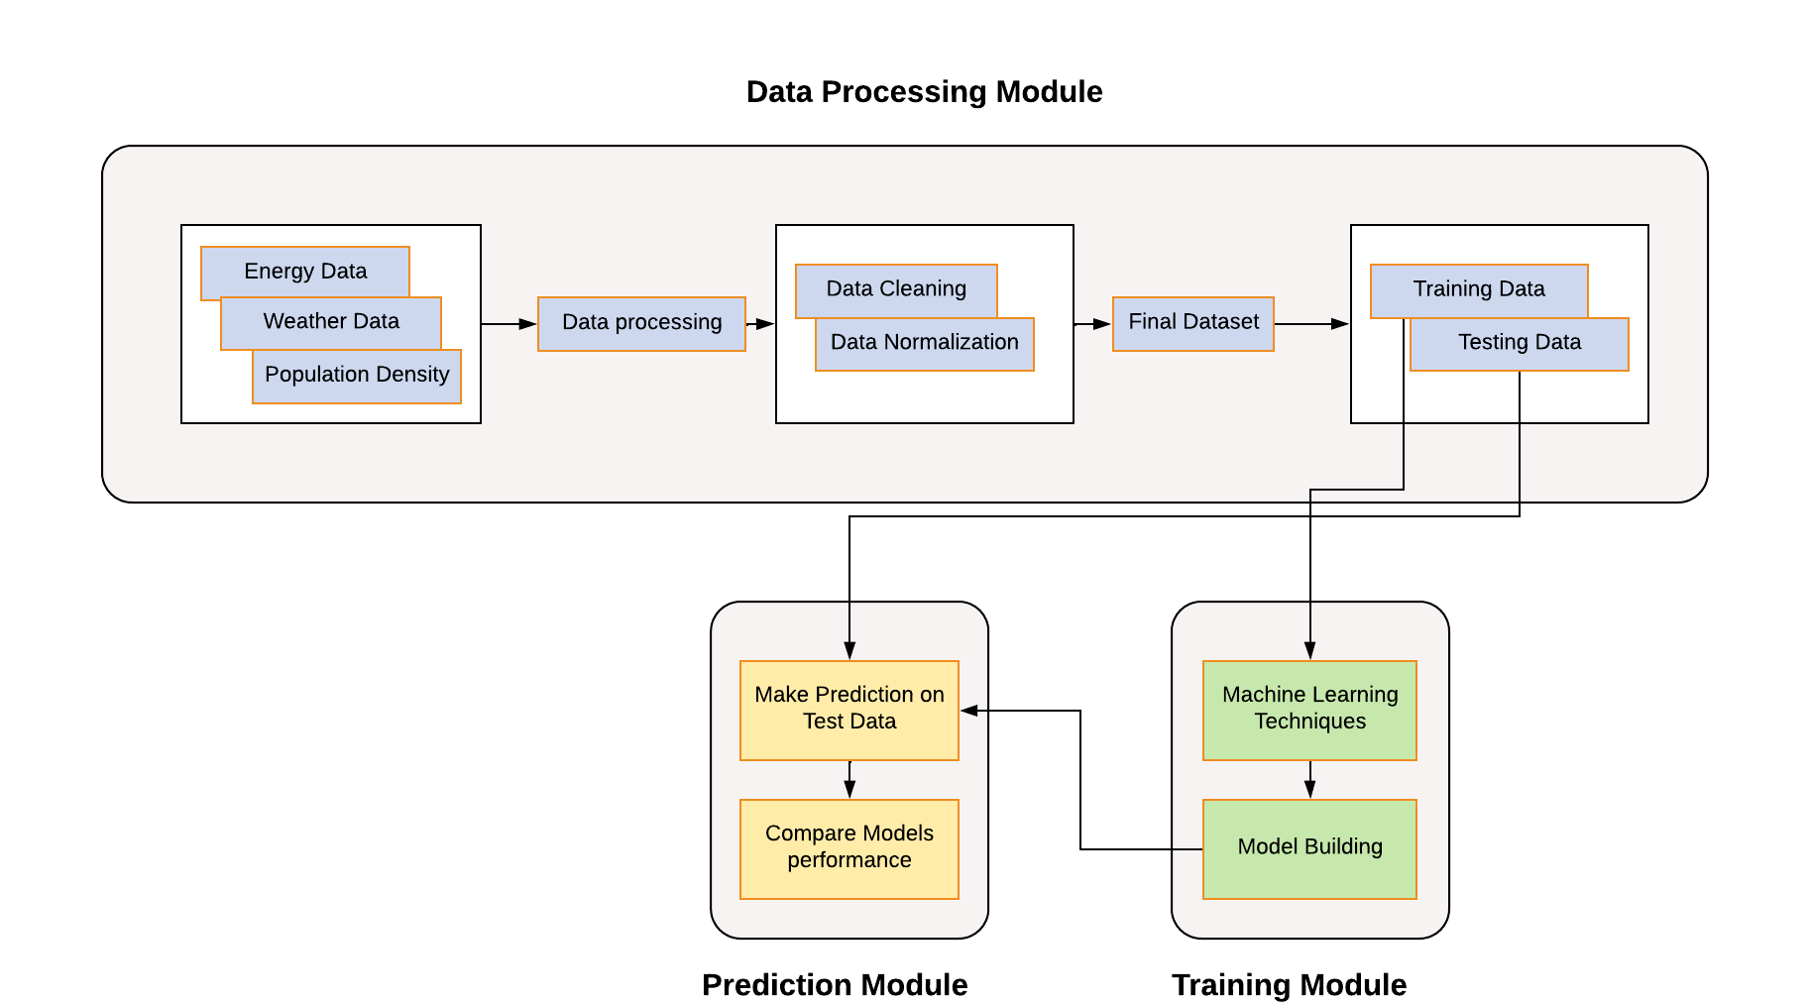
Outline Of Methodology
Figure: System Overview

Slide 12
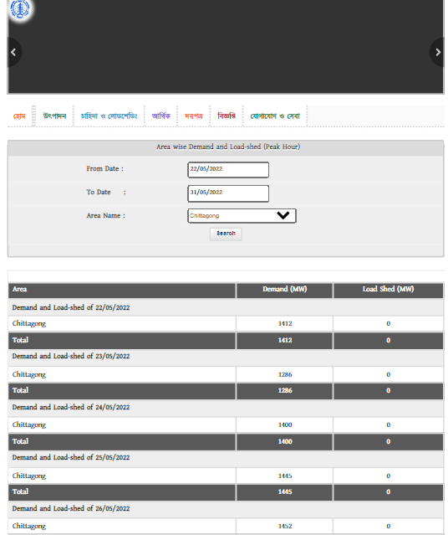
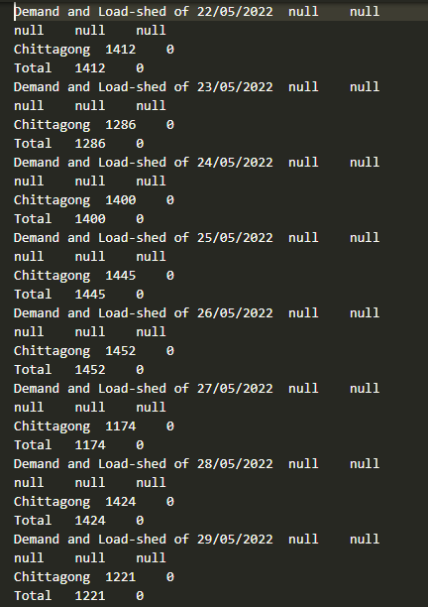
Implementation
Dataset creation: This figure shows the procedure of web scrapping
through which we have collected our demand data from the websites.
Figure: Feature extracted using web scrapping

Slide 13
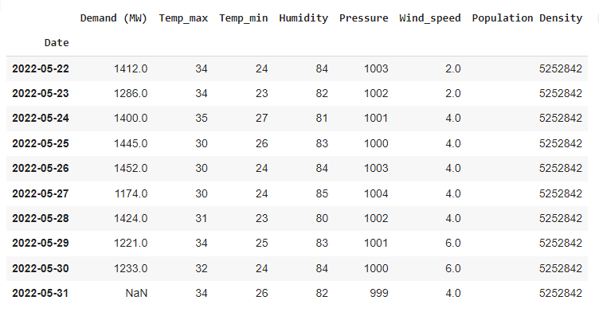
Implementation(Cont.)
Dataset Description : A sample of our dataset is given here. The features of our dataset are demand (MW), temp, humidity, pressure, wind speed, population density.
Figure: Dataset Sample

Slide 14
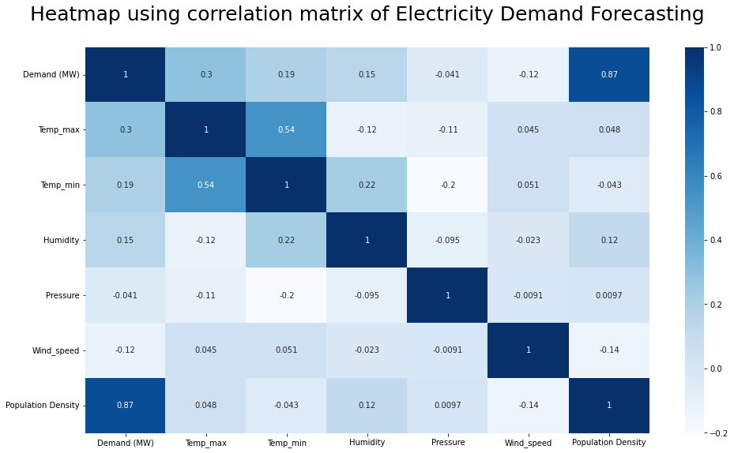
Implementation(Cont.)
Figure: Correlation matrix of features

Slide 15
Implementation(Cont.)
Used Methods for prediction:
Machine Learning
Linear Regression
Decision Tree Regression
Random Forest Regression
Support Vector Regression
K Nearest Neighbours Regression

Slide 16
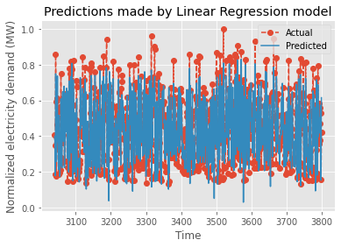
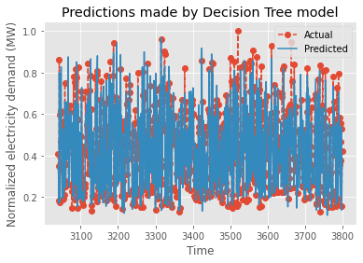
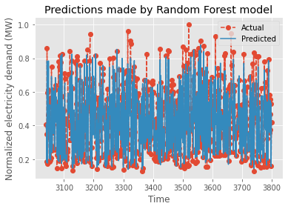
Experimental Evaluation
Evaluation of different models and results
Figure: Actual Vs Predicted Results
Prediction Errors and accuracy score of LR
Prediction Errors and accuracy score of DT
Prediction Errors and accuracy score of RF
MAE | 0.0582
MSE | 0.0057
RMSE | 0.0761
Accuracy | 82.53%
MAE | 0.0615
MSE | 0.0081
RMSE | 0.0903
Accuracy | 74.16%
MAE | 0.0450
MSE | 0.0042
RMSE | 0.0652
Accuracy | 86.24%

Slide 17
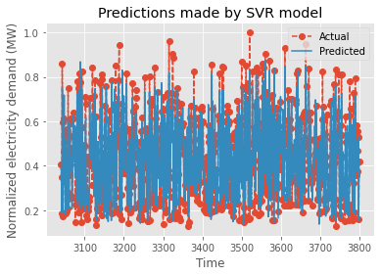

Experimental Evaluation(Cont.)
Evaluation of different models and results
Prediction Errors and accuracy score of SVR
Prediction Errors and accuracy score of KNN
MAE | 0.0540
MSE | 0.0052
RMSE | 0.0724
Accuracy | 84.52%
MAE | 0.0534
MSE | 0.0061
RMSE | 0.0782
Accuracy | 81.15%
Figure: Actual Vs Predicted Results

Slide 18
Experimental Evaluation(Cont.)
Evaluating the prediction models in terms of MAE,MSE,
RMSE and Accuracy.
Table: Comparing the results
Algorithms | Accuracy | MAE | MSE | RMSE
Linear Regression | 82.53% | 0.0582 | 0.0057 | 0.0761
Decision Tree | 74.16% | 0.0615 | 0.0081 | 0.0903
Random Forest | 86.24% | 0.0450 | 0.0042 | 0.0652
Support Vector Regression | 84.52% | 0.0540 | 0.0052 | 0.0724
K Nearest Neighbours | 81.15% | 0.0534 | 0.0061 | 0.0782

Slide 19
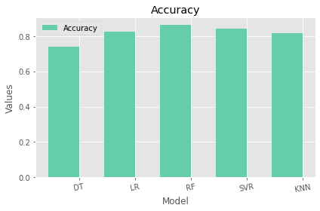
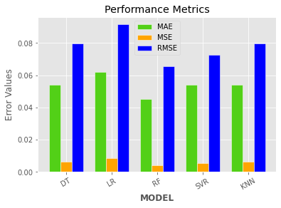
Experimental Evaluation(Cont.)
Graphical representation for evaluating the best model
Figure: Accuracy bar plot
Figure: Error comparison of the models

Slide 20
Contributions
Prepared dataset comprising 3800 records by collecting data from 3 websites.
Obtained demand column through web scrapping and other features via manual insertion.
Finding out the best machine learning regression model for
electricity demand prediction.

Slide 21
Conclusion
This system focuses on developing forecasting models that predicts electricity demand.
Compared the experimental result of different models to observe
promising outcome with machine learning approach.
Random Forest Regression gives the best results with the lowest
error rate.

Slide 22
Future Work
Collecting more data and predicting zone wise electricity demand.
Developing a hybrid system to forecast electricity more efficiently.
Analyzing many more important features which affect the electricity
demand.

Slide 23
References
[1] N. Shabbir, R. Ahmadiahangar, L. Kütt and A. Rosin, ‘Comparison of machine learning based methods for residential load forecasting,’ in 2019 Electric power quality and supply reliability conference (PQ) & 2019 symposium on electrical engineering and mechatronics (SEEM), IEEE, 2019, pp. 1–4 (cit. on pp. 6, 16).
[2] Z. Çamurdan and M. C. Ganiz, ‘Machine learning based electricity demand forecasting,’ in 2017 International Conference on Computer Science and Engineering (UBMK), 2017, pp. 412–417. doi: 10.1109/UBMK.2017.8093 428 (cit. on p. 6).
[3] R. Jena, S. S. Barik and S. K. Nayak, ‘Electricity consumption & prediction using machine learning models,’ Muktshabd, vol. 9, no. 6, pp. 2804– 2818, 2020 (cit. on pp. 18, 19).
[4] A. R. Anik and S. Rahman, ‘Commercial energy demand forecasting in bangladesh,’ Energies, vol. 14, no. 19, p. 6394, 2021 (cit. on p. 6).

Slide 24
References
[5] Z. Liu et al., ‘Accuracy analyses and model comparison of machine learning adopted in building energy consumption prediction,’ Energy Exploration & Exploitation, vol. 37, no. 4, pp. 1426–1451, 2019 (cit. on p. 6).
[6] T. Eseye, M. Lehtonen, T. Tukia, S. Uimonen and R. J. Millar, ‘Machine learning based integrated feature selection approach for improved electricity demand forecasting in decentralized energy systems,’ IEEE Access, vol. 7, pp. 91 463–91 475, 2019 (cit. on p. 7).
[7] S. A. Shaik, ‘Forecasting the electricity demand using machine learning algorithms,’ Ph.D. dissertation, Dublin Business School, 2020 (cit. on p. 27).

Slide 25
Thank You!

