Slide 1

Authors
Malignant and Benign Breast Cancer Classification using Machine Learning Algorithms
Paper Id-54
Department of Computer Science and Engineering,
Chittagong University of Engineering and Technology
Chittagong-4349, Bangladesh
Email : u1604044@student.cuet.ac.bd, annesha@cuet.ac.bd, ashim@cuet.ac.bd
Sharmin Ara,
Annesha Das
and
Ashim Dey
Presented By
Sharmin Ara

Slide 2

Contents
1. Introduction
2. Related Works
3. Objective
4. Workflow
5. Implementation
6. Experimental results
7. Conclusion

Slide 3
Introduction
Breast cancer has always shown extremely high occurrence and death rate .
  affecting about 10% women.
To determine breast cancer, women usually go through barrage of examinations according to the varying nature of breast cancer symptoms.
  ultrasound, biopsy and mammography.

Slide 4
Introduction
Proper identification of BC and patient categorization is an extremely significant avenue of this research.
  malignant or benign classes.
Various methods for predicting breast cancer have been
established in recent years.

Slide 5
Related Works
In [1],[2],[3],authors performed comparative analysis of the precise breast cancer prediction offered by existing ML algorithms.
In [4],authors presented a technique that can be used to detect and identify cell morphology in automated systems that carry out the classification using computer-aided mammogram image features.
In [5],different deep learning concepts related to breast mammogram analysis are reviewed and contributions to this area are summarized.

Slide 6
Objective
To analyze the WBCD dataset for finding relation between the features.
To apply different established classifiers on the WBCD dataset for comparing them.
To find most satisfactory approach supporting the dataset with good prediction accuracy.

Slide 7
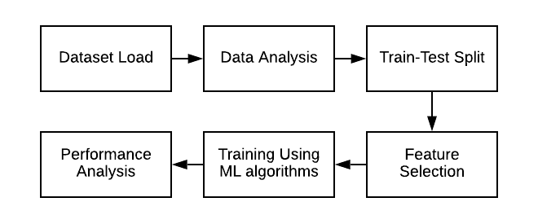
Workflow
Figure 1: Overall Workflow

Slide 8
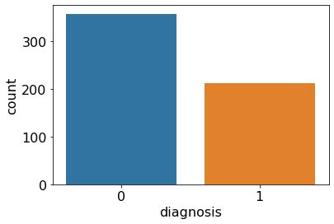
Implementation
Initially, the dataset is read from the CSV file.
Data entries from the dataset are analyzed based on their features .
Figure 2: Class distribution

Slide 9
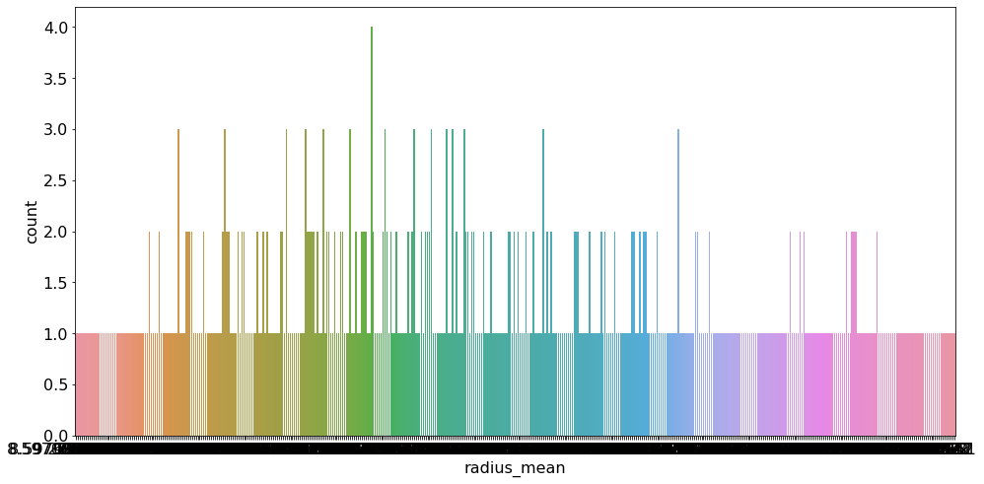
Implementation
Figure 3: Mean radius feature of WBCD dataset.

Slide 10
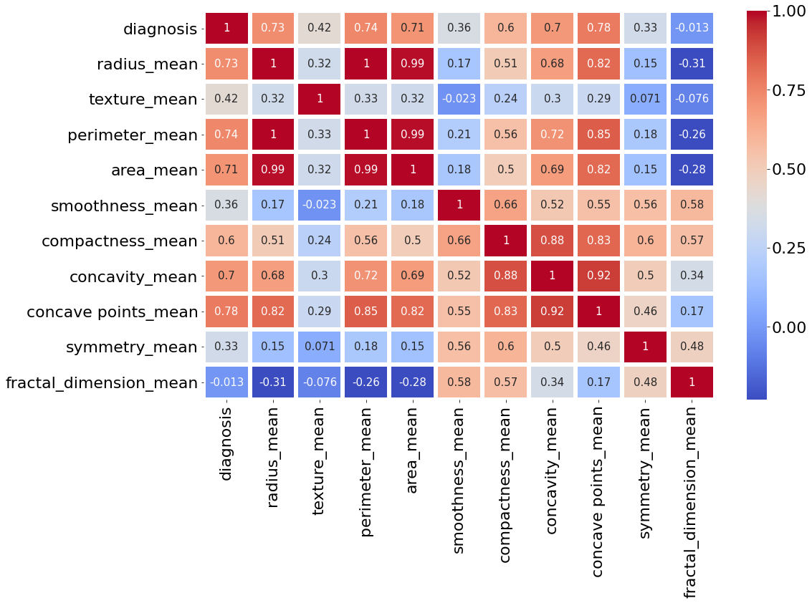
Implementation
In order to increase the accuracy feature selection is done to eliminate less correlated features.
Figure 4: Correlation between the different features.

Slide 11
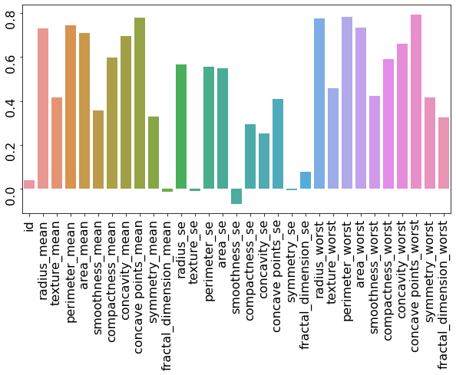
Implementation
Figure 5: Correlation of the features with target.

Slide 12
Implementation
The dataset is split into two portions:
Training set (75%) and testing set (25%).
Application of ML Algorithms:
  Logistic Regression, KNN, Decision Tree, Naïve Bayes, Random Forest, SVM.
Performance analysis accomplished by the comparative study of the resultant testing and training accuracy.

Slide 13
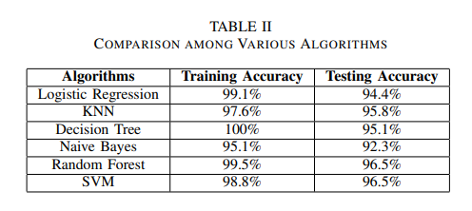
Experimental Results

Slide 14
Experimental Results
Maximum accuracy is achieved from Random Forest
and SVM.
Testing accuracy is 96.5%.
SVM is the preferable algorithm for prediction.
SVM performs relatively good when clear separation between classes is present in high dimensional dataset.

Slide 15
Conclusion
Developed several prediction model to classify malignant and benign cancer.
SVM achieves the highest accuracy and efficiency.
Larger dataset will be incorporated and more algorithms will be applied in future.

Slide 16
References
[1] Y. Khourdifi and M. Bahaj, “Applying best machine learning algorithms for breast cancer prediction and classification,” in 2018 International Conference on Electronics, Control, Optimization and Computer Science (ICECOCS). IEEE, 2018, pp. 1–5.
[2] R. Dhanya, I. R. Paul, S. S. Akula, M. Sivakumar, and J. J. Nair, “A comparative study for breast cancer prediction using machine learning and feature selection,” in 2019 International Conference on Intelligent Computing and Control Systems (ICCS). IEEE, 2019, pp. 1049–1055.

Slide 17
References
[3] M. S. Yarabarla, L. K. Ravi, and A. Sivasangari, “Breast cancer prediction via machine learning,” in 2019 3rd International Conference on Trends in Electronics and Informatics (ICOEI). IEEE, 2019, pp. 121–124.
[4] A. Toprak, “Extreme learning machine (elm)-based classification of benign and malignant cells in breast cancer,” Medical science monitor: international medical journal of experimental and clinical research, vol. 24, p. 6537, 2018.
[5] O. V. Singh and P. Choudhary, “A study on convolution neural network for breast cancer detection,” in 2019 Second International Conference on Advanced Computational and Communication Paradigms (ICACCP). IEEE, 2019, pp. 1–7

Slide 18
Thank You

