Slide 1
Design & Implementation of PHASE LOCKED LOOP(PLL) Using Cadence
PRESENTED BY : 1.Md. Mehedi Hasan - 021131010
2.Sharmin Sultana - 021131112
3.Tamanna Chowdhury - 021131125
4.Kazi Shady - 021132055
Supervised By:
Dr. Md. Iqbal Bahar Chowdhury Associate Professor
EEE Department of UIU

Slide 2
Presentation Outline:
Objective
What is Phase Locked Loop (PLL)
Application of PLL
Parts of a PLL
Schematic of all basic parts of PLL
Transient Response
Layout Representation
LVS & DRC

Slide 3
Objective:
Design a modified PLL at 90nm technology.
Implementation of PLL in Cadence Virtuoso Tool
Layout Design of PLL

Slide 4
Phase Locked Loop
Adjusts frequency of an input signal.
Variable frequency oscillator and a phase detector.
It generates a periodic signal.

Slide 5
Application of Phase Locked Loop :
Used in telecommunications, computers, radio etc.
Used in wireless communication
Used for digital data transmission
Used for microwave signal processing.

Slide 6
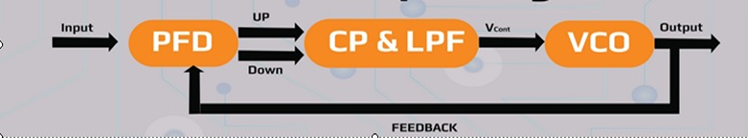

Design Flow of PLL

Slide 7
Phase Frequency detector
Monitors the phase and frequency differences
Transfers the information to charge pump
Generates the voltage signal
Controls the frequency of the voltage-controlled oscillator.

Slide 8
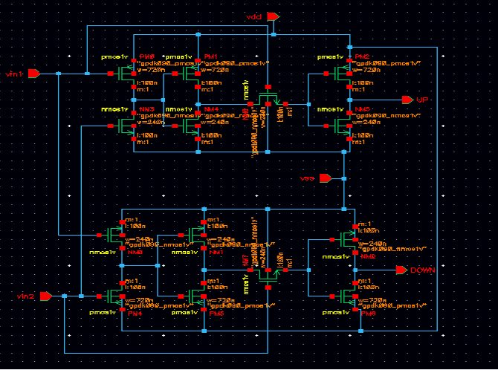
Schematic of Phase Frequency Detector

Slide 9
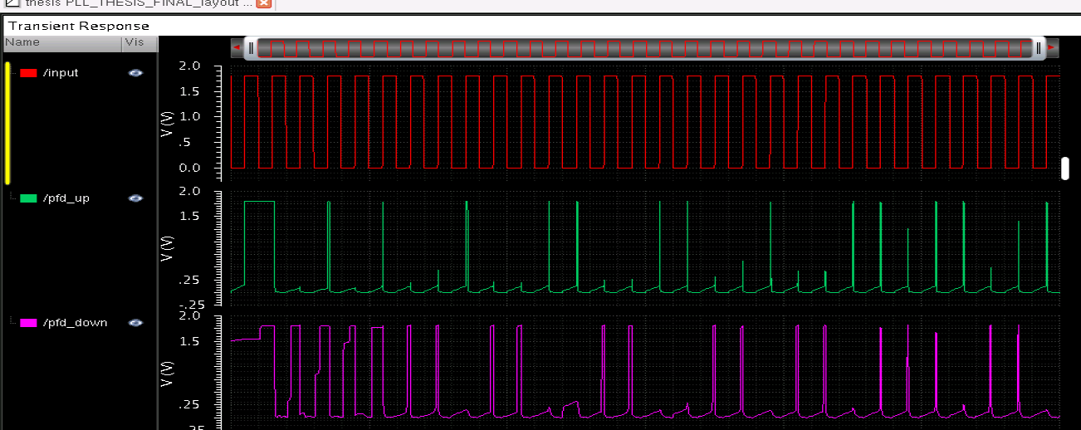
Transient Response of Phase Frequency Detector

Slide 10
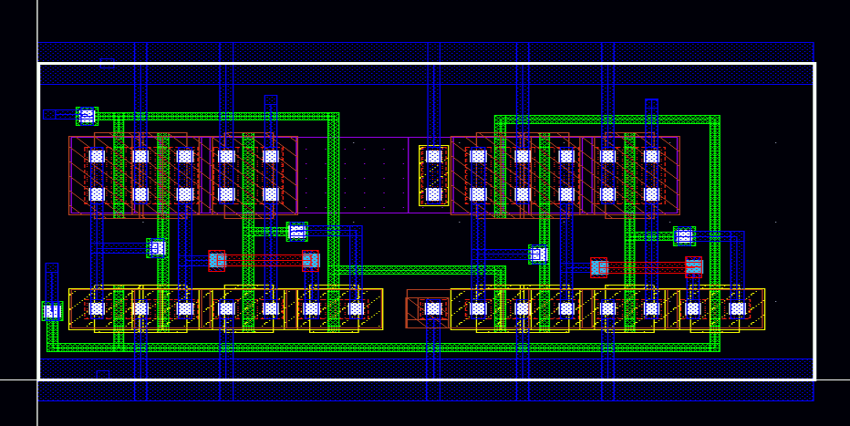
Layout Design of Phase Frequency Detector

Slide 11
Charge pump and Low pass Filter
Charge Pump:
Converts into current signal.
Use capacitors as energy-storage elements.
Creates a higher- or lower-voltage power source.
Low Pass Filter:
Supplies voltage to the VCO.
It ensure voltage is clean DC.

Slide 12
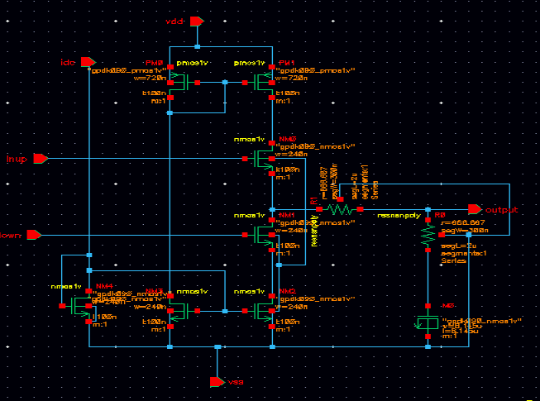
Schematic of Charge pump and Low Pass Filter

Slide 13
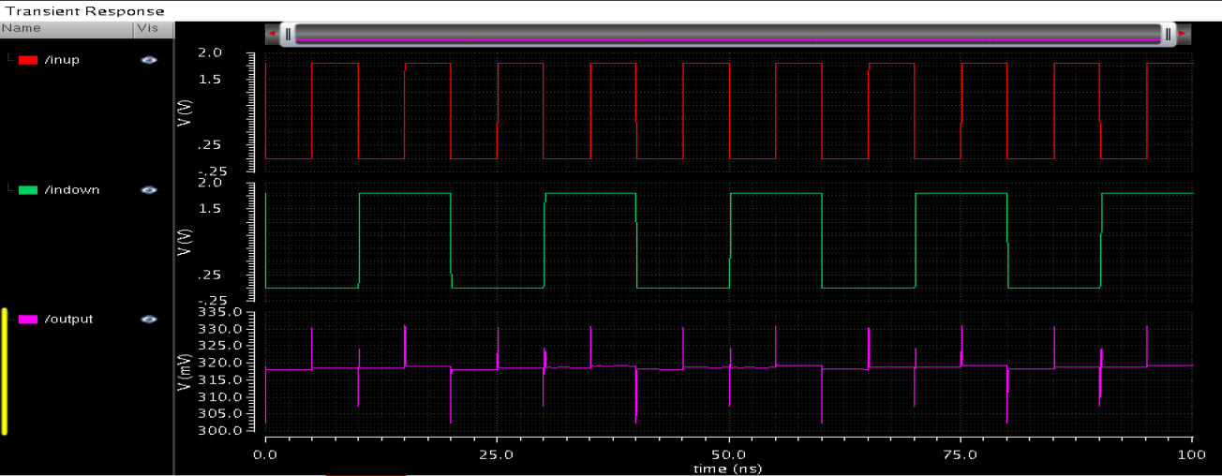
Transient Response of Charge pump and Low Pass Filter

Slide 14
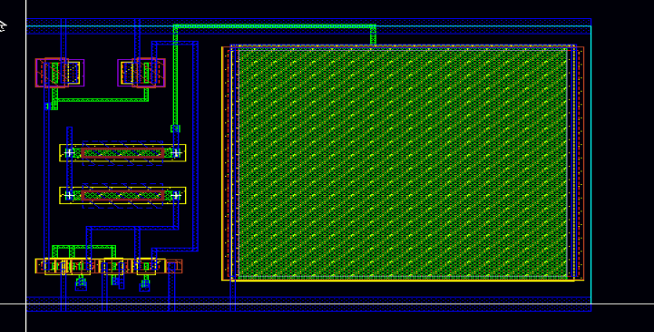
Layout Design of Charge pump and Low pass Filter

Slide 15
Voltage Controlled Oscillator
Output signal can be varied over a range.
Output signal is controlled by input DC voltage.
Output frequency is directly related to the input voltage.

Slide 16
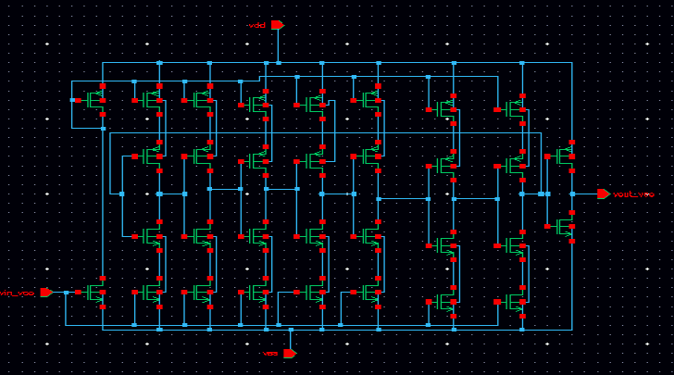
Schematic of Voltage Controlled Oscillator

Slide 17
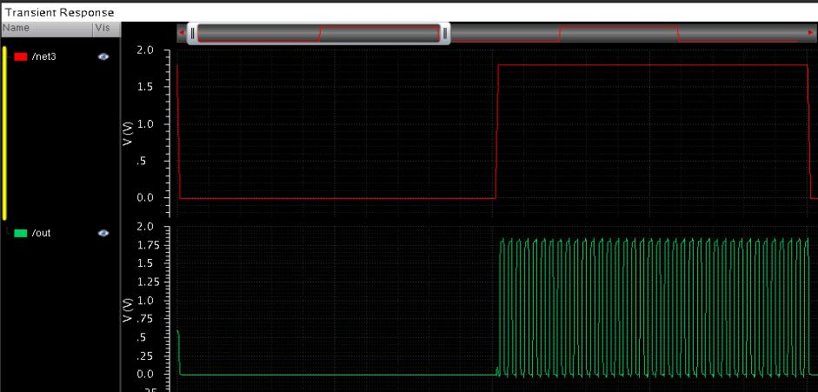
Transient response of Voltage Controlled Oscillator

Slide 18
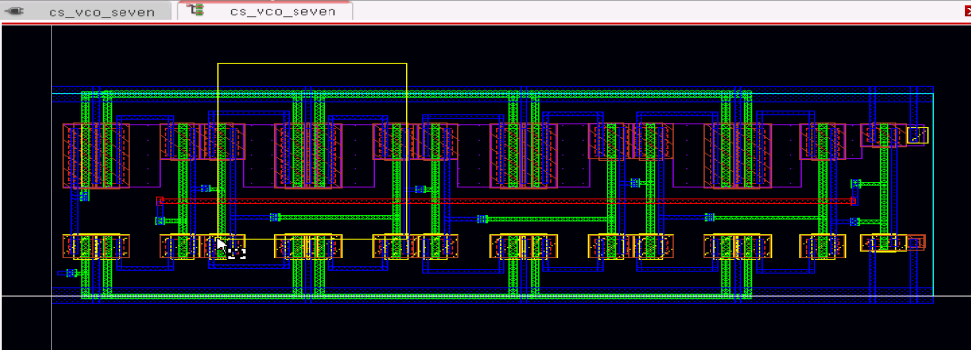
Layout of Voltage Controlled oscillator

Slide 19
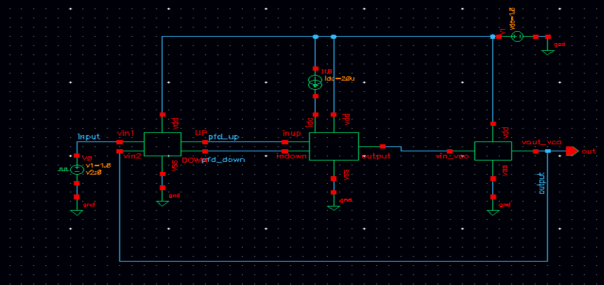
Schematic of Phase Locked Loop(PLL)

Slide 20
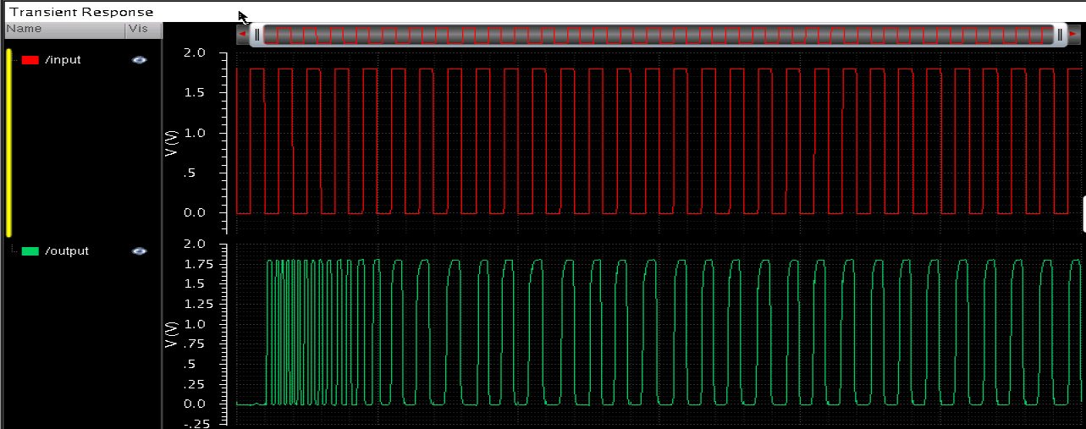
Transient Response of Phase Locked Loop

Slide 21
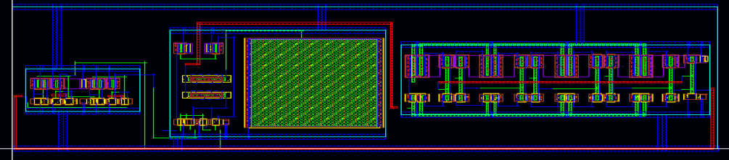
Layout Design of Phase Locked Loop

Slide 22
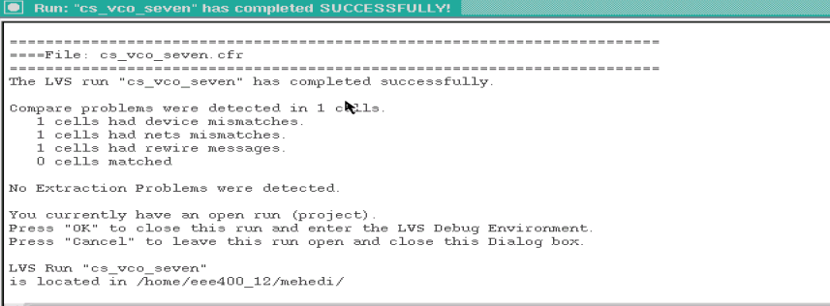
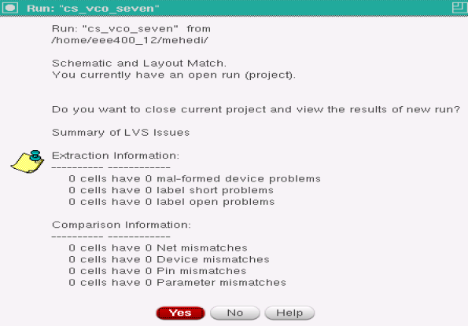
Layout Vs Schematic (LVS)

Slide 23
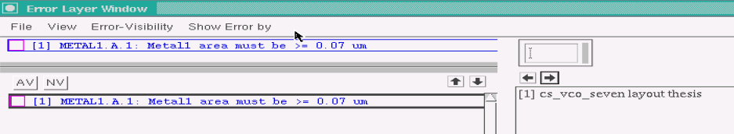

DRC CHECK

Slide 24


