Slide 1
HTML

Slide 2
Introduction
HTML stands for HyperText Markup Language.
HTML is used to create web pages and web applications.
HTML is widely used language on the web.
We can create a static website by HTML only.
Technically, HTML is a Markup language rather than a programming language.

Slide 3
Example Code
<html>
<head>
<title>Training Home Page</title>
</head>
<body>
<h1>Welcome !!</h1>
<p>To Webdesign Taining Program.</p>
</body>
</html>

Slide 4
Description of HTML Example
<html > :This tag informs the browser that it is an HTML document. Text between html tag describes the web document. It is a container for all other elements of HTML except <!DOCTYPE>
<head>: It should be the first element inside the <html> element, which contains the metadata(information about the document). It must be closed before the body tag opens.
<title>: As its name suggested, it is used to add title of that HTML page which appears at the top of the browser window. It must be placed inside the head tag and should close immediately. (Optional)

Slide 5
Description of HTML Example
<body> : Text between body tag describes the body content of the page that is visible to the end user. This tag contains the main content of the HTML document.
<h1> : Text between <h1> tag describes the first level heading of the webpage.
<p> : Text between <p> tag describes the paragraph of the webpage.

Slide 6
Features of HTML
It is a very easy and simple language. It can be easily understood and modified.
It is very easy to make an effective presentation with HTML because it has a lot of formatting tags.
It is a markup language, so it provides a flexible way to design web pages along with the text.
It facilitates programmers to add a link on the web pages (by html anchor tag), so it enhances the interest of browsing of the user.

Slide 7
Features of HTML
It is platform-independent because it can be displayed on any platform like Windows, Linux, and Macintosh, etc.
It facilitates the programmer to add Graphics, Videos, and Sound to the web pages which makes it more attractive and interactive.
HTML is a case-insensitive language, which means we can use tags either in lower-case or upper-case.

Slide 8
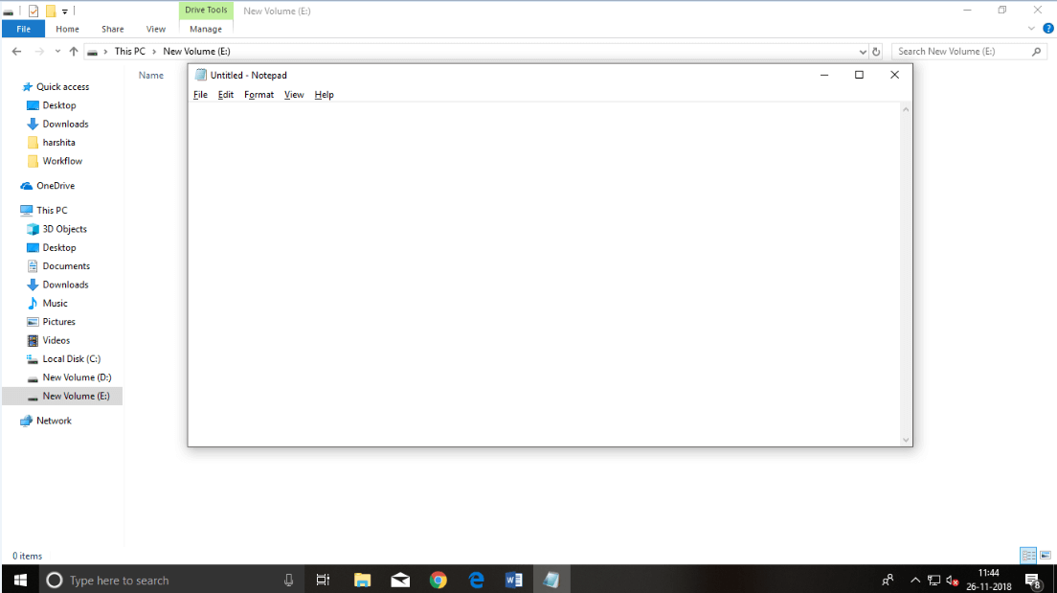
HTML text Editors
Text editors are the programs which allow editing in a written text, hence to create a web page we need to write our code in some text editor.
professional text editors are Notepad++, Sublime Text, Vim, etc.
Notepad is a simple text editor and suitable for beginners to learn HTML

Slide 9
Building blocks of HTML
Tags: An HTML tag surrounds the content and apply meaning to it. It is written between < and > brackets.
Attribute: An attribute in HTML provides extra information about the element, and it is applied within the start tag. An HTML attribute contains two fields: name & value.
Elements: An HTML element is an individual component of an HTML file. In an HTML file, everything written within tags are termed as HTML elements.
Syntax
<tag name attribute_name= " attr_value"> content </ tag name>

Slide 10
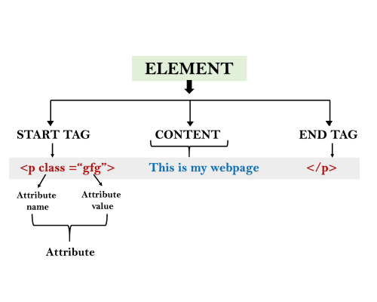
Building blocks of HTML

Slide 11
Example
<html>
<head>
<title>The basic building blocks of HTML</title>
</head>
<body>
<h2>The building blocks</h2>
<p>This is a paragraph tag</p>
<p style="color: red">The style is attribute of paragraph tag</p>
<span>The element contains tag, attribute and content</span>
</body>
</html>

Slide 12
HTML Tags
All HTML tags must enclosed within < > these brackets.
Every tag in HTML perform different tasks.
If you have used an open tag <tag>, then you must use a close tag </tag> (except some tags)
Syntax
<tag> content </tag>

Slide 13
HTML Tags Examples
<html>
<body>
<p> Paragraph Tag </p>
<h2> Heading Tag </h2>
<b> Bold Tag </b>
<i> Italic Tag </i>
<u> Underline Tag</u>
</body>
</html>

Slide 14
HTML Attribute
HTML attributes are special words which provide additional information about the elements or attributes are the modifier of the HTML element.
Each element or tag can have attributes, which defines the behaviour of that element.
Attributes should always be applied with start tag.
The Attribute should always be applied with its name and value pair.
Syntax
<element attribute_name="value">content</element>

Slide 15
HTML Attribute Example
<html>
<head>
</head>
<body>
<h1> This is Style attribute</h1>
<p style="height: 50px; color: blue">It will add style property in element</p>
<p style="color: red">It will change the color of content</p>
</body>
</html>

Slide 16
HTML Elements
Element is a collection of start tag, attributes, end tag, content between them.
Eg:
<p> Hello world!!! </p>

Slide 17
Block-level and Inline HTML elements
A block-level element always start with new line and takes the full width of web page, from left to right.
Elements are
<address>, <article>, <aside>, <blockquote>, <canvas>, <dd>, <div>, <dl>, <dt>, <fieldset>, <figcaption>, <figure>, <footer>, <form>, <h1>-<h6>, <header>, <hr>, <li>, <main>, <nav>, <noscript>, <ol>, <output>, <p>, <pre>, <section>, <table>, <tfoot>, <ul> and <video>

Slide 18
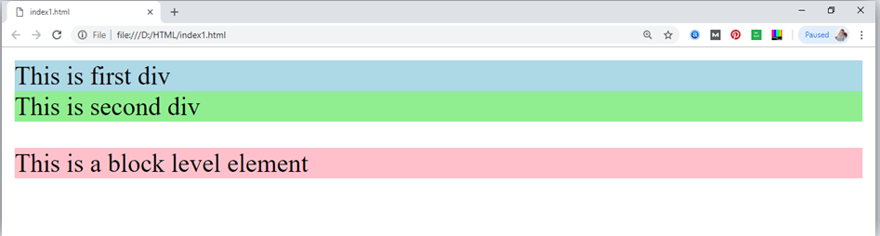
Block level Elements - Example
<html>
<head>
</head>
<body>
<div style="background-color: lightblue">This is first div</div>
<div style="background-color: lightgreen">This is second div</div>
<p style="background-color: pink">This is a block level element</p>
</body>
</html>

Slide 19
Inline elements
These elements does not start with new line and take width as per requirement
Elements are
<a>, <abbr>, <acronym>, <b>, <bdo>, <big>, <br>, <button>, <cite>, <code>, <dfn>, <em>, <i>, <img>, <input>, <kbd>, <label>, <map>, <object>, <q>, <samp>, <script>, <select>, <small>, <span>, <strong>, <sub>, <sup>, <textarea>, <time>, <tt>, <var>.

Slide 20
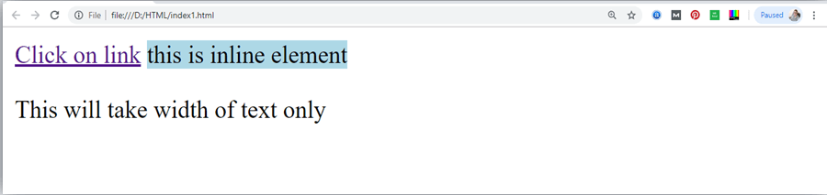
Inline Elements - Example
<html>
<head>
</head>
<body>
<a href="https://www.javatpoint.com/html-tutorial">Click on link</a>
<span style="background-color: lightblue">this is inline element</span>
<p>This will take width of text only</p>
</body>
</html>

Slide 21
HTML Formatting
Formatting Tags used are
<b>-This is a physical tag, which is used to bold the text written between it.
<strong> -This is a logical tag, which tells the browser that the text is important.
<i>-This is a physical tag which is used to make text italic.
<em>-This is a logical tag which is used to display content in italic.
<mark>-This tag is used to highlight text.
<u>-This tag is used to underline text written between it.
<tt>-This tag is used to appear a text in teletype. (not supported in HTML5)

Slide 22
HTML Formatting
<strike> -This tag is used to draw a strikethrough on a section of text. (Not supported in HTML5)
<sup>-It displays the content slightly above the normal line.
<sub>-It displays the content slightly below the normal line.
<del>-This tag is used to display the deleted content.
<ins>-This tag displays the content which is added
<big>-This tag is used to increase the font size by one conventional unit.
<small>-This tag is used to decrease the font size by one unit from base font size.

Slide 23
HTML Heading
A HTML heading or HTML h tag can be defined as a title or a subtitle which you want to display on the webpage
example:
<h1>Heading no. 1</h1>
<h2>Heading no. 2</h2>
<h3>Heading no. 3</h3>
<h4>Heading no. 4</h4>
<h5>Heading no. 5</h5>
<h6>Heading no. 6</h6>

Slide 24
HTML Heading Example
<html>
<head>
<title>Heading elements</title>
</head>
<body>
<h1>This is main heading of page. </h1>
<p>h1 is the most important heading, which is used to display the keyword of page </p>
<h2>This is first sub-heading</h2>
<p>h2 describes the first sub heading of page. </p>
<h3>This is Second sub-heading</h3>
<p>h3 describes the second sub heading of page.</p>
<p>We can use h1 to h6 tag to use the different sub-heading with their paragraphs if
required.
</p>
</body>
</html>

Slide 25
HTML Paragraph
HTML paragraph or HTML p tag is used to define a paragraph in a webpage.
Example:
<p>This is first paragraph.</p>
<p>This is second paragraph.</p>
<p>This is third paragraph.</p>

Slide 26
HTML Anchor
The HTML anchor tag defines a hyperlink that links one page to another page.
It can create hyperlink to other web page as well as files, location, or any URL.
syntax of HTML anchor tag is given below.
<a href = "..........."> Link Text </a>
example of HTML anchor tag.
<a href="second.html">Click for Second Page</a>

Slide 27
HTML Anchor - Example
<html>
<head>
<title></title>
</head>
<body>
<p>Click on <a href="https://www.ictacademy.com/" target="_blank"> this-link </a>to go on home page of ICTACADEMY.</p>
</body>
</html>

Slide 28
HTML Image
HTML img tag is used to display image on the web page.
HTML img tag is an empty tag that contains attributes only, closing tags are not used in HTML image element.
example of HTML image.
<h2>HTML Image Example</h2>
<img src="good_morning.jpg" alt="Good Morning Friends"/>
<img src="animal.png" height="180" width="300" alt="animal image">

Slide 29
HTML Table
HTML table tag is used to display data in tabular form (row * column). There can be many columns in a row.
We can create a table to display data in tabular form, using <table> element, with the help of <tr> , <td>, and <th> elements.
Table Example
<table>
<tr><th>First_Name</th><th>Last_Name</th><th>Marks</th></tr>
<tr><td>Sonoo</td><td>Jaiswal</td><td>60</td></tr>
<tr><td>James</td><td>William</td><td>80</td></tr>
<tr><td>Swati</td><td>Sironi</td><td>82</td></tr>
<tr><td>Chetna</td><td>Singh</td><td>72</td></tr>
</table>

Slide 30
HTML Table with colspan
<table style="width:100%">
<tr>
<th>Name</th>
<th colspan="2">Mobile No.</th>
</tr>
<tr>
<td>Ajeet Maurya</td>
<td>7503520801</td>
<td>9555879135</td>
</tr>
</table>

Slide 31
HTML Table with rowspan
<table>
<tr><th>Name</th><td>Ajeet Maurya</td></tr>
<tr><th rowspan="2">Mobile No.</th><td>7503520801</td></tr>
<tr><td>9555879135</td></tr>
</table>

Slide 32
HTML Lists
There are three different types of HTML lists
Ordered List or Numbered List (ol)
Unordered List or Bulleted List (ul)
Description List or Definition List (dl)

Slide 33
HTML Ordered List or Numbered List
<ol>
<li>Aries</li>
<li>Bingo</li>
<li>Leo</li>
<li>Oracle</li>
</ol>

Slide 34
HTML Unordered List or Bulleted List
<ul>
<li>Aries</li>
<li>Bingo</li>
<li>Leo</li>
<li>Oracle</li>
</ul>

Slide 35
HTML Description List or Definition List
<dl>
<dt>Aries</dt>
<dd>-One of the 12 horoscope sign.</dd>
<dt>Bingo</dt>
<dd>-One of my evening snacks</dd>
<dt>Leo</dt>
<dd>-It is also an one of the 12 horoscope sign.</dd>
<dt>Oracle</dt>
<dd>-It is a multinational technology corporation.</dd>
</dl>

