Slide 1

Machine learning algorithm for disease detection & prediction
By : Sharmishtha Shukla
Univ roll no: 2017668
Mentor : Sharon Crista (Associate Professor)

Slide 2
Introduction
Disease Prediction model is a piece of software that predicts the disease based on the symptoms provided by the user or any patient. The model processes the symptoms as an input and produces an output as the probability of the disease
A disease predictor is a virtual doctor

Slide 3
Problem Statement
Machine Learning Algorithm for disease detection and prediction : Here a multiple disease detection and prediction model is designed with average accuracy of 85 %.

Slide 4
Methodology
Disease Detection:
Detection of : Heart, Diabetes, Parkinson
Dataset Used : Cleveland Heart Disease Dataset, Diabetese Dataset from Kaggle, Parkinson Disease Dataset from Kaggle
Classifier Used : Random Forest, Linear Regression , SVM

Slide 5
Medthodology
Disease Prediction
Prediction of : 41 Disease
Symptoms : 139
Dataset Used : Kaggle Disease Prediction Symptom
Classifier Used : Random Forest

Slide 6
Libraries Used :
Numpy
Pandas
Seaborn
Matplotlib
Streamlit
Sklearn

Slide 7
Result :
The average accuracy is 85% for all detection and prediction
The highest accuracy on the training set is 100%, which is achieved with random forest.
Our predictive system can help and be used in diagnosing diseases.

Slide 8
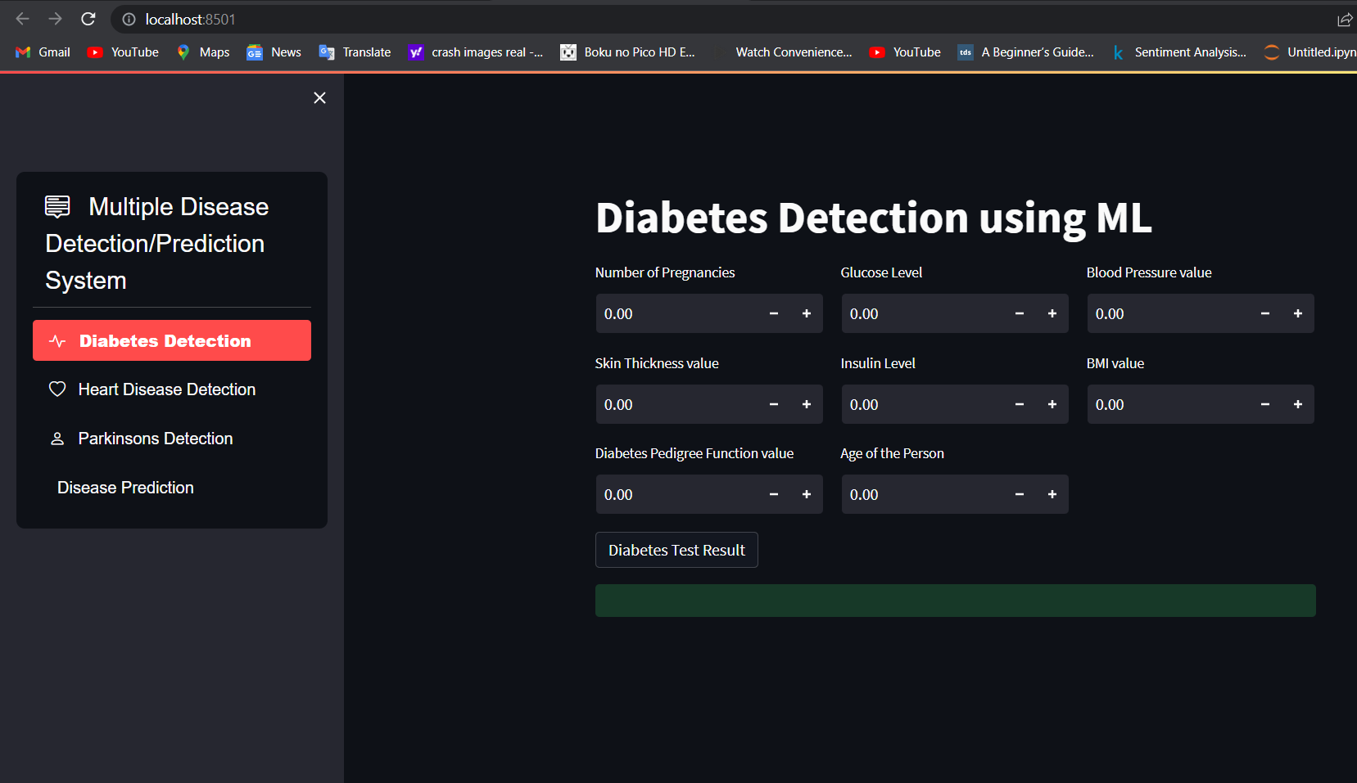

Slide 9

Conclusion and Future Work
Because some models were parameter dependent, they failed to predict disease and had a very low percentage of accuracy. Once disease is predicted, medical resources needed for treatment can be easily managed. This model helps us to reduce the cost of treating the diseases and improves the recovery process.

