Slide 1
PRODUCT MANAGEMENT
Launching Netflix Music
Product sense, problem definition and MVP for a personalized audio app
SUBMITTED BY
Sharmistha Chakrabortty
ROLE
Aspiring Product Manager
UNIVERSITY
UC San Diego Extended Studies
PROGRAM
AI-Powered Product Management Professional Program
DATE
October 19, 2026

Slide 2
Agenda
The story runs from why, to who, to what we build first
• Part 1 The art of why: why Netflix, why now, the business case
• Part 2 Defining the problem: customer research, personas, jobs to be done
• Part 3 Where the experience breaks: user journey maps
• Part 4 From ideas to features: Idea Funnel
• Part 5 Where Netflix can win: competition, SWOT, BCG
• Part 6 What to build first: RICE, WSJF, Kano, MoSCoW
• Part 7 Delivering the MVP: definition, scope, user stories, PRD
• Part 8 Roadmap, success metrics and risks
2

Slide 3
Executive summary
Netflix Music turns what you watch into what you listen to
THE PROBLEM
THE INSIGHT
Listeners can't easily find audio that fits them. 4 of 10 users report a discovery pain and 3 of 10 report missing exclusive or regional content. No app links watching and listening.
Netflix owns the shows, the soundtracks and the viewing data. That is an advantage Spotify, Apple Music and Amazon Music cannot copy.
THE MVP
THE PLAN
Watch-history discovery and AI playlists (top 2 on RICE and WSJF), soundtrack hubs with exclusive audio, offline listening and an ad-free premium tier. Launch target: Binge-Watchers.
MVP by mid-2027, then User Growth, Competitive Differentiation and Monetization through 2028, each phase gated by a measurable target.
3

Slide 4
PART 1
The art of why
Before deciding what to build, be sure why it should exist and why Netflix should build it

Slide 5
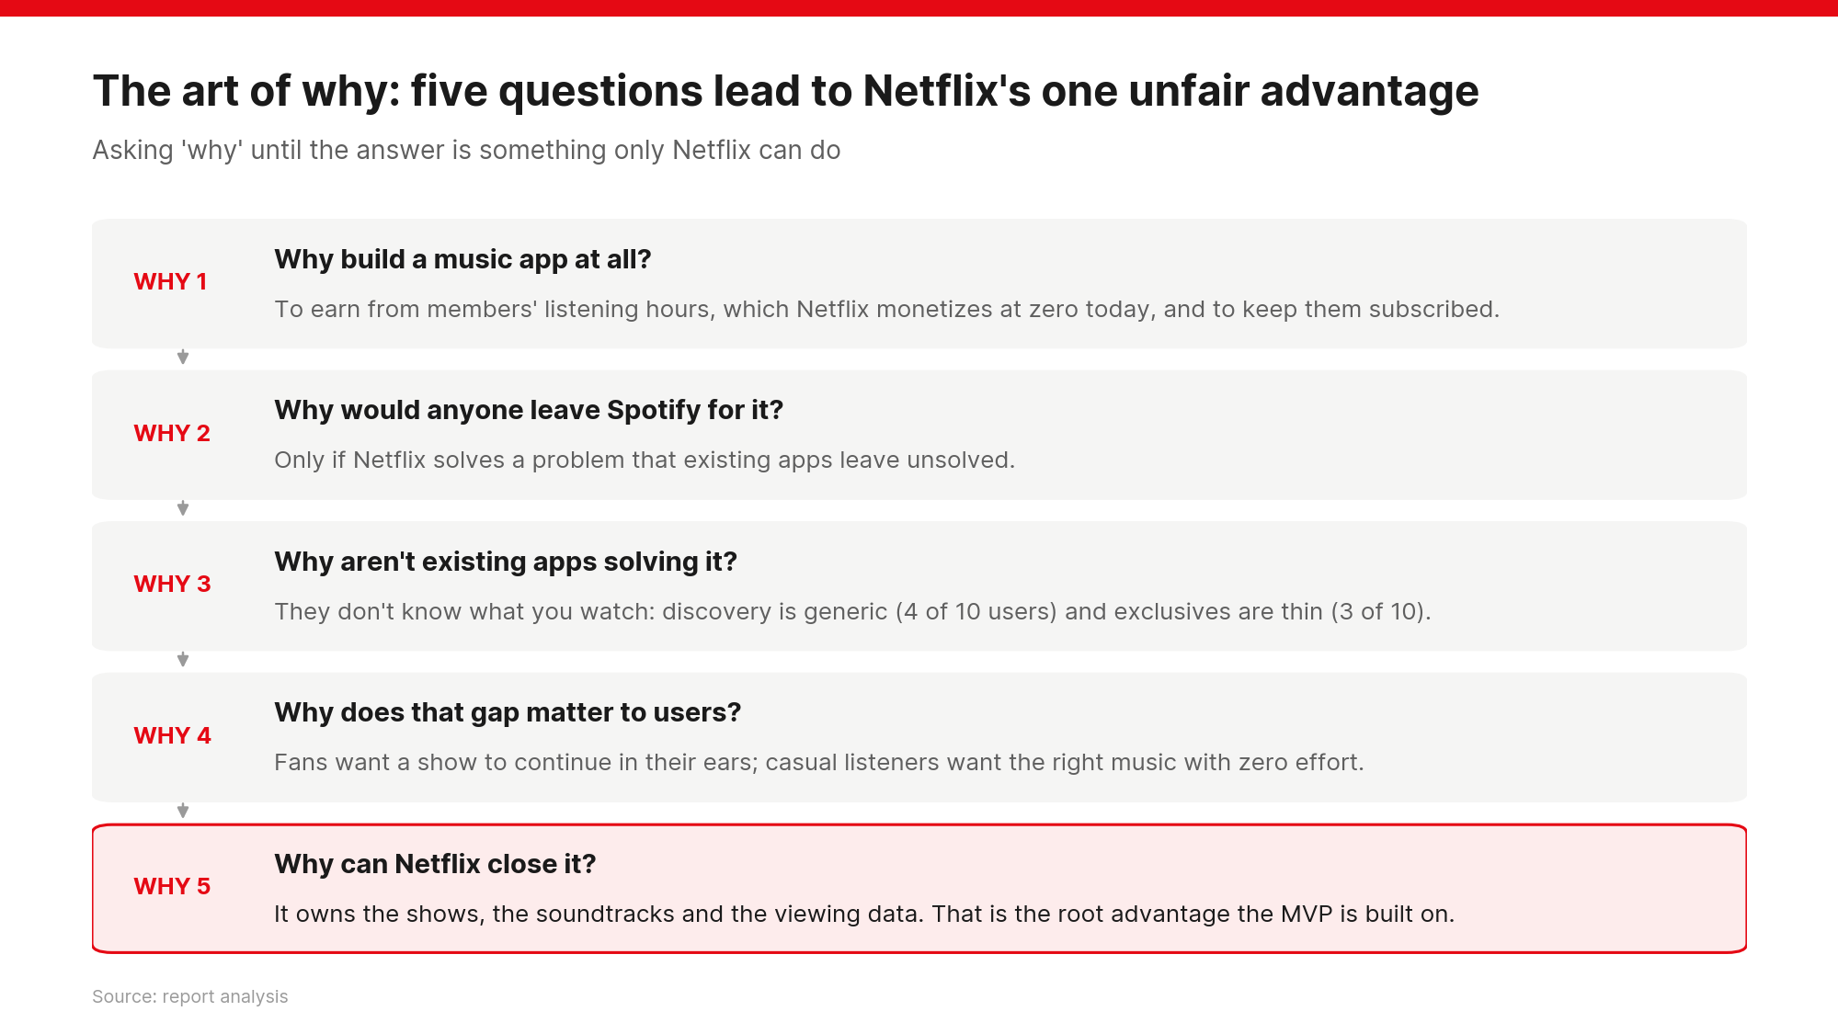
5
Notes:
Five whys: each answer becomes the next question until we reach something only Netflix can do. The root answer (owned shows, soundtracks and viewing data) is what the MVP is built on.

Slide 6
Business case: why Netflix should build this
Turn unmonetized listening hours into revenue and loyalty
WHY BUILD IT
BENEFITS
• Capture the non-screen hours: commuting, work, exercise
• Defend the core subscription: a second daily habit lowers churn
• Monetize owned IP twice: soundtracks, scores, cast podcasts, commentaries
• Feed the recommendation engine in both directions: video and audio
Users: music matched to their shows; easier discovery; exclusives; regional content; offline, ad-free listening
Netflix: new premium and bundle revenue; lower churn; longer engagement; stronger regional growth; richer data
Revenue model: free tier with ads, premium add-on, Netflix + Music bundles, later hi-fi and partnerships
6
Notes:
Business case framed around the art of why: the product must earn its place for users and for Netflix.

Slide 7
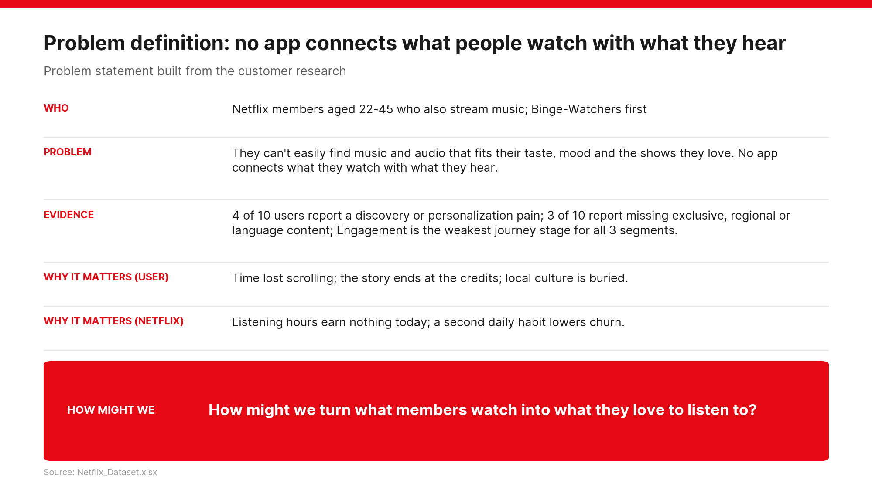
7
Notes:
The problem statement: who, what, evidence from the dataset, why it matters, and the How Might We question that frames the whole product.

Slide 8
Project scope: six steps, each answering a question
What the problem statement asks for and why
Step | What we do | Data | Question it answers
1. Personas | Segment users, build personas | Survey data | Who are we building for?
2. Journey maps | Map discovery to daily use | Journey data | Where does the experience break?
3. Idea Funnel | Generate, screen and refine ideas | Survey and journey data | What could solve it?
4. SWOT and BCG | Benchmark Spotify, Apple, Amazon | Market | Where can Netflix win?
5. Prioritization | RICE, WSJF, Kano, MoSCoW | Feature scores | What do we build first?
6. Roadmap | MVP, Growth, Differentiation, Monetization | All | When and how do we deliver?
8

Slide 9
PART 2
Defining the problem
Who the users are, what hurts, and what they would pay for

Slide 10
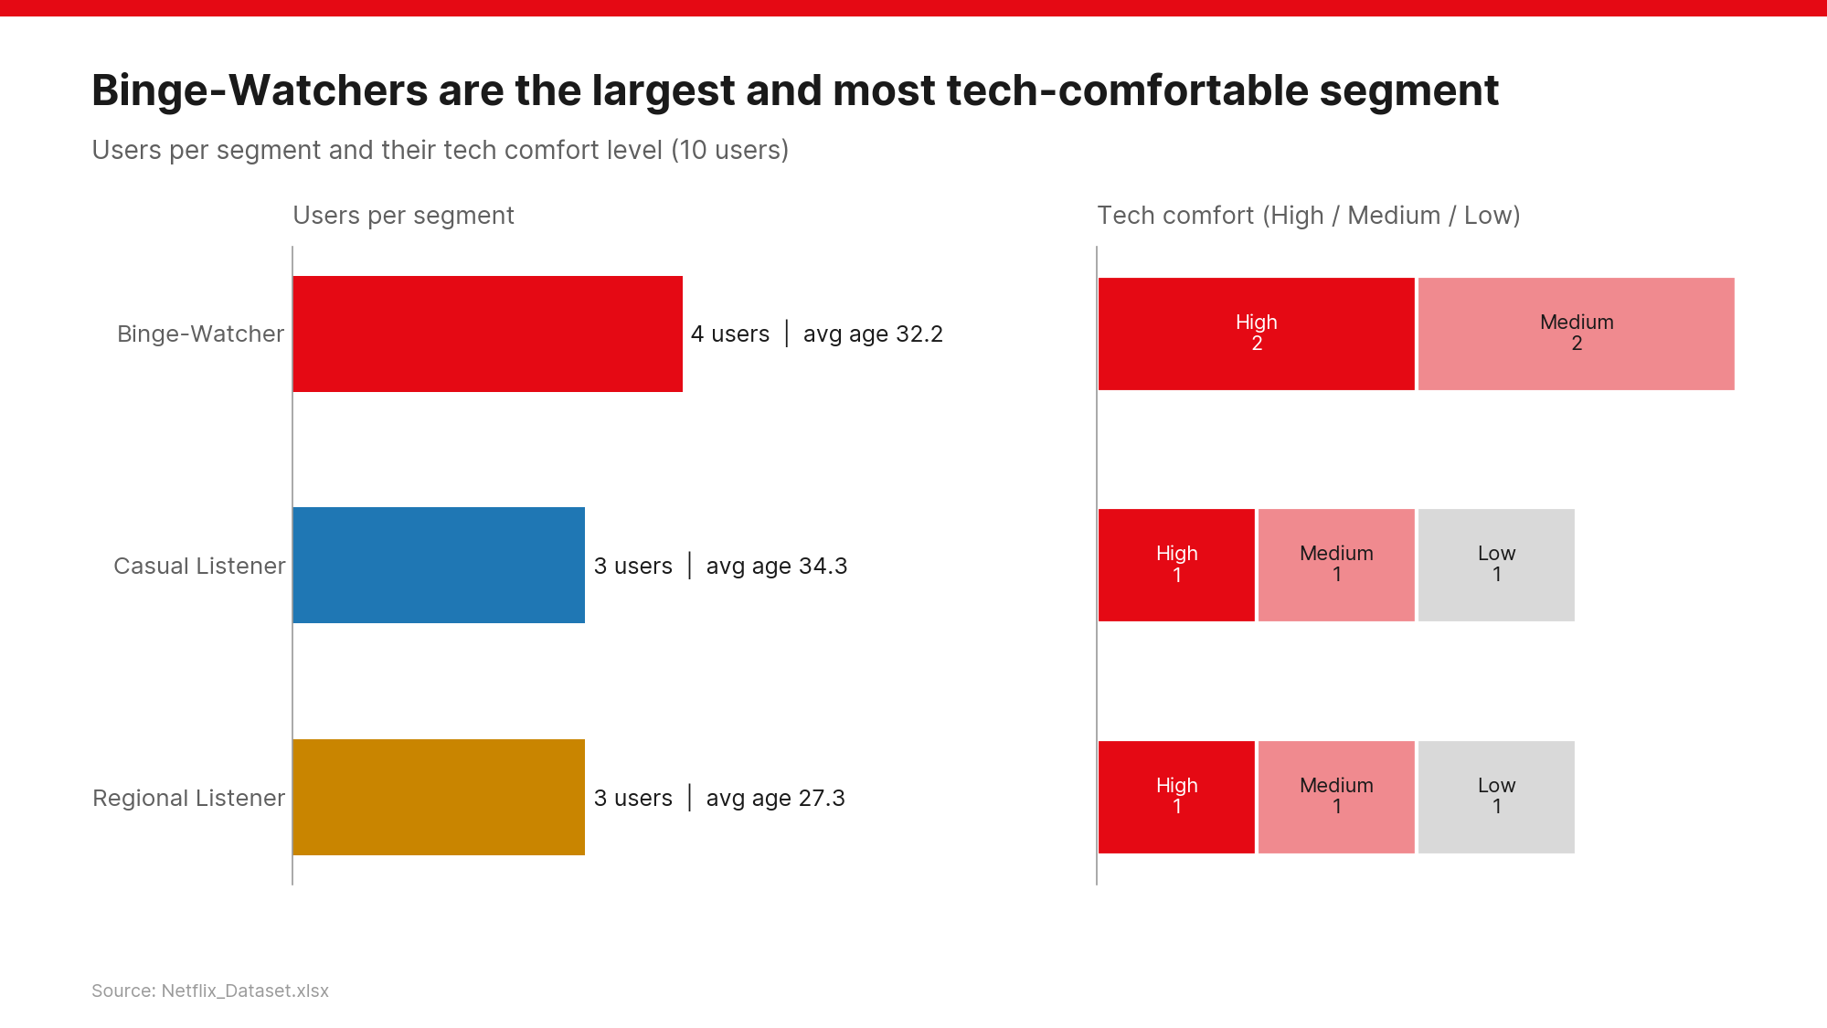
10
Notes:
Three segments: Binge-Watchers (4), Casual Listeners (3), Regional Listeners (3). Binge-Watchers have no low tech-comfort users, so they are the natural early adopters.

Slide 11
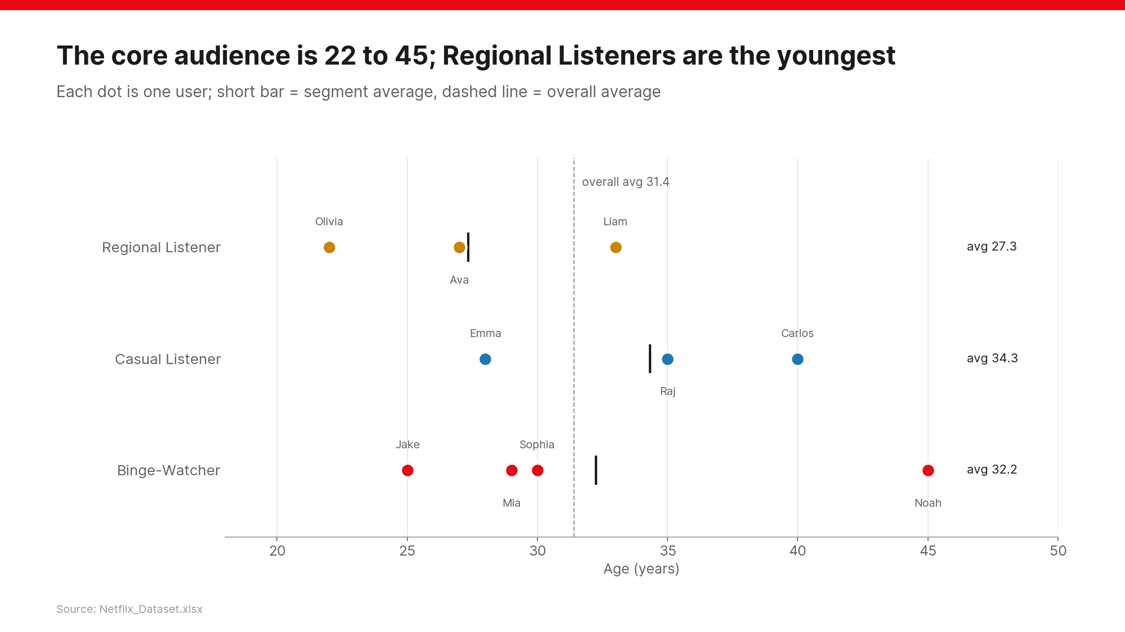
11
Notes:
Users are 22 to 45, average 31.4. Regional Listeners are the youngest (27.3).

Slide 12
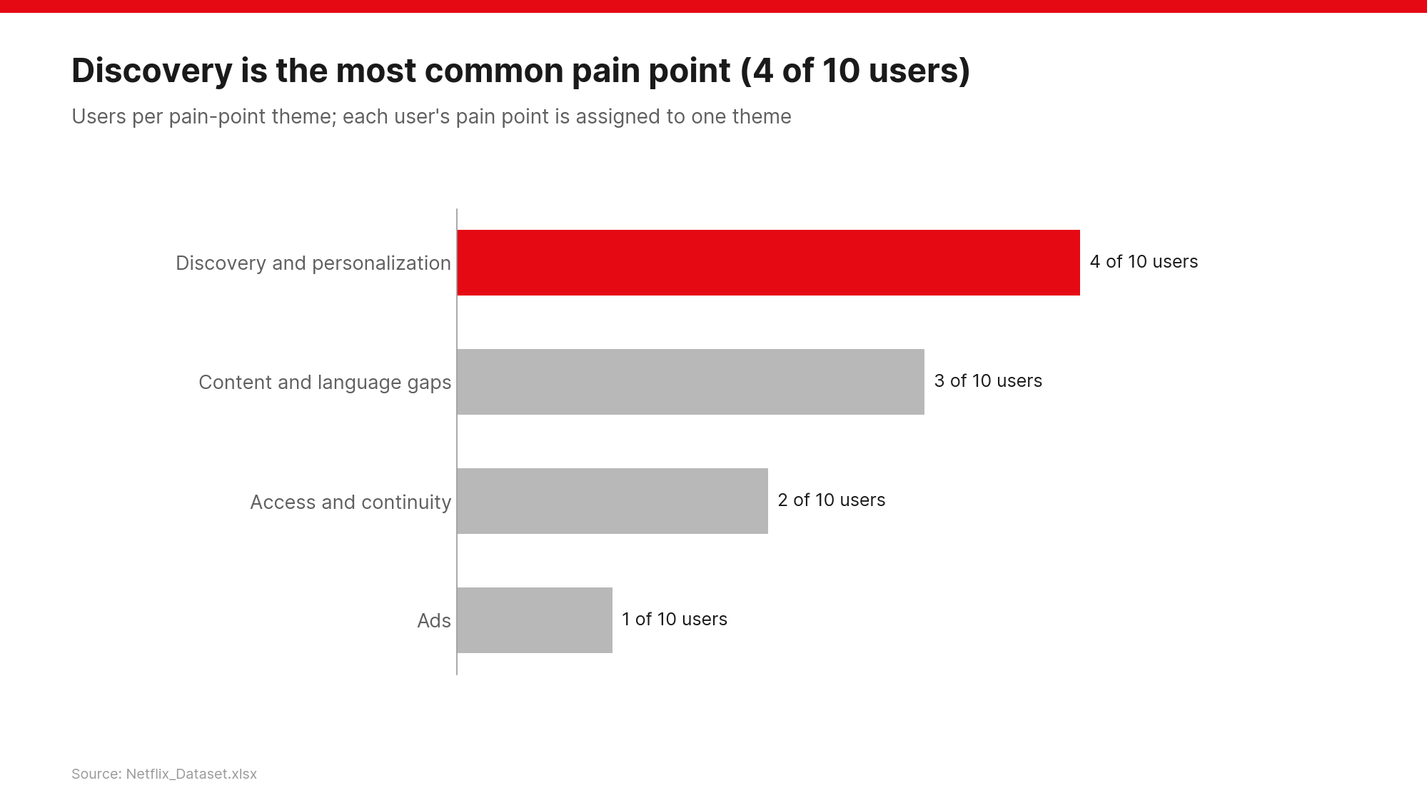
12
Notes:
Discovery and personalization is the most shared pain (4 of 10), followed by content and language gaps (3 of 10). This is why AI discovery leads the MVP.

Slide 13
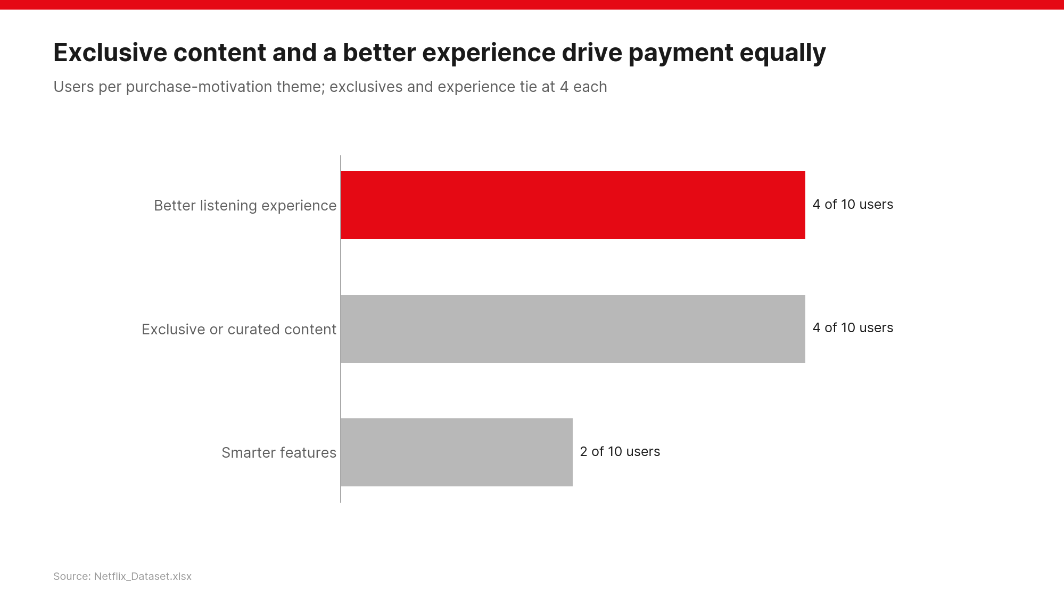
13
Notes:
Exclusive content and a better listening experience tie as reasons to pay, so premium bundles both: exclusives plus ad-free, offline and quality.

Slide 14
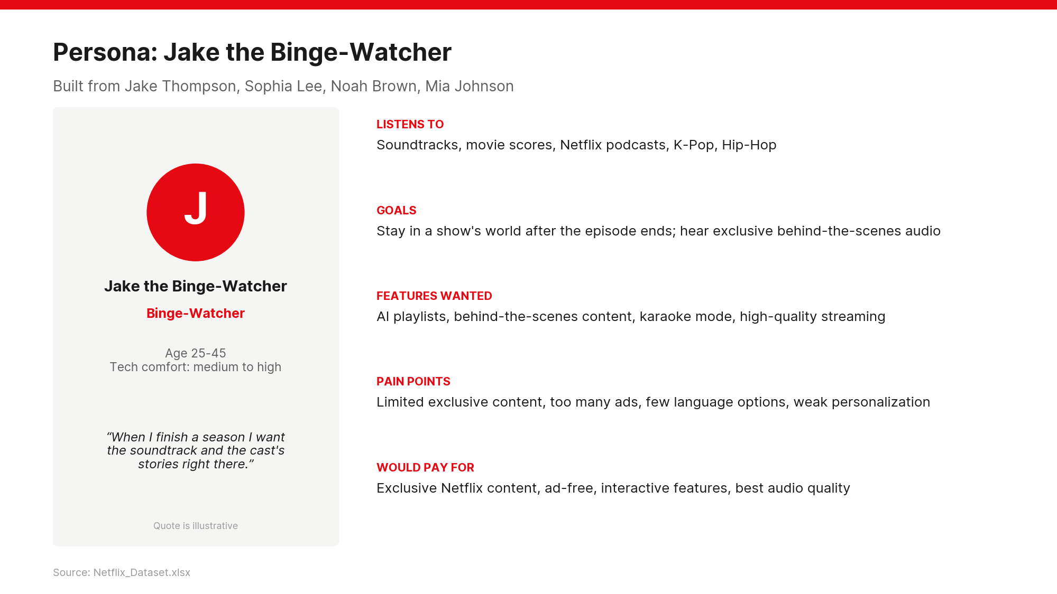
14
Notes:
Persona built from Jake Thompson, Sophia Lee, Noah Brown, Mia Johnson.

Slide 15
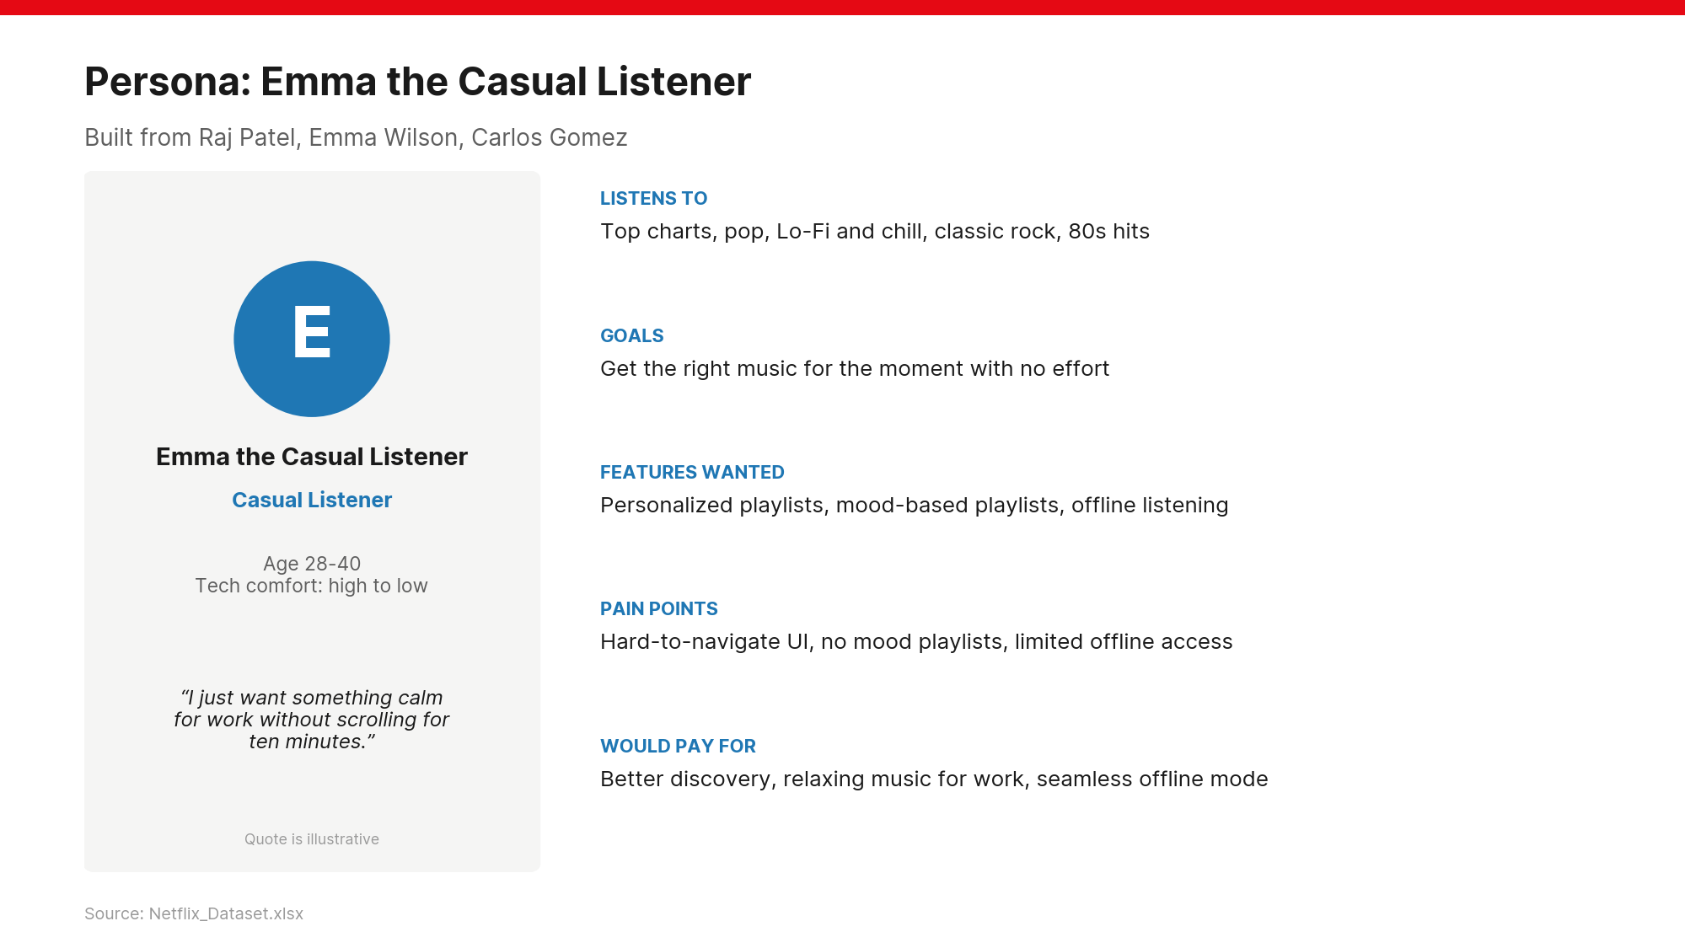
15
Notes:
Persona built from Raj Patel, Emma Wilson, Carlos Gomez.

Slide 16
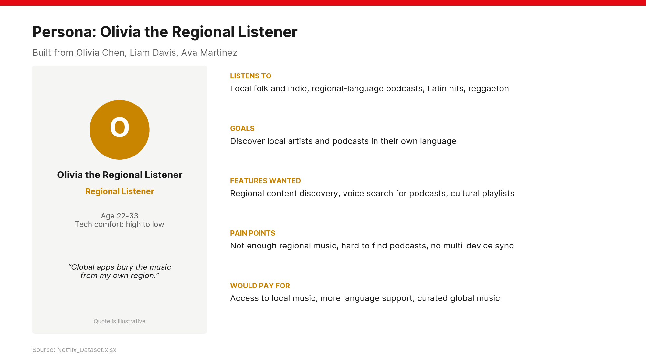
16
Notes:
Persona built from Olivia Chen, Liam Davis, Ava Martinez.

Slide 17
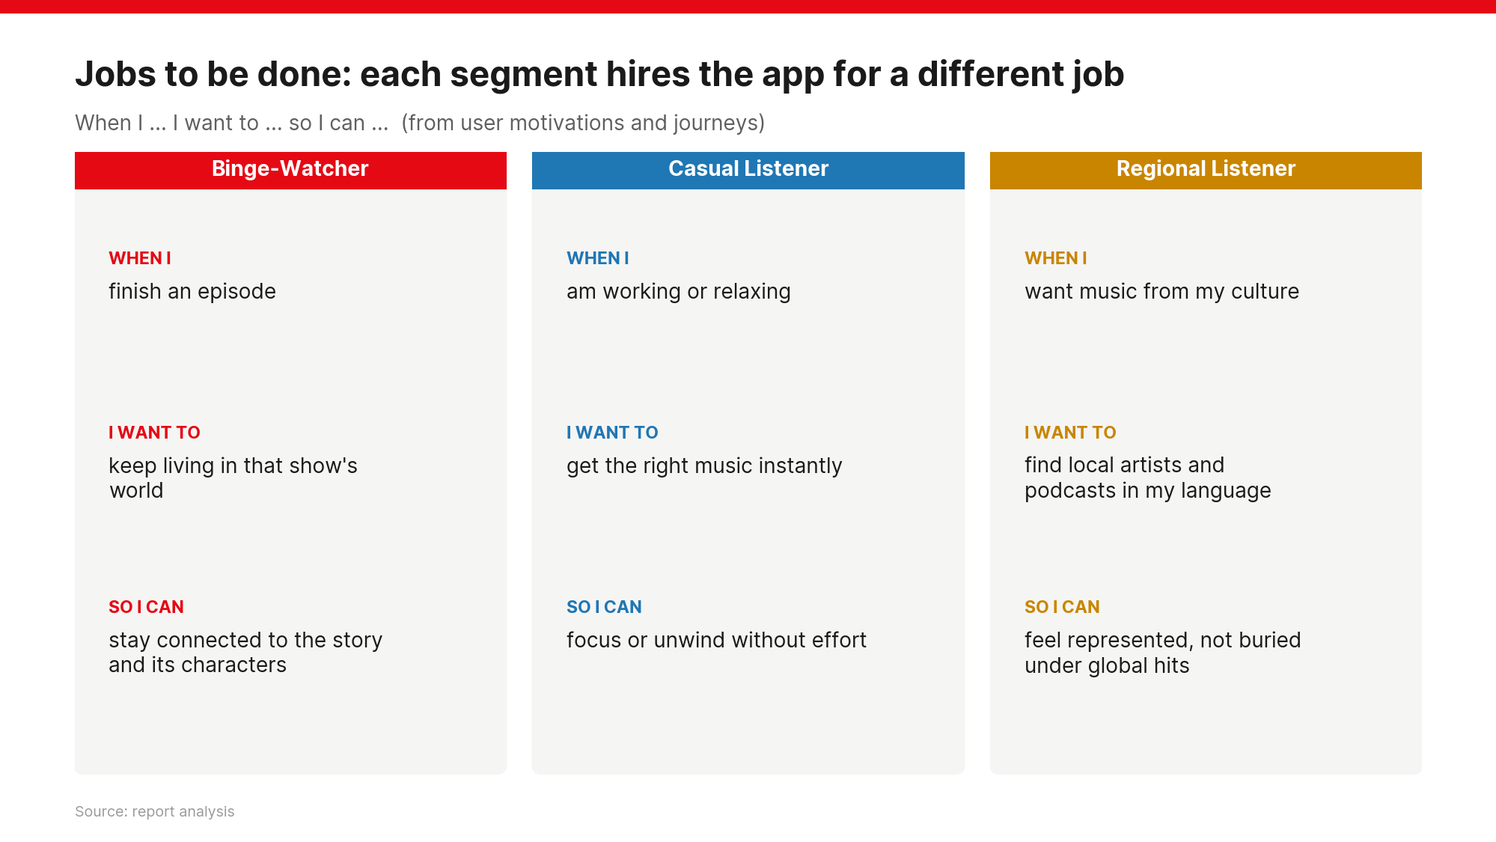
17
Notes:
Jobs to be done: the job each segment hires Netflix Music for. Product sense means designing for the job, not the feature list.

Slide 18
PART 3
Where the experience breaks
End-to-end journey for each persona

Slide 19
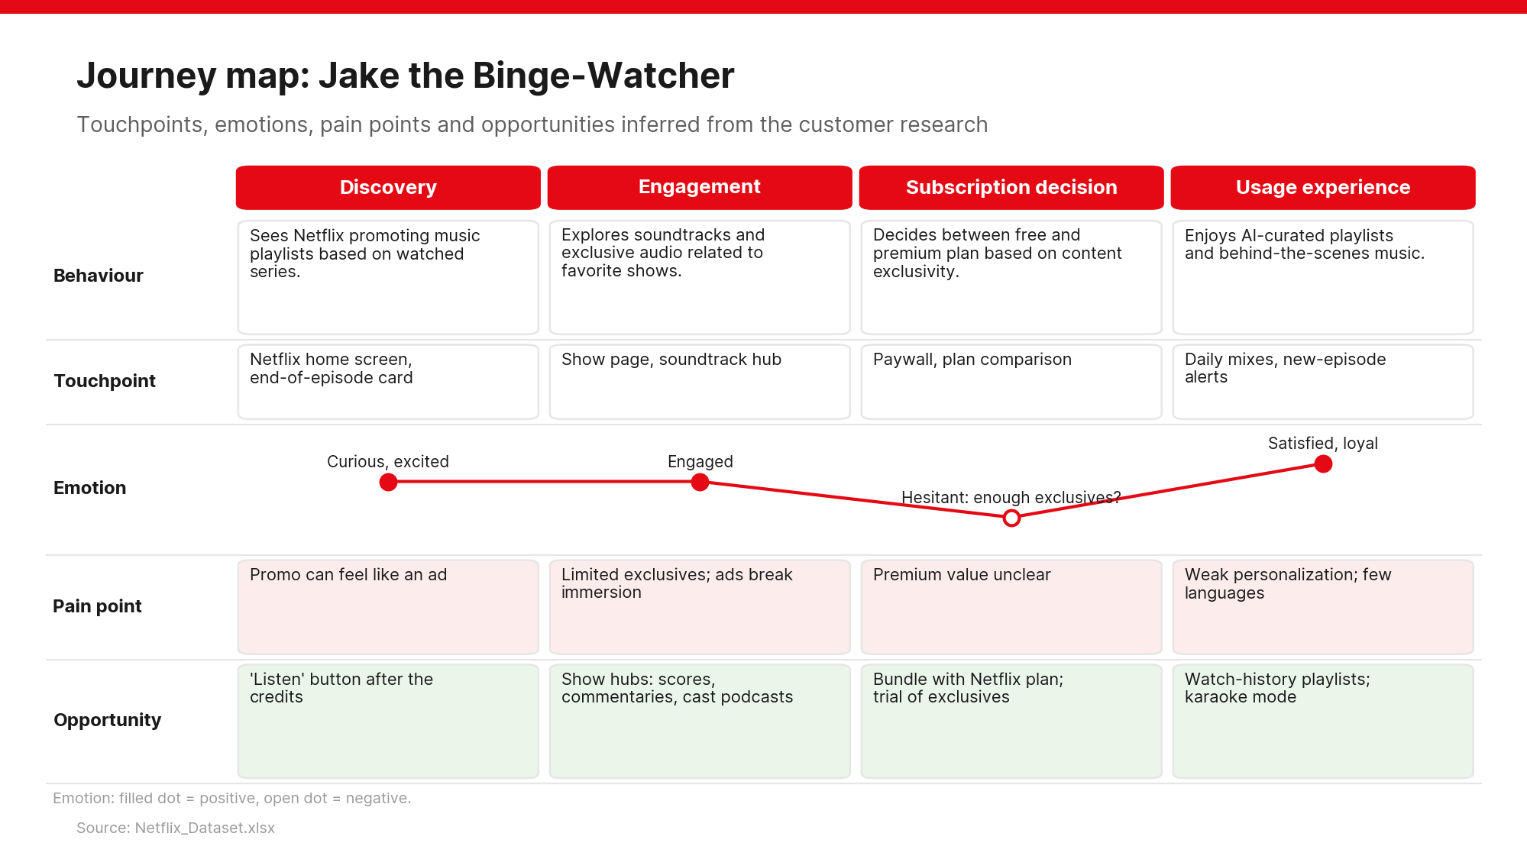
19
Notes:
Journey map for the Binge-Watcher. Behaviour row from Sheet 2; the other rows are inferred from Sheets 1 and 2. Rebuild in Figma as one frame per persona.

Slide 20
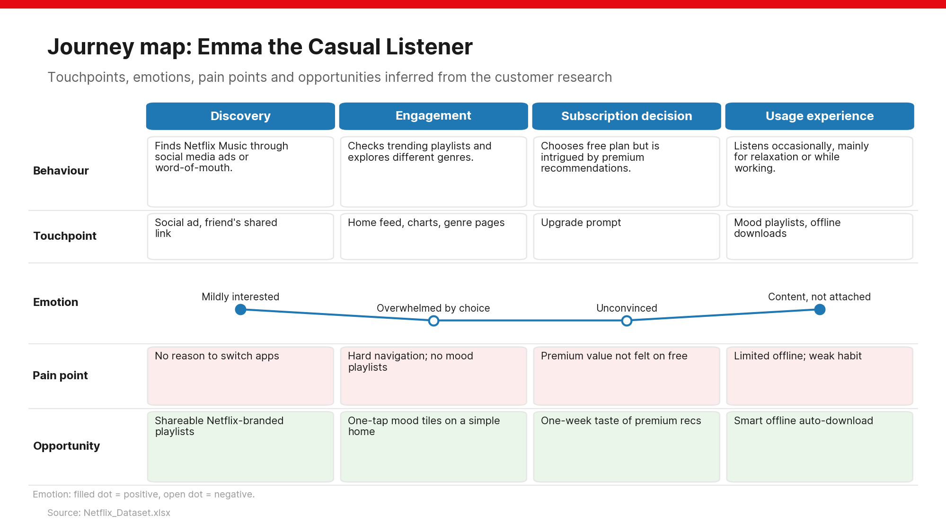
20
Notes:
Journey map for the Casual Listener. Behaviour row from Sheet 2; the other rows are inferred from Sheets 1 and 2. Rebuild in Figma as one frame per persona.

Slide 21
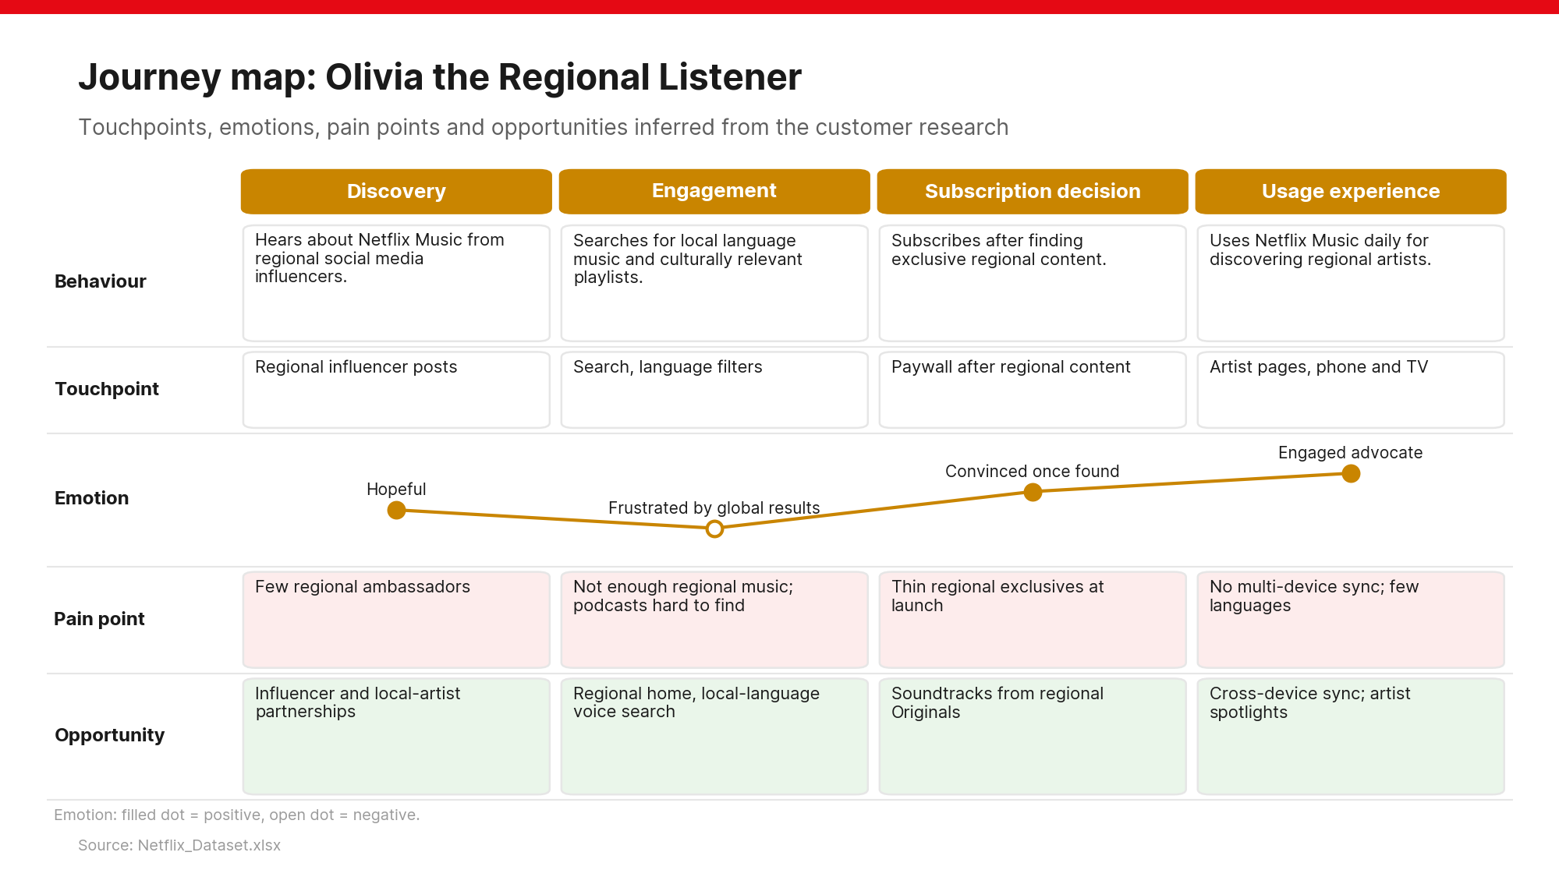
21
Notes:
Journey map for the Regional Listener. Behaviour row from Sheet 2; the other rows are inferred from Sheets 1 and 2. Rebuild in Figma as one frame per persona.

Slide 22
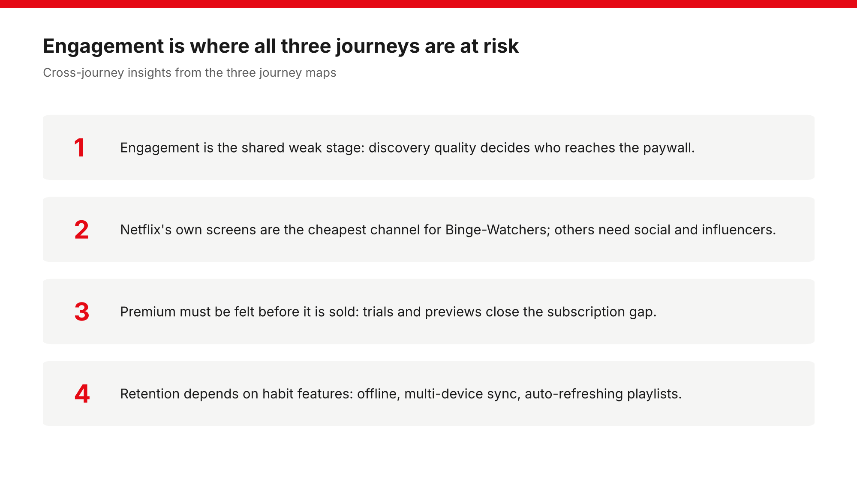
22
Notes:
Cross-journey insights that shape the MVP and roadmap.

Slide 23
PART 4
From ideas to features
Idea Funnel: generate widely, then filter hard

Slide 24
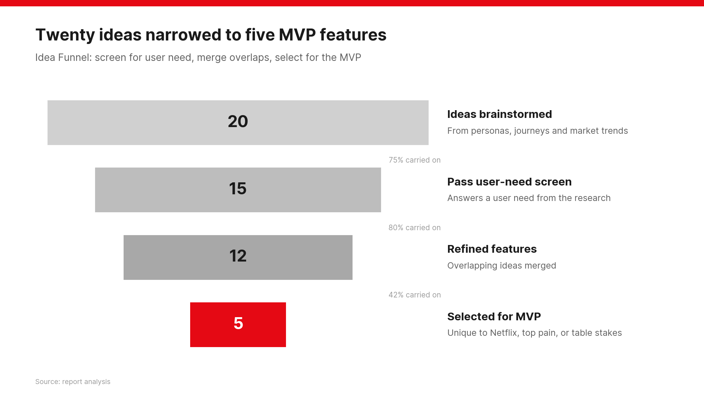
24
Notes:
20 ideas, 15 pass the user-need screen, 12 after merging overlaps, 5 selected for the MVP.

Slide 25
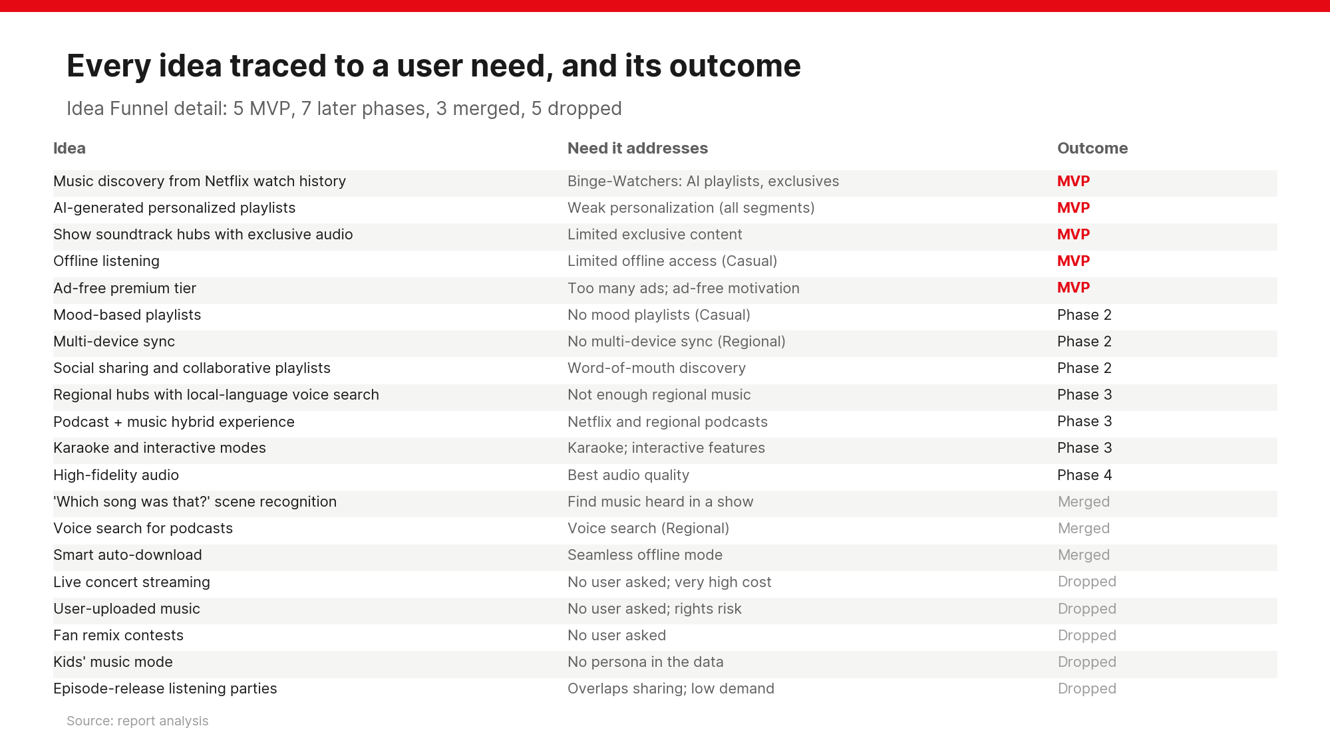
25
Notes:
Each idea traced to a need in the dataset and its outcome.

Slide 26
PART 5
Where Netflix can win
Industry trends, competitor benchmark, SWOT and BCG

Slide 27
Industry trends shaping the launch
Qualitative market view as of 2026
• Audio is converging: music, podcasts and audiobooks in one app
• AI personalization is now expected, not novel
• Video and audio are blending: video podcasts and clips favour a video company
• Bundling drives retention: Apple One and Amazon Prime show the model
• Regional growth: new subscribers increasingly come from non-English markets
27

Slide 28
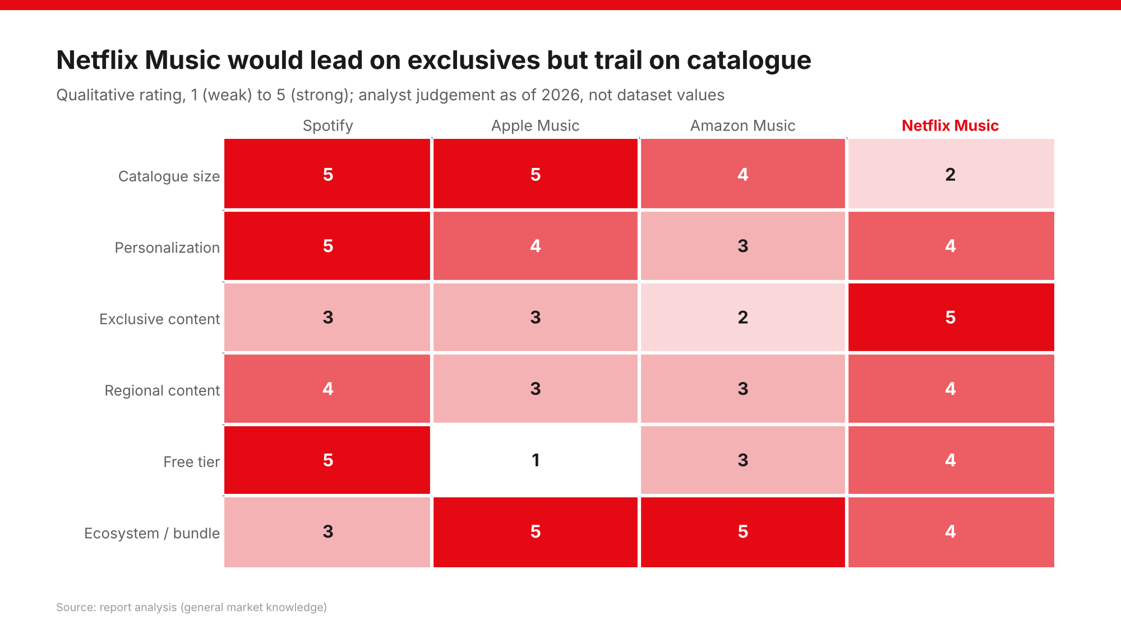
28
Notes:
Netflix Music would lead on exclusive content but trail on catalogue size; ratings are analyst judgement.

Slide 29
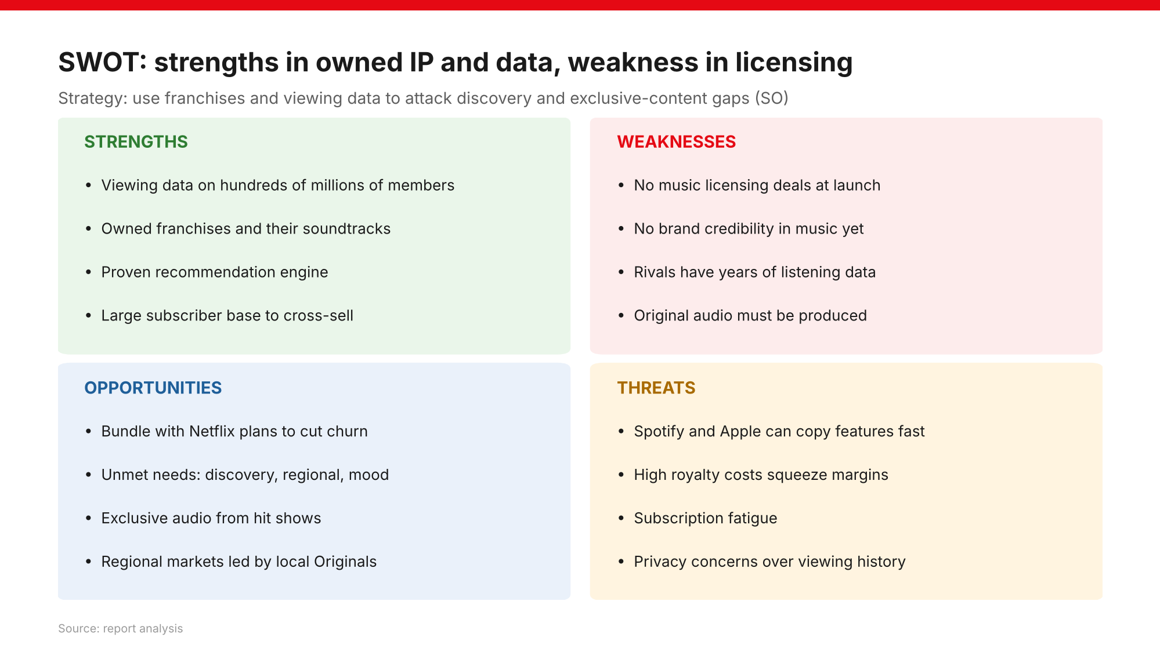
29
Notes:
SO strategy: use owned franchises and viewing data to attack discovery and exclusive-content gaps. Main risk is licensing, so lean on audio Netflix already controls.

Slide 30
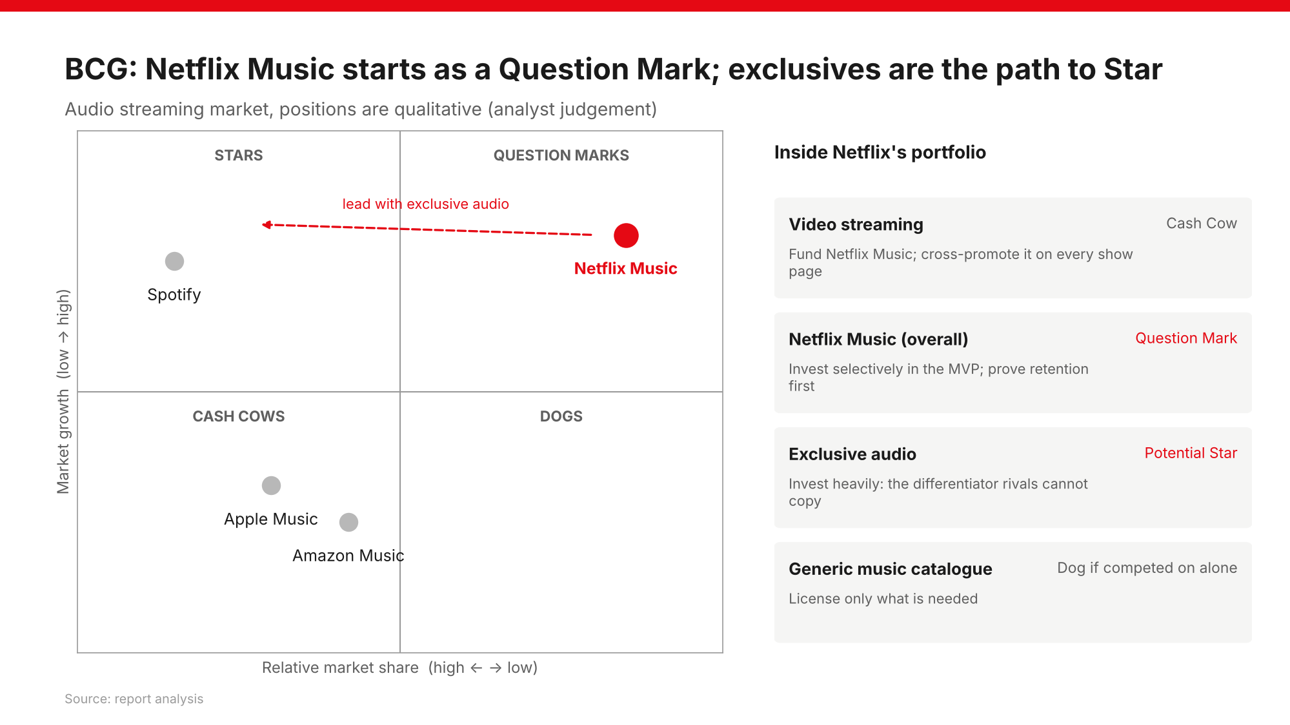
30
Notes:
Netflix Music is a Question Mark. Video streaming is the Cash Cow that funds it; exclusive audio is the potential Star.

Slide 31
PART 6
What to build first
Four frameworks applied to the five features

Slide 32
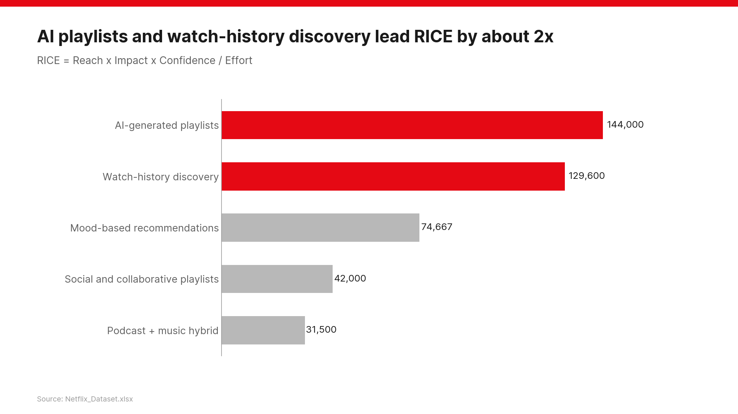
32
Notes:
RICE = Reach x Impact x Confidence / Effort. Top two score about double the third.

Slide 33
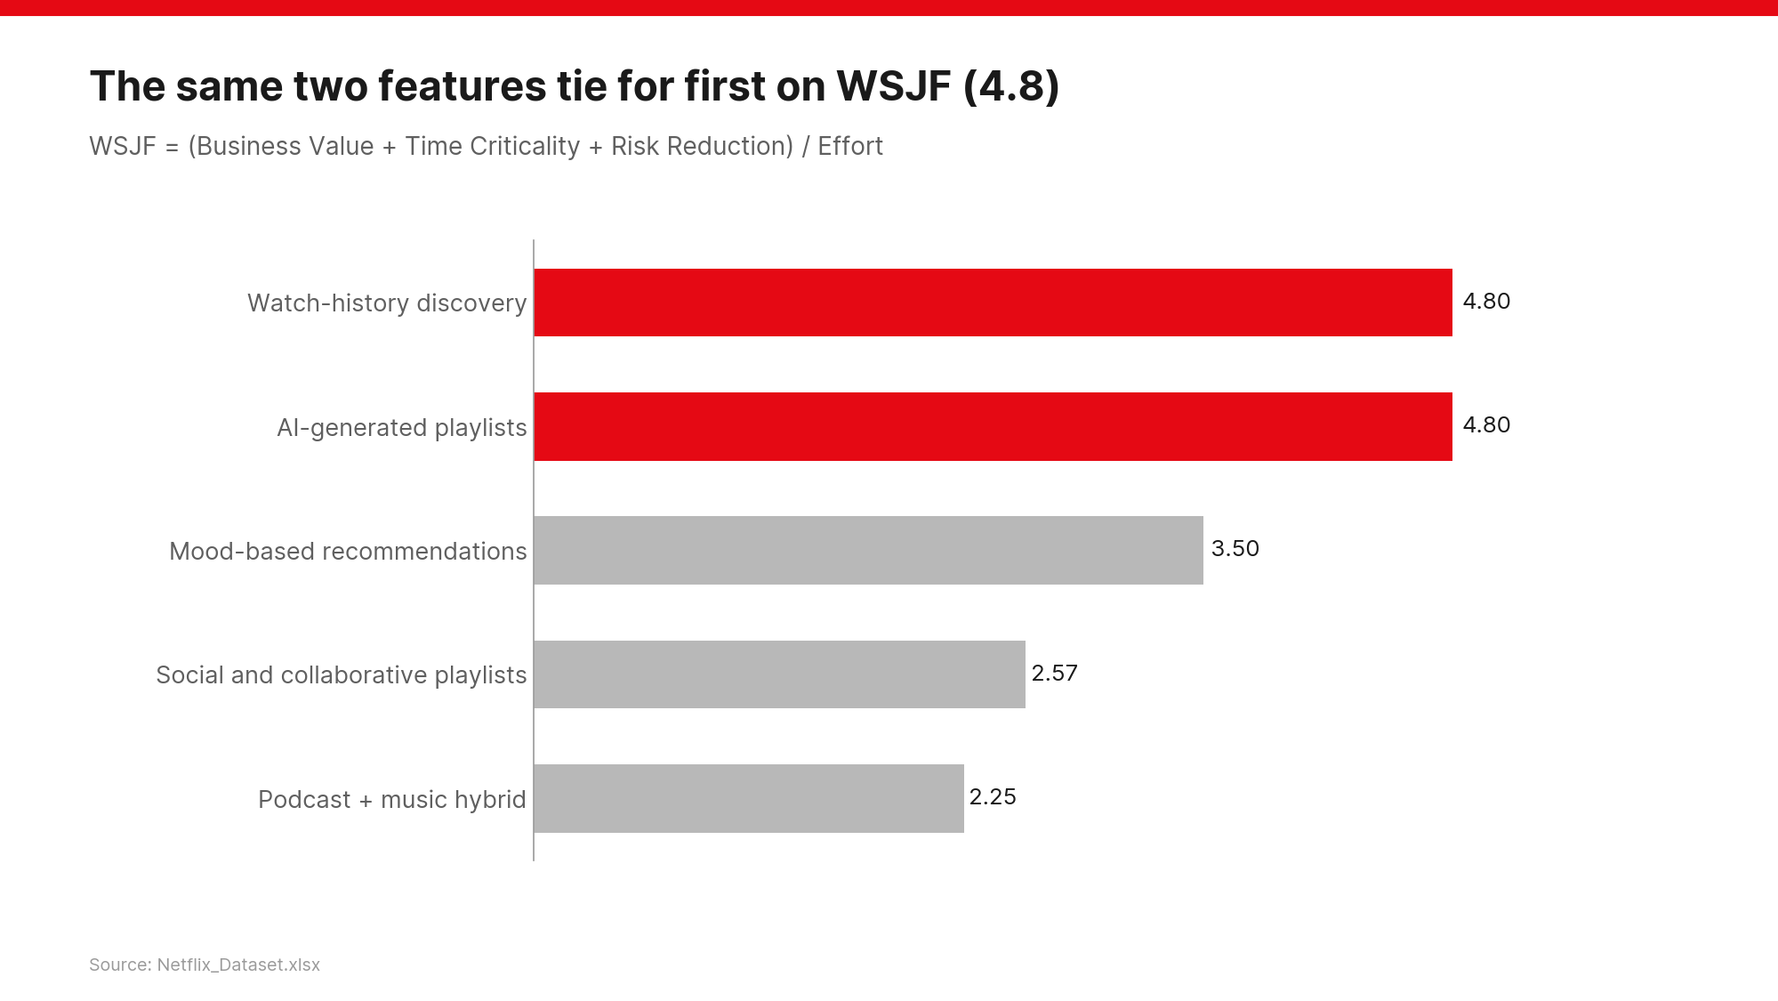
33
Notes:
WSJF = (Business Value + Time Criticality + Risk Reduction) / Effort. Top two tie at 4.8.

Slide 34
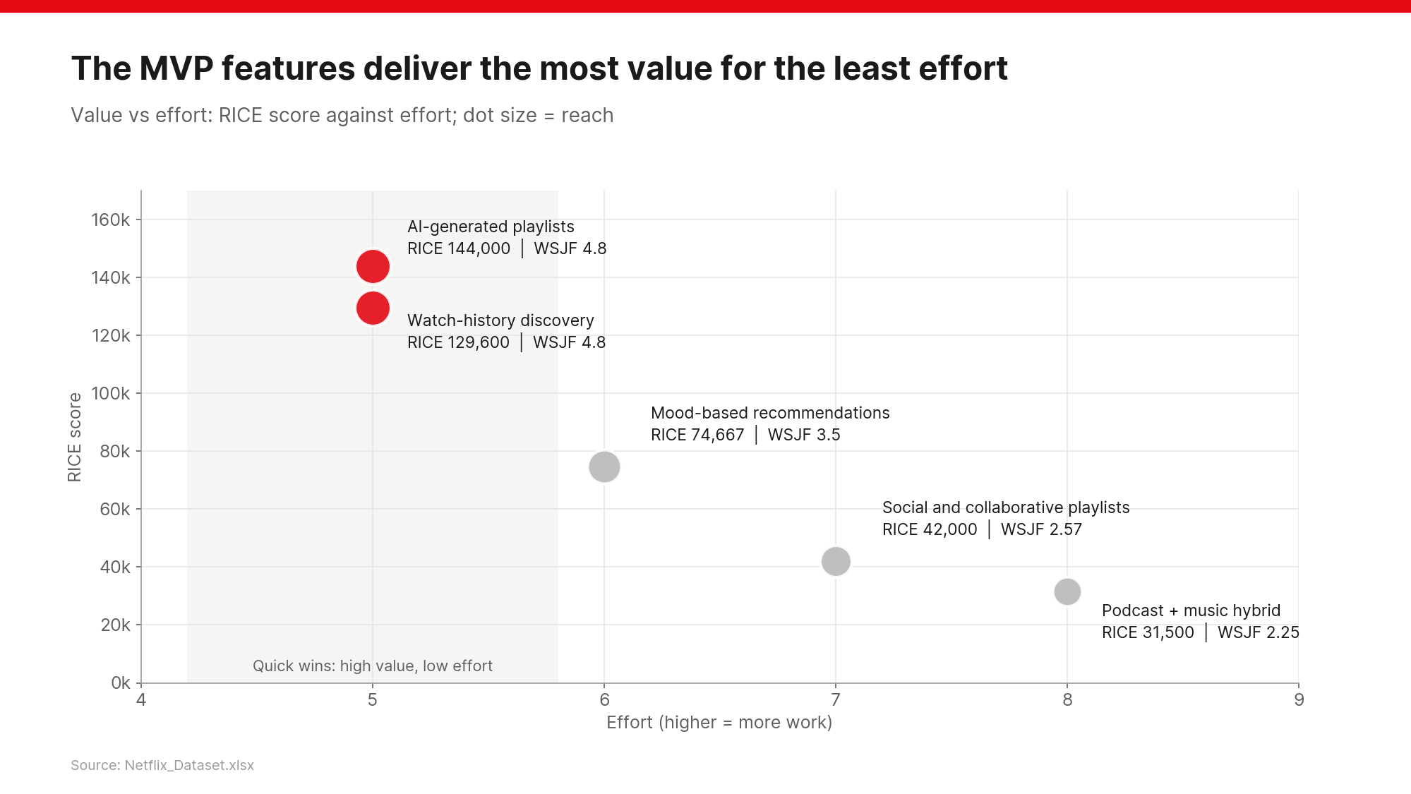
34
Notes:
The top two sit in the quick-win zone: highest value, lowest effort (5).

Slide 35
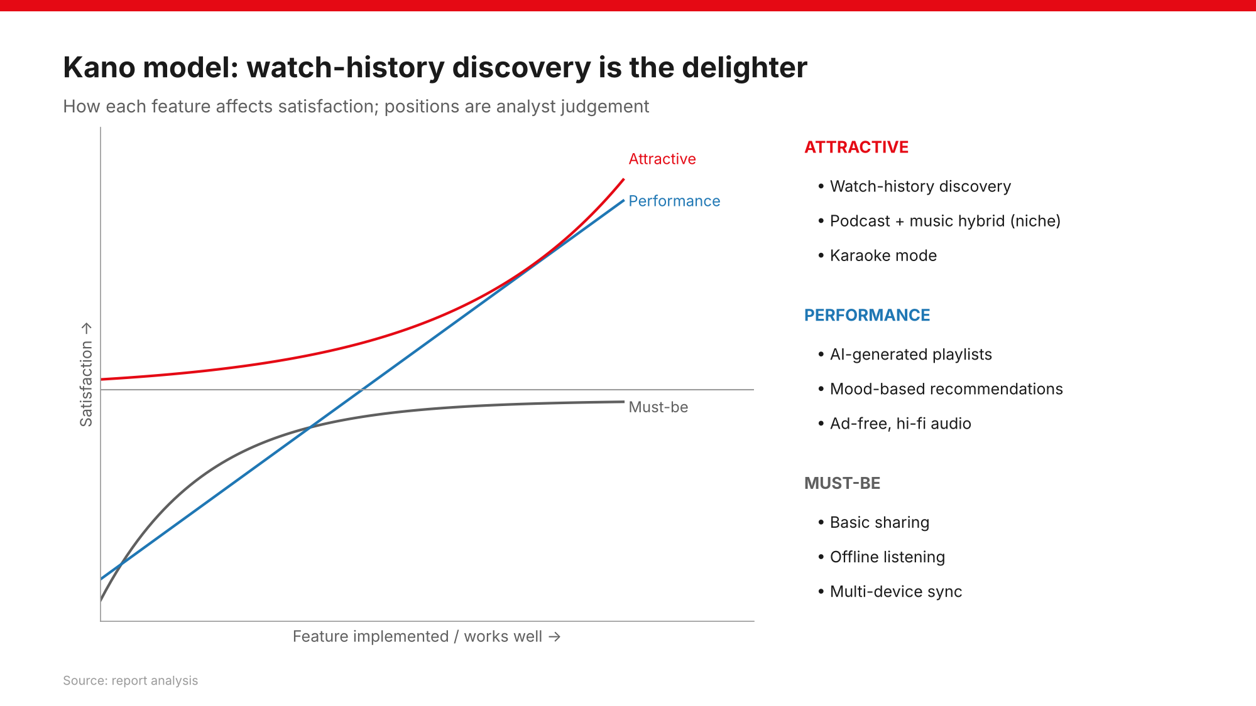
35
Notes:
Kano: watch-history discovery is the delighter; AI and mood playlists are performance features; offline, sync and basic sharing are must-be.

Slide 36
MoSCoW: the launch scope
Combining scores with product judgement
Priority | Feature | Why
Must have | AI-Generated Personalized Playlists | Top RICE, tied top WSJF; solves the most common pain
Must have | Music Discovery Based on Netflix Watch History | Core differentiator; tied top WSJF
Should have | Mood-Based Music Recommendations | Third on both; key for Casual Listeners
Could have | Social Sharing and Collaborative Playlists | Mid scores; share link is cheap, collaboration can wait
Won't have (now) | Podcast + Music Hybrid Experience | Lowest scores, highest effort; revisit later
36

Slide 37
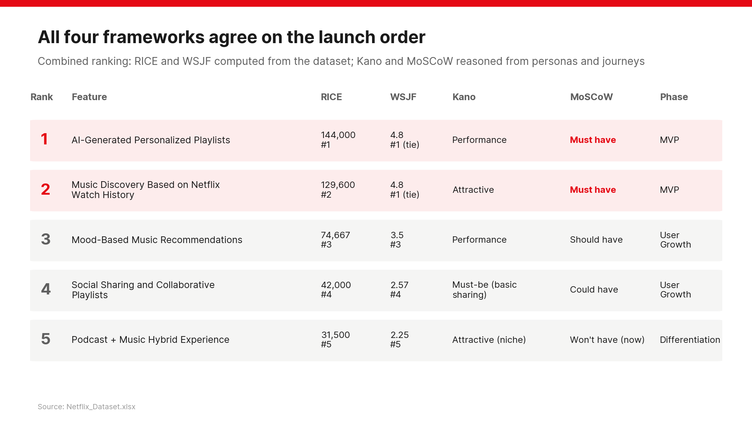
37
Notes:
All four frameworks agree on the order, so the decision is robust.

Slide 38
PART 7
Delivering the MVP
The smallest product that proves Netflix can win in audio

Slide 39
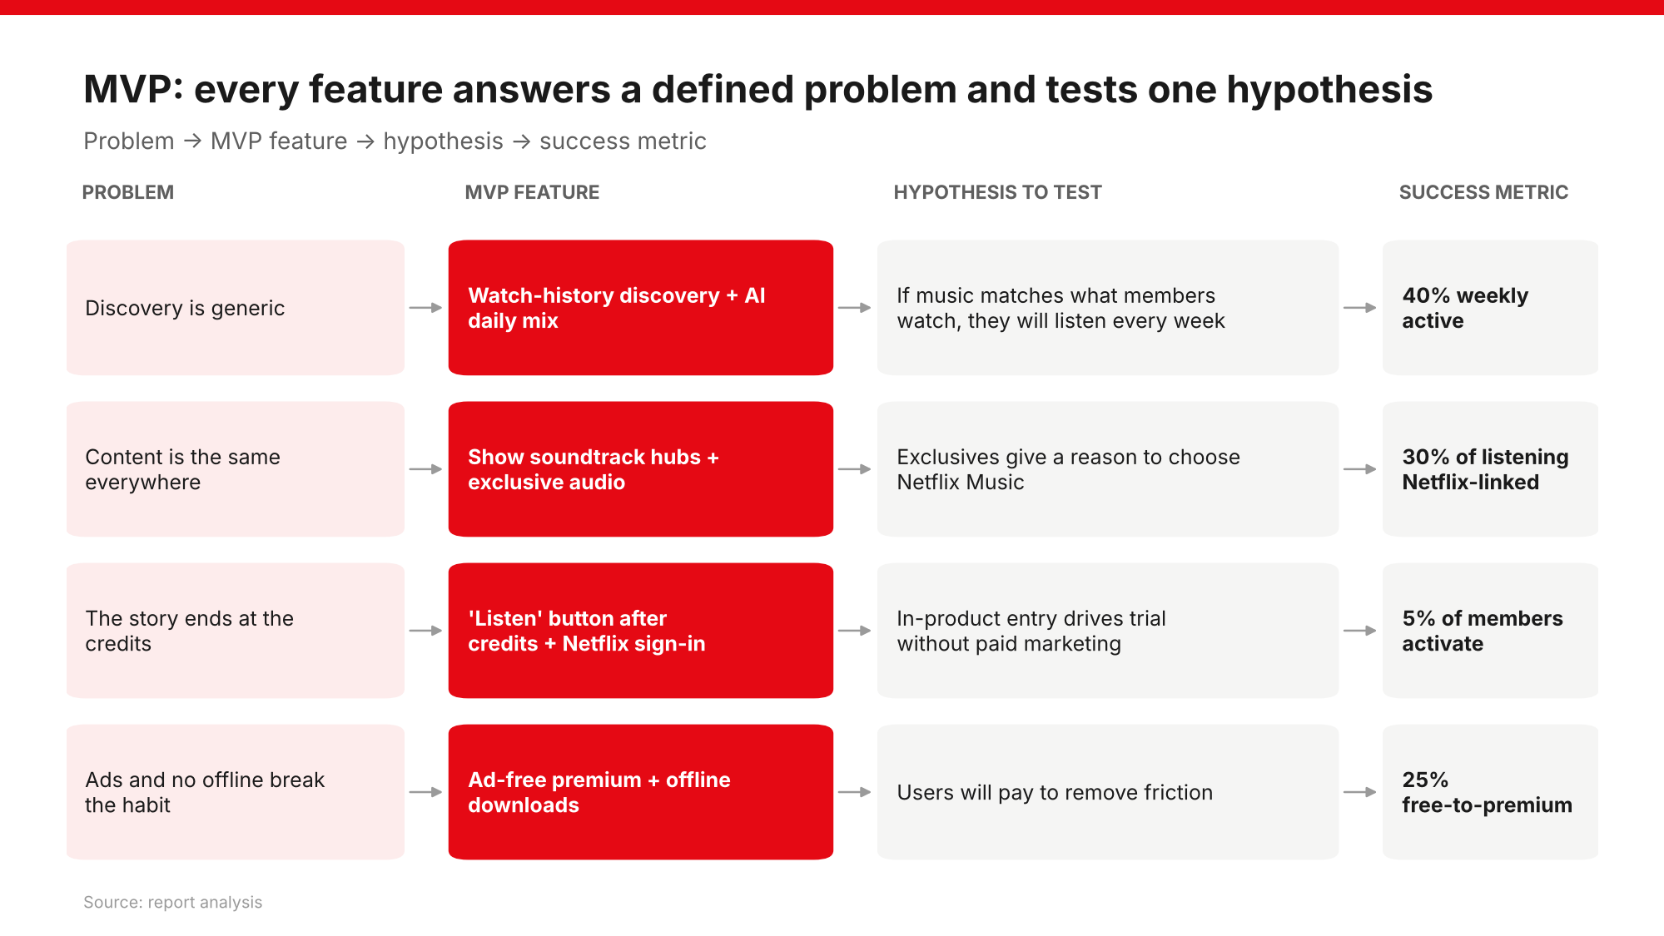
39
Notes:
Each MVP feature maps to a defined problem, a hypothesis to test, and the metric that proves or disproves it.

Slide 40
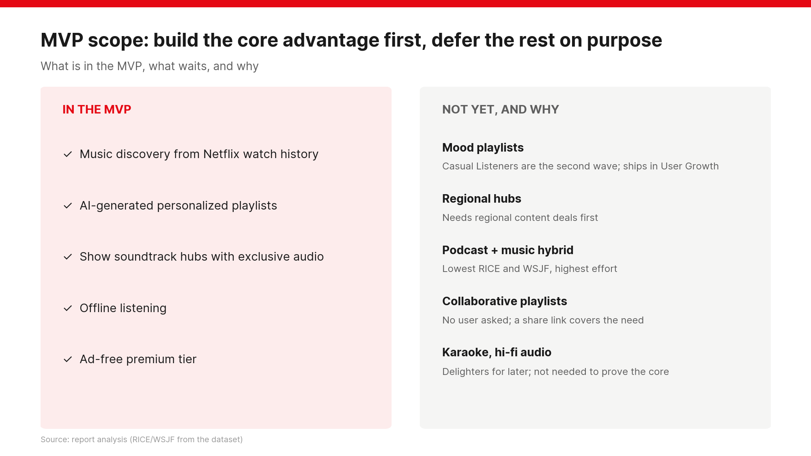
40
Notes:
Scope discipline: build the advantage first, defer everything else on purpose.

Slide 41
User stories for the MVP and first growth phase
As a [persona], I want [goal], so that [benefit]
ID | As a | I want | So that | Priority
US-01 | Binge-Watcher | playlists built from the shows I've watched | keep enjoying a show's world | Must
US-02 | Binge-Watcher | a 'Listen' button after a show's credits | jump straight to its soundtrack | Must
US-03 | Binge-Watcher | behind-the-scenes episodes and commentaries | get content found nowhere else | Must
US-04 | Any listener | AI playlists that learn from plays and skips | recommendations improve over time | Must
US-05 | Casual Listener | to download playlists | listen without data or signal | Must
US-06 | Premium member | ad-free listening | nothing breaks my immersion | Must
US-07 | New user | to sign in with my Netflix account | start without a new account | Must
US-08 | Casual Listener | one-tap mood playlists (Focus, Chill) | get the right music without searching | Should
US-09 | Regional Listener | phone and TV to stay in sync | pick up where I left off | Should
US-10 | Casual Listener | to share a playlist link | friends hear what I like | Could
US-11 | Regional Listener | a home screen in my language | skip past global hits | Should
US-12 | Regional Listener | voice search in my language | find podcasts quickly | Could
41

Slide 42
PRD summary: Netflix Music MVP
Mobile-first, Netflix sign-in, free with ads plus ad-free premium
Area | Requirement
Goal | Prove Netflix viewers adopt and keep listening; convert through exclusives and ad-free
Target users | Primary: Binge-Watchers. Secondary: Casual Listeners. Regional from Phase 3
P0 features | Netflix sign-in; watch-history recs; 'Listen' after credits; soundtrack hubs; AI daily mix; search; offline downloads; free and premium tiers
P1 features | Share link; mood tiles (beta)
Non-functional | Playback < 2 s on 4G; 99.9% availability; opt-in use of viewing history; accessible
Dependencies | Label licensing; exclusive audio for launch titles; Netflix rec platform and accounts
Release criteria | P0 stories pass; 40% of beta users listen weekly; no open privacy or licensing issue
Non-goals | Full catalogue parity; podcast hybrid feed; collaborative playlists; wide regional rollout
42

Slide 43
PART 8
Roadmap and success
From MVP to monetization, with a gate for every phase

Slide 44
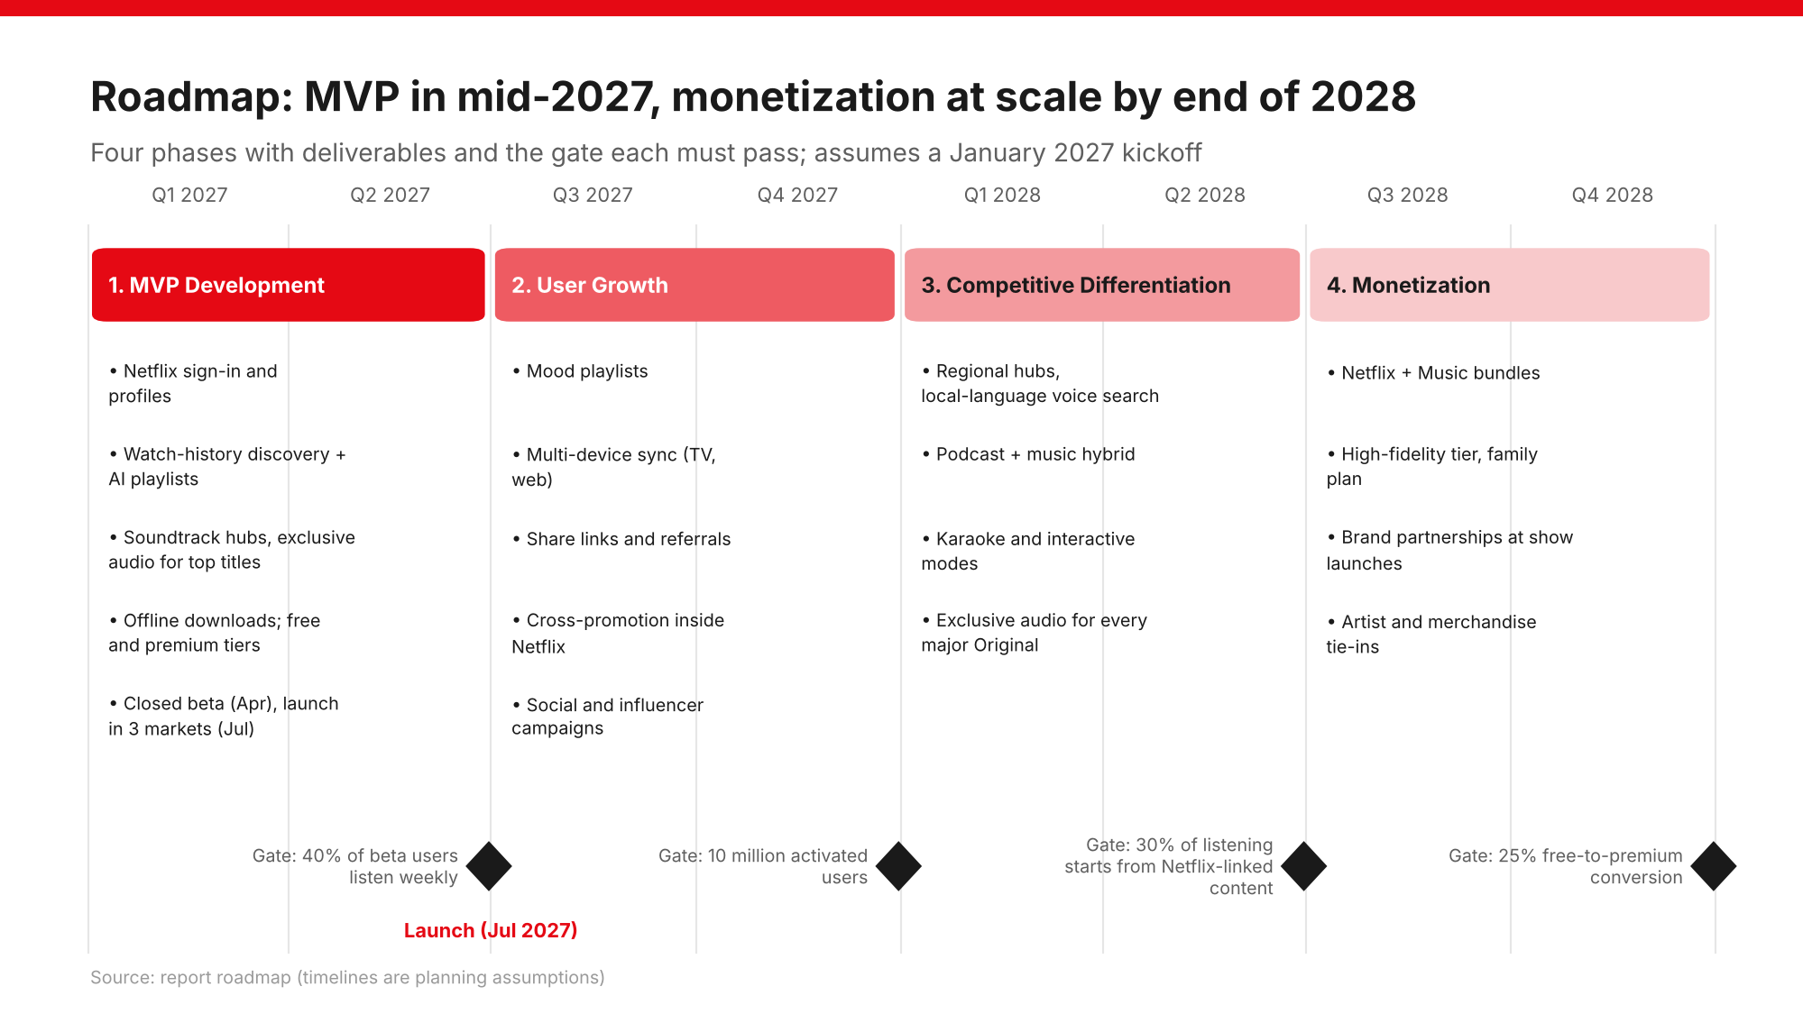
44
Notes:
Four phases from January 2027 to December 2028; each must pass its gate before scaling.

Slide 45
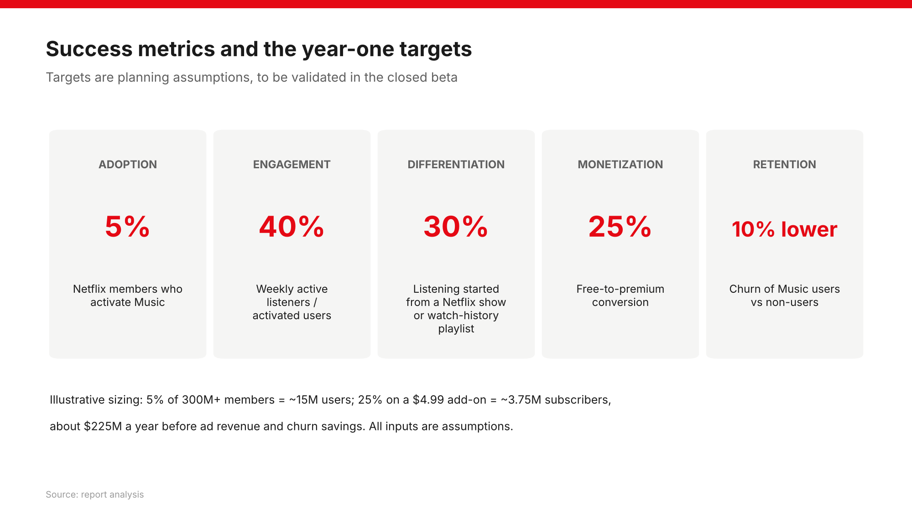
45
Notes:
Year-one targets are planning assumptions to validate in the closed beta.

Slide 46
Key risks and how we reduce them
Risk | Mitigation
Label licensing delays | Launch with soundtracks and original audio Netflix controls; phase in catalogue
Rivals copy features | Lean on exclusive IP that cannot be copied; ship fast
Privacy backlash on viewing data | Clear opt-in, easy off switch, transparent explanations
Royalty costs squeeze margins | Bundle pricing; weight listening toward owned audio
Low adoption beyond Binge-Watchers | Mood playlists, offline and regional hubs in later phases
46

Slide 47
Conclusion
Start with why, define the problem, deliver the smallest product that proves it
• Why: listening hours are unmonetized, and Netflix owns an advantage rivals cannot copy
• Problem: no app connects what people watch with what they hear; discovery and exclusives are the gaps
• Who: Binge-Watchers first, then Casual and Regional Listeners
• MVP: watch-history discovery, AI playlists, soundtrack hubs, offline, ad-free premium
• Proof: 40% weekly active, 30% Netflix-linked listening, 25% conversion
• Next: grow, differentiate regionally, then monetize at scale through 2028
“How might we turn what members watch into what they love to listen to?”
47

