Slide 1
2023
Brain Tumor Segmentation
● Multimodal Brain Tumor Segmentation of BraTS2020 Dataset ●
Presented by:
Sharmistha Das
Aditya Jha
Deep Sarkar
Abhirup Basak

Slide 2
01
Introduction
Gives a brief about our project and solution
02
Data Processing
CONTENTS
Describes the preprocessing of BraTS2020 dataset
03
Model
Describes the Deep Learning Model used
04
Conclusion
Concludes our project with usable capabilities

Slide 3
01
Introduction

Slide 4
Brain Tumor
A brain tumor is an abnormal growth of cells in the brain that can be either benign or malignant.
Tumor
Symptoms
Brain tumors can be either benign or malignant and arise from different types of cells in the brain.
Symptoms of a brain tumor vary depending on its size, location, and type and can include headaches, seizures, changes in vision or speech, and changes in personality.
Early Detection
Cure
Early detection and treatment of brain tumors is crucial for improving outcomes for patients.
Treatment options for brain tumors include surgery, radiation therapy, and chemotherapy.

Slide 5
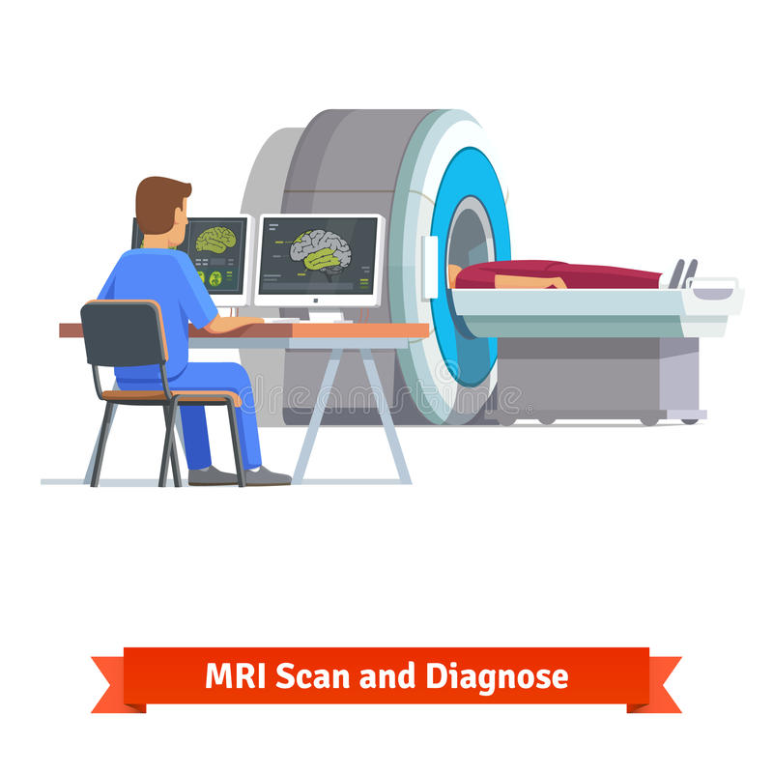

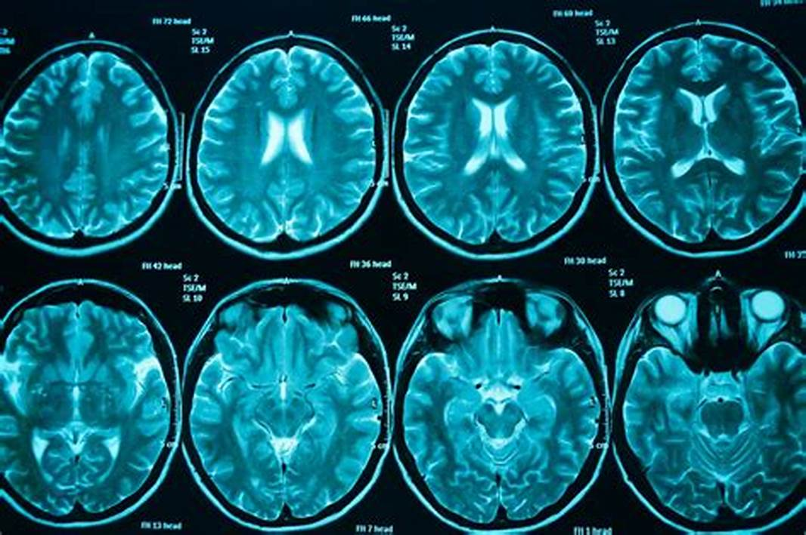

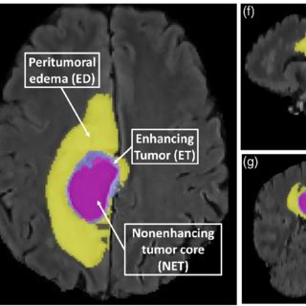
The Process
Report to Doctor
Scan Results after 3 weeks
Scan Segmentation before operation

Slide 6
02
Data Processing

Slide 7
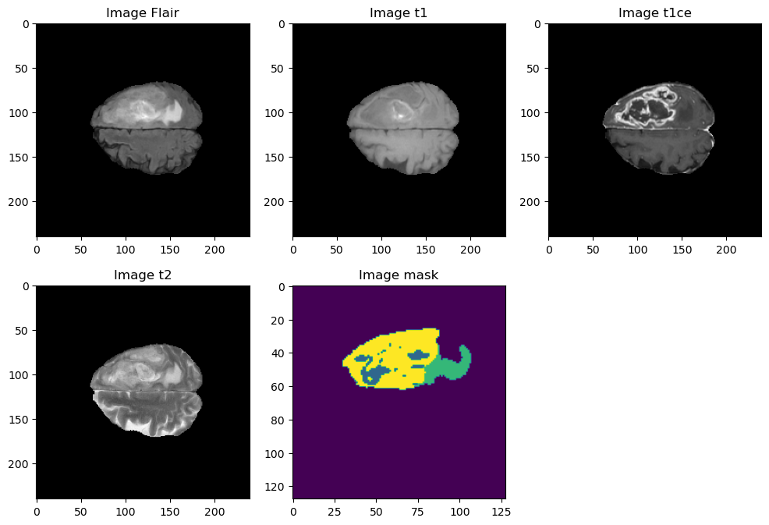
Dataset From Kaggle
Dataset Contents
The BraTS2020 dataset is a widely used dataset for multimodal brain tumor segmentation. It contains MRI scans of the brain that are acquired using different imaging techniques such as T1-weighted, T1-weighted with contrast enhancement, T2-weighted, and fluid-attenuated inversion recovery (FLAIR).
Dataset Link
https://www.kaggle.com/datasets/rohanrao/air-quality-data-in-india

Slide 8
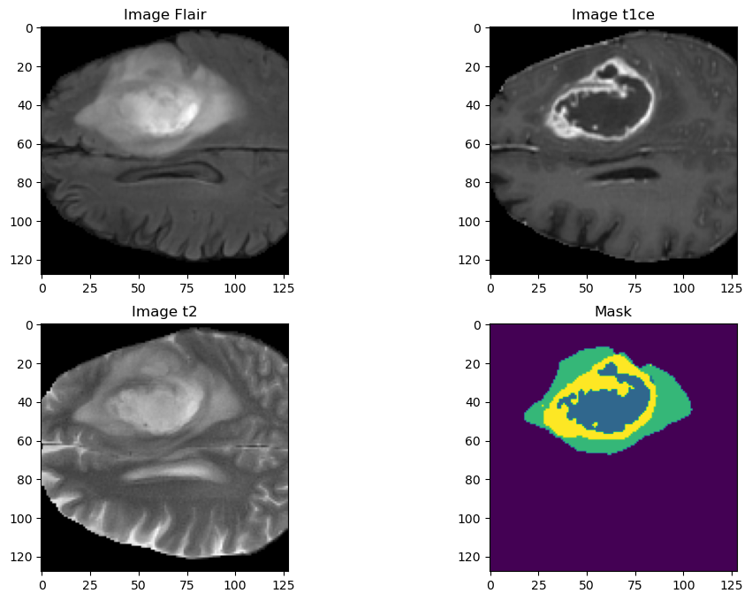
Dataset From Kaggle
Combined Volumes
1.Combining the FLAIR, T1CE, and T2 MRI images into a single image with three channels can be an effective way to enhance the information available for brain tumor segmentation.
2.By creating a multi-channel image, we can include information from each of the different image modalities and improve the accuracy of the segmentation process.
3.It helps in reducing space consumption since this kind of image data tends to have a huge amount of parameters and can take large amount of memory and computing resources

Slide 9
03
Model

Slide 10
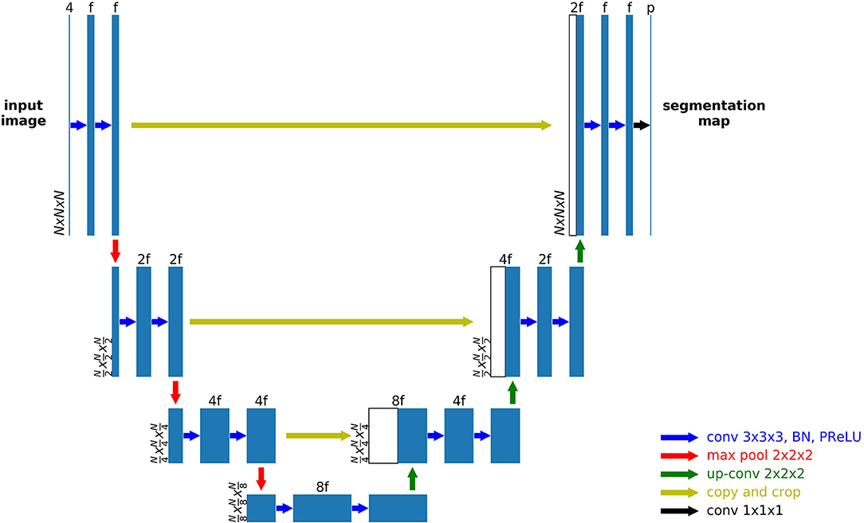
Unet Architechture
1. U-Net consists of two parts - an encoder and a decoder. The encoder network is used to extract features from the input image, while the decoder network is used to produce the final segmentation output.
2. U-Net employs a large number of filters in each convolutional layer, which allows it to capture a large number of image features at different scales.
3.The U-Net architecture also includes the use of batch normalization and ReLU activation functions to improve the stability and non-linearity of the network.

Slide 11
Why Unet?
Design Specific
U-Net is specifically designed for image segmentation tasks, and its architecture is optimized for this purpose.
Parameters
U-Net has a relatively small number of parameters, which makes it computationally efficient and well-suited for training on small datasets.
Inbuilt Filters
U-Net uses a large number of filters in each convolutional layer, which allows it to capture a large number of image features at different scales.
Track Record
U-Net has a proven track record of success in medical imaging applications,Its accuracy and reliability have been demonstrated in numerous studies, making it a trusted choice for many researchers and practitioners.

Slide 12
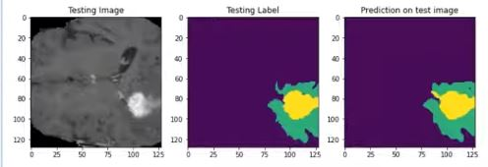
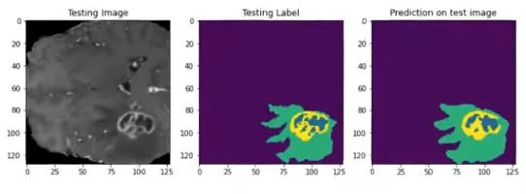
Results
Mean IoU
0.801423

Slide 13
04
Conclusion

Slide 14

01
Accurate Tumour Localization:
The program can use advanced algorithms and image recognition technology to identify and locate the exact location of the tumour in the brain.
02
Precise Tumour Volume Calculation:
The program can calculate the exact volume of the tumour, which can help doctors to determine the appropriate dosage of radiation therapy or chemotherapy required for effective treatment.
03
Better Surgical Planning:
The program can help surgeons plan the surgical procedure by providing a detailed 3D map of the tumour and its surrounding tissue. This can help the surgeon to accurately locate and remove the tumour without damaging healthy brain tissue.
04
Improved Patient Outcomes:
Accurate segmentation can lead to better treatment outcomes, as doctors can develop personalized treatment plans based on the exact size, location, and type of tumour.

Slide 15
2023
THANK YOU
● Summary ●
A brain tumour segmentation program can help improve patient outcomes by enabling accurate tumour localization, precise tumour volume calculation, better surgical planning, and personalized treatment planning.

