Slide 1
Statistical analysis on COVID-19 mortality rate and it's economical impact
Presented by:
Sharmitha. V

Slide 2
ABSTRACT
In 2019, unidentified corona virus named as novel coronavirus emerged from Wuhan, China (later officially named by WHO) and resulted in a formidable outbreak in many cities in china and expanded globally. In this article we are going to discuss about the analysis of death rate in all countries.
INTRODUCTION
On 31 December 2019, a cluster of cases of pneumonia of unknown cause, in the city of Wuhan, Hubei province in China, was reported to the World Health Organization. In January 2020, a previously unknown new virus was identified, subsequently named the 2019 novel coronavirus, and samples obtained from cases and analysis of the virus’ genetics indicated that this was the cause of the outbreak. This novel coronavirus was named Coronavirus Disease 2019 (COVID-19) by WHO in February 2020. The virus is referred to as SARS-CoV-2 and the associated disease is COVID-19. The official names COVID-19 and SARS-CoV-2 were issued by the WHO on 11th February 2020. Tedros Adhanom explained: CO for corona, VI for virus, D for disease and 19 for when the outbreak was first identified.
TRANSMISSION OF VIRUS
Experts believe the virus that causes COVID-19 spreads mainly from person to person. There are several ways this can happen: Droplets or aerosols. When an infected person coughs, sneezes, or talks, droplets or tiny particles called aerosols carry the virus into the air from their nose or mouth.

Slide 3
Impact of COVID-19 in the field of:
AGRICULTURE AND FOOD PROCESSING
FOOD INDUSTRY
PUBLIC TRANSPORT
AVIATION
EDUCATION
ECONOMY AND AUTOMOBILE INDUSTRIES
REAL ESTATE AND CONSTRUCTION
RETAIL
ART AND CULTURE HERITAGE
CINEMA
TOURISM
Mortality Rate:
In order to understand the death data of COVID-19, it is very important to first analyses the (features/ traits) of the disease and how it leads to a death. It is unique among known beta coronaviruses in its incorporation of a polybasic cleavage site, a characteristic known to increase pathogenicity and transmissibility in other viruses. There has been an increasing number of reports of COVID-19 outbreaks in long-term care homes across the world with high associated mortality, highlighting the extreme vulnerability of the elderly in this setting

Slide 4
The five stages of COVID-19 progression as we understand them are:
Stage 1 (asymptomatic or pre-symptomatic)
Stage 2 (mild)
Stage 3 (moderate)
Stage 4 (severe)
Stage 5 (critical)

Slide 5
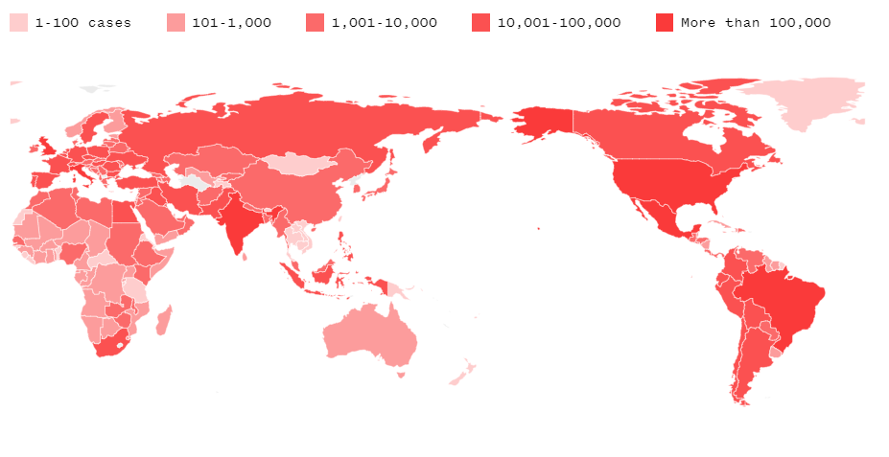
Coronavirus deaths in the world

Slide 6
DEFINITION OF STATISTICS
Statistics is a mathematical body of science that pertains to the collection, analysis, interpretation or explanation, and presentation of data, or as a branch of mathematics. The data are represented by means of graphs . Statistics is used in various disciplines such as psychology, business, physical and social sciences, humanities, government, and manufacturing.
Statistics is a mathematical method that usually involves a sample of a larger population. Researchers collect data from the sample and decide whether to use descriptive or inferential statistics, depending upon the research question and methodology of the study.
TYPES OF STATISTICS
Statistics have majorly categorized into two types:
• Descriptive statistics
• Inferential statistic
Descriptive statistics
Descriptive statistics describes data (for example, a chart or graph).
2. Inferential statistics
Inferential statistics allows you to make predictions (“inferences”) from that data.

Slide 7
GRAPHICAL METHOD
Graphs are powerful data evaluation tools. They provide quick, visual summaries of essential data characteristics. A few simple plots can replace complex statistical equations or tests to interpret environmental data. Box plots, histograms, and normal probability plots are examples of graphs that are commonly used to display environmental data. These graphs can provide information about concentration ranges, shapes of distributions, extreme values (outliers), relationships between different data sets, and trends (increasing, decreasing, and cyclic). Because graphical methods are qualitative, however, they may not be appropriate pirate as a stand-alone technique to make inferences or support conclusions.
Graphical methods are typically used with quantitative statistical evaluations. Graphical methods provide information that may not be otherwise apparent from quantitative statistical evaluations, so it is a good practice to evaluate data using these methods prior to performing statistical evaluations. Graphical methods are also a key component of exploratory data analysis (EDA). In EDA, various graphical techniques are used initially to display data for qualitative assessments prior to selecting appropriate statistical
tests.

Slide 8
• In comparison with other types of presentation, well-designed charts are more effective in creating interest and in appealing to the attention of the reader.
• Visual relationships, as portrayed by charts and graphs, are more clearly grasped and more easily remembered.
• The use of charts and graphs saves time, since the essential meaning of large masses of statistical data can be visualized at a glance.
• Charts and graphs can provide a comprehensive picture of a problem that makes possible a more complete and better-balanced understanding than could be derived from tabular or textual forms of presentation.
• Charts and graphs can bring out hidden facts and relationships and can stimulate, as well as aid, analytical thinking and investigation.
TYPES OF DATA
A common classification is based upon who collected the data. In this way it can be classified into two types,
1.Primary data
2.Secondary data
Primary data
Primary data means original data that has been collected specially for the purpose in mind. It means someone collected the data from the original source first hand. Data collected this way is called primary data.
Secondary data
Secondary data is information which has been collected in the past by someone else.
For example: researching the internet, newspaper articles and company reports.

Slide 9
Advantages of secondary data
•Time-saving.
•Ease of access.
•Anyone can collect the data.
•Low cost or free.
•A huge amount of secondary data with a wide variety of sources.
•It helps to improve the understanding of the problem.
SOFTWARE PACKAGE
SPSS is a widely used program for statistical analysis in social science. It is also used by market researchers, health researchers, survey companies, government, education researchers, marketing organizations, data miners, and others.
Excel definition a software program created by Microsoft that uses spreadsheets to organize numbers and data with formulas and functions.
STATISTICAL ANALYSIS
• Regression
• Time series analysis
• Moving average

Slide 10
REGRESSION
In statistics, regression analysis is a set of statistical processes for estimating the relationships between a dependent variable (often called the ’outcome variable’) and one or more independent variables (often called ’predictors’, ’covariates’, or ’features’). The most common form of regression analysis is linear regression, in which one finds the line (or a more complex linear combination) that most closely fits the data according to a specific mathematical criterion. For example, the method of ordinary least squares computes the unique line (or hyper plane) that minimizes the sum of squared differences between the true data and that line (or hyper plane).
For specific mathematical reasons (see linear regression), this allows the researcher to estimate the conditional expectation (or population average value) of the dependent variable when the independent variables take on a given set of values. Less common forms of regression use slightly different procedures to estimate alternative location parameters (e.g., quantile regression or Necessary Condition Analysis ) or estimate the conditional expectation across a broader collection of non-linear models (e.g., non parametric regression).
Regression analysis is primarily used for two conceptually distinct purposes. First, regression analysis is widely used for prediction and forecasting, where its use has substantial overlap with the field of machine learning. Second, in some situation’s regression analysis can be used to infer causal relationships between the independent and dependent variables. Importantly, regressions by themselves only reveal relationships between a dependent variable and a collection of independent variables in a fixed data set. To use regressions for prediction or to infer causal relationships, respectively, a researcher must carefully justify why existing relationships have predictive power for a new context or why a relationship between two variables has a causal interpretation. The latter is especially important when researchers hope to estimate causal relationships using observational data.

Slide 11
TIME SERIES ANALYSIS
In Mathematics, a time series is a series of data points indexed (or listed or graphed) in time order. Most commonly, a time series is a sequence taken at successive equally spaced points in time. Thus, it is a sequence of discrete-time data. Time series are very frequently plotted via run charts (a temporal line chart). Time series analysis comprises methods for analyzing time series data in order to extract meaningful statistics and other characteristics of the data. Time series forecasting is the use of a model to predict future values based on previously observed values. While regression analysis is often employed in such a way as to test relationships between one more different time series, this type of analysis is not usually called ”time series analysis,” which refers in particular to relationships between different points in time within a single series. Interrupted time series analysis is used to detect changes in the evolution of a time series from before to after some intervention which may affect the underlying variable.
Time series data have a natural temporal ordering. This makes time series analysis distinct from cross-sectional studies, in which there is no natural ordering of the observations (e.g., explaining people’s wages by reference to their respective education levels, where the individuals’ data could be entered in any order). Time series analysis is also distinct from spatial data analysis where the observations typically relate to geographical locations (e.g., accounting for house prices by the location as well as the intrinsic characteristics of the houses). A stochastic model for a time series will generally reflect the fact that observations close together in time will be more closely related than observations further apart. In addition, time series models will often make use of the natural one-way ordering of time so that values for a given period will be expressed as deriving in some way from past values, rather than from future values (seetime reversibility).

Slide 12
MOVING AVERAGE
In statistics, a moving average (rolling average or running average) is a calculation to analyses data points by creating a series of averages of different subsets of the full data set. It is also called as moving mean (MM) or rolling mean and is a type of finite impulse response filter. Variations include: simple, and cumulative, or weighted forms. Given a series of numbers and a fixed subset size, the first element of the moving average is obtained by taking the average of the initial fixed subset of the number series. Then the subset is modified by ”shifting forward”; that is, excluding the first number of the series and including the next value in the subset. A moving average is commonly used with time series data to smooth out short-term fluctuations and highlight longer-term trends or cycles. The threshold between short-term and long-term depends on the application, and the parameters of the moving average will be set accordingly.
Ft = (At−1 +At−2 +…..+ At-n)/n
REGRESSION: INPUT:
Month | Death Rate
1 | 1
2 | 258
3 | 2718
4 | 37621
5 | 183574
6 | 146994
7 | 136889
8 | 149005
9 | 173385
10 | 162194
11 | 182272
12 | 272233
13 | 343008
14 | 414658
15 | 493386

Slide 13
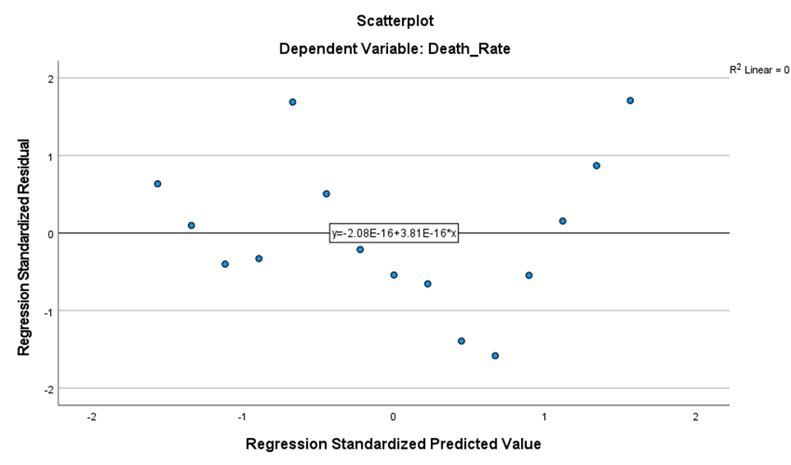
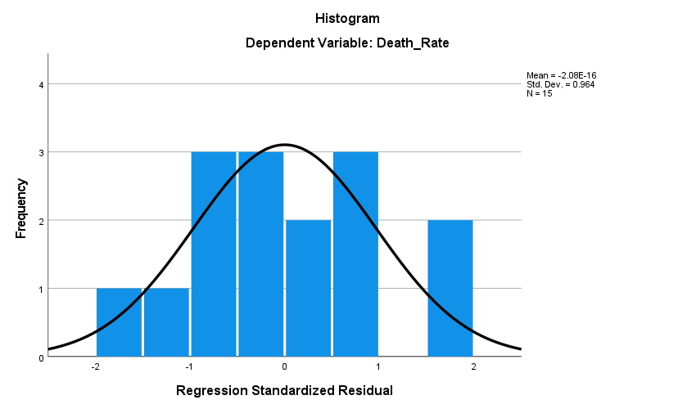
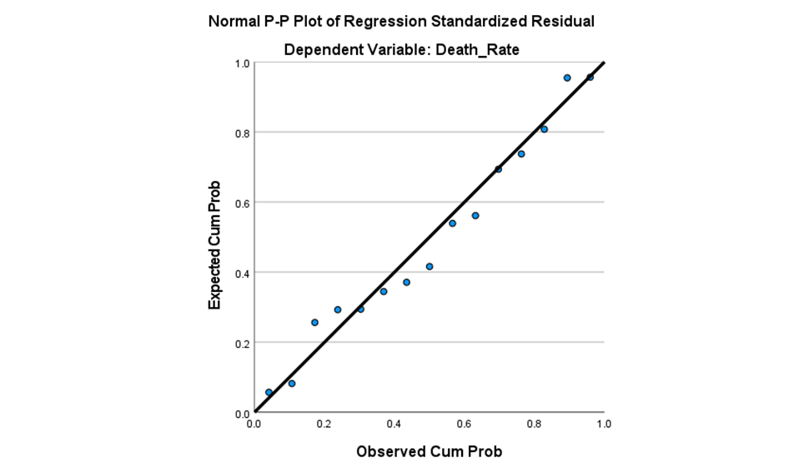
OUTPUT:

Slide 14
Moving Average
In this we have calculated 3 month moving average
F_{t=} (A_{t-1}+A_{t-2}+A_{t-3})/3
INPUT : OUTPUT :
Month | Death Rate | Moving Average
Jan-2020 | 1
Feb-2020 | 258
Mar-2020 | 2718
Apr-2020 | 37621 | 992.3333333
May-2020 | 183574 | 13532.33333
Jun-2020 | 146994 | 74637.66667
Jul-2020 | 136889 | 122729.6667
Aug-2020 | 149005 | 155819
Sep-2020 | 173385 | 144296
Oct-2020 | 162194 | 153093
Nov-2020 | 182272 | 161528
Dec-2020 | 272233 | 172617
Jan-2021 | 343008 | 205566.3333
Feb-2021 | 414658 | 265837.6667
Mar-2021 | 493386 | 343299.6667
Apr-2021 | ? | 417017.3333

Slide 15
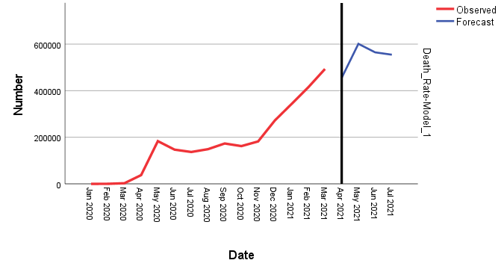
Time Series Analysis:
INPUT: OUTPUT:
Month | Death Rate
Jan-2020 | 1
Feb-2020 | 258
Mar-2020 | 2718
Apr-2020 | 37621
May-2020 | 183574
Jun-2020 | 146994
Jul-2020 | 136889
Aug-2020 | 149005
Sep-2020 | 173385
Oct-2020 | 162194
Nov-2020 | 182272
Dec-2020 | 272233
Jan-2021 | 343008
Feb-2021 | 414658
Mar-2021 | 493386

Slide 16
OBJECTIVE
Using time series analysis we have calculated death rate whether it is increasing or decreasing
As an output we have got to know death rate will increase
By regression we have compared Dependent(Death Rate) and independent (Month)
By using moving we have found smooth graphical representation
CONCLUSION
The main objective of this project is to analyze and predict the death rate of covid-19. We predicted the future impact of this virus. In this project i have forecast the future by past data in our hands. Thus, based upon my data. I predict till July 2021, the death rate is going to increase because of second wave of COVID-19. Also the second wave is dangerous and should drive to safeguard the vulnerable. If strong prevention and action measures not taken in all countries, predicted values of new COVID-19 deaths will rise massively. However, with vaccines available now, several experts are in favor with recovery of many cases around situation. Thus in this study, we have estimated the severity of the COVID 19 outbreak in world. Although this number are huge it is in our hands to overcome with this pandemic.

Slide 17
By the reference of:
https://www.cdc.gov/coronavirus/2019-ncov/about/symptoms.html.
https://www.cdc.gov/coronavirus/2019-ncov/php/risk-assessment.html#table-risk-management.
https://www.cdc.gov/coronavirus/2019-ncov/about/transmission.html.
https://www.cdc.gov/coronavirus/2019-nCoV/summary.html
https://www.cdc.gov/coronavirus/types.html.
https://en.m.wikipedia.org/wiki/Coronavirus_disease_2019

Slide 18
THANK YOU

