Slide 1
Big Data Analysis on
Yelp Dataset
By: Sharna Bahrani

Slide 2
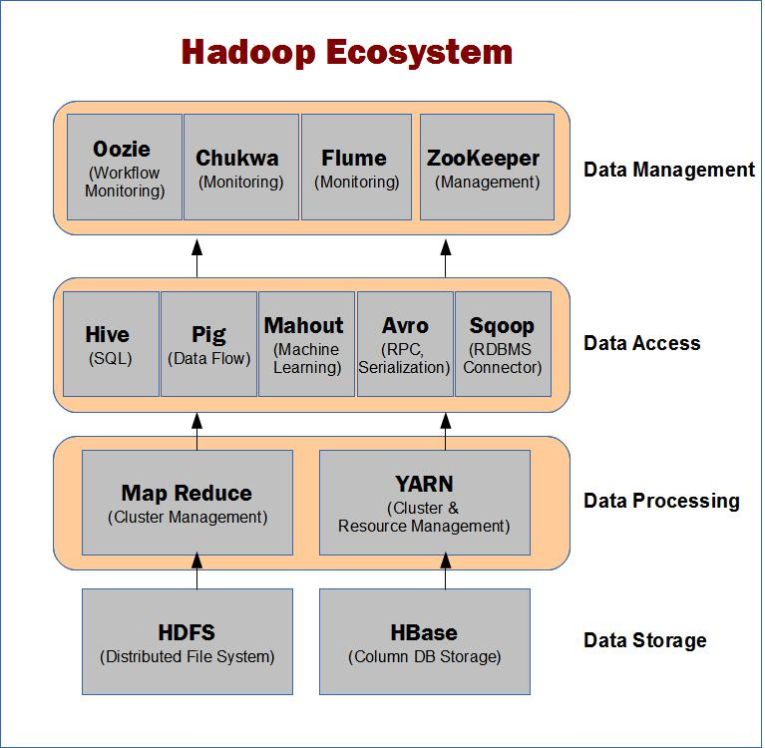
Hadoop Ecosystem

Slide 3
Contents
Technologies Used
Description of Dataset
Demo and screenshots

Slide 4
Technologies Used
Pseudo Distributed Mode :
Hadoop HDFS
Pig
Hive
Data Visualization using Tableau

Slide 5
Description of Dataset
Dataset includes data from Phoenix, Las Vegas, Madison, Waterloo and Edinburgh:
42,153 businesses
31,617 check-in sets
252,898 users
403,210 tips
1,125,458 reviews
The dataset is in JSON
The dataset contains information of local businesses across 10 cities in 4 countries

Slide 6
Description of Dataset (Cont)
Review { 'type': 'review', 'business_id': (encrypted business id), 'user_id': (encrypted user id), 'stars': (star rating, rounded to half-stars), 'text': (review text), 'date': (date, formatted like '2012-03-14'), 'votes': {(vote type): (count)},}
User{ 'type': 'user', 'user_id': (encrypted user id), 'name': (first name), 'review_count': (review count), 'average_stars': (floating point average, like 4.31), 'votes': {(vote type): (count)}, 'friends': [(friend user_ids)], 'elite': [(years_elite)], 'yelping_since': (date, formatted like '2012-03'), 'compliments': { (compliment_type): (num_compliments_of_this_type), ... }, 'fans': (num_fans), }
Checkin { 'type': 'checkin', 'business_id': (encrypted business id), 'checkin_info': { '0-0': (number of checkins from 00:00 to 01:00 on all Sundays), '1-0': (number of checkins from 01:00 to 02:00 on all Sundays), ... '14-4': (number of checkins from 14:00 to 15:00 on all Thursdays), ... '23-6': (number of checkins from 23:00 to 00:00 on all Saturdays) }, # if there was no checkin for a hour-day block it will not be in the dict}

Slide 7
Analysis Performed
Analysis performed on Business Data Set
  Classified no of Business based on Star Count
  For each city classify Business based on Star Count using Pig
  Which City has maximum no of review count using Pig
  Total No of Restaurants Open or closed in a City using Pig
Analysis performed on Review Dataset
  Classify reviews based on stars given using Pig
  Total No of reviews by Distinct users using Pig
  25 Business with maximum no of useful votes
  25 Business with maximum no of funny votes
  25 Business with maximum no of cool votes

Slide 8
Analysis Performed (contd)
Analysis performed on User Dataset
  Top 15 Reviewers
  25 Users who have given maximum no of tips to a business using Pig
  15 Users who have maximum no of likes using Pig
  No of Users yelping since using Pig
Analysis performed on Tip Dataset
  25 Dates with maximum no of likes
  25 Business with maximum no of likes to a tip

Slide 9
Loading file into HDFS
./hdfs dfs -copyFromLocal '/Users/nimeshrajal/Desktop/Sharna_BigData/yelp_academic_dataset_user.json' '/FinalProject/rawdata'
./hdfs dfs -copyFromLocal '/Users/nimeshrajal/Desktop/Sharna_BigData/yelp_academic_dataset_review.json' '/FinalProject/rawdata'
./hdfs dfs -copyFromLocal '/Users/nimeshrajal/Desktop/Sharna_BigData/yelp_academic_dataset_checkin.json' '/FinalProject/rawdata'

Slide 10
Map Reduce with Pig
Register /Users/nimeshrajal/Desktop/Sharna_BigData/elephant-bird-core-4.5.jar
Register /Users/nimeshrajal/Desktop/Sharna_BigData/elephant-bird-pig-4.5.jar
Register /Users/nimeshrajal/Desktop/Sharna_BigData/elephant-bird-hadoop-compat-4.5.jar
Register /Users/nimeshrajal/Downloads/simple-json-1.1.jar

Slide 11
Pig Analysis
Business Data is loaded in businessJson
Tip Data is loaded in tipJson
Review Data in reviewJson

Slide 12
Map Reduce with Pig (contd)
Analysis : count top 25 tips by a user
tipJson = load ‘/FinalProject/rawdata/yelp_academic_dataset_tip.json' using com.twitter.elephantbird.pig.load.JsonLoader('-nestedLoad');
red = foreach tipJson generate $0#'text' as text, $0#'user_id' as userid ,$0#'business_id' as businessid;
group_by_user = group red by (userid,businessid);
tipcount = foreach group_by_user generate group as tcount, COUNT(red) as tcounts;
orderbyre = order tipcount by tcounts desc;
top25 = limit orderbyre 25;

Slide 13
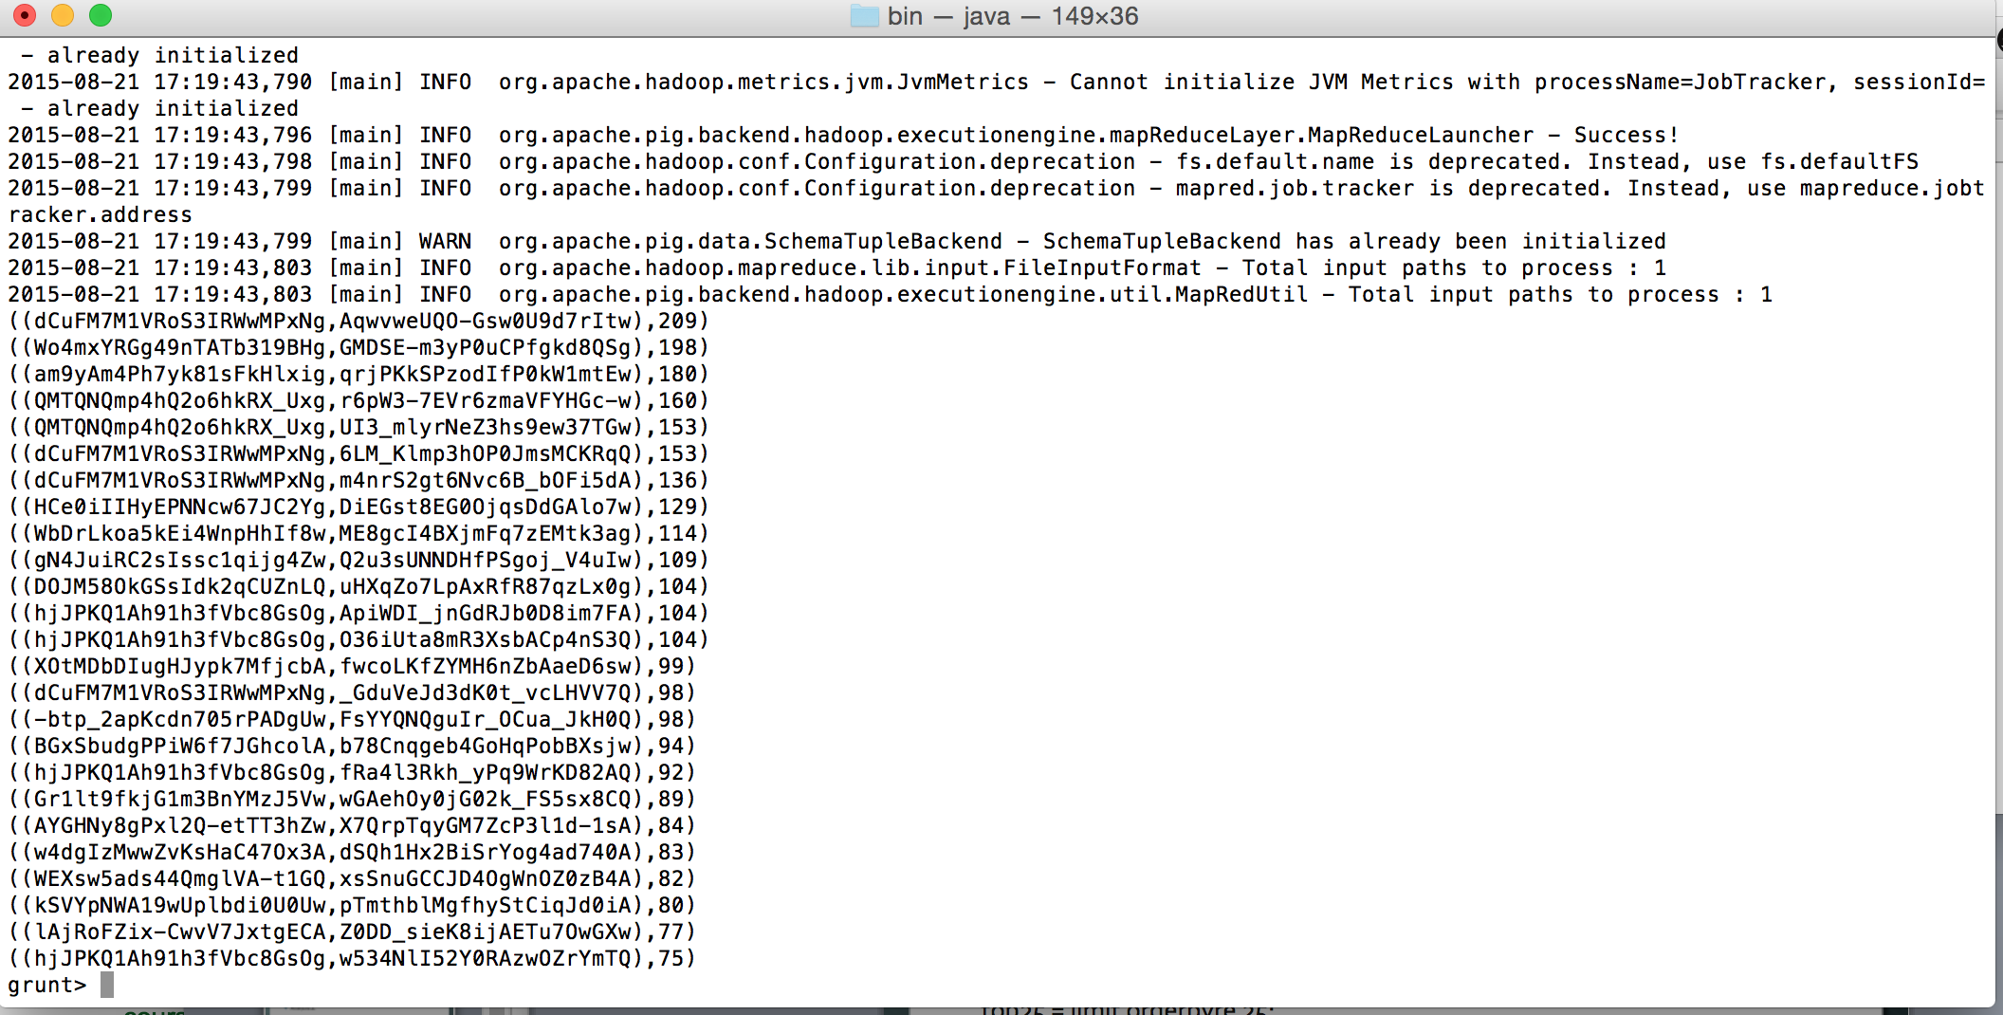
Output of Analysis 1

Slide 14
Pig Analysis 2
Analysis 2 : Top 15 likes by a user
genuser = foreach tipJson generate $0#'user_id' as userid, $0#'likes' as likes;
groupbyuser = group genuser by userid;
countlikes = foreach groupbyuser generate group as likesct, COUNT(genuser.likes) as likes1;
orderdesc = order countlikes by likes1 desc;
top15 = limit orderdesc 15;
Storing the results in HDFS
STORE top25 INTO
‘/FinalProject/Output/PigOutput/Analysis1’ using PigStorage(‘,’);

Slide 15
Hive Analysis
Add JAR files ‘json-serde-1.1.9.2-Hive13-jar-with-dependencies.jar’, ‘json-serde-1.1.9.2-Hive13.jar’
CREATE EXTERNAL TABLE business_yelp(business_id string, name string,full_address string, city string, state string, categories array<string>, latitude double, longitude double) ROW FORMAT SERDE 'org.openx.data.jsonserde.JsonSerDe';
CREATE EXTERNAL TABLE checkin_yelp (business_id string, checkin_infor map<string,int>) ROW FORMAT SERDE 'org.openx.data.jsonserde.JsonSerDe';
CREATE EXTERNAL TABLE user_yelp(user_id string, name string, review_count int, votes map<string,int>, friends array<string>,fans int, yelping_since string, elite array<string>, complements map<string,int>, average_stars float) ROW FORMAT SERDE 'org.openx.data.jsonserde.JsonSerDe';

Slide 16
Hive (contd)
Loading data in the tables
load data inpath '/FinalProject/rawdata/yelp_academic_dataset_review.json' into table review_yelp;
load data inpath '/FinalProject/rawdata/yelp_academic_dataset_user.json' into table user_yelp;
load data inpath '/FinalProject/rawdata/yelp_academic_dataset_checkin.json' into table checkin_yelp;

Slide 17
Hive (contd)
Analysis 1 :
select business_id,SUM(votes['useful']) as vote from review_yelp group by business_id limit 5;
Analysis 2:
select business_id,SUM(votes['useful']) as voteuseful,SUM(votes['cool']) as votecool, SUM(votes['funny']) as votesfunny from review_yelp group by business_id ;

Slide 18
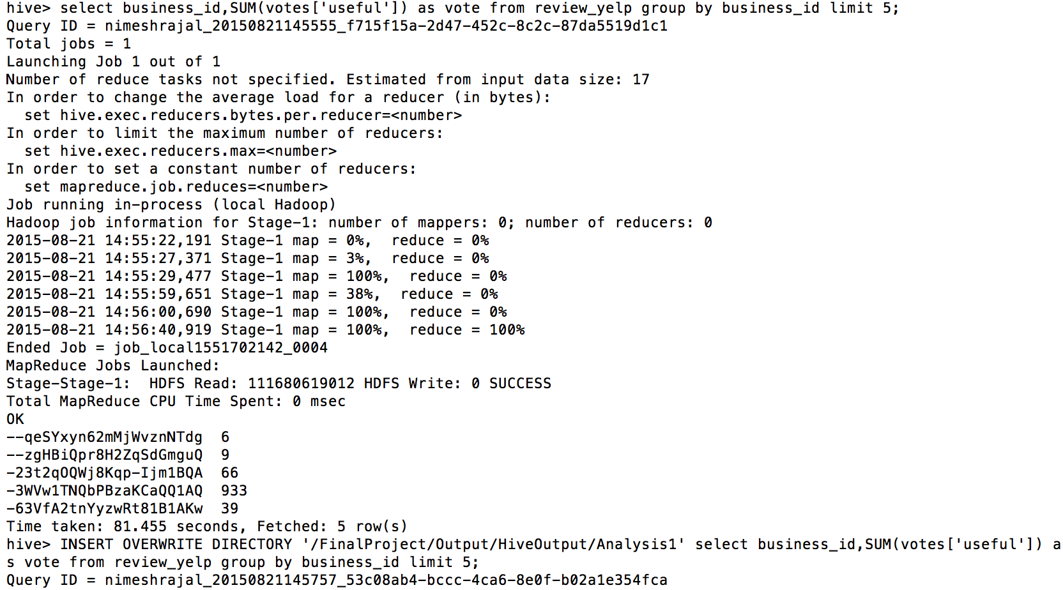
Output

Slide 19
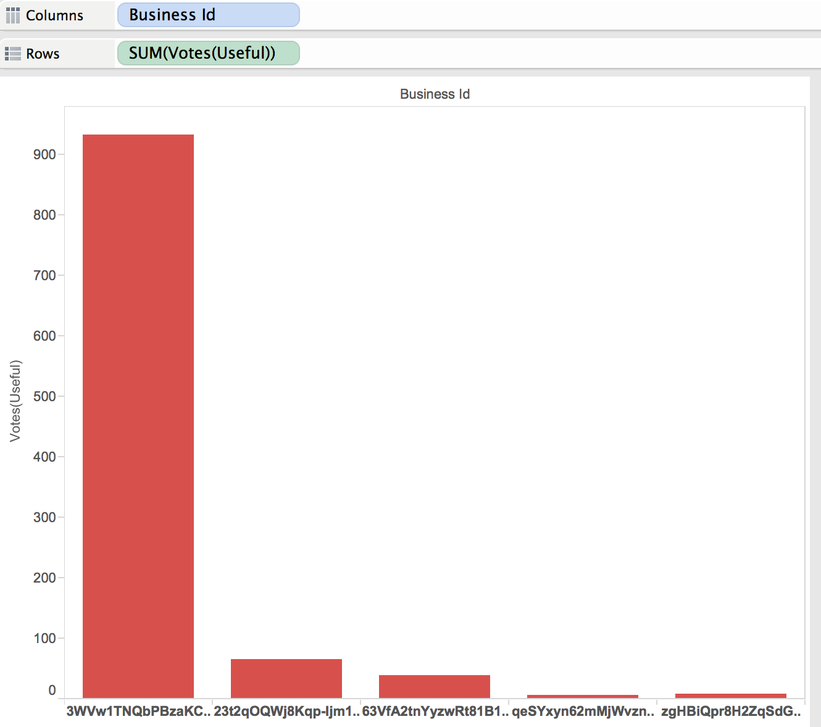
Tableau Analysis

Slide 20
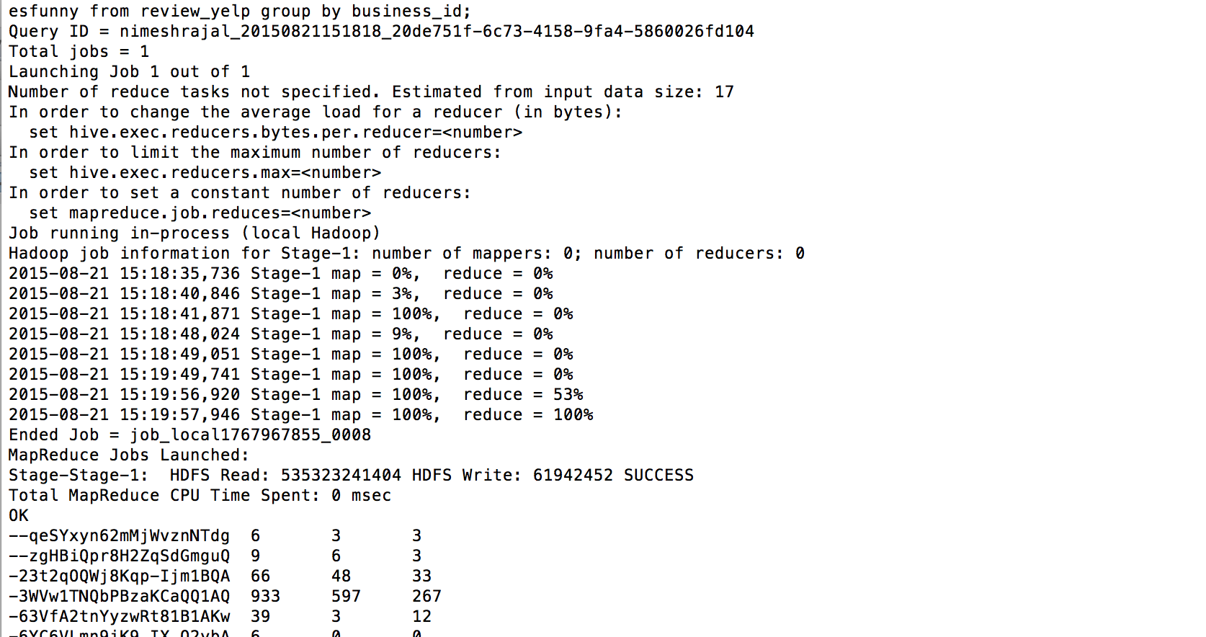
Hive Analysis 2

Slide 21
Hive Analysis contd
Total reviews in the dataset :
Select sum(review_count) as totalReviews from business_yelp;
Top states and cities in number of reviews :
Select state, city, count(*) totalReviews from business_yelp group by state, city order by count(*) desc limit 10;
Top businesses with high review counts(>1000)
Select state, city, review_count from business_yelp where review_count >1000 order by ‘review_count’ desc limit 10;

Slide 22
References
http://www.yelp.com/dataset_challenge

Slide 23
THANK YOU !!

