Slide 1
cmpo running notes
Shuang Liang @ IOP-CAS

Slide 2
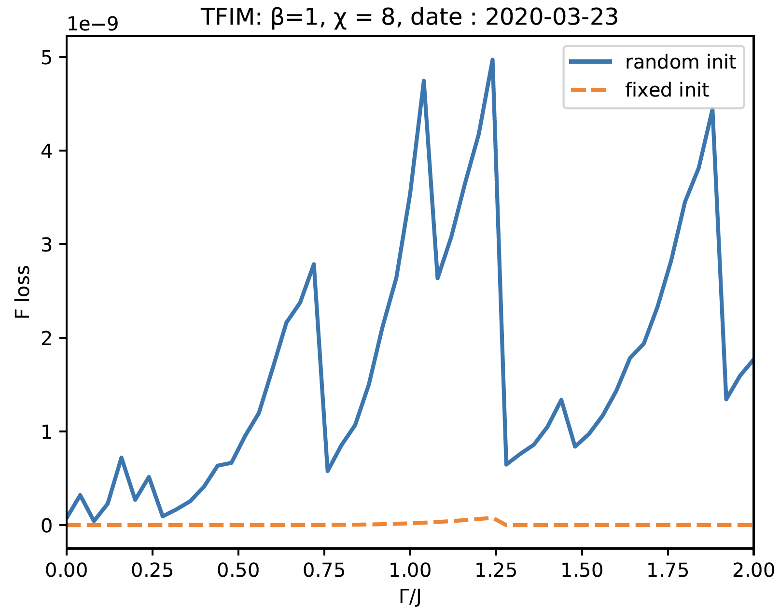
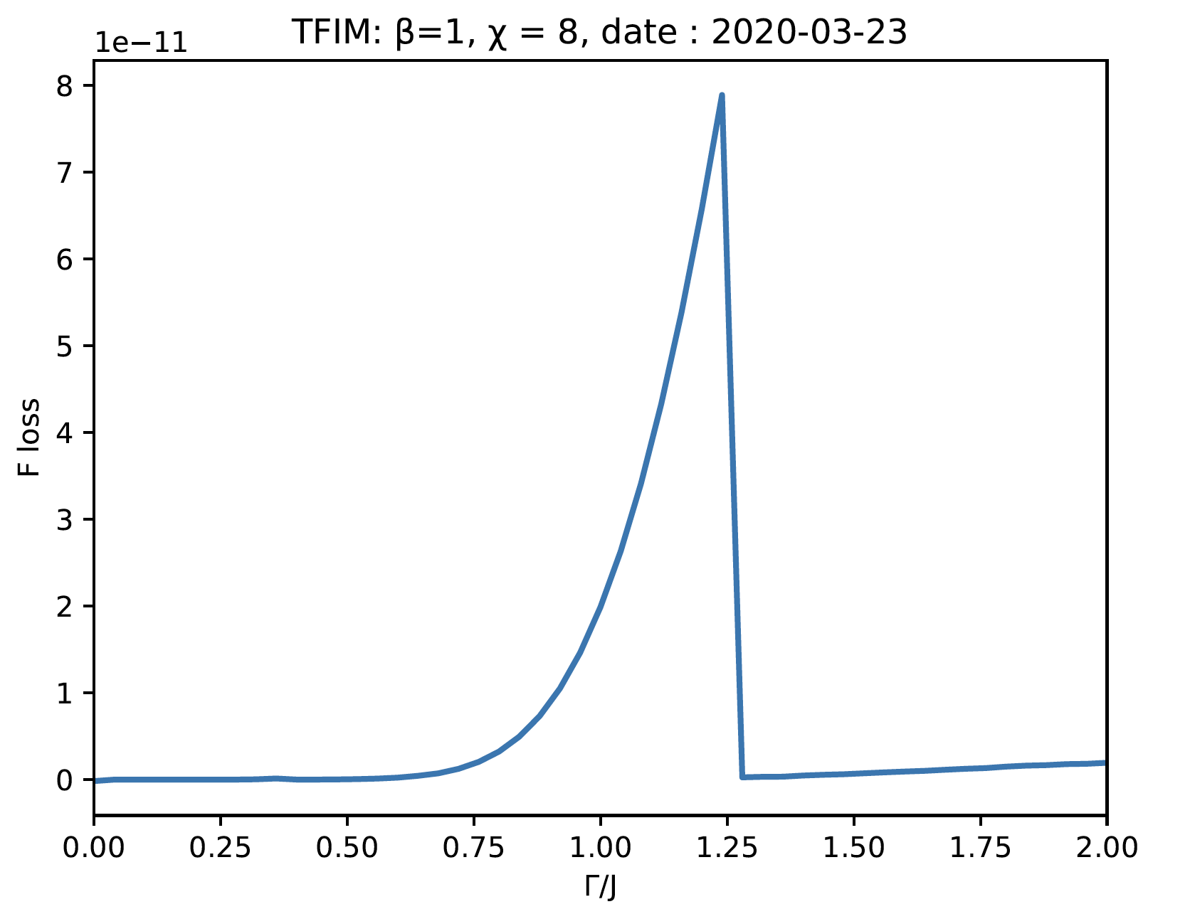

2020.03.23 : $β=1$, free energy loss

Slide 3
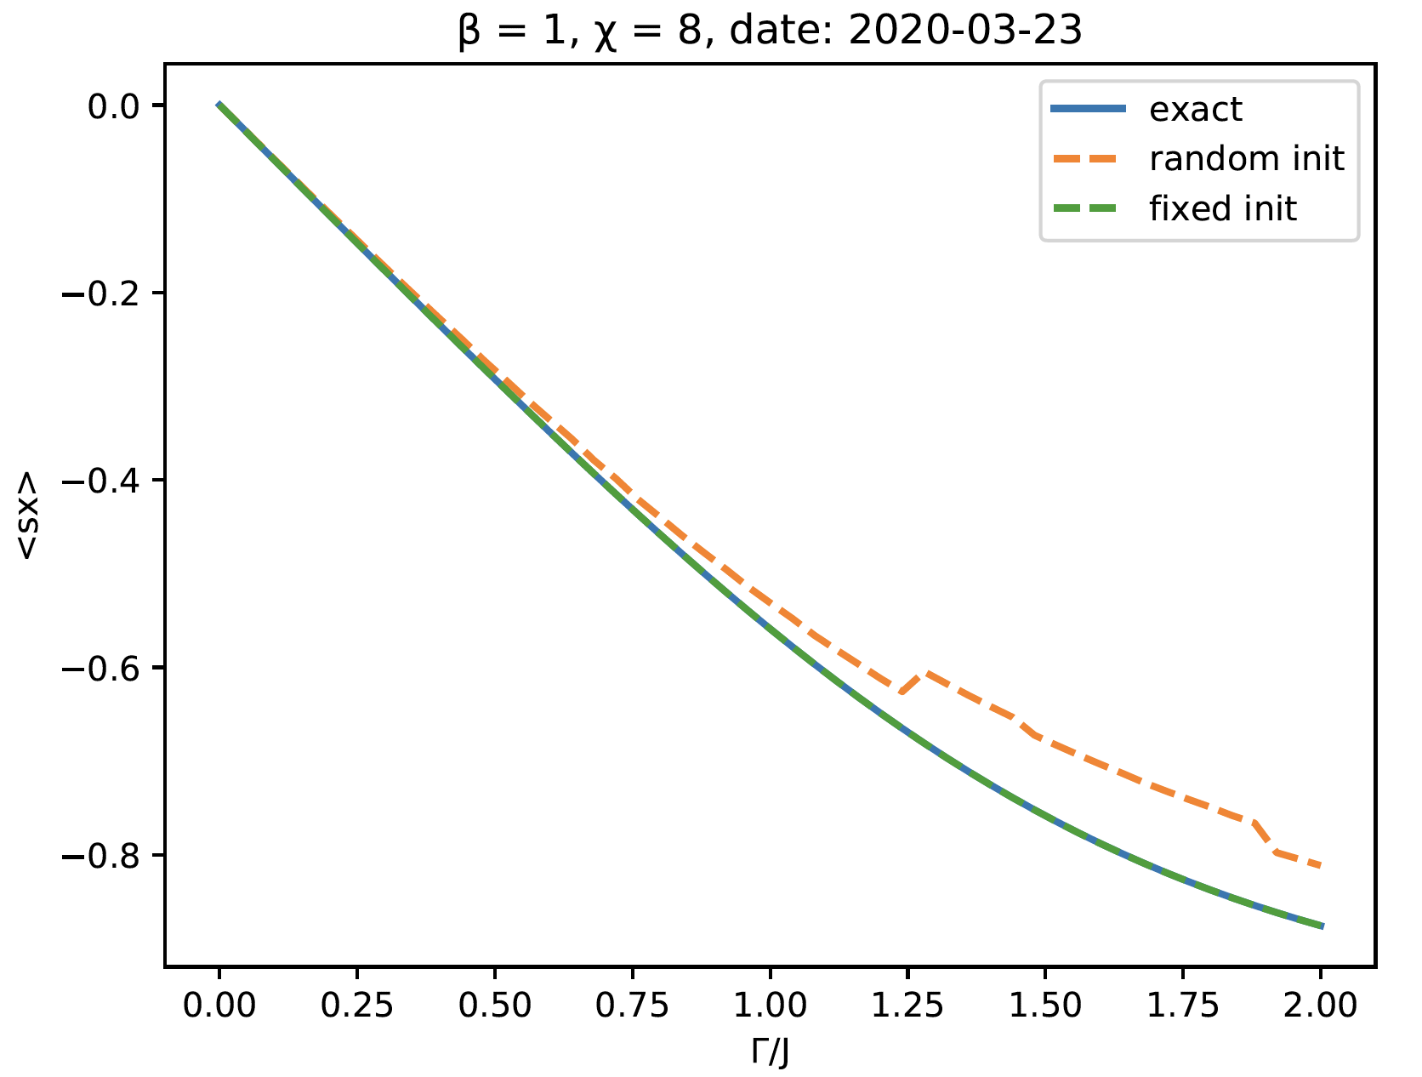

2020.03.23 : $β=1$, < sx >
Notes:
fixed init : ++-|

Slide 4
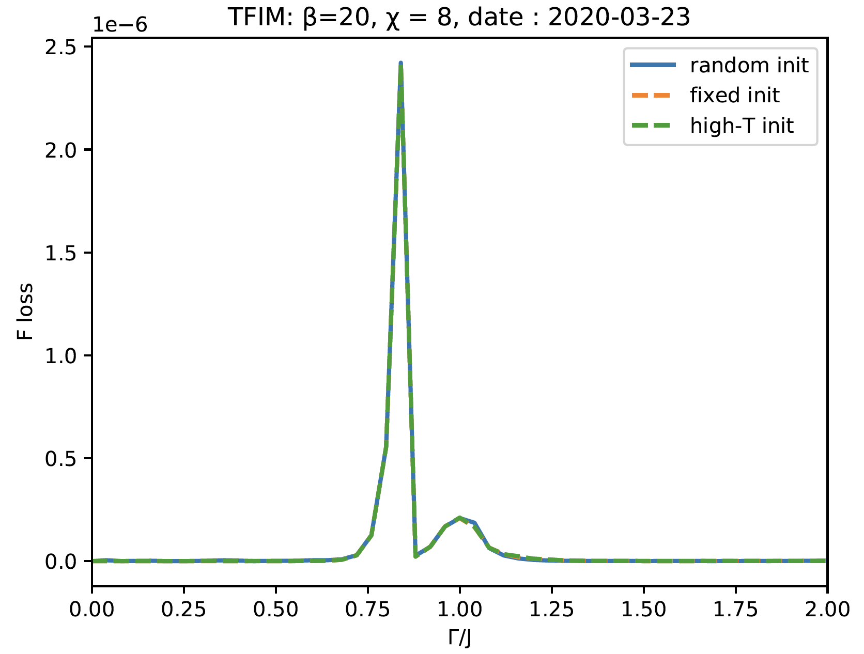
2020.03.23 : β=20, Free energy loss

Slide 5
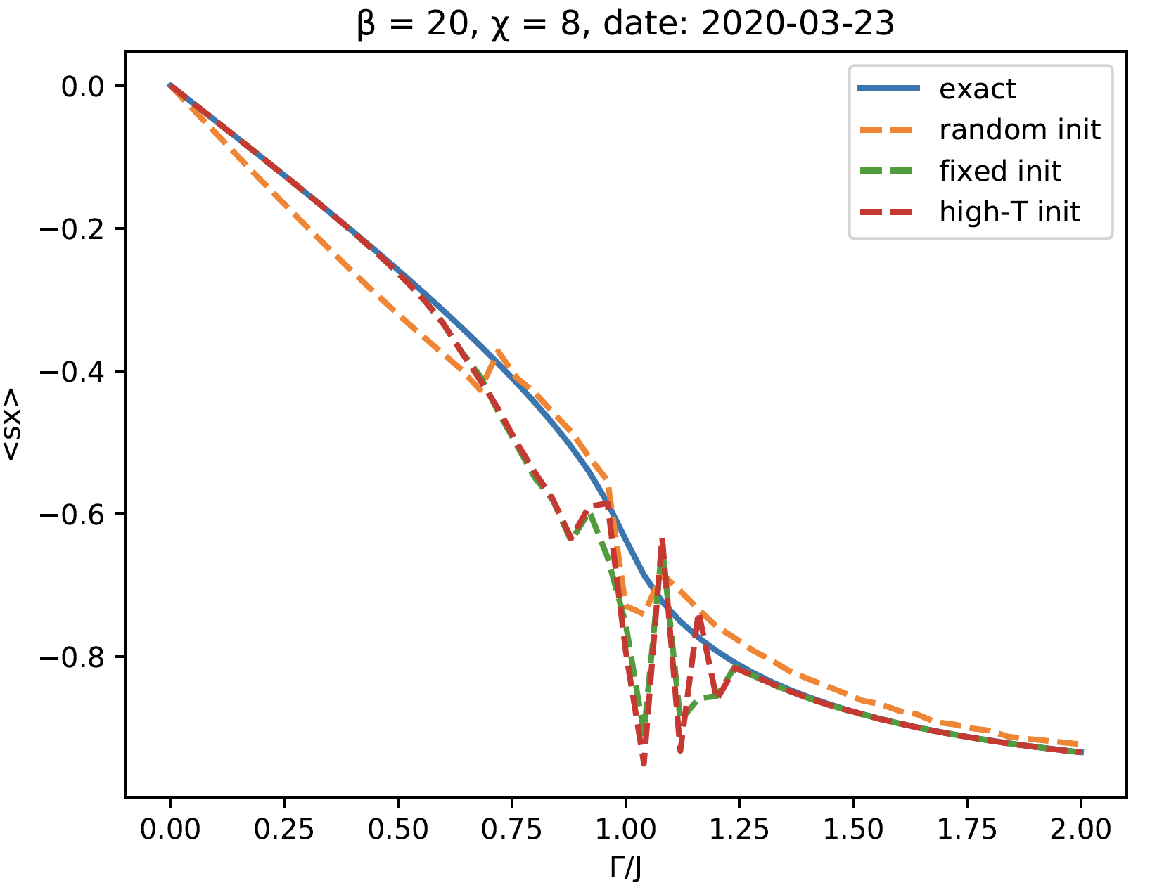

2020.03.23 : $β=20$, < sx >
Notes:
high-T init : use \beta = 1 optimized states to init \beta = 20

Slide 6
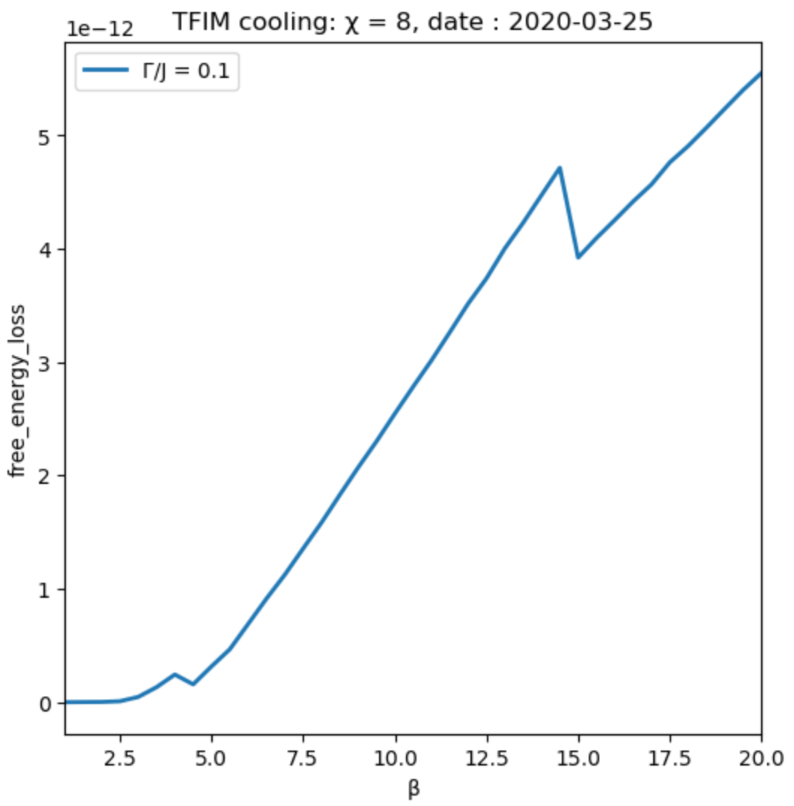
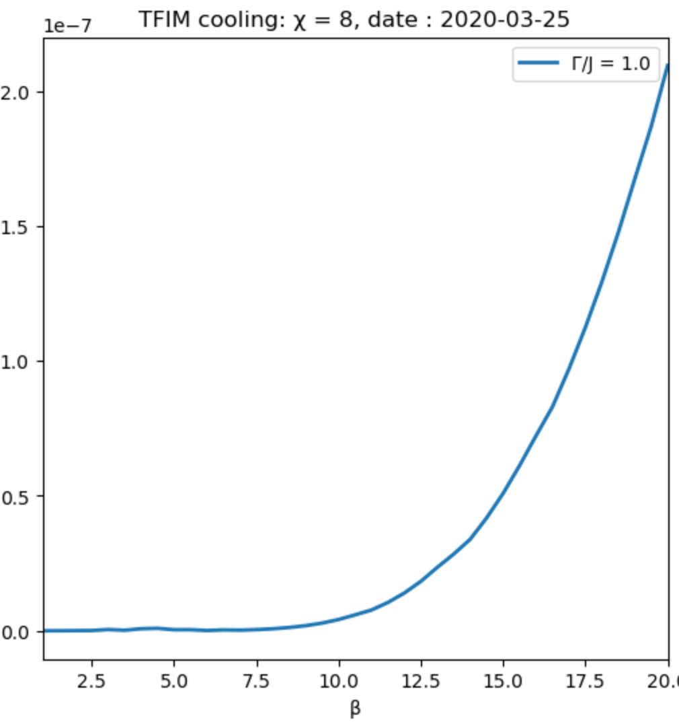
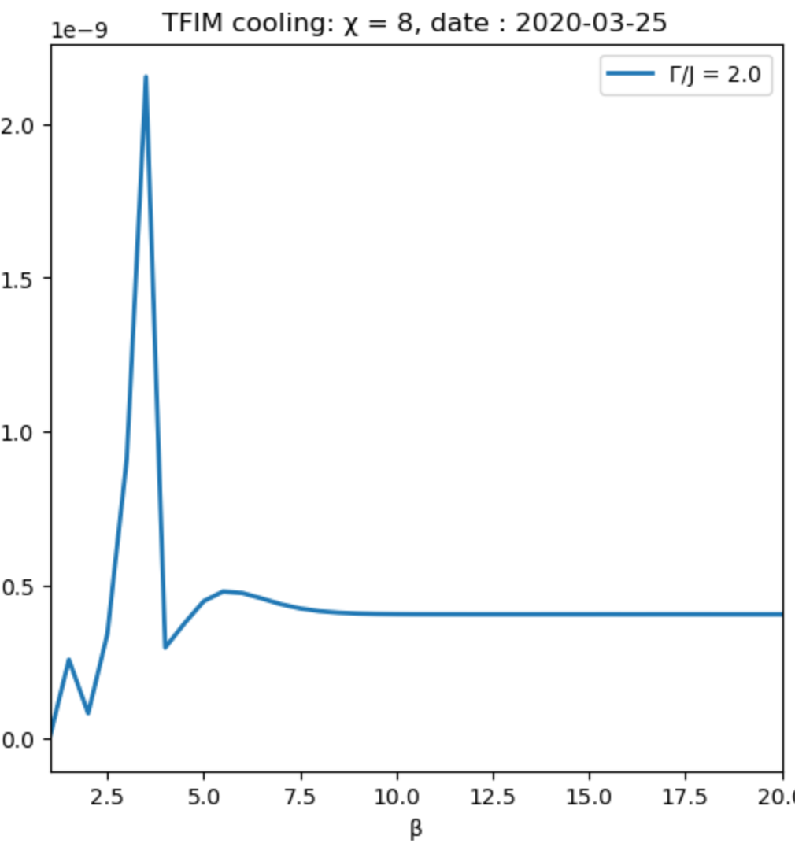
2020.03.25 : Cool, free energy loss
Notes:
fixed init ++-| from now on

Slide 7
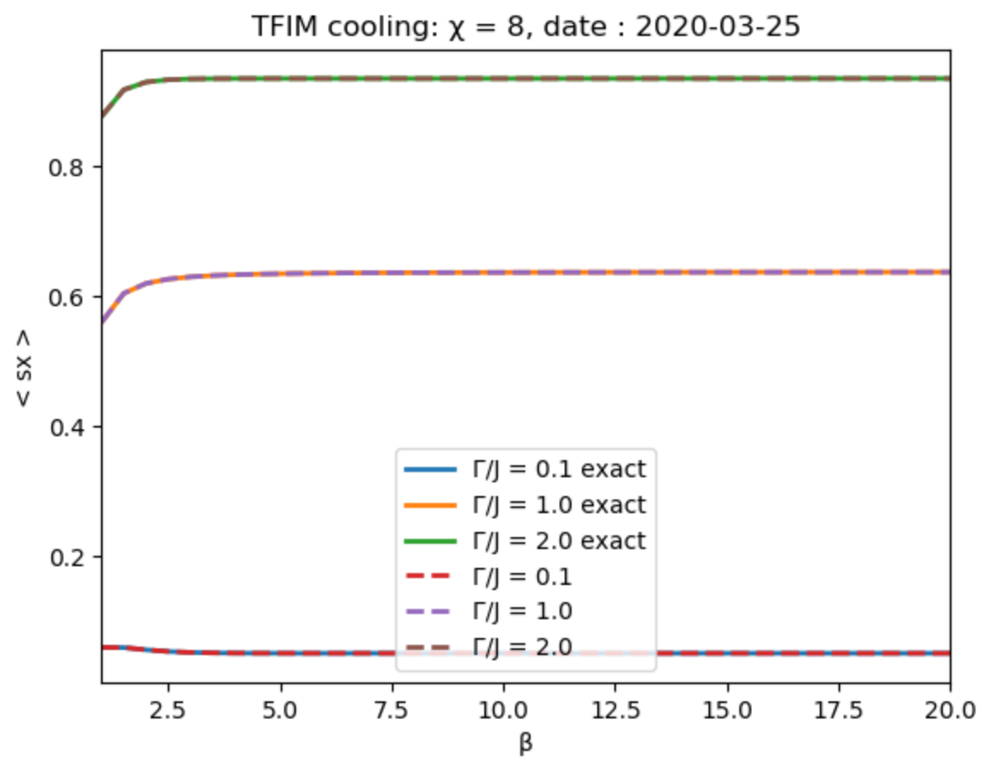
2020.03.25 : Cool, < sx >
Notes:
init ++-|

Slide 8
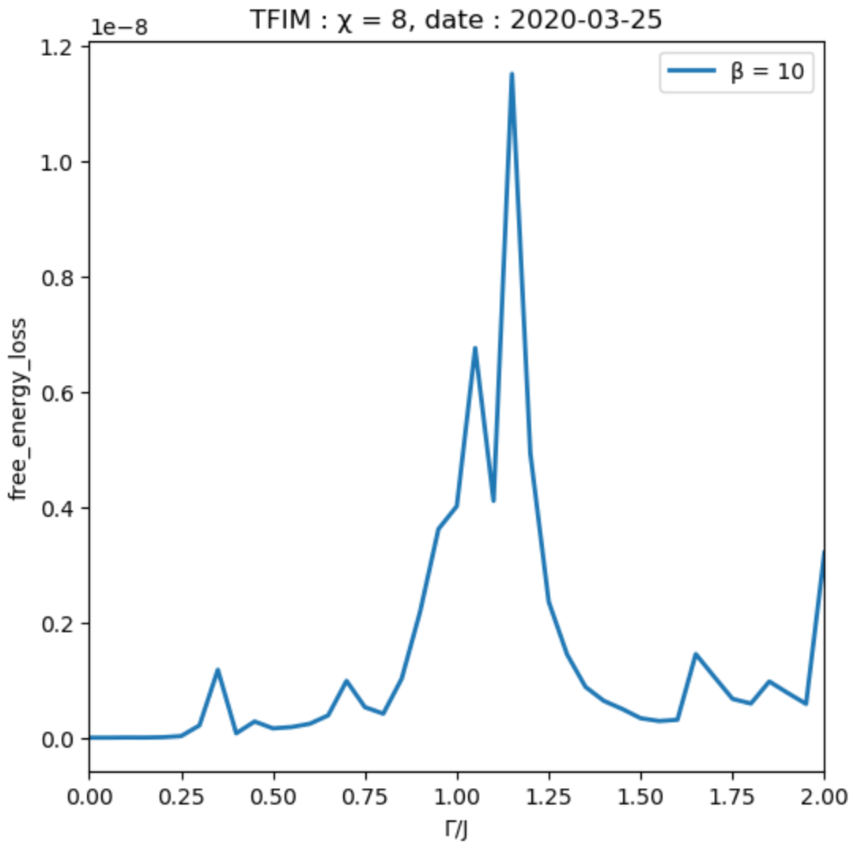
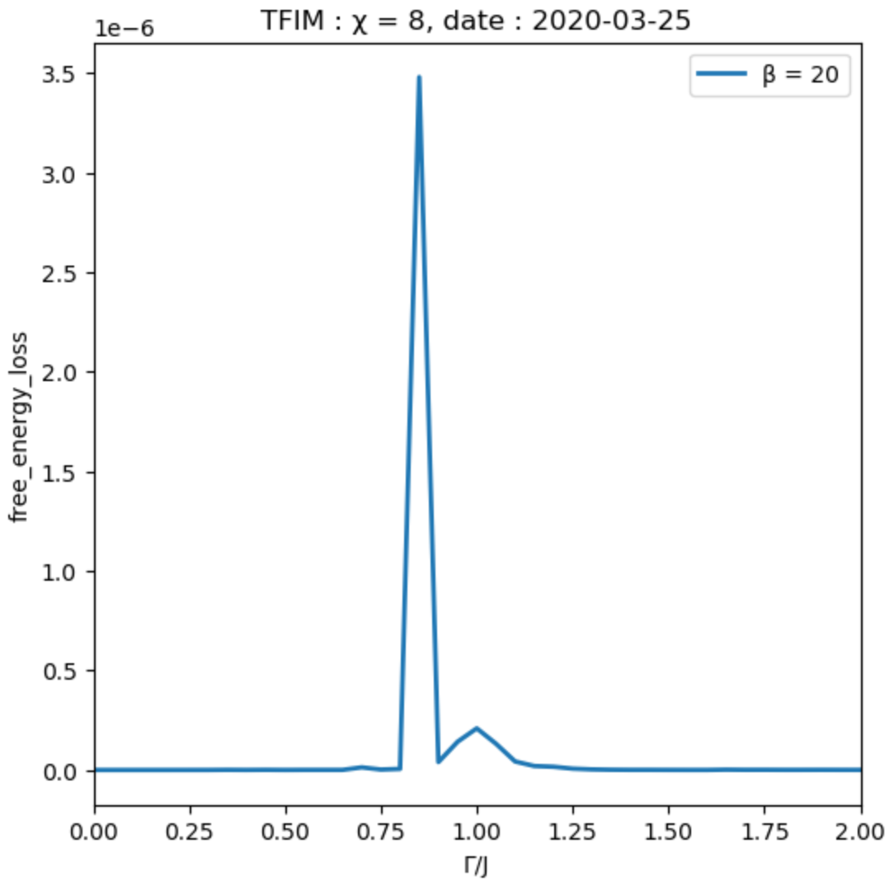
2020.03.25 : β=10, 20 free energy loss
Notes:
init ++-|

Slide 9
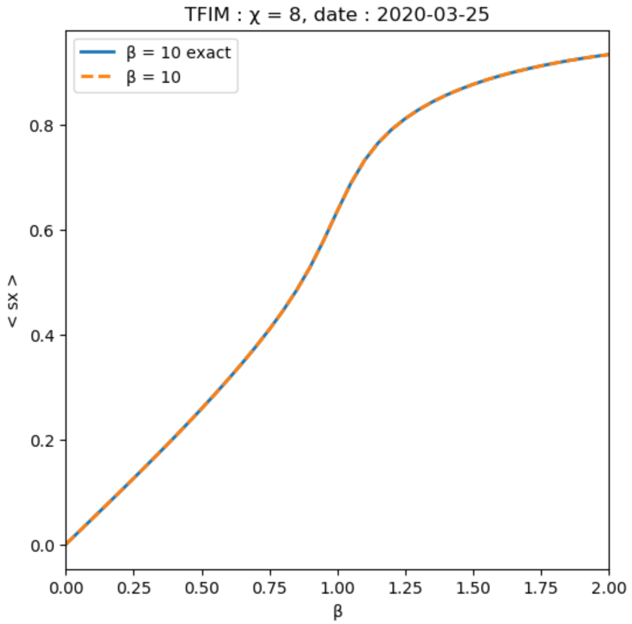

2020.03.25 : β=10, 20 < sx >
Notes:
init ++-|

Slide 10
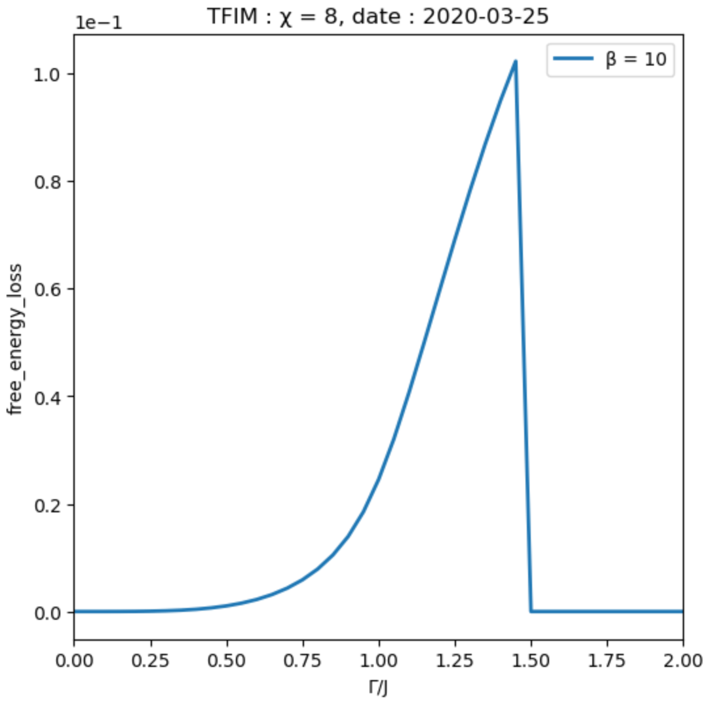
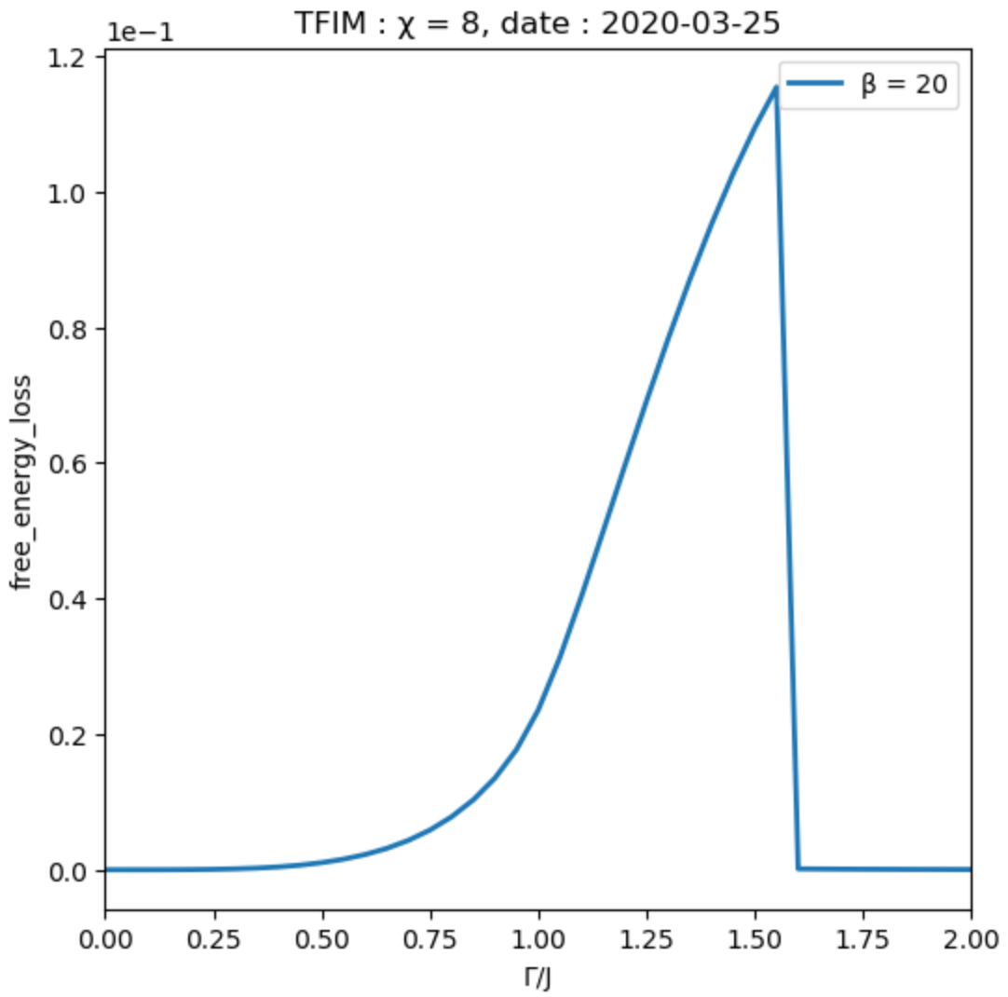
2020.03.25 : β=10, 20 free energy loss
Notes:
init ++-|， gamma = 0, 后一步用前一步结果

Slide 11
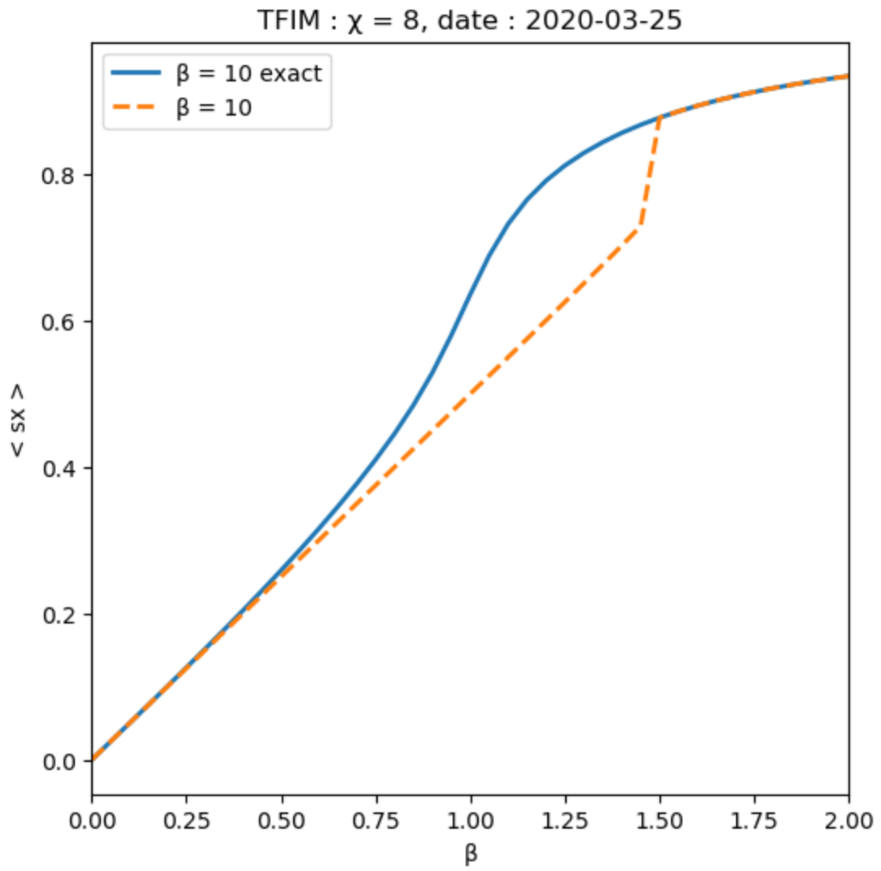
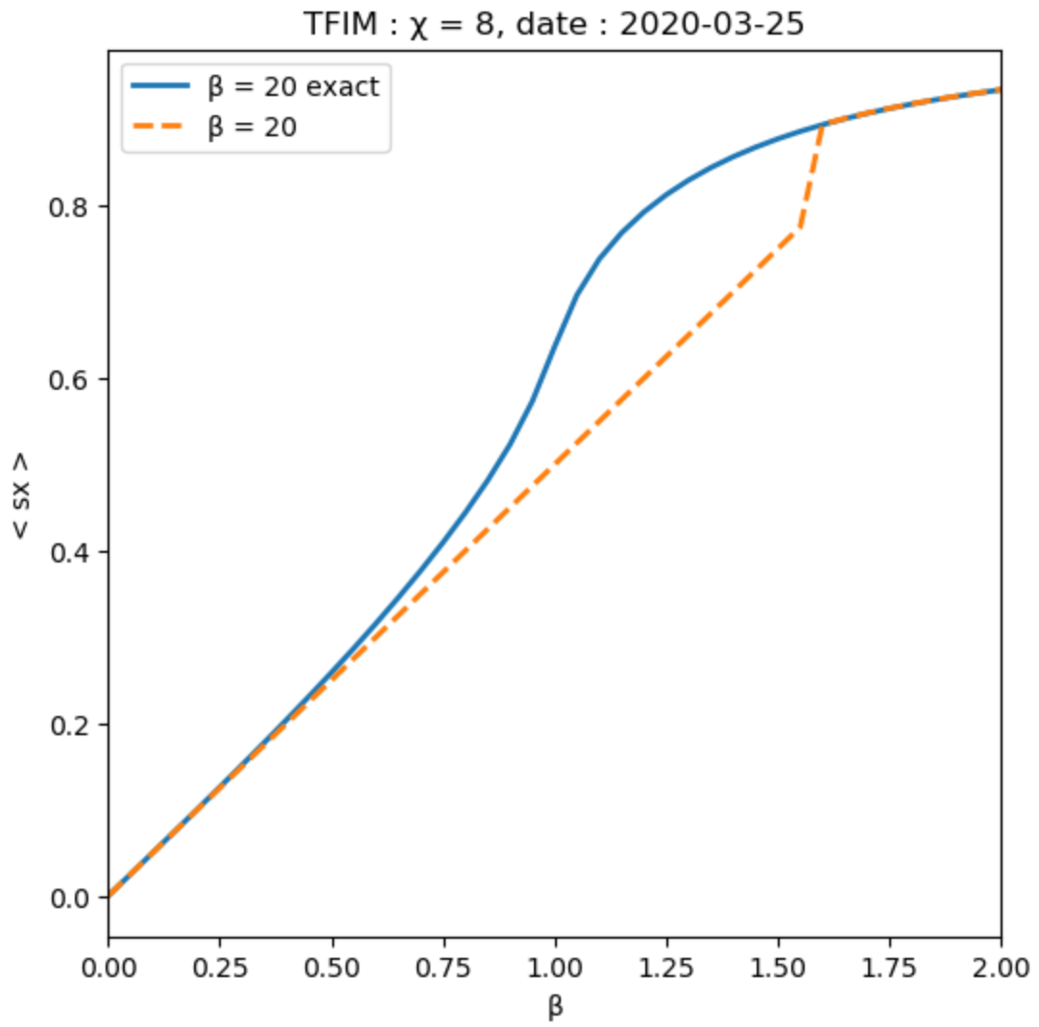
2020.03.25 : β=10, 20 < sx >
Notes:
init ++-|， gamma = 0, 后一步用前一步结果

