Slide 1
cmpo running notes
Shuang Liang @ IOP-CAS

Slide 2
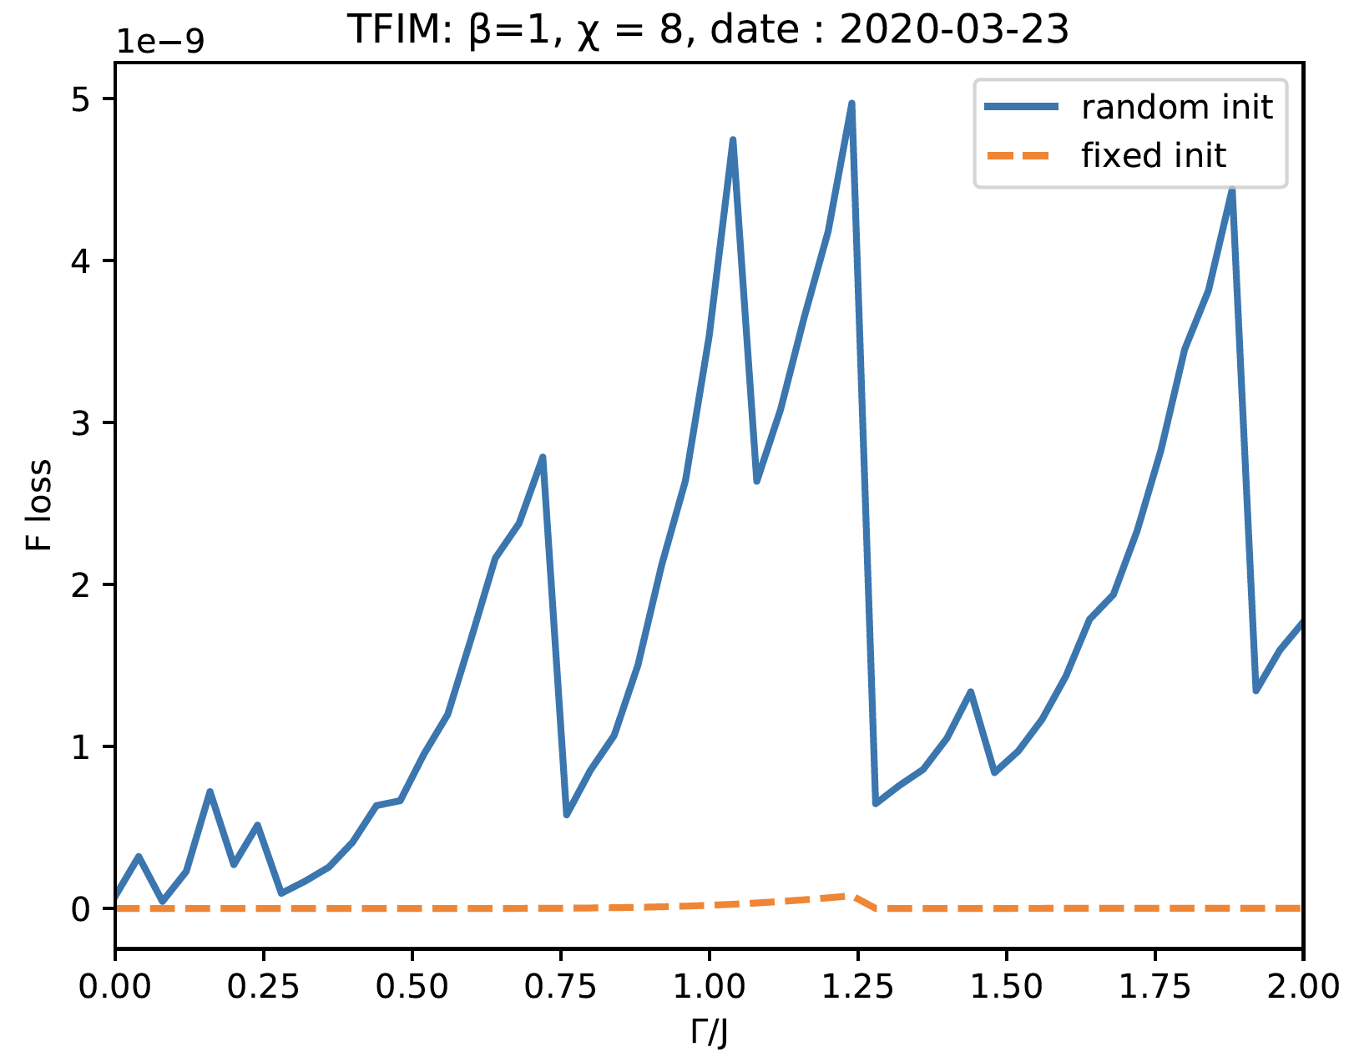
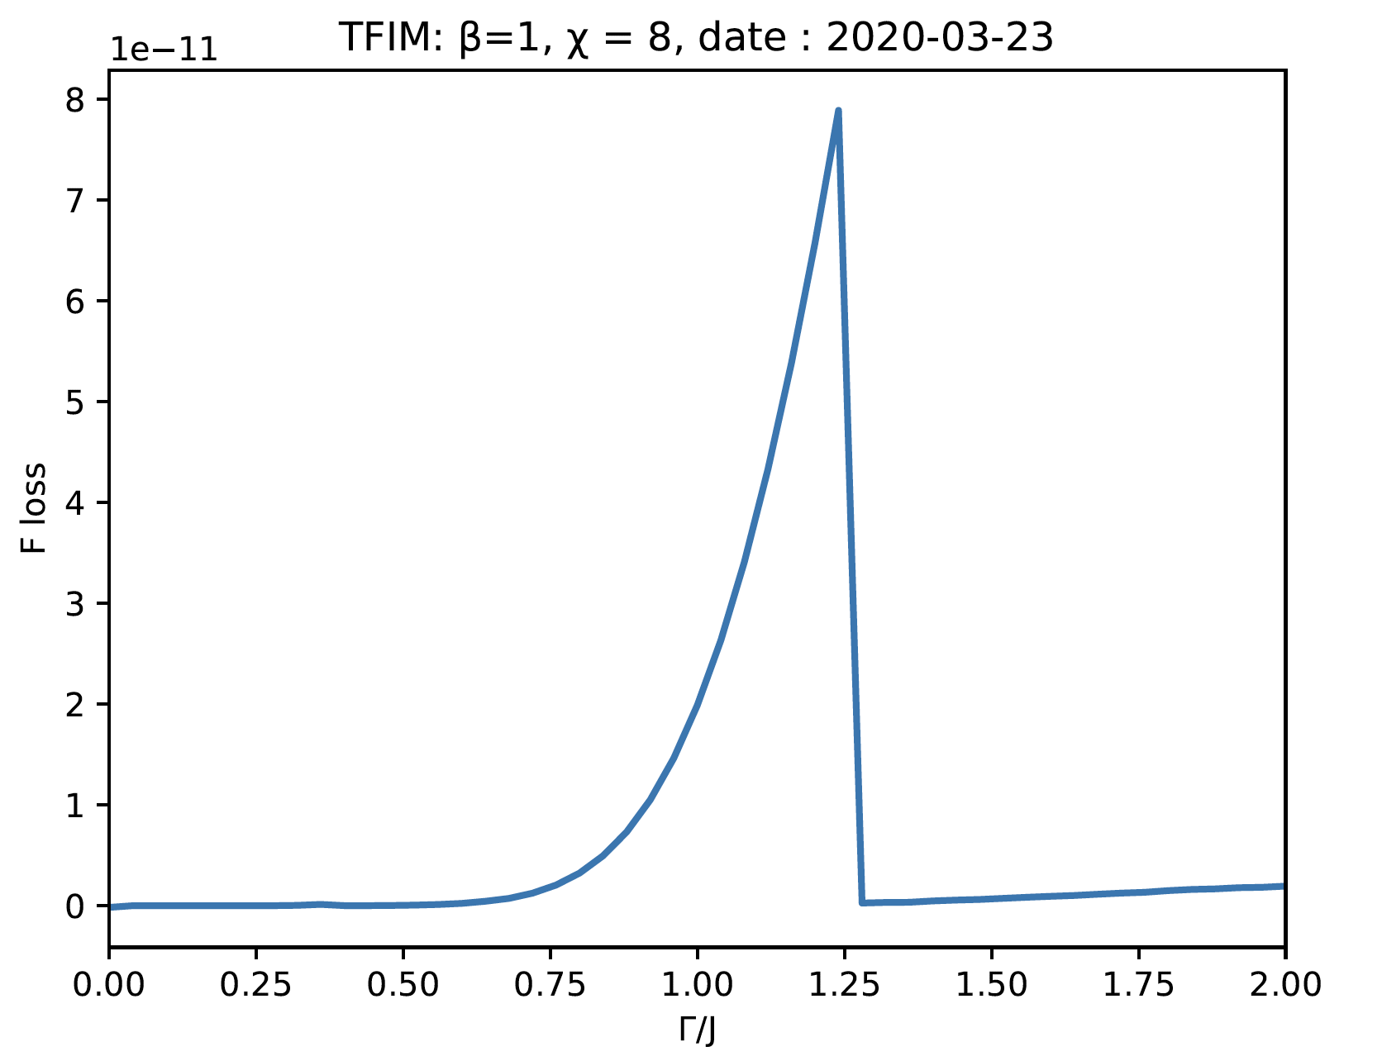

2020.03.23 : $β=1$, free energy loss

Slide 3
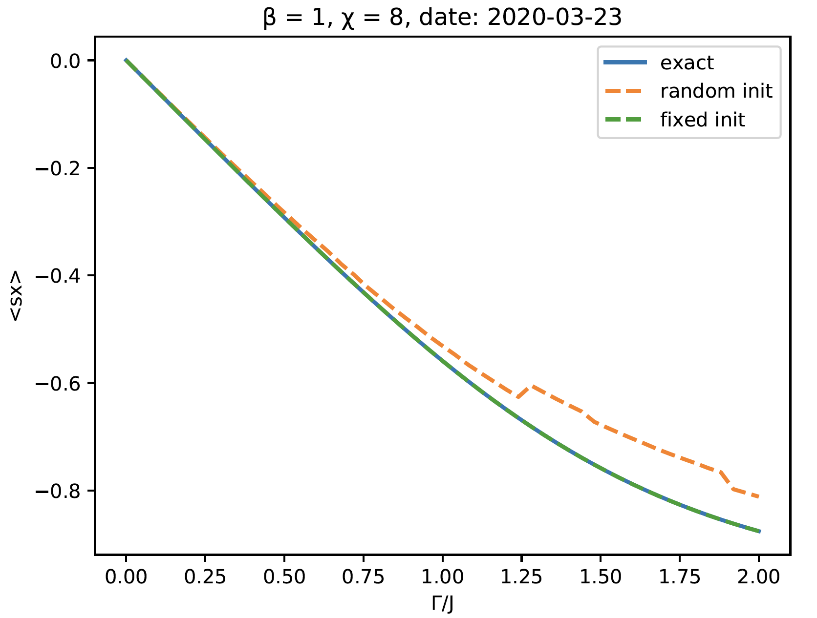
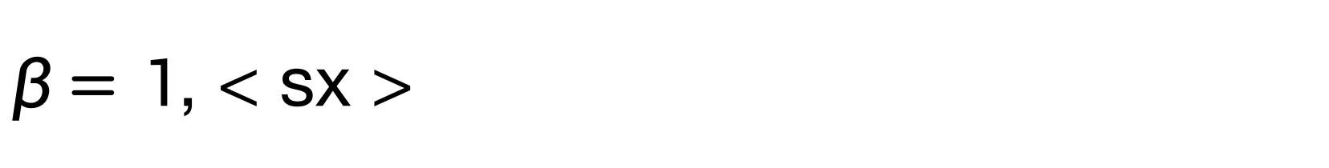
$β=1$, < sx >

Slide 4
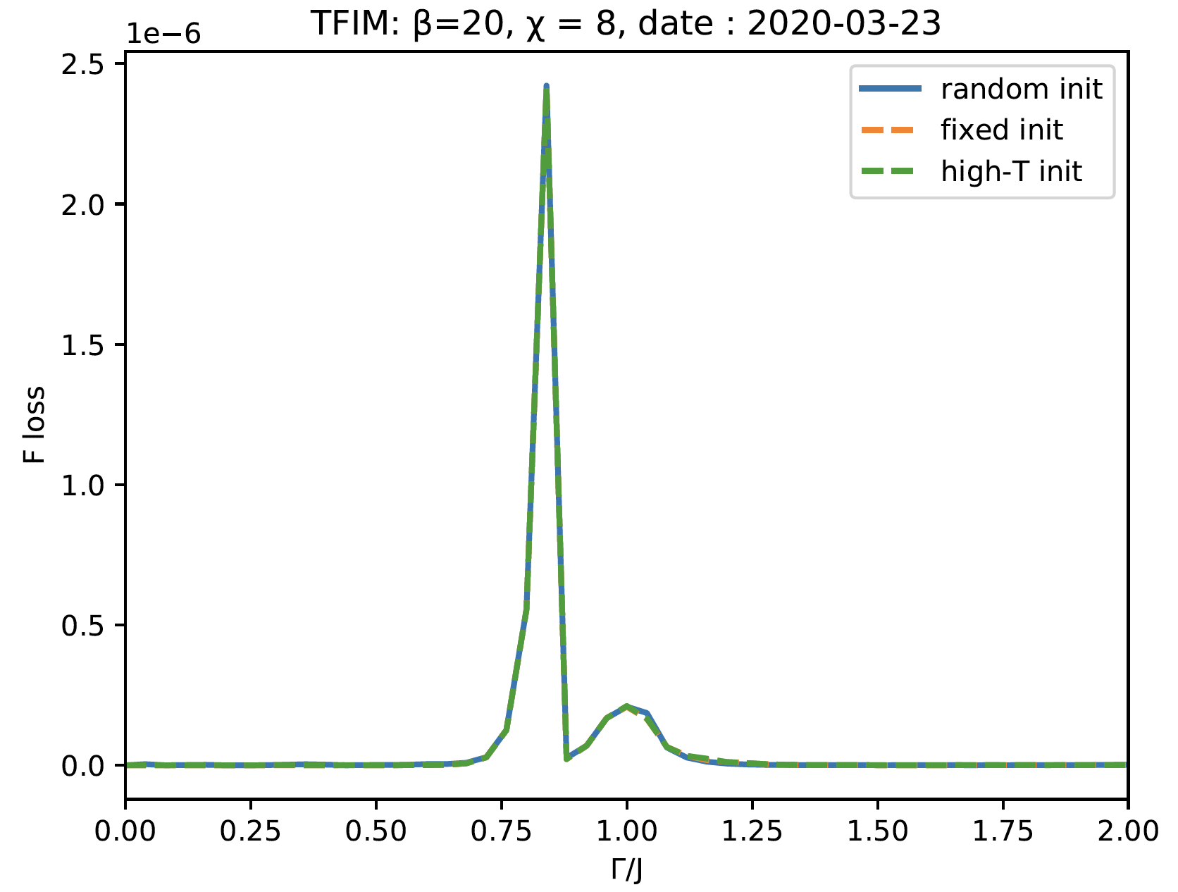
β=20, Free energy loss
Notes:
high-T init： init beta = 20 cmps by beta = 1cmps

Slide 5
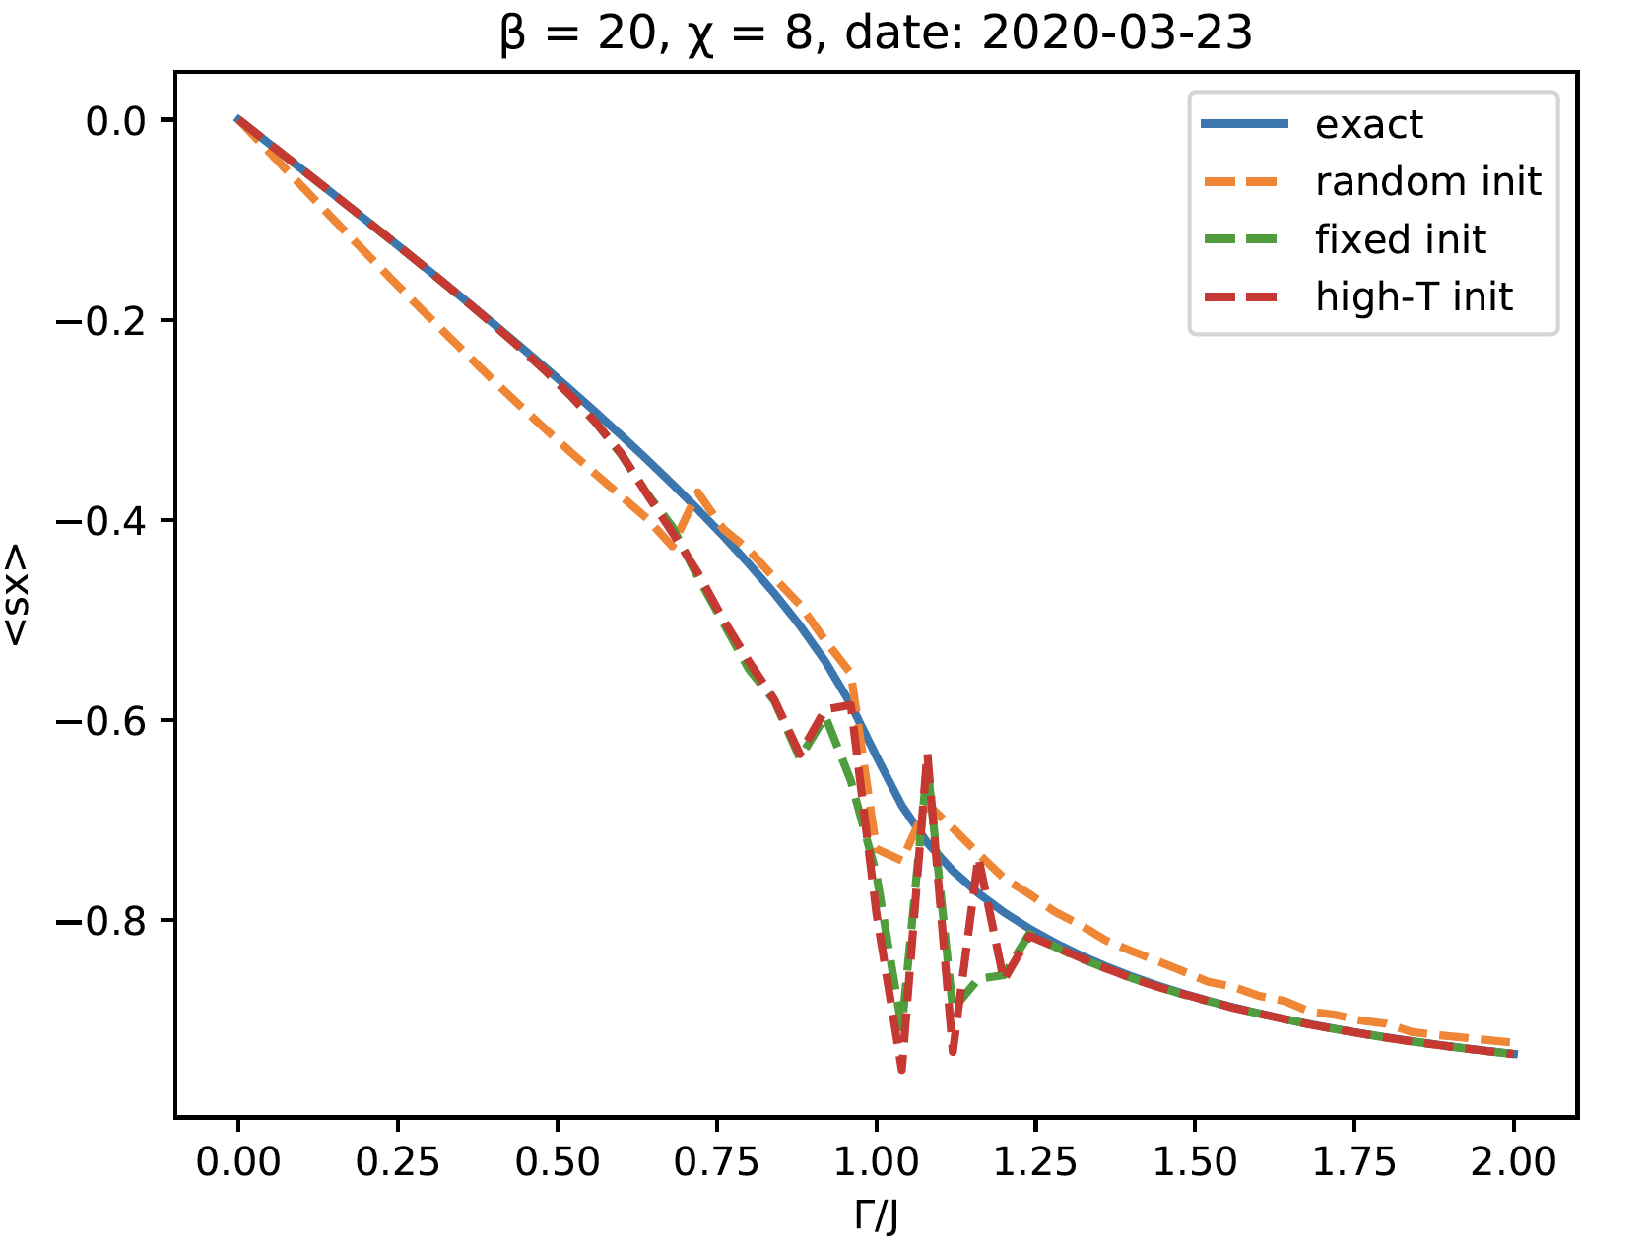
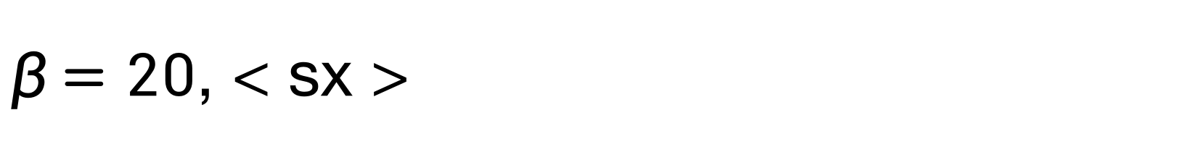
$β=20$, < sx >
错误原因： 低、高能谱权重颠倒
设计Test
Notes:
high-T init： init beta = 20 cmps by beta = 1cmps

Slide 6
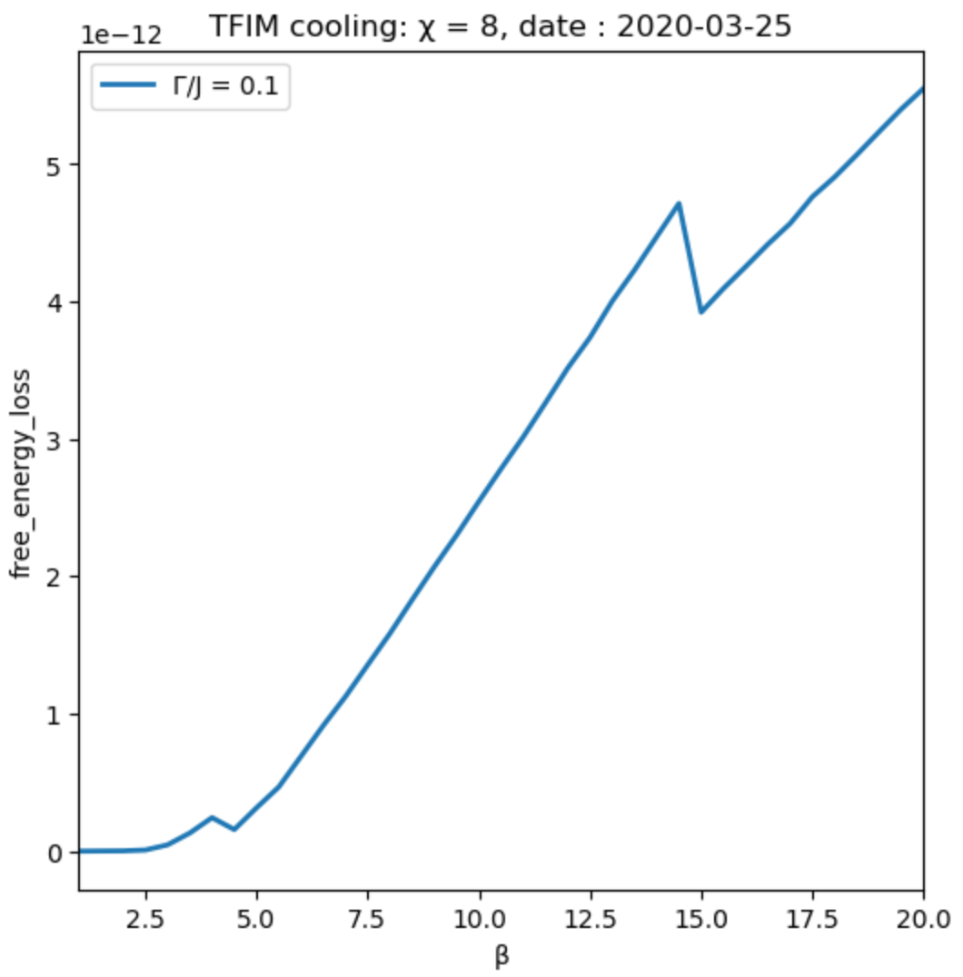
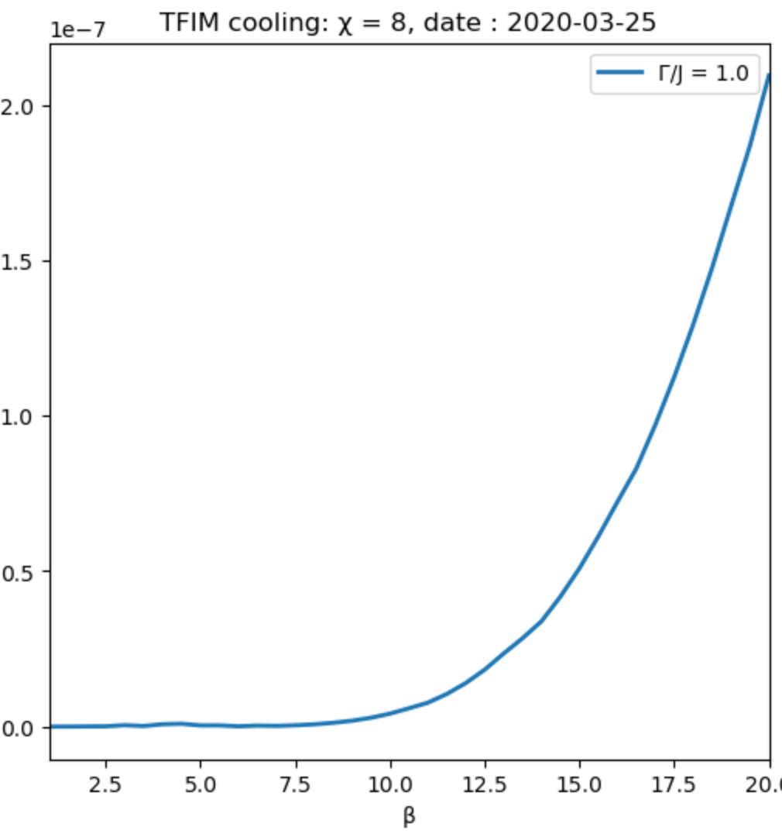
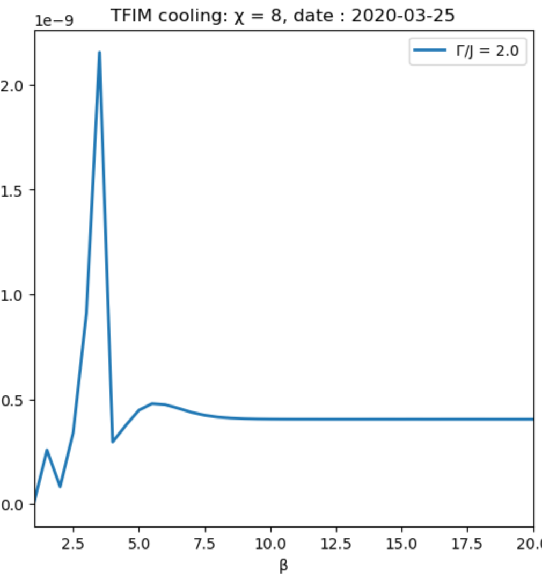
2020.03.25 : Cool, free energy loss
Notes:
fixed init ++-| from now on

Slide 7
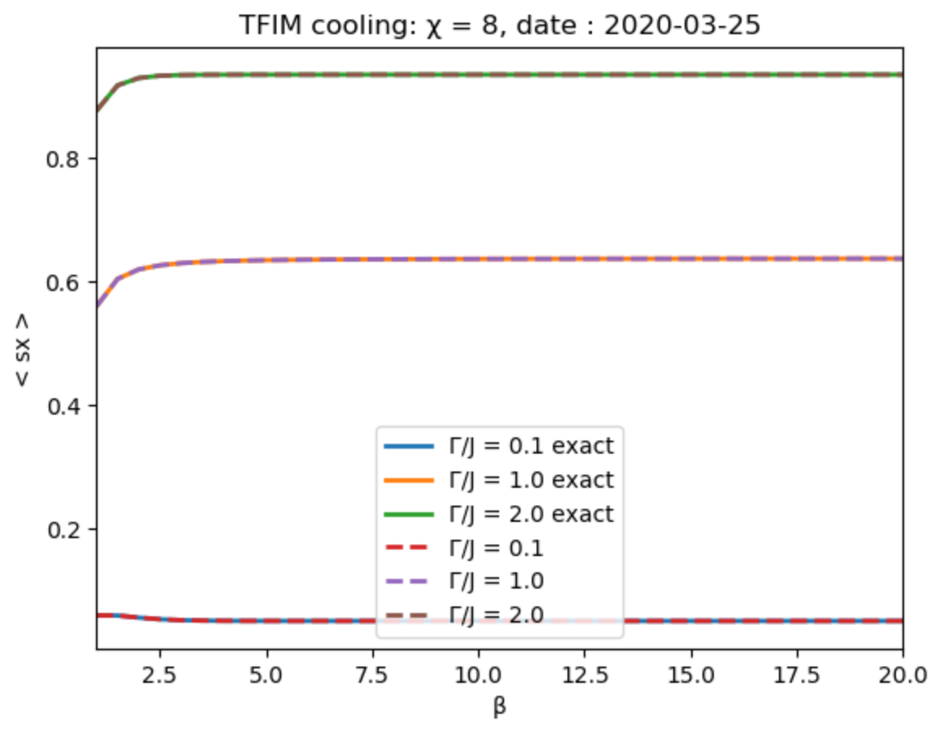
Cool, < sx >
Notes:
init ++-|

Slide 8
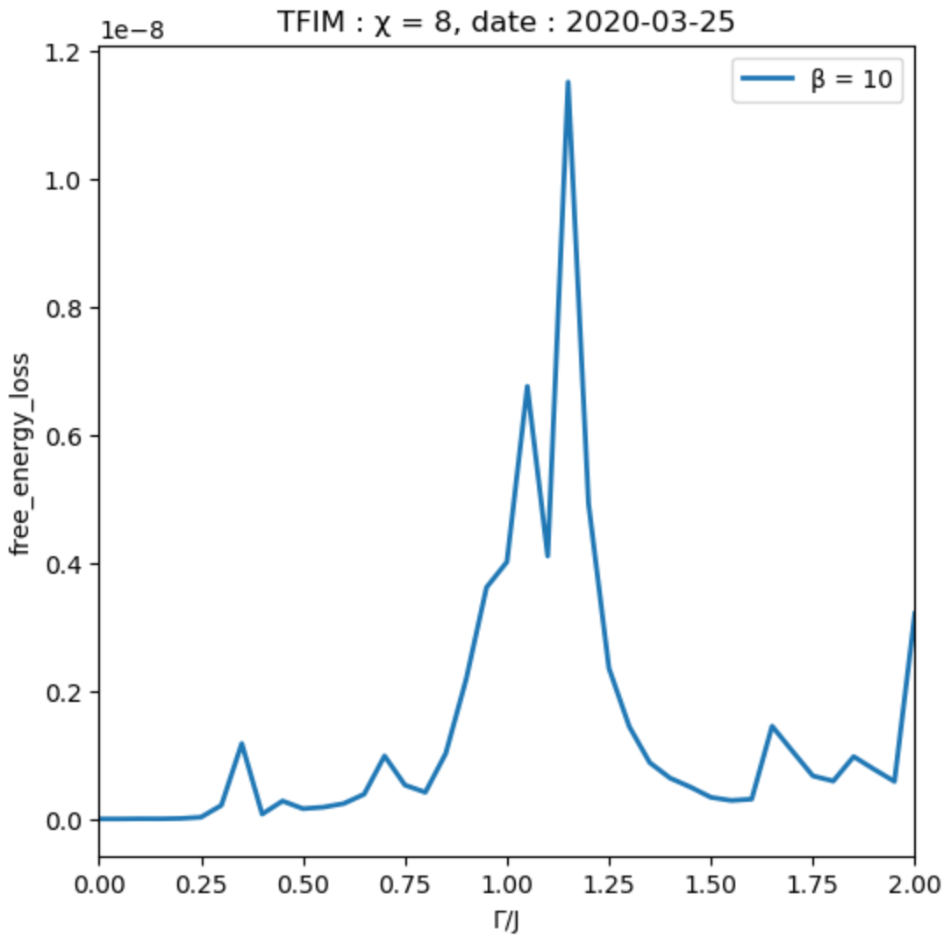
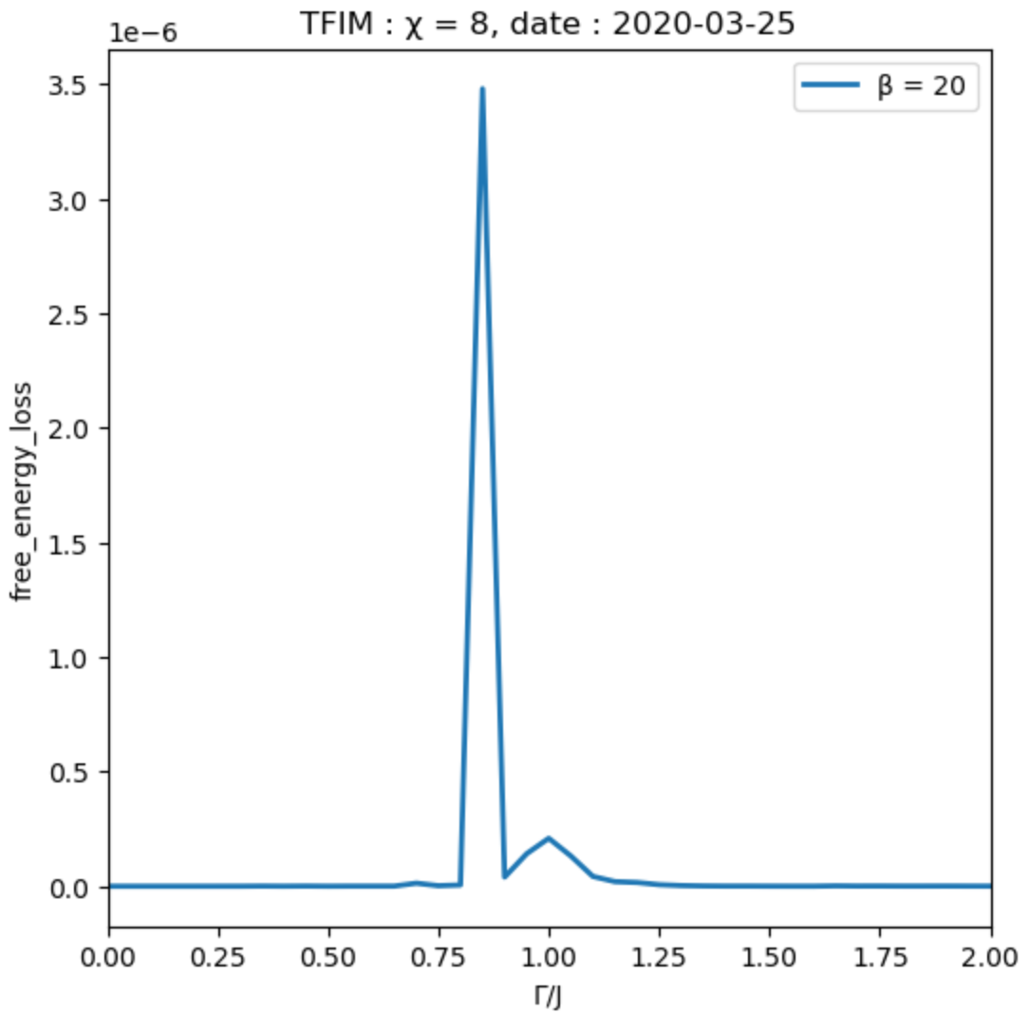
++-|: β=10, 20 free energy loss
Notes:
for every gamma， init cmps = ++-|

Slide 9
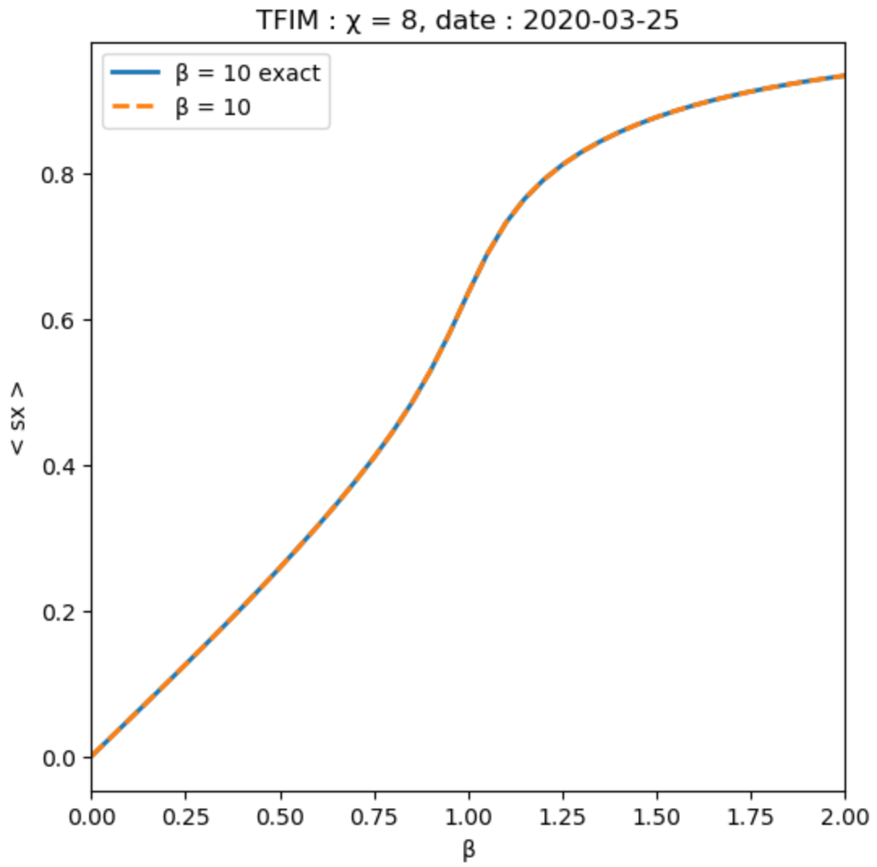

++-|: β=10, 20 < sx >
Notes:
for every gamma， init cmps = ++-|

Slide 10
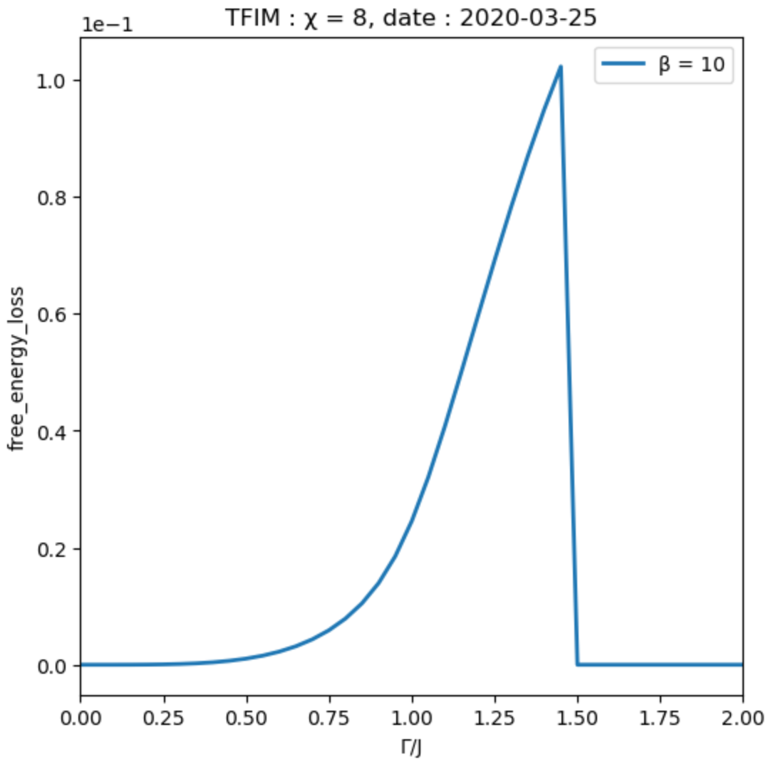
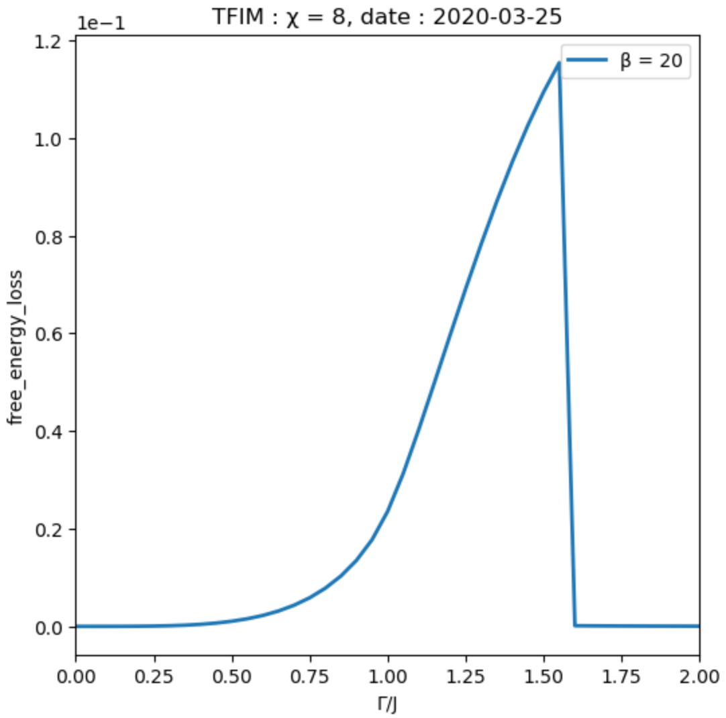
++-|, g[1]: β=10, 20 free energy loss
Notes:
init ++-|， gamma = 0, 后一步用前一步结果

Slide 11
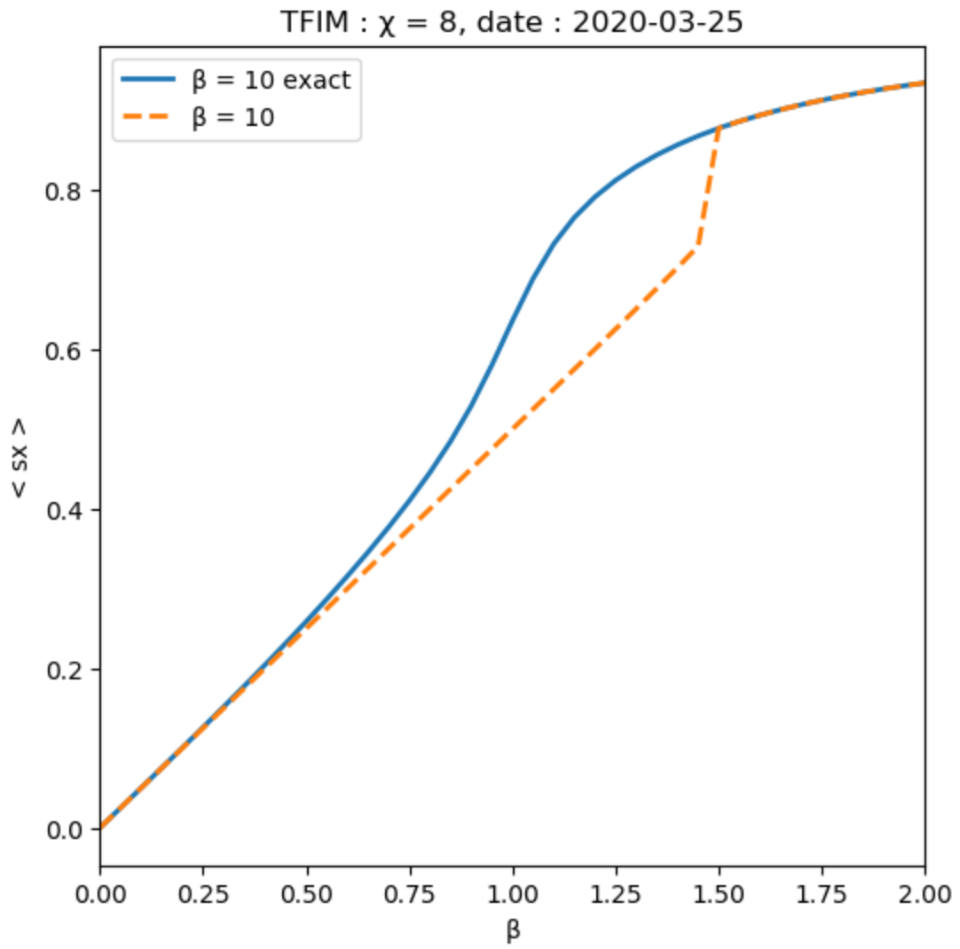
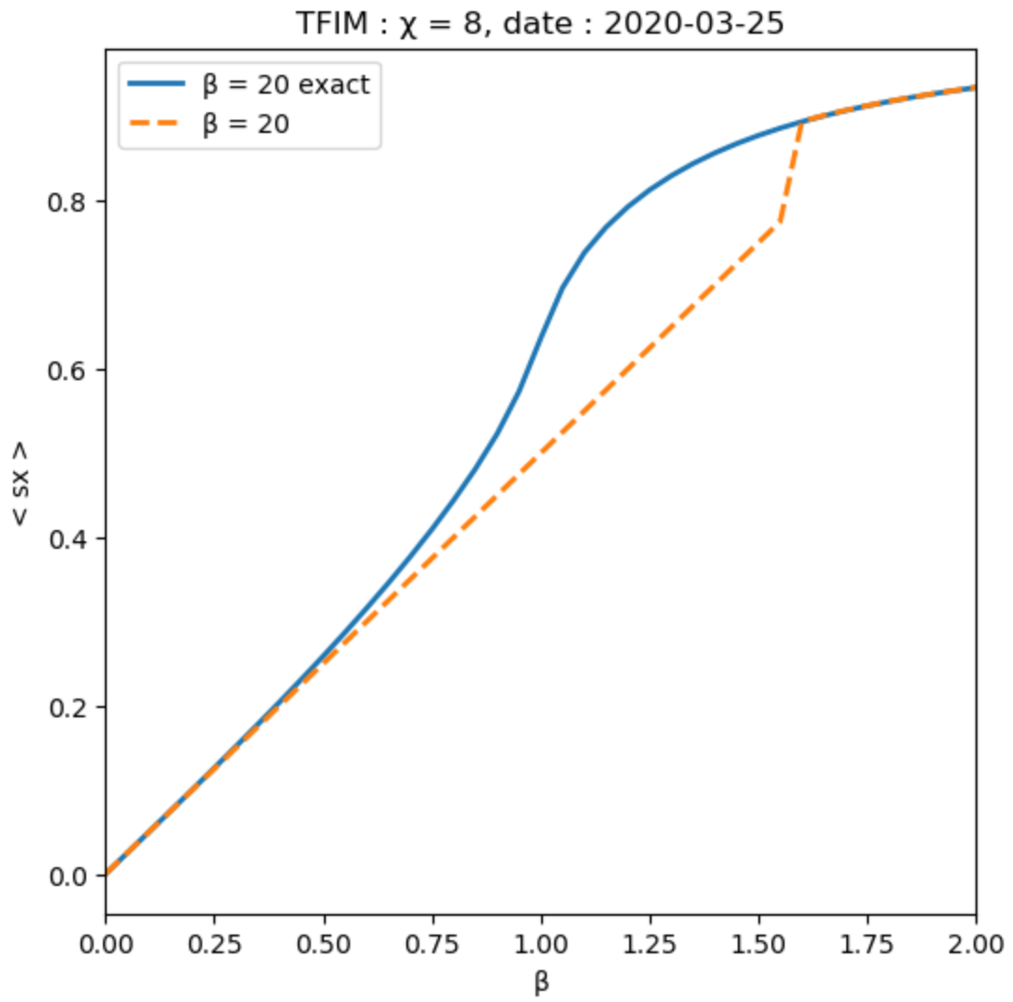
++-|, g[1]: β=10, 20 < sx >
Notes:
init ++-|， gamma = 0, 后一步用前一步结果

Slide 12
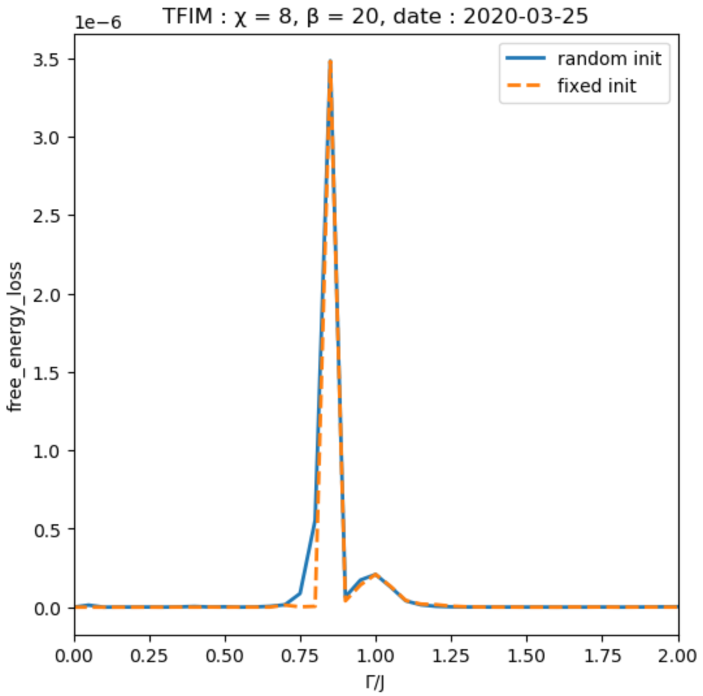
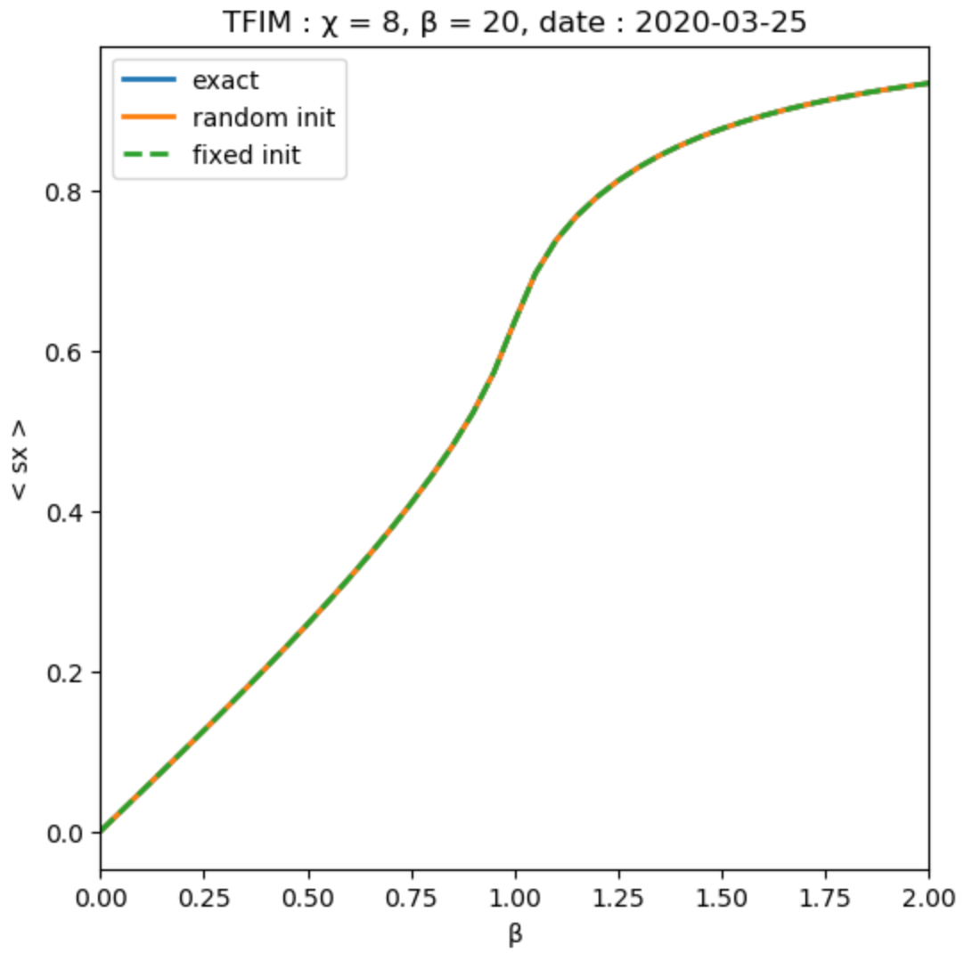
init compare: β=20
CMPO works fine even for random init !
Notes:
init ++-|， gamma = 0, 后一步用前一步结果

Slide 13
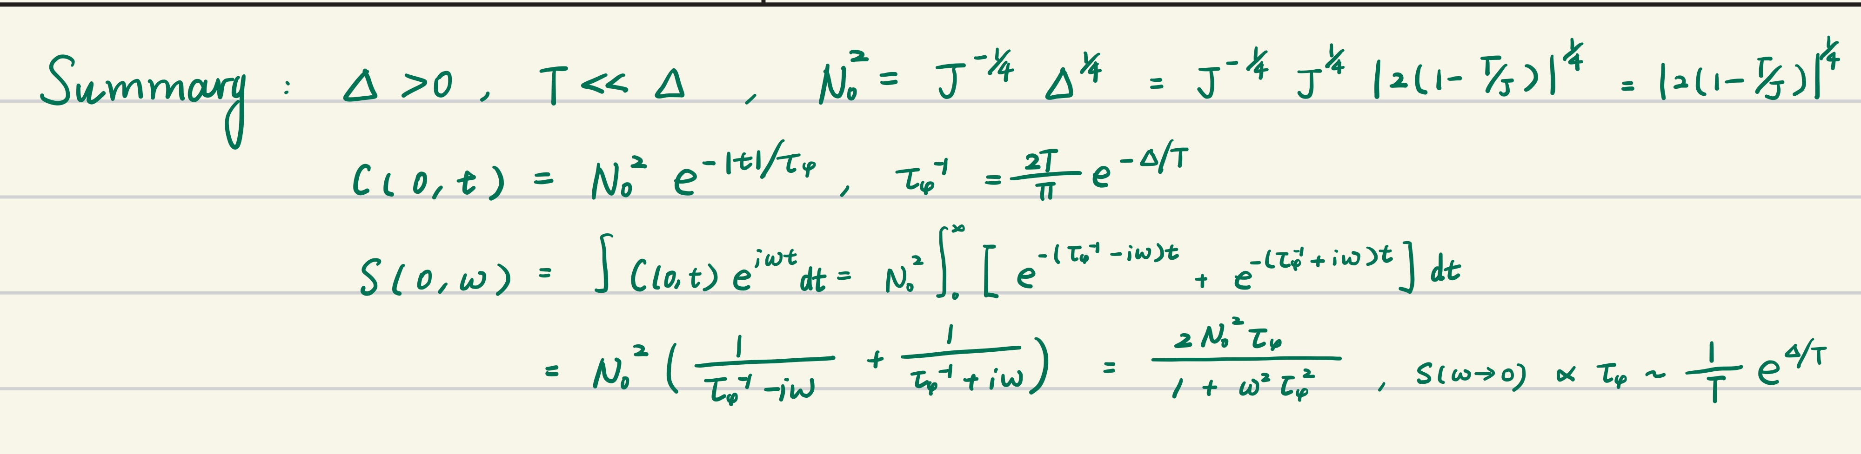
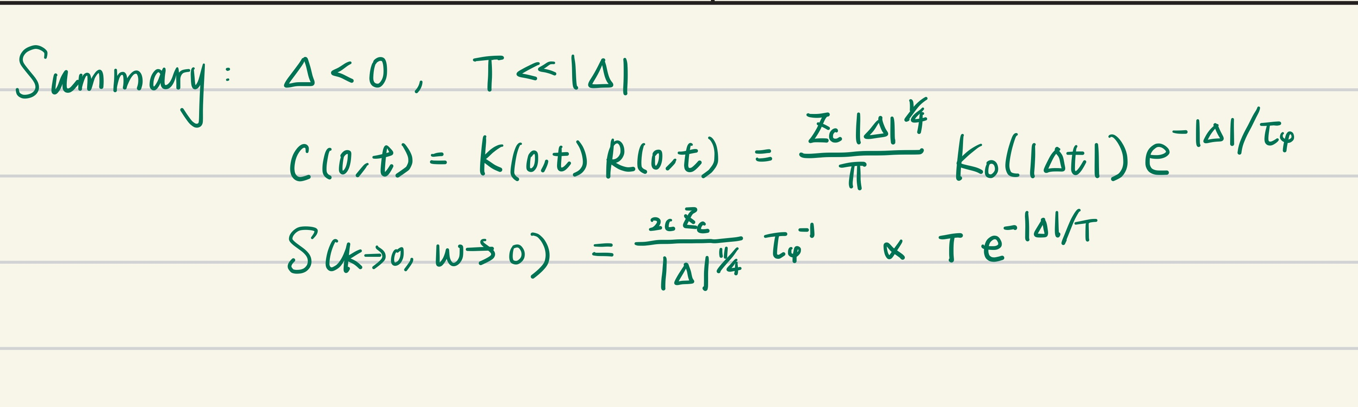
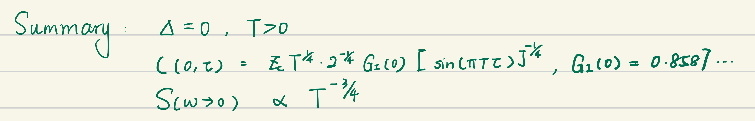
TFIM: theoretical results

Slide 14
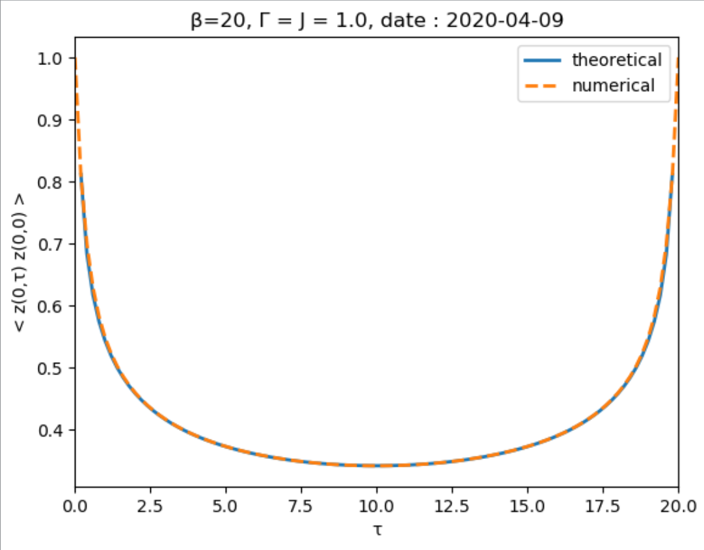
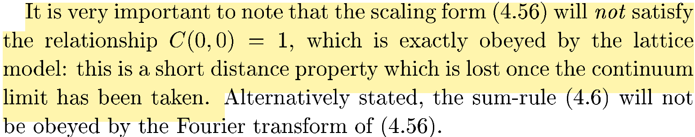
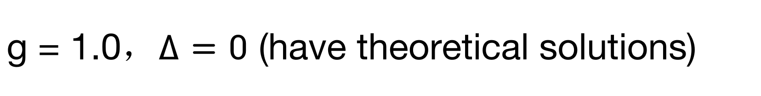
g = 1.0，$∆=0$ (have theoretical solutions)

Slide 15
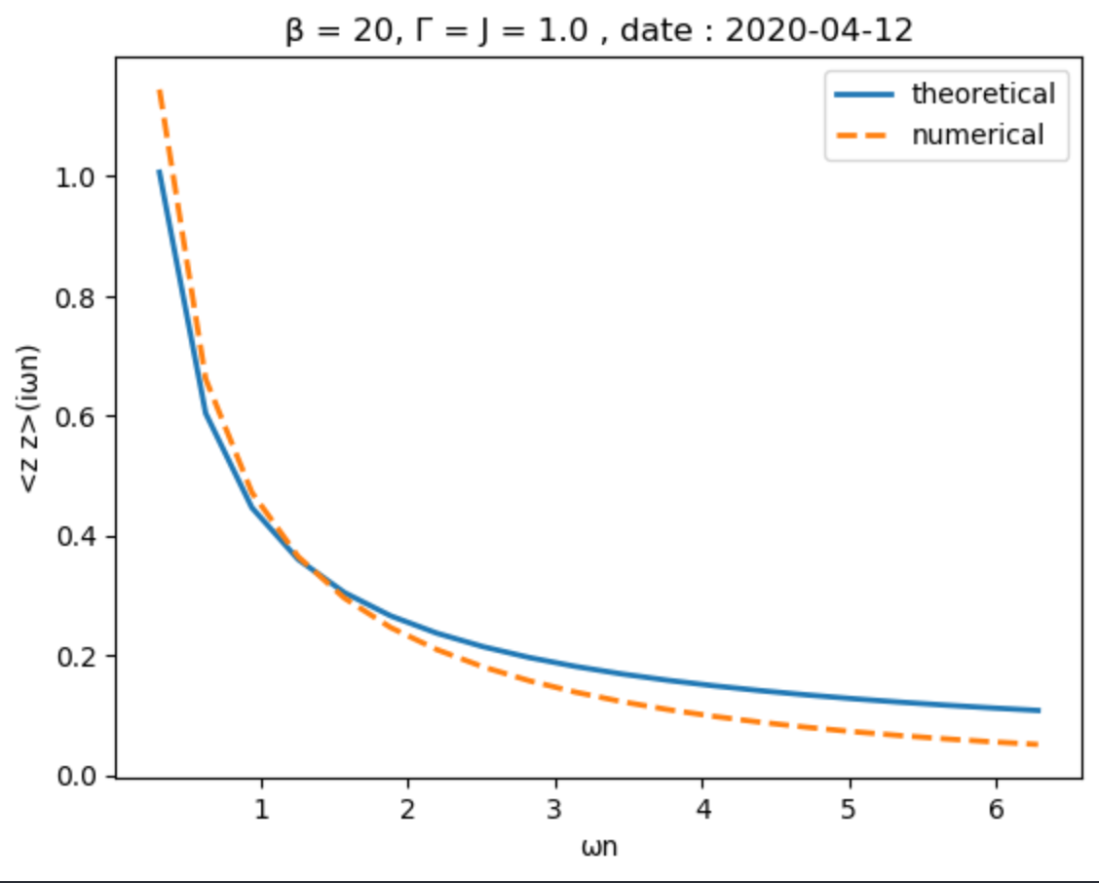
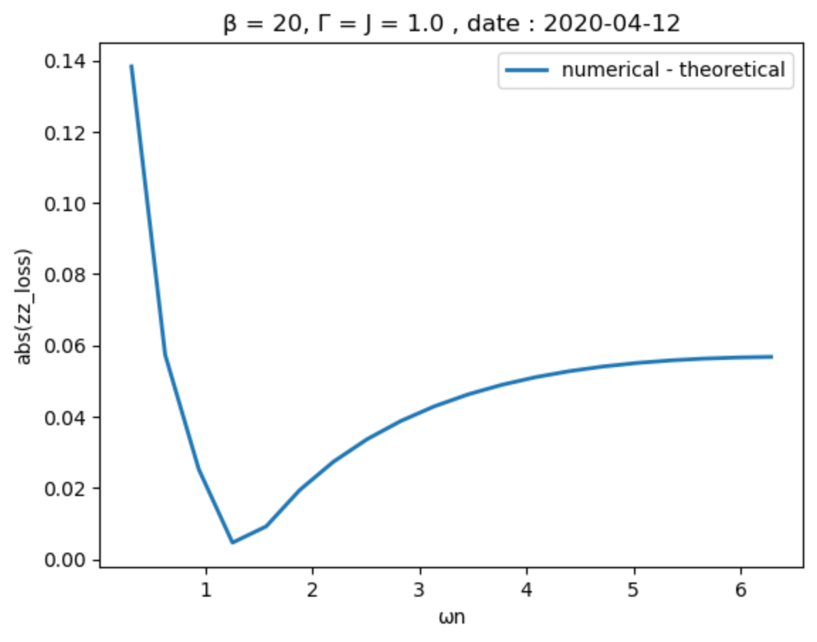
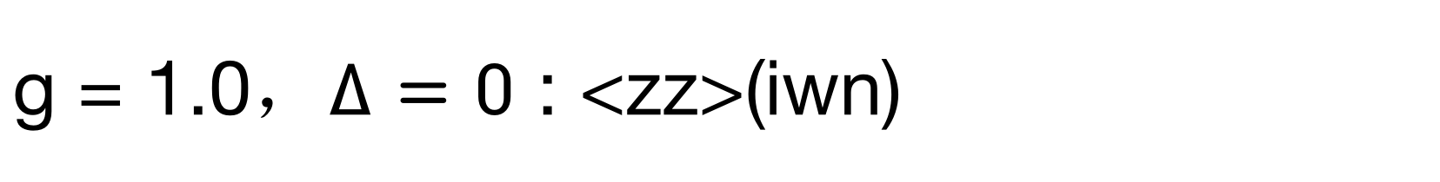
g = 1.0，$∆=0$ : <zz>(iwn)

Slide 16
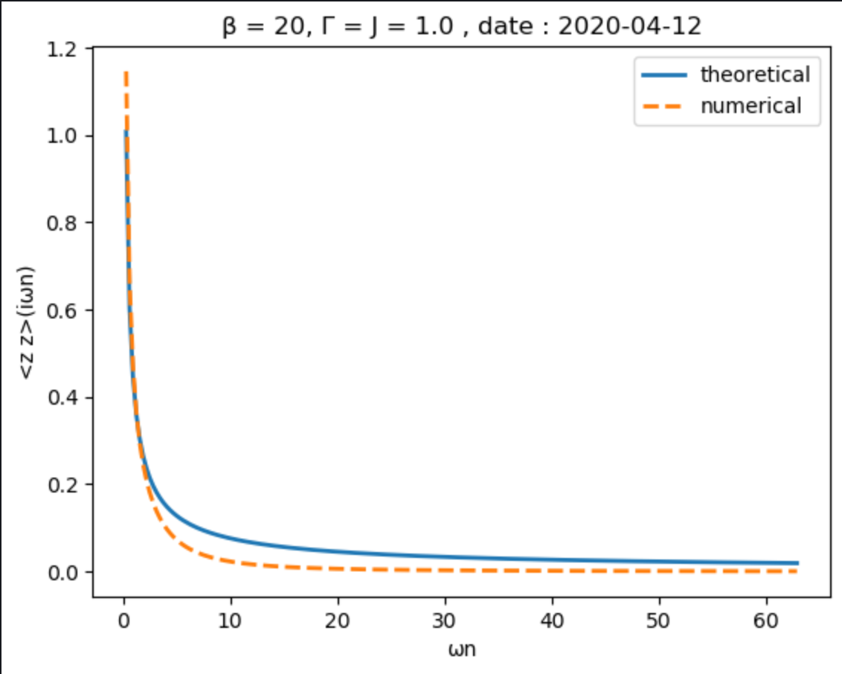
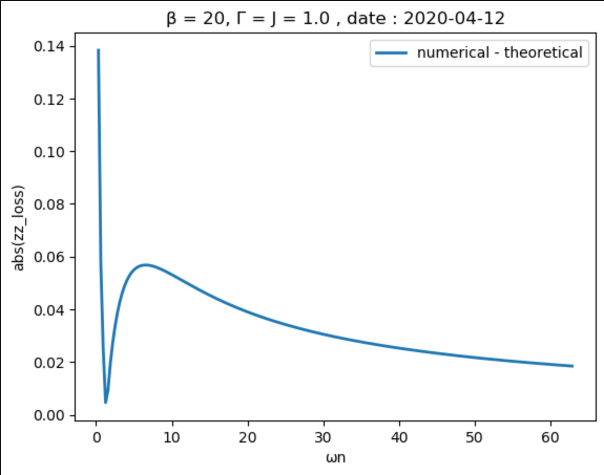
g = 1.0，$∆=0$ : <zz>(iwn)

Slide 17
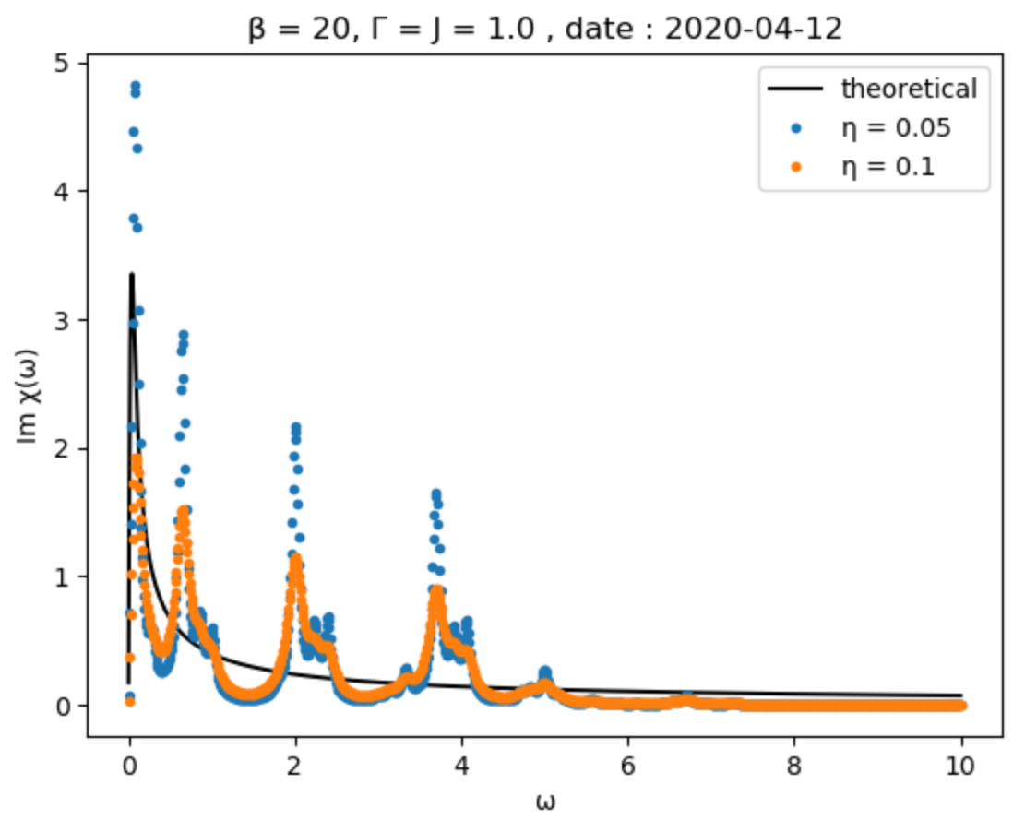
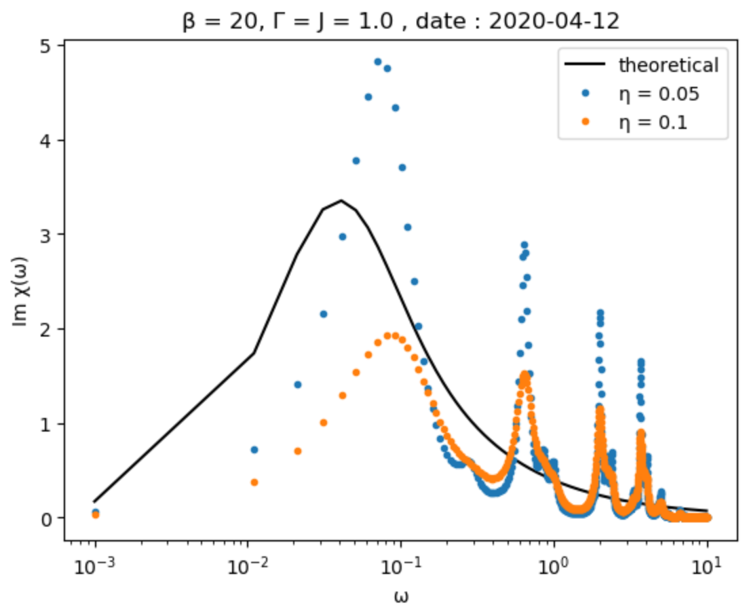
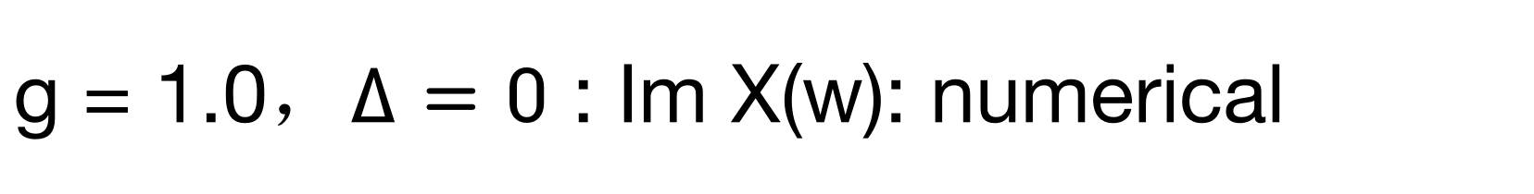
g = 1.0，$∆=0$ : Im X(w): numerical

Slide 18
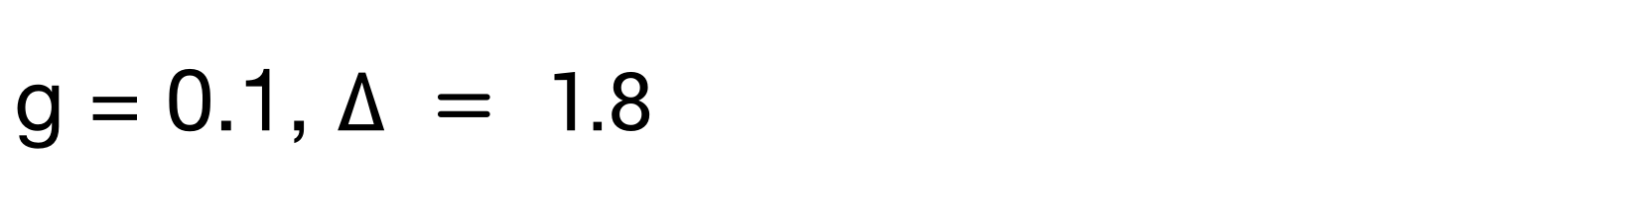
g = 0.1, $∆ = 1.8$

Slide 19
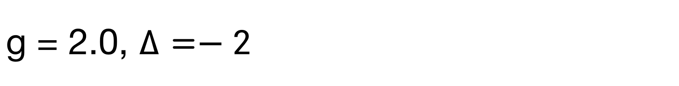
g = 2.0, $∆=−2$

