Slide 1
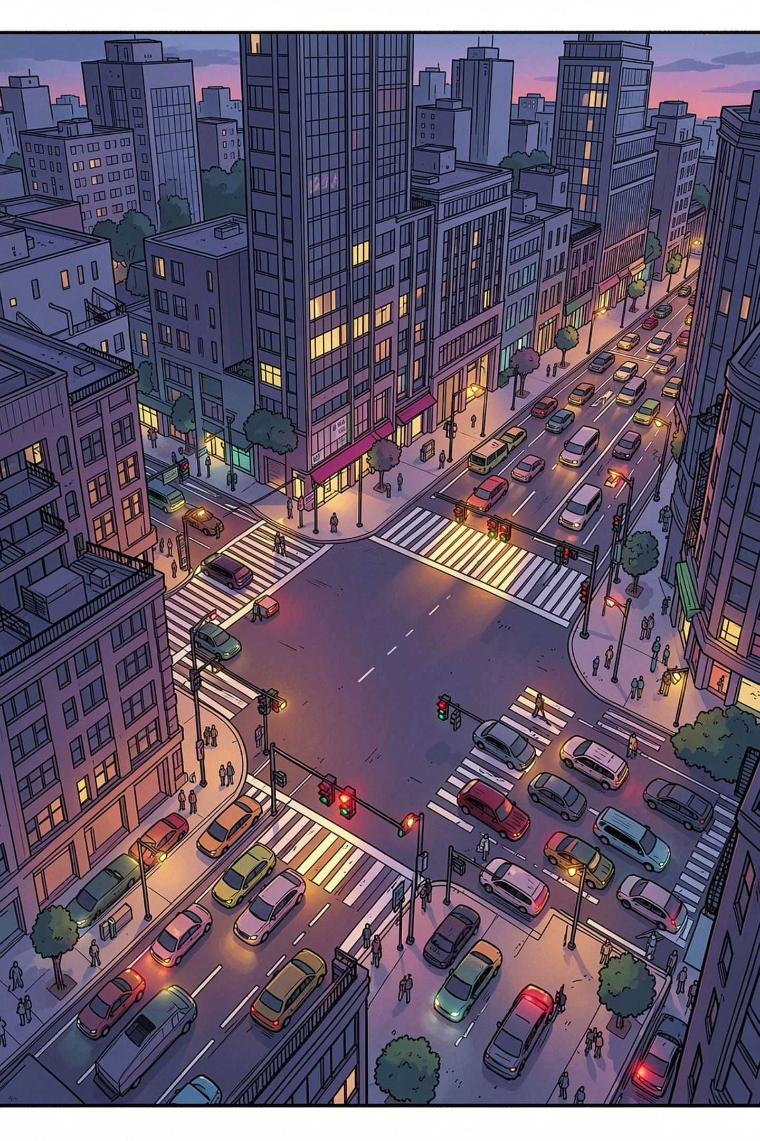
Traffic Accident Analysis
A Data-Driven Study of Road Safety Patterns

Slide 2

Project Overview
About This Study
Research Goal
A comprehensive analysis of 12,316 accident records across 25 variables, uncovering the patterns and root causes behind road accidents.
Prepared by: Sharon Mukami Mungai & Brian Muuo Kitili
Identify temporal, spatial, and behavioral patterns contributing to road accidents — and translate those findings into actionable safety recommendations for authorities and drivers.
12,316
25
Accident records analyzed
Variables examined

Slide 3

Key Research Questions
1
2
When?
Where?
When do most accidents occur — by time of day and day of week?
Which locations are accident hotspots in the urban environment?
3
4
Why?
Who?
What are the leading behavioral and environmental causes?
Which road users and age groups are most affected?

Slide 4
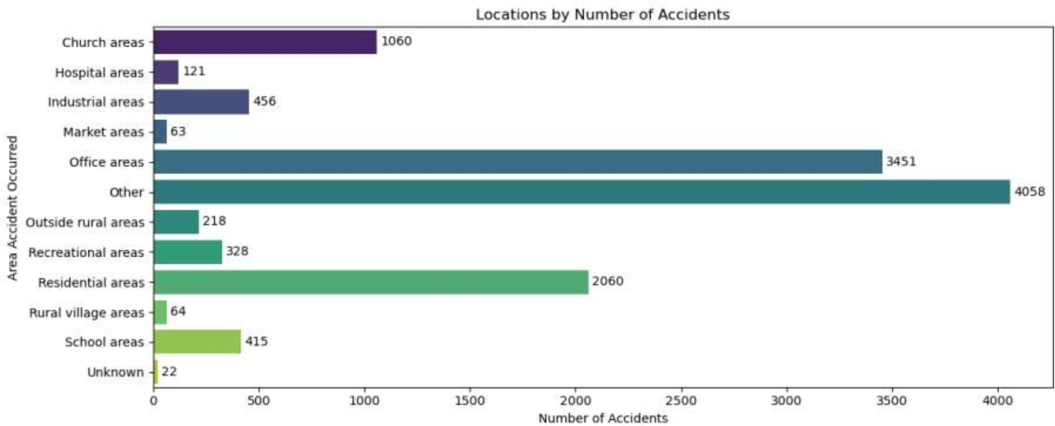

Accident Hotspots by Location
Where Accidents Cluster
Office areas account for the single largest share of accidents, driven by high vehicle density during drop-off and pick-up windows.
Office Areas
Residential Areas
Church Areas
3,451 accidents — highest concentration
2,060 accidents — secondary hotspot
1,060 accidents — notable weekend clustering

Slide 5
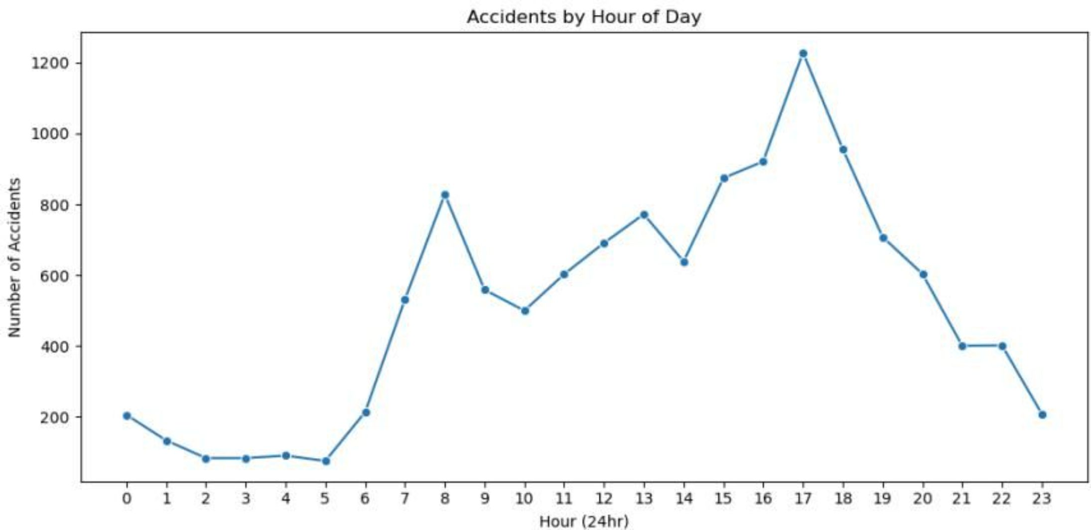
Peak Accident Times
Rush-Hour Risk
Accident frequency follows a clear commuter pattern, spiking sharply at morning and evening rush hours. The 5 PM evening peak is nearly 40% higher than the 8 AM morning peak, likely reflecting driver fatigue and traffic congestion at the end of the workday.
5 PM
8 AM
1,200 accidents — highest hourly count
850 accidents — secondary morning peak

Slide 6
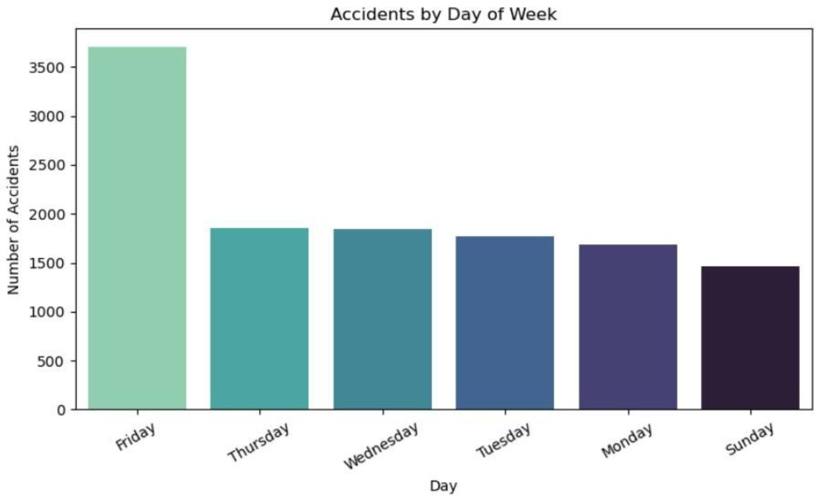
The Friday Effect
Friday stands out dramatically from every other day of the week — recording 3,700 accidents, which is 2.5× higher than Sunday's 1,450. Mid-week days cluster between 1,650–1,850 accidents.
Why Friday?
End-of-week fatigue and reduced driver alertness
Higher traffic volumes as commuters head home for the weekend
Social activities increasing late-night driving
Sunday is the safest day — lowest accident count at 1,450

Slide 7
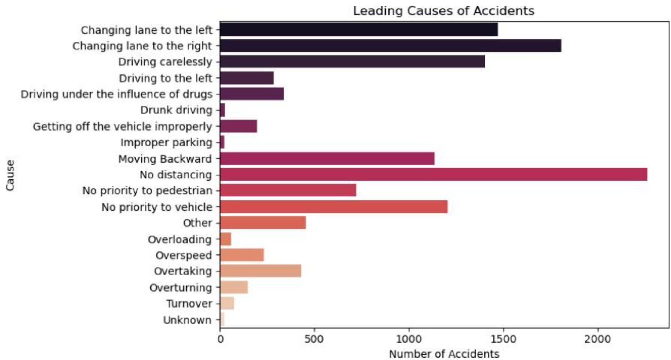

Leading Causes of Accidents
Behavior Is the Primary Driver
The data is clear: driver behavior — not road conditions or weather — is the dominant cause of accidents across all categories.
No Safe Distancing
Improper Lane Changes
Careless Driving
2,250 accidents — the single most common cause
3,300 combined accidents across related violations
1,400 accidents attributed to general recklessness

Slide 8



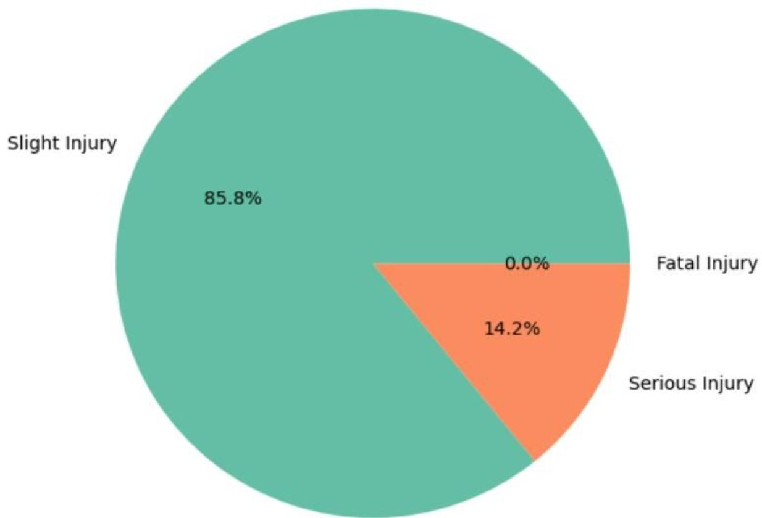
Accident Severity & Weather Conditions
Severity Breakdown
85.8%
14.2%
Slight Injuries
Serious Injuries
Majority of accidents result in minor injuries
A significant share still cause severe harm
Critically, 81% of all accidents occur in normal weather — confirming that conditions are not the root cause. Driver behavior is.

Slide 9
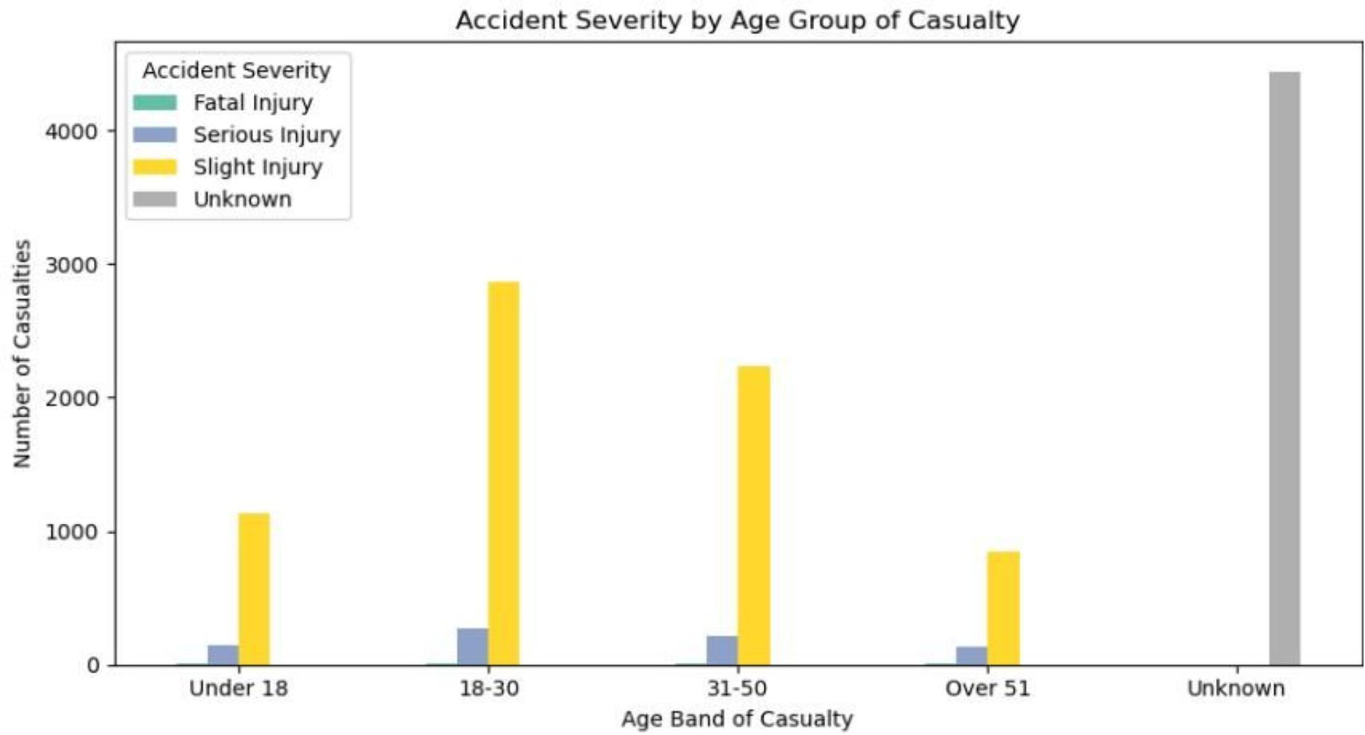
Vehicles & Casualties by Age
Who Is Most at Risk?
Young adults aged 18–30 represent the highest casualty group with 3,110 recorded casualties — making targeted education for this cohort a critical priority.
Automobiles
Large Lorries
Age 18–30
4,100 accidents — highest by vehicle type
2,150 accidents — significant secondary risk
3,110 casualties — most vulnerable group

Slide 10
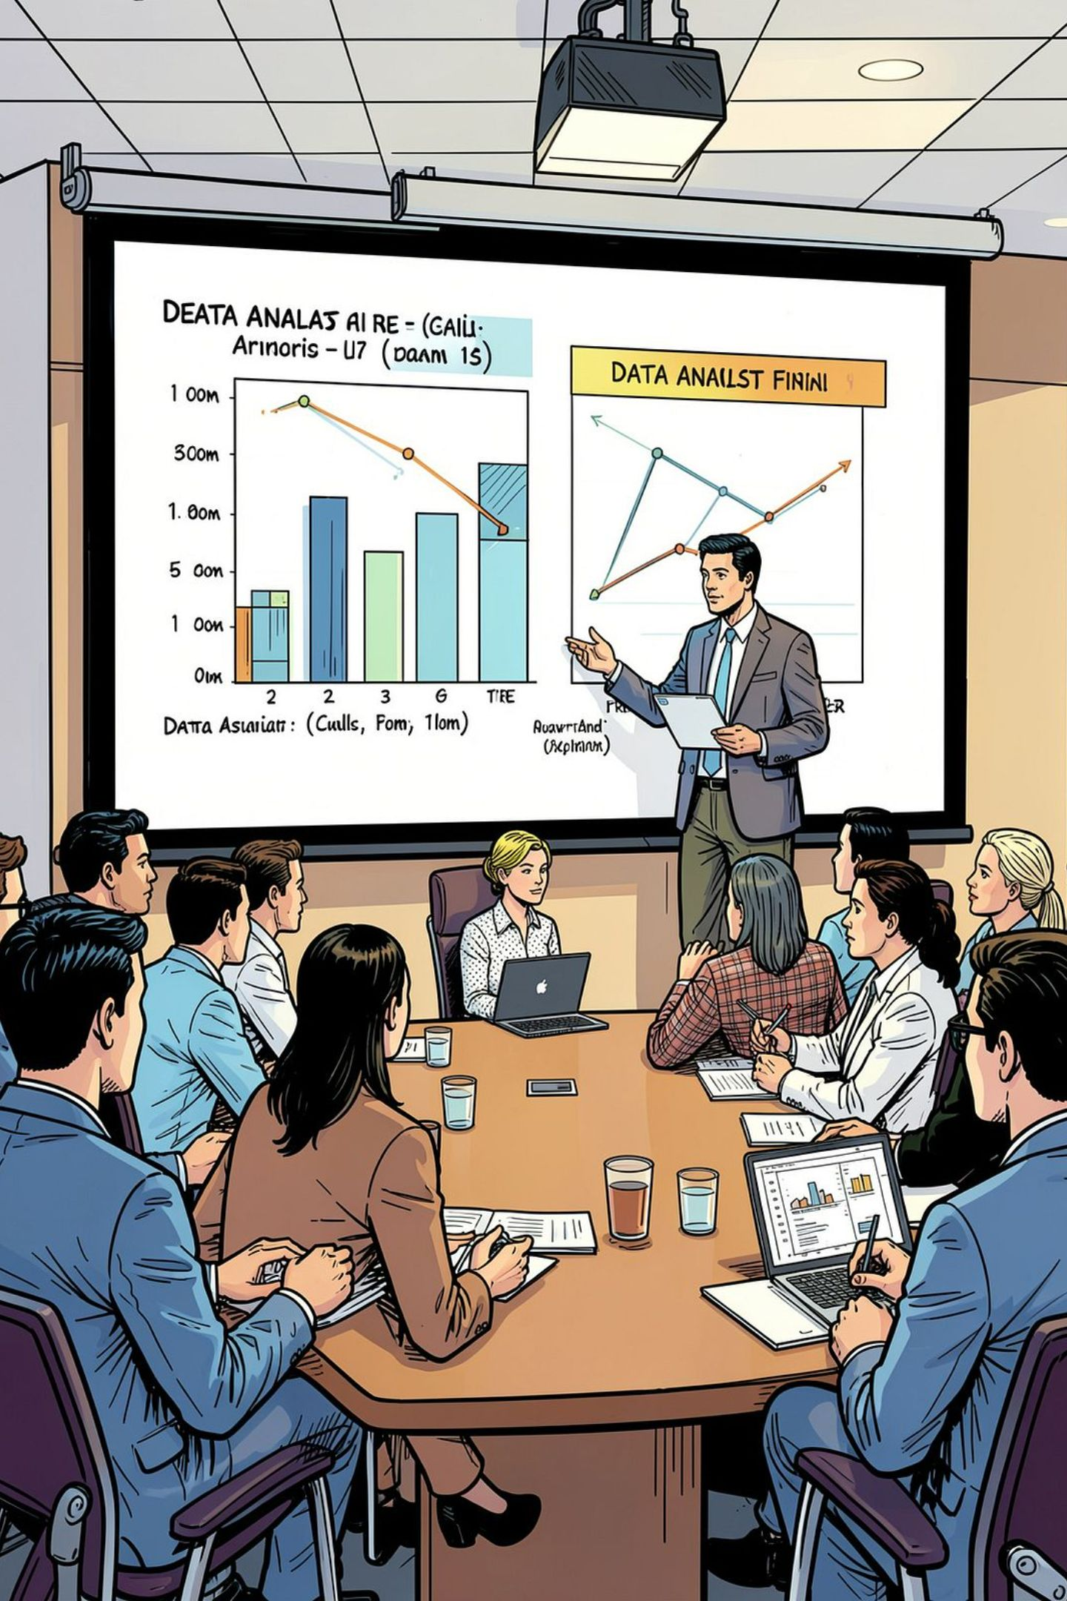

Key Findings Summary
Behavior Over Weather
1
Driver behavior (poor distancing, lane discipline) overwhelmingly outweighs weather as a cause — 81% of accidents happen in clear conditions.
Young Adults Most Vulnerable
2
The 18–30 age group accounts for the highest casualty count at 3,110 — a key demographic for targeted intervention.
Peak Hours Are Predictable
3
5 PM and 8 AM consistently spike — enforcement and awareness resources should be concentrated at these windows.
Friday Is an Outlier
4
With 2.5× Sunday's accident count, Friday demands special attention in enforcement planning and public communications.

Slide 11




Recommendations
Strengthen Peak-Hour Enforcement
Target Hotspot Campaigns
Focus road safety campaigns in office and residential areas where accident density is greatest.
Deploy traffic enforcement resources during 5 PM and 8 AM windows to deter dangerous behavior when accident risk is highest.
Young Driver Education
Promote Safe Driving Behaviors
Develop dedicated education programs for drivers aged 18–30, the most affected demographic across all vehicle types.
Run public awareness initiatives on safe following distance and lane discipline — the two behaviors most linked to accident causation.

