Slide 1
Car Collisions Severity Prediction
Renhuan He

Slide 2
Predicting severity of car collisions in Seattle
More than 38,000 people die every year in crashes on U.S. roadways.
The U.S. traffic fatality rate is 12.4 deaths per 100,000 inhabitants
The cases of vehicle accidents are increasing as increasing number of vehicles on urban and suburban roads.
Predicting the severity of car collisions is helpful to avoid an accident or decrease severity of an future accident

Slide 3
Data source & data cleaning
Data is provided by the Seattle Department of Transportation (SDOT) on vehicle collisions along with its severity starting from 2004 to 2020.
There are 38 columns and 194673 rows in raw dataset.
Duplicate features and missing values were dropped.
Cleaned data contains 11 features.

Slide 4
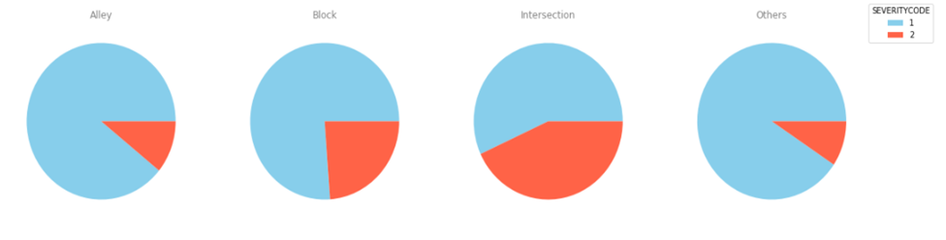
Accident severity and ADDRTYPE

Slide 5
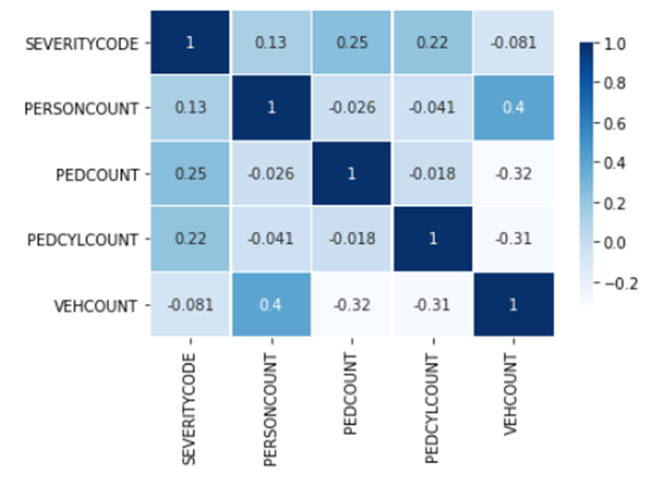
accident severity and people/vehicles involved

Slide 6
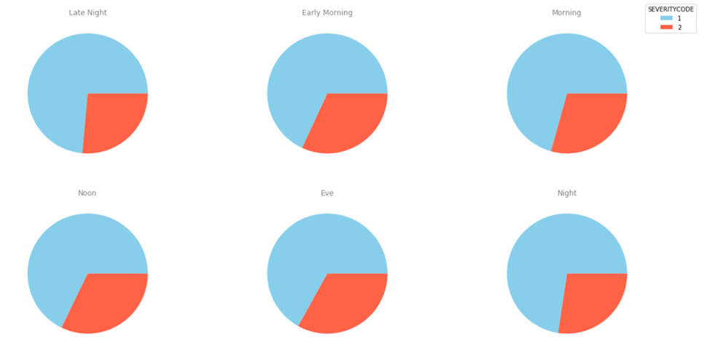
Accident severity and day/time

Slide 7
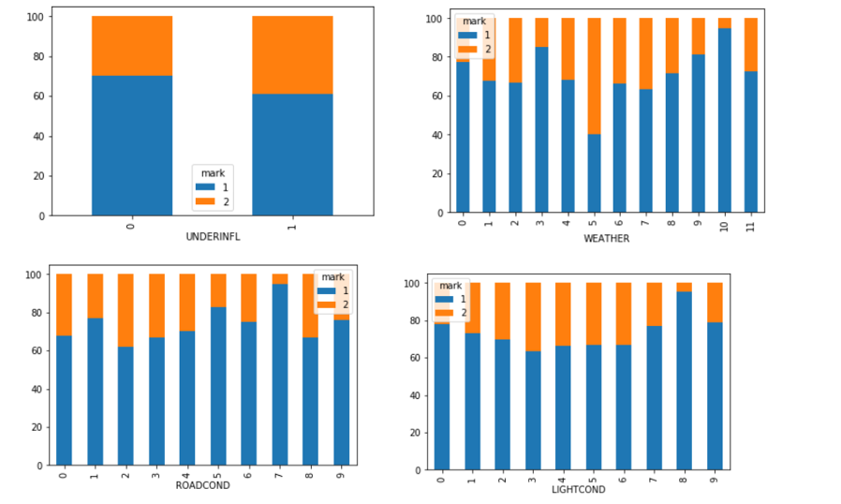
Severity and under influence, weather, road condition, light condition

Slide 8
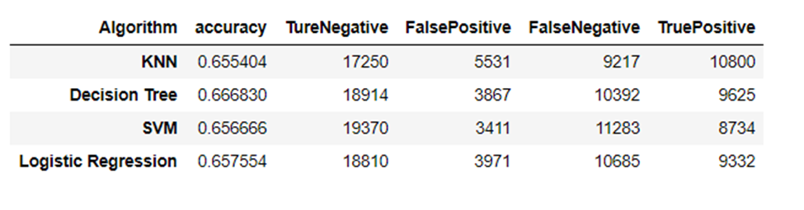
Classification models

Slide 9
Conclusion and future directions
Decision tree model has the best performance
Accuracy of the models has room for improvement.
Record more of car collisions details.
Location data are useful for further analysis.

