Slide 1

COMPUTATIONAL FRACTALS
Bridging Indigenous Knowledge and Modern Algorithmic Thinking
SHARON MAKA
Lessons from African Design Systems

Slide 2
01. INTRODUCTION
CULTURE MEETS COMPUTING
Where Tradition Informs Technology
  Core Idea: This presentation explores how African traditional design principles prefigured and can inspire modern computational concepts.
  Thesis: Fractal patterns are not merely artistic; they are visual algorithms—systematic, rule-based processes for creating complex, scalable structures.
  Key Question: What can centuries-old indigenous knowledge teach us about solving today's computing challenges in graphics, networks, and data?

Slide 3
02. DEFINITION
THE MATHEMATICS OF SELF-SIMILARITY
CORE CONCEPTS
A fractal is a never-ending, infinitely complex pattern that is self-similar across different scales. A small part resembles the whole.
RECURSION:
The process of repeating items in a self-similar way.
ITERATION:
Repeating a process using the output of one step as the input for the next.
UBIQUITY:
Found in nature (ferns, coastlines) and computer science.

Slide 4
04. DEFINITION
Algorithms Before Computers
CORE CONCEPTS
Indigenous knowledge systems often encode step-by-step, repeatable procedures—the essence of an algorithm.
Examples:
  Village Layout: Rules for placing huts around a central circle, then compounds around that.
  Weaving/Textiles: Precise sequences for threading to generate complex geometric patterns.
  Rituals & Storytelling: Repetitive, structured sequences of actions or narrative elements.
The Link: These processes mirror the core of programming: INPUT (materials/concept) → PROCESS (repeatable rules) → OUTPUT (village, cloth, performance).

Slide 5
05. VISUAL SYSTEMS
SELF-SIMILARITY IN PRACTICE
African fractals are social and aesthetic fractals. They encode information about social organization, cosmology, and belonging.
Characteristics:
  Scaled Repetition: The same shape appears at the level of a stool's carving, a house's shape, and the village's overall plan.
  Recursion in Practice: The design rule for a single motif is applied to create the larger pattern.
BAMILEKE ARCHITECTURE
MUD CLOTH (BOGOLAN)
SONA SAND DRAWINGS
Scaled repetition in structural hierarchy.
Geometric blocks generated by recursive rules.
Algorithmic loops forming continuous Eulerian paths.

Slide 6
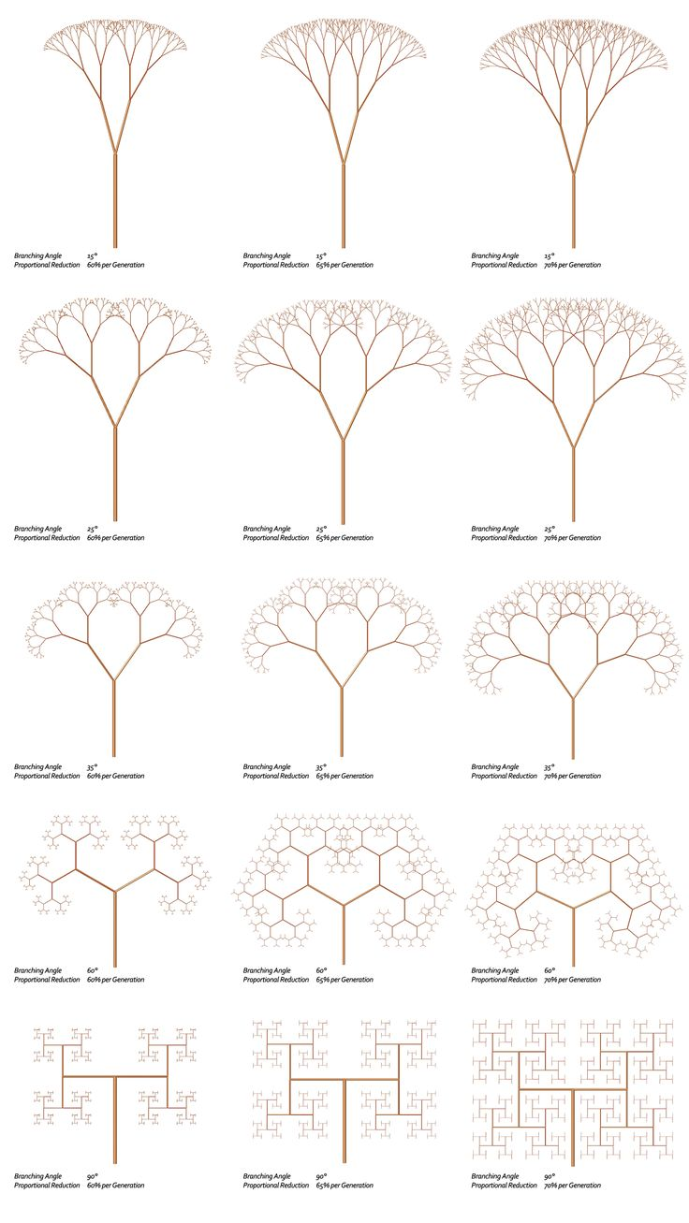


06. DATA STRUCTURES
HIERARCHY AS DATA STRUCTURE
ROOT
The Fractal Rule:
Circular structures are nested within larger circular arrangements, mirroring a tree data structure (Root > Branch > Leaf).

Slide 7
07. DATA STRUCTURES
Iterative Design as a Living Algorithm
Content:
  The artist/artisan follows a mental algorithm—a set of creative constraints and rules.
  Process
  .Breakdown (like a loop):
    Initialize: Start with a base shape or line.
    Iterate: Apply a transformation rule (rotate, scale, translate).
    Repeat: Continue until the space is filled or the design is complete.
  This mirrors a for or while loop in code, generating complexity from simplicity.

Slide 8

08. ALGORITHMS
FROM PATTERN TO CODE
def draw_fractal(scale, depth):
if depth == 0:
return
else:
draw_shape(scale)
draw_fractal(scale * 0.5, depth - 1)
Translating visual rules into formal recursion.

Slide 9

09. APPLICATION
Direct Computational Correlations
Content:
  Recursion: The fractal definition is recursion. Problem-solving by breaking into smaller, self-similar problems.
  Divide-and-Conquer: Like a fractal village, algorithms like Merge Sort or Quicksort break data into hierarchical sub-parts.
  Efficiency & Optimization: Fractal layouts minimize distance and maximize space usage—analogous to optimizing network paths or memory allocation.

Slide 10
10. APPLICATION
Generating Realistic Complexity
Content:
  Procedural Generation: Using algorithms (like fractal noise) to create content automatically.
  Inspired by the way natural and cultural fractals build complexity from simple rules.
  Uses: Creating infinitely variable, realistic terrains, textures (wood, marble), foliage, and visual effects in games and simulations.

Slide 11

11. APPLICATION
Building Resilient and Scalable Systems
Fractal hierarchies offer blueprints for robust networks.
Benefits:
  Scalability: Add new sub-networks (like new village compounds) without redesigning the whole system.
  Fault Tolerance: Redundancy and localized control (if one "branch" fails, others persist).
  Efficient Routing: Hierarchical addressing simplifies finding paths (like mail moving from country → city → street).

Slide 12
Organizing Information Hierarchically
  The fractal principle of "self-similar hierarchy" is fundamental to computing.
  Tree Structures (Binary Trees, B-Trees): Mirrored in family lineages or organizational charts—perfect for fast search (O(log n)).
  Hierarchical & Graph Databases: Model relationships exactly like the interconnected nodes in a fractal social structure.
  Indexing: Creating smaller, self-similar lookup tables to find data efficien

Slide 13
Why This Recognition Matters
Content:
  Broadening the Narrative: Computing history is often narrowly told. This work reveals a global, diverse foundation for logical thinking.
  Enhancing Innovation: Diverse perspectives (like seeing algorithms in culture) fuel creative problem-solving.
  Inclusive Education: Makes CS more relatable and accessible to a wider range of students by connecting it to their heritage or new cultural contexts.

Slide 14
A Roadmap for Interdisciplinary Innovation
Content:
  For Research: Bio-inspired computing, novel algorithms for network design, and AI pattern generation.
  For Pedagogy: Develop curricula that use cultural fractals to teach recursion, algorithms, and systems thinking in an engaging way.
  For Industry: Design principles for more scalable, resilient, and human-centric tech infrastructure.

Slide 15
CONCLUSION:
Tradition as a Catalyst for Future Tech
Content:
  Reiteration: African fractal patterns are encoded systems logic—demonstrating algorithmic thinking, recursive design, and scalable hierarchy.
  The Bridge: They provide a rich, untapped resource of metaphors and models for modern computing challenges.
  Final Thought: By looking back at these sophisticated cultural systems, we can find innovative paths forward in technology, making it more elegant, efficient, and inclusive.

