Slide 1
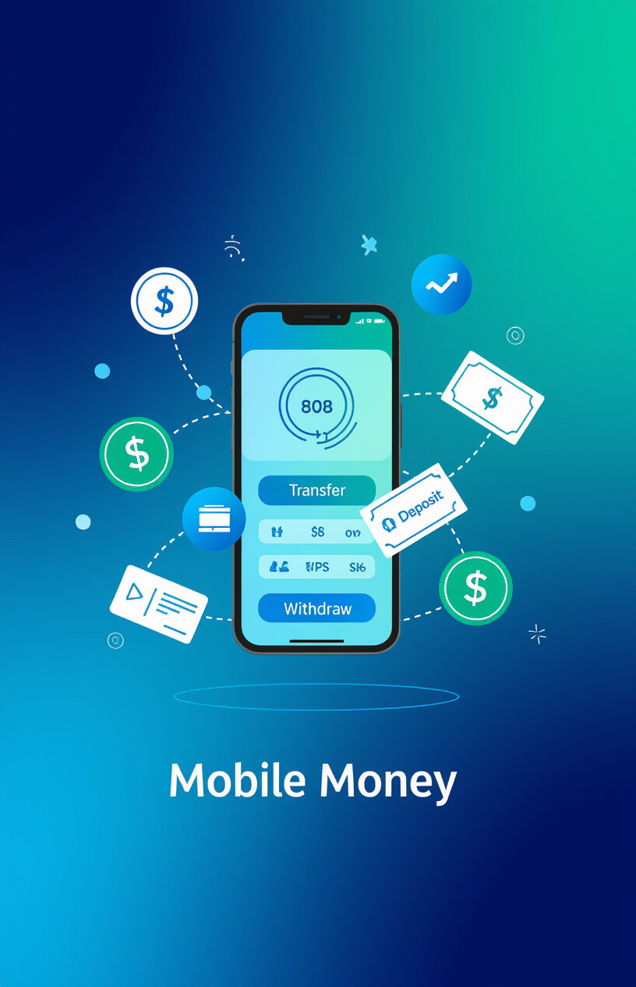
Title:Mobile Money Systems
Subtitle: M-Pesa as an IT Innovation
Sharon Mwaka
C027-01-1034/2022
BBIT
DATE:10-12-2025

Slide 2
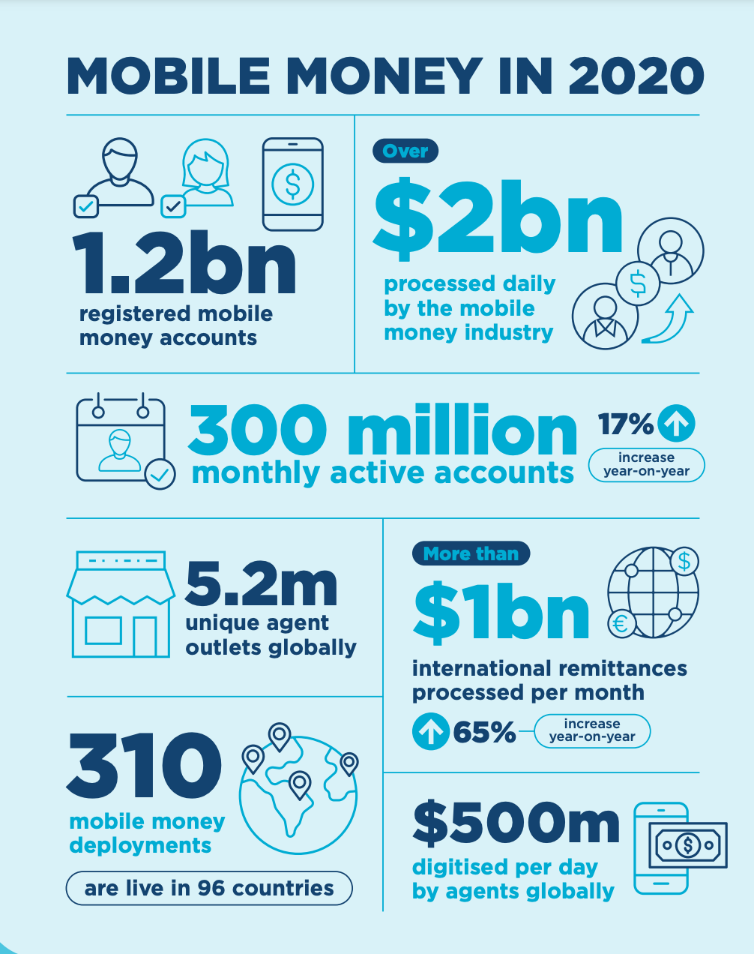
Introduction: Define mobile money systems, describe M-Pesa’s role and IT importance
Mobile money systems: Digital platforms enabling financial transactions via mobile devices, eliminating the need for a traditional bank account.
M-Pesa Overview: Launched in Kenya by Safaricom and Vodafone, facilitating deposits, withdrawals, money transfers, bill payments, and access to financial services via mobile phones.
IT Importance: Bridges the banking gap through technology, empowering millions lacking access to traditional banking services, and fostering financial inclusion.

Slide 3
Historical Background: Timeline from concept to global reach
Conceptualization by Vodafone & Safaricom, aiming to address financial access challenges in developing markets.
2003
Official launch in Kenya, marking a pivotal moment in mobile financial services.
2007
Expansion to Tanzania, Ghana, and India, extending M-Pesa's reach across Africa and Asia.
2010+
Serving over 50 million users across multiple countries, demonstrating its sustainable and global impact.
Today

Slide 4
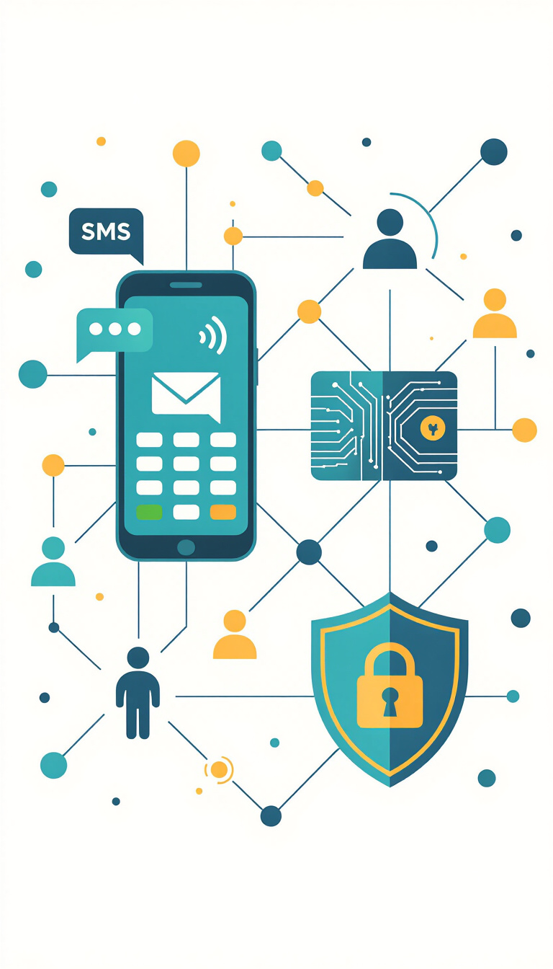
Technical Architecture: SMS-based system, agent network, mobile wallet, and security
SMS-based Transactions: Enables secure money transfers via simple text messages, ensuring accessibility even on basic mobile phones.
Agent Network: Extensive network of local agents facilitating cash deposits and withdrawals, overcoming infrastructure limitations.
Mobile Wallet: Digital account linked to a user’s phone number, providing a secure and convenient way to store and manage funds.
Security: PIN authentication and data encryption protect transactions, ensuring user confidence and trust.

Slide 5
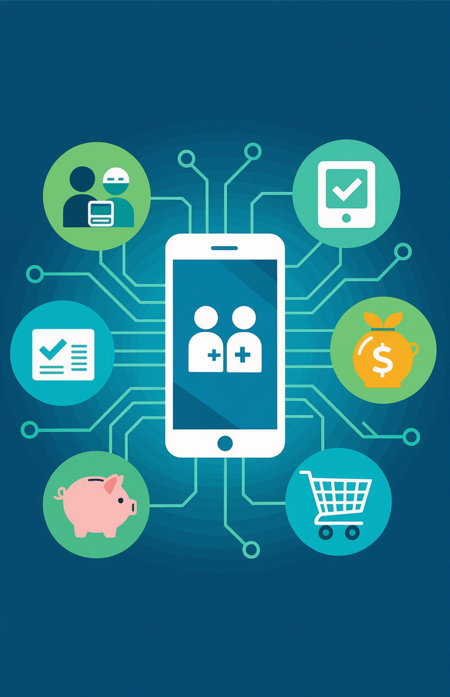
Key Features & Services: P2P transfers, bill payments, loans, merchant services
Peer-to-peer (P2P) money transfers: Allows users to easily send and receive money directly to each other, fostering social and economic connections.
Bill payments: Enables payment of utility bills, school fees, and other expenses directly from the mobile phone.
Savings & microloans: Offered through partnerships like M-Shwari and KCB M-Pesa, providing access to savings accounts and small loans.
Merchant and retail payments: Facilitates payments for goods and services at participating merchants and retailers, enhancing transactional convenience.

Slide 6
Impact & Statistics: User base, transaction volume, financial inclusion, social impact
50M
1B/month
84%
2% reduction
Reaching over 50 million users, predominantly in Kenya (~30M)
Processing more than 1 billion transactions per month (as of 2023)
Enabling 84% of Kenyan adults to use mobile money
Contributing to a 2% reduction in poverty and empowering women entrepreneurs

Slide 7

Business Model: Revenue sources, advantages
Revenue: Generates revenue through transaction fees, merchant fees, and interest on microloans, ensuring financial sustainability.
Competitive Advantage: Achieves a competitive edge through a ubiquitous agent network, reliability, and strong user trust, key factors for success.

Slide 8
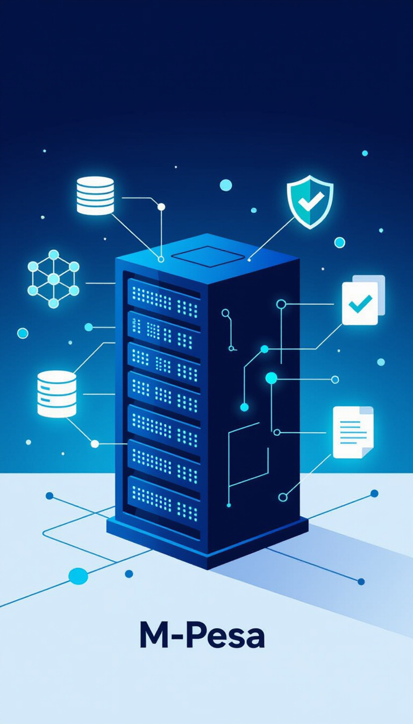
IT Infrastructure: Databases, encryption, compliance
Databases: Employs secure storage of transaction histories to maintain accurate records and facilitate regulatory compliance.
Security: Utilizes end-to-end encryption, PIN-based access, and anti-fraud systems to protect user data and prevent unauthorized access.
Compliance: Operates under the regulation of the Central Bank of Kenya, adhering to strict financial standards and guidelines.

Slide 9
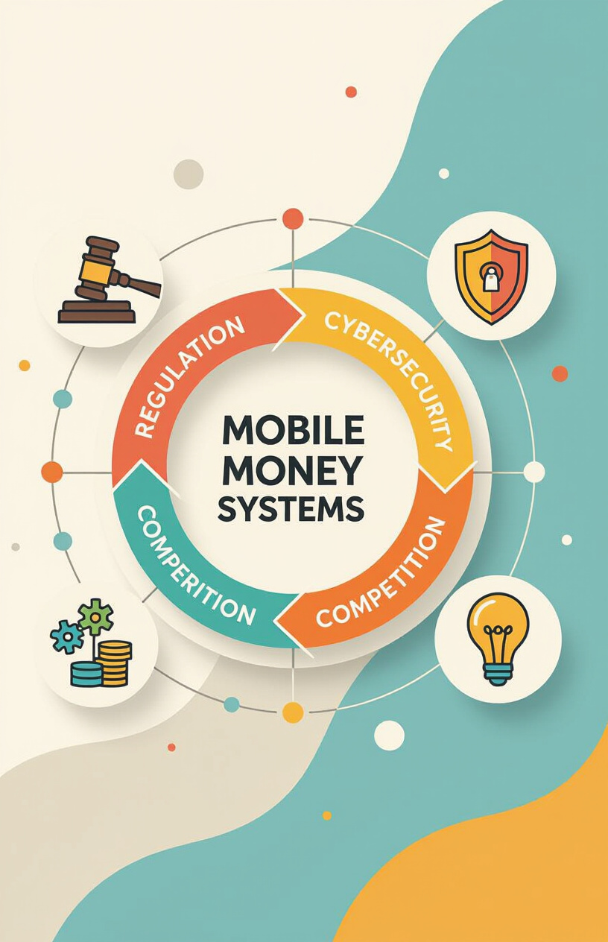
Challenges & Solutions: Regulation, cybersecurity, competition
Regulation: Addresses regulatory challenges through compliance and collaboration with government bodies to ensure smooth operations.
Cybersecurity: Implements robust authentication and real-time monitoring to mitigate cybersecurity threats and safeguard user accounts.
Competition: Manages competition through continuous innovation and expansion of the agent network, ensuring a competitive edge.
Lessons: Highlights that local context and trust are critical for successful adoption and sustainability of mobile money systems.

Slide 10
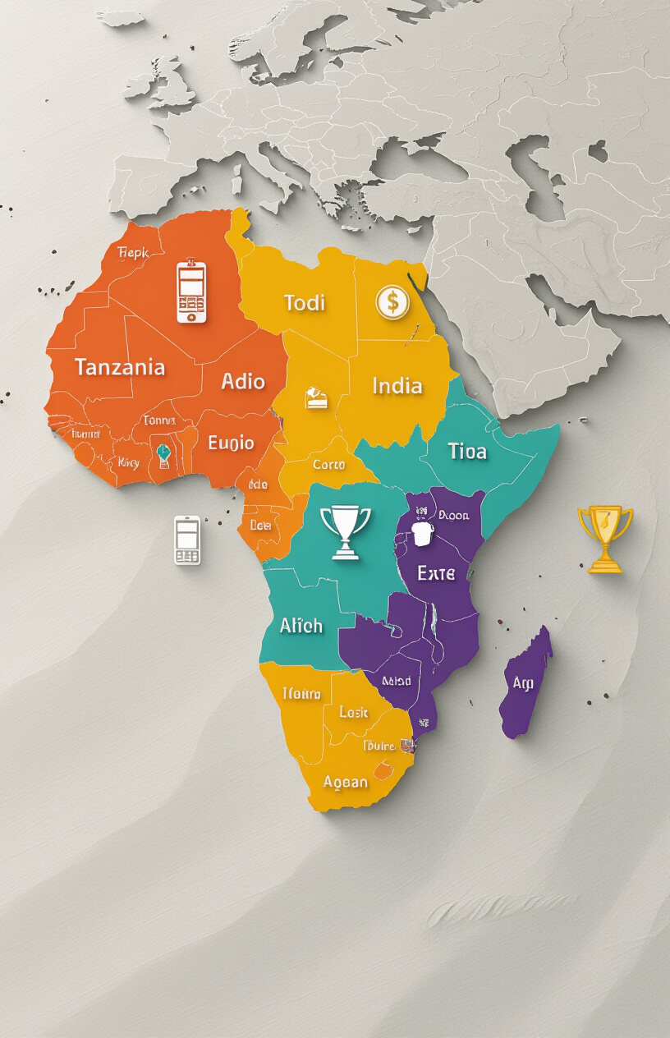
Global Impact: Expansion, recognition, global influence
Expansion: Expanded to Tanzania, India, Eastern Europe, and Afghanistan, demonstrating its adaptability to diverse markets.
Model: Serves as an inspiration for mobile money platforms worldwide, influencing the development of digital financial services.
Recognition: Received accolades from GSMA, the World Bank, and MIT Technology Review, acknowledging its transformative impact.

Slide 11
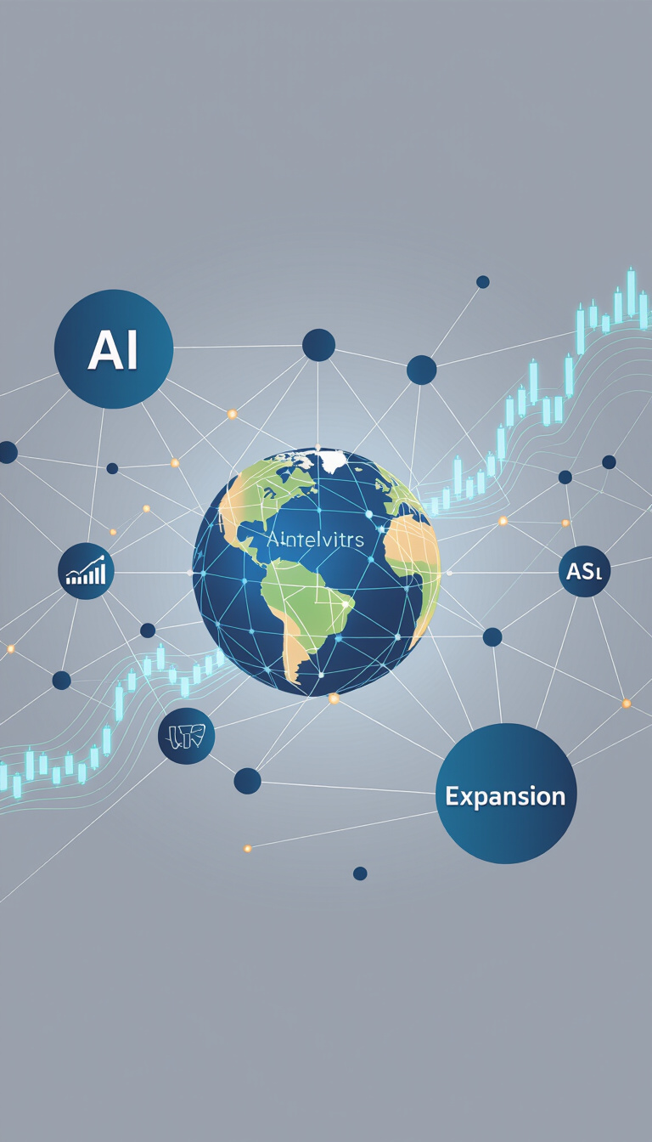
Future Developments: AI, analytics, new financial services
If there's any paragraph that should go before the points, add it in this field
Integration: Planned integration with AI and cloud services to enhance efficiency and personalization.
Analytics: Leveraging advanced analytics for risk scoring and personalized financial advice to improve user experience.
Expansion: Exploring expansion to insurance, investments, and cross-border payments to offer a comprehensive suite of services.

Slide 12
Lessons for IT Professionals: Design, security, innovation
If there's any paragraph that should go before the points, add it in this field
User-Centric Design: Emphasizes the importance of focusing on accessibility and simplicity to enhance user adoption and satisfaction.
Security: Prioritizes safe and reliable transactions to build trust and maintain the integrity of the mobile money system.
Innovation for Impact: Showcases how technology can solve real-world problems and improve lives through innovative solutions.
Takeaways: Underscores the importance of context-driven IT solutions in addressing specific needsand challenges.

Slide 13
Conclusion:
M-Pesa Revolution: M-Pesa revolutionized mobile financial services, providing access to millions previously excluded from the formal banking sector.
IT's power: Proved the power of IT in addressing societal challenges, demonstrating the potential for technology to drive positive change.
Global Inspiration: Inspired global digital finance innovation, serving as a model for mobile money systems worldwide.

Slide 14
References:
Safaricom M-Pesa Annual Reports
Jack & Suri (2014), Science Magazine
World Bank Financial Inclusion Reports
GSMA Mobile Money Metrics

Slide 15
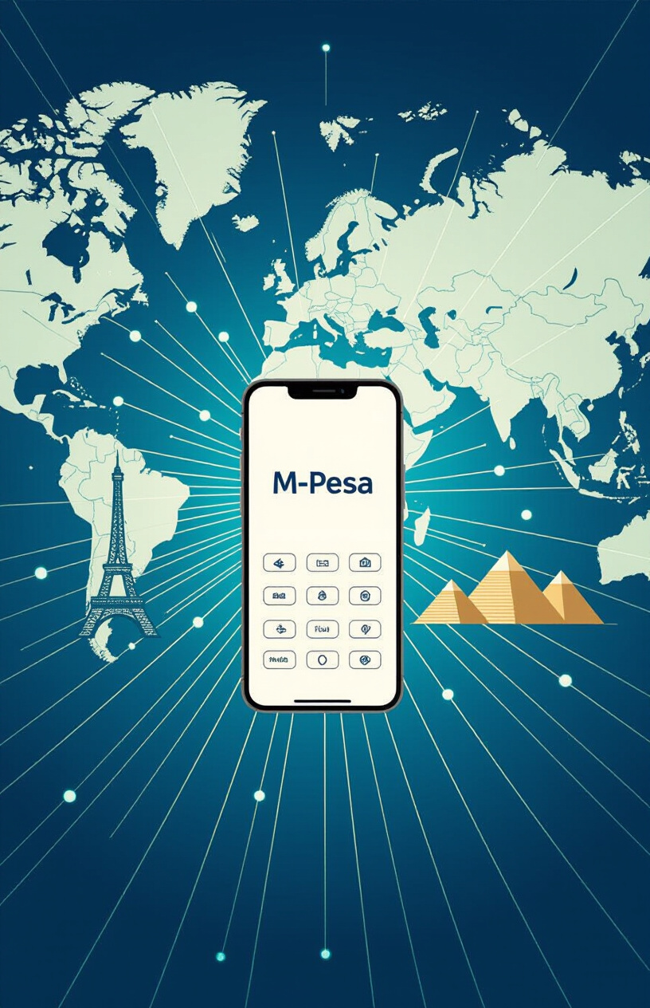
Thank You
for your attention.

