Slide 1
Stock Market Prediction App Harnessing AI for Informed Investing!
BY-
Aida Sharon Bruce
21SCSE1011272
B.Tech CSE
Section-12(Elective)

Slide 2
agenda
INTRODUCTION 3
PRIMARY GOALS 4
IMPORTANCE 5
PROCESS 6
RESULT 7
CONSLUSION
8

Slide 3

introduction
Research on Stock Price Prediction Method Based on Convolutional Neural Network. The financial markets are known for their inherent complexity and unpredictability, posing significant challenges for investors and analysts seeking to anticipate stock price movements. As technological advancements continue to reshape various industries, the integration of machine learning techniques, particularly neural networks, has emerged as a powerful tool for stock market prediction.

Slide 4
areas of focus
Enhancing Investment Decision-Making
Mitigating Risks
Improving Portfolio Performance
Facilitating Long-Term Planning
Harnessing Technological Advancements
Capitalizing on Opportunities
Real-Time Decision Support
Minimizing Emotional Decision-Making
Empowering a Diverse Range of Investors
Facilitating Financial Inclusion

Slide 5
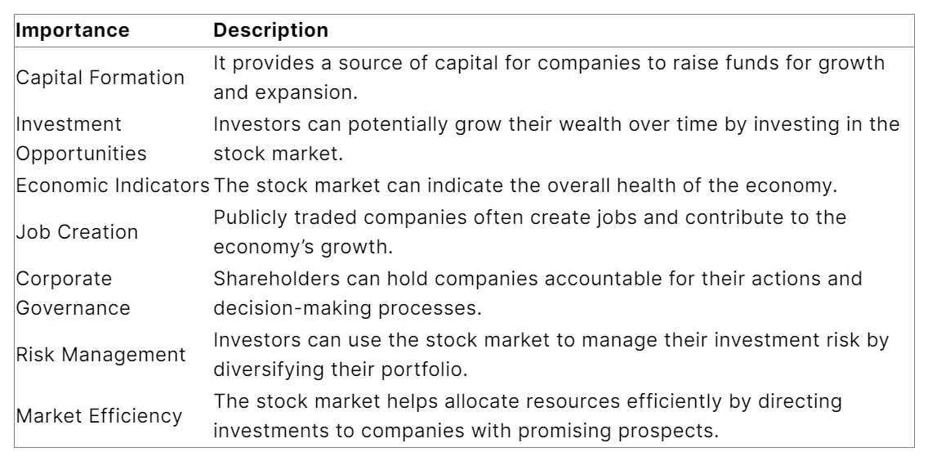
importance

Slide 6
process
Problem Definition
Data Collection
Data Cleaning and Pre-processing
Exploratory Data Analysis
Feature Engineering
Data Splitting
Model Selection
Model Tuning
Hyperparameter Tuning
Model Evaluation
Real-Time Testing
Deployment
Monitoring and Maintenance
Documentation

Slide 7
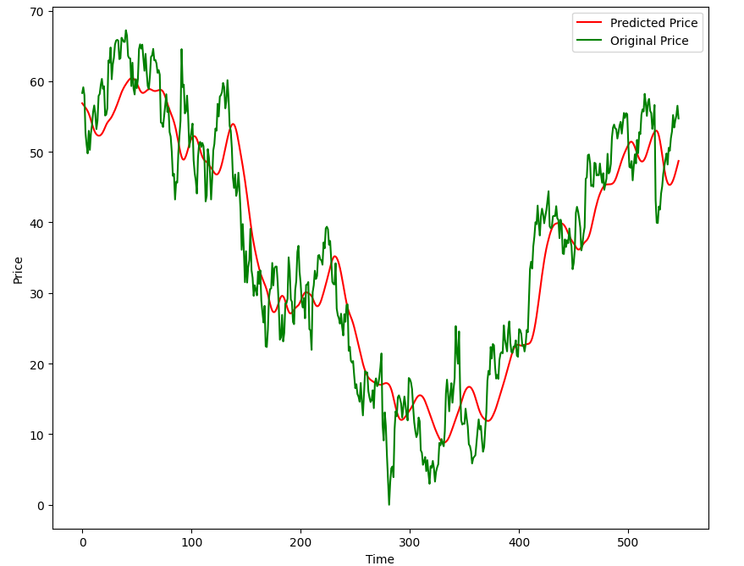
result and finding

Slide 8

conclusion
The development of the Stock Market Prediction Machine Learning Model is a significant step towards enhancing decision-making processes in the financial domain. By combining sophisticated algorithms, real-time data integration, and comprehensive feature engineering, the model stands as a robust tool for predicting stock prices with a high level of accuracy. Ongoing evaluation and refinement will ensure its relevance and effectiveness in an ever-evolving market landscape.

Slide 9
thank you

