Slide 1
CoderGirl Survival Guide
Tips for excelling at learning

Slide 2
Topics in the Guide
Mind and Body
Exercise
Learning How to Learn
Productivity Tips
Personal Engery
Scheduling
Don't Fall Behind!
These could be a 24 Week course on their own!

Slide 3

24 Weeks is NOT easy!
It's going to be a challenge to juggle normal life responsibilities plus classroom time and study time.
Jobs, relationships, kids, pets, bills, hobbies and countless others!
Plus focused learning, homework and classroom time?
It is possible!
It's impossible to do everything in this guide in 24 weeks.
Pick 2-3 concepts that interest you and focus on them!
You will be rewarded for your effort!
Any edge you can get WILL help!

Slide 4
Two Most important Tips!!!
Learning How to Learn
Not once in 32 years have I had a mandatory class on How to Learn
Feelings of I'm a slow learner or I have a bad memory are normal
Learning is a skill that can be acquired!
Deep Work
Time spent on cognitively intense tasks is exceedingly valuable
Time spent on easily reproducible tasks is less valuable
You can get more done in less time than your peers if you spend most of your time in Deep Work
All studying/work is NOT created equal.

Slide 5
Mastering Deep Work
It's not easy to focus with all the distractions around us
TV, family, pets, co-workers, phones and their pesky machine learning algorithms that keep us addicted :-)
The Number 1 Tip is to engage in focused learning! (Also known as "Deep Work")
Deep Work: “Professional activity performed in a state of distraction-free concentration that push your cognitive capabilities to their limit. These efforts create new value, improve your skill, and are hard to replicate.”
Computer programming, mathematics, creative writing, studying
Shallow Work: “Non-cognitively demanding, logistical-style tasks, often performed while distracted. These efforts tend to not create new value in the world and are easy to replicate.”
Responding to some email, formatting documents, shopping, paying bills
The more time you spend in Deep Work the more productive you will be!
Resources
In a Nutshell
Cal Newport Blog

Slide 6
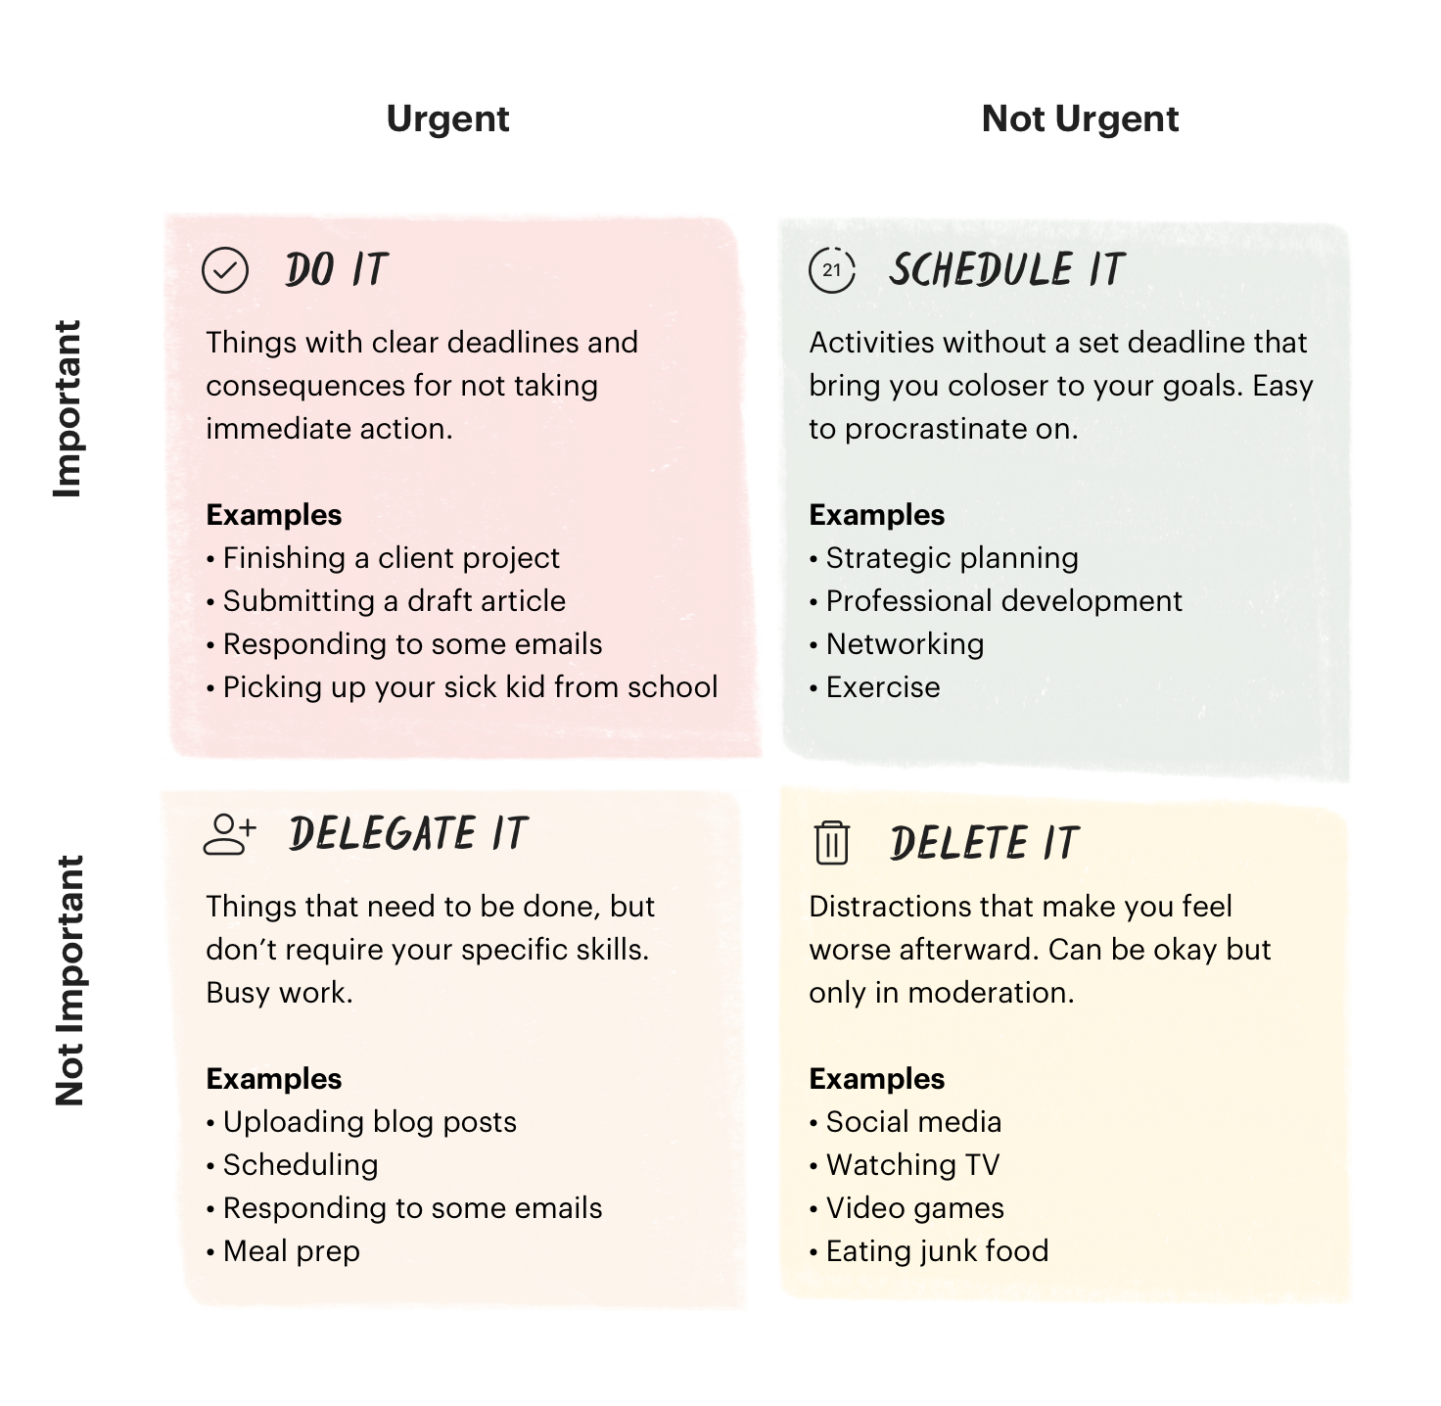
The Eisenhower Matrix
Where do you spend most of your time?
Most of your time should be spent in the important-not urgent category.
You will spend time in each category.
It's a good thing to spend some time in Not-urgent not-important. You can't be 100% engaged all the time! (Reward yourself!)
Working ahead

Slide 7
Learning How To Learn
Chunking is at the cornerstone of learning and problem-solving…
Learning = linking information together to create and slowly add to conceptual chunks
Problem-solving = Identifying what chunks to use when (and how) to tackle a specific problem
… and we tackle it with two types of thinking.
Focused thinking (requiring active attention) is conscious, analytical and serial in nature.
Diffuse thinking (requiring passive attention) is subconscious, creative and parallel in nature.
Diffuse thinking is done in a more relaxed state. Taking walks, exercising, showering.
Ever had an Aha!! moment not at work? That was diffuse thinking taking place behind the scenes!
Resources
In a Nutshell
Barbara Oakley

Slide 8
Learning How to Learn
So, how can we learn effectively?
1. Create the best conditions for focused and diffuse thinking
Focused thinking needs meaningful stretches of undisturbed time to focus and think.
Prioritize making distraction-free time and space to think deeply
Read effectively (SQ3R: Survey, Question, Read, Recall, Review)
Practice purposefully (Work the hardest bits, generalise through variation)
Think on paper, (or code Editor!) there’s magic between the hand and the brain
Diffuse thinking occurs subconsciously by temporarily loosening attention.
Relax/disengage attention: Sleep, walk, drive, blink, exercise
Keep information fresh: Recall and test frequently (e.g., spaced repetition techniques)
Both Dali and Eddison used a form of napping in which objects dropping from their hands would wake them up just as they were falling asleep to trigger diffuse thinking.
2. Actively build time into each day to alternate between both modes

Slide 9
Learning How to Learn
Many common pitfalls are easily avoidable
The difference between great and average thinkers is the way in which they frame and approach many of the following avoidable pitfalls.
Procrastination (stress also further inhibits learning)
Focus on process instead of product (Pomodoro technique)
Rushing through homework and readings is counter-productive!!!!!
Use to-do lists (weekly into daily, only add if urgent and important)
Get organised in advance (make productivity the course of least resistance: layout clothes, tidy workspace etc…)
Make it easy to study.
Eat your frogs first (do the hardest task of the day first)
Set a quitting time (work backwards, avoid Parkinson’s law)
Distraction (including multitasking – has big switching costs and depletes limited willpower resources)
Eliminate cues (disable phone notifications, delete apps, block websites)
Find a quiet space (early) / buy noise cancelling headphones
Learn to note and then ignore cues (mindfulness / meditation)

Slide 10
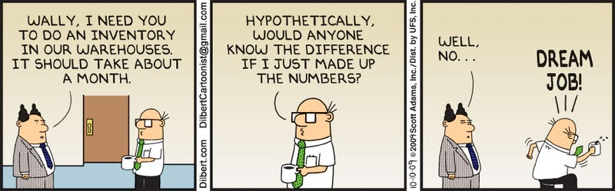
Systems and Personal Energy by Scott Adams
Systems are much better than Goals
Goal: I want to study and get my homework done this week.
System: Schedule my study time for 1-3 one hr blocks each day.
Goals have no indication of "HOW" you will accomplish them.
Systems give you daily/hourly wins. You are always short of your Goal until you reach it. Which can be depressing.
Embrace Selfishness:
Look after yourself first. This involves eating right, exercising, avoiding unnecessary stress and getting enough sleep.
You can’t be generous to others if you’re not in a good place. Adams argues that once your needs are met, you can focus on the needs of others.
Resources
In a Nutshell
How to Fail at Almost Everything and Stil Win Big (Book)

Slide 11
Systems and Personal Energy by Scott Adams
Scott has a very simple litmus test for his daily activities. We can get more done when we have high personal energy. Ask one simple question: "What will this do for my energy?"
What's the suspected effect on personal energy?
Eating a stack of pancakes and gallon of OJ for breakfast?
Taking a 15 minute walk around the block?
Eating a small salad for lunch and an apple in the afternoon?
Drinking coffee at lunch?
Drinking coffee prior to bedtime? (Hint: what's the effect now vs in the morning? )
Training as hard as you can at the gym until you can barely walk?

Slide 12
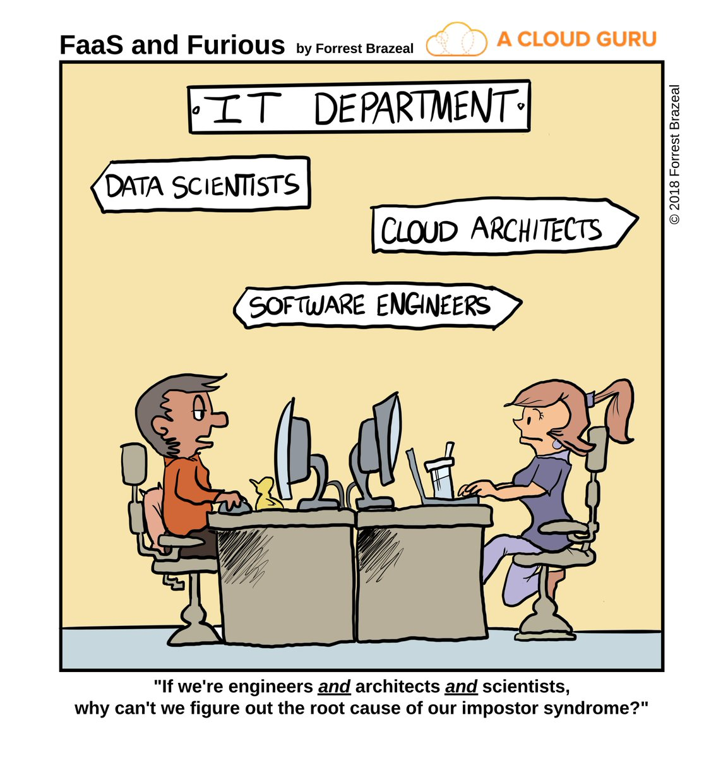
Imposter Syndrome
Feelings like you don't belong or aren't as capable as your peers are normal!
Nothing bad happens with a bad line of code
Don't be afraid to send code to instructors during class.
No one is judging your code. There is no 'perfect code'. It either works or it doesn't. And broken code is the first step towards working code!

Slide 13
Scheduling Your Week
“In preparing for battle I have always found that plans are useless but planning is indispensable.” Eisenhower
Schedules helps us stay on track and forecast the future.
Schedules are NOT static. You run your schedule not the other way around.
Build in time for everything. Work, alone-time, fun, sleep and the unexpected.
See Example Schedule
Time for everything including fun time and a large block on Saturday for the unexpected.
However, there's not much time left over. Only writing it down allows us to see it!
8 hrs of study on Saturday and 8 hrs on Sunday is NOT!!! going to work.
Does not allow for repetition, diffuse thinking or brain chemistry changes.
Process not the product!
Build in time for the unexpected. Scheduling 4hrs of Homework time just prior to the homework deadline is tempting fate.
Also offers an opportunity to discuss the week with your family. Maybe they can take some tasks off your plate!
Electronic schedules are good but a slip of paper you can keep in your pocket may be better.
Build a weekly schedule. And then build a daily schedule that can change as needed.
You manage your schedule. It doesn't manage you!

Slide 14
Exercise is very important!
Bodies are meant to be in motion!
Exercise improves memory, knowledge retention and helps us engage in diffuse thinking.
Exercise also leads to better sleep.
And it will increase your overall energy!
Unfortunately it's the first thing to go when we get busy. :-(
The length and intensity of this class may lead to a few bootcamp pounds...
Avoid this by getting regular exercise!
Make exercise enjoyable:
Leisurely walks around the neighborhood
Dust off that treadmill and watch some trash TV
Tennis with friends
Active Every Day!
Get in 30 mins/day. 60 mins is ideal.

Slide 15

Don't Fall Behind in this Class
Once you fall behind it's nearly impossible to catch up.
Unless you are the 2018-2019 STL Blues :-)
Build in time each week for the unexpected
Work ahead if possible.
Ask Questions! If you have a question chances are someone else does too.
Pull the Andon cord if necessary. (Japanese methodology of allowing anyone to stop the production line to address issues.)
Your mentors and peers can help but only if you alert us there is a problem.
Take Action early in the week.

Slide 16
Read error messages
Error message are more than just light pink alerts!
Read the error message carefully. Don't just glance at it!
If it doesn't make sense copy the message and put it into Google

Slide 17
Power of Habit
In a Nutshell
Power of Habit
Almost impossible to stop a habit. But! You can modify it!
Habit Loops
I. Cues
First, there is a cue. This is a trigger that tells your brain to go into automatic mode, and which habit to use.
Cues can be almost anything, from a visual trigger to a time of day, an emotion, a sequence of thoughts, the company of particular people, etc.
II. Routines
Next, there is the routine. This can be physical, mental, or emotional.
Routines can be incredibly complex or fantastically simple.
III. Rewards
Finally, there is the reward. This helps your brain figure out if this particular loop is worth remembering for the future.
Rewards can range from food or drugs that cause physical sensations, to emotional payoffs, such as the feelings of pride that accompany praise or self-congratulation.
To change a habit, you must keep the old cue, and deliver the old reward, but insert a new routine.
Use the same cue.
Provide the same reward.
Change the routine.

Slide 18
Power of Habit
Identify the Cue, Habit and Reward and you can begin to change the habit.
Not always easy!
Experiment with different routines!
Want to get rid of that afternoon Little Debbie Habit?
Identify your cues.
Is it hunger? Mental fatigue? Boredom? Yearning for conversation?
Not always easy to tell which.
Identify your reward.
Is it satiation? Engery increase? Feeling connected to others?
Experiment with routines.
Eat an apple instead.
Drink a cup of coffee.
Talk with friends and skip the cakes.
Go for a walk.
Some combination of routines will likely give the same reward you are craving!
Same cue, same reward new healthy routine!
“When patterns are broken, new worlds emerge.”
― Tuli Kupferberg

Slide 19
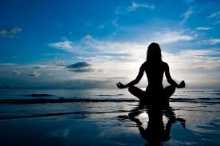
Mindfulness Meditation
Do you have any of these experiences?
Mind jumps from thought to thought without your control?
Anxiety?
Trouble dealing with stressful situations?
Trouble concentrating?
Mindfulness Meditation may be for you!
Increased focus
Lower stress
Reduced anxiety
Better mental stamina
Deeper or broader compassion
Insight into yourself and your sensory experience
A better relationship with your emotions
Backed by Science! (Audiobook) (Google Talk by Author) (Try 1.5 or 2X Speed! Except the meditation parts)
Can start with as little as 1 minute per day
1-3 minutes and work your way up to 15 minute sessions.
Can be done anywhere. In line at the grocery store, bedtime, cough** meetings.
r/meditation
See the FAQ section

Slide 20
Miscellaneous Tips
Just say No to things that aren't important. You will not have much time available so give it sparingly.
"No." Is a complete sentence and answer. You are not required to give reasons.
"No, I can't do that, I have to study." If you must have a reason.
Or as Scott Adams would do, give them the following answer.
"No, I have a rule that I don't do (fill in the blank)."
Can't argue with a rule. It's your rule.
"No, I have a rule that I can't commit to anything until my homework is done."
If it takes less than 2 minutes. Do it now!
Pending tasks take up brain space.
Have you ever had a task that you worried about for days/weeks and it only took a few minutes to complete?
Willpower. You only have a finite amount of it each day. Better to do hard things in the morning.
How much willpower do you have when you have come home from work and are hangry?
Are you ready to pull out the study materials or chow down on some fast food?
Set yourself up for success by making it easy to do the right thing.
Meal prep, eat a snack to avoid hangriness. Take your study materials with you.
Take small steps.
Instead of "Read for 1 hour" start with "go to my desk and pull out my materials." Chances are you fall right into studying without a hitch.

Slide 21
This is Not a Zero-Sum Game
Too many times in life we are pitted agains one another in a fight for success.
This class is not one of those places.
Your classmates success is your success.
The faster we master material the more we can learn.
Help each other grow!
Share resources you've found.
Offer help to those in need.
Off a different spin on a hard to grasp subject.
You are participating in a free class with free reading materials carried out by volunteers using a potentially free OS, free browser and using a free language.
It's hard to imagine that there's no time to give something back to your classmates.
Participate in the slack discussions.
Thos who don't participate may be a favorite to call on in class. :-)

Slide 22
Good Luck!!!

