Slide 1
MAZE
---Shortest Path
By Yixin Cao
19536 CS 455

Slide 2

Table of Content
Introduction
Design
Implementation
Test
Enhancement Ideas
Conclusion
References

Slide 3
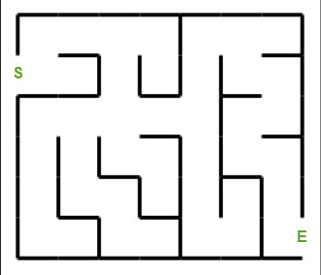
Introduction
This project is to find the shortest path of the maze on the right using Dijkstra’s Algorithm.

Slide 4
Design
Understand the problem:
This project is to find the shortest path from S to E in the maze.
Investigate to find possible solutions which may include your own solution:
Convert the maze to a tree of nodes and use Dijkstra’s Algorithm, Bellman Ford’s Algorithm and spinning tree to find the shortest path.

Slide 5
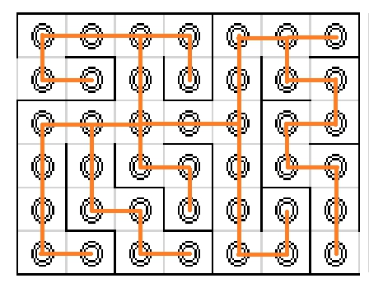
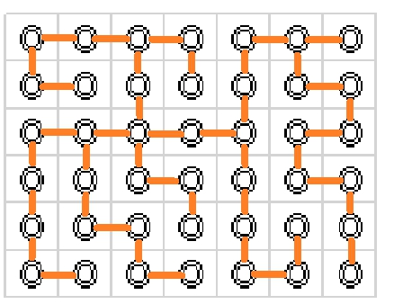
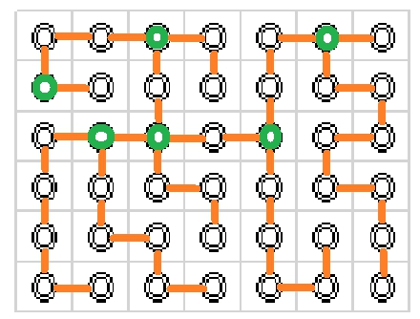
Implement
Step 1: Step 2: Step 3: Step 3:

Slide 6
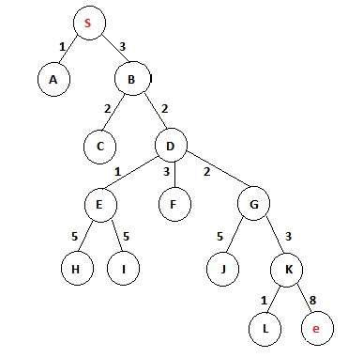
Implement (cont.)
Convert to tree:
Shortest Path:
S -> B -> D -> G -> K -> E

Slide 7
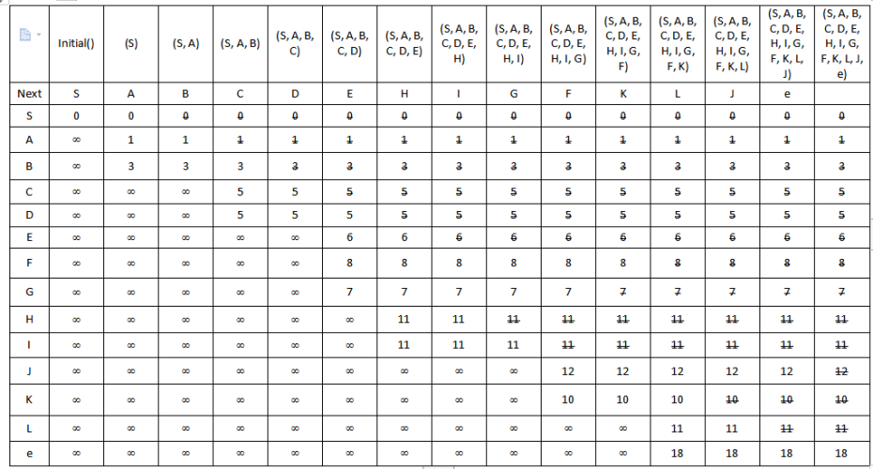
Implement (cont.) ---Dijkstra’s Algorithm

Slide 8
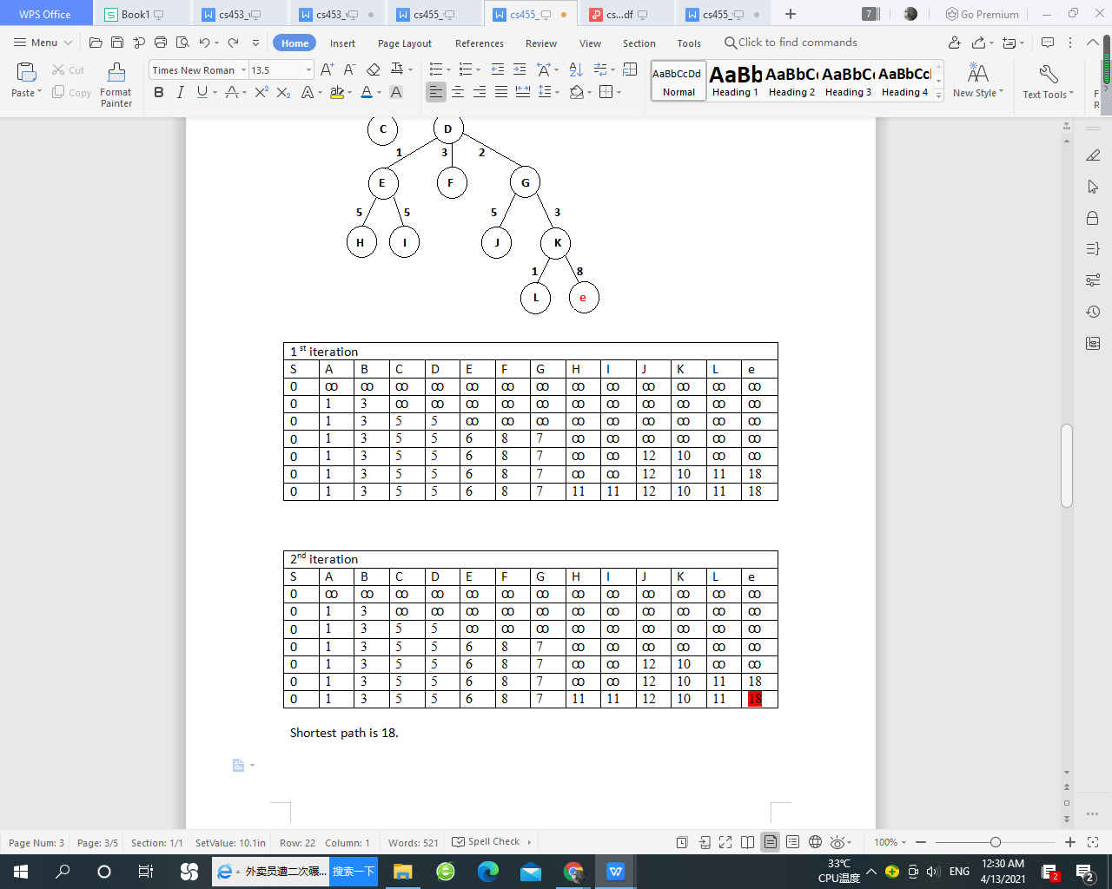
Implement (cont.) ---Bellman Ford’s Algorithm

Slide 9
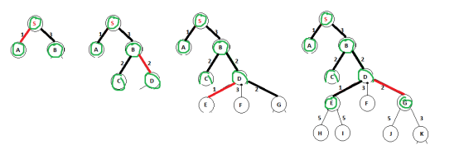
Implement (cont.) ---Prim’s Minimum Spanning Tree

Slide 10
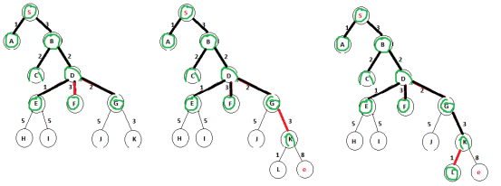
Implement (cont.) ---Prim’s Minimum Spanning Tree

Slide 11
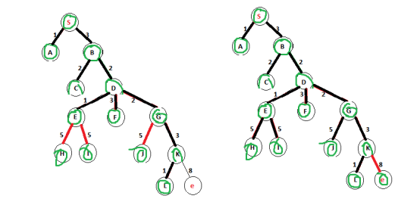
Implement (cont.) ---Prim’s Minimum Spanning Tree

Slide 12
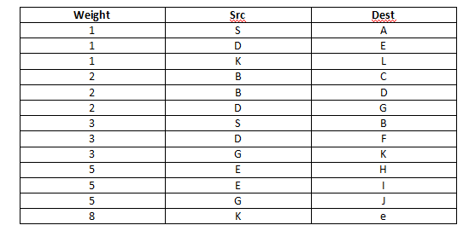
Implement (cont.) ---Kruskal’s Minimum Spanning Tree

Slide 13
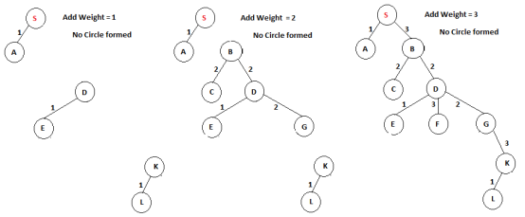
Implement (cont.) ---Kruskal’s Minimum Spanning Tree

Slide 14
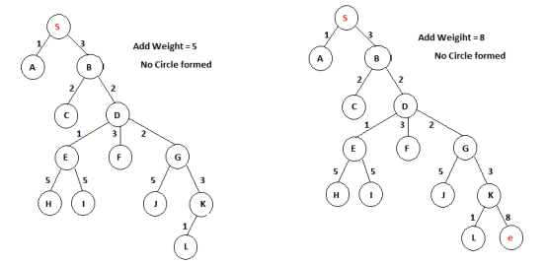
Implement (cont.) ---Kruskal’s Minimum Spanning Tree

Slide 15
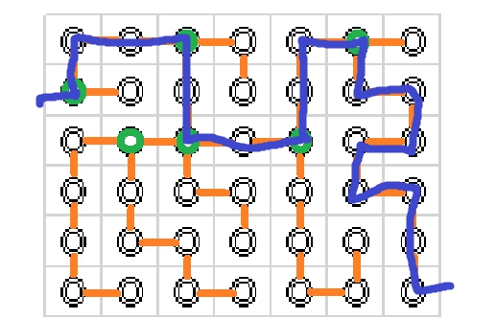
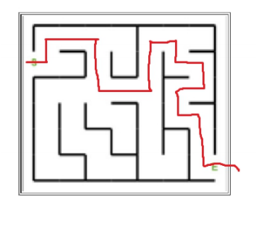

Test

Slide 16
Enhancement Ideas --- Compare algorithms
 | Time Complexity | Steps
Dijkstra’s Algorithm | O(V^2+E) | 15 Steps
Bellman Ford’s Algorithm | O(VE) | 14 Steps * 2 iterations
Prim’s Minimum Spanning Tree | O((v + E)logV) | NA
Kruskal’s Minimum Spanning Tree | O(E * logV) | NA

Slide 17
Enhancement Ideas
For very complicated maze problem, we can also convert the maze into x by y squares, and convert it to tree with nodes. Using either Dijkstra’s Algorithm or Bellman Ford’s Algorithm to find out the shortest path and tested with the other. Spinning tree is another way to find the shortest path.
We can also think the other way to create different mazes.
This shortest path project can be imply on real world such as finding shortest route on map etc..

Slide 18
Conclusion
The shortest path is successfully found out with Dijkstra’s Algorithm, Bellman Ford’s Algorithm and spinning tree. By comparison of Big O, Kruskal’s Minimum Spanning Tree is the fastest. All methods are tested with no issue.

Slide 19
References
https://npu85.npu.edu/~henry/npu/classes/algorithm/tutorialpoints_daa/slide/shortest_paths.html
https://npu85.npu.edu/~henry/npu/classes/algorithm/graph_alg/slide/exercise_graph_alg.html
https://npu85.npu.edu/~henry/npu/classes/capstone/job/slide/portofolio.html#step_2
https://towardsdatascience.com/solving-mazes-with-python-f7a412f2493f
https://daemianmack.org/posts/2019/12/mazes-for-programmers-dijkstras-algorithm.html

