Slide 1

PI PROJECT
CS570 Big Data Processing Project
By Yixin Cao

Slide 2
Introduction
TABLE OF CONTENT
2. Design
3. Implementation
4. Test
5. Enhancement
6. Conclusion
7. Reference

Slide 3
INTRODUCTION
This Pi Project is to use Google Cloud Platform to implement Hadoop with MapReduce to calculate pi value.

Slide 4
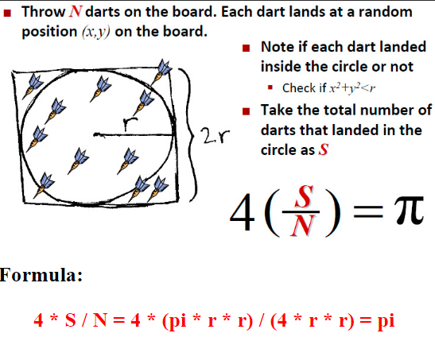
THEORY OF
Pi Calculation
As the illustrated on the right, the value of pi can be calculated by counting the number of random darts that falls in the circle and outside the circle.

Slide 5
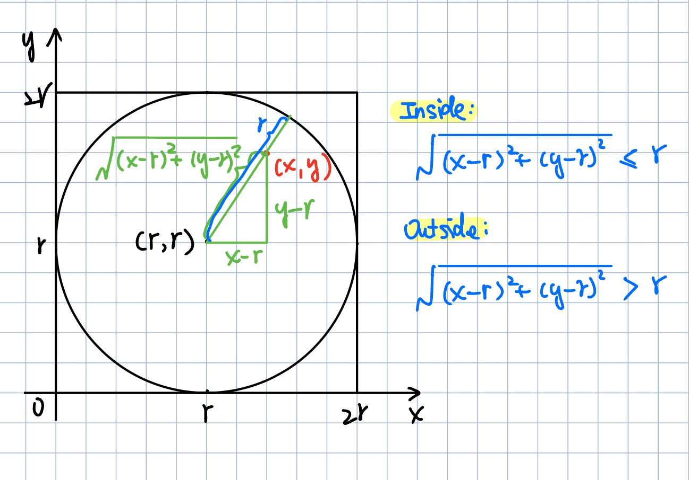
THEORY OF
Pi Calculation
To determine whether the dot is inside or outside, us the formula for distance for reference

Slide 6
DESIGN
This section will discuss about the process and methods designed to solve pi calculation.

Slide 7
TECHNOLOGY USED
Using GCP Ubuntu as project environment.
Using Hadoop framework to implement MapReduce model.
Program in Java Language.

Slide 8
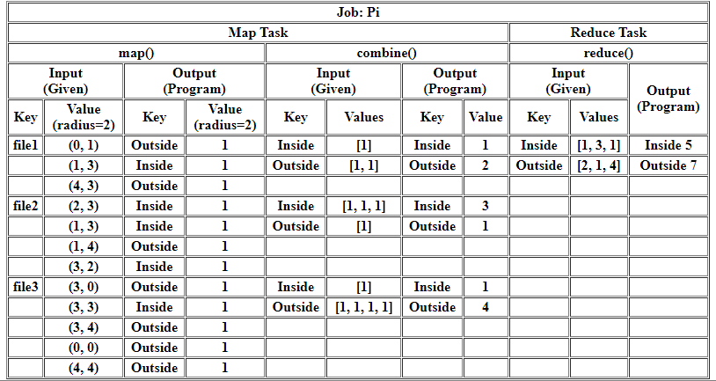

Slide 9
PROCESS
1. Prepare Input File
2. Code for MapReduce
3. Run Mapreduce on GCP
4. Calculate Pi
Write a Java program to generate numbers of random pairs of point(x, y) with given radius
Save the result in file to use as MapReduce input file
Write MapReduce program in Java Language to count number of points inside and outside of the circle with given radius.
Using the input file generated in step 1 to run MapReduce program in Step 2
Output should be like:
Inside xxx
Outside xxx
Write a Java Program to calculate pi value
Using the output from Step 3 get pi value

Slide 10
IMPLEMENTATION
Getting ready to test

Slide 11
PROJECT IMPLEMENTATION
Login and start instance on GCP. Establish start connection
GenerateDots.java
CalculatePiMR.java
CalculatePi.java
ENVIRONMENT
CODE

Slide 12
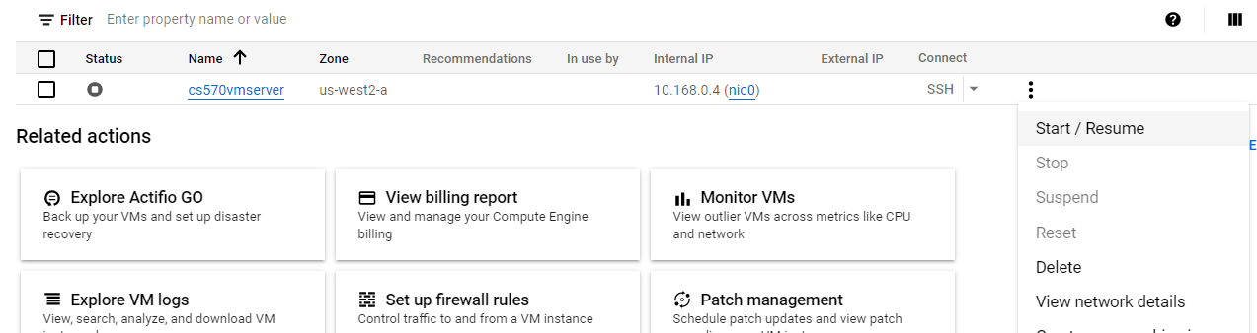
ENVIRONMENT—-GCP
VM instance is stopped while not on GCP

Slide 13
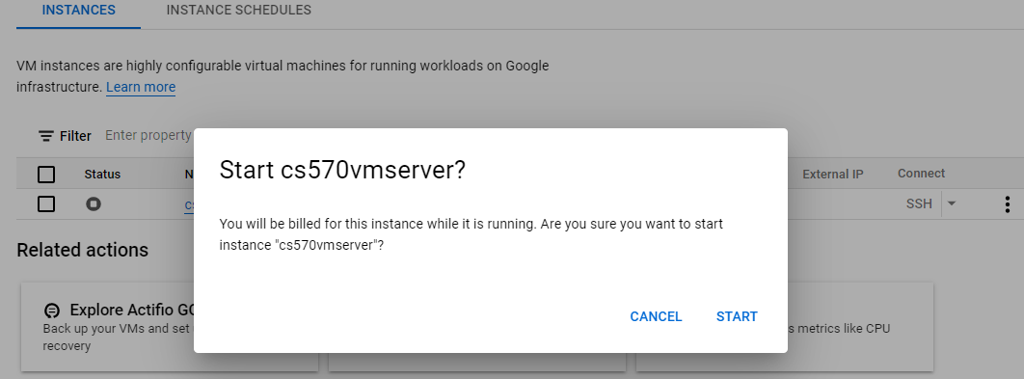
ENVIRONMENT—-GCP
Start VM instance on GCP

Slide 14
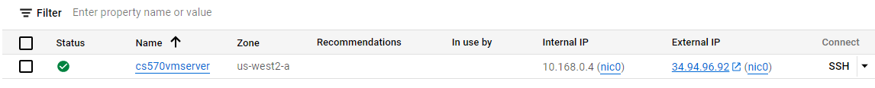
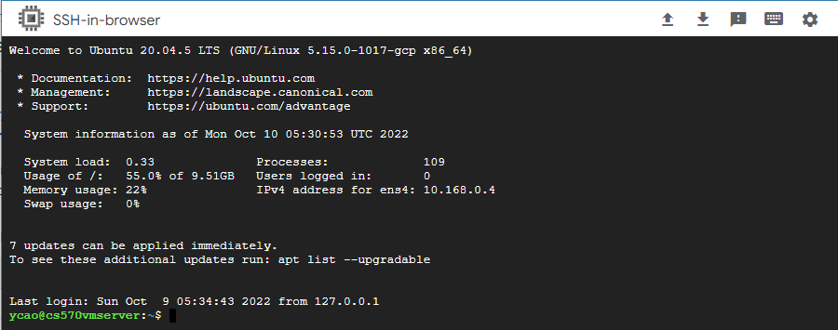
ENVIRONMENT—-GCP
Instance Started
and
Connect VM through SSH

Slide 15
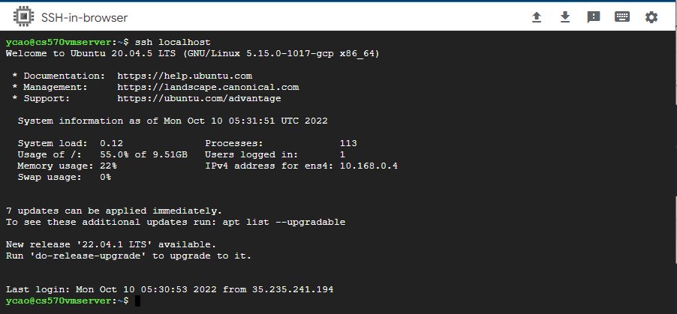
ENVIRONMENT—-Connection
Connect with localhost

Slide 16
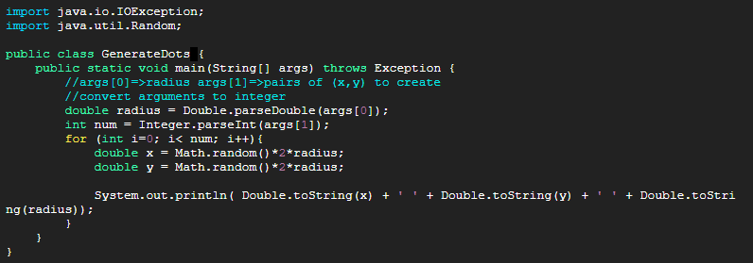
CODE–-GenerateDots.java
Java Program to generate random dot pairs with command line arguments taken in as radius and number of pairs. Output format: x y radius

Slide 17
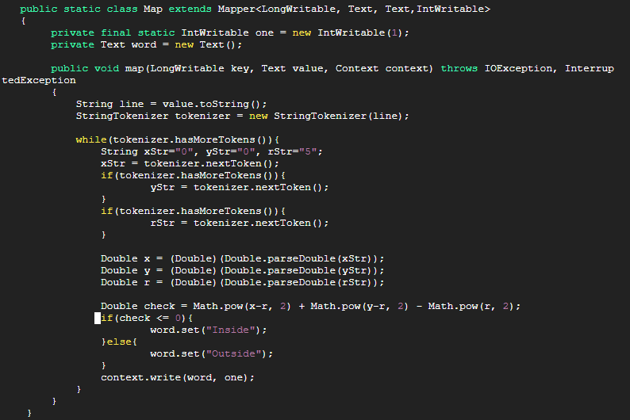
CODE–-CalculatePiMR.java
Map() for MapReduce

Slide 18
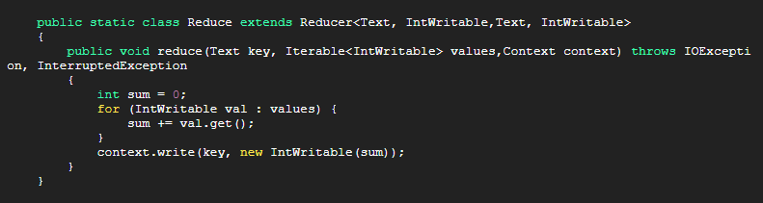
CODE–-CalculatePiMR.java
Reduce() for MapReduce

Slide 19
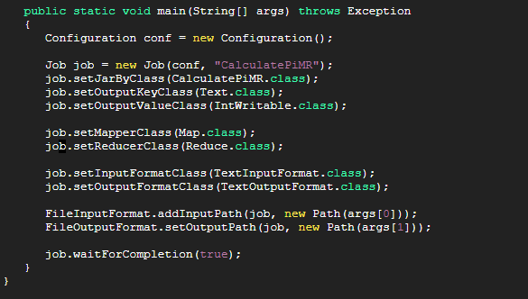
CODE–-CalculatePiMR.java
main() for MapReduce

Slide 20
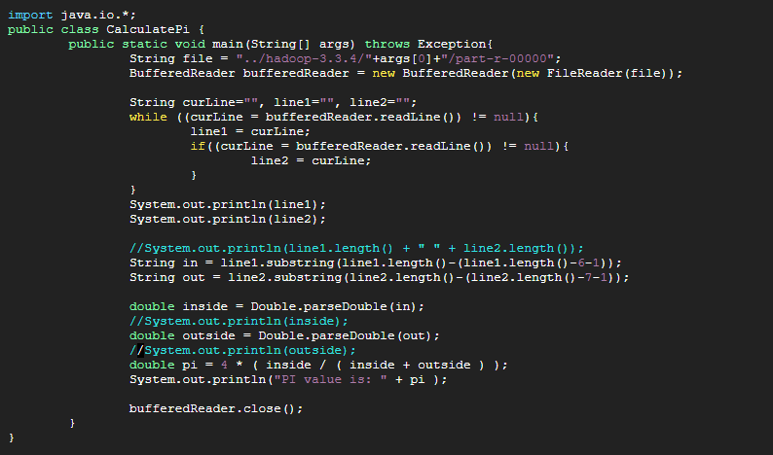
CODE–-CalculatePi.java
Java Program to calculate pi value with MapReduce result taken in by reading the file.

Slide 21
CODE–-Structure
Run bin/hadoop; bin/hdfs under this directory
Generate *.class files here
Input files
Final output will be saved locally in this folder
home
PiProject
hadoop-3.3.4
*.java x 3
Input
*MR.java
Output

Slide 22
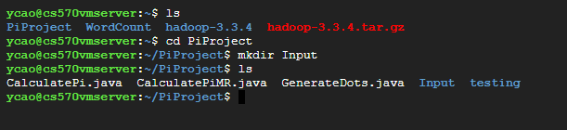
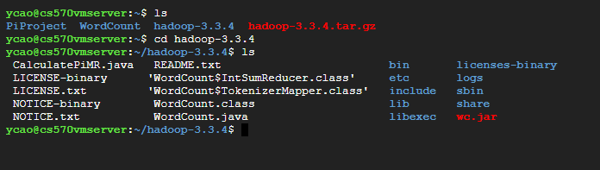
CODE–-Structure
PiProject directory
hadoop-3.3.4
directory

Slide 23
TEST
Process to test the project

Slide 24
GCP-HADOOP-MAPREDUCE
STEPS & RESULT
STEPS
RESULT
Final Result for pi value calculated.
Detailed steps of running the project and outputs.

Slide 25
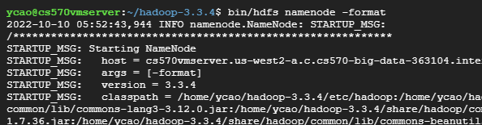
STEPS
Format the file system
$ bin/hdfs namenode -format

Slide 26
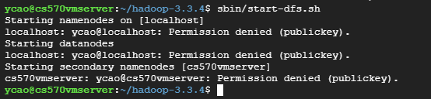
STEPS
Start NameNode daemon and DataNode daemon
Permission Denied, need to connect ssh again.
$ sbin/start-dfs.sh

Slide 27
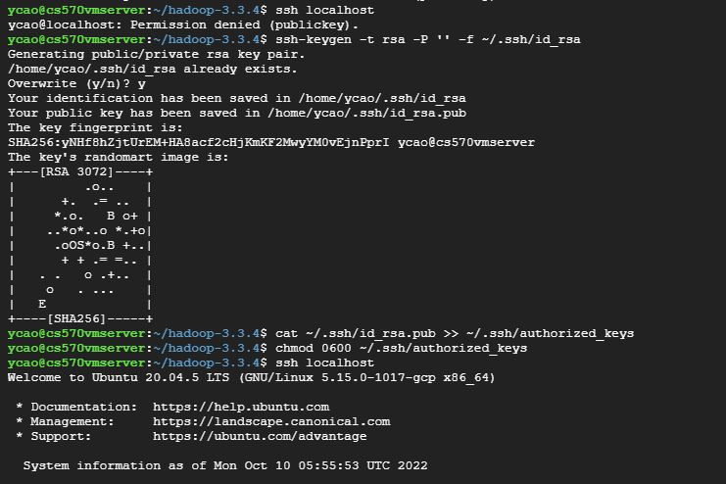
STEPS
Successfully Connected!
$ ssh-keygen -t rsa -P '' -f ~/.ssh/id_rsa
$ cat ~/.ssh/id_rsa.pub >> ~/.ssh/authorized_keys
$ chmod 0600 ~/.ssh/authorized_keys
$ ssh localhost

Slide 28
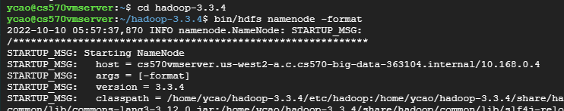

STEPS
Format again!
Successful started!

Slide 29
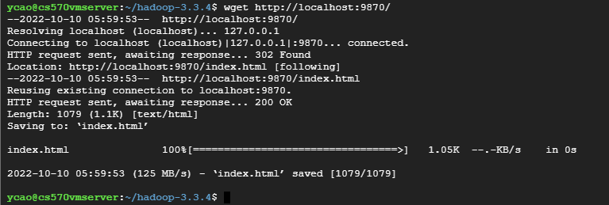
STEPS
Test Connection with localhost
$ wget http://localhost:9870/

Slide 30
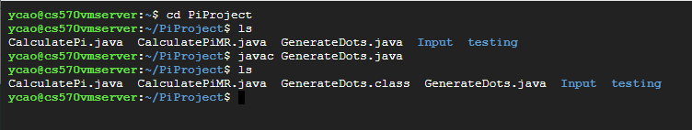
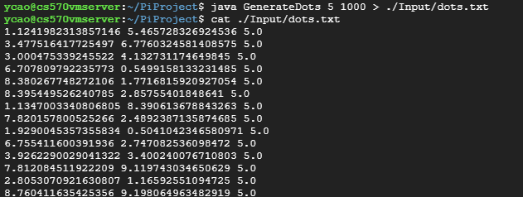
STEPS
Compile and run java program to generate dots with radius=5, number = 1000
Output save in ./Input/dots.txt
$ javac GenerateDots.java
$ java GenerateDots 5 1000 > ./Input/dots.txt

Slide 31
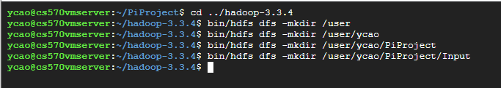

STEPS
Copy file from local to hadoop and check
$ bin/hdfs dfs -mkdir /user/ycao/PiProject/Input
$ bin/hdfs dfs -put ../PiProject/Input/* PiProject/Input
$ bin/hdfs dfs -ls PiProject/Input

Slide 32
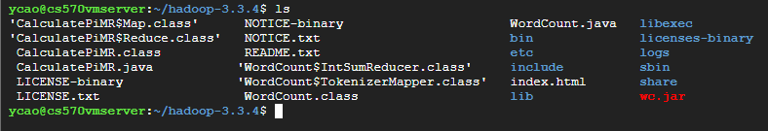
STEPS
Compile Mapreduce program in Hadoop with *.class files created
$ bin/hadoop com.sun.tools.javac.Main ./CalculatePiMR.java

Slide 33
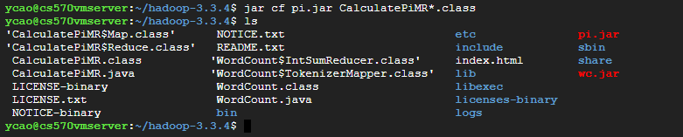
STEPS
Create .jar file with *.class files
$ jar cf pi.jar CalculatePiMR*.class

Slide 34
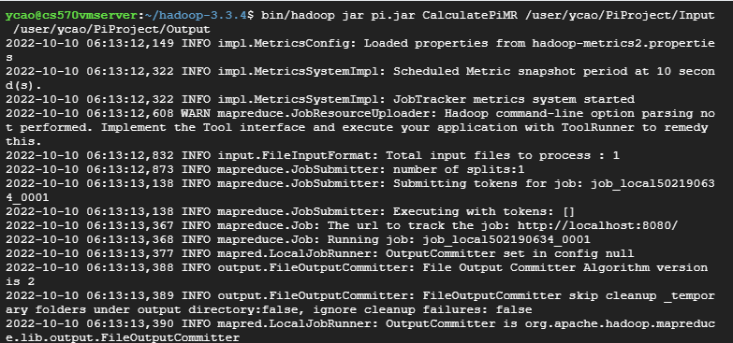
STEPS
Run MapReduce Program with input file and save result in Output
$ bin/hadoop jar pi.jar CalculatePiMR /user/ycao/PiProject/Input /user/ycao/PiProject/Output

Slide 35

RESULT
Get output and save to local
Display Output
$ bin/hdfs dfs -get PiProject/Output Output
$ cat Output/*

Slide 36
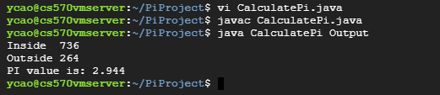
RESULT
Using the output (local output folder as command line arguments) from MapReduce Program to compile and run java program to get pi value
The pi value calculated is 2.944, and it is quite off from 3.1415926
$ jvac CalculatePi.java
$ java CalculatePi Output

Slide 37
ENHANCEMENT
Can we get better result?

Slide 38
HOW TO PROVE TEST RESULTS?
2.944
radius = 5
number = 1000
Base Case
To make the dots cover more area, we can decrease the radius
Or to increase the number of dots
?
?
radius = 1
number = 1000
radius = 5
number = 100000

Slide 39
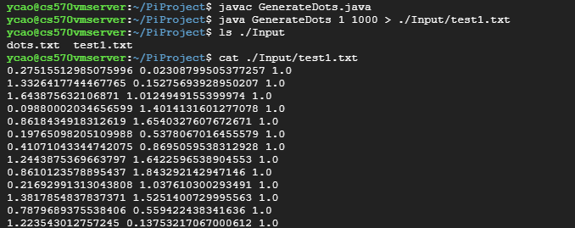
ENHANCED RESULT —- Decrease Radius
radius = 1
number = 1000

Slide 40
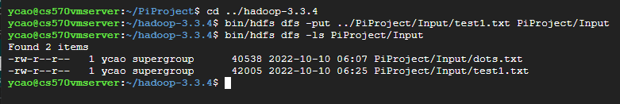
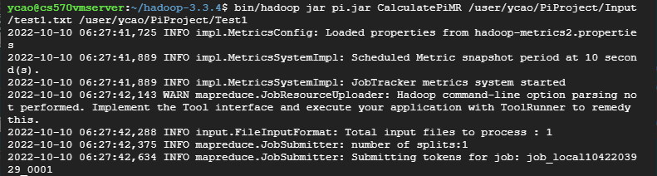
ENHANCED RESULT—- Decrease Radius

Slide 41


ENHANCED RESULT—- Decrease Radius
Pi value calculate is 3.224 which is a better value to the real pi value then the base case value

Slide 42

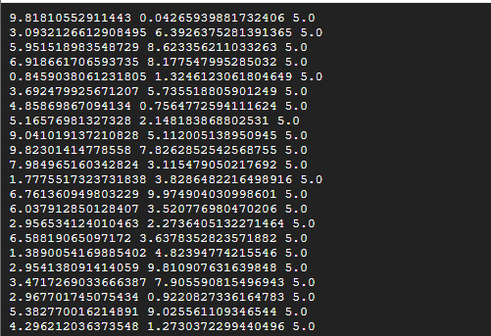
ENHANCED RESULT —- Increase Number
radius = 5
number = 100000

Slide 43
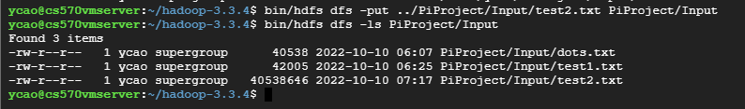
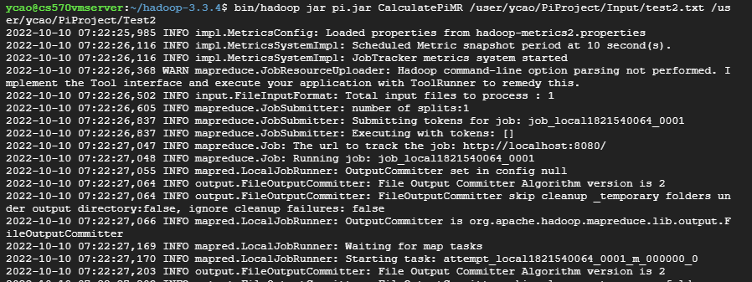
ENHANCED RESULT—- Increase Number

Slide 44


ENHANCED RESULT—- Increase Number
Pi value calculate is 3.14006 which is very close to the real pi value

Slide 45

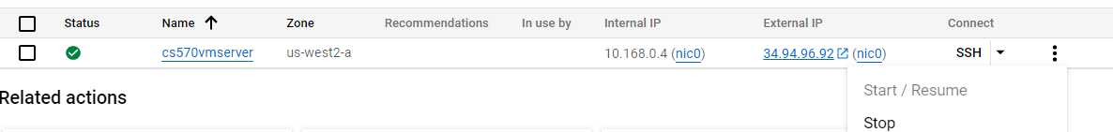
STOP INSTANCE ON GCP
After done with project, stop namenode and stop the instance on GCP.

Slide 46
CONCLUSION
Summarize for Pi Project

Slide 47
MapReduce is good for dealing with large data set using minimal amount of memory and get result fast.
The more random dots generated to cover the area, the more accurate pi value we will get. This is determined by radius and number of dots generated.

Slide 48
REFERENCES
Chang, H. (2022, 10 09). Overview of Pi Calculation. Overview of Pi Calculation. https://hc.labnet.sfbu.edu/~henry/npu/classes//mapreduce/pi/slide/overview.html
Strengths and Weaknesses of MapReduce. (2016, September 11). LinkedIn. Retrieved October 10, 2022, from https://www.linkedin.com/pulse/strengths-weaknesses-mapreduce-muazzam-ali
Taylor, D. (2022, September 17). What is MapReduce in Hadoop? Big Data Architecture. Guru99. Retrieved October 10, 2022, from https://www.guru99.com/introduction-to-mapreduce.html
Value of Pi in Maths - Definition, Forms & Solved Examples. (n.d.). Byju's. Retrieved October 10, 2022, from https://byjus.com/maths/value-of-pi/

Slide 49
THANKS!
Do you have any questions?

