Slide 1

Analysis of Poisson frequency data
under a simple crossover trial
Kung-Jong Lui and Kuang-Chao Chang
Speaker：Yi-Hsuan Liu
Date：2022/11/28
Notes:
呂剛中、張光昭

Slide 2
Outline
01
Introduction
02
Notation, model assumption and methods
Goal
Crossover Design
Non-equality, Non-inferiority and Equivalence
Notation
Model assumption
Asymptotic Test procedure and Exact Test Procedure
03
Monte Carlo Simulation and Result
04
Example
Non-equality
Non-inferiority
Interval Estimation
Double-Blind Crossover Trial for Asthma patients
05
Discussion
Contribution
Conclusion of asymptotic test procedure and exact test procedure

Slide 3
Introduction
01
The Goal of This Article
Frequency of patient response follows the commonly-assumed Poisson distribution under a crossover design.
Present asymptotic and exact procedures for testing non-equality, non-inferiority and equivalence.
Develop asymptotic and exact interval estimators for evaluate.
02
Crossover Design
What is crossover design?
Advantage & Disadvantage
03
Non-equality, Non-inferiority and Equivalence
Relationship among non-equality, non-inferiority and equivalence
Testing for non-equality, non-inferiority and equivalence
Notes:
作者研究動機：
過去的研究多專注使用常態假設對連續型資料做推論，或是使用random effects的logistic risk model對二元資料進行討論，針對個數型資料的探討較少。
雖然針對簡單交叉設計下的個數型資料已有文獻提出無母數的方法對treatment effect作區間估計，但當患者數少的時候，個數型資料在卜瓦松分布的假設下，這些依賴大樣本理論發展出的推論方式會失去其準確性甚至是無效的。
目的：
此篇文章作者假設個數型資料服從卜瓦松分配，提出了小樣本與大樣本下的檢定方式，去做Non-equality, Non-inferiority and Equivalence的testing與區間估計。

Slide 4
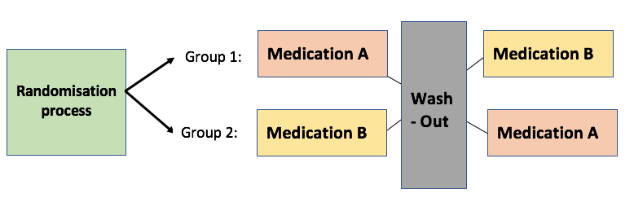
Crossover Design
What’s Crossover Design?
Treatment | Period 1 | Period 2
Sequence AB | A | B
Sequence BA | B | A
Notes:
交叉設計實驗中，患者會被隨機分配到不同治療順序對應的組別，在臨床上這樣的設計經常被用來研究無法完全治癒的疾病或慢性病的治療效應，比如心絞痛，癲癇、高血壓或氣喘之類的疾病。

Slide 5
Crossover Design
Advantage
Sometimes more efficient than parallel design.
Require fewer patients than a parallel study.
The treatment are compared ‘within subjects’.
Disadvantage
Carryover effect
Wash out period
Constraint
In medical clinical trials, the disease should be chronic and stable.
The treatments should not result in total cures but only alleviate the disease condition.
Notes:
交叉設計相較於平行設計需要的患者數量較少，同一位受試者在不同時間使用兩種藥的量測方式也可以減少個體差異性的疑慮，相較於平行設計在某些層面上較有效率。
但他的缺點在於受試者需要一段wash-out period，那每個受試者的代謝時間不盡相同，仍可能有前一期使用的藥效遺留下的效應。
臨床上，交叉設計的實驗方式僅限於慢性病或是無法完全治癒的疾病。

Slide 6
Non-equality、Non-inferiority and Equivalence
Relationship among non-inferiority, superiority, and equivalence
Inferiority
Equivalence
Superiority
Non-inferiority
Equivelence tests can be applied to any instance where the research question asks whether the means of two sets of scores are practically or theoretically equivalent.
Non-equality is used to show that a new drug that is cheaper than available alternatives works as well as an existing drug.
Ref : https://ntuhmc.ntuh.gov.tw/epaper-70th.htm
Notes:
等效性試驗(equivalence trials):
用來證明新、舊藥效相當，虛無假設為新藥與舊藥的效果有差異(更好或更壞)，屬於雙尾檢定。
不劣性試驗(non-inferiority trials):
旨在評估新藥與已上市藥物間之相對療效，以新舊藥物間療效差異不小於一個事先選定的量(即不劣性臨界值)來證明其療效。
不劣性設計的必要性
已上市藥物的療效很好，新藥的療效要超過標準治療藥物的可能性較小，但新藥又具備其他的特點(更安全、)更方便使用或尊醫囑性更好)，則可以考慮採用不劣性設計。
不劣性試驗的虛無假設：新藥比舊藥差

Slide 7
Contribution
Present asymptotic and exact procedures for testing non-equality, non-inferiority and equivalence.
Develop asymptotic and exact interval estimators for evaluate.
Provide asymptotic and exact test procedures to do testing no matter sample size is small, moderate or large.
Asymptotic interval estimator with logarithmic transform will be more precise than exact interval estimator.
Notes:
We note that all asymptotic
test procedures developed here can generally perform well with respect to Type I error and can be
preferable to the exact test procedure with respect to power if the number of patients per group is
moderate or large. We further find that in these cases the asymptotic interval estimator with the
logarithmic transformation can be more precise than the exact interval estimator without sacrificing
the accuracy with respect to the coverage probability. However, the exact test procedure and exact
interval estimator can be of use when the number of patients per group is small.

Slide 8
，
Notation
-frequency of the response on patient I assigned to sequence s at period t
patient
sequence
period
-covariate of treatment receipt
-covariate of period
-the effect due to the underlying characteristics of the $i^{th}$ patient assigned to sequence s
-the effect of treatment B relative to treatment A
-the effect for period 2 v.s. period 1

Slide 9
，
Model assumption
Conditional MLE of
is

Slide 10
，
Model assumption
given a fixed period, the ratio of two mean frequencies of responses on a given patient between treatment B and A
given a fixed treatment, the ratio of two mean frequencies for period 2 versus period 1 on a given patient
Conditional MLE of
is
Notes:
根據中央極限定理與MLE的不變性，得知p hat便可以做treatment effect eta的檢定與區間估計。

Slide 11
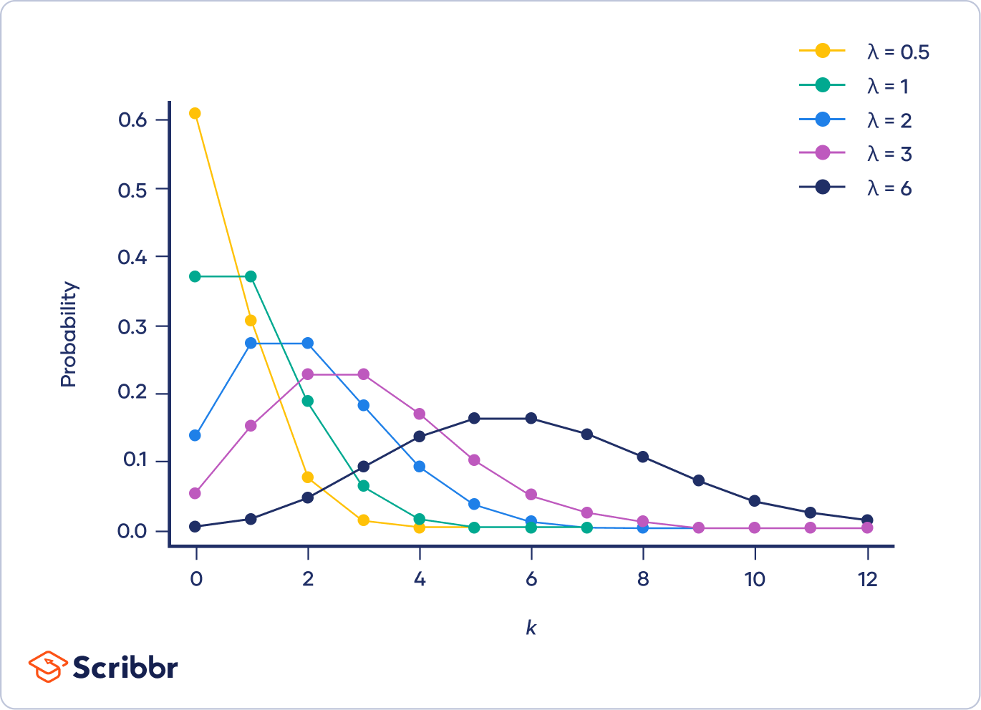
，
Methods-Fieller’s Theorem
02
For skewed distribution, use delta method we may obtained asymmetric confidence limits.
While is small, then the large-sample confidence limits will be close to those given by Fieller's theorem.
Assuming that ,we must have
t ：the appropriate percentile of the t-distribution
Let
Partial derivatives
Notes:
在大樣本理論下，漸進常態性與對稱的信賴區間是容易成立的，但在小樣本下，分配的偏度會影響到信賴區間的對稱性。
在大樣本之下，經過Fieller‘s theorem提供的轉換方法，再根據delta method 得到的信賴區間會近似於常態。
In large samples, asymptotic normality takes over and symmetric confidence intervals are appropriate. It’s not difficult to see that these variances are identical to the first-order approximate obtained from the corresponding linear models by the delta method.
But for small samples, the skewness of distribution may give rise to asymmetry of the exact confidence limits.
In large samples, the confidence interval given by the delta method is approximately the same as that obtained from Fieller's theorem. If g is small, then the large-sample confidence limits will be close to those given by Fieller's theorem. When the value of g is not small, however, the confidence limits given by Fieller's theorem are in fact usually wider than those obtained from the large-sample standard deviation, and are not centered on the estimate.

Slide 12
，
Methods-Fisher Exact Test
 | Guess
Actually | Milk | Tea
Milk
Tea
Notes:
適用於樣本數小的情況， 而且這個方法並不需要假設資料母體的分布，換句話說，Fisher’s Exact Test 屬於 一種無母數的檢定方法。
P-value :P(x>n11) x在拒絕域之內的機率

Slide 13


Methods
Test non-equality
Reject $H_{0}$ at the $α$-level if
(7)
where
To alleviate the concern of our inference directly based on the possibly skewed distribution of
By Filler’s Theorem
Reject $H_{0}$ at the $α$-level if
(9)
Notes:
單點檢定

Slide 14
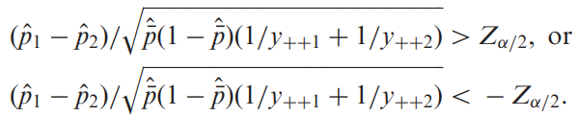
Notation, model assumption and methods
Test non-equality
Two Sample T-Test
Given the total $y_{+s+}$being reasonably large for both $s$ , reject $H_{0}$ at the $α$-level if
(10)
where
Fisher Exact Test
(13)
Notes:
單點檢定

Slide 15
Methods
Test non-inferiority
Reject $H_{0}$ at the $α$-level and claim that treatment B is non-inferior to treatment A if the test statistic
(14)
(15)
(16)
Notes:
單尾檢定

Slide 16
Methods
Test equivalence
(17)
(18)
(19)
Notes:
左尾檢定與右尾檢定

Slide 17
Methods
Interval Estimation
(20)
If $A>0$, $B^{2}−AC>0$, asymptotic 100($1−α$)% confidence interval for ${RM}_{T}$as given by
(22)
(23)
Notes:
(22)由於RMT為exp(eta)必然大於零，故為max( ,0)<-下限為零

Slide 18
Monte Carlo Simulations
Equivalence
Type I error
Power

Slide 19
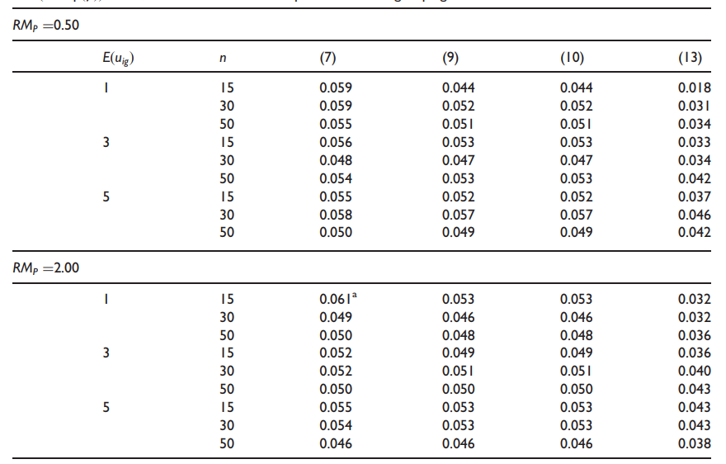
Result
Equivalence
Notes:
從上表可以看到(7)、(9)、(10)的asymptotic procedure皆較為接近0.05，但同樣的樣本數在RMp的值不一樣的狀況下，exact test procedur在樣本數大的狀況下才會比較接近0.05.。

Slide 20
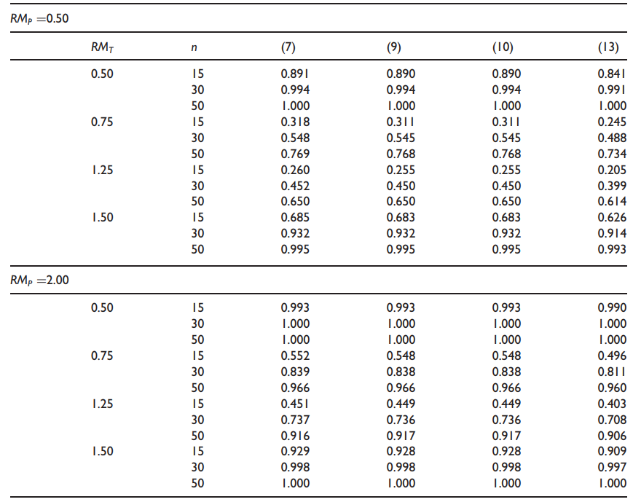
Result
Equivalence
Notes:
7、9、10的power在樣本數小的時候，asymptotic和exact的差距並不如type I error來的大。
在這樣的設計下asymptotic的simulation即便在小樣本下仍比exact好
exact的type i error較為保守，值較低，power也相對應較小，即便如此，其表現也不會太差，尤其在樣本數大的時候exact 的power和asymptotic的power差不多。

Slide 21
Monte Carlo Simulations
Non-inferiority
Type I error
Power

Slide 22
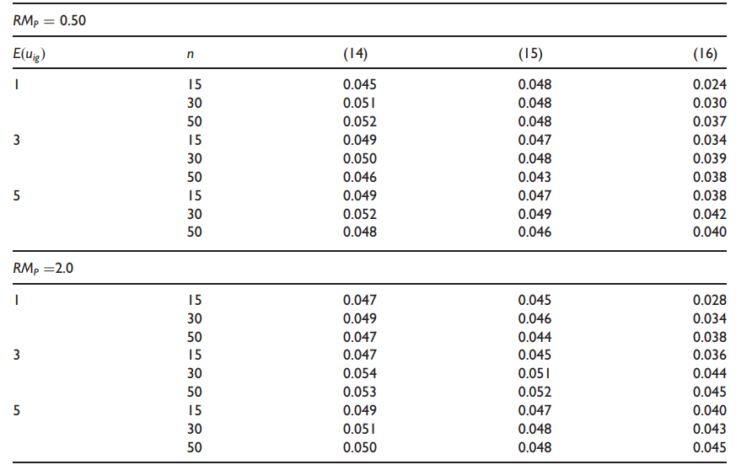
Result
Non-inferiority
Notes:
相較於15、16來說14整體的type I error會更加接近0.05

Slide 23
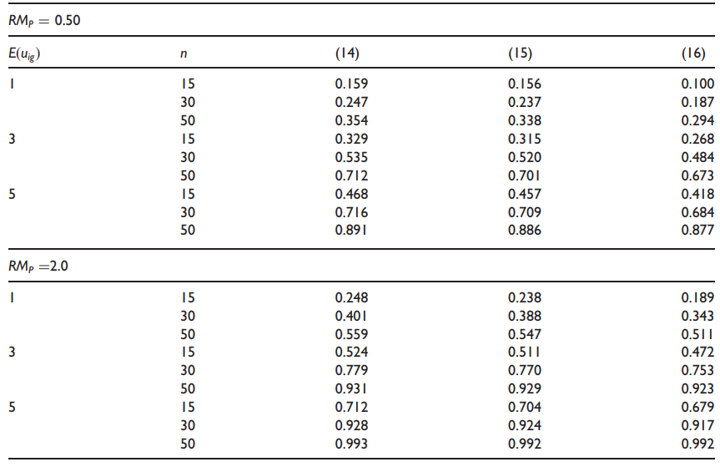
Result
Non-inferiority
Notes:
且14的power相較於15、16也比較高。

Slide 24
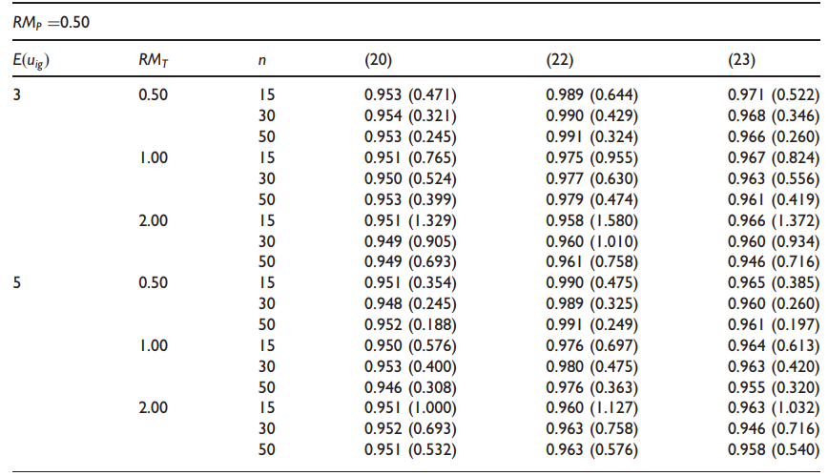
Monte Carlo Simulations and Result
Interval Estimator
Notes:
we calculate the estimated coverage
probability (for measuring the accuracy) and the average length (for measuring the precision).
覆蓋率高平均長度也隨之增加，這三種結果都有這樣的趨勢，但只有20最接近我們的critetion 0.95，從這角度來說20會比另外兩者好一些，但從區間估計的結果來說，exact test procedure的表現也相當不錯。

Slide 25
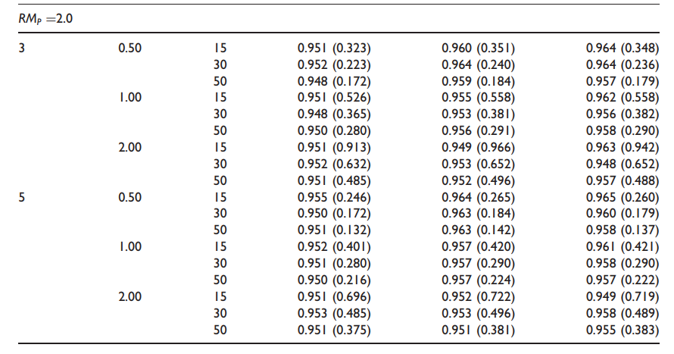
Monte Carlo Simulations and Result
Interval Estimator
Notes:
Thus, the relative efficiency of the
interval estimator (20) versus the interval estimator (22) and (23) are 134 % (&0.429/0.321) and
108% (& 0.346/0.321),

Slide 26
An Example
01
Double-Blind Crossover Trial for Asthma patients
Treatment A：Placebo
Treatment B：Beta-agonist salmeterol (50g twice daily)
02
101 participate only 87 patients who completed the trial
Randomized to sequence AB or sequence BA
Sequence AB
24 weeks placebo
Washeout period
24 weeks salmeterol
4 weeks
Sequence BA
24 weeks salmeterol
Washeout period
24 weeks placebo

Slide 27
An Example
Sums of exacerbations in asthma on the 87 patients
Test non-equality | (7) | (9) | (10) | (13)
P-value | 0.010 | 0.014 | 0.014 | 0.028
All these suggest that there be significant evidence that taking salmeterol at the 5% level can reduce the mean number of exacerbations in asthma.
Test non-equality | (20) | (22) | (23)
95% confidence interval | [0.227, 0.880] | [0.167, 0.931] | [0.252, 0.937]
Notes:
We can see that the resulting 95% confidence interval of using (20) has the shortest length among these three interval estimators. This is consistent with the previous finding that using the asymptotic interval estimator (20) tends to gain precision as compared with the other two (Table 5). Because all the upper limits of these resulting 95% confidence intervals fall below 1, we may claim that taking salmeterol reduces the mean number of exacerbations in asthma as compared with the placebo. These results are certainly consistent with the previous findings based on procedures for testing non-equality.

Slide 28
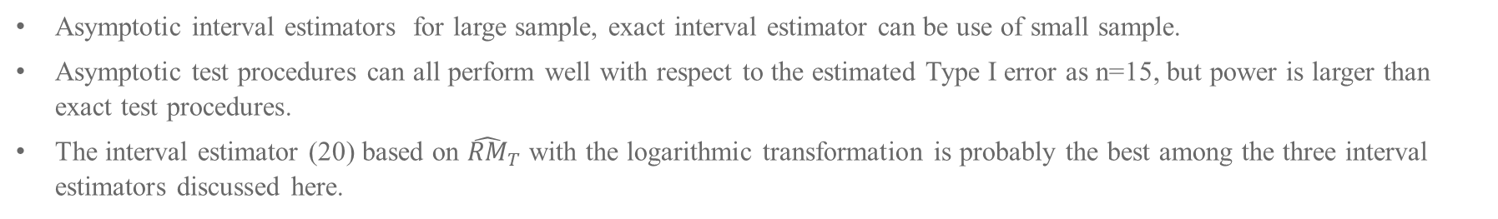
Discussions
Asymptotic interval estimators for large sample, exact interval estimator can be use of small sample.
Asymptotic test procedures can all perform well with respect to the estimated Type I error as n=15, but power is larger than exact test procedures.
The interval estimator (20) based on ${\hat{RM}}_{T}$ with the logarithmic transformation is probably the best among the three interval estimators discussed here.
Notes:
從區間估計的結果來說，asymptotic和exact的覆蓋率與平均長度表現均不錯
從type i error 來看，小樣本用aysmptotic也是不錯的。
用logRMt作區間估計相較於另外兩者較好。

Slide 29
Reference
Christopher Cox. Fieller's Theorem, the Likelihood and the Delta Method, Biometrics Sep. 1990; 46, 709-718.
Kung-Jong Lui and Kuang-Chao Chang. Analysis of Poisson frequency data under a simple crossover trial, Statistical Methods in Medical Research 2012; 0(0) 1–15.
St´ephanie M. van den Berg. Analysing data using linear models. Fifth edition
Casella G and Berger RL. Statistical inference. Belmont,CA: Duxbury Press, 1990.

Slide 30
Thanks!

