Slide 1

Analysis of Poisson frequency data
under a simple crossover trial
Kung-Jong Lui and Kuang-Chao Chang
Speaker：Yi-Hsuan Liu
Advisor：Dr. Tsung-Shan Tsou
Notes:
呂剛中張光昭

Slide 2
Outline
Analysis of Poisson frequency data under a simple crossover trial
01
Introduction
04
Example
02
Notation, model assumption and methods
05
Discussion
03
Monte Carlo Simulation and Result

Slide 3
Introduction
Analysis of Poisson frequency data under a simple crossover trial
01
The Goal of This Article
Frequency of patient response follows the commonly-assumed Poisson distribution under a crossover design.
Present asymptotic and exact procedures for testing non-equality, non-inferiority and equivalence.
Develop asymptotic and exact interval estimators for evaluate.
02
Crossover Design
What is crossover design?
Advantage & Disadvantage
03
Non-equality, Non-inferiority and Equivalence
Relationship among non-equality, non-inferiority and equivalence
Testing for non-equality, non-inferiority and equivalence

Slide 4
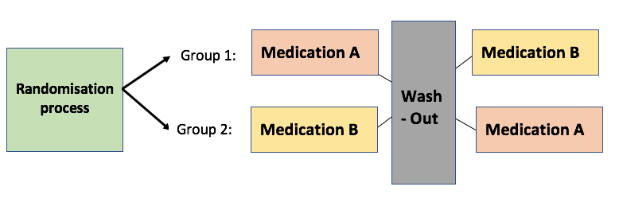
Introduction
Crossover Design
What’s Crossover Design
Treatment | Period 1 | Period 2
Sequence AB | A | B
Sequence BA | B | A
Notes:
What’s Crossover Design?
-(randomly assigns)a repeated measurements design such that each experimental unit (patient) receives different treatments during the different time periods, i.e., the patients cross over from one treatment to another during the course of the trial.
-In medical clinical trials, the disease should be chronic and stable, and the treatments should not result in total cures but only alleviate the disease condition. Therefore this type of design works only for those conditions that are chronic, such as asthma where there is no cure and the treatments attempt to improve quality of life.
Advantage
-more efficient, each patient serves as his/her own matched control.
- require fewer patients than a parallel study
-
Disadvantage
-washed out period
The washout period is a predetermined amount of time during which patients receive no treatment.
-carryover effect
the carryover effect due to treatment A differs from the carryover effect due to treatment B.

Slide 5
Introduction
Crossover Design
Advantage
Sometimes more efficient than parallel design.
Require fewer patients than a parallel study.
The treatment are compared ‘within subjects’.
Disadvantage
Carryover effect
Wash out period
Constraint
In medical clinical trials, the disease should be chronic and stable.
The treatments should not result in total cures but only alleviate the disease condition.
Notes:
What’s Crossover Design?
-(randomly assigns)a repeated measurements design such that each experimental unit (patient) receives different treatments during the different time periods, i.e., the patients cross over from one treatment to another during the course of the trial.
-In medical clinical trials, the disease should be chronic and stable, and the treatments should not result in total cures but only alleviate the disease condition. Therefore this type of design works only for those conditions that are chronic, such as asthma where there is no cure and the treatments attempt to improve quality of life.
Advantage
-more efficient, each patient serves as his/her own matched control.
- require fewer patients than a parallel study
-
Disadvantage
-washed out period
The washout period is a predetermined amount of time during which patients receive no treatment.
-carryover effect
the carryover effect due to treatment A differs from the carryover effect due to treatment B.

Slide 6
Introduction
Non-equality、Non-inferiority and Equivalence
Relationship among non-inferiority, superiority, and equivalence
Inferiority
Equivalence
Superiority
Non-inferiority
Ref : https://ntuhmc.ntuh.gov.tw/epaper-70th.htm
Notes:
不劣性試驗(non-inferiority trials):
旨在評估新藥與已上市藥物間之相對療效，以新舊藥物間療效差異不小於一個事先選定的量(即不劣性臨界值)來證明其療效。
不劣性設計的必要性
基於倫理考量，若市面上已經有確認療效且安全的藥物，安慰劑組的設計則是不能被接受的，例如癌症、心血關疾病或細菌感染疾病等地用藥。
已上市藥物的療效很好，新藥的療效要超過標準治療藥物的可能性較小，但新藥又具備其他的特點(更安全、)更方便使用或尊醫囑性更好)，則可以考慮採用不劣性設計。
不劣性試驗的虛無假設：
新藥比舊藥差
等效性試驗(equivalence trials):
用來證明新、舊藥效相當，虛無假設為新藥與舊藥的效果有差異(更好或更壞)，屬於雙尾檢定。

Slide 7
，
Notation, model assumption and methods
Analysis of Poisson frequency data under a simple crossover trial
01
Model assumption
-frequency of the response on patient I assigned to sequence s at period t
patient
sequence
period
-covariate of treatment receipt
-covariate of period
-the effect due to the underlying characteristics of the $i^{th}$ patient assigned to sequence s
-the effect of treatment B relative to treatment A
-the effect for period 2 v.s. period 1

Slide 8
，
Notation, model assumption and methods
Analysis of Poisson frequency data under a simple crossover trial
01
Model assumption
Conditional MLE of
is

Slide 9
，
Notation, model assumption and methods
Analysis of Poisson frequency data under a simple crossover trial
01
Model assumption
given a fixed period, the ratio of two mean frequencies of responses on a given patient between treatment B and A
given a fixed treatment, the ratio of two mean frequencies for period 2 versus period 1 on a given patient
Conditional MLE of
is

Slide 10
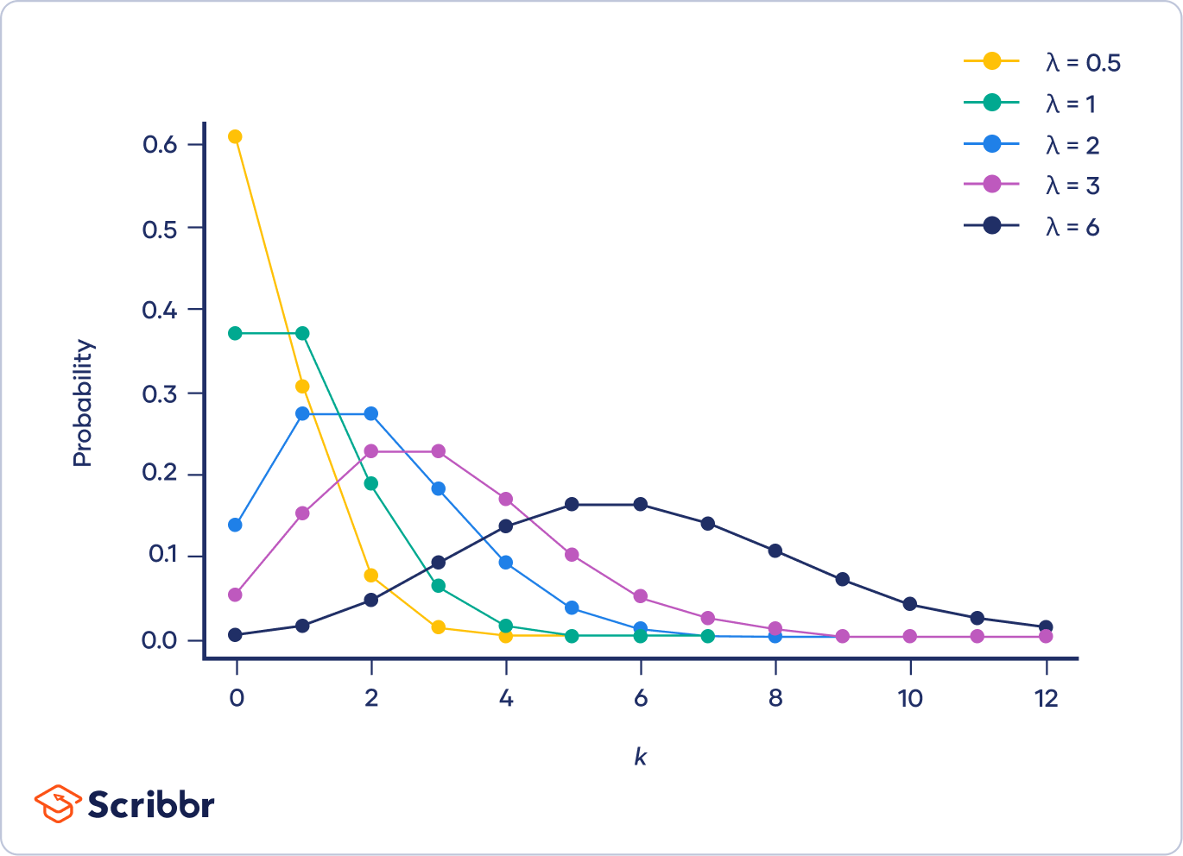
，
Notation, model assumption and methods
Analysis of Poisson frequency data under a simple crossover trial
02
Methods
Fieller’s Theorem
For skewed distribution, use delta method we may obtained asymmetric confidence limits.
While is small, then the large-sample confidence limits will be close to those given by Fieller's theorem.
Assuming that ,we must have
t ：the appropriate percentile of the t-distribution
Let
Partial derivatives
Notes:
In large samples, asymptotic normality takes over and symmetric confidence intervals are appropriate. It’s not difficult to see that these variances are identical to the first-order approximate obtained from the corresponding linear models by the delta method.
But for small samples, the skewness of distribution may give rise to asymmetry of the exact confidence limits.
In large samples, the confidence interval given by the delta method is approximately the same as that obtained from Fieller's theorem. If g is small, then the large-sample confidence limits will be close to those given by Fieller's theorem. When the value of g is not small, however, the confidence limits given by Fieller's theorem are in fact usually wider than those obtained from the large-sample standard deviation, and are not centered on the estimate.

Slide 11
，
Notation, model assumption and methods
Analysis of Poisson frequency data under a simple crossover trial
02
Methods
Fisher Exact Test
 | Guess
Actually | Milk | Tea
Milk
Tea

Slide 12


Notation, model assumption and methods
Analysis of Poisson frequency data under a simple crossover trial
Test non-equality
Wald Test
Reject $H_{0}$ at the $α$-level if
(7)
where
To alleviate the concern of our inference directly based on the possibly skewed distribution of
By Filler’s Theorem
Reject $H_{0}$ at the $α$-level if
(9)

Slide 13
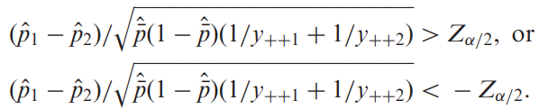
Notation, model assumption and methods
Analysis of Poisson frequency data under a simple crossover trial
Test non-equality
Two Sample T-Test
Given the total $y_{+s+}$being reasonably large for both $s$ , reject $H_{0}$ at the $α$-level if
(10)
where
Fisher Exact Test
(13)

Slide 14
Notation, model assumption and methods
Analysis of Poisson frequency data under a simple crossover trial
Test non-inferiority
Reject $H_{0}$ at the $α$-level and claim that treatment B is non-inferior to treatment A if the test statistic
(14)
(15)
(16)

Slide 15
Notation, model assumption and methods
Analysis of Poisson frequency data under a simple crossover trial
Test equivalence
(17)
(18)
(19)

Slide 16
Notation, model assumption and methods
Analysis of Poisson frequency data under a simple crossover trial
Interval Estimation
(20)
If $A>0$, $B^{2}−AC>0$, asymptotic 100($1−α$)% confidence interval for ${RM}_{T}$as given by
(22)
(23)

Slide 17

Spark Jonson
Manejar Of Freepiker
Leo Adnan
Were hath waters divided fill may days air bring Were hath waters divided fill may days air bring Were hath waters divided fill may days air bring.
Manejar Of Freepiker

Slide 18
Monte Carlo Simulations
Analysis of Poisson frequency data under a simple crossover trial
01
What’s Our Title
Were hath waters divided fill may days
Expertise
Expertise
Expertise
Expertise
02
What’s Our Title
Were hath waters divided fill may days
03
What’s Our Title
Were hath waters divided air bring
05
What’s Our Title
Were hath waters divided fill may days

Slide 19
Monte Carlo Simulations
Analysis of Poisson frequency data under a simple crossover trial
01
Equivalence
Type I error
Power

Slide 20
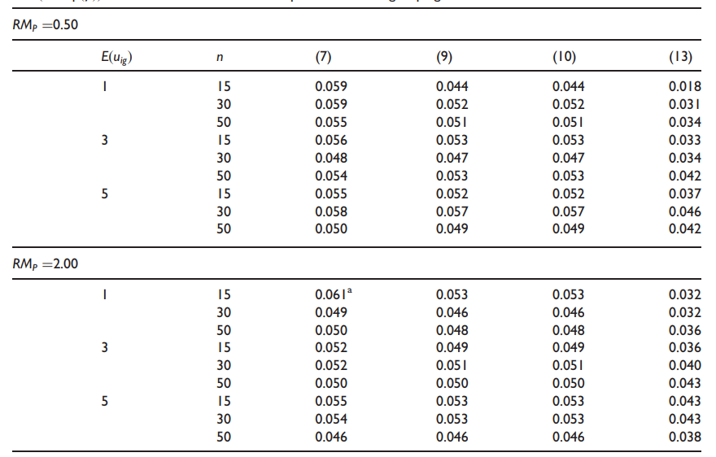
Result
Analysis of Poisson frequency data under a simple crossover trial
Table1- Type I error

Slide 21
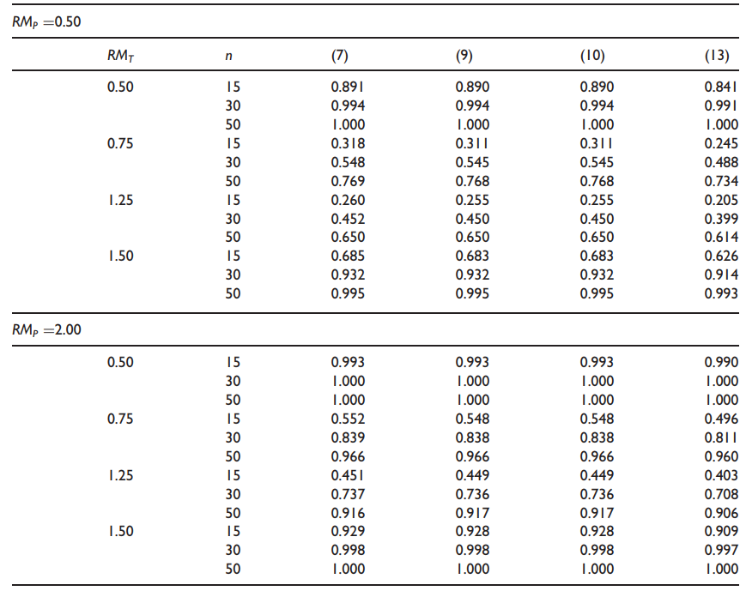
Result
Analysis of Poisson frequency data under a simple crossover trial
Table2-Power

Slide 22
Monte Carlo Simulations
Analysis of Poisson frequency data under a simple crossover trial
02
Non-inferiority
Type I error
Power

Slide 23
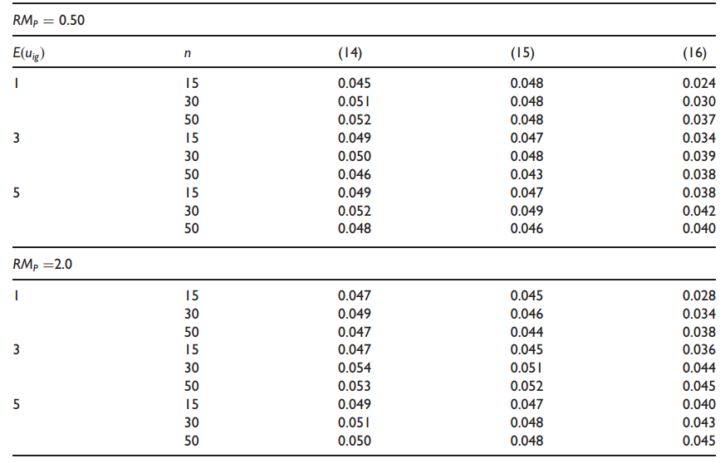
Result
Analysis of Poisson frequency data under a simple crossover trial
Table3- Type I error

Slide 24
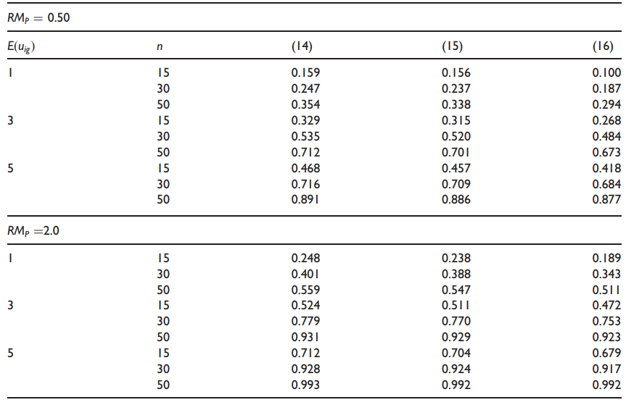
Result
Analysis of Poisson frequency data under a simple crossover trial
Table4-Power

Slide 25
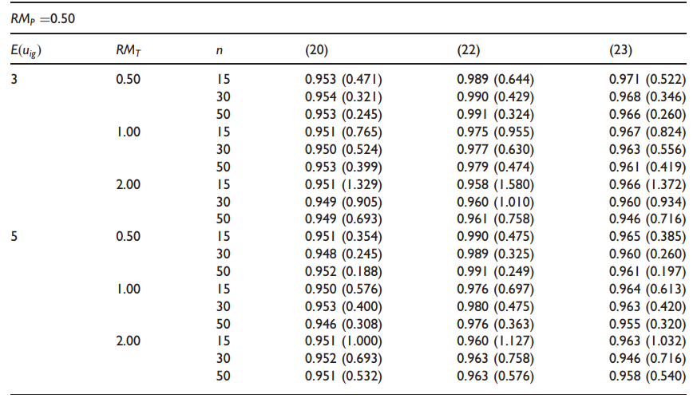
Monte Carlo Simulations and Result
Analysis of Poisson frequency data under a simple crossover trial
03
Interval Estimator

Slide 26
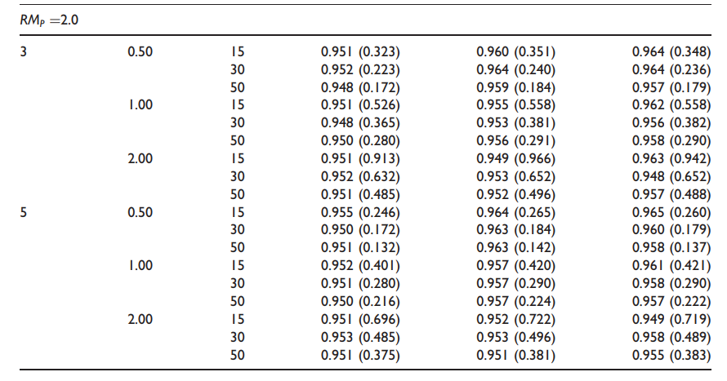
Monte Carlo Simulations and Result
Analysis of Poisson frequency data under a simple crossover trial
03
Interval Estimator

Slide 27
An Example
Analysis of Poisson frequency data under a simple crossover trial
01
Double-Blind Crossover Trial for Asthma patients
Treatment A：Placebo
Treatment B：Beta-agonist salmeterol (50g twice daily)
02
101 participate only 87 patients who completed the trial
Randomized to sequence AB or sequence BA
Sequence AB
24 weeks placebo
Washeout period
24 weeks salmeterol
4 weeks
Sequence BA
24 weeks salmeterol
Washeout period
24 weeks placebo

Slide 28
An Example
Analysis of Poisson frequency data under a simple crossover trial
Sums of exacerbations in asthma on the 87 patients
Test non-equality | (7) | (9) | (10) | (13)
P-value | 0.010 | 0.014 | 0.014 | 0.028
All these suggest that there be significant evidence that taking salmeterol at the 5% level can reduce the mean number of exacerbations in asthma.
Test non-equality | (20) | (22) | (23)
95% confidence interval | [0.227, 0.880] | [0.167, 0.931] | [0.252, 0.937]
Notes:
We can see that the resulting 95% confidence interval of using (20) has the shortest length among these three interval estimators. This is consistent with the previous finding that using the asymptotic interval estimator (20) tends to gain precision as compared with the other two (Table 5). Because all the upper limits of these resulting 95% confidence intervals fall below 1, we may claim that taking salmeterol reduces the mean number of exacerbations in asthma as compared with the placebo. These results are certainly consistent with the previous findings based on procedures for testing non-equality.

Slide 29

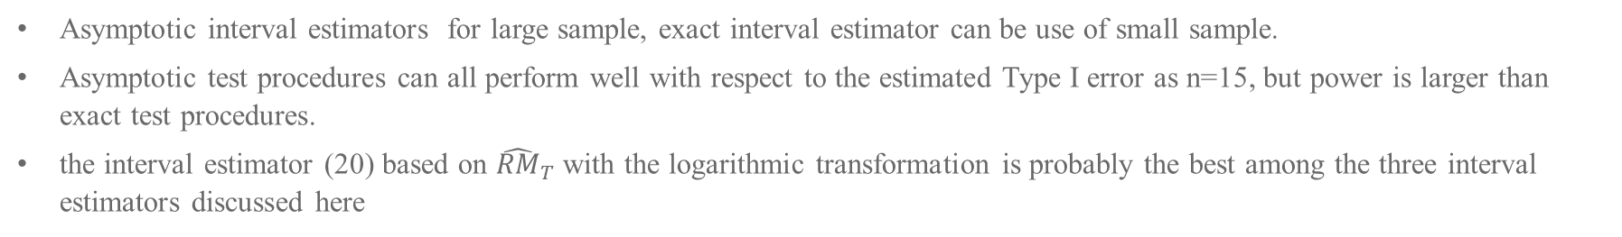
Discussions
Analysis of Poisson frequency data under a simple crossover trial
Asymptotic interval estimators for large sample, exact interval estimator can be use of small sample.
Asymptotic test procedures can all perform well with respect to the estimated Type I error as n=15, but power is larger than exact test procedures.
the interval estimator (20) based on ${\hat{RM}}_{T}$ with the logarithmic transformation is probably the best among the three interval estimators discussed here
Conditional MLE of ${\hat{RM}}_{P}$

Slide 30
Reference
Analysis of Poisson frequency data under a simple crossover trial
Christopher Cox. Fieller's Theorem, the Likelihood and the Delta Method, Biometrics Sep. 1990; 46, 709-718.
Kung-Jong Lui and Kuang-Chao Chang. Analysis of Poisson frequency data under a simple crossover trial, Statistical Methods in Medical Research 2012; 0(0) 1–15.
St´ephanie M. van den Berg. Analysing data using linear models. Fifth edition
Casella G and Berger RL. Statistical inference. Belmont,CA: Duxbury Press, 1990.

Slide 31
Thanks!

