Slide 1

Casual Rides
By: Sharon Makunura
Last Updated: 23 March 2022

Slide 2
Outline
Introduction
Casual rides summary
Recommendations
Appendix

Slide 3
Introduction
Aim
To identify unique trends and patterns in how casual riders use Cyclistic Bikeshare.

Slide 4
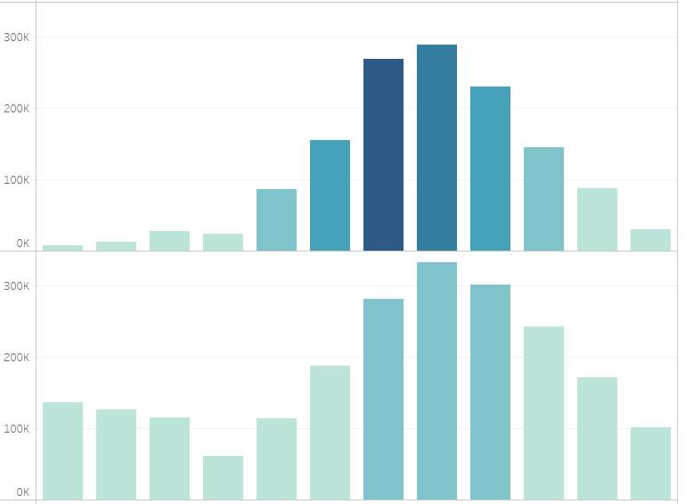

Monthly Rides by Membership
Annual Casual Rides
The following patterns emerge for casual rides:
Total casual rides are lower than member rides
Casual rides have longer durations, particularly between May and October.
The busiest period is between May and November, with rides peaking in August.
Casual rides are at their lowest between December and April, especially January and February.
Casual
Number of rides
Members
Number of rides
Duration(Hours)
97,636
253,466
Jan
Feb
Mar
Apr
May
Jun
Jul
Aug
Sept
Oct
Nov
Dec
Month
Notes:
I analysed the data which consisted of ride records for 2020 for Cyclic Rideshare. It contained dates, times and start and end destinations for all rides. It also specified whether the rider was a member or casual. This graph shows the number of rides per category of membership. The top bars represent the casual, and the members are at the bottom over the same monthly period. The color of the bars represents the total duration of the rides. The lighter the bars, the shorter the trips, the darker the bars the longer the trips.

Slide 5
Annual Casual Rides (contd)
 | Max. Duration (Hrs) | Avg. Duration (Mins)
January | 2607.50 | 161.64
February | 2398.95 | 127.53
March | 954.17 | 62.67
April | 928.07 | 73.07
May | 481.62 | 51.18
June | 642.28 | 51.61
July | 832.75 | 59.83
August | 680.77 | 44.78
September | 904.72 | 38.12
October | 595.40 | 30.20
November | 598.90 | 31.77
December | 162.35 | 26.85
Overall | 2607.50 | 47.32
The analysis of maximum and average duration showed a pattern slightly dissimilar to the total rides analysis.
Despite low total rides overall, January and December recorded the highest maximum durations of the year.
The lowest average durations were experienced between October and December, with December recording the lowest maximum and average ride duration.
Notes:
Table summarizes mean and max duration per month

Slide 6
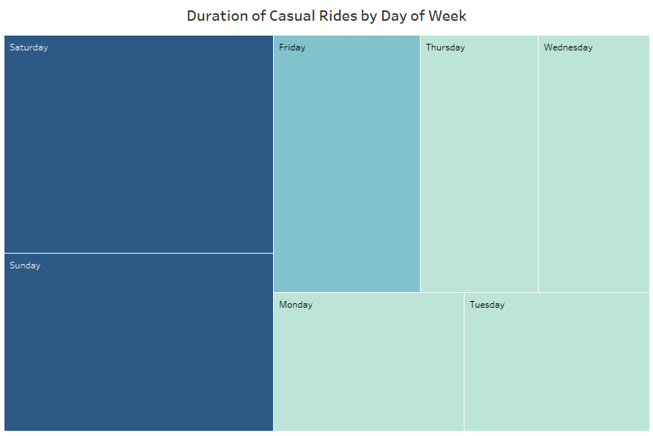
Daily Casual Rides Duration
253,465
152,390
125,447
108,056
Casual riders clocked more hours during the weekends, with significantly longer durations between Friday and Sunday.
Tuesday had the lowest total rides and ride durations of all the days of the week.
231,051
109,399
97,636
Notes:
The heatmap shows the total duration in hours by day of week. The size of each represents the number of rides on the day, while the color shows the duration of the rides.

Slide 7
Casual Rides by Weekday
 | Max. Duration (Hrs) | Ave. Duration (Mins)
Sunday | 2398.95 | 54.14
Monday | 769.42 | 46.35
Tuesday | 1158.42 | 42.62
Wednesday | 1245.05 | 42.51
Thursday | 2607.50 | 46.27
Friday | 1955.38 | 45.26
Saturday | 1094.37 | 48.47
Overall | 2607.50 | 47.32
Thursday unexpectedly had the highest maximum length of rides. Although Sunday and Friday had significantly high maximum length of ride, Saturday was not as high
Clearly maintains trend that weekends are the most active days.
Saturday and Sunday did record above average for their average durations, with Tuesday and Wednesday as the lowest.
Notes:
Table summarizes mean and max duration per weekday

Slide 8
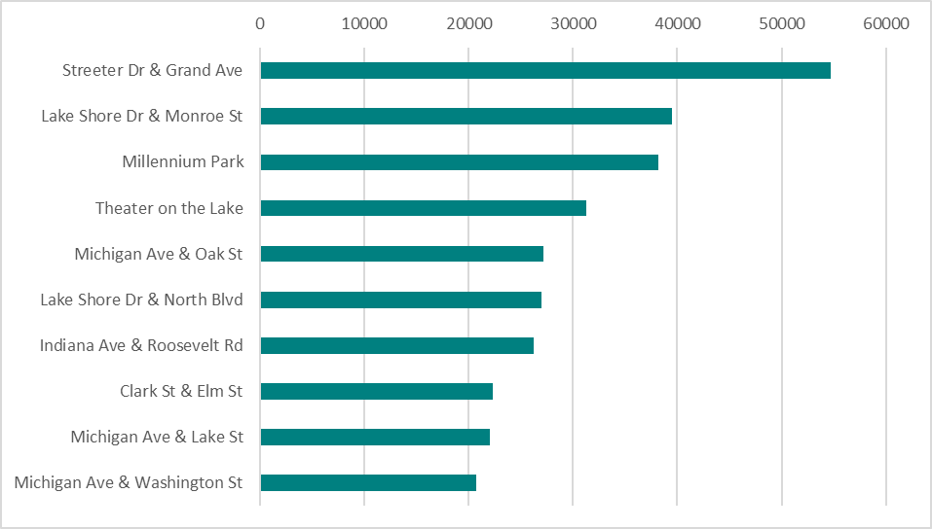
Top 10 Most Popular Stations
Streeter Dr & Grand Ave
Lake Shore Dr & Monroe St
Casual riders favor these 10 stations and start or end their rides there
Streeter Dr & Grand Ave is by far the most popular station
Millennium Park
Theater on the Lake
Michigan Ave & Oak St
Lake Shore Dr & North Blvd
Indiana Ave & Roosevelt Rd
Clark St & Elm St
Michigan Ave & Lake St
Michigan Ave & Washington St
Notes:
Shows top 10 stations with the highest number of combined start and end of rides.

Slide 9
Conclusions
So what trends and patterns are unique to the casual rider?
They are clearly most active over the weekends, particularly on Sunday
They are less active mid-week, especially between Tuesday and Wednesday.
They are also active seasonally, favoring April to November, but especially August.
Despite these clear patterns there is also a tendency to have significant activity outside of the expected active times, for example significantly high average ride lengths in January, when total number of rides is very low.
The most popular station of use is Streeter Dr & Grand Ave

Slide 10
Implications
Considerations for luring the casual rider to become a member:
Appeal to weekend and seasonal riders
Focus on ride lengths rather than total rides for member benefits
Further analysis can help determine the significance of Streeter Dr & Grand Ave station

Slide 11
Appendix
Source files provided by Coursera
All analysis files including R script, Tableau workbook and Excel sheets are available on Github here.

Slide 12
Thank You

