Slide 1
Movie Recommender System Project
Prepared by Group 1

Slide 2




Team Members
JUSTIN MBUGUA DENNIS MWANIA SHARON MOMANYI STEPHEN MUNYIALA TABBY MIRARA

Slide 3
INTRODUCTION
“What movie should I watch this evening?”
Have you ever had to answer this question at least once when you came home from work? As for me—yes, and more than once.
This project aims to build a movie recommendation system by analyzing patterns in how users rate different movies, then suggesting the top 5 movies that a user is most likely to enjoy therefore increasing engagement for streaming platforms.

Slide 4
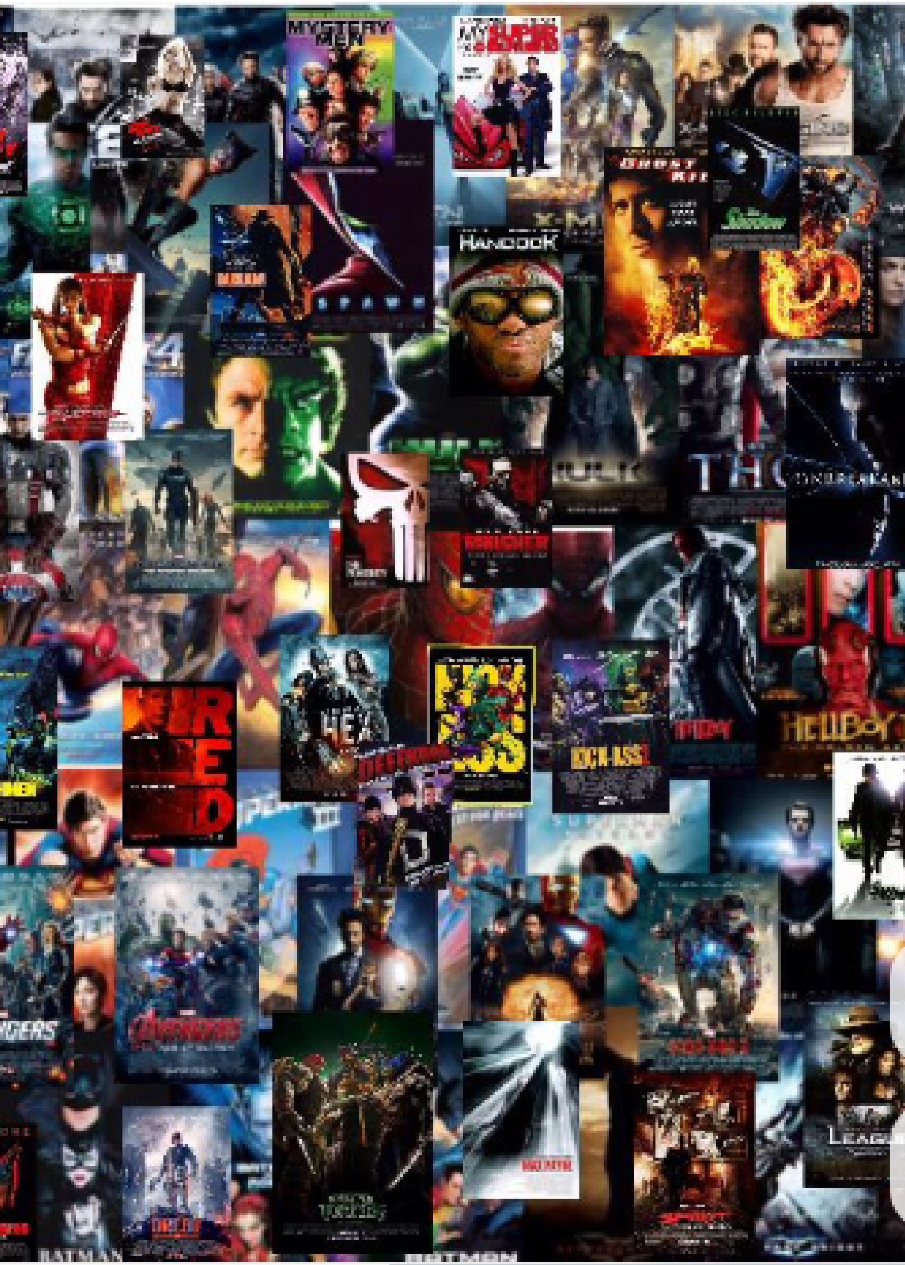
Business Problem
Irrelevant movie recommendations could lead to lower watch times and users disengaging from streaming platforms.
The aim is to implement a recommendation system that will improve user satisfaction by making relevant recommendations to users leading to high watch times and customer retention.

Slide 5


Project Objectives
Create a movie recommendation system.
Predict the rating that a user would give to a movie that he has not yet rated.
Minimize the difference between predicted and actual rating (RMSE and MAE)

Slide 6

Data Overview
This dataset utilizes information from IMDb and TMDb and describes 5-star rating and free-text tagging activity from MovieLens, a movie recommendation service. It contains 100,836 ratings and 3,683 tag applications across 9742 movies.
Movielens

Slide 7
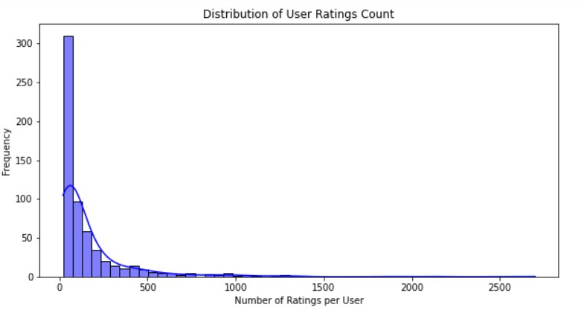
Exploratory Data Analysis
We can see that most users rate very few movies, and few users rate many movies.
This shows that the dataset has a lot of users with little interaction.

Slide 8
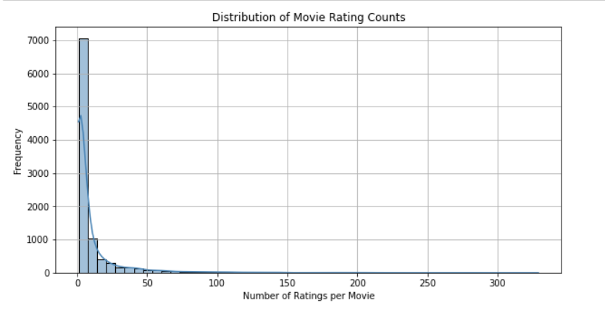
Exploratory Data Analysis
From this plot, it is evident that, very many movies have few ratings while few movies have many ratings.
This suggests that most movies are either niche, less popular, or newer additions to the platform.

Slide 9
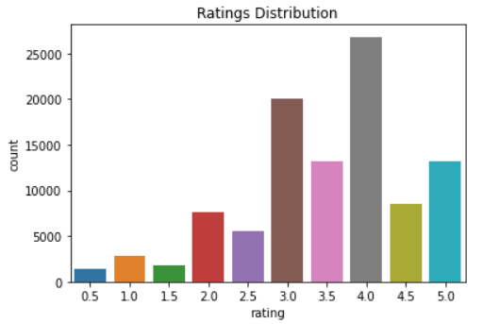
Exploratory Data Analysis
Most movies recieve a rating of 4.0 followed by 3.0.
It is possible that users are generous with their ratings, giving a 3 if they don't really like a movie, 4 if the movie was alright and 5 if they really enjoyed the movie.

Slide 10
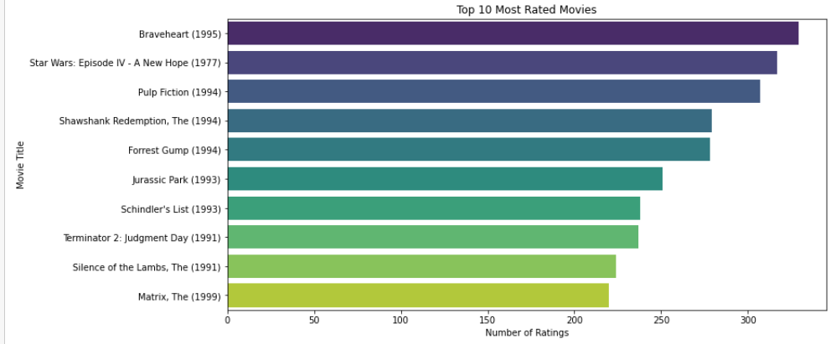
Exploratory Data Analysis
The top 10 movies are critically praised, culturally significant, or blockbuster hits from the 1990s (except Star Wars: Episode IV, released in 1977).

Slide 11
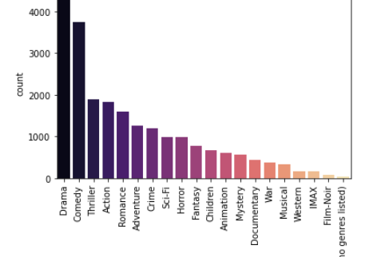
Exploratory Data Analysis
Drama and Comedy are likely the most common genres, given their typical prevalence in dataset.These genres appeal to broad audiences, explaining their high representation.

Slide 12
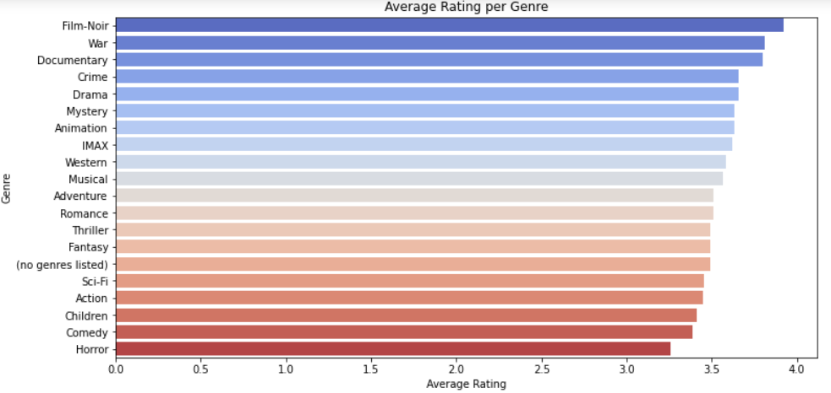
Exploratory Data Analysis
Film-Noir, War, and Documentary have the highest average ratings although they appear least frequently in the previous graph.
This implies that these genres have niche audiences, who enjoy these movies and rate them highly.

Slide 13
Recommendation Models
Collaborative Filtering (SVD)
This was used to recommend movies based on user behaviour.
Content-Based Filtering
This was used to compute the similarity between movies based on their genres. It allows us to recommend movies that share similar genre characteristics.
Hybrid Recommendation System
This was used to improve recommendation quality, CF (SVD) is blended with CBF (genre similarity).
This approach balances personalized predictions with genre- based similarities, helping address the cold start problem for new users.

Slide 14
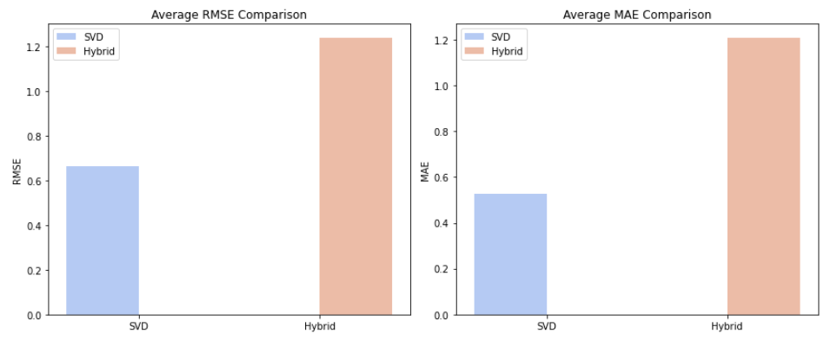
Model Comparison
SVD Performance: SVD consistently has a lower RMSE and MAE compared to the Hybrid system. This suggests that, in this particular evaluation, SVD is making more accurate predictions than the Hybrid approach.
Hybrid Performance: The Hybrid system shows significantly higher RMSE and MAE. This indicates that its predictions are further away from the actual ratings than those of SVD.

Slide 15
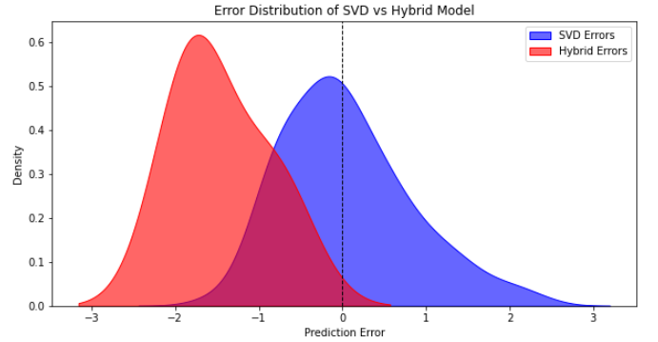
Model Comparison
The Hybrid Model appears to be biased negatively but appears to be more consistent and has lower error variance. Since the goal is to have errors closer to zero on average, the SVD model is more preferable but its spread suggests that it's inconsistent.

Slide 16



Recommendations
Collaborative filtering (SVD) is the best model for the recommender system since it has a lower RMSE and MAE compared to the hybrid recommendation system.
When a user is new ,recommend movies based on their popularity while, for a current user , use their previous information on movie ratings and genres preferred to tailor recommendation.

Slide 17

Conclusion
In this Analysis, we evaluated the performance of different models for predicting movie ratings; SVD and a Hybrid model. Though the hybrid model was more consistent, the goal was to have errors close to zero on average which is why the SVD model is more preferable.

Slide 18
Next Steps
Model Tuning: Further hyperparameter tuning for both models.
Hybrid model enhancements: Advanced hybridization techniques such as weighted blending or even adding more CBF should be considered to help reduce hybrid model's bias and improve performance.
Cold-Start Problem: In the analysis, we attempted to solve the problem using global genre preference. Popularity-Based Recommendations should also be considered to try and address the problem.

Slide 19


Thank you!

