Slide 1
FS China Sales LoB AI Coach Project
GCR FS Account Team
2025.08.13

Slide 2
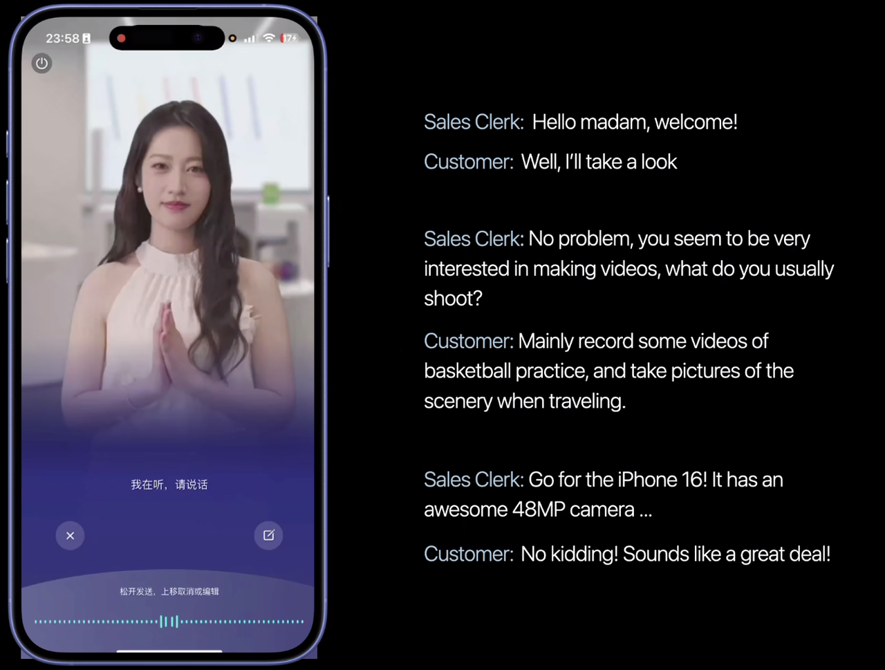
Background
Virtual Digital Human play as clients interacting with Apple sales
6 rounds role play
Each round LLM generates
Client dialogue
Best answer for Sales
Overall feedback after 6 rounds
VDH streaming response latency < 3s
Vendor offered frontend + FS in-house backend
LLM – Deepseek Qwen 32 B
VDH – OSS framework LiveKit
Usage Patterns
Daily traffic
Peak traffic (3x daily traffic) during exam period
Notes:
They're developing a virtual digital human (VDH) application to coach Apple sales staff in their customer interactions.
The system allows sales staff to initiate training sessions where they engage in a six-round role play with an AI client.
For each round:
The LLM generates realistic client dialogue
Sales staff respond to the simulated client
The system provides optimal answer examples
After completing all six rounds, the AI generates comprehensive feedback highlighting strengths and areas for improvement in the conversation.
Technical Requirements
Response latency must be under 3 seconds to ensure natural interaction
The deployment architecture involves:
Front-end mobile application (provided by customer's vendor)
Back-end solution hosted on AWS
LLM component using DeepSeek Qianwen (32B parameter model)
VDH framework built on open-source LiveKit with ASR, TTS, wav2lip and WebRTC capabilities
Usage Patterns
Sales staff are assigned training tasks to complete over 1-2 months
During exam periods, we expect traffic spikes up to 3x normal volume
Peak usage will occur during new iPhone release events

Slide 3
Progress Track
Functionality Test
Monolithic application on 1xP4d
Architecture redesign with micro-services
LLM ( GPU intensive )
VDH ( CPU intensive ) – G5.24x/48x , H20
Flagship event (iPhone 17)
for 20k users
Medium-scale test for 3k users
Sep 2024
May 2025
June 2025
July 2025
Aug 2025
Sep 2025
Small-scale test for 200 users
Monolithic application
P4d ASG + NLB
Monthly 3 x H20 with MP NWCD
Resource redistribution
E2E performance optimization
Teamwork: GCR SS, Industry, AILab, Partner
Notes:
3x p4d ( 96c ) hardly servig for 200 users
Project Timeline & Progress
September 2024: Customer approached us after AliCloud couldn't meet their infrastructure needs
Initial Phase: Deployed monolithic application on P4d instances, zero limit experience on aws or cloud, we were kind of babysitting them
After several months development and test, Earlier this year we believed the emerging of deekpseek models improved the chineses content generation quality
May 2023: Successfully conducted first test with 200 users using auto-scaling groups
June 2023: Redesigned for scalability to support 20,000 users:
Replaced monolithic application with microservices
Implemented Redis caching
Separated LLM and VDH workloads for independent scaling
Identified G5 instances as optimal but faced availability constraints
Implemented H20 instances through AWS partner solution
Current Status
Customer is scheduled to conduct a 3,000-user test this Thursday/Friday
Final goal is to support all 20,000 sales staff in China region, they are planning
This has been a successful cross-team collaboration with GCR, Sales, Service, Industry, and Partner teams. Despite not being the official cloud provider for Fruit Stand China, we've earned their trust and business through our support.

Slide 4
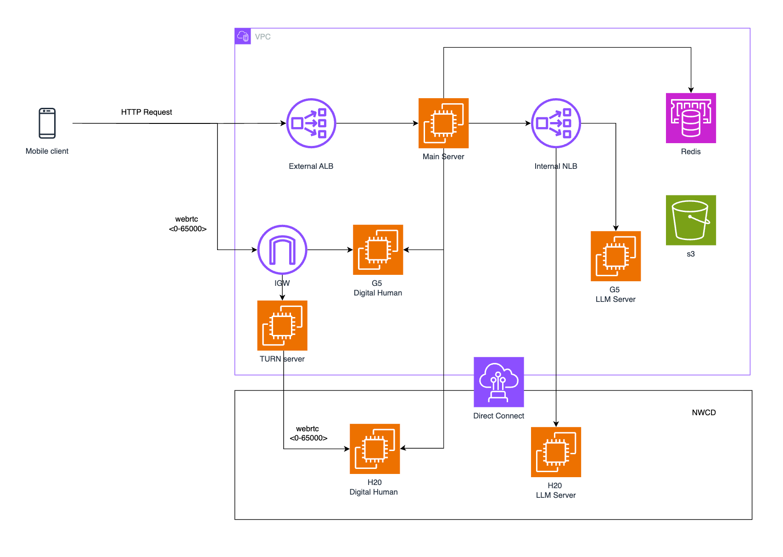
Architecture
Notes:
Get rid of DX and TURN
Technical Architecture
H20 instances hosted via partner connection to customer VPC
Load balancing, Redis, and S3 for storage
We convinced the customer to use aws native G5 instances to cover busy hours
TURN server implementation for secure WebRTC connections

Slide 5
GPU planning
Key ask: H20 & G5 GPU AWS native capacity
Within acceptable latency
LLM - 120 concurrency per H20 instance
VDH - 72 concurrency per H20 / G5.48xl instance
20k user daily access – max concurrency 120
RI : LLM – 1xH20, VDH - 2xH20
20k September Flagship Event ( max concurrency 3x)
RI + On Demand (H20 + G5)
Notes:
This data can be updated and precised after this week’s test.
Based on stress testing, each H20 instance can support:
120 concurrent LLM sessions
72 concurrent VDH sessions
We estimate needing 3 instances for daily traffic and 9 instances for peak periods

Slide 6
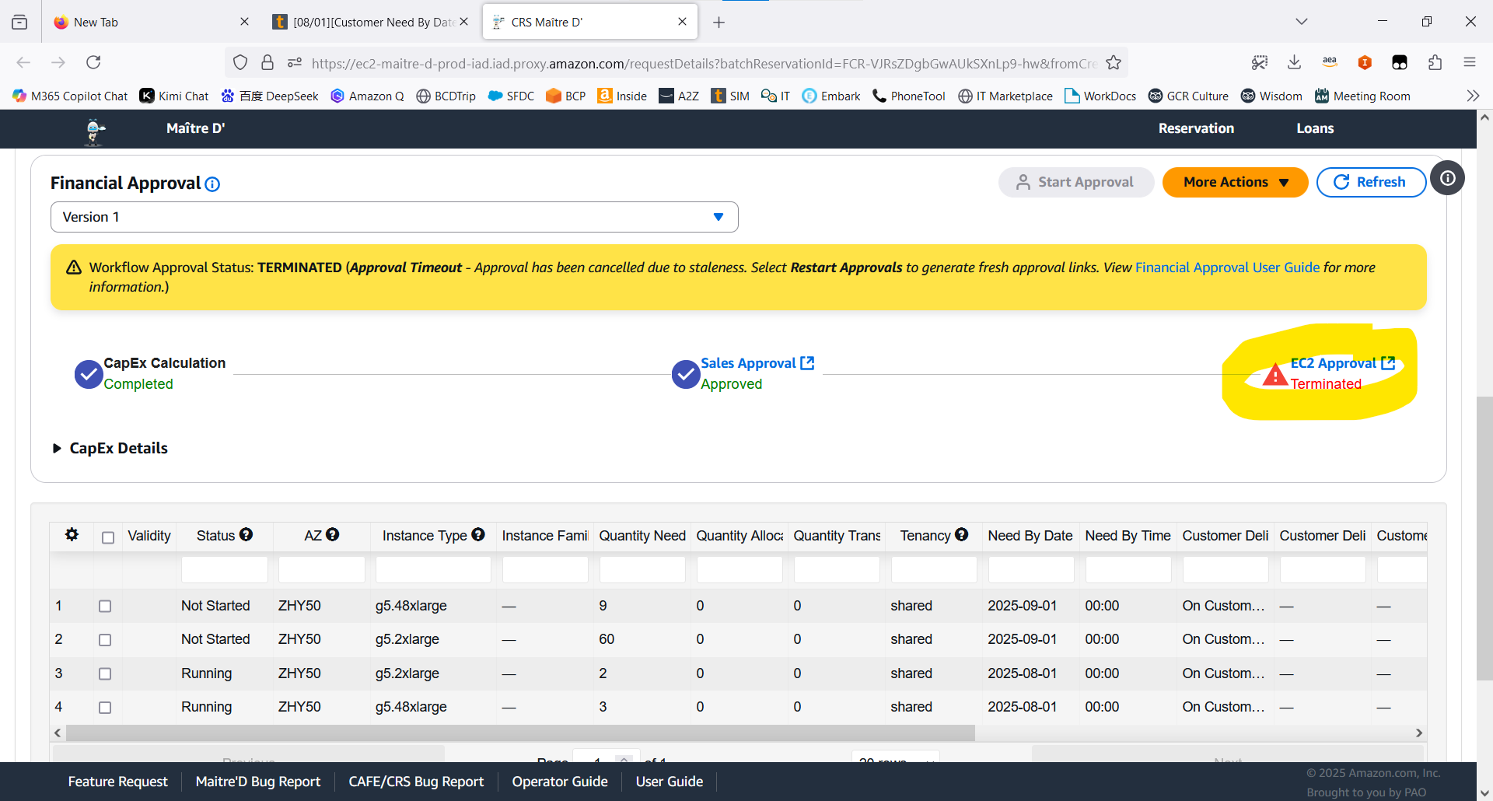
Foob Approval Terminated
Notes:
Challenges & Requests
We need sufficient GPU capacity but our request was rejected by the EC2 service team
We're requesting Global Account team assistance to:
Accelerate H20 instance availability in China regions
Expand G5 GPU instance capacity with Apple endorsement
As we proceed with the PPA signature process, any guidance and knowledge sharing on will be much appreciated
How to effectively use "AWS at Apple"
Best practices for account management
Migration procedures for existing accounts

Slide 7
AWS@Apple onboaring
Account management
Migration procedure – MP H20 to aws native H20

