Slide 1
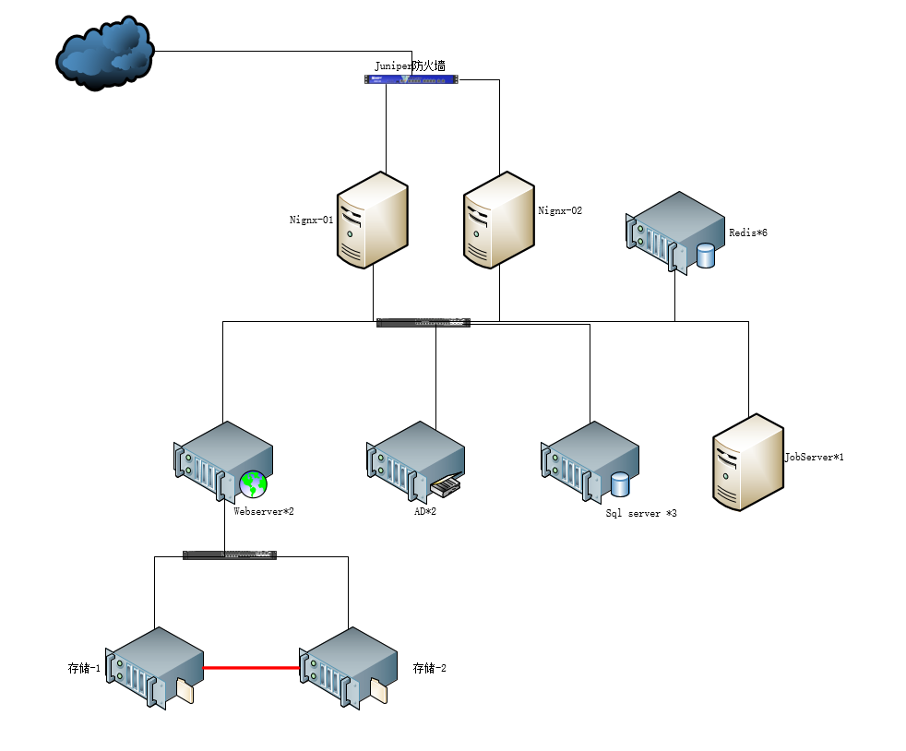

Slide 2




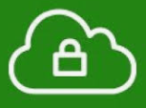
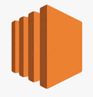

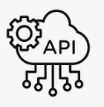










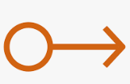
AWS Cloud
CloudWatch
AWS Shield
Region
VPC
Public Subnet
Private Subnet
Apple
Internet Gateway
Public Router
Table
AD 1
AD 2
SQL Server 1
Nginx 1
Web Server 1
Redis 1
User
Route 53
Network Load
Balancer
SQL Server 2
FSx
S3
Nginx 2
Web Server 2
Redis 2
SQL Server 3
NAT Gateway
Maintenance
Elastic IP
Private Router
Table
Job Server

