Slide 1
KijaniKiosk DevOps Foundation
Track A: Infrastructure-First
DevOps Capstone Project
Sharon Ombonya
21 August 2026

Slide 2
Problem
KijaniKiosk initially lacked a repeatable and controlled way to build, deploy, verify, and monitor the kk-payments service. The project needed automated CI/CD, infrastructure provisioning, configuration separation, a Kubernetes staging environment, health monitoring, and a controlled path toward production. The capstone addresses this operational gap by combining Jenkins, Docker, Terraform, Ansible, Kubernetes, Prometheus, and the Week 10 receipt-processing workflow into one documented delivery system.

Slide 3
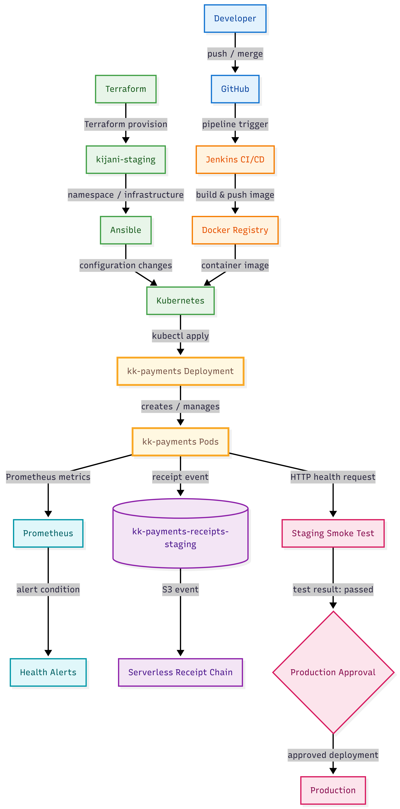
Architecture
GitHub → Jenkins → Build/Test → Docker → Kubernetes → Monitoring
And:
kk-payments → Receipt Processing

Slide 4
Key Technical Decision
Staging deployment before production approval
I chose:
A Jenkins pipeline that deploys to kijani-staging, runs a smoke test, and only then presents the production approval gate.
I did not choose:
Direct automatic deployment from the build stage to production.
Why:
The staging environment provides a verification point before production and allows a human to review the result before promotion.
Trade-off:
This improves deployment control and reduces the risk of promoting a failed build, but it adds deployment time and requires staging infrastructure plus human approval.
Production change
In a larger production environment:
I would keep the approval control for high-risk changes while using automated tests and progressive delivery to reduce unnecessary waiting.

Slide 5
AI Tooling & Governance
How I used AI
Used ChatGPT and Google Gemini to troubleshoot Jenkins, Docker, Kubernetes/Minikube, and deployment issues.
AI suggestions were tested against the actual project environment before implementation.
What AI got right
Identified that Jenkins needed access to Docker, Kubernetes, and Minikube resources.
Correctly identified the kubeconfig/Minikube path mismatch inside the Jenkins container.
Helped identify possible causes of the Jenkins production-stage issue.
What AI got wrong
ChatGPT initially suggested increasing the overall Jenkins pipeline timeout from 15 → 30 minutes, then suggested increasing it further.
This did not solve the problem because Jenkins was intentionally waiting for human approval.
Gemini also offered increasing the timeout as Option 1, which I rejected.
What I changed
I tested the timeout recommendation and rejected further increases.
I chose Gemini's Option 2: inspect the running Jenkins pipeline.
I found the pending approval request, entered the approval reason, and allowed the pipeline to continue.
This reinforced that AI recommendations are advisory, not authoritative.

Slide 6
Production Gaps & Required Changes
1. Kubernetes / Infrastructure
Gap: Local Minikube and development infrastructure.
Change: Move to managed/hardened Kubernetes with stronger security, availability, networking, backups and disaster recovery.
2. Jenkins / Webhook
Gap: Local Jenkins and temporary ngrok webhook.
Change: Use production-grade CI/CD and a stable, secured webhook endpoint.
3. Secrets / Monitoring / Receipts
Gap: Development-level secrets, monitoring and receipt processing.
Change: Add dedicated secrets management, production monitoring, and stronger reliability, security and error handling.

