Slide 1
AVIATION DATA ANALYSIS

Slide 2
INTRODUCTION
Let’s start with the objective of this analysis
1

Slide 3
BUSINESS CONTEXT
The company would like to explore a new business venture - The aircraft industry.
The objective of this analysis:
Determine if delving into the aircraft industry is worthwhile for the company
Identify which types of aircrafts the company should purchase to reduce risks.

Slide 4
BUSINESS QUESTIONS
Question 1
What is the trend of aircraft accidents and fatal injuries over the years?
Question 2
Which Phases of Flight are more prone to accidents? Which accidents result in more fatalities, and damage to the aircraft?
Question 3
Is there a relation between number of engines in an aircraft and fatalities in the occurrence of an accident?

Slide 5
THE DATA
Let’s look at the data we’ll use to answer these questions
2

Slide 6

DATA UNDERSTANDING
For this analysis, a dataset from the National Transportation Safety Board that includes accident data from 1962 to 2023 was used.
It contains records of civil aviation accidents and selected incidents in the USA and international waters.

Slide 7
DATA ANALYSIS
Now let’s answer the questions
3

Slide 8
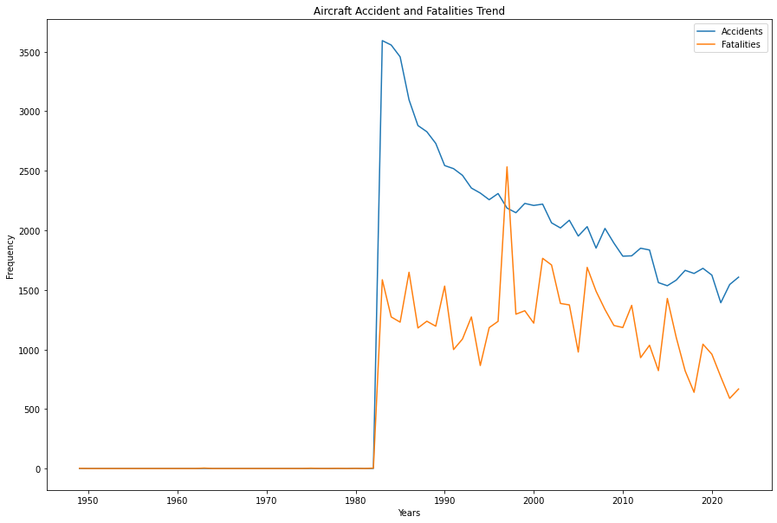
Trend of Aircraft Accidents and Fatalities Over The Years

Slide 9
Trend of Aircraft Accidents and Fatalities Over The Years
Number of aircraft accidents have been decreasing over the years.
Deaths due to aircraft accidents have similarly been decreasing over the years.

Slide 10
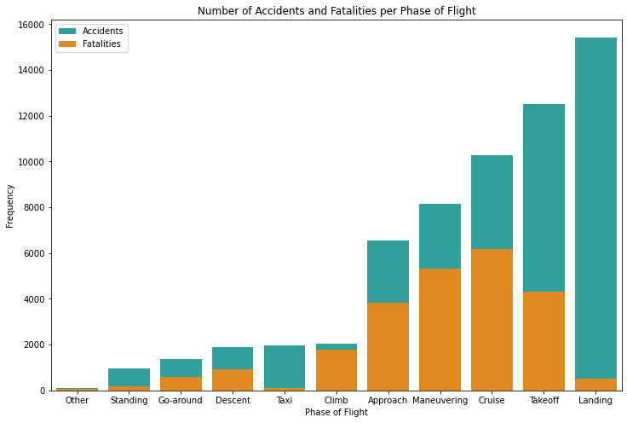
Aircraft Accidents at different Phases of Flight

Slide 11
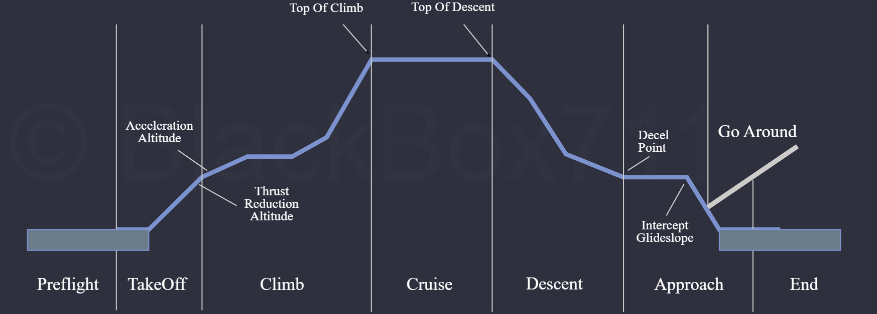
Aircraft Accidents at different Phases of Flight
Accidents are more likely to happen at the Landing and Takeoff phases of flight.
However, few accidents in the Landing and Takeoff phase result in fatalities.

Slide 12
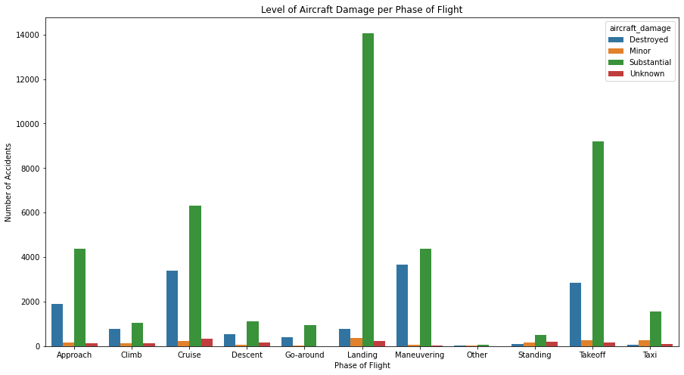
Aircraft Accidents at different Phases of Flight

Slide 13
Aircraft Accidents at different Phases of Flight
In addition to most accidents occurring at Landing and Takeoff, most of the accidents in this phase cause substantial damage to the aircraft.
For phases that have higher risks of having fatalities (Cruise, Maneuvering), the aircrafts tend to be destroyed in the event of an accident.

Slide 14
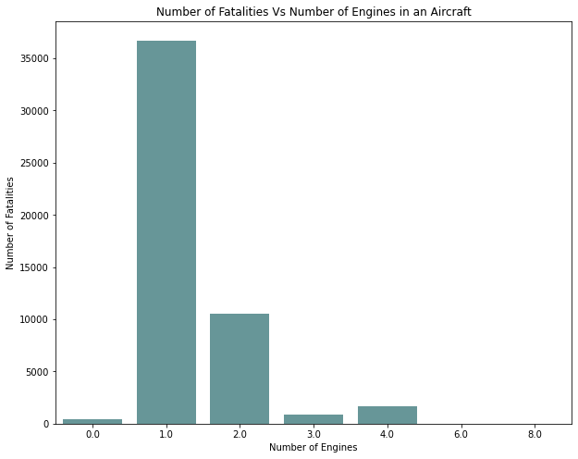
Number of Engines in an Aircraft Vs Fatal Accidents
The highest number of fatal injuries occur when the aircraft has only one engine.

Slide 15
RESULTS AND RECOMMENDATIONS
4

Slide 16
Results
Aircrafts are becoming safer. The number of accidents and fatalities over the years continues to decrease.
When accidents do occur, most of them tend to be in the Landing and in the Takeoff phases of flight. Although, these accidents rarely result in fatalities, they cause substantial damage to the aircrafts.
There is a higher risk of fatal injuries in accidents that involve aircrafts with only one engine while those with more than one engine have less fatal injuries.

Slide 17
Recommendations
The aircraft industry is a worthwhile business venture for the company given that a lot of effort has been put into advancing aviation technology and making air travel safer.
Investing in aircrafts that have sophisticated auto-pilot and auto-landing systems will assist to enhance flight precision and reduce number of accidents at Landing and Takeoff.
Finally, it is also advisable for the company to invest in aircrafts that have at least two engines, to further reduce the risk of fatalities.

Slide 18

THANKS!
Any questions?
You can find me at
sharon.maina1@student.moringaschool.com

