Slide 1
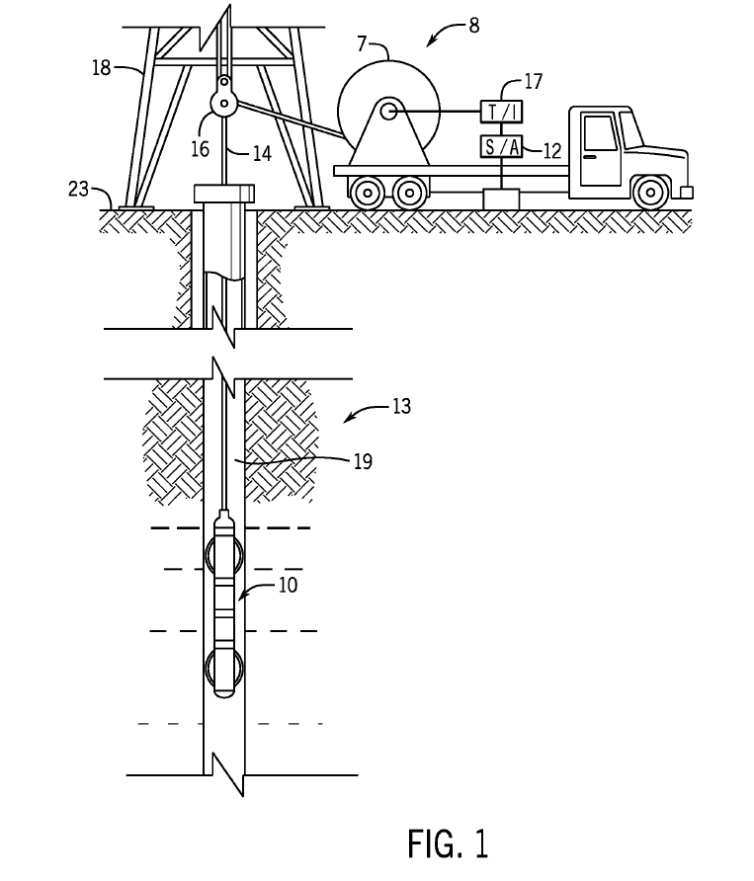
{b1}
{c1}
{i1}
{h1}
{g1}
{f1}
{d1}
{k1}
{e1}
{j1}
{a1}
FIG. {fig}
Notes:
11035974
FIG. 1 is a schematic side view of an embodiment of a wireline system for electrical logging, in accordance with embodiments of the present disclosure.
FIG. figref000 shows a resistivity imaging tool ref100 suspended in a bore hole ref118 that penetrates earth formations such as ref108, from a suitable cable ref110 that passes from drum ref102 over a sheave ref112 mounted on drilling rig ref116. By industry standard, the cable ref110 includes a stress member and seven conductors for transmitting commands to the tool and for receiving data back from the tool as well as power for the tool. In various embodiments, the resistivity imaging tool ref100 is a part of a downhole tool or assembly (also referred to as the bottomhole assembly or “BHA”) attached to the bottom end of the cable ref110. Such a downhole assembly may include various tools, sensors, measurement devices, communication devices, and the like, which will not all be described for clarity. The resistivity imaging tool ref100 is raised and lowered by draw works. The truck ref104 includes electronics module ref114, on the surface ref120 that transmits the required operating commands downhole and in return, receives data back which may be recorded on an archival storage medium of any desired type for concurrent or later processing. The data may be transmitted in analog or digital form. Data processors such as a suitable computer ref106, may be provided for performing data analysis in the field in real time or the recorded data may be sent to a processing center or both for post processing of the data.
Embodiments of the invention may be used in measurement-while-drilling (MWD), logging-while-drilling (LWD) or logging-while-tripping (LWT) operations. A slickline implementation of the invention is also possible in which the sensor assembly is conveyed downhole on a slickline, the data recorded on a suitable memory device, and retrieved for subsequent processing.

Slide 2
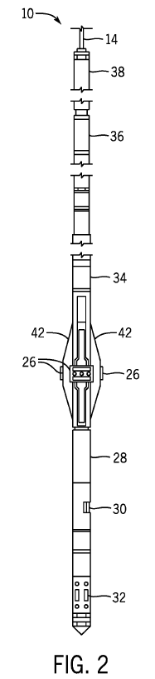
{a2}
{b2}
{j2}
{i2}
{h2}
{k2}
{k2}
{c2}
{d2}
{e2}
{f2}
{g2}
FIG. {fig}
Notes:
11035974
FIG. 2 illustrates the resistivity imaging tool, in accordance with example embodiments.
FIG. figref000 illustrates the resistivity imaging tool ref100 as suspended from cable ref102, in accordance with example embodiments. The resistivity imaging tool ref100 includes a mandrel ref114 and a plurality of outwardly extendable measurement pads ref104. The resistivity imaging tool ref100 may optionally include a mud cell ref110 and a circumferential acoustic televiewer ref112. Electronics modules ref106 and ref108 may be located at suitable locations in the tool and not necessarily in the locations indicated. Various other components may be mounted on a mandrel ref114. In some embodiments, the resistivity imaging tool ref100 includes an orientation module ref116 including a magnetometer and an accelerometer or inertial guidance system. The upper portion ref118 of the tool ref100 may contain a telemetry module for sampling, digitizing and transmission of the data samples from the various components uphole to surface electronics. If acoustic data are acquired, they are preferably digitized, although in an alternate arrangement, the data may be retained in analog form for transmission to the surface where it is later digitized by surface electronics.
In some embodiments, position guides such as bowsprings ref120 help maintain the resistivity imaging tool ref100 in a centralized position within a wellbore. The measurement pads ref104 extend in a plurality of azimuthal directions to contact different sides of the wellbore. The number of measurement pads ref104 may vary based on the tool ref100 design, size of the well, and the like. The measurement pads ref104 may be retracted towards the mandrel ref114 when lowering or raising the tool ref100 and extend radially outward to make contact with the walls of the well to conduct measurements. The mandrel ref114 remains relatively centered in the well.
The external surface of a measurement pad ref104 (alternatively referred to as a pad face) is positioned against the wellbore wall and accommodates one or more transmitting electrodes and one or more sensing electrodes. Specifically, each pad has a set of transmitting electrodes and sensing electrodes. The transmission electrodes may be driven at a high frequency voltage and inject the voltage into the formation. The sensing electrodes measure the current in the formation, which is converted from respective voltages into amplitude and phase values by comparison to a transmitter signal. In some embodiments, the complex data is sent in digital form by the tool downhole telemetry module to the surface for use in further data processing, for example estimation of real and imaginary components of impedance associated with the measurement pads. In some embodiments, raw data such as measured voltage and phase or impedance can be used to obtain imaging data.
Some downhole applications need the resistivity logging tool ref100 to be able to measure at low resistivity levels. However, conventional tools are not capable of accurately providing such low resistivity measurements largely due to electrical leakage that tends to occur between the pad electronics and the mandrel. The leakage can cause erroneous and negative resistivity measurements. Embodiments of the present disclosure provide a resistivity logging tool with no or reduced electrical leakage between the pads and the mandrel. The pad electronics are galvanically isolated from the mandrel and pad's body by having, for example, an isolated DC/DC or AC/DC power supply implemented inside the pad. The output of this power supply is used to power all of the electronics on the pads, including a high frequency signal generator also implemented inside the pad. This eliminates or reduces signal leakage that may get back into the main measuring loop by disconnecting possible leakage paths.

Slide 3
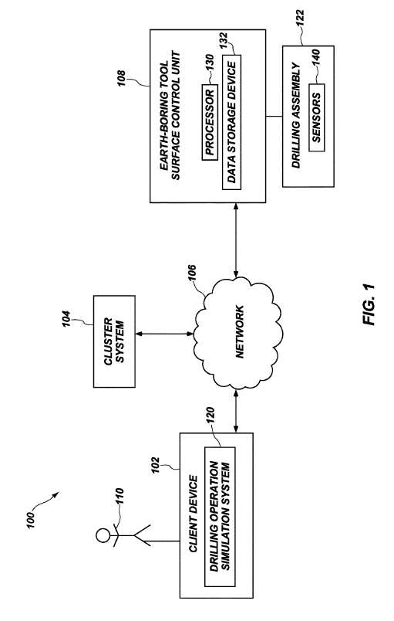
{h3}
{j3}
{i3}
{k3}
{e3}
{d3}
FIG. {fig}
{c3}
{g3}
{b3}
{f3}
{a3}
Notes:
11,047,215
FIG. 1 illustrates a schematic diagram of an example communication system in which a drilling operation simulation system can operate in accordance with one or more embodiments of the present disclosure;
FIG. 1 illustrates a schematic diagram of an example communication system 100 in which a drilling operation simulation system 120 can operate in accordance with one or more embodiments. As illustrated, the communication system 100 includes a client device 102, a cluster system 104, an earth-boring tool surface control unit 108 (hereinafter “surface control unit”), and a network 106. The client device 102, the cluster system 104, and the surface control unit 108 may communicate via the network 106. The network 106 can include one or more networks, such as the Internet, and can use one or more communications platforms or technologies suitable for transmitting data and/or communication signals. Although FIG. 1 illustrates a particular arrangement of the client device 102, the cluster system 104, the surface control unit 108, and the network 106, various additional arrangements are possible. For example, the surface control unit 108 can directly communicate with the client device 102, bypassing the network 106. In alternative embodiments, the communication system 100 does not include the surface control unit 108 and/or the network 106. Rather, the cluster system 104 can directly communicate with the client device 102. In particular, the surface control unit 108 and the network 106 are not required in every embodiment of the present disclosure.
As shown in FIG. 1, in some embodiments, the client device 102 may include the drilling operation simulation system 120 (hereinafter “simulation system”) installed thereon. As is described in greater detail below, the simulation system 120 may interface with the cluster system 104 and/or the surface control unit 108 to perform direction drill ahead simulations (“DDAS”) and to determine (e.g., generate) a predictive algorithm based on the DDAS simulations that can be utilized to perform additional simulations of drilling operations. Furthermore, utilizing the predictive algorithm, the simulation system 120 may optimize selecting an earth-boring tool (e.g., drill bit) and drilling parameters for a given formation and desired trajectory to achieve a desired borehole quality and trajectory. Additionally, upon selecting an earth-boring tool and drilling parameters, the simulation system 120 may provide interactive graphical user interfaces (“GUIs”) (e.g., graphs, tables, and/or plots) that represent simulated drilling operations with the selected earth-boring tool and the associated drilling parameters. Although the simulation system 120 is described herein as being part of the client device 102, the disclosure is not so limited. Rather, as will be understood by one of ordinary skill in the art, the simulation system 120 may, in alternative embodiments, be part of the cluster system 104 and/or the surface control unit 108. The simulation system 120 is described in greater detail in regard to FIGS. 2-5.
Referring still to FIG. 1, a user 110 can interface with the client device 102, for example, to utilize the simulation system 120 to simulate drilling operations and determine predictive algorithms. The user 110 can be an individual (i.e., a human user), a business, a group, or any other entity. For instance, the user 110 can be an operator and/or engineer of an earth-boring tool and/or drilling operation. Although FIG. 1 illustrates only one user 110 associated with the client device 102, the communication system 100 can include any number of a plurality of users that each interact with the simulation system 120 using a corresponding client device 102.
In some embodiments, the simulation system 120 of the client device 102 includes a simulation application installed thereon. The simulation application may be associated with the simulation system 120. For example, the simulation application enables the user 110 to interact with the simulation system 120, to provide drilling operation inputs (e.g., lithology and drilling parameters) to the simulation system 120, to run DDAS simulations, utilize a predictive algorithm, view data resulting from simulations, etc.
Referring still to FIG. 1, the surface control unit 108 may be placed at a surface of a drilling rig for receiving and processing downhole data transmitted by sensors 140 in a drill bit and/or sensors 140 in a drilling assembly 122, and for controlling selected operations of the various devices and sensors 140 in the drilling assembly 122. The sensors 140 may include one or more of sensors 140 that determine build-up-rate, turn rate, acceleration, weight on bit, torque, pressure, rate of penetration (“ROP”), lateral ROP, contact forces, rib forces, inclination, azimuth, formation lithology, etc. In some embodiments, the surface control unit 108 may receive downhole data from any of the sensors described in, for example, in U.S. Pat. No. 8,100,196, to Pastusek et al., filed Feb. 6, 2009, issued Jan. 24, 2012, U.S. Pat. No. 7,849,934, to Pastusek et al., filed Feb. 16, 2007, issued Dec. 14, 2010, and U.S. Pat. No. 7,604,072, to Pastusek et al., filed Jun. 7, 2005, issued Oct. 20, 2009, the disclosures of which are incorporated in their entireties by this reference herein.
In some embodiments, the surface control unit 108 may include a processor 130 and a data storage device 132 (or a computer-readable medium) for storing data, algorithms, and computer programs. The data storage device 132 may be any suitable device, including, but not limited to, a Read-Only Memory (ROM), a Random-Access Memory (RAM), a Flash memory, a magnetic tape, a hard disk, and an optical disk. Additionally, the surface control unit 108 may further include one or more devices for presenting output to an operator of the drilling assembly 122, including, but not limited to, a graphics engine, a display (e.g., a display screen), one or more output drivers (e.g., display drivers), one or more audio speakers, and one or more audio drivers. In certain embodiments, the surface control unit 108 is configured to provide graphical data to a display for presentation to the operator. The graphical data may be representative of one or more graphical user interfaces and/or any other graphical content as may serve a particular implementation.
Both the client device 102 and the surface control unit 108 may represent various types of computing devices with which users can interact. For example, the client device 102 and/or the surface control unit 108 can be a mobile device (e.g., a cell phone, a smartphone, a PDA, a tablet, a laptop, a watch, a wearable device, etc.). In some embodiments, however, the client device 102 and/or surface control unit 108 can be a non-mobile device (e.g., a desktop or server). Additional details with respect to the client device 102 and the surface control unit 108 are discussed below with respect to FIG. 5.
The cluster system 104 may include a plurality of connected (loosely or tightly) computers that work together such that the plurality of connected computers can be considered a single system. For instance, each computer of the plurality of computers may have a respective node that is set to perform a common task with the other computers of the plurality of computers. The cluster system 104 may be at least partially controlled and/or scheduled by software (e.g., portions of the simulation system 120). Furthermore, in additional embodiments, cluster system 104 may be a cloud system. For instance, the cluster system 104 may include software and services operated on the Internet.
In some embodiments, the plurality of computers of the cluster system 104 may be connected through relatively fast local area networks, with each node (computer used as a server) running its own instance of an operating system. For example, in one or more embodiments, all of the nodes may use the same hardware configuration and the same operating system. In alternative embodiments, the plurality of computers may utilize differing operating systems and/or different hardware (e.g., Open Source Cluster Application Resources (OSCAR)).
As will be understood by one of ordinary skill in the art, the cluster system 104 improves performance and availability over that of a single computer and is much more cost-effective than single computers of comparable speed or availability. In view of the foregoing, the communication system 100 may include any cluster system 104 known in the art.

Slide 4
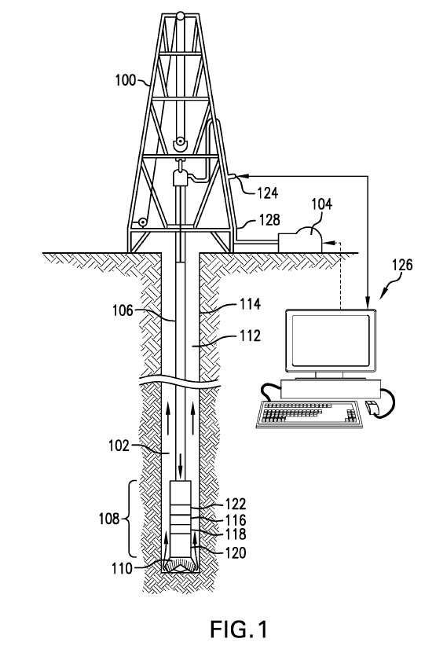
{a4}
{m4}
{c4}
{o4}
{n4}
{d4}
{h4}
{g4}
{b4}
{e4}
{l4}
{i4}
{j4}
{f4}
{k4}
FIG. {fig}
Notes:
US20210189873
FIG. 1 is a schematic diagram showing a drilling rig 1 engaged in drilling operations that can incorporate embodiments of the present disclosure.
FIG. 1 is a schematic diagram showing a drilling rig 100 engaged in drilling operations. A drilling fluid 102, also called drilling mud, is circulated by a pump 104 through an inner bore of a drill string 106 down through a bottom hole assembly (BHA) 108, through a drill bit 110 and back to the surface through an annulus 112 between the drill string 106 and a borehole wall 114. The BHA 108 can include any of a number of sensor modules 116, 118, 120. The sensor modules 116, 118, 120 can include formation evaluation sensors, directional sensors, probes, detects, etc. as will be appreciated by those of skill in the art. Such sensors and modules are well known in the art and are not described further. The BHA 108 also contains a pulser assembly 122. The pulser assembly 122 is configured to induce pressure fluctuations in a mud flow of the drilling fluid 102. The pressure fluctuations, or pulses, propagate to the surface through the drilling fluid 102 in the drill string 106 and/or through the drilling fluid 108 in the annulus 112 and are detected at the surface by a pulse sensor 124 and an associated a control unit 126. The control unit 126 may be a general purpose or specialized computer or other processing unit, as will be appreciated by those of skill in the art. The pulse sensor 124 is connected to a flow line 128 and may be a pressure transducer or flow transducer, as will be appreciated by those of skill in the art. The BHA 108 includes or defines a longitudinal axis.

Slide 5
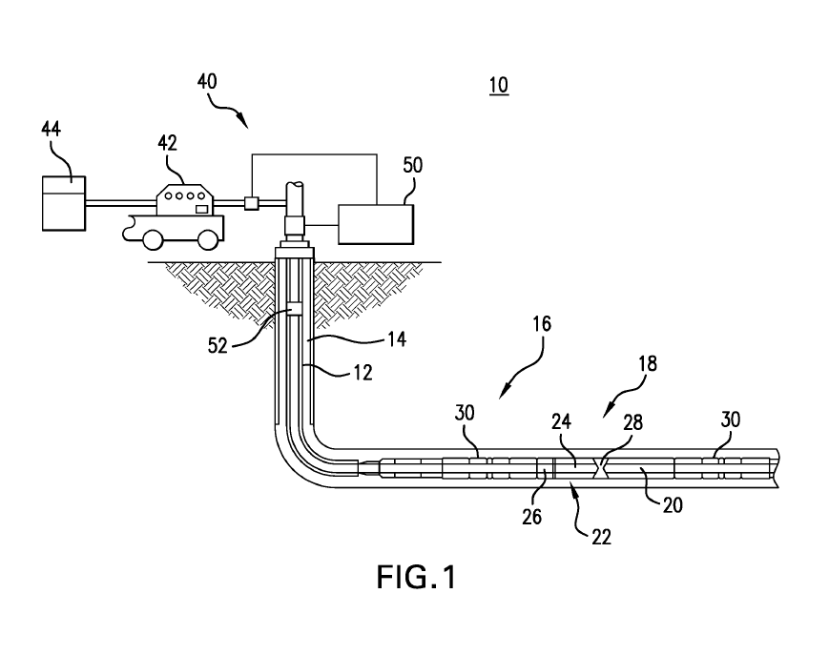
{l5}
{a5}
{n5}
{m5}
{o5}
{c5}
{d5}
{p5}
{e5}
{b5}
{k5}
{h5}
{j5}
{k5}
{i5}
{f5}
{g5}
FIG. {fig}
Notes:
US20210198986
FIG. 1 illustrates an embodiment of an energy production and/or exploration system including a flow control system having a flow control device and a resonant sensing device.
Referring to FIG. 1, an embodiment of a resource or energy production system 10 includes a borehole string 12 disposed in a borehole 14 extending into a subterranean region or a resource bearing formation, such as an earth formation 16. The borehole string 12 is configured as, for example, a production string that establishes a production conduit through which production fluid is brought to the surface. As described herein, “borehole” or “wellbore” refers to a hole that makes up all or part of a drilled well. It is noted that the borehole 14 may include vertical, deviated and/or horizontal sections, and may follow any suitable or desired path. As described herein, “formations” refer to the various features and materials that may be encountered in a subsurface environment and surround the borehole 14.
[0015]
The formation 16 may be a hydrocarbon bearing formation or strata that includes, e.g., oil and/or natural gas. In one embodiment, the system 10 is configured for production of hydrocarbons, but is not so limited. The system 10 may be configured for various purposes, such as well drilling operations, completions, resource extraction and recovery, steam assisted gravity drainage (SAGD), CO2 sequestration, geothermal energy production and other operations for which fluid flow control is desired.
[0016]
For example, the borehole string 12 includes a completion string having a production assembly 18. The production assembly 18, in one embodiment, includes a screen assembly 20 such as a sand screen assembly or sub, and a production fluid flow control assembly 22. In one embodiment, the flow control assembly 22 includes a production fluid control device 24 configured to receive production fluid from a region around the borehole, and a resonant sensing device 26 that includes a resonant sensor in fluid communication with fluid flowing through the flow control assembly 22. An example of a flow control device is an inflow control device (ICD). The resonant sensing device 26 is configured to measure one or more fluid properties, such as density and/or viscosity, and communicate with a valve component 28 or a valve component controller. An example of a valve component is an inflow control valve (ICV) such as an autonomous inflow control valve (AICV).
[0017]
In one embodiment, the production assembly 18 is configured to control fluid flow by shutting off or restricting fluid flow through the flow control assembly 22 based on a viscosity and/or density of the fluid meeting or exceeding a selected threshold. For example, a threshold is selected based on a desired proportion of water in the production fluid, so that fluid having an unacceptably high proportion of water can be restricted to maintain production efficiency and prevent water breakthrough.
[0018]
The borehole string 12 and/or the production assembly 18 may also include one or more packer assemblies 30. Each packer assembly 30 includes one or more packer elements, which are actuated to isolate components and/or zones in the borehole 12. For example, multiple packer assemblies 30 can be used to establish production zones around the borehole 14. The borehole string 12 and/or the production assembly 18 may include other components to facilitate production, such as an electric submersible pump (ESP), other artificial lift devices, a fracture or “frac” sleeve device and/or a perforation assembly.
[0019]
The system 10 also includes surface equipment 40 such as a drill rig, rotary table, top drive, blowout preventer and/or others to facilitate deploying the borehole string 12, operating various downhole components, monitoring downhole conditions and controlling fluid circulation through the borehole 14 and the borehole string 12. In one embodiment, the surface equipment 40 includes a fluid control system 42 including one or more pumps in fluid communication with a fluid tank 44 or other fluid source. The fluid control system 42 facilitates injection of fluids, such as drilling fluid (e.g., drilling mud), stimulation fluid (e.g., a hydraulic fracturing fluid), gravel slurries, proppant and others.
[0020]
One or more components of the borehole string 12 may be configured to communicate with a surface location (e.g., the surface equipment 40). The communication may be wired or wireless. Examples of wireless communications include mud pulse telemetry, electromagnetic communications and others. Wired communication may be performed via one or more conductors (e.g., electrical wires, hydraulic control lines and/or fiber optics) extending along the borehole string in a cable or other conductor passage.
[0021]
In one embodiment, the system 10 includes a processing device such as a surface processing unit 50, and/or a subsurface processing unit 52 disposed in the borehole 14 and connected to one or more downhole components. The processing device may be configured to perform functions such as controlling downhole components, transmitting and receiving data, processing measurement data and/or monitoring operations. The processing device may also control aspects of fluid circulation, such as fluid pressure and/or flow rate in the borehole string 12.
[0022]
The processing device may be disposed at any suitable location. In one embodiment, the processing device is disposed at or in communication with the resonant sensing device 26 and/or the flow control device 24. The processing device, in this embodiment, performs functions that include receiving measurement signals from the resonant sensing device 26, processing or analyzing the signals to estimate a fluid property, and controlling the flow control device 24 and/or the valve component 28 based on the fluid property, as discussed herein.

Slide 6
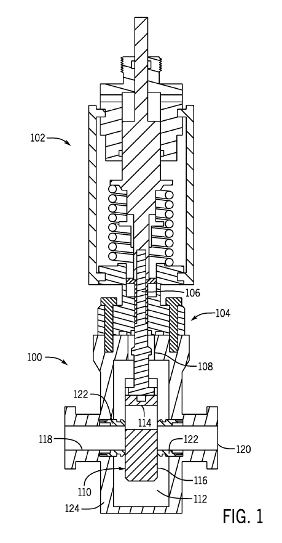
{b6}
{d6}
{c6}
{a6}
{e6}
{l6}
{h6}
{j6}
{l6}
{k6}
{i6}
{f6}
{g6}
{m6}
FIG. {fig}
Notes:
US20210199201
FIG. 1 is a cross-sectional side view of an embodiment of a valve assembly, in accordance with embodiments of the present disclosure.
FIG. 1 is a cross-sectional side elevation view of an embodiment of a valve 100 that includes an actuator 102 coupled to a bonnet 104. The illustrated actuator 102 is coupled to a valve stem 106 that extends through a central bore 108 and couples to a valve member 110 arranged within a chamber 112. The valve member 110 is a gate in the illustrated embodiment, but it should be appreciated that embodiments of the present disclosure may be utilized in other types of valves. The illustrated valve member 110 includes a passage 114 and a block 116. As shown, fluid (e.g., gas, liquid, solid, or a combination thereof) may enter the valve 100 through an inlet passage 118 and engage the valve member 110 en route to an outlet passage 120. In the illustrated embodiment, the valve member 110 is transitioning between an open position, in which the passage 114 is substantially aligned with the inlet passage 118 and the outlet passage 120, and a closed position, in which the block 116 is substantially aligned with the inlet passage 118 and the outlet passage 120. The illustrated valve member 110 may seal against valve seats 122.
[0021]In operation, the actuator 102, which may be manual, but is illustrated as automated (e.g., hydraulic, pneumatic, electric, etc.), drives movement of the valve member 110 between the open position and the closed position. When moving the valve member 110 from the closed position to the open position, the actuator overcomes an opposing force present in the valve 100 (e.g., the pressure of the fluid). This opening force may be referred to as a total operational force and includes components of both stem thrust and gate drag. Stem thrust refers to the linear force to seat and unseat the valve member. Gate drag refers to a lateral force applied by the fluid to the valve member. In various embodiments, each component may account for approximately one half of the opening force. Accordingly, reducing the stem thrust may reduce the opening and/or closing force by approximately one half, thereby enabling smaller actuators and/or manual actuators in place of automated actuators.
[0022]Embodiments of the present disclosure may include one or more components, which may be externally coupled to a valve body 124, in order to convert the valve 100 from an unbalanced stem valve to a balanced stem valve, and vice versa. That is, embodiments of the present disclosure include systems and methods to enable dual mode operation valves using external fasteners, which may reduce the use of internal fasteners (e.g., fasteners within the chamber 112). Furthermore, embodiments of the present disclosure may be directed toward a coupling system that facilitates joining the lower stem to the valve member utilizing external actions (e.g., actions outside the valve, actions that may be initiated from outside the valve), thereby enabling coupling and decoupling while the valve is in service.

Slide 7
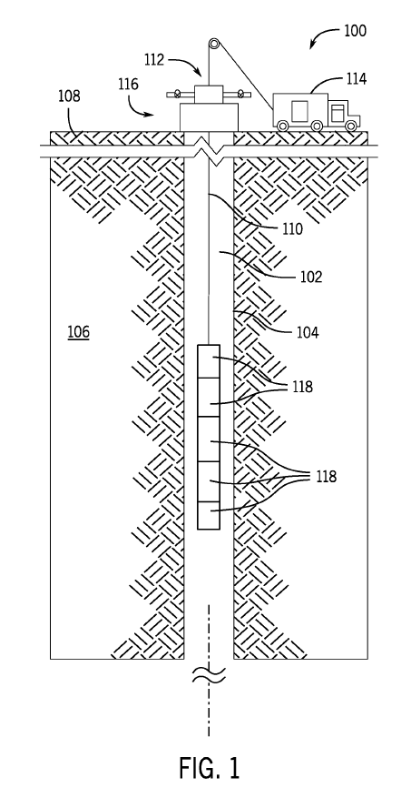
{a7}
{g7}
{e7}
{i7}
{h7}
{f7}
{b7}
{d7}
{c7}
{j7}
{j7}
{l7}
FIG. {fig}
Notes:
20210201178
FIG. 1 is a cross-sectional side view of an embodiment of a wellbore system, in accordance with embodiments of the present disclosure.
FIG. 1 is a schematic cross-sectional view of an embodiment of a wellbore system 100 including a downhole tool 102 arranged within a wellbore 104 formed in a formation 106. The downhole tool 102 is lowered from a surface location 108 via a conveyance system, such as the illustrated wireline 110. In various embodiments, the electric wireline may transmit electric signals and/or energy from the surface location 108 into the wellbore, for example to provide operational power for the tool 102 and/or to transmit data, such as data obtained from sensors arranged on the tool 102. In various embodiments, the tool 102 may be utilized to perform downhole logging operations, such as an imaging tool, a resistivity tool, a nuclear magnetic resonance tool, or any other logging tool that may be used in a downhole environment. It should be appreciated that embodiments exist where the downhole tool 102 is deployed with any other type of conveyance means, including coiled tubing, pipes, cable, and slickline. That is, embodiments of the present disclosure may be utilized in other scenarios, such as measurement while drilling, production logging, and the like.
[0026]The wellbore system 100 includes a wellhead assembly 112, shown at an opening of the wellbore 104, to provide pressure control of the wellbore 104 and allow for passage of equipment into the wellbore 104, such as the cable 110 and the tool 102. In this example, the cable 110 is a wireline being spooled from a service truck 114. The wellhead assembly 112 may include a blowout preventer (BOP) 116 (e.g., pressure control device).
[0027]In various embodiments, the downhole tool 102 includes a number of segments 118, which may represent different devices or sensors utilized to obtain information from the downhole environment. By way of example only, one segment may relate to a nuclear detection tool that may include one or more radiation sources and detectors to receive signals corresponding to radiation emitted from the formation. The radiation may be naturally occurring or in response to interrogation from the source. The tools associated with these segments 118 may be utilized to determine one or more properties of the formation 106 and/or identify specific features of the wellbore, such as properties of the tubing and/or casing. As another example, the segments 118 may correspond to a downhole resonance tool and/or optical sensing tools that emit light.
[0028]In the illustrated embodiment, the tool 102 is deployed on the wireline 110 and may be transitioned through the wellbore 104 via gravity. While the illustrated wellbore 104 is shown as being substantially straight (e.g., straight up and down) it should be appreciated that wellbores may be deviated or have geometric differences along their length. Furthermore, the illustrated wellbore 104 does not include a casing, cement securing the casing to the formation 106, or a multi-barrier structure, as may be present in wellbores, such as subsea wellbores and/or older wellbores undergoing plugging and abandonment, but it should be appreciated that various embodiments may be utilized in wellbores with different configurations.

Slide 8
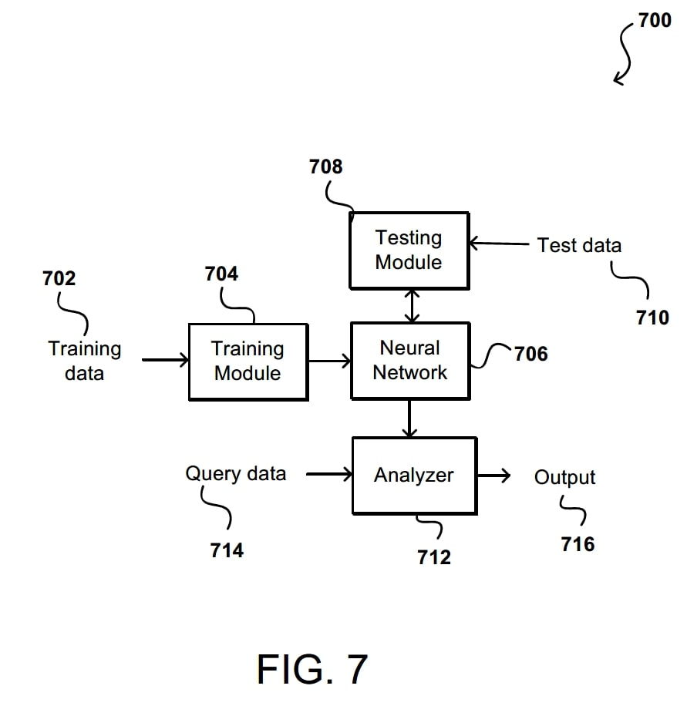
{a8}
{e8}
{b8}
{c8}
{f8}
{d8}
{h8}
{g8}
{i8}
FIG. {fig}

Slide 9
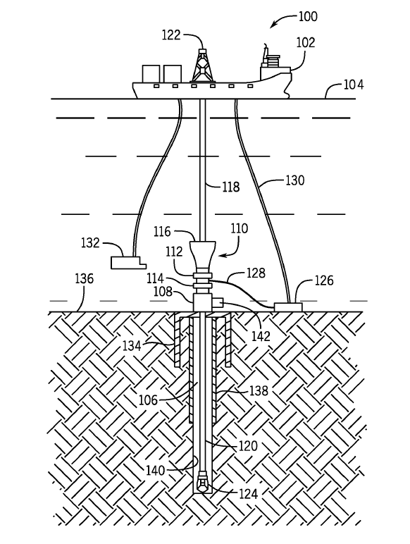
{a9}
{l9}
{b9}
{c9}
{j9}
{p9}
{i9}
{f9}
{q9}
{g9}
{s9}
{h9}
{o9}
{n9}
{e9}
{r9}
{v9}
{d9}
{t9}
{k9}
{u9}
{m9}
FIG. {fig}
Notes:
20210222506
FIG. 1 is a schematic side view of an embodiment of an offshore drilling operation, in accordance with embodiments of the present disclosure.
FIG. 1 is a side schematic view of an embodiment of subsea drilling operation 100. The drilling operation includes a vessel 102 floating on the sea surface 104 substantially above a wellbore 106. It should be appreciated that the vessel 102 is shown for illustrative purposes only, and in various embodiments, other structures such as drilling platforms may be utilized with embodiments of the present disclosure. A wellbore housing 108 sits at the top of the wellbore 106 and is connected to a blowout preventer (BOP) assembly 110, which may include shear rams 112, sealing rams 114, and/or an annular ram 116. One purpose of the BOP assembly 110 is to help control pressure in the wellbore 106. The BOP assembly 110 is connected to the vessel 102 by a riser 118. During drilling operations, a drill string 120 passes from a rig 122 on the vessel 102, through the riser 118, through the BOP assembly 110, through the wellhead housing 108, and into the wellbore 106. The lower end of the drill string 120 is attached to the drill bit 124 that extends the wellbore 106 as the drill string 120 turns. It should be appreciated that while a drilling operation is illustrated, embodiments of the present disclosure may also be incorporated into logging operations, stimulation operations, recovery operations, and the like. Additional features shown in FIG. 1 include a mud pump 126 with mud lines 128 connecting the mud pump 126 to the BOP assembly 110, and a mud return line 130 connecting the mud pump 126 to the vessel 102. It should be appreciated that the illustrated mud pump 126 is at a subsea location, but in other embodiments, the mud pump 126 may be arranged on the vessel 102. Moreover, in embodiments, the mud pump 126 may receive a mud supply from a pit or mud shake on the vessel 102. A remotely operated vehicle (ROV) 132 can be used to make adjustments to, repair, or replace equipment as necessary. Although the BOP assembly 110 is shown in the figures, the wellhead housing 108 could be attached to other well equipment as well, including, for example, a tree, a spool, a manifold, or another valve or completion assembly.
[0022]
One efficient way to start drilling the wellbore 106 is through use of a suction pile 134. Such a procedure is accomplished by attaching the wellhead housing 108 to the top of the suction pile 134 and lowering the suction pile 134 to a sea floor 136. As interior chambers in the suction pile 134 are evacuated, the suction pile 134 is driven into the sea floor 136, as shown in FIG. 1, until the suction pile 134 is substantially submerged in the sea floor 136 and the wellhead housing 108 is positioned at the sea floor 136 so that further drilling can commence. As the wellbore 106 is drilled, the walls of the wellbore are reinforced with concrete casings 138 that provide stability to the wellbore 108 and help to control pressure from the formation.
[0023]
During operations, such as drilling operations, mud is injected into the wellbore 106 via the drilling string 120. For example, the mud pump 126 may receive drilling mud from the vessel 102 and direct the mud through the drill string 120. The mud flows through the drilling string 120 and exits at the drill bit 124, carrying rock away from the bit 124 and also cooling the bit. The mud enters an annulus 140 surrounding the drill string 120. Advantageously, this mud may be utilized to provide pressure control within the wellbore 106, for example, due to pressures from the formation. The mud may fill the wellbore 106 and the riser 118, where it is returned to the vessel 102 for processing and reuse.
[0024]
During these operations, the BOP 110 may include one or more control systems 142. The control systems 142 may direct hydraulic fluid toward the components of the BOP 110, for example, toward the various rams. The control systems 142 may be arranged with redundancies, for example, by using two or more control systems 142 with the BOP 110. As will be described herein, various components of the control systems 142 may utilize one or more power supplies in order to perform operations. Power lines may be insulated due to the subsea environment, where ingress of fluid, among other potential operational challenges, may lead to faults. These faults may be detected, but present systems may detect the fault on a circuit level, rather than individually for separate components. As a result, the BOP 110 may be pulled to investigate the fault, even if the fault is a minor, non-critical component. Systems and methods of the present disclosure describe an improved system for identifying faults for individual components and alerting operators of these conditions, where the operator can then determine how to proceed.

Slide 10
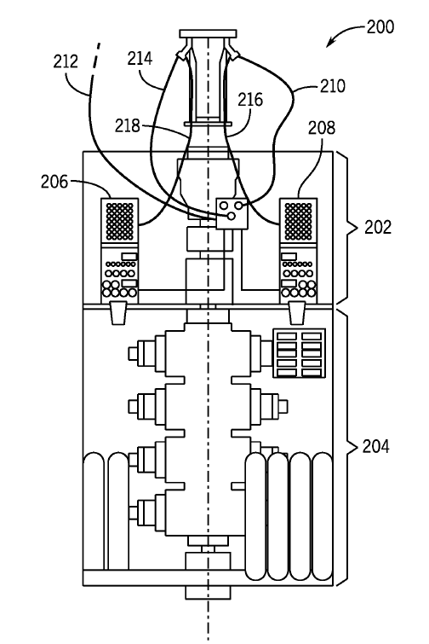
{a10}
{g10}
{h10}
{i10}
{f10}
{j10}
{e10}
{d10}
{b10}
{c10}
FIG. {fig}
Notes:
20210222506
FIG. 2 is a schematic side view of an embodiment of a blowout preventer (BOP) stack, in accordance with embodiments of the present disclosure.
FIG. 2 is a schematic view of an embodiment of a BOP stack 200, which includes a lower marine riser package 202 and a lower stack 204. It should be appreciated that various components have been removed or will not be described for clarity. The illustrated BOP stack 200 includes first control pod 206 (e.g., blue pod) and a second control pod 208 (e.g., yellow pod). These control pods 206, 208 may include one or more sensors, power supplies, and the like. Moreover, various sensors for measuring one or more properties of the subsea operation may be present and associated with the BOP stock 200. As noted above, the redundancies may provide operational benefits where an upset or failure with the first pod 206 may be overcome using the second pod 208, thereby eliminating extra operational steps and time to remove the BOP stack 200 from service. In the illustrated embodiment, various conduits 210, 212, 214, 216, 218 extend from a riser 220 to the control pods 206, 208. For example, the conduits 210, 212, 214, 216, 218 may be used for hydraulic controls, power controls, communications, and the like.
[0026]
In various embodiments, information may be transmitted to and from the control pods 206, 208, which may be further supplied to a surface location. For example, operational information may be provided to enable operators to adjust drilling operations and the like. In various embodiments, different values for various pieces of information may be indicative of undesirable operating conditions. For example, pressures above a certain level, forces on a drill bit, and the like may cause operational upsets that may be avoided if operators respond with modifications to drilling operations. However, it should be appreciated that some of these systems may be deemed “non-critical,” while others are “critical.” It should be appreciated that a sensor being considered “critical” is not intended to reflect a component that is required for operation of the present disclosure, but rather, to reflect a component that an operator has deemed as having a threshold level of importance for drilling operations. As a result, the terms “critical” and “non-critical” are used to describe components having importance values above and below a threshold, respectively. For example, a “critical” component may be a component without a backup, while a “non-critical” component may have a redundancy or information obtained by the component may be derived from other components.

Slide 11
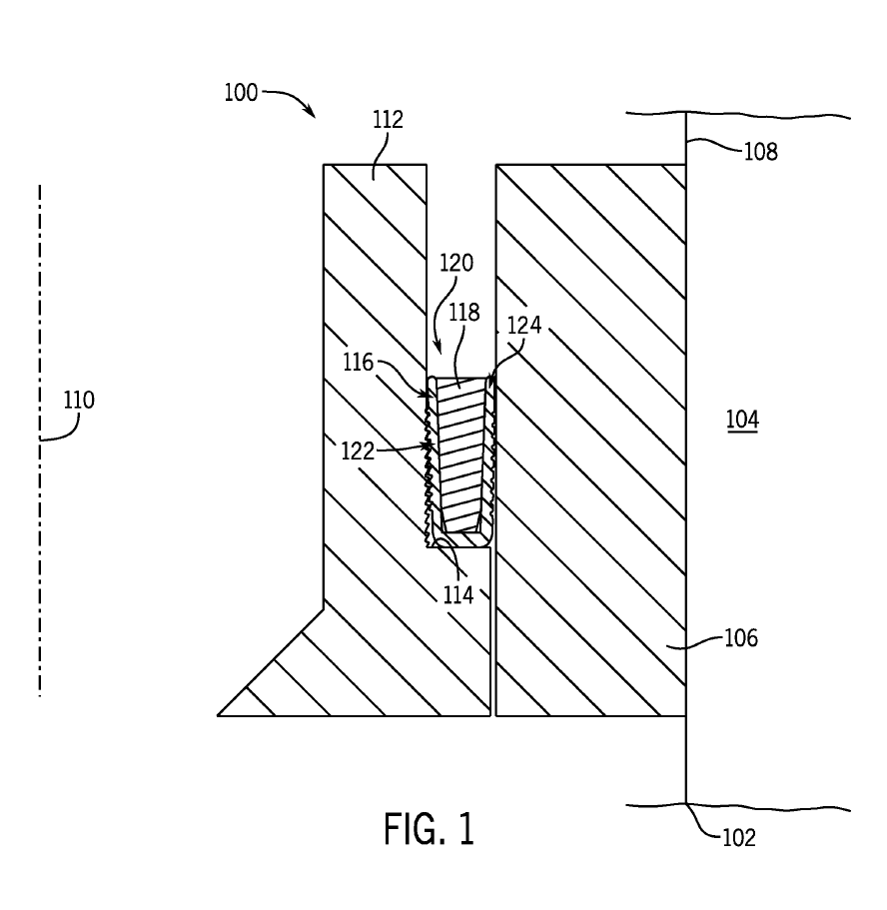
{a11}
{g11}
{e11}
{k11}
{j11}
{m11}
{i11}
{f11}
{c11}
{l11}
{h11}
{d11}
FIG. {fig}
{b11}
Notes:
20210222508
FIG. 1 is a cross-sectional side view of an embodiment of an energizing ring within a seal opening, in accordance with embodiments of the present disclosure.
FIG. 1 is a cross-sectional side view of an embodiment of a wellbore sealing system 100 arranged within a borehole 102 extending into a downhole formation 104. It should be appreciated that, for clarity with the discussion herein, various components of a well site that may include the borehole 102 have been eliminated. For example, the well site may include surface equipment, such as drilling rigs, wellhead components, and the like. In the illustrated embodiment, a housing 106 is arranged against a borehole wall 108 and radially outward with respect to a borehole axis 110. It should be appreciated that the borehole 102, housing 106, and various other components may be annular components that extend about the borehole axis 110. Furthermore, in various embodiments, the housing 106 may be a casing that is cemented to the borehole wall 108. Additionally, in embodiments, the hanger 112 may be arranged at an uphole location, for example within a wellhead, and may include one or more test ports that may extend into the space between the hanger 112 and the housing 106 to test the integrity of the seal, among other things.
[0027]In the illustrated embodiment, a hanger 112 is arranged radially inward from the housing 106 and includes a shoulder 114 that receives the wellbore sealing system 100. The illustrated hanger 112 may receive one or more wellbore tubulars that are suspended into the borehole 102, for example, to recover hydrocarbons. The wellbore sealing system 100 illustrated in FIG. 1 includes a seal 116 that is a U-shaped cup. In operation, the seal 116 receives an energizing ring 118 within an opening 120 that drives a first leg 122 and a second leg 124 of the seal 116 radially away from an axis 126 of the seal 116, such that a seal is formed between the hanger 112 and the housing 106. In various embodiments, the seal 116 is formed from an elastomer, metal, composite material, or the like. However, for clarity with the present discussion, the seal 116 will be described as a metallic seal that forms a metal-to-metal seal between the hanger 112 and the housing 106. As noted above, other components, such as lock rings and the like, have been removed for clarity.

Slide 12
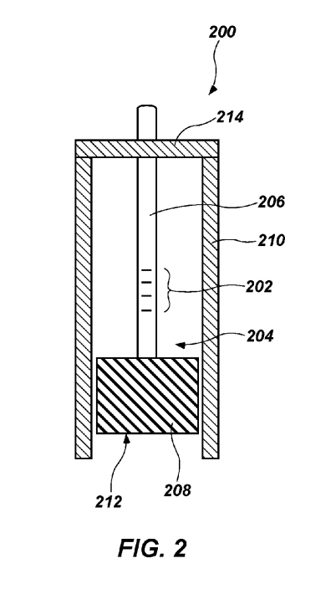
{a12}
{h12}
{d12}
{f12}
{b12}
{c12}
{g12}
{e12}
FIG. {fig}
Notes:
10371502
FIG. 2 shows a partial cross-sectional view of an embodiment of a fiber optic sensor according to the present disclosure.
Referring to FIG. 2, wellbore sensing systems of the present disclosure may include a fiber optic sensor 200 including a fiber Bragg grating 202 proximate a distal end 204 of an optical fiber 206 and a mass of sensor material 208 coupled to the distal end 204 of the optical fiber 206. A housing 210 may cover lateral sides of the mass of sensor material 208, while leaving at least a portion of an end surface 212 of the mass of sensor material 208 exposed to the surrounding environment. The distal end 204 of the optical fiber 206 and the mass of sensor material 208 may be suspended from a suspension element 214, such that the fiber Bragg grating 202 is positioned between the suspension element 214 and the mass of sensor material 208. The mass of sensor material 208 may be restricted from moving laterally (e.g., to the left and right and into and out of the page from the perspective of FIG. 2), but not restricted from moving axially (e.g., up and down from the perspective of FIG. 2) by the housing 210. Thus, the weight of the mass of sensor material 208 may physically stress (e.g., stretch) the portion of the optical fiber 206 including the fiber Bragg grating 202 between the suspension element 214 and the mass of sensor material 208.
Optical fibers including fiber Bragg gratings are known in the art and are described in, for example: U.S. patent application Ser. No. 09/979,345 to Kraemmer et al., titled “BRAGG GRATING DEVICE FOR MEASURING AN ACCELERATION,” issued as U.S. Pat. No. 6,807,325 on Oct. 19, 2004; U.S. patent application Ser. No. 11/180,389 to Childers et al., titled “FIBER OPTIC POSITION AND SHAPE SENSING DEVICE AND METHOD RELATING THERETO,” filed Jul. 13, 2005; and U.S. patent application Ser. No. 11/451,207 to Poland et al., titled “MULTI-CORE DISTRIBUTED TEMPERATURE SENSING FIBER,” filed on Jun. 12, 2006; the entire disclosure of each of which is incorporated herein by reference.
By way of example, the fiber Bragg grating 202 may include a portion of a core of the optical fiber 206 characterized by periodic variations in refractive index. The period of the fiber Bragg grating 202 (i.e., the distance between adjacent portions having variations in refractive index) results in reflection and/or refraction of light of a specific wavelength or range of wavelengths correlating to the period of the fiber Bragg grating 202. If the period of the fiber Bragg grating 202 is relatively larger, then light having a relatively longer wavelength will be reflected and/or refracted by the fiber Bragg grating 202. Conversely, if the period of the fiber Bragg grating 202 is relatively smaller, then light having a relatively shorter wavelength will be reflected and/or refracted by the fiber Bragg grating 202. An analysis module (e.g., the analysis module 116 described above with reference to FIG. 1) operatively coupled to the at least one optical fiber 206 can be used to sense the wavelength of light reflected and/or refracted by the fiber Bragg grating 202. A single fiber Bragg grating 202 may have a variable period (and, therefore, may reflect and/or refract light having a corresponding variable wavelength) that is dependent on the axial stretching and compressing of the optical fiber 206, which respectively increases and decreases the period of the fiber Bragg grating 202. Axial stretching and compressing of the optical fiber 206 may result from, for example, changes in temperature of and axial physical stress on the optical fiber 206.
The fiber optic sensor 200 shown in FIG. 2 may be used to sense corrosion of the mass of sensor material 208 due to chemical and/or physical degradation of the end surface 212 of the mass of sensor material 208. As material from the mass of sensor material 208 is exposed to a corrosive environment and corroded, the weight of the mass of sensor material 208 may be reduced, which may reduce stress on the optical fiber 206 resulting from the weight of the mass of sensor material 208. As a result, the period of the fiber Bragg grating 202 may be reduced as the stress thereon is relaxed. A signal (e.g., light reflected and/or refracted) from the fiber Bragg grating 202 may be altered due to the change in the period of the fiber Bragg grating 202. The signal may be sensed remotely by an analysis module coupled to a proximal end of the optical fiber 206, and the change in the signal may be correlated to corrosion of the mass of sensor material 208. Thus, the fiber optic sensor 200 may be used to remotely sense corrosion at the distal end 204 of the optical fiber 206. The fiber optic sensor 200 may be a single-point sensor for sensing corrosion at a single point within a wellbore (e.g., at a position of the distal end 204 of the optical fiber 206). In some embodiments, multiple fiber optic sensors 200 may be used within a single wellbore to sense corrosion at multiple points within the wellbore.
In use within a wellbore, the fiber optic sensor 200 may be positioned proximate a downhole component, such as by coupling the housing 210 to the downhole component or simply by extending the fiber optic sensor 200 into the wellbore to the position of the downhole component. The material of the mass of sensor material 208 may include a corrodible material that is selected to have a corrosion rate that is at least substantially the same as a corrosion rate of a material of the downhole component. In some embodiments, the material of the mass of sensor material 208 may be the same as the material of the downhole component. By way of example and not limitation, the material of the mass of sensor material 208 may include one or more of aluminum, titanium, a carbon steel, a tool steel, a stainless steel, and a so-called “corrosion-resistant alloy.” Corrosion resistant alloys may include, for example, steels such as those identified in industry as 9 Cr-1 Mo, 13 Cr, 13 Cr-2 Mo, 416 stainless steel, 316 stainless steel, and nickel alloys such as those identified in industry as nickel alloy 625, nickel alloy 718, and MONEL® K-500. Thus, corrosion of the mass of sensor material 208 that is sensed by the fiber optic sensor 200 may be directly correlated to corrosion of the corresponding downhole component. The surface area of the mass of sensor material 208 end surface 212 may be known and used to calculate a corrosion rate of the material based on a mass loss over time detected by the fiber optic sensor 200. Thus, the fiber optic sensor 200 may be used to detect occurrence of corrosion and/or a corrosion rate of the downhole component.
In some embodiments, the fiber optic sensor 200 may additionally or alternatively be configured and used to sense deposition of scale on the downhole component. For example, if the material of the downhole component is susceptible to scale deposition, the material of the mass of sensor material 208 or a portion thereof may be selected to also be susceptible to scale deposition (e.g., by forming the mass of sensor material 208 of the same material as the downhole component). In operation, as scale is deposited on the end surface 212 of the mass of sensor material 208, a combined weight of the mass of sensor material 208 and deposited scale increases and induces greater tension on the fiber Bragg grating 202. The increased tension, in turn, increases the period of the fiber Bragg grating 202. A corresponding shift in wavelength of reflected and/or refracted light may be sensed and correlated to the scale deposition.
The mass of sensor material 208 may be formed of a substantially uniform and homogeneous material, or may be formed of a non-uniform and heterogeneous material. For example, in some embodiments, the mass of sensor material 208 may be formed of a substrate coupled to the distal end 204 of the optical fiber 206, with a material at least substantially similar to the material of the downhole component coupled to (e.g., attached to, sputtered on, bonded to, deposited on) the substrate.
The fiber optic sensor 200 of FIG. 2 has been described as including a single optical fiber 206. However, the present disclosure is not so limited. Rather, in some embodiments, multiple optical fibers 206 may be coupled to the mass of sensor material 208. In such embodiments, the mass of sensor material 208 may be larger than would be possible with a single optical fiber 206 because the multiple optical fibers 206 would, in combination, be capable of holding more weight without breaking. Therefore, the mass of sensor material 208 may include more material to corrode for longer operational life. In addition, respective signals from the multiple optical fibers 206 may be independently sensed and analyzed to identify non-uniform corrosion of the mass of sensor material 208.

Slide 13
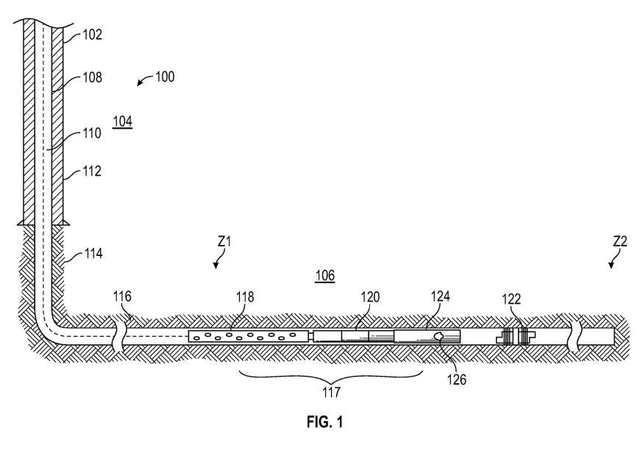
Notes:
US9745847
FIG. 1 shows an exemplary wellbore system that includes a occlusion release device, according to one non-limiting embodiment of the disclosure.
FIG. 1 is a line diagram of a wellbore system 100 that may be used for completion operations in a formation 104 with multiple production zones Z1, Z2, etc. In an exemplary embodiment, the system includes a casing 112 cemented in wellbore 102 formed in a formation 104. In certain embodiments, wellbore 102 is cemented with cement 116 in an open hole 114 without casing 112. Tubing or tubular 108 is deployed within wellbore 102 to a downhole location 106. In certain embodiments, downhole location 106 and zones Z1, Z2 are in horizontal or near horizontal orientations.
In an exemplary embodiment, during completion operations, such as “plug and perforation” operations, a perforation gun 118, frac plug setting tool 120 and a ball releasing tool 124 are deployed as bottom hole assembly (BHA) 117 to a downhole location 106 in a zone Z1, Z2, etc. In an exemplary embodiment, the BHA 117 is deployed via wireline 110. In alternative embodiments, the BHA 117 is deployed via coiled tubing. The frac plug setting tool 120 sets the frac plug 122 within tubing 108, wherein the frac plug 122 allows for a flow therethrough when unobstructed.
The perforation gun 118 may be fired in a downhole location 106. In response to wellbore events, wellbore conditions may change accordingly. After certain wellbore conditions are met, such as a combination of elapsed time, wellbore pressure, wellbore temperature, etc., the ball releasing tool 124 releases an occlusion, such as ball 126 into frac plug 122 to stop fluid flow beyond the plugged area to allow completion operations, such as fracing. In certain embodiments, it is desirable to deploy ball 126 into frac plug 122 after the perforation gun 118 has successfully created perforations at the downhole location 106. In an exemplary embodiment an operator may choose to release ball 126 when certain conditions are met or for any suitable operating parameter. In order to deploy the ball 126 under the desired conditions, ball releasing tool 124 is utilized to selectively release the ball 126.

Slide 14
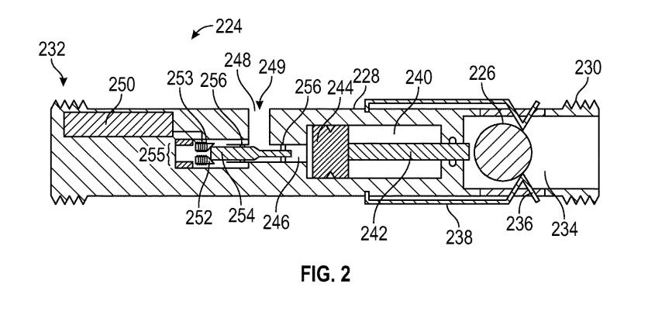
Notes:
US9745847
FIG. 2 shows a non-limiting embodiment of an occlusion release device for use in a wellbore system, including the wellbore system shown in FIG. 1, for deployment in a wellbore, such as wellbore shown in FIG. 1.
FIG. 2 shows a cross-sectional view of a non-limiting embodiment of a ball releasing tool for use in a wellbore system, including the wellbore system shown in FIG. 1 for deployment in a wellbore, such as wellbore shown in FIG. 1. The ball releasing tool 224 includes body 228, ball chamber 234, drive piston 244, and controller 250.
Body 228 includes an upper connection 232 and a lower connection 230. Upper connection 232 and lower connection 230 allow body 228 of ball releasing tool 214 to be assembled with other components in BHA 117 that may be deployed down hole together. In an exemplary embodiment, ball releasing tool 224 is coupled via upper connection 232 with BHA 117 to perforation gun 118 and frac plug setting tool 120. In other embodiments, ball releasing tool 224 is associated with other components to form BHA 117. Advantageously, this coupling allows for a single deployment for plugging operations, perforation operations, and ball release applications, minimizing time and expense.
Integrated controller 250 is disposed within ball release tool 224. In an exemplary embodiment, integrated controller 250 may operate independently and rely on battery power or any other suitable power source. In alternative embodiments, integrated controller 250 is cooperatively associated with other wellbore equipment. In an exemplary embodiment, integrated controller 250 is associated perforation gun 118 and is used to monitor the firing of the perforation gun 118. In other embodiments, integrated controller 250 monitors other relevant conditions.
In an exemplary embodiment, integrated controller 250 is preset with wellbore conditions, including, but not limited to desired elapsed time, pressure, and temperature. Such conditions may relate to, or signal a wellbore event or location of interest. Controller 250 then monitors those conditions at a downhole location 106 to see if such conditions are met via integrated or external sensors. In an exemplary embodiment, if all the desired conditions are met, such as time elapsed, pressure, and temperature, the controller allows shaft 254 to be displaced. An operator may configure the desired conditions.
Shaft 254 is retained in upper chamber 246 of tool 224. O-rings 256 provide a sealing relationship with shaft 254 while keeper 252 further retains the shaft 254 in an initial position. When integrated controller 250 provides the signal that the conditions are met, the shaft 254 is displaced. In an exemplary embodiment, keeper 252 is coil 255 wrapped with an electrical wire 253, which acts as a release mechanism or member. In certain embodiments, controller 250 provides an electrical signal to the electrical wire 253, wherein the resistance of the wire 253 causes the wire 253 to disintegrate or release. Accordingly, the coil 255 is displaced, causing shaft 254 to displace.
After shaft 254 is displaced, the sealing relationship between shaft 254 and upper chamber 246 is disrupted. Fluid flow 249 from port 248 is then received in upper chamber 246.
Drive piston 244 receives wellbore fluid in an upper chamber 246. The pressure differential between upper chamber 246 and lower chamber 240 causes fluid pressure on drive piston 244 to urge drive piston 244 toward a lower extent of ball release tool 224. As the drive piston 244 is urged downwardly, the drive shaft 242 pushes frac ball 226 against the force of the retainers 236 and retainer springs 238.
Until selectively released, frac ball 226 is selectively retained within an occlusion retaining mechanism, such as ball chamber 234. In an exemplary embodiment, frac ball 226 is retained by retainers 236 within ball chamber 234. Retainer springs 238 generally urge retainers 236 inward to keep frac ball 226 within ball chamber 234. The retainer springs 238 are selected to allow the force of the springs to be selectively overcome, without allowing frac ball 226 to be inadvertently deployed.
When the force of retainer springs 238 is overcome, the frac ball 226 is pushed out of the ball chamber 234 to be deployed in the wellbore 102. The frac ball 226 is then seated in a frac plug 122 when desired.
Advantageously, ball release tool 224 allows for frac ball 226 to be delivered during frac plug setting and perforation operations, saving operation time and expense. Further, ball release tool 224 allows for the redeployment of BHA 117 in the event of perforation gun 118 failures, particularly in horizontal wellbores. Additionally, the operation of ball release tool 224 is not necessarily linked to any particular wellbore event. Since controller 250 may monitor wellbore conditions, frac ball 226 may be released when conditions are met reflecting a wellbore event.

Slide 15
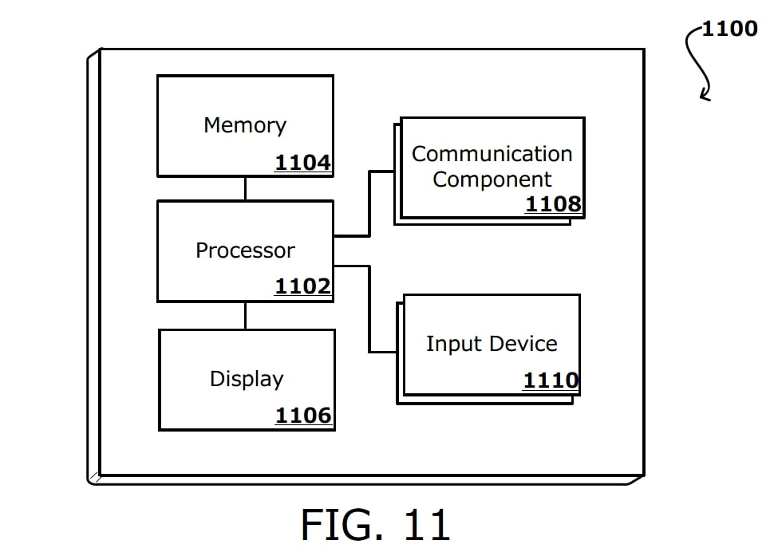
{a14}
{c14}
{e14}
{b14}
{f14}
{d14}
FIG. {fig}

