Slide 1

Tweet Analysis_ Song Suggestion
Eli
Valar
Sharon

Slide 2


HYPOTHESIS
Can we Analyze and decide, whether the Tweet is positive(happy) or negative(sad) and Suggest song to uplift their current emotion?

Slide 3
Data Source and Contents
KaaGle-
Twitter dataset-
Github-
Music dataset- https://github.com/SebinDuke/Sentiment-Analysis-of-songs-by-lyrics/tree/master/FullDataSet
Dataset consists of xxxx and xxxx observations
Twitter dataset- Tweet, Category
Music dataset- Title, Artist, Word count, Category, Lyrics

Slide 4
Programming Language and Libraries Used
Data Reading and Cleaning
Data Processing and Data Base
- Machine Learning
Sklearn
Gensim
Keras
Tokenizer
Pad_sequences
Sequential
Activation
Dense
Dropout
LSTM
Embedding
To_Categorical
Python
Nltk
Nltk.corpus
stopwords
Re
MongoDb
Python
Pandas
Numpy
Front End
Python Flask
Boot Strap/HTML/CSS
Javascript D3.js

Slide 5
Flow Chart
Twitter and Music Dataset
Preprocessing
Tokenizer
Extracting features and doing word Matching and Score analysis
Emotion Classification, Song Suggestion

Slide 6









Packages Used

Slide 7
DATASET GRAPHICAL ANALYSIS USING PLOTLY

Slide 8
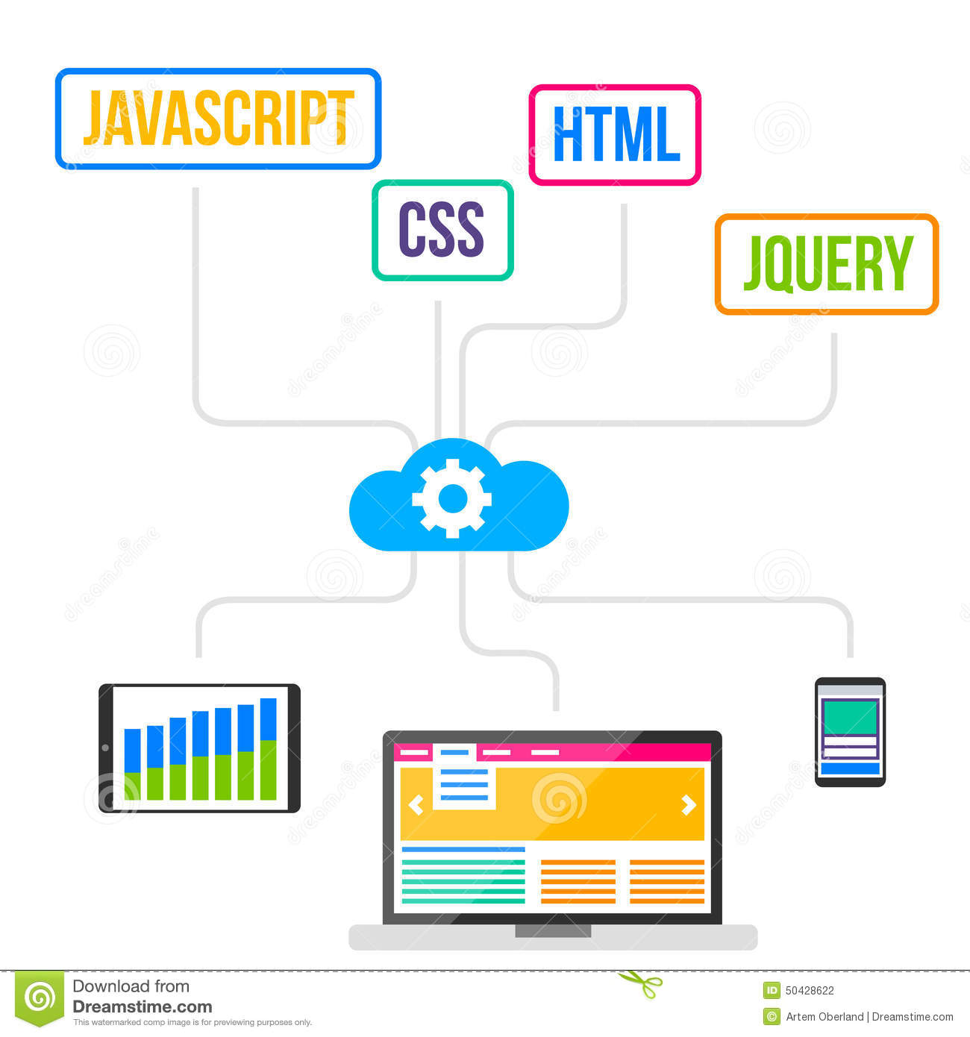
analysis
DATASET GRAPHICAL ANALYSIS USING PLOTLY
LINK

Slide 9
CHALLENGES ON ANALYSIS
Searching Problem
Tokenization and Classification
Reliable Content identification
Stop words- as, a, is the, asap, Lol, @ #$&# does not indicate any sentiment.
Non-English Slang words
Repeated letters like aaaannnngggrrry , aaaaaangry

Slide 10
FUTURE LEARNINGS
Recursive Deep Model Development on multilanguages

Slide 11


Thank you

