Slide 1
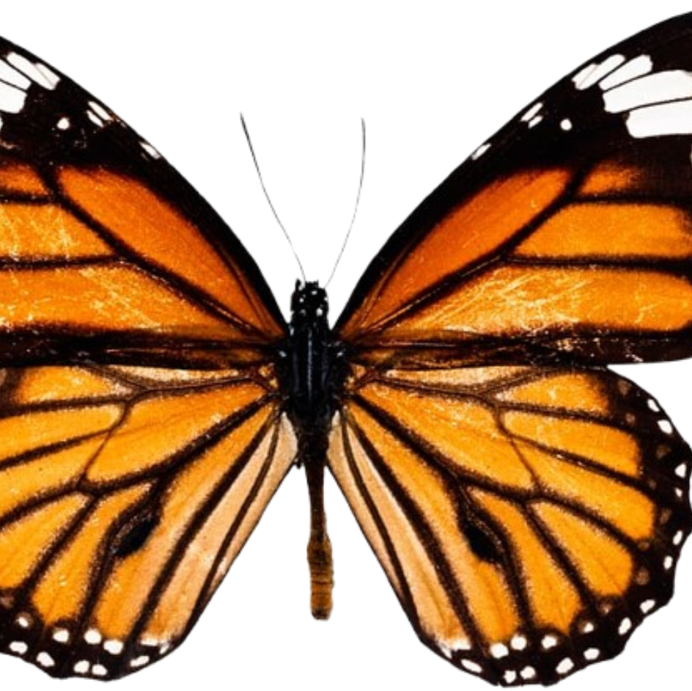
Machine Learning Classification of Butterfly Subfamilies and Mitochondrial Genes
Sharon Tsukernik
https://github.com/Sharont21/Assignment-4.git

Slide 2
Classifying butterflies and its scientific relevance
This project uses machine-learning classifiers (random forest and SVM) to analyze butterfly DNA barcode sequences and distinguish between:
  Genes (COI vs COII)
  Subfamilies (Danainae vs Heliconiinae)
Butterflies play a critical role in ecosystems as pollinators, food-web components and bioindicators of environmental health, making their accurate identification essential for conservation and biodiversity monitoring [3]
DNA barcoding provides a standardized genetic tool for biological identification, allowing for rapid and reliable species classification [5]
Applying machine learning improves the speed, scalability and accuracy of barcode-based classification [2]

Slide 3
Gap in knowledge
Most DNA barcoding studies focus on species-level identification, and less attention is given to:
Higher taxonomic classifications like subfamilies
Performance comparisons between different machine-learning models
Random forests perform well on:
Ecological classification problems [2]
SVMs perform well on:
Genetic expression data classification tasks [6]
Few studies compare RF vs SVM performance across multiple biological classification levels, especially in insect DNA barcoding

Slide 4
Objective
This project addresses the gap in knowledge by comparing gene-level vs. subfamily-level classification accuracy using both models
Goal is to build and evaluate machine-learning classified that:
  Distinguish between COI and COII genes
  Distinguish between Danainae vs Heliconiinae subfamilies
  Compare Random Forest vs SVM performance
Classifier creation and software comparison study that uses:
  Exploratory data analysis
  Model benchmarking using ROC and AUC
Question: How effectively can machine-learning classifiers distinguish between mitochondrial genes (COI vs COII) and butterfly subfamilies (Danainae vs Heliconiinae) using nucleotide composition features?

Slide 5
Description of datasets
This project analyzes butterfly mitochondrial DNA barcode sequences, focusing on the COI and COII genes from two butterfly subfamilies: Danainae and Heliconiinae.
Sequences were obtained from the Barcode of Life Data System (BOLD) and NCBI GenBank, which are internationally curated public genetic databases.
  These databases contain verified DNA barcode records used for species identification and biodiversity research.
Data was downloaded in November 2025
Sequence files were retrieved using manual database downloads (read_tsv and entrez_fetch + entrez_search)
  Data was cleaned, filtered, and processed using R scripts
References:
https://bench.boldsystems.org/taxonomy
https://www.ncbi.nlm.nih.gov/datasets/

Slide 6
Description of datasets
The properties of the dataset are:
  Mitochondrial DNA barcode sequences analyzed (COI and COII)
The number of samples (after combining datasets):
  COI: 25, 796 sequences
  COII: 2, 832 sequences
  Danainae: 11, 217 sequenced
  Heliconiinae: 20, 067 sequences
Key variables of interest:
  Gene label: COI vs COII
  Subfamily label: Danainae vs Heliconiinae
Nature of groups that are being compared:
  Gene classification that tests if 2 mitochondrial genes can be separated by just nucleotide composition
  Subfamily classification that tests if closely related butterfly species can be separated by genetic composition differences

Slide 7
Methods
Downloaded COI & COII butterfly sequences
from BOLD & GenBank
Cleaned and filtered sequences
Removed incomplete or low-quality records
Separated by classification task
Gene (COI vs COII)
Subfamily (Danainae vs Heliconiinae)
Calculated nucleotide proportions
A, T, G, C for each sequence
Generated sequence length histograms
Compared COI lengths between subfamilies
Prepared feature matrices for machine learning
Split data into training and validation sets
Trained Random Forest & SVM classifiers
Evaluated models using ROC, AUC, and confusion matrices

Slide 8
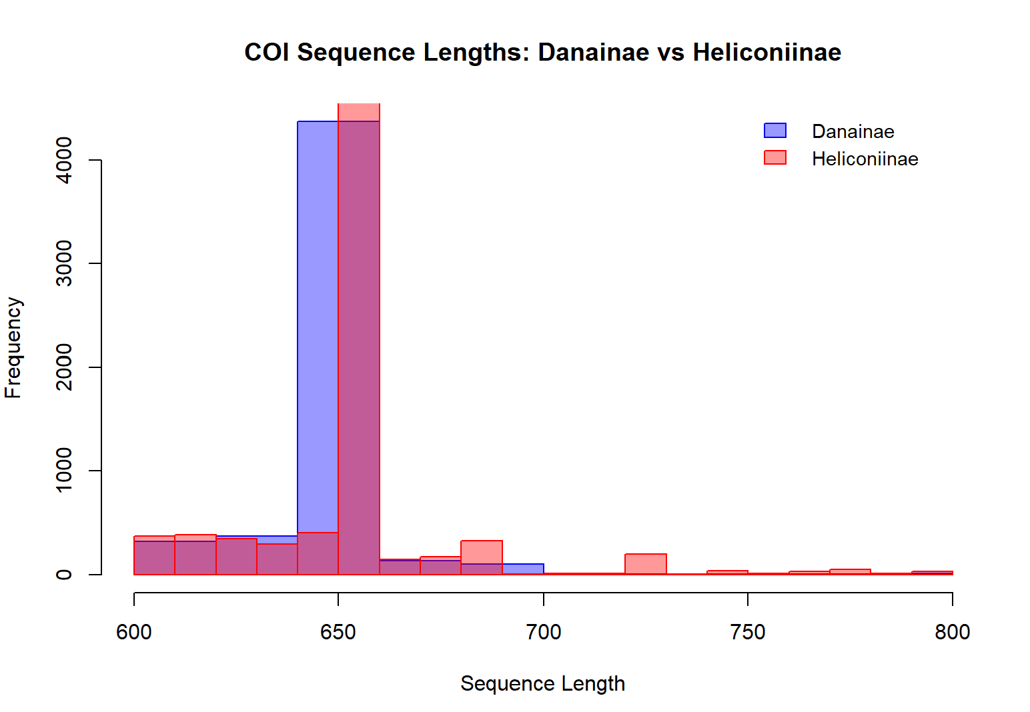
COI barcode sequence lengths are highly conserved across both butterfly subfamilies
Figure 1

Slide 9
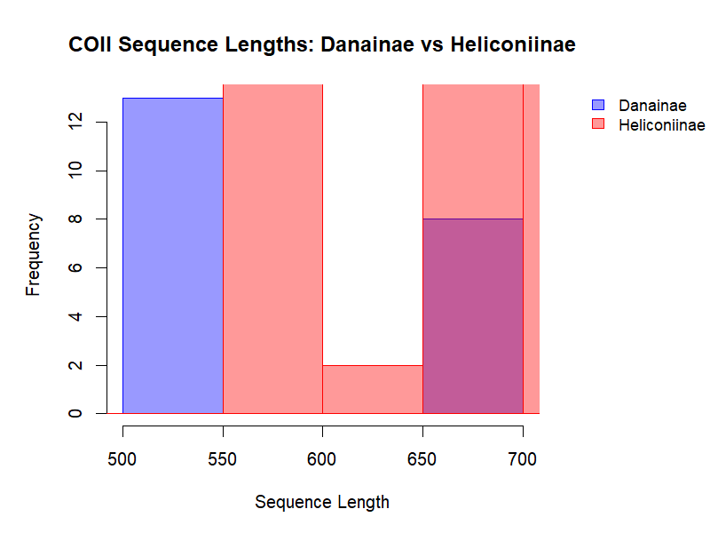
COII sequences show greater length variability and overlap between subfamilies
Figure 2

Slide 10
COI is a more reliable and standardized barcode marker than COII
Figure 1 shows that COI sequence lengths for both subfamilies cluster tightly around ~650 bp
  This matches the standard insect COI barcode length [4]
  Very few outliers remain after filtering
  Interpretation: The tight clustering around ~650 bp confirms that the COI sequences are high-quality DNA barcodes and are directly comparable across subfamilies
Figure 2 shows that COII sequence lengths show substantial variation and strong overlap between the subfamilies
  There is not clear separation between the two subfamilies based on length alone
  Danainae sequences cluster more at shorter lengths, and Heliconiinae span a broader ranger, indicating higher variability within Heliconiinae
  COII sequences span a broader range of lengths than COI
Overall, COII shows greater structural variability, suggesting it may be less ideal as a standardized barcode marker for consistent taxonomic comparisons
  The strong clustering of COI around ~650 bp supports its widespread use in species identification and biodiversity studies [5]
The increased variability seen in COII suggests:
  Greater structural flexibility
  Lower consistency as a universal barcode
Since both subfamilies overlap in length for both genes, sequence length alone is not sufficient for taxonomic classification
This supports the need for further testing with:
  Nucleotide composition features
  Machine learning classifiers, rather than relying on simple sequence properties
These results were expected, as COI is known to be a highly conserved barcode region, while COII is less uniformly standardized across insects [1]

Slide 11
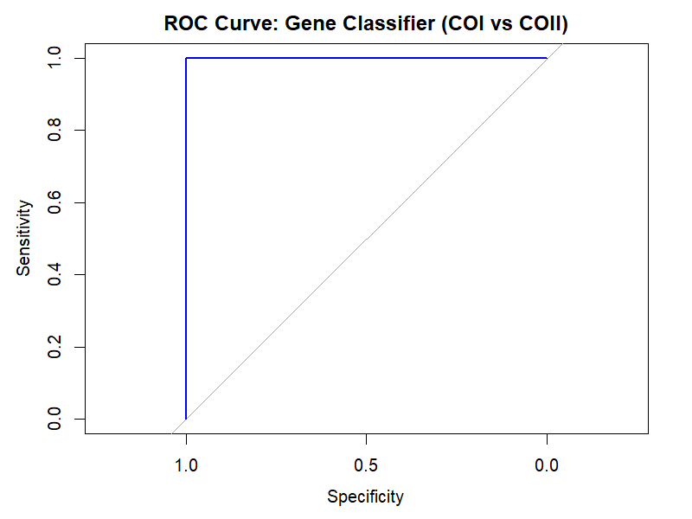
The gene classifier perfectly separates COI and COII
Figure 3

Slide 12
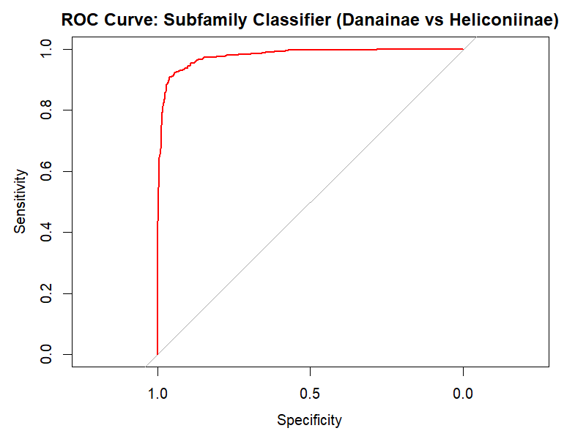
Subfamily classification is highly accurate but not perfect
Figure 4

Slide 13
Gene-level classification is more accurate than subfamily-level classification
Figure 3 shows an ROC curve that reaches the top-left corner with an AUC of 1
  This indicates perfect classification, with the model achieving 100% sensitivity and specificity
  The nucleotide composition features provide complete separation between COI and COII, making gene classification trivially easy for the model
Figure 4 shows an ROC curve with a steep rise in sensitivity at high specificity and an AUC of 0.9781
  This indicates very strong classification with most sequences being correctly classified
  Some overlap between subfamilies still exists
  The classifies performs very well at separating Danainae and Heliconiinae
    Subfamily classification is more difficult than gene classification due to greater biological similarity and overlapping sequence features, which increases classification complexity in ecological datasets [2]
Overall:
  COI and COII are distinct mitochondrial genes, which explains the perfect classification performance
  Danainae and Heliconiinae are closely related butterfly subfamilies, so their nucleotide compositions show greater overlap, and classification remains strong but not perfect
This demonstrates how taxonomic depth directly affects classification difficult
These results were expected because separating different genes is biologically simpler than separating closely related taxonomic groups [2]

Slide 14
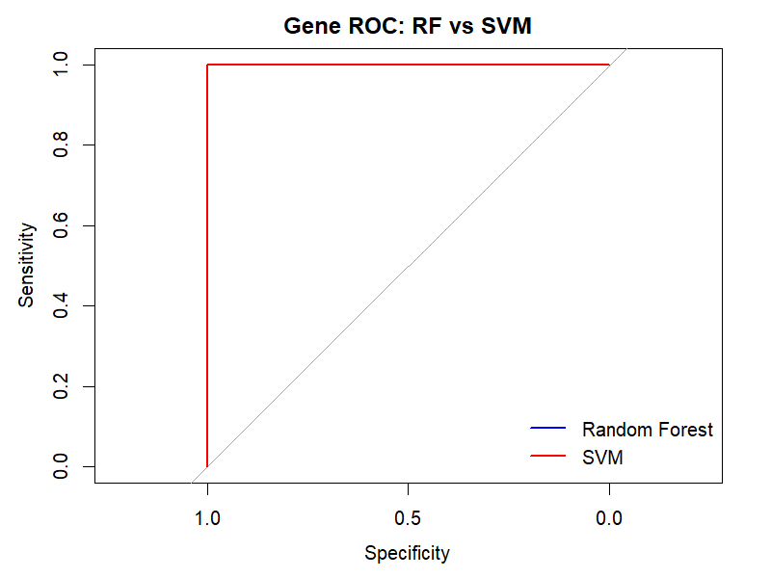
Random Forest and SVM perform identically for gene classification
Figure 5

Slide 15
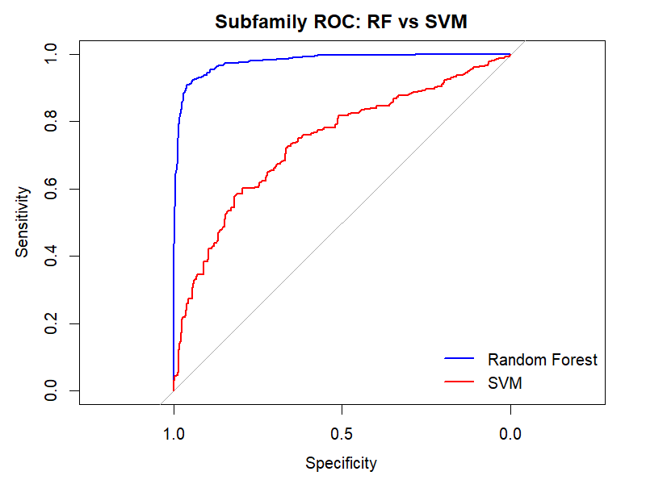
Classifier performance depends on biological complexity of the task
Figure 6

Slide 16
Random Forest is better suited for complex ecological classification
Figure 5 shows that both the Random Forest and SVM ROC curves completely overlap
  Both models achieve an AUC = 1, 100% sensitivity and 100% specificity
  There is no visible difference in performance between both models
  Both Random Forest and SVM classify COI vs COII perfectly, indicating that gene-level classification is trivially separable using nucleotide composition features, regardless of classifier choice.
Figure 6 shows that the Random Forest ROC curve rises much more steeply than the SVM ROC curve
  The Random Forest shows:
    Very high sensitivity at high specificity
    Strong overall discrimination
  The SVM shows:
    Lower sensitivity across most specificity values
    Moderate overall performance
Overall:
  At the gene level, COI and COII are fundamentally distinct genes, so both the Random Forest and SVM classifiers reach perfect performance
  At the subfamily level, Danainae and Heliconiinae are closely related evolutionarily and more similar in nucleotide composition
    This increases biological overlap, which reduces SVM performance and is better more effectively by Random Forest
  This demonstrates a clear performance gap between the two classifiers
    While both models can classify subfamilies, Random Forest is substantially more effective than SVM for separating Danainae and Heliconiinae
These results were expected, as Random Forest performs better than linear SVM when class boundaries are non-linear and biologically complex [6]

Slide 17
Key Caveats
Uneven sample sizes:
  COI greatly outnumbered COII, so the natural database availability is unbalanced
  Subfamily sample sizes also differed in the natural data
Biological imbalance in task difficulty for classifier:
  gene classification is inherently easier than subfamily classification [2] [6]
  COI and COII more genetically distinct than the subfamilies
Generalizability:
  results may not transfer to other taxa or other genetic markers depending on how well sampled they are
Feature simplicity:
  Classifiers relied on nucleotide proportions and dinucleotide frequencies
  More complex features (k-mer >2) might improve subfamily-level classification
Could have found 2 genes that were more closely related
  I originally was comparing COI vs CytB, but was having complications downloading cytb/cytochrome b/CytB data specifically for Heliconiinae so chose to compare COI vs COII which are more genetically distinct and therefore allow for easy classification

Slide 18
Next Steps
Expand classification across taxonomic levels
  Compare how classification accuracy changes across species → genus → subfamily → family
Add additional genetic markers that are less distinct in the nucleotide composition
  Other mitochondrial genes
Test additional machine-learning models
  Decision tree, KNN, non-linear SVM
Enhance feature complexity
  Add k-mer > 2, amino acid composition

Slide 19
Acknowledgements
  Sabrina: Helped me build the function to download data from NCBI and also looked over my slideshow and gave me useful tips to make it look more presentable
  Saira: Was able to look over my script and provide me with very useful advice on how to improve it so that I can interpret my results better
  I think because classes ended and I wasn’t seeing people in person, there was less helpful communication between peers about how to improve each other’s code and project

Slide 20
Reflection
Completing this project helped me meaningfully connect theoretical concepts from BINF 6210 with hands-on bioinformatics practice, especially in applying machine learning to real biological data. I gained confidence in working with large public genetic datasets, cleaning and filtering sequence data, engineering meaningful features, and evaluating classifier performance using ROC curves and AUC. One of the most important lessons I learned was that strong model performance is not just about choosing the “best” algorithm, but about understanding the biological context, feature design, and limitations of the data. I also strengthened my troubleshooting, scripting, and workflow organization skills—particularly in building a fully reproducible analysis pipeline in R. On a personal level, this project reinforced the importance of time management, breaking large tasks into smaller steps, and seeking help early when challenges arose. Moving forward into BINF*6999 and a future career in bioinformatics, I want to continue developing my skills in advanced machine learning, multi-omic data integration, and pipeline automation, while also improving my scientific communication and project planning skills.

Slide 21
References
[1] Caterino, M. S., & Sperling, F. A. (1999). Papilio phylogeny based on mitochondrial cytochrome oxidase I and II genes. Molecular Phylogenetics and Evolution, 11(1), 122. https://doi.org/10.1006/mpev.1998.0549
[2] Cutler, D. R., Edwards, T. C. J., Beard, K. H., Cutler, A., Hess, K. T., Gibson, J., & Lawler, J. J. (2007). Random forests for classification in ecology. Ecology (Durham), 88(11), 2783–2792. https://doi.org/10.1890/07-0539.1
[3] Ghazanfar, M., Malik, M. F., Hussain, M., Iqbal, R., & Younas, M. (2016). Butterflies and their contribution in ecosystem: A review. Journal of Entomology and Zoology Studies, 4(2), 115-118.
[4] Guo, M., Yuan, C., Tao, L., Cai, Y., & Zhang, W. (2022). Life barcoded by DNA barcodes. Conservation Genetics Resources, 14(4), 351–365. https://doi.org/10.1007/s12686-022-01291-2
[5] Hebert, P. D. N., Cywinska, A., Ball, S. L., & deWaard, J. R. (2003). Biological identifications through DNA barcodes. Proceedings of the Royal Society B : Biological Sciences, 270(1512), 313–321. https://doi.org/10.1098/rspb.2002.2218
[6] Statnikov, A., Wang, L., & Aliferis, C. F. (2008). A comprehensive comparison of random forests and support vector machines for microarray-based cancer classification. BMC Bioinformatics, 9(1), Article 319. https://doi.org/10.1186/1471-2105-9-319
R documentation
svm function - RDocumentation. (2024). Rdocumentation.org. https://www.rdocumentation.org/packages/e1071/versions/1.7-16/topics/svm
TechVidvan Team. (2020, May 17). SVM in R for Data Classification using e1071 Package. TechVidvan. https://techvidvan.com/tutorials/svm-in-r/
roc.curve function - RDocumentation. (2015). Rdocumentation.org. https://www.rdocumentation.org/packages/PRROC/versions/1.3.1/topics/roc.curve
Rickert, J. (2019). Some R Packages for ROC Curves. Rstudio.com. https://rviews.rstudio.com/2019/03/01/some-r-packages-for-roc-curves/

