Slide 1
Quick Introduction to the Workshop and Core
Dr. Matthew L. Settles
Genome Center
University of California, Davis
settles@ucdavis.edu

Slide 2
The mission of the Bioinformatics Core facility is to facilitate outstanding omics- scale research through these activities:
Data Analysis
The Bioinformatics Core promotes experimental design, advanced computation and informatics analysis of ‘omics’ scale datasets that drives research forward.
Research Computing
Maintain and make available high-performance computing hardware and software necessary for todays data-intensive bioinformatic analyses.
Training
The Core helps to educate the next generation of bioinformaticians through highly acclaimed training workshops, seminars and through direct participation in research activities.
Data Analysis
Research Computing
Training
Data Analysis
Research Computing
Training
Data Analysis
Research Computing
Training
Data Analysis
Research Computing
Training
Intelligently analyzing data from genomics, and other projects, to help drive research forward
Helping build high-performance software and hardware bioinformatics solutions
Providing acclaimed training workshops that will equip people with in-demand bioinformatics skills
Intelligently analyzing data from genomics, and other projects, to help drive research forward
Helping build high-performance software and hardware bioinformatics solutions
Providing acclaimed training workshops that will equip people with in-demand bioinformatics skills
Intelligently analyzing data from genomics, and other projects, to help drive research forward
Helping build high-performance software and hardware bioinformatics solutions
Providing acclaimed training workshops that will equip people with in-demand bioinformatics skills
Intelligently analyzing data from genomics, and other projects, to help drive research forward
Helping build high-performance software and hardware bioinformatics solutions
Providing acclaimed training workshops that will equip people with in-demand bioinformatics skills

Slide 3
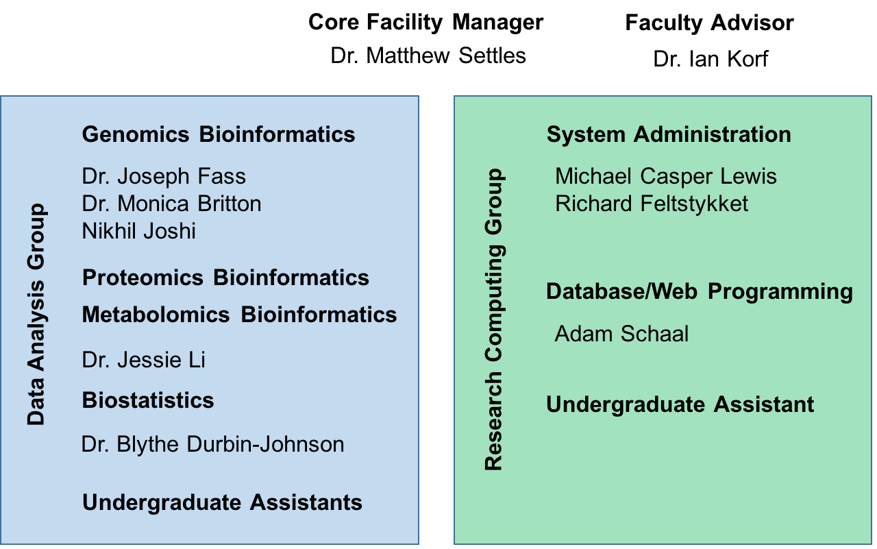
UC Davis Bioinformatics Core in the Genome Center

Slide 4
Contacts
Bioinformatics related questions, include but not limited to
bioinformatic methods questions, software use, data questions
Bioinformatics.core@ucdavis.edu
Computing Issues, include but not limited to
User account questions, equipment failure/malfunction, software install, software failures (not related to use)
helpdesk@genomecenter.ucdavis.edu
Training courses information
training.bioinformatics@ucdavis.edu

Slide 5
Goals
End to End understanding of microbial community analysis
Discussions
Experimental design
Cost estimation
Technologies
Workflow
To work through a complete experiment, starting from raw data to completion, including making a few figures.
Goal is 30-40% lecture/discussion 60-70% hands-on

Slide 6
Workshop Info
Internet
If your home institution is on eduroam, you should be on already
If not you can use CalVisitor
https://technology.berkeley.edu/wi-fi
Schedule is loose, we will try and have short breaks, lunch is ~12-1pm

Slide 7
More Info
Workshop materials posted on github
https://ucdavis-bioinformatics-training.github.io/2018-May-Microbial-Community-Analysis-Workshop_UCB/
https://github.com/ucdavis-bioinformatics-training/2018-May-Microbial-Community-Analysis-Workshop_UCB
Course will be conducted on our server and cluster
ganesh.genomecenter.ucdavis.edu
Cluster usage will be under reservation ‘workshop’
Everyone should have a username/password.

Slide 8
Monday 21st Introductions Morning Hands on: Intro to Command Line (Joe) Morning Talk: “What is Bioinformatics?” (Matt) Afternoon Talk: “Intro to Microbial Sequencing” (Shana & Dylan)
Late Afternoon Hands On:
Installing workshop software and setting the environment
Homework: Running Jobs on the cluster
Tuesday 22nd
dbcAmplicons: Processing Sequence Reads Through abundance tables
Friday 23rd Morning Hands on: Intro to R (Jessie) Afternoon Hands on: Microbial Community Analysis with R (Matt)
Closing

