Slide 1
dbcAmplicons pipeline Amplicons
Matthew L. Settles
Genome Center Bioinformatics Core
University of California, Davis
settles@ucdavis.edu; bioinformatics.core@ucdavis.edu

Slide 2
Microbial community analysis
Goal: A culture independent method for profiling the diversity of a community.
High-throughput sequencing technologies (such as Illumina) can sequence millions of amplicons, across thousands of samples in a single run, and are today our best approach to deeply assess the environmental or clinical diversity of complex microbial assemblages of archaea, bacteria, and eukaryotes.
Using sequence variation within a common gene (e.g. 16s) to assign and count community members rather than counting individual cells. Assume each sequence variant is one community member.

Slide 3
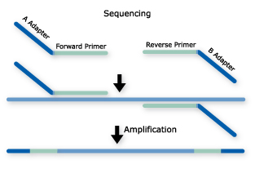
Amplicons: Common Approach (among many)
Single PCR
Long primer sequences (~75bp) that contain barcodes and sequencing adapters
Single or dual barcodes
(dual barcode often within read 2)
Common approach

Slide 4
dbcAmplicons
Originally conceived in late 2012 to lower per sample costs on relatively short targeted (PCR) regions
16S, ITS, LSU, 18S, etc. Community profiling
Extraction of mitochondria, virae, chloroplast regions, plasmids by PCR
Genotyping of samples for phylogenomics, genome to phenotype interactions
Uses the Illumina platform, capably of pooling thousands, or even tens of thousands of barcoded samples/targets per sequencing run.
Core Facility friendly, facilitates interactions between and across individual labs, standardizing workflows.

Slide 5
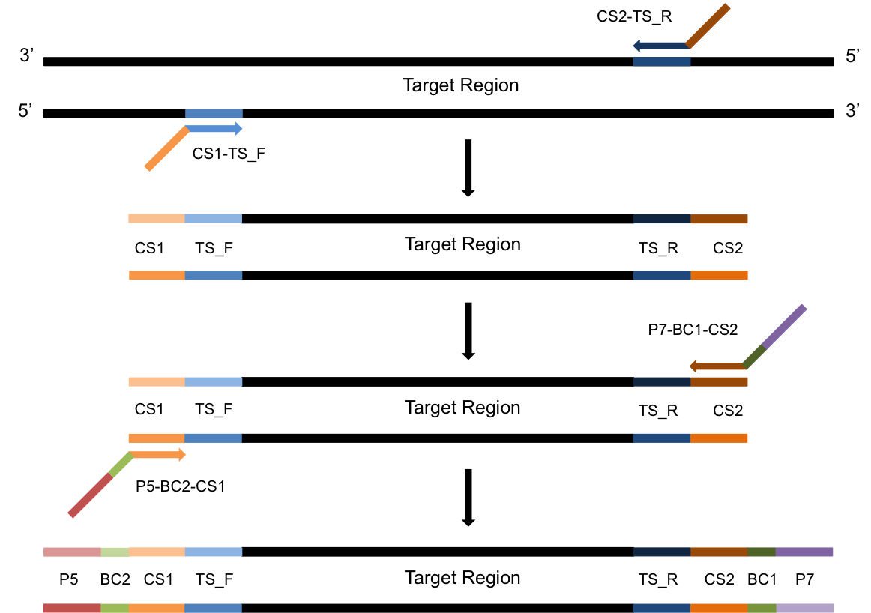
Amplicons: Two Step PCR Approach
PCR-1
Template with overhang
PCR-2
Add barcodes and adapters
Barcodes and adapters are added in the second round of PCR

Slide 6
Amplicon sequencing with dual barcoding
2-step PCR, where the first PCR extracts out the target specific region and the second PCR add on adapters and barcodes. Target specific primers include universal sequences CS1 and CS2, the second PCR extends the universal sequences with adapters and barcodes.
Adapters and barcodes are not included in the target specific primers which allows for maximum flexibility in target specific primer usage and the ability to swap out targets, or include multiple targets in the same sequencing reaction without needing to purchase a large number of barcoded, target specific primers.
Barcodes are included in both adapters, therefor a pair of barcodes are used to uniquely identify a samples. This allows for 32 barcode pairs to be able to uniquely identify 1024 samples.

Slide 7
Multiplex Samples
Dual barcoding allows for massively multiplexing of samples using only a relatively few primers
Pairing of BC1 and BC2 uniquely identifies sample
^{GTATCGTC}
^{TGCTCGTA}
^{GTCGTCGT}
^{GTGCGTGT}
^{GCGTCGTG}
^{GTCGTGTA}
^{GATGTAGC}
^{GAGTGATC}
^{CGCTATCA}
^{CGCTGTAG}
8bp [Error-Correcting]
Barcodes
5 Pairs of Barcodes allows for multiplexing of 25 samples.
32 Pairs can multiplex 1024 samples in the same sequencing reaction

Slide 8
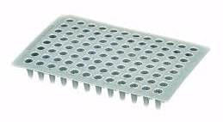
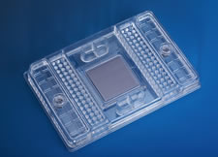
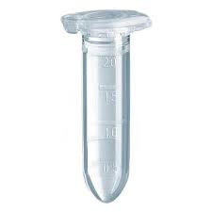
Multiplex Amplicon Targets
Fluidigm Access Array System
PCR-1 product
PCR-2 product
48 samples X 48 amplicons
2304 Two-step PCR reactions
Pool many samples

Slide 9
Primer Design

Slide 10
Template Specific Primer Design
Each primer pair contains the following parts
CS1 or CS2 to attach second adapter/barcode primer
Phase-shifting bases [see below]
Linker sequence
Template specific primer sequence
Phase shifting primer
Phase shifting primers with PCR duplicate detection
CA
CA
TCA
NCA
GTCA
NNCA
AGTCA
NNNCA
CS
TS
CS
TS
Ns, resolve to be PCR duplicate keys and should only ever appear once

Slide 11
Components of the target specific primer
CS1, or CS2 sequence
Provides the sequence necessary for priming of PCR-2, also serves as the sequencing primer site
Phase-shifting bases
Generates diversity in the sequencing reaction
Linker sequence
Buffers the target specific primer sequence from the rest of the primer, preventing some taxa (longer priming) from being more efficient than others.
Target specific primer sequence

Slide 12
Example target specific primers
Example 27F and 534R (red bases are the inserted bases)
ID | Primer
CS1-27F | ACACTGACGACATGGTTCTACAAGAGTTTGATCCTGGCTCAG
CS1-27F_2 | ACACTGACGACATGGTTCTACACAGAGTTTGATCCTGGCTCAG
CS1-27F_3 | ACACTGACGACATGGTTCTACATCAGAGTTTGATCCTGGCTCAG
CS1-27F_4 | ACACTGACGACATGGTTCTACAGTCAGAGTTTGATCCTGGCTCAG
ID | Primer
CS2-534R | TACGGTAGCAGAGACTTGGTCTATTACCGCGGCTGCTGG
CS2-534R_2 | TACGGTAGCAGAGACTTGGTCTCATTACCGCGGCTGCTGG
CS2-534R_3 | TACGGTAGCAGAGACTTGGTCTTGATTACCGCGGCTGCTGG
CS2-534R_4 | TACGGTAGCAGAGACTTGGTCTGCGATTACCGCGGCTGCTGG
CS1/CS2 sequence, Phase-shifting bases, Linker sequence, target specific primer

Slide 13
Components of the Barcoded adapter primers sequence
P5, or P7 sequence
Primers to the Illumina flow cell, Sequence on the P5 strand typically constitutes R1, those on P7 strand typically constitutes R2.
Barcode sequence
Uniquely identifies sample
CS1, or CS2 sequence
Necessary for extending PCR-1

Slide 14
Example barcoded adapter primers
Example 27F and 534R (red bases are the inserted bases)
ID | Primer
P5-Index1-CS1 | AATGATACGGCGACCACCGAGATCTACACTAGATCGCACACTGACGACATGGTTCTACA
P5-Index2-CS1 | AATGATACGGCGACCACCGAGATCTACACCTCTCTATACACTGACGACATGGTTCTACA
P5-Index3-CS1 | AATGATACGGCGACCACCGAGATCTACACTATCCTCTACACTGACGACATGGTTCTACA
P5-Index4-CS1 | AATGATACGGCGACCACCGAGATCTACACAGAGTAGAACACTGACGACATGGTTCTACA
ID | Primer
P7-Index1-CS2 | CAAGCAGAAGACGGCATACGAGATTAAGGCGATACGGTAGCAGAGACTTGGTCT
P7-Index2-CS2 | CAAGCAGAAGACGGCATACGAGATCGTACTAGTACGGTAGCAGAGACTTGGTCT
P7-Index3-CS2 | CAAGCAGAAGACGGCATACGAGATAGGCAGAATACGGTAGCAGAGACTTGGTCT
P7-Index4-CS2 | CAAGCAGAAGACGGCATACGAGATTCCTGAGCTACGGTAGCAGAGACTTGGTCT
P5/P7 sequence, Barcode, CS1/CS2 sequence

Slide 15
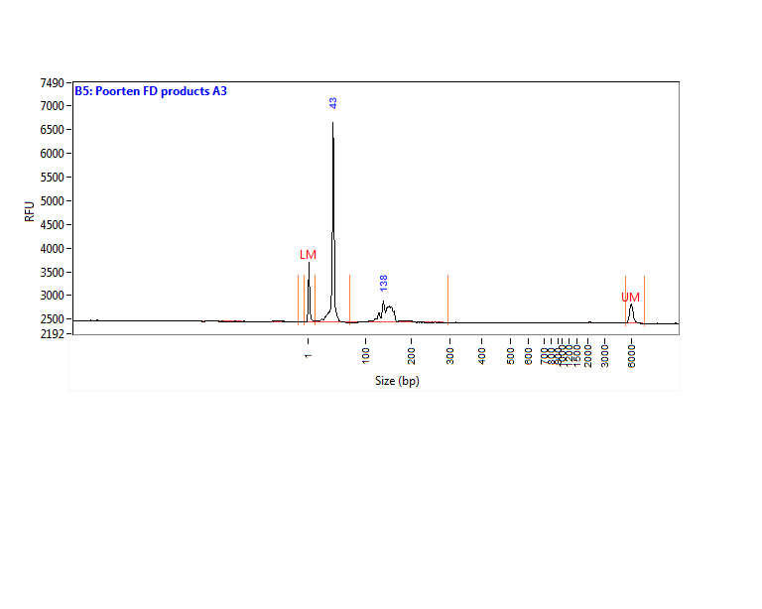
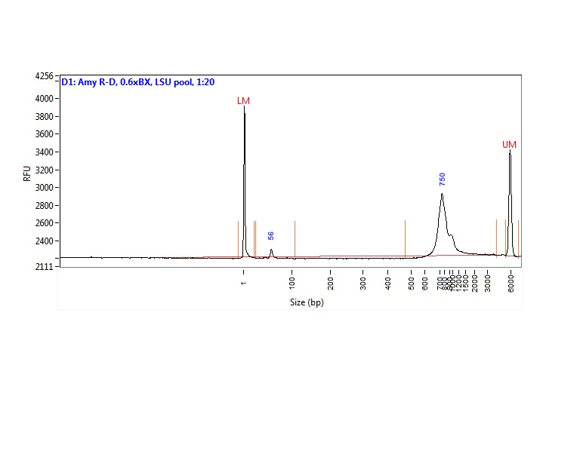
QC: what is a “good” library?
Unused primers and adapters
Unused primer
BAD!
Template of interest
Good!

Slide 16
Pooling Samples/Amplicons
Even amplicon representation is important and difficult to achieve. Amplicon counts can vary from sample to sample by 100x
Each amplicon should be evaluated by quality (ideally by trace) and quantity (fluourometery). Both qualities will effect final counts.
Best practices
First group amplicons by quality/quantity profiles
Pool each group separately
If a small number of groups consider qPCR on each group for final pooling concentrations
If a large number re-quantify and pool to final pool.

Slide 17
Benefits/Drawbacks
Benefits
Maximum Flexibility, fewer target specific primers needed.
Dual barcoding, allowing for massively multiplexing of samples to occur.
Pool multiple targets per run
Software for demultiplexing
Drawbacks
Two – step PCR reaction
Sequence the target specific primer

Slide 18
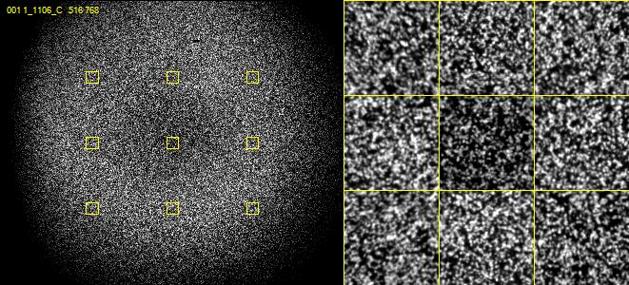
Nucleotide diversity
Critically important for imaging clusters

Slide 19
Nucleotide Diversity
Once a sample library is converted to clusters on a flow cell, “nucleotide diversity” refers to the distribution of nucleotides across the flow cell at any given cycle. From the viewpoint of the instrument software, a high diversity library translates into analyzing images containing an even distribution of spots from 4 different color channels corresponding to the 4 nucleotide bases A, T, C & G. In contrast, an unbalanced nucleotide distribution or “low diversity library” means that for any given image, or to two bases are present at a high percentage

Slide 20
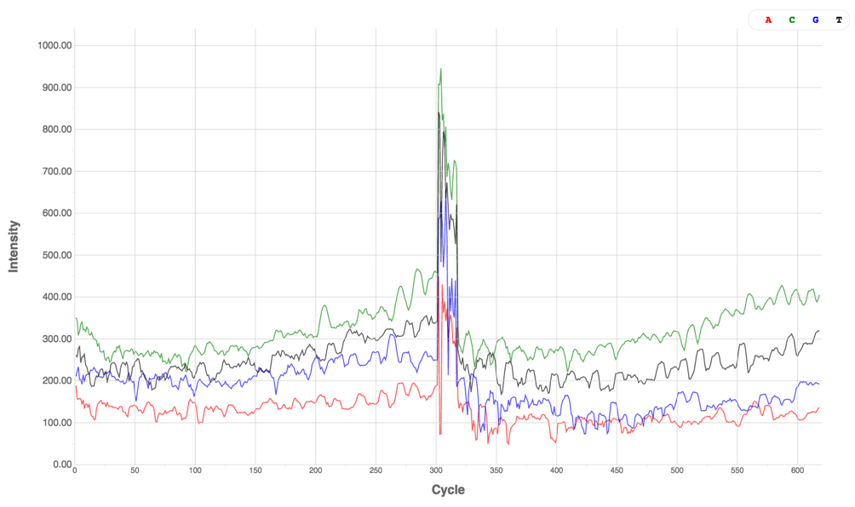

Low Diversity Library vs High Diversity Library
Low Diversity Library
High Diversity Library

Slide 21
Ways to ensure nucleotide diversity
Appropriate nucleotide diversity and cluster density are important for high quality data. Low nucleotide diversity in combination with high cluster density will most-likely lead to poor data quality and/or low data yield.
Ways to avoid low nucleotide diversity
Sequence the sample at a 30-40% lower density
Spiking in at a 5-50% a nucleotide balanced library
(such as PhiX, or better a shotgun library of a sample of interest)
Multiplex a high number of amplicon regions 12 or greater)
Build phase-shifted primers
Note: Experience has shown, that 15% shotgun spike-in, plus phase-shifted primers and/or multiple target region typically yields good results.

Slide 22
Illumina Sequencing Requires custom sequencing primers to be added to the reaction (Typical Illumina sequencing primers remain in the reaction for sequencing of PhiX or other shotgun library)
BC2 primer
BC2 (8bp)
BC1 primer
BC1 (8bp)
Read1 primer
Read1 (300bp)
Read2 (300bp)
Read2 primer
P5
BC2
CS1
Target Sequence
CS2
BC1
P7
Read | Sequencing Primers
Read1 primer | CS1 - 5’ ACACTGACGACATGGTTCTACA 3’
Read2 primer | CS2 - 5’ TACGGTAGCAGAGACTTGGTCT 3’
BC1 primer | CS2rc - 5’ AGACCAAGTCTCTGCTACCGTA 3’
BC2 primer | Uses the P5 amplification primer

Slide 23
Common Analysis Workflow
Identify barcodes
Identify primer sequence (if present) and trim
Overlap paired end reads to produce single read, full amplified target sequence
Generate operational taxonomic unites (“OTUs”), via clustering or classification
Assign ”OTUs” to an organism
Generate abundance tables
Statistical testing

Slide 24
Common workflows
Qiime
Worst piece of software to install ever
Mothur
Dada2
dbcAmplicons (my software)

Slide 25
dbcAmplicons
Two-step PCR
highly multiplexed and modular amplicon design
DNA
Performed in Researcher’s Lab
Target Specific
Primer Design
Primer Validation
Dual-barcoded
Two-step
PCR
Pooling
And
Quantification
Python dbcAmplicons application
Performed in Core Facility
Downstream
Analysis
Preprocess:
Demuliplex by barcodes and primer sequences
Illumina Sequencing
Four Read Setup

