Slide 1


Slide 2
Column Description
id: A unique identifier for each match, facilitating easy reference and data management.
season: Indicates the year and edition of the league, which helps in categorizing matches over time (e.g., "2007/08").
city: The city where the match took place, providing geographic context.
date: The specific date of the match, essential for chronological analysis.
match_type: Classifies the match type, such as League, Qualifier, or Final, which affects its significance.
player_of_match: Identifies the standout player for the match, highlighting individual performances.
venue: Specifies the stadium or ground where the match was held, important for understanding playing conditions.
team1: The first team participating in the match, necessary for match context.
team2: The second team participating in the match, completing the match-up.
toss_winner: The team that won the toss, which can influence match strategies.
toss_decision: The decision made by the toss-winning team (whether to bat or field), impacting the game's flow.
winner: The team that emerged victorious in the match, crucial for match outcomes.
result: Describes how the match was won, either by runs or wicketas, indicating the nature of the victory.

Slide 3
result_margin: The margin by which the match was won, providing insight into the competitiveness of the match.
target_runs: The score that the chasing team needs to achieve, relevant for understanding match dynamics.
target_overs: The total number of overs allocated to the chasing team, which dictates their run rate requirement.
super_over: Indicates whether a super over was played (Y/N), useful for identifying tied matches.
umpire1: Name of the first umpire officiating the match, relevant for accountability and match management.
umpire2: Name of the second umpire officiating the match, completing the officiating details.

Slide 4
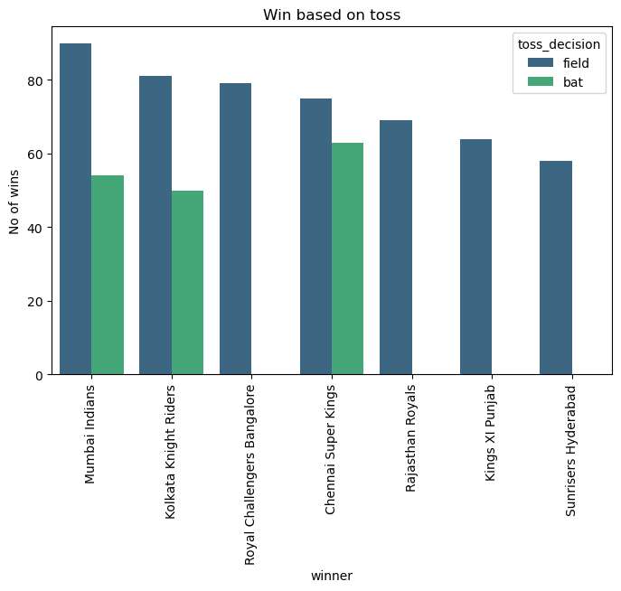
Win Based on Toss Decisions
The bar plot displays the number of wins for IPL teams based on toss decisions (whether the team chose to bat or field after winning the toss).
Mumbai Indians, Kolkata Knight Riders, Royal Challengers Bangalore, and other teams appear on the x-axis (labeled "winner").
The y-axis shows the "No of wins".
Each team has two bars: one for when they chose to field (dark green) and one for when they chose to bat (light green).
The chart provides insights into how teams' decisions after winning the toss impact their success.

Slide 5
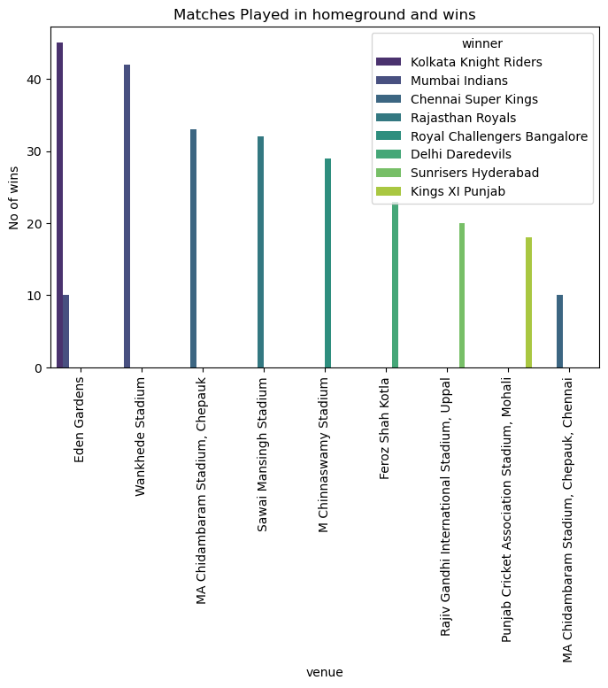
Matches Played at Home Ground and Wins
This barplot displays data about matches played in home grounds and the number of wins for different IPL teams.
The x-axis lists the venues, which correspond to the home grounds of various teams (e.g., Eden Gardens, Wankhede Stadium, etc.).
The y-axis represents the number of wins each team has at their respective home grounds.
Each color in the bars represents a different IPL team, For example:
Kolkata Knight Riders (Eden Gardens) is represented in purple.
Mumbai Indians (Wankhede Stadium) is in blue.
Chennai Super Kings (MA Chidambaram Stadium) is in a darker teal shade.
This visualization highlights which teams have a strong home advantage based on their win counts at these grounds.

Slide 6
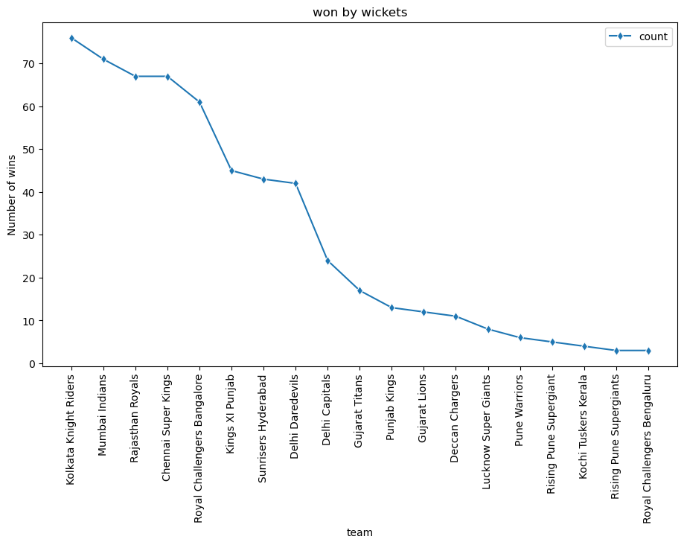
Winning by Wickets
This line chart shows the number of wins by wickets for different teams, with Kolkata Knight Riders having the most and Royal Challengers Bengaluru having the least.
Top Teams: Kolkata Knight Riders, Mumbai Indians, and Rajasthan Royals lead in wins by wickets.
Close Competition: The top four teams have similar win counts, indicating competitive strength in chasing.
Drop-off After Top Teams: Significant decline in wins after Chennai Super Kings, especially for Kings XI Punjab.
Lower Performing Teams: Gujarat Titans, Delhi Capitals, and Punjab Kings have fewer wins by wickets.
Least Wins: Kochi Tuskers Kerala, Rising Pune Supergiant, and Royal Challengers Bengaluru have the fewest wins by wickets.

Slide 7
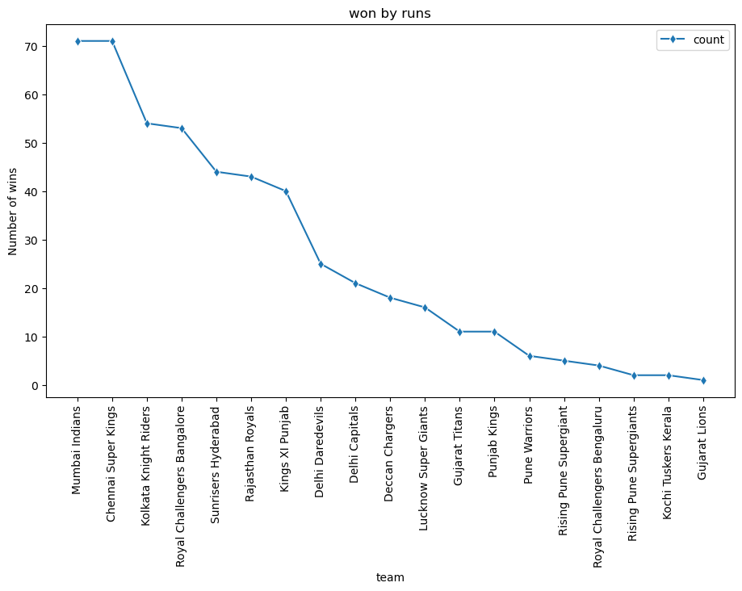
Winning by Runs
This line chart shows the number of wins by runs for different teams
Top Teams: Mumbai Indians and Chennai Super Kings lead with over 70 wins by runs.
Strong Defenders: Kolkata Knight Riders and Royal Challengers Bangalore follow with solid defending records.
Mid-Range Performers: Sunrisers Hyderabad, Rajasthan Royals, and Kings XI Punjab have moderate success (40-50 wins).
Noticeable Decline: Wins drop significantly after Delhi Capitals and Deccan Chargers.
Least Wins: Kochi Tuskers Kerala, Rising Pune Supergiant, and Gujarat Lions have the fewest wins by runs.

Slide 8
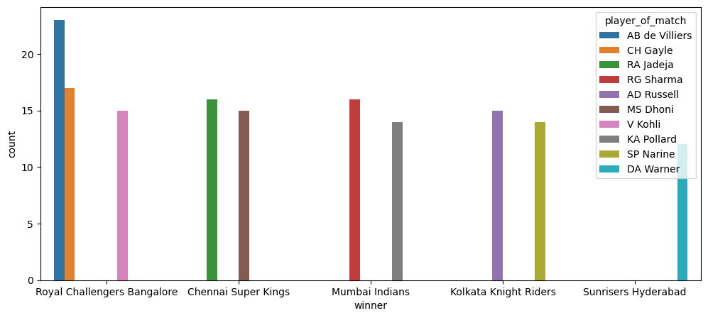
Player of the Match Awards
The Bar plot describes the distribution of "Player of the Match" awards among key players from various teams in a cricket league (likely the Indian Premier League). It shows:
Teams and Players: The teams represented include Royal Challengers Bangalore, Chennai Super Kings, Mumbai Indians, Kolkata Knight Riders, and Sunrisers Hyderabad. Each team has specific players highlighted who have won "Player of the Match" awards.
Top Performers: Players like AB de Villiers, Chris Gayle, MS Dhoni, Rohit Sharma, Andre Russell, and David Warner are among the prominent award winners for their respective teams.
Award Distribution: The number of awards each player has won is represented, with Royal Challengers Bangalore players AB de Villiers and Chris Gayle having the most.
The plot gives insight into which players have had the most impactful performances for their teams, earning them "Player of the Match" recognition.

Slide 9
Conclusion
Fielding after winning the toss is a commonly successful strategy, leading to more victories for teams across the board.
Home ground advantage plays a significant role, with venues like Eden Gardens, Wankhede Stadium, and MA Chidambaram Stadium proving to be tough for visiting teams.
The combination of smart toss decisions and leveraging home conditions has been a defining factor in IPL team success, particularly for teams like Mumbai Indians, Kolkata Knight Riders, and Chennai Super Kings.
Top Teams' Consistency: Mumbai Indians, Chennai Super Kings, and Kolkata Knight Riders are consistent in winning matches by both runs and wickets, showing adaptability and strength.
Reliance on Star Players: These successful teams depend heavily on key players for match-defining performances.
Struggling Teams' Issues: Teams that struggle lack either a balanced approach to match situations or consistent star players to rely on.
Star Player Dominance: The dominance of star players is crucial for securing wins and staying competitive in the league. Their performances often determine a team’s success

