Slide 1
Baseline document
Student: Roberto Carlos Gutierrez Constantino
Teacher: Dr. Omar Ali Zatarain Durán
Software Configuration Management
24/01/2025

Slide 2
Introduction
This baseline document describes the fundamental aspects of the system called “WebCongress” intended for the management of a congress.
The system will provide users with the possibility of consulting information about workshops and conferences, purchasing their tickets and registering for the events of their choice.

Slide 3
SYSTEM DESCRIPTION
The project involves the development of a website dedicated to the management of conferences. This site will be divided into two modules:
User module
allows users to access detailed information about workshops and conferences, including schedules, specific locations and available seats. In addition, users will be able to purchase entrance passes to the conference, which will be of two types:
Free package: Limited access to some workshops and conferences.
Full package: Full access to all events.
Users who have purchased a pass will be able to register for the workshops or conferences of their choice, provided there are available seats. To purchase a pass, it is necessary to create an account on the website.
Administrator module
The system includes an administrator profile which can be accessed with administrator credentials. From this section, the content of the site can be managed, such as the data of speakers, events and registered users.

Slide 4
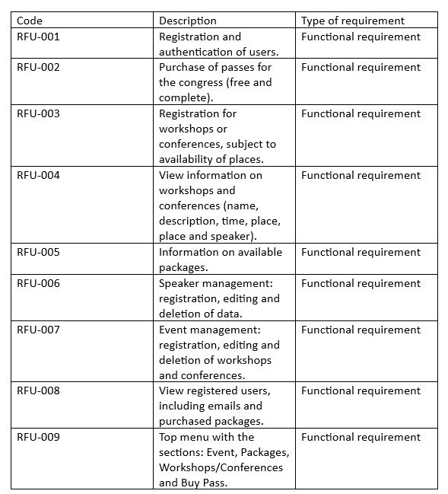
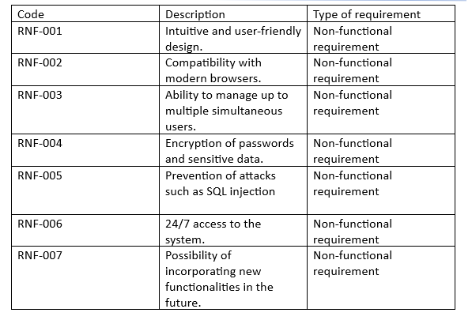
FUNTIONAL ANDO NON-FUNTIONAL REQUIREMENTS

Slide 5
REQUIREMENTS ANALYSIS
The system is designed to meet the needs of three main types of users:
Visitors
Check conference information.
Create an account to purchase passes.
Administrators:
Manage speaker and event data.
Monitor registered user information
Attendees:
Buy passes.
Register for workshops or conferences.

Slide 6
The following priorities were identified:
High priority: User registration, purchase of passes, event registration, event management
Medium priority: User review by administrator.
Low priority: Future optimizations and scalability.

Slide 7
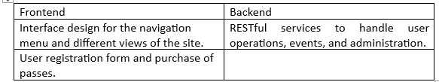
SYSTEM DESIGN
The system will follow a client-server-based architecture. The frontend will be developed in React, while the backend will use Node with Express. The database will be MySQL to store information about users, events and speakers.

Slide 8
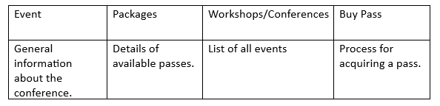
Navigation Diagram
There will be a top menu that will connect the main sections:
Administrator Profile
A control panel will be included for the administrator view that will contain the following:

