Slide 1
How has COVID 19 affected crop production and food consumption in UK
Group Members:
Sharoz
Abdul
Mithun
James
Project Group: CTRL+BU

Slide 2
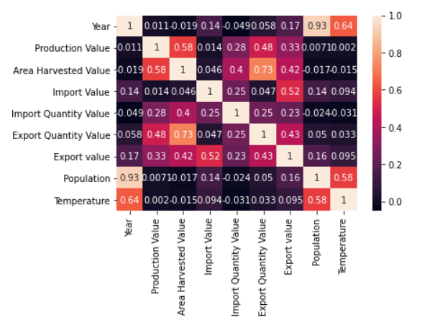
exploratory data analysis
Factors affecting crop production:
Climatic Factors
Rainfall
Temperature
Topography – Area harvested
Import/Export
Population

Slide 3
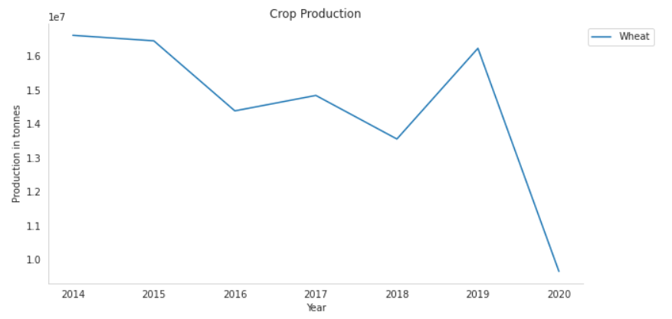
Crop PRODUCTION VS YEAR

Slide 4
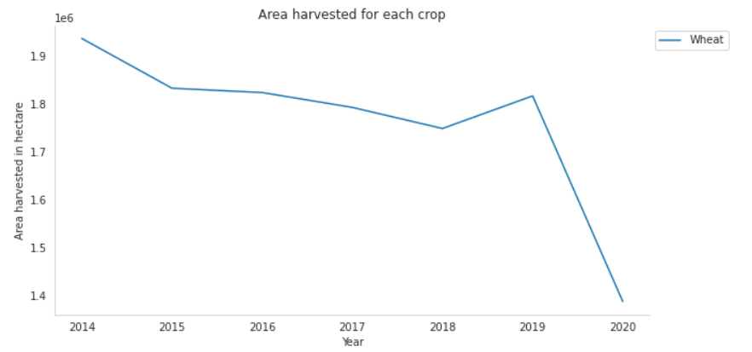
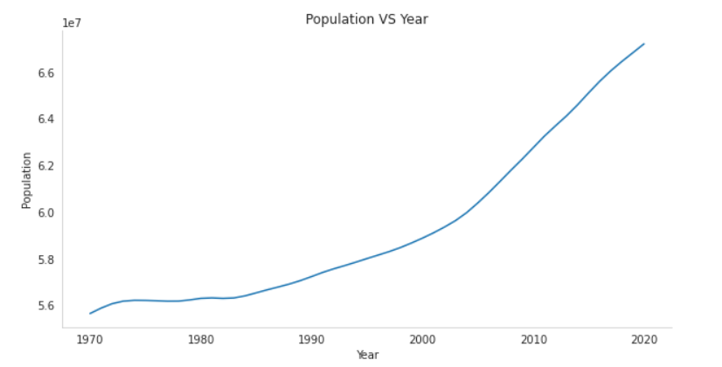
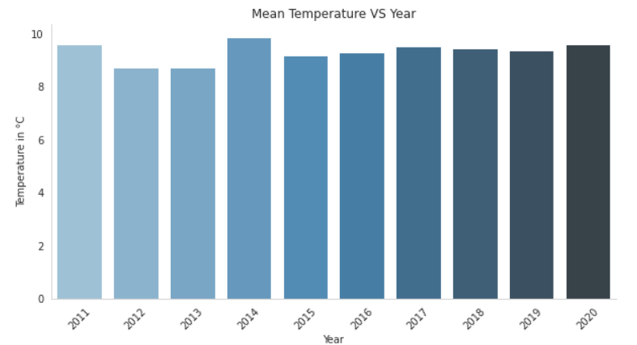
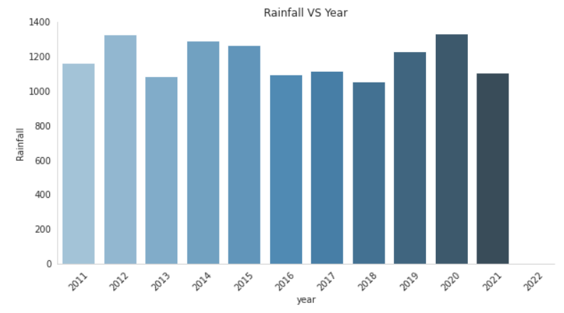
Factors vs year

Slide 5
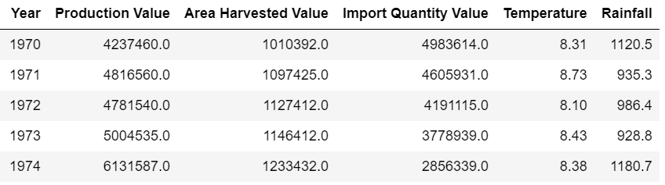
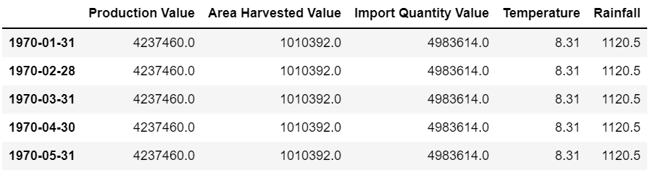
Feature selection & resampling
Selected Features :
Area Harvested,
Import Quantity
Temperature & Rainfall
Target : Production Value
Resampling of the dataset – Converting Yearly Data Into Monthly Data

Slide 6
Model selection
Coefficient of determination R²
LSTM vs Random Forest Regressor (Time-Series Analysis)
Computational Time : RFR > LSTM
GPU limitations & No. of units : RFR > LSTM (Reference: Evaluation and Comparison of Random Forest and A-LSTM Networks for Large-scale Winter Wheat Identification)
Gradient Boosting Regressor | Random Forest Regressor | SVR | Decision Tree Regressor
0.8642 | 0.8924 | -0.3892 | 0.7787

Slide 7
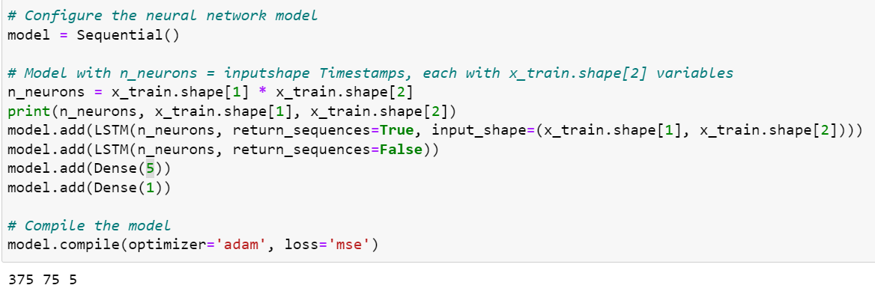
LSTM Model
Transformation of Data:
“Slicing Window” - This approach moves a window through the time series data, adding a sequence of multiple data points to the input data with each step.
Implemented on our Dataset with resultant as – (466, 75, 5) (466,)
LSTM Model

Slide 8
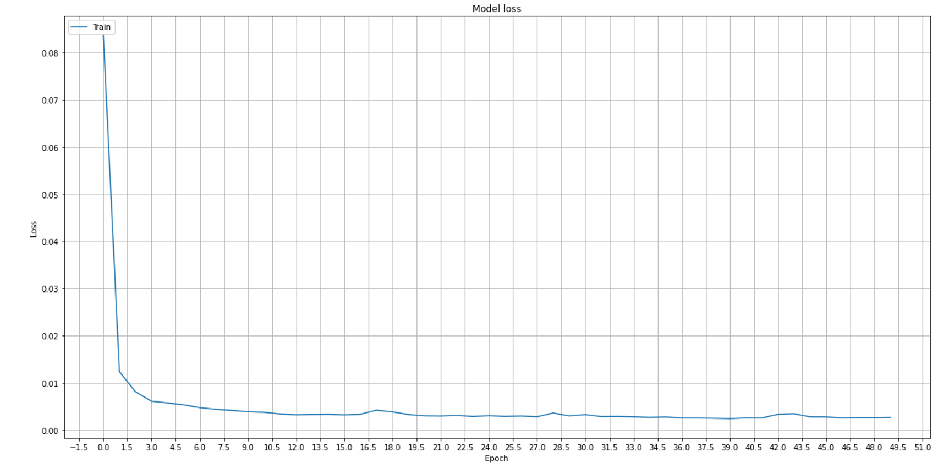
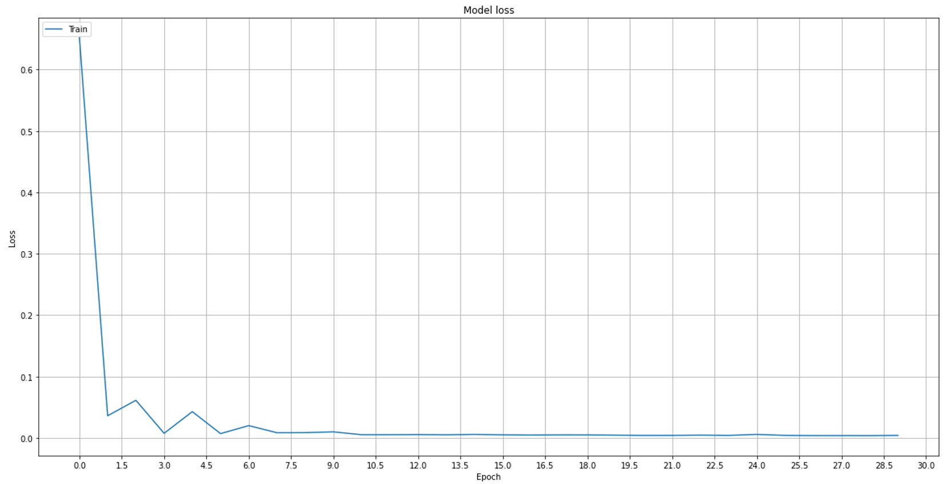
Evaluation of loss curve
Crop Production:
Epochs = 50
Batch Size = 32
Food Consumption:
Epochs = 30
Batch Size = 32

Slide 9
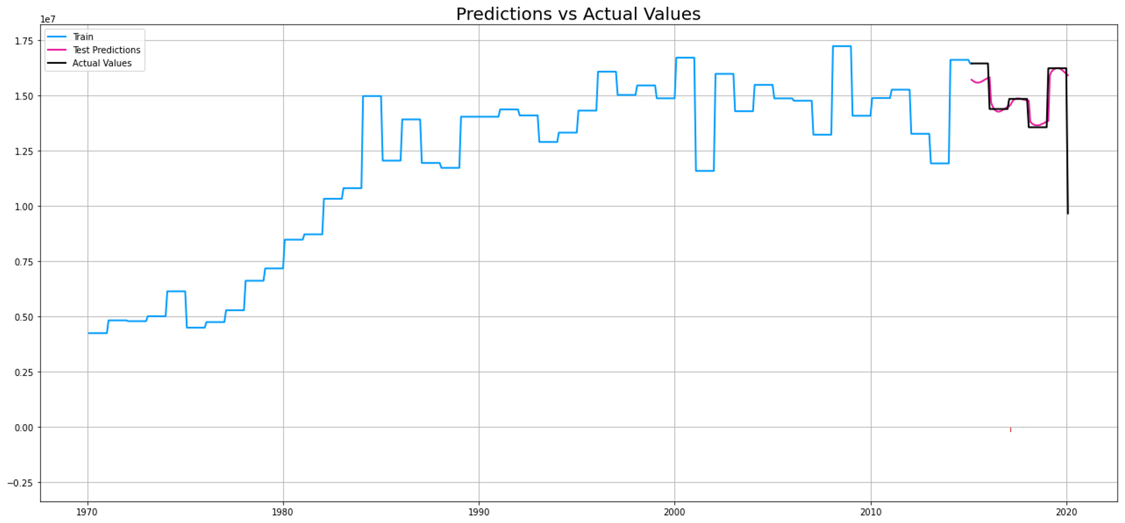
Crop Production(Trained, Actual, Predicted) vs year

Slide 10
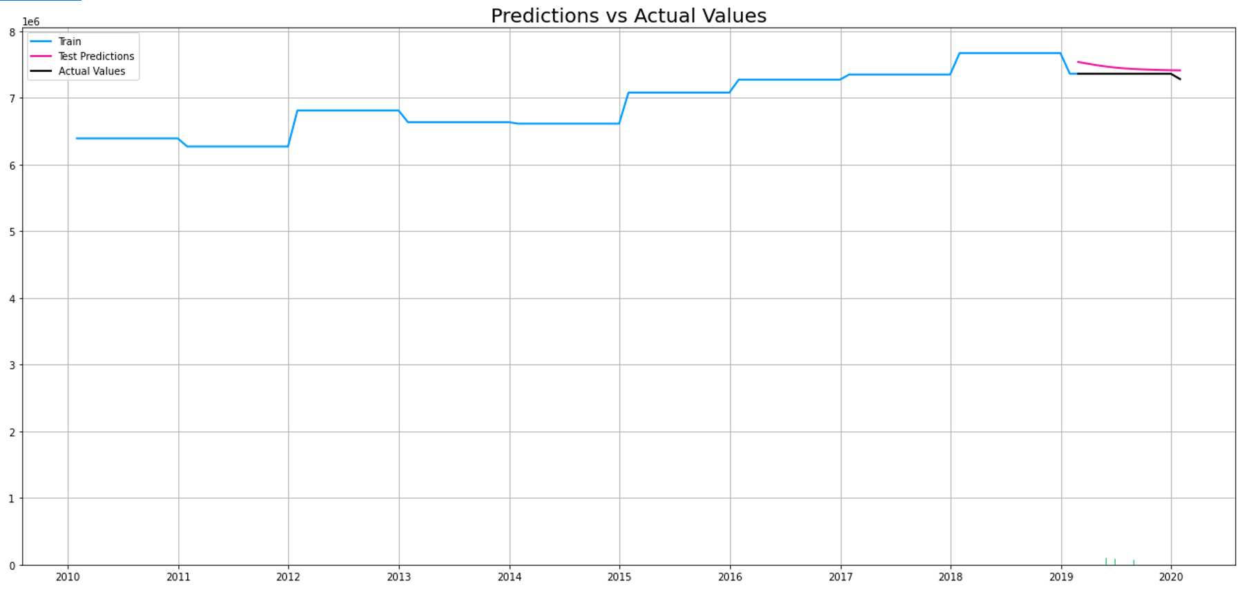
Food consumption (Trained, Actual, Predicted) vs year

