Slide 1
CS101 Algorithms and Data Structures
Array and Linked List
Textbook Ch 10.2

Slide 2

Excellent Resources
Please subscribe, follow, and like (“一键三连”) ！！！
WeChat Video Code:

Slide 3
Outline
List ADT
Array
Linked list
Doubly linked list
Node-based storage with arrays
Application

Slide 4
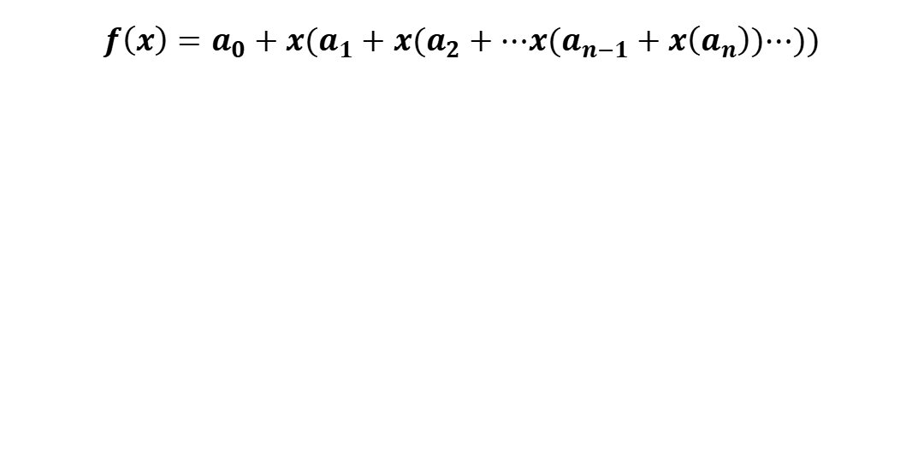
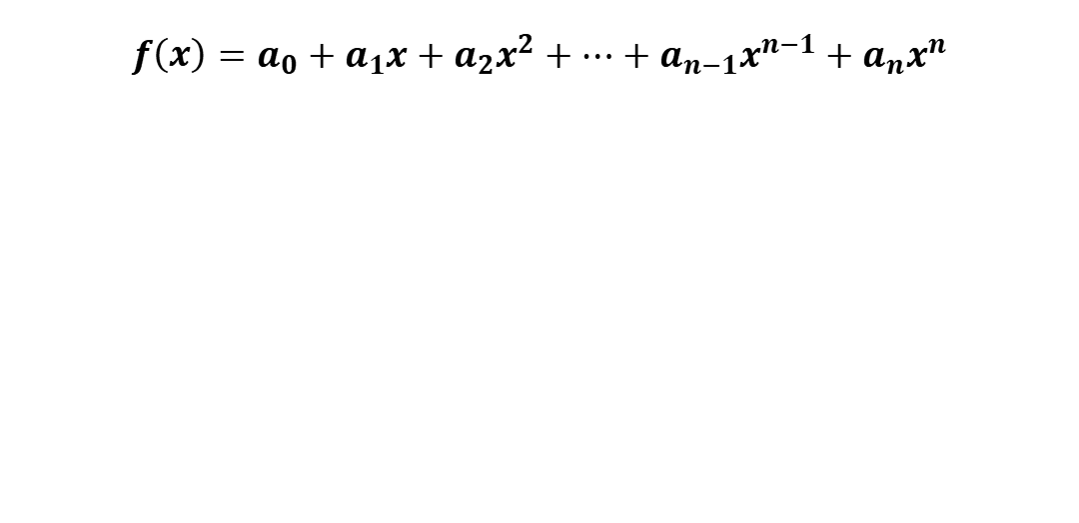
Ex1 compute the summation for a polynomial at a fixed value x.
$$f\left(x\right)=a_{0}+a_{1}x+a_{2}x^{2}+⋯+a_{n−1}x^{n−1}+a_{n}x^{n}$$
double fpoly1 ( int n, double a[ ], double x )
{ int i;
double p = a[0];
for (i = 1; i <=n; i++)
p += (a[i] * pow( x, i) );
return p;
}
$$f\left(x\right)=a_{0}+x{(a}_{1}+x(a_{2}+⋯x(a_{n−1}+x\left(a_{n}\right))⋯))$$
double fpoly2 ( int n, double a[ ], double x )
{ int i;
double p = a[n];
for (i = n; i > 0; i-- )
p = a[i-1] + x* p;
return p;
}

Slide 5


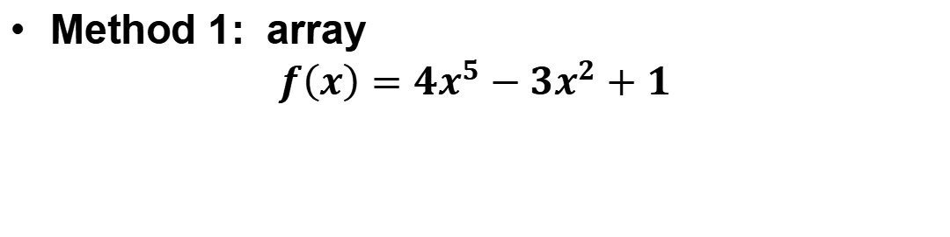

Representation of polynomial coefficients $a_{n}$
$$f\left(x\right)=a_{0}+a_{1}x+a_{2}x^{2}+⋯+a_{n−1}x^{n−1}+a_{n}x^{n}$$
double fpoly1 ( int n, double a[ ], double x )
{ int i;
double p = a[0];
for (i = 1; i <=n; i++)
p += (a[i] * pow( x, i) );
return p;
}
Method 1: array
$$f\left(x\right)=4x^{5}−3x^{2}+1$$
$$a[i]$$
1
0
-3
0
0
4
$$⋯$$
Array indices
0
1
2
3
4
5
$$⋯$$
Problem?

Slide 6


Discussion 1
( 4 0 0 0 0 0 0 0 0 0 0 0 0 0 0 0 0 0 0 0 0 0 0 0 0 0 0 0 0 0 0 0 0 0 0 0 0 0 0 0 0 0 0 0 0 0 0 0 0 0 0 0 0 0 0 0 0 0 0 0 0 0 0 0 0 0 0 0 0 0 0 0 0 0 0 0 0 0 0 0 0 0 0 0 0 0 0 0 0 0 0 0 0 0 0 0 0 0 0 0 0 0 0 0 0 0 0 0 0 0 0 0 0 0 0 0 0 0 0 0 0 0 0 0 0 0 0 0 0 0 0 0 0 0 0 0 0 0 0 0 0 0 0 0 0 0 0 0 0 0 0 0 0 0 0 0 0 0 0 0 0 0 0 0 0 0 0 0 0 0 0 0 0 0 0 0 0 0 0 0 0 0 0 0 0 0 0 0 0 0 0 0 0 0 0 0 0 0 0 0 0 0 0 0 0 0 0 0 0 0 0 0 0 0 0 0 0 0 0 0 0 0 0 0 0 0 0 0 0 0 0 0 0 0 0 0 0 0 0 0 0 0 0 0 0 0 0 0 0 0 0 0 0 0 0 0 0 0 0 0 0 0 0 0 0 0 0 0 0 0 0 0 0 0 0 0 0 0 0 0 0 0 0 0 0 0 0 0 0 0 0 0 0 0 0 0 0 0 0 0 0 0 0 0 0 0 0 0 0 0 0 0 0 0 0 0 0 0 0 0 0 0 0 0 0 0 0 0 0 0 0 0 0 0 0 0 0 0 0 0 0 0 0 0 0 0 0 0 0 0 0 0 0 0 0 0 0 0 0 0 0 0 0 0 0 0 0 0 0 0 0 0 0 0 0 0 0 0 0 0 0 0 0 0 0 0 0 0 0 0 0 0 0 0 0 0 0 0 0 0 0 0 0 0 0 0 0 0 0 0 0 0 0 0 0 0 0 0 0 0 0 0 0 0 0 0 0 0 0 0 0 0 0 0 0 0 0 0 0 0 0 0 0 0 0 0 0 0 0 0 0 0 0 0 0 0 0 0 0 0 0 0 0 0 0 0 0 0 0 0 0 0 0 0 0 0 0 0 0 0 0 0 0 0 0 0 0 0 0 0 0 0 0 0 0 0 0 0 0 0 0 0 0 0 0 0 0 0 0 0 0 0 0 0 0 0 0 0 0 0 0 0 0 0 0 0 0 0 0 0 0 0 0 0 0 0 0 0 0 0 0 0 0 0 0 0 0 0 0 0 0 0 0 0 0 0 0 0 0 0 0 0 0 0 0 0 0 0 0 0 0 0 0 0 0 0 0 0 0 0 0 0 0 0 0 0 0 0 0 0 0 0 0 0 0 0 0 0 0 0 0 0 0 0 0 0 0 0 0 0 0 0 0 0 0 0 0 0 0 0 0 0 0 0 0 0 0 0 0 0 0 0 0 0 0 0 0 0 0 0 0 0 0 0 0 0 0 0 0 0 0 0 0 0 0 0 0 0 0 0 0 0 0 0 0 0 0 0 0 0 0 0 0 0 0 0 0 0 0 0 0 0 0 0 0 0 0 0 0 0 0 0 0 0 0 0 0 0 0 0 0 0 0 0 0 0 0 0 0 0 0 0 0 0 0 0 0 0 0 0 0 0 0 0 0 0 0 0 0 0 0 0 0 0 0 0 0 0 0 0 0 0 0 0 0 0 0 0 0 0 0 0 0 0 0 0 0 0 0 0 0 0 0 0 0 0 0 0 0 0 0 0 0 0 0 0 0 0 0 0 0 0 0 0 0 0 0 0 0 0 0 0 0 0 0 0 0 0 0 0 0 0 0 0 0 0 0 0 0 0 0 0 0 0 0 0 0 0 0 0 0 0 0 0 0 0 0 0 0 0 0 0 0 0 0 0 0 0 0 0 0 0 0 0 0 0 0 0 0 0 0 0 0 0 0 0 0 0 0 0 0 0 0 0 0 0 0 0 0 0 0 0 0 0 0 0 0 0 0 0 0 0 0 0 0 0 0 0 0 0 0 0 0 0 0 0 0 0 0 0 0 0 0 0 0 0 0 0 0 0 0 0 0 0 0 0 0 0 0 0 0 0 0 0 0 0 0 0 0 0 0 0 0 0 0 0 0 0 0 0 0 0 0 0 0 0 0 0 0 0 0 0 0 0 0 0 0 0 0 0 0 0 0 0 0 0 0 0 0 0 0 0 0 0 0 0 0 0 0 0 0 0 0 0 0 0 0 0 0 0 0 0 0 0 0 0 0 0 0 0 0 0 0 0 0 0 0 0 0 0 0 0 0 0 0 0 0 0 0 0 0 0 0 0 0 0 0 0 0 0 0 0 0 0 0 0 0 0 0 0 0 0 0 0 0 0 0 0 0 0 0 0 0 0 0 0 0 0 0 0 0 0 0 0 0 0 0 0 0 0 0 0 0 0 0 0 0 0 0 0 0 0 0 0 0 0 0 0 0 0 0 0 0 0 0 0 0 0 0 0 0 0 0 0 0 0 0 0 0 0 0 0 0 0 0 0 0 0 0 0 0 0 0 0 0 0 0 0 0 0 0 0 0 0 0 0 0 0 0 0 0 0 0 0 0 0 0 0 0 0 0 0 0 0 0 0 0 0 0 0 0 0 0 0 0 0 0 0 0 0 0 0 0 0 0 0 0 0 0 0 010 0 0 0 0 0 0 0 0 0 0 0 0 0 0 0 0 0 0 0 0 0 0 0 0 0 0 0 0 0 0 0 0 0 0 0 0 0 0 0 0 0 0 0 0 0 0 0 0 0 0 0 0 0 0 0 0 0 0 0 0 0 0 0 0 0 0 0 0 0 0 0 0 0 0 0 0 0 0 0 0 0 0 0 0 0 0 0 0 0 0 0 0 0 0 0 0 0 0 0 0 0 0 0 0 0 0 0 0 0 0 0 0 0 0 0 0 0 0 0 0 0 0 0 0 0 0 0 0 0 0 0 0 0 0 0 0 0 0 0 0 0 0 0 0 0 0 0 0 0 0 0 0 0 0 0 0 0 0 0 0 0 0 0 0 0 0 0 0 0 0 0 0 0 0 0 0 0 0 0 0 0 0 0 0 0 0 0 0 0 0 0 0 0 0 0 0 0 0 0 0 0 0 0 0 0 0 0 0 0 0 0 0 0 0 0 0 0 0 0 0 0 0 0 0 0 0 0 0 0 0 0 0 0 0 0 0 0 0 0 0 0 0 0 0 0 0 0 0 0 0 0 0 0 0 0 0 0 0 0 0 0 0 0 0 0 0 0 0 0 0 0 0 0 0 0 0 0 0 0 0 0 0 0 0 0 0 0 0 0 0 0 0 0 0 0 0 0 0 0 0 0 0 0 0 0 0 0 0 0 0 0 0 0 0 0 0 0 0 0 0 0 0 0 0 0 0 0 0 0 0 0 0 0 0 0 0 0 0 0 0 0 0 0 0 0 0 0 0 0 0 0 0 0 0 0 0 0 0 0 0 0 0 0 0 0 0 0 0 0 0 0 0 0 0 0 0 0 0 0 0 0 0 0 0 0 0 0 0 0 0 0 0 0 0 0 0 0 0 0 0 0 0 0 0 0 0 0 0 0 0 0 0 0 0 0 0 0 0 0 0 0 0 0 0 0 0 0 0 0 0 0 0 0 0 0 0 0 0 0 0 0 0 0 0 0 0 0 0 0 0 0 0 0 0 0 0 0 0 0 0 0 0 0 0 0 0 0 0 0 0 0 0 0 0 0 0 0 0 0 0 0 0 0 0 0 0 0 0 0 0 0 0 0 0 0 0 0 0 0 0 0 0 0 0 0 0 0 0 0 0 0 0 0 0 0 0 0 0 0 0 0 0 0 0 0 0 0 0 0 0 0 0 0 0 0 0 0 0 0 0 0 0 0 0 0 0 0 0 0 0 0 0 0 0 0 0 0 0 0 0 0 0 0 0 0 0 0 0 0 0 0 0 0 0 0 0 0 0 0 0 0 0 0 0 0 0 0 0 0 0 0 0 0 0 0 0 0 0 0 0 0 0 0 0 0 0 0 0 0 0 0 0 0 0 0 0 0 0 0 0 0 0 0 0 0 0 0 0 0 0 0 0 0 0 0 0 0 0 0 0 0 0 0 0 0 0 0 0 0 0 0 0 0 0 0 0 0 0 0 0 0 0 0 0 0 0 0 0 0 0 0 0 0 0 0 0 0 0 0 0 0 0 0 0 0 0 0 0 0 0 0 0 0 0 0 0 0 0 0 0 0 0 0 0 0 0 0 0 0 0 0 0 0 0 0 0 0 0 0 0 0 0 0 0 0 0 0 0 0 0 0 0 0 0 0 0 0 0 0 0 0 0 0 0 0 0 0 0 0 0 0 0 0 0 0 0 0 0 0 0 0 0 0 0 0 0 0 0 0 0 0 0 0 0 0 0 0 0 0 0 0 0 0 0 0 3 )
How to present coefficients for$f\left(x\right)=4+3x^{2001}$?
$$a[i]$$
4
0
0
0
$$⋯$$
$$⋯$$
3
Array indices
0
1
2
3
$$⋯$$
$$⋯$$
$200$1

Slide 7

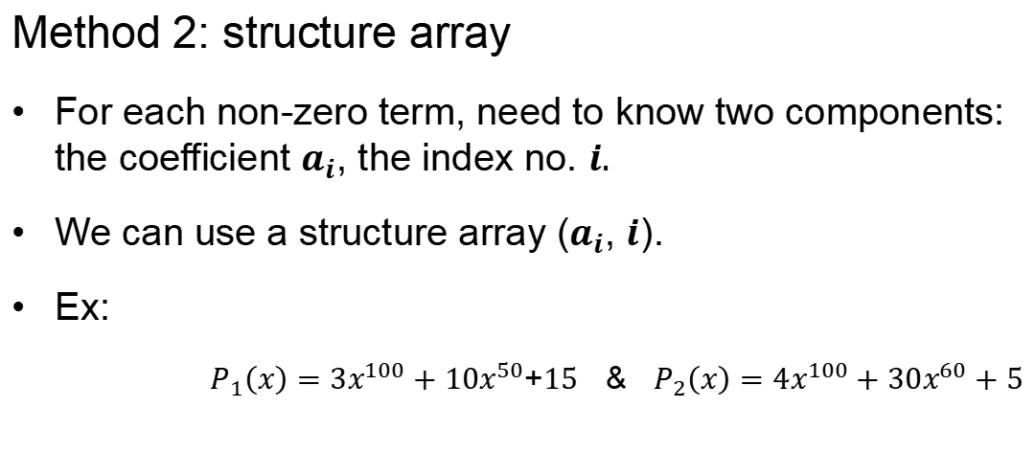
Method 2: structure array
For each non-zero term, need to know two components: the coefficient $a_{i}$, the index no. $i.$
We can use a structure array ($a_{i}$, $i$).
Ex:
$P_{1}\left(x\right)=3x^{100}+10x^{50}$+$15$ & $P_{2}\left(x\right)=4x^{100}+30x^{60}+5$
$$a[i]$$
3
10
15
4
30
5
Expon index $i$
100
50
0
100
60
0
Array indices
0
1
2
$$⋯$$
0
1
2
$$⋯$$
Store the coefficients in descent order of exponential index.

Slide 8

Addition of Two Polynomials?
$P_{1}\left(x\right)=3x^{100}+10x^{50}$+$15$ & $P_{2}\left(x\right)=4x^{100}+30x^{60}+5$
$$a[i]$$
3
10
15
4
30
5
Expon index $i$
100
50
0
100
60
0
Array indices
0
1
2
$$⋯$$
0
1
2
$$⋯$$

Slide 9
Addition of Two Polynomials?
$P_{1}\left(x\right)=3x^{100}+10x^{50}$+$15$ & $P_{2}\left(x\right)=4x^{100}+30x^{60}+5$
$$a[i]$$
3
10
15
4
30
5
Expon index $i$
100
50
0
100
60
0
Array indices
0
1
2
$$⋯$$
0
1
2
$$⋯$$

Slide 10

Addition of Two Polynomials?
$P_{1}\left(x\right)=3x^{100}+10x^{50}$+$15$ & $P_{2}\left(x\right)=4x^{100}+30x^{60}+5$
$$a[i]$$
3
10
15
4
30
5
Expon index $i$
100
50
0
100
60
0
Array indices
0
1
2
$$⋯$$
0
1
2
$$⋯$$
$$a[i]$$
Expon index $i$
Array indices
0
1
2
$$3$$
4
5
6
$$⋯$$

Slide 11
Addition of Two Polynomials?
$P_{1}\left(x\right)=3x^{100}+10x^{50}$+$15$ & $P_{2}\left(x\right)=4x^{100}+30x^{60}+5$
$$a[i]$$
3
10
15
4
30
5
Expon index $i$
100
50
0
100
60
0
Array indices
0
1
2
$$⋯$$
0
1
2
$$⋯$$
$$a[i]$$
7
Expon index $i$
100
Array indices
0
1
2
$$3$$
4
5
6
$$⋯$$

Slide 12
Addition of Two Polynomials?
$P_{1}\left(x\right)=3x^{100}+10x^{50}$+$15$ & $P_{2}\left(x\right)=4x^{100}+30x^{60}+5$
$$a[i]$$
3
10
15
4
30
5
Expon index $i$
100
50
0
100
60
0
Array indices
0
1
2
$$⋯$$
0
1
2
$$⋯$$
$$a[i]$$
7
Expon index $i$
100
Array indices
0
1
2
$$3$$
4
5
6
$$⋯$$

Slide 13
Addition of Two Polynomials?
$P_{1}\left(x\right)=3x^{100}+10x^{50}$+$15$ & $P_{2}\left(x\right)=4x^{100}+30x^{60}+5$
$$a[i]$$
3
10
15
4
30
5
Expon index $i$
100
50
0
100
60
0
Array indices
0
1
2
$$⋯$$
0
1
2
$$⋯$$
$$a[i]$$
7
30
Expon index $i$
100
60
Array indices
0
1
2
$$3$$
4
5
6
$$⋯$$

Slide 14
Addition of Two Polynomials?
$P_{1}\left(x\right)=3x^{100}+10x^{50}$+$15$ & $P_{2}\left(x\right)=4x^{100}+30x^{60}+5$
$$a[i]$$
3
10
15
4
30
5
Expon index $i$
100
50
0
100
60
0
Array indices
0
1
2
$$⋯$$
0
1
2
$$⋯$$
$$a[i]$$
7
30
Expon index $i$
100
60
Array indices
0
1
2
$$3$$
4
5
6
$$⋯$$

Slide 15
Addition of Two Polynomials?
$P_{1}\left(x\right)=3x^{100}+10x^{50}$+$15$ & $P_{2}\left(x\right)=4x^{100}+30x^{60}+5$
$$a[i]$$
3
10
15
4
30
5
Expon index $i$
100
50
0
100
60
0
Array indices
0
1
2
$$⋯$$
0
1
2
$$⋯$$
$$a[i]$$
7
30
10
Expon index $i$
100
60
50
Array indices
0
1
2
$$3$$
4
5
6
$$⋯$$

Slide 16
Addition of Two Polynomials?
$P_{1}\left(x\right)=3x^{100}+10x^{50}$+$15$ & $P_{2}\left(x\right)=4x^{100}+30x^{60}+5$
$$a[i]$$
3
10
15
4
30
5
Expon index $i$
100
50
0
100
60
0
Array indices
0
1
2
$$⋯$$
0
1
2
$$⋯$$
$$a[i]$$
7
30
10
Expon index $i$
100
60
50
Array indices
0
1
2
$$3$$
4
5
6
$$⋯$$

Slide 17
Addition of Two Polynomials?
$P_{1}\left(x\right)=3x^{100}+10x^{50}$+$15$ & $P_{2}\left(x\right)=4x^{100}+30x^{60}+5$
$$a[i]$$
3
10
15
4
30
5
Expon index $i$
100
50
0
100
60
0
Array indices
0
1
2
$$⋯$$
0
1
2
$$⋯$$
$$a[i]$$
7
30
10
20
Expon index $i$
100
60
50
0
Array indices
0
1
2
$$3$$
4
5
6
$$⋯$$

Slide 18
Addition of Two Polynomials?
$P_{1}\left(x\right)=3x^{100}+10x^{50}$+$15$ & $P_{2}\left(x\right)=4x^{100}+30x^{60}+5$
$$a[i]$$
3
10
15
4
30
5
Expon index $i$
100
50
0
100
60
0
Array indices
0
1
2
$$⋯$$
0
1
2
$$⋯$$
$$a[i]$$
7
30
10
20
Expon index $i$
100
60
50
0
Array indices
0
1
2
$$3$$
4
5
6
$$⋯$$
${P_{3}\left(x\right)=P}_{1}\left(x\right)+P_{2}\left(x\right)=7x^{100}+30x^{60}+10x^{50}$+$20$
Can we store the coefficients in an increase order of exponential index?

Slide 19

Different data types can be used for the same type of problem.
There exists a common problem: the organization and management of ordered linear data.

Slide 20
Outline
List ADT
Array
Linked list
Doubly linked list
Node-based storage with arrays
Application

Slide 21
List ADT
An Abstract List (or List ADT) is linearly ordered data (with same data type)
( A₁ A₂ … A_{n-1} A_{n} )
  The number of elements in the List denotes the length of the List.
  When there is no element, it is an empty List.
  The beginning of a List is called the List head; the end of a List is called the List tail.
  The same value may occur more than once.

Slide 22

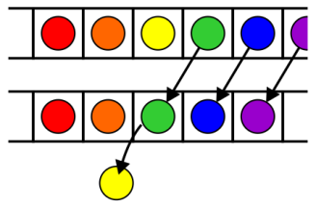
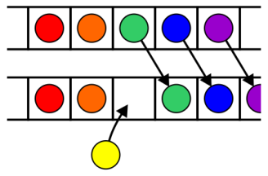
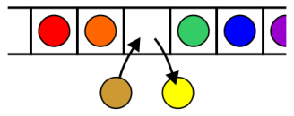
Operations
Operations at the k^{th} entry of the list include:
  Access to the object Erasing an object
  Insertion of a new object Replacement of the object

Slide 23
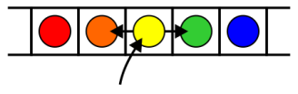
Operations
Given access to the k^{th} object, gain access to either the previous or next object
Given two abstract lists, we may want to
  Concatenate the two lists
  Determine if one is a sub-list of the other

Slide 24
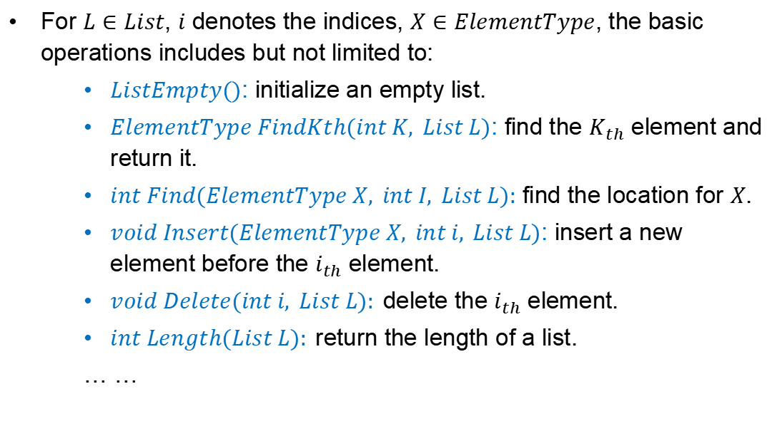
Operations
For $L∈List$, $i$ denotes the indices, $X∈ElementType$, the basic operations includes but not limited to:
    $ListEmpty()$: initialize an empty list.
    $ElementType FindKth(int K, List L)$: find the $K_{th}$ element and return it.
    $int Find(ElementType X, int I, List L):$ find the location for $X$.
    $void Insert(ElementType X, int i, List L)$: insert a new element before the $i_{th}$ element.
    $void Delete(int i, List L):$delete the $i_{th}$ element.
    $int Length(List L):$return the length of a list.
    … …

Slide 25
Outline
List ADT
Array
Linked list
Doubly linked list
Node-based storage with arrays
Application

Slide 26









List based on array
$$Data$$
$$a_{1}$$
$$a_{2}$$
$$⋯$$
$$a_{i}$$
$$a_{i+1}$$
$$⋯$$
$$a_{n}$$
$$⋯$$
$Array$ indice
0
1
$$⋯$$
i-1
i
$$⋯$$
n-1
$$⋯$$
$MAXSIZE$-1

Slide 27
List based on array
O(n)
Insert element
$$Data$$
$$a_{1}$$
$$a_{2}$$
$$⋯$$
$$a_{i}$$
$$a_{i+1}$$
$$⋯$$
$$a_{n}$$
$$⋯$$
$Array$ indice
0
1
$$⋯$$
i-1
i
$$⋯$$
n-1
$$⋯$$
$MAXSIZE$-1
Last
Delete element
$$Data$$
$$a_{1}$$
$$a_{2}$$
$$⋯$$
$$a_{i}$$
$$a_{i+1}$$
$$⋯$$
$$a_{n}$$
$$⋯$$
$Array$ indice
0
1
$$⋯$$
i-1
i
$$⋯$$
n-1
$$⋯$$
$MAXSIZE$-1
Last

Slide 28
Outline
List ADT
Array
Linked list
Doubly linked list
Node-based storage with arrays
Application

Slide 29
Definition
A linked list is a data structure where each object is stored in a node
As well as storing data, the node must also contain a reference/pointer to the node containing the next item of data
L
42
95
70
81
∅

Slide 30
Node Class
L
42
95
70
81
∅
The node must store data and a pointer:
class Node {
private:
int element;
Node *next_node;
public:
Node( int = 0, Node * = nullptr );
int retrieve() const;
Node *next() const;
};

Slide 31
Node Constructor
The constructor assigns the two member variables based on the arguments
    Node::Node( int e, Node *n ):
    element( e ),
    next_node( n ) {
    // empty constructor
    }
The default values are given in the class definition:
Node( int = 0, Node * = nullptr );

Slide 32
Accessors
The two member functions are accessors which simply return the element and the next_node member variables, respectively
    int Node::retrieve() const {
    return element;
    }
    Node *Node::next() const {
    return next_node;
    }
Notes:
Member functions that do not change the object acted
upon are variously called accessors, readonly functions,
inspectors, and, when it involves simply returning a
member variable, getters

Slide 33
Linked List Class
Because each node in a linked lists refers to the next, the linked list class need only link to the first node in the list
The linked list class requires member variable: a pointer to a node
    class List {
    private:
    Node *list_head;
    // ...
    };

Slide 34
Structure
Let us look at the internal representation of a linked list
Suppose we want a linked list to store the values
42 95 70 81
in this order

Slide 35
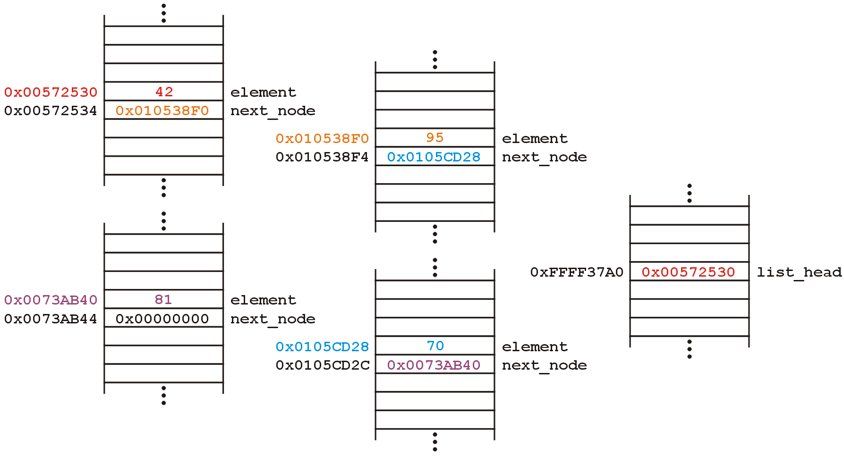
Structure
A linked list uses linked allocation, and therefore each node may appear anywhere in memory:
Linked List Object

Slide 36
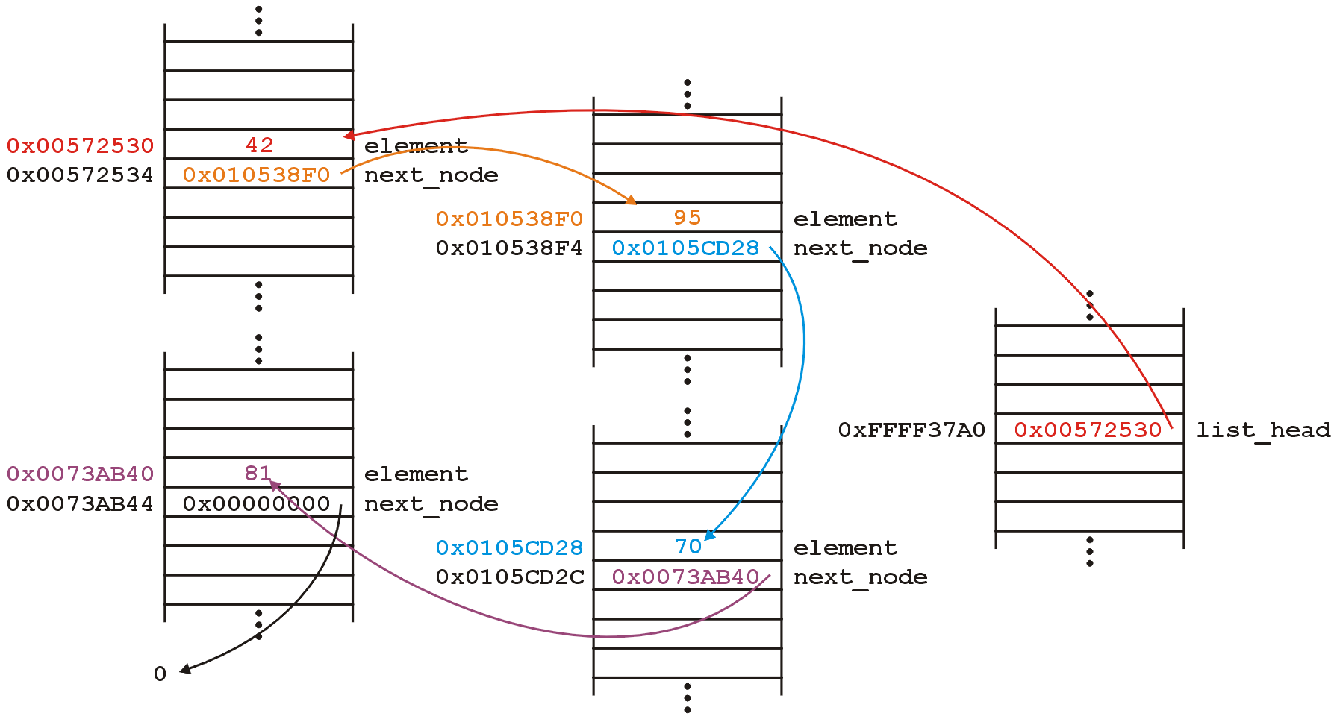
Structure
The next_node pointers store the addresses
of the next node in the list

Slide 37
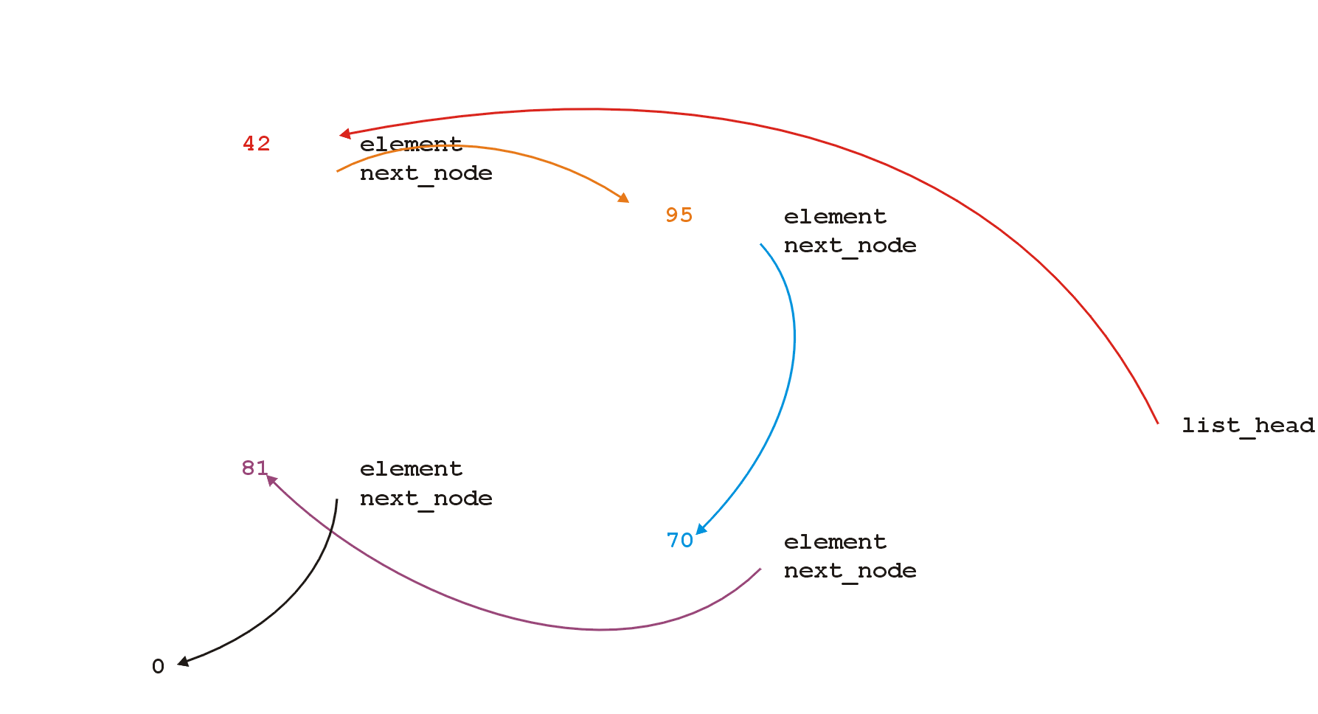
Structure
Because the addresses are arbitrary, we can remove that information:

Slide 38
Structure
We will clean up the representation as follows:
We do not specify the addresses because they are arbitrary and:
  The contents of the circle is the element
  The next_node pointer is represented by an arrow
list_

Slide 39
Operations
First, we want to create a linked list
We also want to be able to:
  insert into
  access
  erase from
the elements stored in the linked list

Slide 40
Operations
We can do them with the following operations:
  Adding, retrieving, or removing the value at the front of the linked list
    void push_front( int );
    int front() const;
    int pop_front();
  We may also want to access the head of the linked list
  Node *head() const;
  We may wish to check whether the linked list is empty
  bool empty() const;
  The list is empty when the list_head pointer is set to nullptr

Slide 41
Operations
All these operations relate to the first node of the linked list
We may want to perform operations on an arbitrary node of the linked list, for example:
  Find the number of instances of an integer in the list:
  int count( int ) const;
  Remove all instances of an integer from the list:
  int erase( int );

Slide 42
Linked Lists
Additionally, we may wish to check the state:
  Is the linked list empty?
  bool empty() const;
  How many objects are in the list?
  int size() const;
The list is empty when the list_head pointer is set to nullptr

Slide 43
Linked Lists
Consider this simple (but incomplete) linked list class:
class List {
private:
Node *list_head;
public:
List();
// Accessors
bool empty() const;
int size() const;
int front() const;
Node *head() const;
int count( int ) const;
// Mutators
void push_front( int );
int pop_front();
int erase( int );
};

Slide 44
The Constructor
In the constructor, we assign list_head the value nullptr
List::List():list_head( nullptr ) {
// empty constructor
}
We will always ensure that when a linked list is empty, the list head is assigned nullptr

Slide 45
bool empty() const
Starting with the easier member functions:
bool List::empty() const {
if ( list_head == nullptr ) {
return true;
} else {
return false;
}
}
Better yet:
bool List::empty() const {
return ( list_head == nullptr );
}

Slide 46
Node *head() const
The member function Node *head() const is easy enough to implement:
Node *List::head() const {
return list_head;
}
This will always work: if the list is empty, it will return nullptr

Slide 47
int front() const
To get the first element in the linked list, we must access the node to which the list_head is pointing
Because we have a pointer, we must use the -> operator to call the member function:
int List::front() const {
return head()->retrieve();
}

Slide 48
int front() const
What if the list is empty?
If we tried to access a member function of a pointer set to nullptr, we would access restricted memory and the OS would terminate the running program

Slide 49
int front() const
Instead, we can use an exception handling mechanism where we thrown an exception
We define a class
class underflow {
// emtpy
};
and then we throw an instance of this class:
throw underflow();

Slide 50
int front() const
Thus, the full function is
int List::front() const {
if ( empty() ) {
throw underflow();
}
return head()->retrieve();
}

Slide 51
int front() const
Why is emtpy() better than
    int List::front() const {
    if ( list_head == nullptr ) {
    throw underflow();
    }
    return list_head->element;
    }
Two benefits:
  More readable
  If the implementation changes, we do nothing

Slide 52


void push_front( int )
Next, let us add an element to the list
If it is empty, we start with:
and, if we try to add 81, we should end up with:

Slide 53
void push_front( int )
We must:
  create a new node which:
    stores the value 81, and
    is pointing to 0(null)
  assign its address to list_head
We can do this as follows:
list_head = new Node( 81, nullptr );

Slide 54
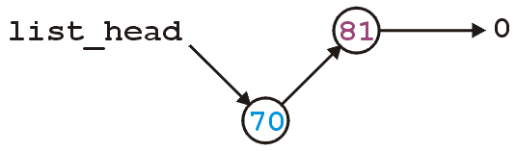
void push_front( int )
Suppose however, we already have a non-empty list
Adding 70, we want:

Slide 55
void push_front( int )
To achieve this, we must we must create a new node which:
    stores the value 70, and
    is pointing to the current list head
  we must then assign its address to list_head
We can do this as follows:
list_head = new Node( 70, list_head );

Slide 56
void push_front( int )
Thus, our implementation could be:
    void List::push_front( int n ) {
    if ( empty() ) {
    list_head = new Node( n, nullptr );
    } else {
    list_head = new Node( n, head() );
    }
    }

Slide 57
void push_front( int )
We could, however, note that when the list is empty,
list_head == 0, thus we could shorten this to:
    void List::push_front( int n ) {
    list_head = new Node( n, list_head );
    }

Slide 58
void push_front( int )
Are we allowed to do this?
    void List::push_front( int n ) {
    list_head = new Node( n, head() );
    }
Yes: the right-hand side of an assignment is evaluated first
  The original value of list_head is accessed first before the function call is made

Slide 59
void push_front( int )
Question: does this work?
    void List::push_front( int n ) {
    Node new_node( n, head() );
    list_head = &new_node;
    }
  Why or why not? What happens to new_node?
  How does this differ from
    void List::push_front( int n ) {
    Node *new_node = new Node( n, head() );
    list_head = new_node;
    }

Slide 60

int pop_front()
Erasing from the front of a linked list is even easier:
  We assign the list head to the next pointer of the first node
Graphically, given:
we want:

Slide 61
int pop_front()
Easy enough:
    int List::pop_front() {
    int e = front();
    list_head = head()->next();
    return e;
    }
Unfortunately, we have some problems:
  The list may be empty
  We still have the memory allocated for the node containing 70

Slide 62
int pop_front()
Does this work?
    int List::pop_front() {
    if ( empty() ) {
    throw underflow();
    }
    int e = front();
    delete head();
    list_head = head()->next();
    return e;
    }

Slide 63
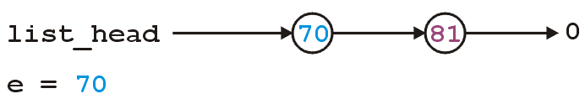
int pop_front()
int List::pop_front() {
if ( empty() ) {
throw underflow();
}
int e = front();
delete head();
list_head = head()->next();
return e;
}

Slide 64
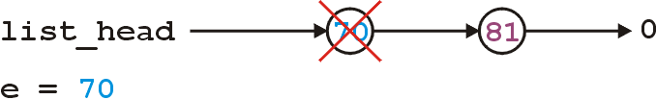
int pop_front()
int List::pop_front() {
if ( empty() ) {
throw underflow();
}
int e = front();
delete head();
list_head = head()->next();
return e;
}

Slide 65
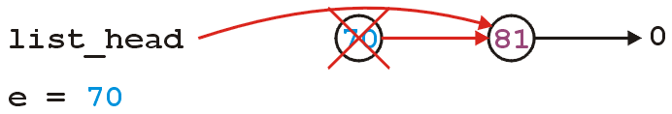
int pop_front()
int List::pop_front() {
if ( empty() ) {
throw underflow();
}
int e = front();
delete head();
list_head = head()->next();
return e;
}
Any problem with the above code?

Slide 66
int pop_front()
The correct implementation assigns a temporary pointer to point to the node being deleted:
    int List::pop_front() {
    if ( empty() ) {
    throw underflow();
    }
    int e = front();
    Node *ptr = list_head;
    list_head = list_head->next();
    delete ptr;
    return e;
    }

Slide 67
Stepping through a Linked List
The next step is to look at member functions which potentially require us to step through the entire list:
int size() const;
int count( int ) const;
int erase( int );
The second counts the number of instances of an integer, and the last removes the nodes containing that integer

Slide 68
Stepping through a Linked List
The process of stepping through a linked list can be thought of as being analogous to a for-loop:
  We initialize a temporary pointer with the list head
  We continue iterating until the pointer equals nullptr
  With each step, we set the pointer to point to the next object

Slide 69
Stepping through a Linked List
Thus, we have:
    for ( Node *ptr = head(); ptr != nullptr; ptr = ptr->next() ) {
    // do something
    // use ptr->fn() to call member functions
    // use ptr->var to assign/access member variables
    }

Slide 70
Stepping through a Linked List
Analogously:
for ( Node *ptr = head(); ptr != nullptr; ptr = ptr->next() )
for ( int i = 0; i != N; ++i )

Slide 71
int count( int ) const
To implement int count(int) const, we simply check if the argument matches the element with each step
  Each time we find a match, we increment the count
  When the loop is finished, we return the count
  The size function is simplification of count

Slide 72
int count( int ) const
The implementation:
  int List::count( int n ) const {
  int node_count = 0;
  for ( Node *ptr = list(); ptr != nullptr; ptr = ptr->next() ) {
  if ( ptr->retrieve() == n ) {
  ++node_count;
  }
  }
  return node_count;
  }

Slide 73
int erase( int )
To remove an arbitrary element, i.e., to implement
int erase( int ), we must update the previous node
For example, given
if we delete 70, we want to end up with

Slide 74
Accessing Private Member Variables
Notice that the erase function must modify the member variables of the node prior to the node being removed
Thus, it must have access to the member variable next_node
We could supply the member function
void set_next( Node * );
however, this would be globally accessible
Possible solutions:
  Friends
  Nested classes
  Inner classes (Java/C#)

Slide 75
C++ Friends
In C++, you explicitly break encapsulation by declaring the class List to be a friend of the class Node:
    class Node {
    Node *next() const;
    // ... declaration ...
    friend class List;
    };
Now, inside erase (a member function of List), you can modify all the member variables of any instance of the Node class

Slide 76
C++ Friends
For example, the erase member function could be implemented using the following code:
    int List::erase( int n ) {
    int node_count = 0;
    // ...
    for ( Node *ptr = head(); ptr != nullptr; ptr = ptr->next() ) {
    // ...
    if ( some condition ) {
    ptr->next_node = ptr->next()->next();
    // ...
    ++node_count;
    }
    }
    return node_count;
    }

Slide 77
Destructor
We dynamically allocated memory each time we added a new int into this list
Suppose we delete a list before we remove everything from it
  This would leave the memory allocated with no reference to it

Slide 78
Destructor
Thus, we need a destructor:
    class List {
    private:
    Node *list_head;
    public:
    List();
    ~List();
    // ...etc...
    };

Slide 79
Destructor
The destructor has to delete any memory which had been allocated but has not yet been deallocated
This is straight-forward enough:
while ( !empty() ) {
pop_front();
}

Slide 80
Making Copies
Is this sufficient for a linked list class?
Initially, it may appear yes, but we now have to look at how C++ copies objects during:
  Passing by value (making a copy), and
  Assignment

Slide 81
Pass by Value
Recall that when you pass an integer to a function, a copy is made, so any changes to that parameter does not affect the original:
#include <iostream>
void increment( int n ) {
++n;
}
int main() {
int counter = 0;
increment( counter );
std::cout << counter << std::endl; // counter is still 0
}

Slide 82
Pass by Reference
If you want to change the value, you can pass by reference:
#include <iostream>
void increment( int &n ) {
++n;
}
int main() {
int counter = 0;
increment( counter );
std::cout << counter << std::endl; // counter is now 1
}

Slide 83
Pass by Pointer (C)
In C, you would pass the address of the object to change it:
#include <stdio.h>
void increment( int *pn ) {
++(*pn);
}
int main() {
int counter = 0;
increment( &counter );
printf( "%d", counter ); // counter is now 1
}

Slide 84
Modifying Arguments
Pass by reference could be used to modify a list
void reverse( List &list ) {
List tmp;
while ( !list.empty() ) {
tmp.push_front( ls.pop_front() );
}
// All the member variables of 'list' and 'tmp' are swapped
std::swap( list, tmp );
// The memory for 'tmp' will be cleaned up
}

Slide 85
Modifying Arguments
If you wanted to prevent the argument from being modified, you
could declare it const:
double average( List const &ls, int min, int max ) {
double sum = 0, count = 0;
for ( Node *ptr = head(); ptr != nullptr; ptr = ptr->next() ) {
sum += ptr->retrieve();
++count;
}
return sum/count;
}
Note: this reveals a weakness in our model—we will discuss iterators later…

Slide 86
Modifying Arguments
You want to pass a copy of a linked list to a function—where the function may modify the copy, but the original list shall be unchanged.
void func( List ls ) {
// The compiler creates a new instance and copies the values
// The function does something with 'ls'
// The compiler ensures the destructor is called on 'ls'
}
  With the default copy constructor, all the member variables are simply copied over into the new instance of the class

Slide 87
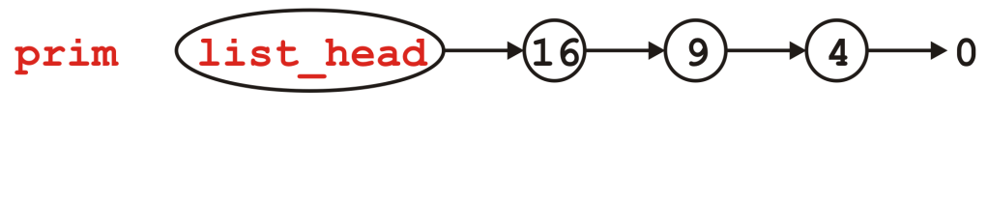
Modifying Arguments
void send_copy( List ls ) {
// The compiler creates a new instance and copies the values
// The function does something with 'ls'
// The compiler ensures the destructor is called on 'ls'
}
int main() {
List prim;
for ( int i = 2; i <= 4; ++i ) {
prim.push_front( i*i );
}
send_copy( prim );
std::cout << prim.empty() << std::endl;
return 0;
}
First, the list prim is created and three elements are pushed onto it

Slide 88
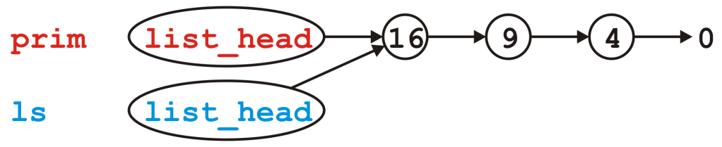
Modifying Arguments
void send_copy( List ls ) {
// The compiler creates a new instance and copies the values
// The function does something with 'ls'
// The compiler ensures the destructor is called on 'ls'
}
int main() {
List prim;
for ( int i = 2; i <= 4; ++i ) {
prim.push_front( i*i );
}
send_copy( prim );
std::cout << prim.empty() << std::endl;
return 0;
}
Next, we call send_copy and assigns a copy of prim to ls. The default is to copy member variables:
ls.list_head = prim.list_head

Slide 89
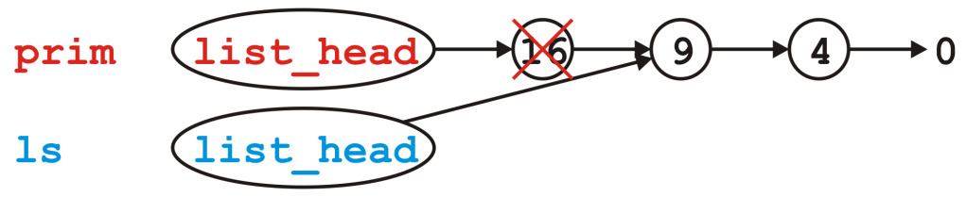
Modifying Arguments
void send_copy( List ls ) {
// The compiler creates a new instance and copies the values
// The function does something with 'ls'
// The compiler ensures the destructor is called on 'ls'
}
int main() {
List prim;
for ( int i = 2; i <= 4; ++i ) {
prim.push_front( i*i );
}
send_copy( prim );
std::cout << prim.empty() << std::endl;
return 0;
}
When send_copy returns, the destructor is called on ls

Slide 90
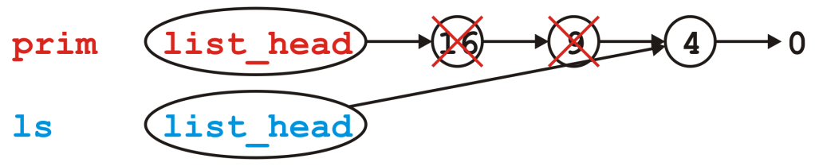
Modifying Arguments
void send_copy( List ls ) {
// The compiler creates a new instance and copies the values
// The function does something with 'ls'
// The compiler ensures the destructor is called on 'ls'
}
int main() {
List prim;
for ( int i = 2; i <= 4; ++i ) {
prim.push_front( i*i );
}
send_copy( prim );
std::cout << prim.empty() << std::endl;
return 0;
}
When send_copy returns, the destructor is called on ls

Slide 91
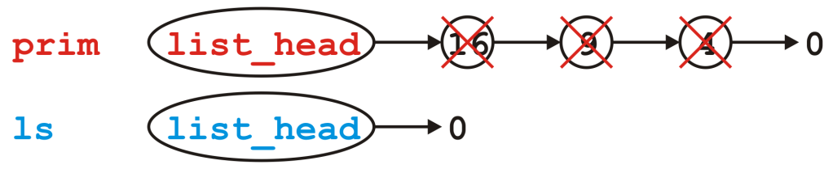
Modifying Arguments
void send_copy( List ls ) {
// The compiler creates a new instance and copies the values
// The function does something with 'ls'
// The compiler ensures the destructor is called on 'ls'
}
int main() {
List prim;
for ( int i = 2; i <= 4; ++i ) {
prim.push_front( i*i );
}
send_copy( prim );
std::cout << prim.empty() << std::endl;
return 0;
}
When send_copy returns, the destructor is called on ls

Slide 92
Modifying Arguments
void send_copy( List ls ) {
// The compiler creates a new instance and copies the values
// The function does something with 'ls'
// The compiler ensures the destructor is called on 'ls'
}
int main() {
List prim;
for ( int i = 2; i <= 4; ++i ) {
prim.push_front( i*i );
}
send_copy( prim );
std::cout << prim.empty() << std::endl;
return 0;
}
Back in main(), prim.list_head still stores the address of the Node containing 16, memory that has since been returned to the OS

Slide 93
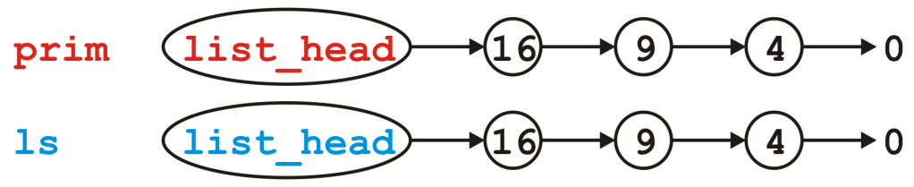
Modifying Arguments
What do we really want?
  We really want a copy of the linked list
  If this copy is modified, it leaves the original unchanged

Slide 94
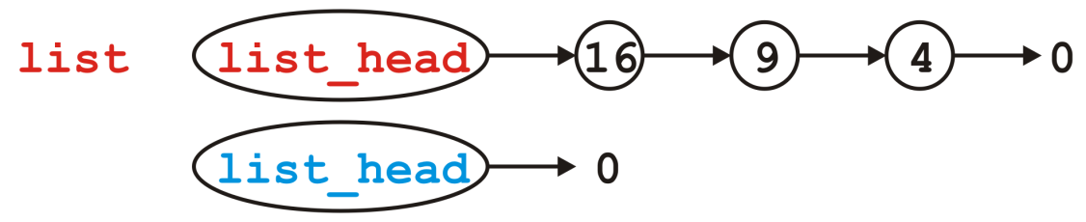
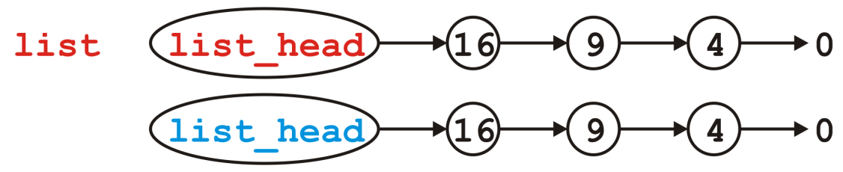
Copy Constructor
You can modify how copies are made by defining a copy constructor
  List::List( List const &list ):list_head( nullptr ) {
  // Make a copy of list
  }
We now want to go from
to

Slide 95
Copy Constructor
Naïvely, we step through list and call push_front( int ):
  List::List( List const &list ):list_head( nullptr ) {
  for ( Node *ptr = list.head(); ptr != nullptr; ptr = ptr->next() ) {
  push_front( ptr->retrieve() );
  }
  }
Does this work?
  How could we make this work?
  We need a push_back( int ) member function:
  List::List( List const &list ):list_head( nullptr ) {
  for ( Node *ptr = list.head(); ptr != nullptr; ptr = ptr->next() ) {
  push_back( ptr->retrieve() );
  }
  }

Slide 96
Copy Constructor
Unfortunately, to make push_back( int ) more efficient, we need a pointer to the last node in the linked list
  We require a list_tail member variable
  Otherwise, push_back( int ) becomes a Θ(n) function
    This would make the copy constructor Θ(n²)
  In Project 1, you will define and use the member variable list_tail

Slide 97
Copy Constructor
First, make life simple: if list is empty, we are finished, so return
  List::List( List const &list ):list_head( nullptr ) {
  if ( list.empty() ) {
  return;
  }
  }

Slide 98
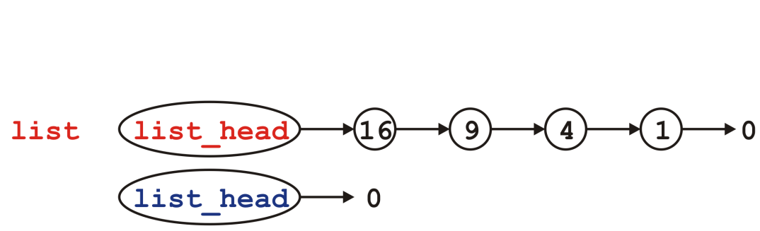
Copy Constructor
Otherwise, the list being copied is not empty…
  List::List( List const &list ):list_head( nullptr ) {
  if ( list.empty() ) {
  return;
  }
  }

Slide 99
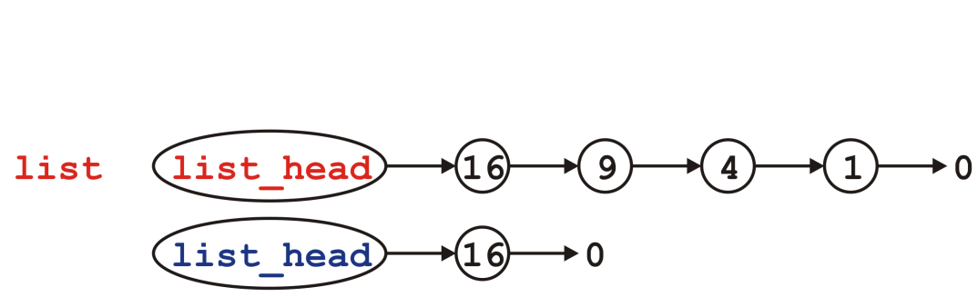
Copy Constructor
Copy the first node—we no longer modifying list_head
  List::List( List const &list ):list_head( nullptr ) {
  if ( list.empty() ) {
  return;
  }
  push_front( list.front() );
  }

Slide 100
Copy Constructor
We will need to loop through the list… How about a for loop?
  List::List( List const &list ):list_head( nullptr ) {
  if ( list.empty() ) {
  return;
  }
  push_front( list.front() );
  }

Slide 101
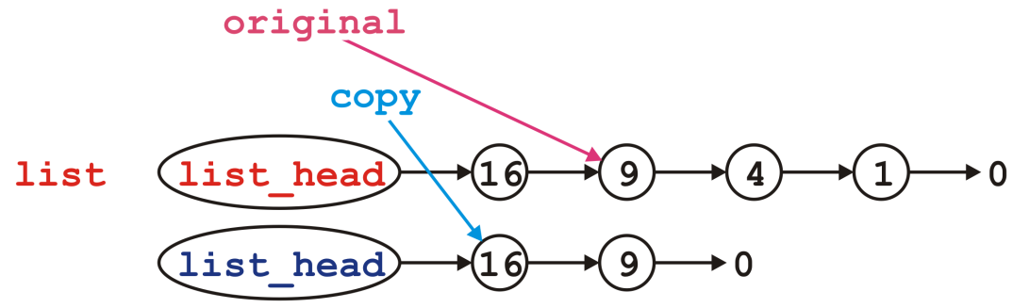
Copy Constructor
We modify the next pointer of the node pointed to by copy
  List::List( List const &list ):list_head( nullptr ) {
  if ( list.empty() ) {
  return;
  }
  push_front( list.front() );
  for (
  Node *original = list.head()->next(), *copy = head();
  original != nullptr;
  original = original->next(), copy = copy->next()
  ) {
  copy->next_node = new Node( original->retrieve(), nullptr );
  }
  }

Slide 102
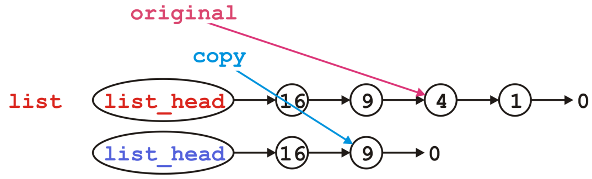
Copy Constructor
Then we move each pointer forward:
  List::List( List const &list ):list_head( nullptr ) {
  if ( list.empty() ) {
  return;
  }
  push_front( list.front() );
  for (
  Node *original = list.head()->next(), *copy = head();
  original != nullptr;
  original = original->next(), copy = copy->next()
  ) {
  copy->next_node = new Node( original->retrieve(), nullptr );
  }
  }

Slide 103
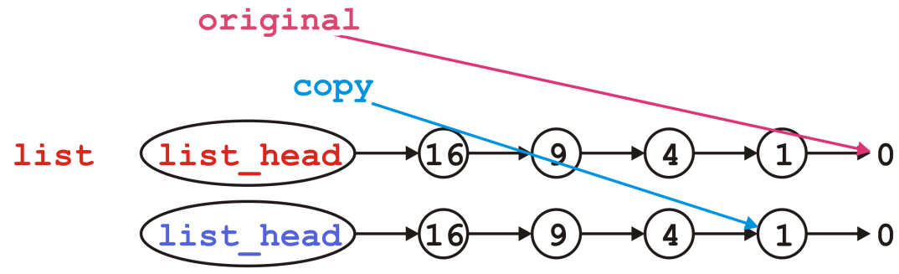
Copy Constructor
We’d continue copying until we reach the end
  List::List( List const &list ):list_head( nullptr ) {
  if ( list.empty() ) {
  return;
  }
  push_front( list.front() );
  for (
  Node *original = list.head()->next(), *copy = head();
  original != nullptr;
  original = original->next(), copy = copy->next()
  ) {
  copy->next_node = new Node( original->retrieve(), nullptr );
  }
  }

Slide 104
Assignment
What about assignment?
  Suppose you have linked lists:
List lst1, lst2;
lst1.push_front( 35 );
lst1.push_front( 18 );
lst2.push_front( 94 );
lst2.push_front( 72 );

Slide 105
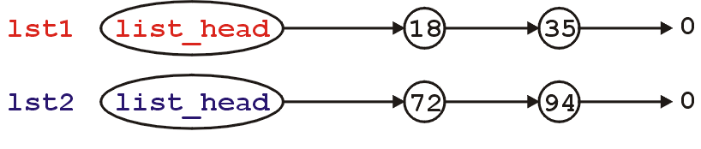
Assignment
This is the current state:
Consider an assignment:
lst2 = lst1;
What do we want? What do we actually do?

Slide 106
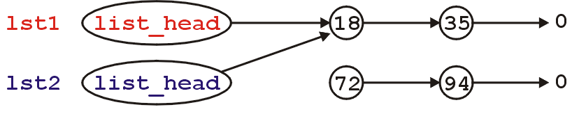
Assignment
The default behavior: the member variables of this class are copied over
It is equivalent to writing:
lst2.list_head = lst1.list_head;
Graphically:

Slide 107
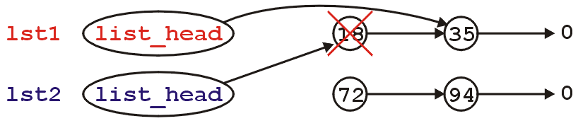
Assignment
What’s wrong with this picture?
  We no longer have links to either of the nodes storing 72 or 94 (memory leak)
  Also, suppose we call the member function
  lst1.pop_front();
  lst2 is now invalid

Slide 108
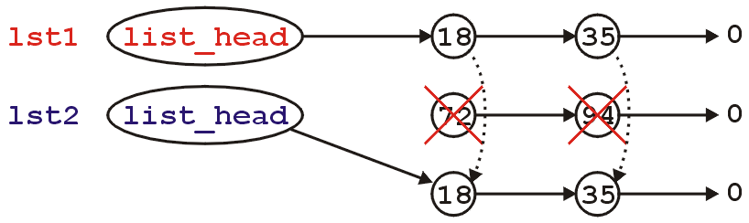
Assignment
Like making copies, we must have a reasonable means of assigning
  Starting with
  We need to erase the content of lst2 and copy over the nodes in lst1

Slide 109
Assignment
First, to overload the assignment operator, we must overload the function named operator=
  This is a how you indicate to the compiler that
  you are overloading the assignment (=) operator
The signature is: (normal version)
    List &operator=( List const & );

Slide 110
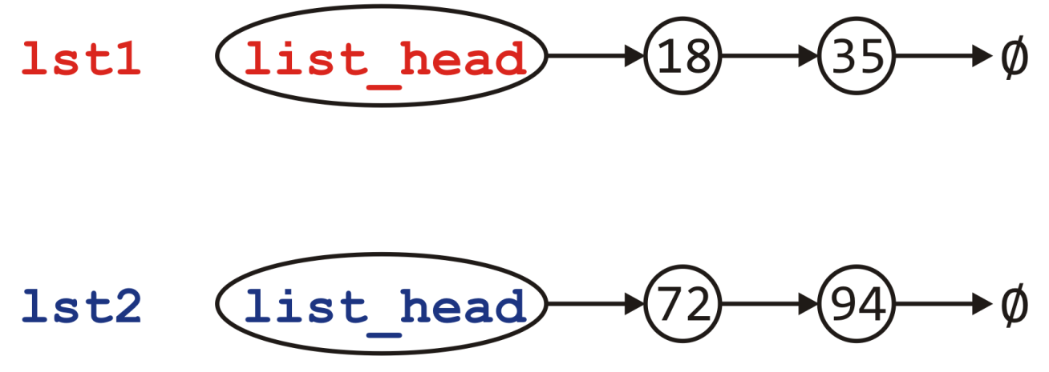
Assignment
Visually, we are doing the following:

Slide 111
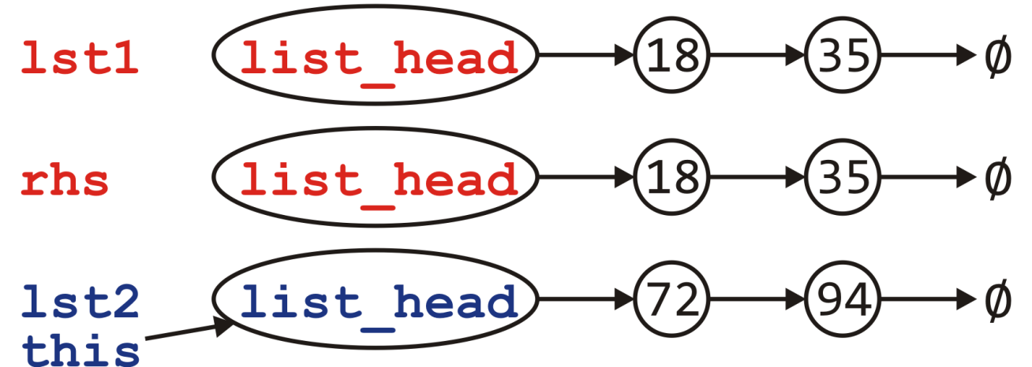
Assignment
Visually, we are doing the following:
  Call the copy constructor to create rhs

Slide 112
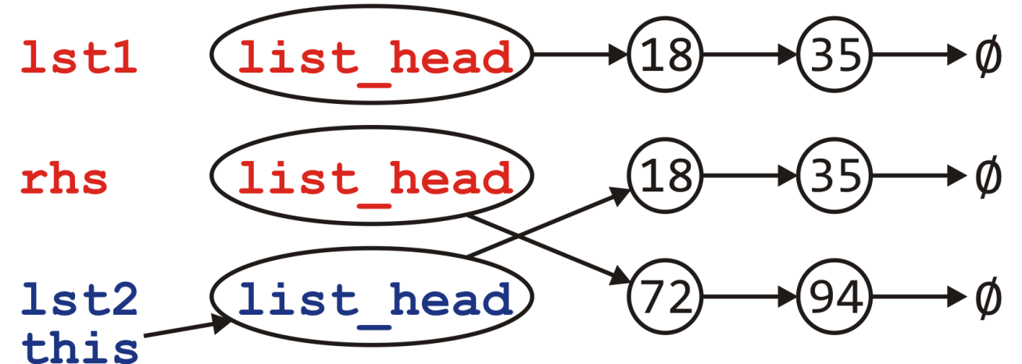
Assignment
Visually, we are doing the following:
  Call the copy constructor to create rhs
  Swapping the member variables of *this and rhs

Slide 113
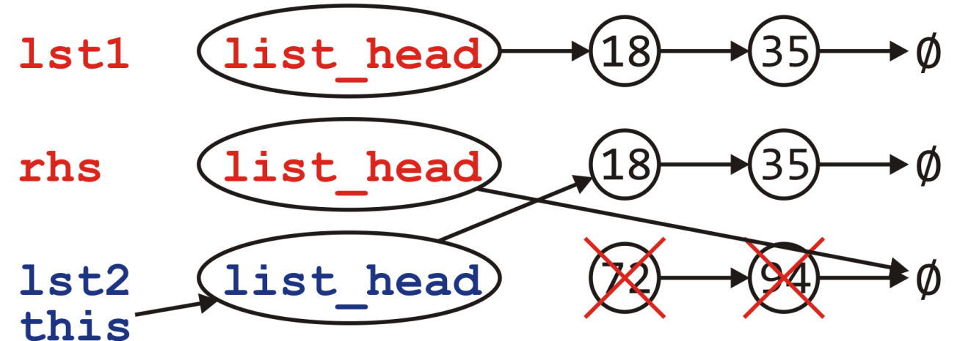
Assignment
Visually, we are doing the following:
  Call the copy constructor to create rhs
  Swapping the member variables of *this and rhs
  The destructor is called on rhs

Slide 114
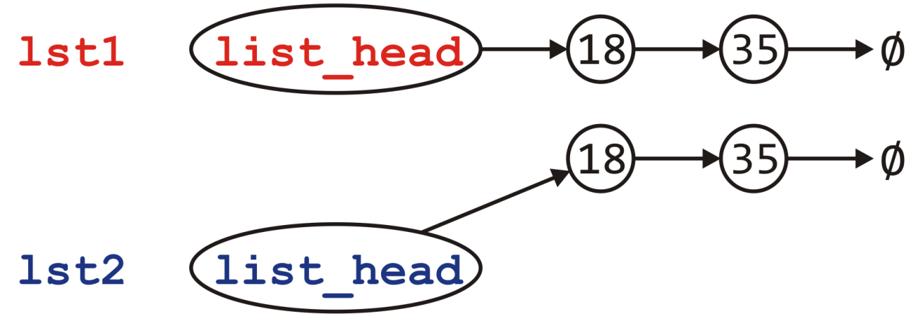
Assignment
Visually, we are doing the following:
  Call the copy constructor to create rhs
  Swapping the member variables of *this and rhs
  The destructor is called on rhs

Slide 115
Assignment
Visually, we are doing the following:
  Call the copy constructor to create rhs
  Swapping the member variables of *this and rhs
  The destructor is called on rhs
  The copy-and-swap idiom.
    The assignment operator may be typically declared as
    List &operator=( List );

Slide 116
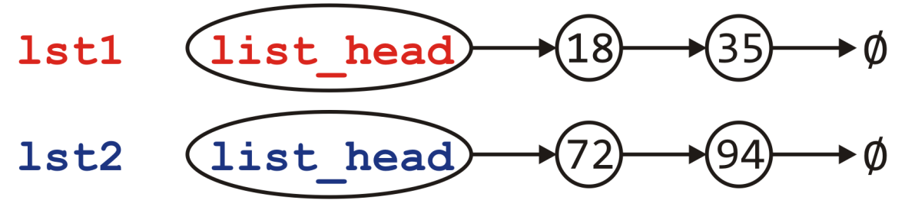
Assignment
Can we do better?
Consider the calls to new and delete
  Each of these is very expensive…
  Would it not be better to reuse the nodes if possible?
Notes:
Reference: Howard Hinnant

Slide 117
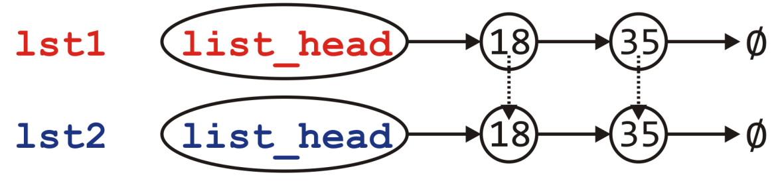
Assignment
Can we do better?
Consider the calls to new and delete
  Each of these is very expensive…
  Would it not be better to reuse the nodes if possible?
  No calls to new or delete
Notes:
Reference: Howard Hinnant

Slide 118
Assignment
What is the plan?
  If the right-hand side is empty, it’s straight-forward:
    Just empty this list
  Otherwise, step through the right-hand side list and for each node there
    If there is a corresponding node in this, copy over the value, else
    There is no corresponding node; create a new node and append it
  If there are any nodes remaining in this, delete them

Slide 119
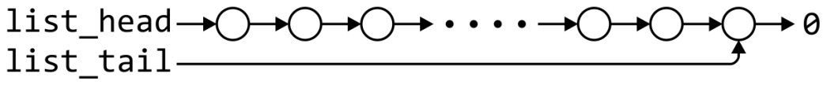
Linked list
 | Front/1st node | k^{th} node | Back/n^{th} node
Find | Θ(1) | Ο(n)* | Θ(1)
Insert Before | Θ(1) | Ο(n)* | Θ(n)
Insert After | Θ(1) | Θ(1)* | Θ(1)
Replace | Θ(1) | Θ(1)* | Θ(1)
Erase | Θ(1) | Ο(n)* | Θ(n)
Next | Θ(1) | Θ(1)* | n/a
Previous | n/a | Ο(n)* | Θ(n)
* These assume we have already accessed the k^{th} entry—an O(n) operation
Assume we have a tail pointer

Slide 120
Linked list
 | Front/1st node | k^{th} node | Back/n^{th} node
Find | Θ(1) | Ο(n)* | Θ(1)
Insert Before | Θ(1) | Θ(1)* | Θ(1)
Insert After | Θ(1) | Θ(1)* | Θ(1)
Replace | Θ(1) | Θ(1)* | Θ(1)
Erase | Θ(1) | Θ(1)* | Θ(n)
Next | Θ(1) | Θ(1)* | n/a
Previous | n/a | Ο(n)* | Θ(n)
By replacing the value in the node in question, we can speed things up
Assume we have a tail pointer

Slide 121
Outline
List ADT
Array
Linked list
Doubly linked list
Node-based storage with arrays
Application

Slide 122
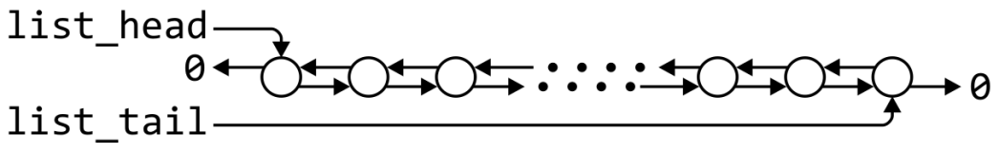
Doubly linked lists
 | Front/1st node | k^{th} node | Back/n^{th} node
Find | Θ(1) | Ο(n)* | Θ(1)
Insert Before | Θ(1) | Θ(1)* | Θ(1)
Insert After | Θ(1) | Θ(1)* | Θ(1)
Replace | Θ(1) | Θ(1)* | Θ(1)
Erase | Θ(1) | Θ(1)* | Θ(1)
Next | Θ(1) | Θ(1)* | n/a
Previous | n/a | Θ(1)* | Θ(1)
* These assume we have already accessed the k^{th} entry—an O(n) operation

Slide 123
Memory usage versus run times
Using a doubly linked list requires Θ(n) additional memory, but it speeds up many operations

Slide 124
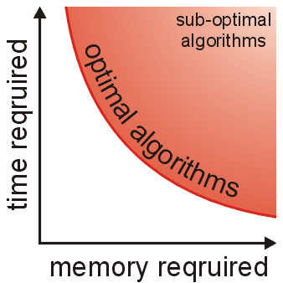
Memory usage versus run times
In general, there is an interesting relationship between memory and time efficiency
For a data structure/algorithm:
  Improving the run time usually
  requires more memory
  Reducing the required memory
  usually requires more run time
Notes:
As well as determining run times, we are also interested in memory usage

Slide 125
Memory usage versus run times
Warning: programmers often mistake this to suggest that given any solution to a problem, any solution which may be faster must require more memory
This guideline not true in general: there may be different data structures and/or algorithms which are both faster and require less memory
  This requires thought and research

Slide 126
Outline
List ADT
Array
Linked list
Doubly linked list
Node-based storage with arrays
Application

Slide 127
The issue
A significant issue with linked lists: node-based data structures require Θ(n) calls to new
  Each new operation requires a call to the operating system requesting a memory allocation

Slide 128
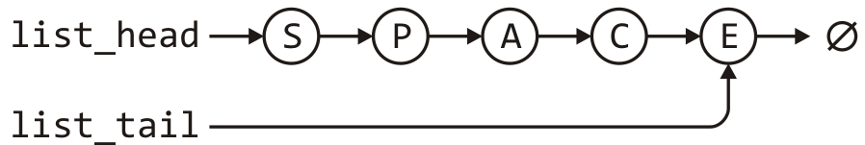
Using an array?
Suppose we store this linked list in an array?
list_head = 5;
list_tail = 2;
0 | 1 | 2 | 3 | 4 | 5 | 6 | 7
A |  | E | P |  | S | C
6 |  | -1 | 0 |  | 3 | 2

Slide 129
Using an array?
Rather than using, -1, use a constant assigned that value
  This makes reading your code easier
list_head = 5;
list_tail = 2;
0 | 1 | 2 | 3 | 4 | 5 | 6 | 7
A |  | E | P |  | S | C
6 |  | NULLPTR | 0 |  | 3 | 2

Slide 130
A solution
To achieve this, we must create an array of objects that:
  Store the value
  Store the array index where the next entry is stored
    template <typename Type>
    class Single_node {
    private:
    Type element;
    int next_node;
    public:
    Type retrieve() const;
    int next() const;
    };

Slide 131
A solution
Now, memory allocation is done once in the constructor:
  template <typename Type>
  class Single_list {
  private:
  int list_capacity;
  int list_head;
  int list_tail;
  int list_size;
  Single_node<Type> *node_pool;
  static const int NULLPTR;
  public:
  Single_list( int = 16 );
  // member functions
  };
  const int Single_list::NULLPTR = -1;
template <typename Type>
Single_list<Type>::Single_list( int n ):
list_capacity( n ),
list_head( NULLPTR ),
list_tail( NULLPTR ),
list_size( 0 ),
node_pool( new Single_node<Type>[n] ) {
// Empty constructor
}

Slide 132
A solution
Problem: when inserting a new element…
how do you know which cell to use?
  Solution: keep a container (a stack) of the indices of unused nodes
list_head = 5;
list_tail = 2;
0 | 1 | 2 | 3 | 4 | 5 | 6 | 7
A |  | E | P |  | S | C
6 |  | NULLPTR | 0 |  | 3 | 2
stack_size = 3;
0 | 1 | 2 | 3 | 4 | 5 | 6 | 7
7 | 1 | 4

Slide 133
A solution
The stack would be initialized with all the entries
list_head = NULLPTR;
list_tail = NULLPTR;
0 | 1 | 2 | 3 | 4 | 5 | 6 | 7
stack_size = 8;
0 | 1 | 2 | 3 | 4 | 5 | 6 | 7
0 | 1 | 2 | 3 | 4 | 5 | 6 | 7

Slide 134
A solution
When pushing onto the list, the entry at the top of the stack is used
list_head = NULLPTR;
list_tail = NULLPTR;
0 | 1 | 2 | 3 | 4 | 5 | 6 | 7
stack_size = 8;
0 | 1 | 2 | 3 | 4 | 5 | 6 | 7
0 | 1 | 2 | 3 | 4 | 5 | 6 | 7

Slide 135
A solution
Now, push_front( 'O' ) would result in
list_head = 7;
list_tail = 7;
0 | 1 | 2 | 3 | 4 | 5 | 6 | 7
 |  |  |  |  |  |  | O
 |  |  |  |  |  |  | NULLPTR
stack_size = 7;
0 | 1 | 2 | 3 | 4 | 5 | 6 | 7
0 | 1 | 2 | 3 | 4 | 5 | 6 | 7

Slide 136
A solution
Suppose we call push_front( 'N' )
list_head = 7;
list_tail = 7;
0 | 1 | 2 | 3 | 4 | 5 | 6 | 7
 |  |  |  |  |  |  | O
 |  |  |  |  |  |  | NULLPTR
stack_size = 7;
0 | 1 | 2 | 3 | 4 | 5 | 6 | 7
0 | 1 | 2 | 3 | 4 | 5 | 6 | 7

Slide 137
A solution
Suppose we call push_front( 'N' )
  The next node is at index 6
list_head = 6;
list_tail = 7;
0 | 1 | 2 | 3 | 4 | 5 | 6 | 7
 |  |  |  |  |  | N | O
 |  |  |  |  |  | 7 | NULLPTR
stack_size = 6;
0 | 1 | 2 | 3 | 4 | 5 | 6 | 7
0 | 1 | 2 | 3 | 4 | 5 | 6 | 7

Slide 138
A solution
Suppose we call push_back( 'R' )
list_head = 6;
list_tail = 7;
0 | 1 | 2 | 3 | 4 | 5 | 6 | 7
 |  |  |  |  |  | N | O
 |  |  |  |  |  | 7 | NULLPTR
stack_size = 6;
0 | 1 | 2 | 3 | 4 | 5 | 6 | 7
0 | 1 | 2 | 3 | 4 | 5 | 6 | 7

Slide 139
A solution
Suppose we call push_back( 'R' )
  The next node is at index 5
list_head = 6;
list_tail = 5;
0 | 1 | 2 | 3 | 4 | 5 | 6 | 7
 |  |  |  |  | R | N | O
 |  |  |  |  | NULLPTR | 7 | 5
stack_size = 5;
0 | 1 | 2 | 3 | 4 | 5 | 6 | 7
0 | 1 | 2 | 3 | 4 | 5 | 6 | 7

Slide 140
A solution
Finally, suppose we call pop_front()
list_head = 6;
list_tail = 5;
0 | 1 | 2 | 3 | 4 | 5 | 6 | 7
 |  |  |  |  | R | N | O
 |  |  |  |  | NULLPTR | 7 | 5
stack_size = 5;
0 | 1 | 2 | 3 | 4 | 5 | 6 | 7
0 | 1 | 2 | 3 | 4 | 5 | 6 | 7

Slide 141
A solution
Finally, suppose we call pop_front()
  The popped node is placed back into the stack
list_head = 7;
list_tail = 5;
0 | 1 | 2 | 3 | 4 | 5 | 6 | 7
 |  |  |  |  | R | N | O
 |  |  |  |  | NULLPTR | 7 | 5
stack_size = 6;
0 | 1 | 2 | 3 | 4 | 5 | 6 | 7
0 | 1 | 2 | 3 | 4 | 6 | 6 | 7

Slide 142
A better solution
Problem:
  Our solution requires Θ(N) additional memory
  In our initial example, the unused nodes are 1, 4 and 7
  How about using these to define a second stack-as-linked-list?
list_head = 5;
list_tail = 2;
0 | 1 | 2 | 3 | 4 | 5 | 6 | 7
A |  | E | P |  | S | C
6 |  | NULLPTR | 0 |  | 3 | 2

Slide 143
A better solution
Problem:
  Our solution requires Θ(N) additional memory
  In our initial example, the unused nodes are 1, 4 and 7
  How about using these to define a second stack-as-linked-list?
  We only need a head pointer for the stack-as-linked-list
list_head = 5;
list_tail = 2;
stack_top = 1;
0 | 1 | 2 | 3 | 4 | 5 | 6 | 7
A |  | E | P |  | S | C
6 | 4 | NULLPTR | 0 | 7 | 3 | 2 | NULLPTR

Slide 144
A better solution
Suppose we call pop_front()
list_head = 5;
list_tail = 2;
stack_top = 1;
0 | 1 | 2 | 3 | 4 | 5 | 6 | 7
A |  | E | P |  | S | C
6 | 4 | NULLPTR | 0 | 7 | 3 | 2 | NULLPTR

Slide 145
A better solution
Suppose we call pop_front()
  The extra node is placed onto the stack
list_head = 3;
list_tail = 2;
stack_top = 5;
0 | 1 | 2 | 3 | 4 | 5 | 6 | 7
A |  | E | P |  | S | C
6 | 4 | NULLPTR | 0 | 7 | 1 | 2 | NULLPTR

Slide 146
A better solution
Suppose we now call push_back( 'D' )
list_head = 3;
list_tail = 2;
stack_top = 5;
0 | 1 | 2 | 3 | 4 | 5 | 6 | 7
A |  | E | P |  | S | C
6 | 4 | NULLPTR | 0 | 7 | 1 | 2 | NULLPTR

Slide 147
A better solution
Suppose we now call push_back( 'D' )
  We pop the node off of the top of the stack
list_head = 3;
list_tail = 5;
stack_top = 1;
0 | 1 | 2 | 3 | 4 | 5 | 6 | 7
A |  | E | P |  | D | C
6 | 4 | 5 | 0 | 7 | NULLPTR | 2 | NULLPTR

Slide 148
A better solution
Suppose we finally call pop_front() again
list_head = 3;
list_tail = 5;
stack_top = 1;
0 | 1 | 2 | 3 | 4 | 5 | 6 | 7
A |  | E | P |  | D | C
6 | 4 | 5 | 0 | 7 | NULLPTR | 2 | NULLPTR

Slide 149
A better solution
Suppose we finally call pop_front() again
  The node containing 'P' is pushed back onto the stack
list_head = 0;
list_tail = 5;
stack_top = 3;
0 | 1 | 2 | 3 | 4 | 5 | 6 | 7
A |  | E | P |  | D | C
6 | 4 | 5 | 1 | 7 | NULLPTR | 2 | NULLPTR

Slide 150
A better solution
In this case, our data structure would be initialized to:
list_head = NULLPTR;
list_tail = NULLPTR;
stack_top = 0;
0 | 1 | 2 | 3 | 4 | 5 | 6 | 7
1 | 2 | 3 | 4 | 5 | 6 | 7 | NULLPTR

Slide 151
A solution
Our class would look something like:
template <typename Type>
class Single_list {
private:
int list_head;
int list_tail;
int list_size;
int list_capacity;
Single_node<Type> *node_pool;
int stack_top;
static const int NULL;
public:
Single_list( int = 16 );
// member functions
};
const int Single_list::NULLPTR = -1;
template <typename Type>
Single_list<Type>::Single_list( int n ):
list_head( NULLPTR ),
list_tail( NULLPTR ),
list_size( 0 ),
list_capacity( n ),
node_pool( new Single_node<Type>[n] ),
stack_top( 0 ) {
for ( int i = 1; i < n; ++i ) {
node_pool[i - 1].next = i;
}
node_pool[n - 1] = NULLPTR;
}

Slide 152
Analysis
This solution:
  Requires only three more member variable than our linked list class
  It still requires O(N) additional memory over an array
  All the run-times are identical to that of a linked list
  Only one call to new, as opposed to Θ(n)
  There is a potential for up to O(N) wasted memory
Question: What happens if we run out of memory?

Slide 153
Reallocation of memory
Suppose we start with a capacity N but after a while, all the entries have been allocated
  We can double the size of the array and copy the entries over
list_head = 6;
list_tail = 4;
list_size = 8;
list_capacity = 8;
stack_top = NULLPTR;
0 | 1 | 2 | 3 | 4 | 5 | 6 | 7
C | R | U | T | R | U | S | T
7 | 2 | 0 | 1 | NULLPTR | 4 | 3 | 5

Slide 154
Reallocation of memory
Suppose we start with a capacity N but after a while, all the entries have been allocated
  We can double the size of the array and copy the entries over
  Only the stack needs to be updated and the old array deleted
list_head = 6;
list_tail = 4;
list_size = 8;
list_capacity = 16;
stack_top = 8;
0 | 1 | 2 | 3 | 4 | 5 | 6 | 7
C | R | U | T | R | U | S | T
7 | 2 | 0 | 1 | NULLPTR | 4 | 3 | 5
0 | 1 | 2 | 3 | 4 | 5 | 6 | 7 | 8 | 9 | 10 | 11 | 12 | 13 | 14 | 15
C | R | U | T | R | U | S | T
7 | 2 | 0 | 1 | NULLPTR | 4 | 3 | 5 | 9 | 10 | 11 | 12 | 13 | 14 | 15 | NULLPTR

Slide 155
Reallocation of memory
Now push_back( 'E' ) would use the next location
list_head = 6;
list_tail = 4;
list_size = 8;
list_capacity = 16;
stack_top = 8;
0 | 1 | 2 | 3 | 4 | 5 | 6 | 7 | 8 | 9 | 10 | 11 | 12 | 13 | 14 | 15
C | R | U | T | R | U | S | T
7 | 2 | 0 | 1 | NULLPTR | 4 | 3 | 5 | 9 | 10 | 11 | 12 | 13 | 14 | 15 | NULLPTR

Slide 156
Reallocation of memory
Now push_back( 'E' ) would use the next location
list_head = 6;
list_tail = 8;
list_size = 9;
list_capacity = 16;
stack_top = 9;
0 | 1 | 2 | 3 | 4 | 5 | 6 | 7 | 8 | 9 | 10 | 11 | 12 | 13 | 14 | 15
C | R | U | T | R | U | S | T | E
7 | 2 | 0 | 1 | 8 | 4 | 3 | 5 | NULLPTR | 10 | 11 | 12 | 13 | 14 | 15 | NULLPTR

Slide 157
Reallocation of memory
If at some point, we decide it is desirable to reduce the memory allocated, it might be easier to just insert the entries into a newer and smaller table
list_head = 4;
list_tail = 5;
list_size = 4;
list_capacity = 16;
stack_top = 7;
0 | 1 | 2 | 3 | 4 | 5 | 6 | 7 | 8 | 9 | 10 | 11 | 12 | 13 | 14 | 15
 |  | T |  | D | A |  |  |  |  | A
14 | 9 | 5 | 0 | 10 | NULLPTR | 8 | 12 | NULLPTR | 3 | 2 | 13 | 1 | 15 | 11 | 6

Slide 158
Reallocation of memory
If at some point, we decide it is desirable to reduce the memory allocated, it might be easier to just insert the entries into a newer and smaller table
list_head = 4;
list_tail = 5;
list_size = 4;
list_capacity = 16;
stack_top = 7;
0 | 1 | 2 | 3 | 4 | 5 | 6 | 7 | 8 | 9 | 10 | 11 | 12 | 13 | 14 | 15
 |  | T |  | D | A |  |  |  |  | A
14 | 9 | 5 | 0 | 10 | NULLPTR | 8 | 12 | NULLPTR | 3 | 2 | 13 | 1 | 15 | 11 | 6
0 | 1 | 2 | 3 | 4 | 5 | 6 | 7
D | A | T | A
1 | 2 | 3 | NULLPTR | 5 | 6 | 7 | NULLPTR

Slide 159
Reallocation of memory
If at some point, we decide it is desirable to reduce the memory allocated, it might be easier to just insert the entries into a newer, and smaller table
  Now, delete the old array and update the member variables
list_head = 0;
list_tail = 3;
list_size = 4;
list_capacity = 8;
stack_top = 4;
0 | 1 | 2 | 3 | 4 | 5 | 6 | 7
D | A | T | A
1 | 2 | 3 | NULLPTR | 5 | 6 | 7 | NULLPTR

Slide 160
Outline
List ADT
Array
Linked list
Doubly linked list
Node-based storage with arrays
Application

Slide 161
Sparse Matrices
m
1
1
18
3
33
4
4
99
6
6
27
Notes:
稀疏矩阵应用于类似图像处理、电路分析、机器学习、压缩感知等领域。

Slide 162
Summary
List ADT
  A sequence of elements (special case: string)
  Array
Linked list
  Accessors and mutators
  Stepping through a linked list
Doubly linked list
  Memory usage versus run times
Node-based storage with arrays
  No longer need to call new for each new node
Application
  Polynomial, sparse matrix

