Slide 1
CS101 Algorithms and Data Structures
Queue
Textbook Ch 10.1
Notes:
Adapted from the slides by Douglas Wilhelm Harder of U Waterloo (https://ece.uwaterloo.ca/~dwharder/aads/Lecture_materials/)
May also contain material from the slides at https://courses.cs.washington.edu/courses/cse326/03wi/326lecturesb.shtml (by Dan Suciu of U Washington)
目前放映状态下有大概35页PPT，
1. 这一个部分主要要讲解的只有circular array的思想，所以与这个部分无关的，涉及伪代码的页就都隐去了。
2. 后面有关扩容的问题，跟stack里面有一点overlap，重点讲一个部分就可以，所以也隐藏掉了。
3. Double-ended queue的概念也隐藏了

Slide 2
Outline
Queue ADT
Implementation
Example

Slide 3
Queue ADT
Uses an explicit linear ordering
Two principal operations
  Push: insert an object at the back of the queue
  Pop: remove the object from the front of the queue

Slide 4
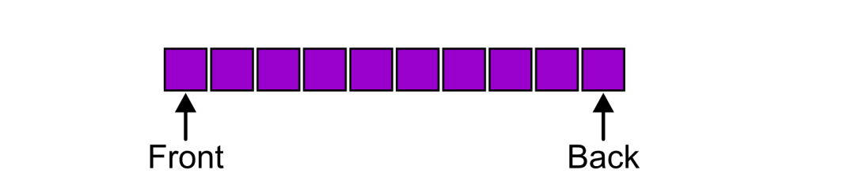
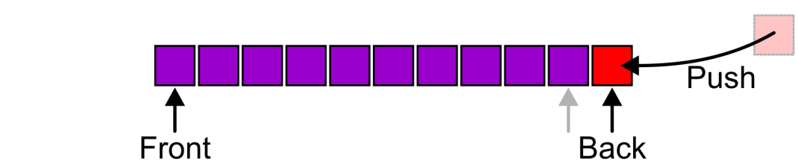
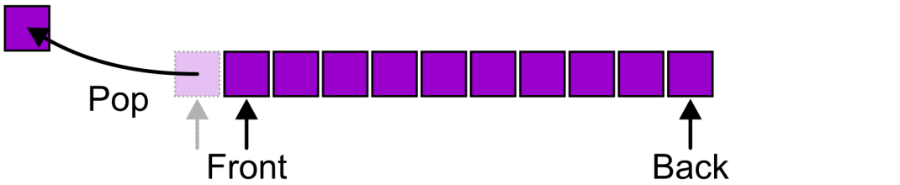
Queue ADT
Also called a first-in–first-out (FIFO) data structure
  Graphically, we may view these operations as follows:
Notes:
需要两个指针，分别指着头和尾
每次Pop。。。
每次Push。。。

Slide 5
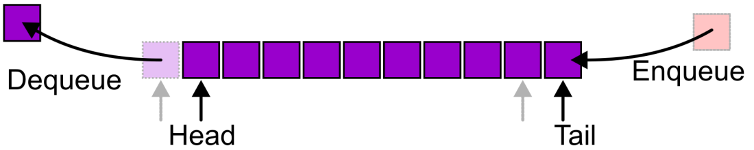
Queue ADT
Alternative terms may be used for the four operations on a queue, including:
Notes:
There are two exceptions associated with this abstract data structure:
It is an undefined operation to call either pop or front on an empty queue

Slide 6

Applications
Grocery stores, banks, airport security…

Slide 7
Applications
Tree traversals, graph traversals
  Will see in coming lectures
The most common application is in client-server models (web, file, ftp, database, mail, printers, etc.)
  Multiple clients may be requesting services from one or more servers
  Some clients may have to wait while the servers are busy
  Those clients are placed in a queue and serviced in the order of arrival

Slide 8
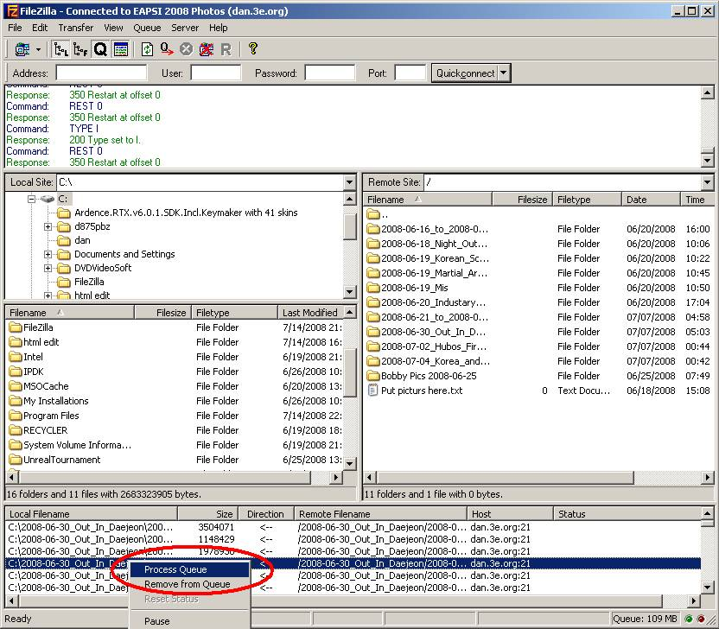
Applications
Example:
When downloading files from a web server, the requests not currently being downloaded are
marked as “Queued”

Slide 9
Outline
Queue ADT
Implementation
Example

Slide 10
Implementations
We will look at two implementations of queues:
  Singly linked lists
  Circular arrays
All queue operations run in Θ(1) time

Slide 11
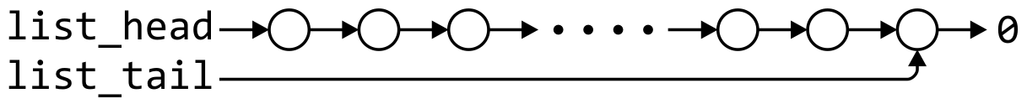
Linked-List Implementation
List head/tail → Queue front/back?
Removal is only possible at the front with Θ(1) run time
The desired behavior of an Abstract Queue may be produced by performing insertions at the back and removal at the front
 | Front/1st | Back/n^{th}
Find | Θ(1) | Θ(1)
Insert | Θ(1) | Θ(1)
Erase | Θ(1) | Θ(n)

Slide 12
Single_list Definition
The definition of single list class:
template <typename Type>
class Single_list {
public:
int size() const;
bool empty() const;
Type front() const;
Type back() const;
Single_node<Type> *head() const;
Single_node<Type> *tail() const;
int count( Type const & ) const;
void push_front( Type const & );
void push_back( Type const & );
Type pop_front();
int erase( Type const & );
};
Notes:
代表队列最重要两个指针，front和rear，代表头和尾的位置

Slide 13
Queue-as-List Class
The queue class using a singly linked list has a single private member variable: a singly linked list
template <typename Type>
class Queue{
private:
Single_list<Type> list;
public:
bool empty() const;
Type front() const;
void push( Type const & );
Type pop();
};

Slide 14
Queue-as-List Class
The implementation is similar to that of a Stack-as-List
template <typename Type>
bool Queue<Type>::empty() const {
return list.empty();
}
template <typename Type>
void Queue<Type>::push( Type const &obj ) {
list.push_back( obj );
}
template <typename Type>
Type Queue<Type>::front() const {
if ( empty() ) {
throw underflow();
}
return list.front();
}
template <typename Type>
Type Queue<Type>::pop() {
if ( empty() ) {
throw underflow();
}
return list.pop_front();
}

Slide 15

Array Implementation
A one-ended array does not allow all operations to occur in Θ(1) time
 | Front/1st | Back/n^{th}
Find | Θ(1) | Θ(1)
Insert | Θ(n) | Θ(1)
Remove | Θ(n) | Θ(1)

Slide 16
Array Implementation
Using a two-ended array, Θ(1) are possible by pushing at the back and popping from the front
 | Front/1st | Back/n^{th}
Find | Θ(1) | Θ(1)
Insert | Θ(1) | Θ(1)
Remove | Θ(1) | Θ(1)
Notes:
比起on-ended array， two ended array 需要定义一个指向front的指针，通过多定义这么一个指针，将push、pop front的复杂度降到1

Slide 17
Array Implementation
We need to store an array:
Type *array;
We need additional information, including:
  The number of objects currently in the queue and the front and back indices
int queue_size;
int ifront; // index of the front entry
int iback; // index of the back entry
  The capacity of the array
int array_capacity;

Slide 18
Queue-as-Array Class
The class definition is similar to that of the Stack:
template <typename Type>
class Queue{
private:
int queue_size;
int ifront;
int iback;
int array_capacity;
Type *array;
public:
Queue( int = 10 );
~Queue();
bool empty() const;
Type front() const;
void push( Type const & );
Type pop();
};

Slide 19
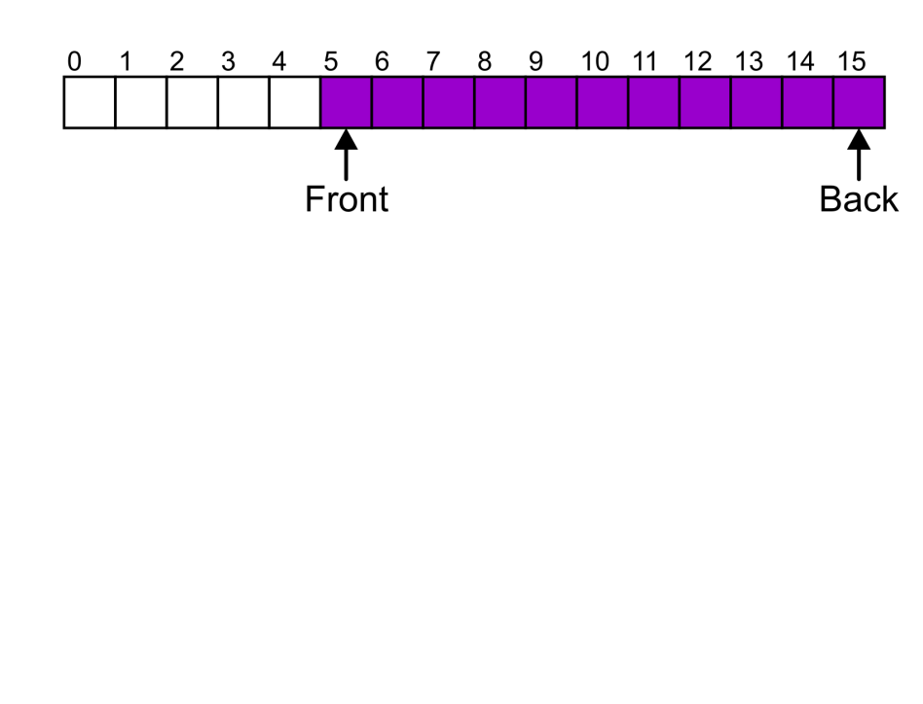
Constructor
We must initialize the values
  Allocate memory for the array
  Initialize the member variables
  iback is initialized to -1
template <typename Type>
Queue<Type>::Queue( int n ):
queue_size( 0 ),
iback( -1 ),
ifront( 0 ),
array_capacity( std::max(1, n) ),
array( new Type[array_capacity] ) {
// Empty constructor
}
$$⋯$$
$$n$$
Back
Front

Slide 20
Member Functions
template <typename Type>
bool Queue<Type>::empty() const {
return ( queue_size == 0 );
}
template <typename Type>
Type Queue<Type>::front() const {
if ( empty() ) {
throw underflow();
}
return array[ifront];
}

Slide 21
Member Functions
A naïve implementation of push and pop:
template <typename Type>
void Queue<Type>::push( Type const &obj ) {
if ( queue_size == array_capacity ) {
throw overflow();
}
++iback;
array[iback] = obj;
++queue_size;
}
queue_size=0
$$⋯$$
$$n$$
Back
Front

Slide 22
Member Functions
A naïve implementation of push and pop:
template <typename Type>
void Queue<Type>::push( Type const &obj ) {
if ( queue_size == array_capacity ) {
throw overflow();
}
++iback;
array[iback] = obj;
++queue_size;
}
queue_size=1
$$⋯$$
$$n$$
Front
Back
Push obj1
Notes:
1. 入队操作：

Slide 23
Member Functions
A naïve implementation of push and pop:
template <typename Type>
void Queue<Type>::push( Type const &obj ) {
if ( queue_size == array_capacity ) {
throw overflow();
}
++iback;
array[iback] = obj;
++queue_size;
}
queue_size=2
$$⋯$$
$$n$$
Front
Back
Push obj1
Push obj2
Notes:
1. 入队操作：

Slide 24
Member Functions
A naïve implementation of push and pop:
template <typename Type>
void Queue<Type>::push( Type const &obj ) {
if ( queue_size == array_capacity ) {
throw overflow();
}
++iback;
array[iback] = obj;
++queue_size;
}
queue_size=3
$$⋯$$
$$n$$
Front
Back
Push obj1
Push obj2
Push obj3
Notes:
1. 入队操作：

Slide 25
Member Functions
A naïve implementation of push and pop:
template <typename Type>
Type Queue<Type>::pop() {
if ( empty() ) {
throw underflow();
}
--queue_size;
++ifront;
return array[ifront - 1];
}
queue_size=2
$$⋯$$
$$n$$
Back
Front
Push obj1
Push obj2
Push obj3
Pop obj1

Slide 26
Member Functions
A naïve implementation of push and pop:
template <typename Type>
Type Queue<Type>::pop() {
if ( empty() ) {
throw underflow();
}
--queue_size;
++ifront;
return array[ifront - 1];
}
queue_size=2
$$⋯$$
$$n$$
Back
Front
Push obj1
Push obj2
Push obj3
Pop obj1
Problem?

Slide 27

Member Functions
A naïve implementation of push and pop:
template <typename Type>
Type Queue<Type>::pop() {
if ( empty() ) {
throw underflow();
}
--queue_size;
++ifront;
return array[ifront - 1];
}
queue_size=n-3
$$⋯$$
$$n$$
Front
Back
Push obj1
Push obj2
Push obj3
Pop obj1
Push obj4
Push obj5
Push obj6
Push obj7
Pop obj2
Pop obj3
Pop obj4
Push obj8
Push obj9
$$⋯$$
Push obj (n-1)
Push obj n
Problem?

Slide 28
Member Functions
Suppose that:
  The array capacity is 16
  We have performed 16 pushes
  We have performed 5 pops
    The queue size is now 11
  We perform one further push
In this case, the array is not full and yet we cannot place any more objects into the array

Slide 29
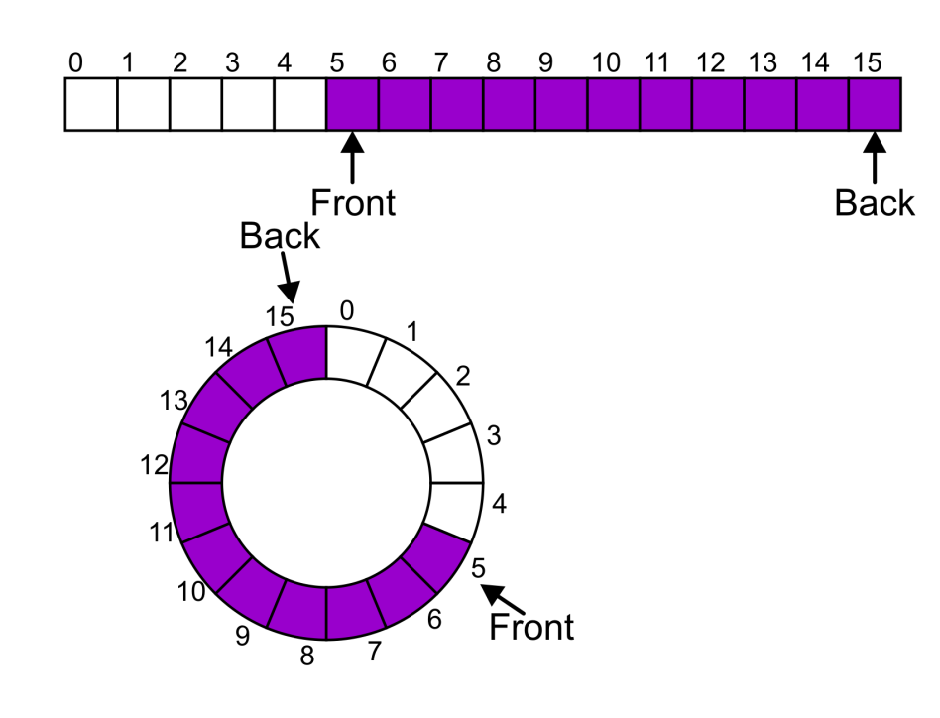
Member Functions
Instead of viewing the array on the range 0, …, 15, consider the indices being cyclic:
…, 15, 0, 1, …, 15, 0, 1, …, 15, 0, 1, …
This is referred to as a circular array

Slide 30
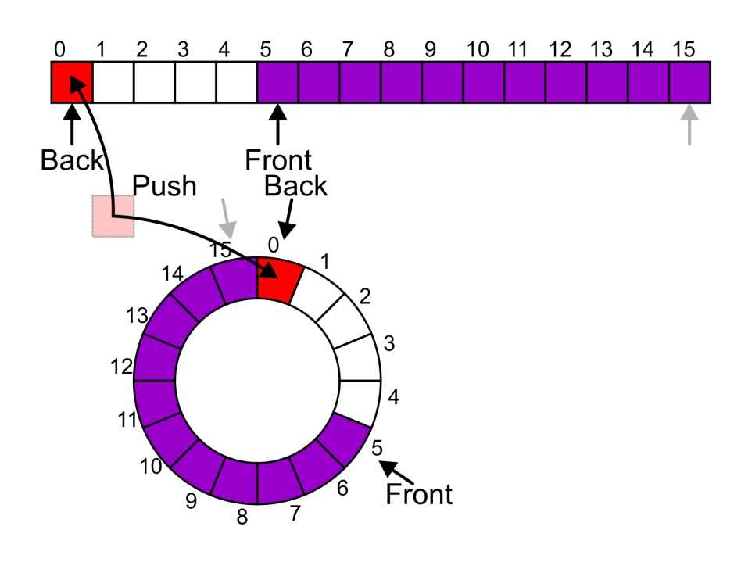
Member Functions
Now, the next push may be performed in the next available location of the circular array:
  ++iback;
  if ( iback == capacity() ) {
  iback = 0;
  }

Slide 31
Exceptions
As with a stack, there are a number of options which can be used if the array is filled
If the array is filled, we have five options:
  Increase the size of the array
  Throw an exception
  Ignore the element being pushed
  Put the pushing process to “sleep” until something else pops the front of the queue
Include a member function bool full()
Notes:
满了，要入队新的元素，怎么办？
增容
报错
忽略此时要入队的对象
休眠入队功能，直到有出队操作出现

Slide 32
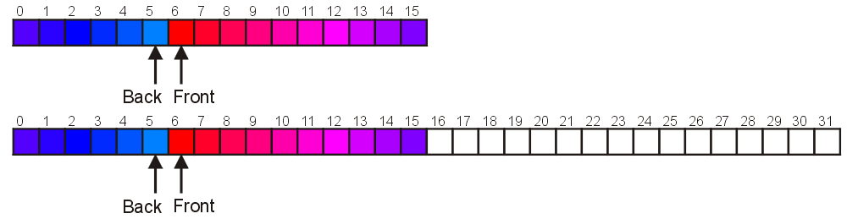
Increasing Capacity
When the array is full, increasing the capacity is slightly more complex than in the case of stack:
  A direct copy does not work:

Slide 33
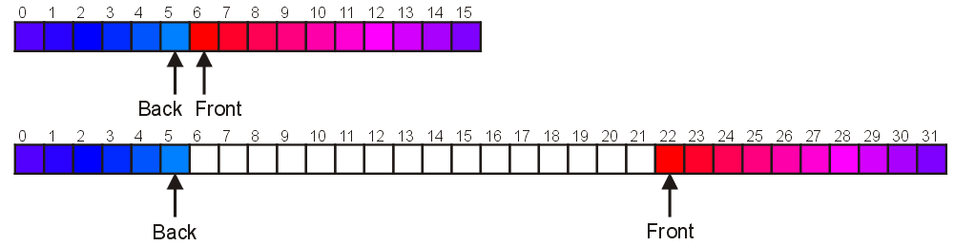
Increasing Capacity
One solution:
  Move those beyond the front to the end of the array
  The next push would then occur in position 6

Slide 34
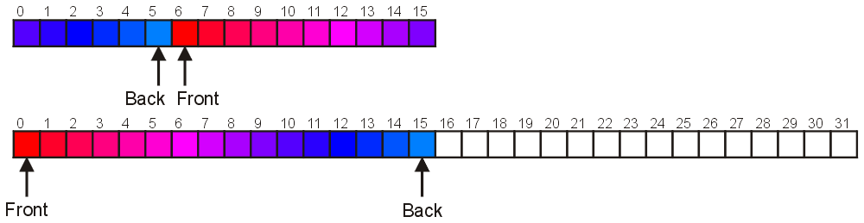
Increasing Capacity
An alternate solution is normalization:
  Map the front at position 0
  The next push would then occur in position 16

Slide 35
Destructor
template <typename Type>
Queue<Type>::~Queue() {
delete [] array;
}

Slide 36
Outline
Queue ADT
Implementation
Example

Slide 37
Example：Maze Routing
0
1
2
3
4
5
6
7
8
9
Entrance：(1,1)
Exit：(5,8)
0
1
2
Objective：
One shortest path from the entrance to the exit
3
4
5
6
7
8
9

Slide 38
Example：Maze Routing
0
1
2
3
4
5
6
7
8
9
0
1
(1,1)
2
3
4
5
6
7
8
9
Notes:
出队时，令可行的邻接位置入队，同时将步数标记在相应的迷宫位置

Slide 39
Example：Maze Routing
0
1
2
3
4
5
6
7
8
9
0
1
1
(1,2)
(2,1)
2
1
3
4
5
6
7
8
9

Slide 40
Example：Maze Routing
0
1
2
3
4
5
6
7
8
9
0
1
1
(2,2)
(3,1)
2
1
2
3
2
4
5
6
7
8
9

Slide 41
Example：Maze Routing
0
1
2
3
4
5
6
7
8
9
0
1
1
(3,2)
(4,1)
2
1
2
3
2
3
4
3
5
6
7
8
9

Slide 42
Example：Maze Routing
0
1
2
3
4
5
6
7
8
9
0
1
1
(3,3)
(5,1)
2
1
2
3
2
3
4
4
3
5
4
6
7
8
9

Slide 43
Example：Maze Routing
0
1
2
3
4
5
6
7
8
9
0
1
1
(3,4)
(5,2)
(6,1)
2
1
2
3
2
3
4
5
4
3
5
4
5
6
5
7
8
9

Slide 44
Example：Maze Routing
0
1
2
3
4
5
6
7
8
9
0
1
1
(2,4)
(5,3)
(7,1)
2
1
2
6
3
2
3
4
5
4
3
5
4
5
6
6
5
7
6
8
9

Slide 45
Example：Maze Routing
0
1
2
3
4
5
6
7
8
9
0
1
1
7
(2,5)
(1,4)
(6,3)
2
1
2
6
7
3
2
3
4
5
4
3
5
4
5
6
6
5
7
7
6
8
9

Slide 46
Example：Maze Routing
0
1
2
3
4
5
6
7
8
9
0
1
1
7
8
(2,6)
(1,5)
(6,4)
2
1
2
6
7
8
3
2
3
4
5
4
3
5
4
5
6
6
5
7
8
7
6
8
9

Slide 47
Example：Maze Routing
0
1
2
3
4
5
6
7
8
9
0
1
1
7
8
9
(1,6)
(6,5)
2
1
2
6
7
8
3
2
3
4
5
4
3
5
4
5
6
6
5
7
8
9
7
6
8
9

Slide 48
Example：Maze Routing
0
1
2
3
4
5
6
7
8
9
0
1
1
7
8
9
(5,5)
(7,5)
2
1
2
6
7
8
3
2
3
4
5
4
3
5
4
5
6
10
6
5
7
8
9
7
6
10
8
9

Slide 49
Example：Maze Routing
0
1
2
3
4
5
6
7
8
9
0
1
1
7
8
9
(4,5)
(5,6)
(8,5)
2
1
2
6
7
8
3
2
3
4
5
4
3
11
5
4
5
6
10
11
6
5
7
8
9
7
6
10
8
11
9

Slide 50
Example：Maze Routing
0
1
2
3
4
5
6
7
8
9
0
1
1
7
8
9
(4,6)
(5,7)
(8,4)
(8,6)
2
1
2
6
7
8
3
2
3
4
5
4
3
11
12
5
4
5
6
10
11
12
6
5
7
8
9
7
6
10
8
12
11
12
9

Slide 51
Example：Maze Routing
0
1
2
3
4
5
6
7
8
9
0
1
1
7
8
9
(4,5)
(5,8)
2
1
2
6
7
8
3
2
3
4
5
4
3
11
12
13
Find the exit. Stop!
5
4
5
6
10
11
12
13
6
5
7
8
9
7
6
10
8
12
11
12
9

Slide 52
Example：Maze Routing
0
1
2
3
4
5
6
7
8
9
0
1
1
7
8
9
2
1
2
6
7
8
3
2
3
4
5
4
3
11
12
13
5
4
5
6
10
11
12
13
6
5
7
8
9
7
6
10
8
12
11
12
9
Notes:
从(5,8)开始回退，直到(1,1)，即可求出从入口到出口的最短路径，
13,12,11,10, …, 2,1

Slide 53
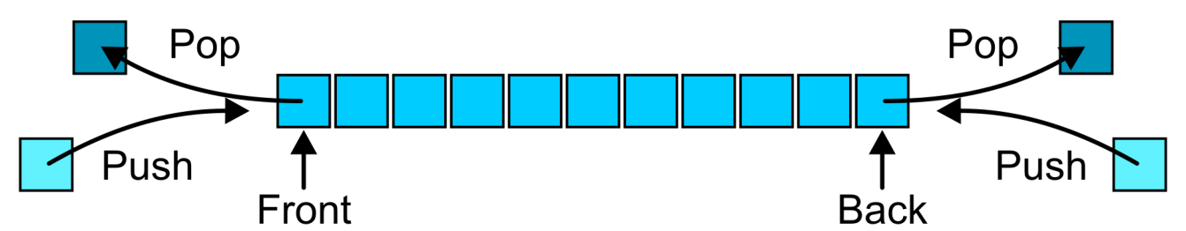
Deque ADT
Deque = Double-ended queue
  pronounced like "deck"
Uses an explicit linear ordering
Allows insertion/removal at both the front and the back of the deque

Slide 54
Applications
Useful as a general-purpose tool:
  Can be used as either a queue or a stack
Can be used in certain job scheduling algorithms for parallel programming

Slide 55
Implementations
Can we use linked list?
  Pop_back requires Θ(n)
Two efficient implementations:
  Doubly linked list
  Circular array

Slide 56
Summary
Queue ADT
  Push, pop, FIFO
Implementation
  Singly linked lists
  Circular arrays
Example

Slide 57
Standard Template Library
An example of a queue in the STL is:
#include <iostream>
#include <queue>
using namespace std;
int main() {
queue <int> iqueue;
iqueue.push( 13 );
iqueue.push( 42 );
cout << "Head: " << iqueue.front() << endl;
iqueue.pop(); // no return value
cout << "Head: " << iqueue.front() << endl;
cout << "Size: " << iqueue.size() << endl;
return 0;
}

