Slide 1
CS101 Algorithms and Data Structures
Stack
Textbook Ch 10.1
Notes:
目前除去动画效果，保留了大概40页PPT，主要思路：
从Reverse-Polish Notation引出堆栈这种结构的需求和作用。
明确堆栈的抽象数据类型。
利用堆栈的实现，引导学生思考用链表和线性表实现堆栈的利弊，同时复习两种数据类型的特点。
在利用链表实现部分，主要复习入栈时插入一个结点和出栈时删除一个结点的操作。
在利用array实现部分，主要讨论array扩容引起的操作复杂度问题，并由此引出平均复杂度的思路和计算方法。
Mazing routing 例子（可以根据时间删去）

Slide 2
Outline
Stack ADT
Implementation
Example applications

Slide 3
Reverse-Polish Notation
Normally, mathematics is written using what we call in-fix notation:
  (3 + 4) × 5 – 6
The operator is placed between two operands
One weakness: parentheses are required
  (3 + 4) × 5 – 6 = 29
  3 + 4 × 5 – 6 = 17
  3 + 4 × (5 – 6) = –1
  (3 + 4) × (5 – 6) = –7

Slide 4
Reverse-Polish Notation
Alternatively, we can place the operands first, followed by the operator:
  (3 + 4) × 5 – 6
  3 4 + 5 × 6 –
Parsing reads left-to-right and performs any operation on the
last two operands:
3 4 + 5 × 6 –
7 5 × 6 –
35 6 –
29

Slide 5
Reverse-Polish Notation
Other examples:
3 4 5 × + 6 –
3 20 + 6 –
23 6 –
17
3 4 5 6 – × +
3 4 –1 × +
3 –4 +
–1
  3 + 4 × 5 – 6= 17
  3 + 4 × (5 – 6)= –1

Slide 6
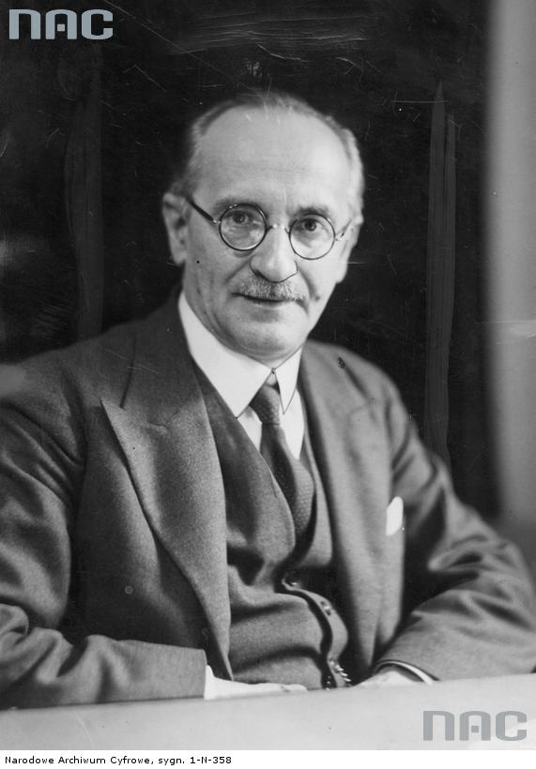
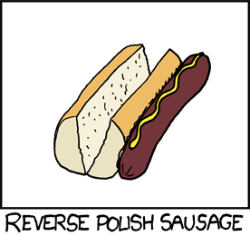
Reverse-Polish Notation
This is called reverse-Polish notation after the mathematician Jan Łukasiewicz
http://xkcd.com/645/
http://www.audiovis.nac.gov.pl/

Slide 7
Reverse-Polish Notation
Benefits:
  No ambiguity and no brackets are required
  It is the same process used by a computer to perform computations:
    operands must be loaded into registers before operations can be performed on them
Notes:
Reverse-Polish can be processed using stacks
后缀表达式的优越：不用等待运算符，不需要定义priority，没有任何歧义。

Slide 8
Reverse-Polish Notation
The easiest way to parse reverse-Polish notation is to use an operand stack:
  operands are processed by pushing them onto the stack
  when processing an operator:
    pop the last two items off the operand stack,
    perform the operation, and
    push the result back onto the stack
Notes:
后缀表达式具体最简单地实现方式，就是用栈

Slide 9
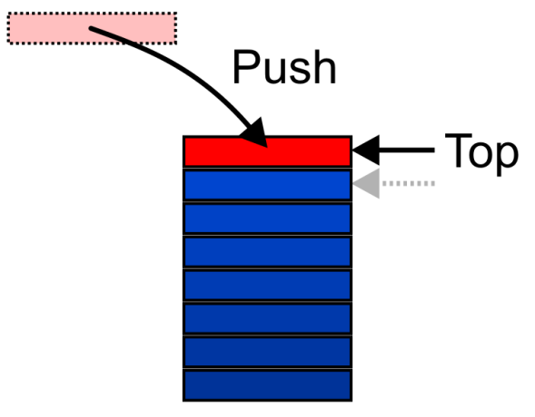
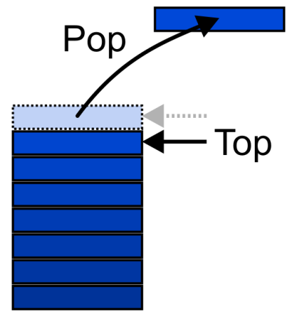
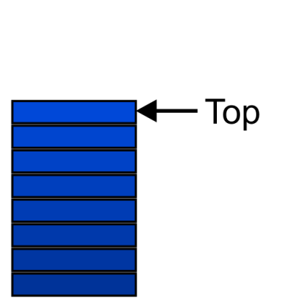
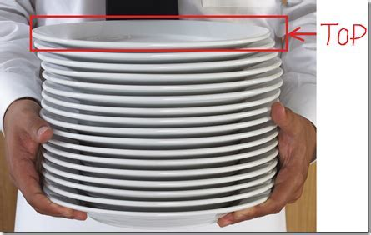
Stack ADT
Also called a last-in–first-out (LIFO) behaviour
  Graphically, we may view these operations as follows:
Notes:
There are two exceptions associated with abstract stacks:
It is an undefined operation to call either pop or top on an empty stack

Slide 10
Applications
Numerous applications:
  Parsing code:
    Matching parenthesis
    XML (e.g., XHTML)
  Tracking function calls
  Dealing with undo/redo operations
  Reverse-Polish calculators
  Assembly language

Slide 11
Reverse-Polish Notation
Evaluate the following reverse-Polish expression using a stack:
1 2 3 + 4 5 6 × – 7 × + – 8 9 × +

Slide 12
Reverse-Polish Notation
Push 1 onto the stack
1 2 3 + 4 5 6 × – 7 × + – 8 9 × +
1

Slide 13
Reverse-Polish Notation
Push 1 onto the stack
1 2 3 + 4 5 6 × – 7 × + – 8 9 × +
2
1

Slide 14
Reverse-Polish Notation
Push 3 onto the stack
1 2 3 + 4 5 6 × – 7 × + – 8 9 × +
3
2
1

Slide 15
Reverse-Polish Notation
Pop 3 and 2 and push 2 + 3 = 5
1 2 3 + 4 5 6 × – 7 × + – 8 9 × +
5
1

Slide 16
Reverse-Polish Notation
Push 4 onto the stack
1 2 3 + 4 5 6 × – 7 × + – 8 9 × +
4
5
1

Slide 17
Reverse-Polish Notation
Push 5 onto the stack
1 2 3 + 4 5 6 × – 7 × + – 8 9 × +
5
4
5
1

Slide 18
Reverse-Polish Notation
Push 6 onto the stack
1 2 3 + 4 5 6 × – 7 × + – 8 9 × +
6
5
4
5
1

Slide 19
Reverse-Polish Notation
Pop 6 and 5 and push 5 × 6 = 30
1 2 3 + 4 5 6 × – 7 × + – 8 9 × +
30
4
5
1

Slide 20
Reverse-Polish Notation
Pop 30 and 4 and push 4 – 30 = –26
1 2 3 + 4 5 6 × – 7 × + – 8 9 × +
–26
5
1

Slide 21
Reverse-Polish Notation
Push 7 onto the stack
1 2 3 + 4 5 6 × – 7 × + – 8 9 × +
7
–26
5
1

Slide 22
Reverse-Polish Notation
Pop 7 and –26 and push –26 × 7 = –182
1 2 3 + 4 5 6 × – 7 × + – 8 9 × +
–182
5
1

Slide 23
Reverse-Polish Notation
Pop –182 and 5 and push –182 + 5 = –177
1 2 3 + 4 5 6 × – 7 × + – 8 9 × +
–177
1

Slide 24
Reverse-Polish Notation
Pop –177 and 1 and push 1 – (–177) = 178
1 2 3 + 4 5 6 × – 7 × + – 8 9 × +
178

Slide 25
Reverse-Polish Notation
Push 8 onto the stack
1 2 3 + 4 5 6 × – 7 × + – 8 9 × +
8
178

Slide 26
Reverse-Polish Notation
Push 1 onto the stack
1 2 3 + 4 5 6 × – 7 × + – 8 9 × +
9
8
178

Slide 27
Reverse-Polish Notation
Pop 9 and 8 and push 8 × 9 = 72
1 2 3 + 4 5 6 × – 7 × + – 8 9 × +
72
178

Slide 28
Reverse-Polish Notation
Pop 72 and 178 and push 178 + 72 = 250
1 2 3 + 4 5 6 × – 7 × + – 8 9 × +
250

Slide 29
Reverse-Polish Notation
Thus
1 2 3 + 4 5 6 × – 7 × + – 8 9 × +
evaluates to the value on the top: 250
The equivalent in-fix notation is
((1 – ((2 + 3) + ((4 – (5 × 6)) × 7))) + (8 × 9))
We reduce the parentheses using order-of-operations:
1 – (2 + 3 + (4 – 5 × 6) × 7) + 8 × 9

Slide 30
Stack ADT
Uses an explicit linear ordering
Two principal operations
  Push: insert an object onto the top of the stack
  Pop: erase the object on the top of the stack
  CreateStack: generate an empty stack
  IsEmpty: determine if stack is empty
  IsFull: determine if stack is full

Slide 31
Outline
Stack ADT
Implementation
Example applications

Slide 32
Implementations
We will look at two implementations of stacks:
  Singly linked lists
  One-ended arrays
The optimal asymptotic run time of any algorithm is Θ(1)
  The run time of the algorithm is independent of the number of objects being stored in the container
Notes:
两种存储结构：单向链表 和 单向数组

Slide 33
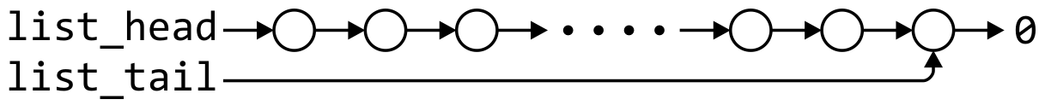
Linked-List Implementation
Operations at the front of a singly linked list are all Θ(1)
The desired behavior of an Abstract Stack may be reproduced by performing all operations at the front
 | Front/1st | Back/n^{th}
Find | Θ(1) | Θ(1)
Insert | Θ(1) | Θ(1)
Erase | Θ(1) | Θ(n)

Slide 34
Single_list Definition
The definition of single list class:
template <typename Type>
class Single_list {
public:
Single_list();
~Single_list();
int size() const; /* return the length of the List */
bool empty() const; /* return true when List is empty */
Type front() const; /* return the data in the first node */
Type back() const; /* return the data in the last node */
Single_node<Type> *head() const; /* return the first node */
Single_node<Type> *tail() const; /* return the last node */
int count( Type const & ) const; /* counts the number of instances of data*/
void push_front( Type const & ); /* insert a node as the first node*/
void push_back( Type const & ); /* insert a node as the last node*/
Type pop_front(); /* return the data in the first node and delete the first node*/
int erase( Type const & ); /* removes the nodes containing that integer*/
};

Slide 35
Stack-as-List Class
The stack class using a singly linked list has a single private member variable:
template <typename Type>
class Stack {
private:
Single_list<Type> list;
public:
bool empty() const;
Type top() const;
void push( Type const & );
Type pop();
};
Notes:
需要定义已经满了吗？如果决定要用链表表示栈，应该把Top放在表尾还是表头？

Slide 36
Stack-as-List Class
The empty and push functions just call the appropriate functions of the Single_list class
template <typename Type>
bool Stack<Type>::empty() const {
return list.empty();
}
template <typename Type>
void Stack<Type>::push( Type const &obj ) {
list.push_front( obj );
}
Notes:
1。 判断是否空栈，直接继承单向链表是否是空表
2. 出栈操作，用的是 push_front (复习push_front) PPT1 Page 53-59

Slide 37


void push_front( int )
We could, however, note that when the list is empty,
list_head == 0, thus we could shorten this to:
    void List::push_front( int n ) {
    list_head = new Node( n, list_head );
    }
If it is empty, we start with:
and, if we try to add 81, we should end up with:

Slide 38
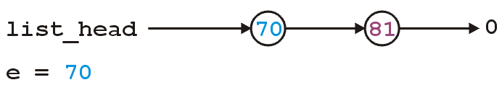
void push_front( int )
We could, however, note that when the list is empty,
list_head == 0, thus we could shorten this to:
    void List::push_front( int n ) {
    list_head = new Node( n, list_head );
    }
If it is not empty, we start with:
and, if we try to add 70, we should end up with:

Slide 39
Stack-as-List Class
The top and pop functions, however, must check the boundary case:
template <typename Type>
Type Stack<Type>::top() const {
if ( empty() ) {
throw underflow();
}
return list.front();
}
template <typename Type>
Type Stack<Type>::pop() {
if ( empty() ) {
throw underflow();
}
return list.pop_front();
}
Notes:
读取栈顶数据：判断不是空表，list.front();
出栈：删除表头节点

Slide 40
int pop_front()
The correct implementation assigns a temporary pointer to point to the node being deleted:
    int List::pop_front() {
    if ( empty() ) {
    throw underflow();
    }
    int e = front();
    Node *ptr = list_head;
    list_head = list_head->next();
    delete ptr;
    return e;
    }
int front() const
int List::front() const {
if ( empty() ) {
throw underflow();
}
return head()->retrieve();
}

Slide 41
int pop_front()
The correct implementation assigns a temporary pointer to point to the node being deleted:
    int List::pop_front() {
    if ( empty() ) {
    throw underflow();
    }
    int e = front();
    Node *ptr = list_head;
    list_head = list_head->next();
    delete ptr;
    return e;
    }
int front() const
int List::front() const {
if ( empty() ) {
throw underflow();
}
return head()->retrieve();
}

Slide 42
int pop_front()
The correct implementation assigns a temporary pointer to point to the node being deleted:
    int List::pop_front() {
    if ( empty() ) {
    throw underflow();
    }
    int e = front();
    Node *ptr = list_head;
    list_head = list_head->next();
    delete ptr;
    return e;
    }

Slide 43
int pop_front()
The correct implementation assigns a temporary pointer to point to the node being deleted:
    int List::pop_front() {
    if ( empty() ) {
    throw underflow();
    }
    int e = front();
    Node *ptr = list_head;
    list_head = list_head->next();
    delete ptr;
    return e;
    }
*ptr

Slide 44
int pop_front()
The correct implementation assigns a temporary pointer to point to the node being deleted:
    int List::pop_front() {
    if ( empty() ) {
    throw underflow();
    }
    int e = front();
    Node *ptr = list_head;
    list_head = list_head->next();
    delete ptr;
    return e;
    }
*ptr

Slide 45
int pop_front()
The correct implementation assigns a temporary pointer to point to the node being deleted:
    int List::pop_front() {
    if ( empty() ) {
    throw underflow();
    }
    int e = front();
    Node *ptr = list_head;
    list_head = list_head->next();
    delete ptr;
    return e;
    }
*ptr

Slide 46
int pop_front()
The correct implementation assigns a temporary pointer to point to the node being deleted:
    int List::pop_front() {
    if ( empty() ) {
    throw underflow();
    }
    int e = front();
    Node *ptr = list_head;
    list_head = list_head->next();
    delete ptr;
    return e;
    }
*ptr

Slide 47
int pop_front()
The correct implementation assigns a temporary pointer to point to the node being deleted:
    int List::pop_front() {
    if ( empty() ) {
    throw underflow();
    }
    int e = front();
    Node *ptr = list_head;
    list_head = list_head->next();
    delete ptr;
    return e;
    }

Slide 48
int pop_front()
The correct implementation assigns a temporary pointer to point to the node being deleted:
    int List::pop_front() {
    if ( empty() ) {
    throw underflow();
    }
    int e = front();
    Node *ptr = list_head;
    list_head = list_head->next();
    delete ptr;
    return e;
    }

Slide 49
Stack-as-List Class
A constructor and destructor is not needed
  Because list is declared, the compiler will call the constructor of the Single_list class when the Stack is constructed

Slide 50

Array Implementation
For one-ended arrays, all operations at the back are Θ(1)
 | Front/1st | Back/n^{th}
Find | Θ(1) | Θ(1)
Insert | Θ(n) | Θ(1)
Erase | Θ(n) | Θ(1)

Slide 51
Stack-as-Array Class
template <typename Type>
class Stack {
private:
int stack_size; //number of objects in the stack
int array_capacity; //capacity of the array
Type *array;
public:
Stack( int = 10 );
~Stack();
bool empty() const;
Type top() const;
void push( Type const & );
Type pop();
};

Slide 52
Constructor
The class is only storing the address of the array
  We must allocate memory for the array and initialize the member variables
#include <algorithm>
// ...
template <typename Type>
Stack<Type>::Stack( int n ):
stack_size( 0 ),
array_capacity( std::max( 1, n ) ),
array( new Type[array_capacity] ) {
// Empty constructor
}
Notes:
初始stack_size=0;
容量是N

Slide 53
Constructor
template <typename Type>
class Stack {
private:
int stack_size;
int array_capacity;
Type *array;
public:
Stack( int = 10 );
~Stack();
bool empty() const;
Type top() const;
void push( Type const & );
Type pop();
};
template <typename Type>
Stack<Type>::Stack( int n ):
stack_size( 0 ),
array_capacity( std::max( 1, n ) ),
array( new Type[array_capacity] ) {
// Empty constructor
}
Warning: in C++, the variables are initialized in the order in which they are defined:

Slide 54
Destructor
The destructor must release the memory for the array
template <typename Type>
Stack<Type>::~Stack() {
delete [] array;
}
Notes:
顺便提一下lincked_list怎么删除

Slide 55
Empty
The stack is empty if the stack size is zero:
template <typename Type>
bool Stack<Type>::empty() const {
return ( stack_size == 0 );
}
Notes:
判断是否空栈：只需要看stack_size是否为零

Slide 56
Top
If there are n objects in the stack, the last is located at index n – 1
template <typename Type>
Type Stack<Type>::top() const {
if ( empty() ) {
throw underflow();
}
return array[stack_size - 1];
}

Slide 57
Pop
Removing an object simply involves reducing the size
  By decreasing the size, the previous top of the stack is now at the location stack_size
template <typename Type>
Type Stack<Type>::pop() {
if ( empty() ) {
throw underflow();
}
--stack_size;
return array[stack_size];
}

Slide 58
Push
Pushing an object onto the stack can only be performed if the
array is not full
template <typename Type>
void Stack<Type>::push( Type const &obj ) {
if ( stack_size == array_capacity ) {
throw overflow();
}
array[stack_size] = obj;
++stack_size;
}

Slide 59
Exceptions
The case where the array is full is not an exception defined in the Abstract Stack
If the array is filled, we have five options:
  Increase the size of the array
  Throw an exception
  Ignore the element being pushed
  Replace the current top of the stack
  Put the pushing process to “sleep” until something else removes
  the top of the stack
Include a member function bool full() const;

Slide 60
Array Capacity
The best option is to increase the array capacity
If we increase the array capacity, the question is:
  How much?
  By a constant? array_capacity += c;
  By a multiple? array_capacity *= c;

Slide 61
Array Capacity
count == 4
array_capacity == 4
array
S
I
S
T
First, let us visualize what must occur to allocate new memory

Slide 62
Array Capacity
First, this requires a call to new Type[N] where N is the new capacity
  We must have access to this so we must
  store the address returned by new in a
  local variable, say tmp
count == 4
array_capacity == 4
array
tmp
S
I
S
T

Slide 63
Array Capacity
count == 4
array_capacity == 4
array
tmp
S
S
I
I
S
S
T
T
Next, the values must be copied over

Slide 64
Array Capacity
count == 4
array_capacity == 4
array
tmp
S
S
I
I
S
S
T
T
The memory for the original array must be deallocated

Slide 65
Array Capacity
count == 4
array_capacity == 8
array
tmp
S
I
S
T
Finally, the appropriate member variables must be reassigned

Slide 66
Array Capacity
count == 4
array_capacity == 4
array
S
I
S
T
The implementation:
void double_capacity() {
}

Slide 67
Array Capacity
count == 4
array_capacity == 4
array
tmp_array
S
I
S
T
The implementation:
void double_capacity() {
Type *tmp_array = new Type[2*array_capacity];
}

Slide 68
Array Capacity
count == 4
array_capacity == 4
array
tmp_array
S
S
I
I
S
S
T
T
The implementation:
void double_capacity() {
Type *tmp_array = new Type[2*array_capacity];
for ( int i = 0; i < array_capacity; ++i ) {
tmp_array[i] = array[i];
}
}

Slide 69
Array Capacity
count == 4
array_capacity == 4
array
tmp_array
S
S
I
I
S
S
T
T
The implementation:
void double_capacity() {
Type *tmp_array = new Type[2*array_capacity];
for ( int i = 0; i < array_capacity; ++i ) {
tmp_array[i] = array[i];
}
delete [] array;
}

Slide 70
Array Capacity
count == 4
array_capacity == 8
array
tmp
S
I
S
T
The implementation:
void double_capacity() {
Type *tmp_array = new Type[2*array_capacity];
for ( int i = 0; i < array_capacity; ++i ) {
tmp_array[i] = array[i];
}
delete [] array;
array = tmp_array;
}

Slide 71
Array Capacity
count == 4
array_capacity == 8
array
tmp
S
I
S
T
The implementation:
void double_capacity() {
Type *tmp_array = new Type[2*array_capacity];
for ( int i = 0; i < array_capacity; ++i ) {
tmp_array[i] = array[i];
}
delete [] array;
array = tmp_array;
array_capacity *= 2;
}

Slide 72
Array Capacity
Back to the original question:
  How much do we change the capacity?
  Add a constant?
  Multiply by a constant?
First, we recognize that any time that we push onto a full stack, this requires n copies, and the run time is Θ(n)
Therefore, push is usually Θ(1) except when new memory is required

Slide 73
Array Capacity
To state the average run time, we will introduce the concept of amortized time:
  If n operations requires Θ(f(n)), we will say that an individual operation has an amortized run time of Θ(f(n)/n)
  Therefore, if inserting n objects requires:
    Θ(n²) copies, the amortized time is Θ(n)
    Θ(n) copies, the amortized time is Θ(1)

Slide 74
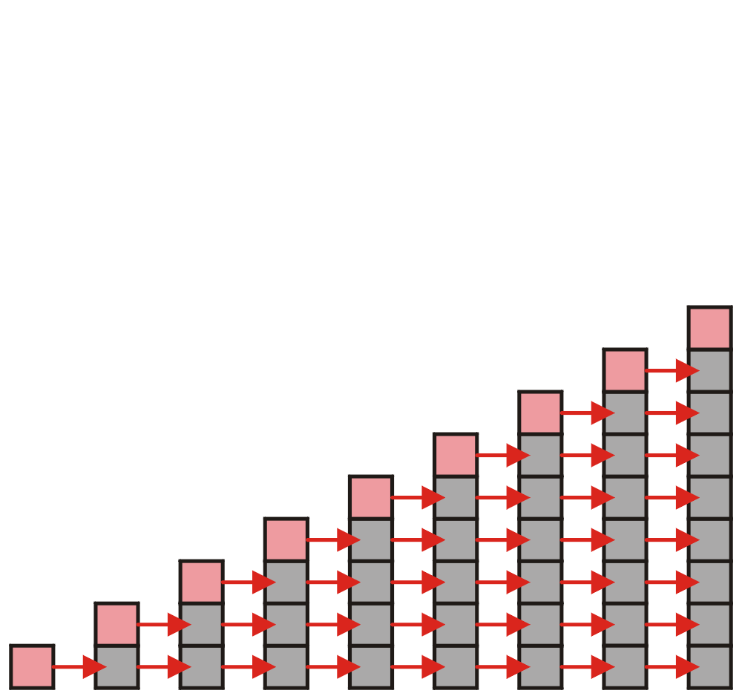
Array Capacity
Let us consider the case of increasing the capacity by 1 each time the array is full
  With each insertion when the array is full, this requires all entries to be copied

Slide 75
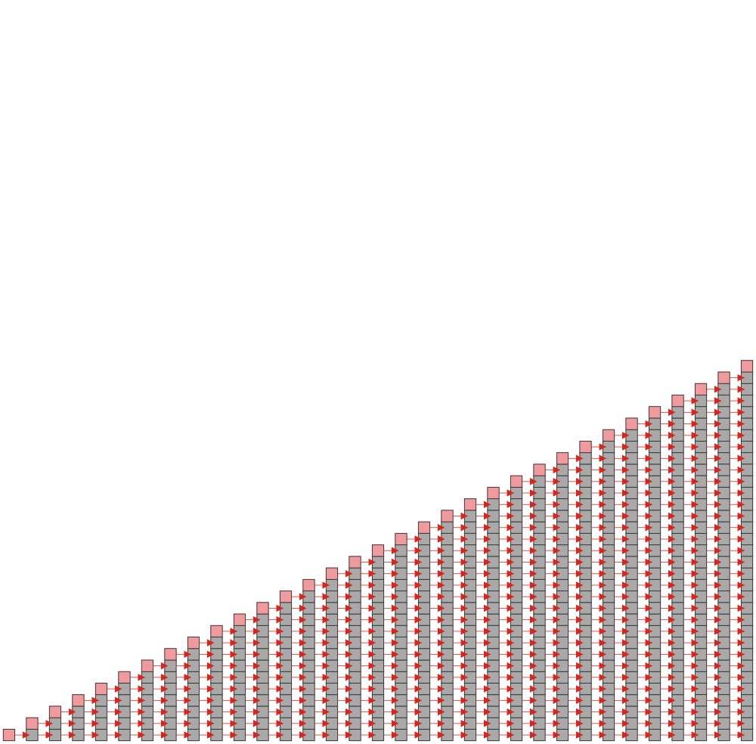
Array Capacity
Suppose we insert k objects
  The pushing of the k^{th} object on the stack requires k-1 copies
  The total number of copies is now given by:
  Therefore, the amortized number of copies
  is given by
  Therefore, each push must run in
  Θ(n) time
  The wasted space, however
  is Θ(1)

Slide 76
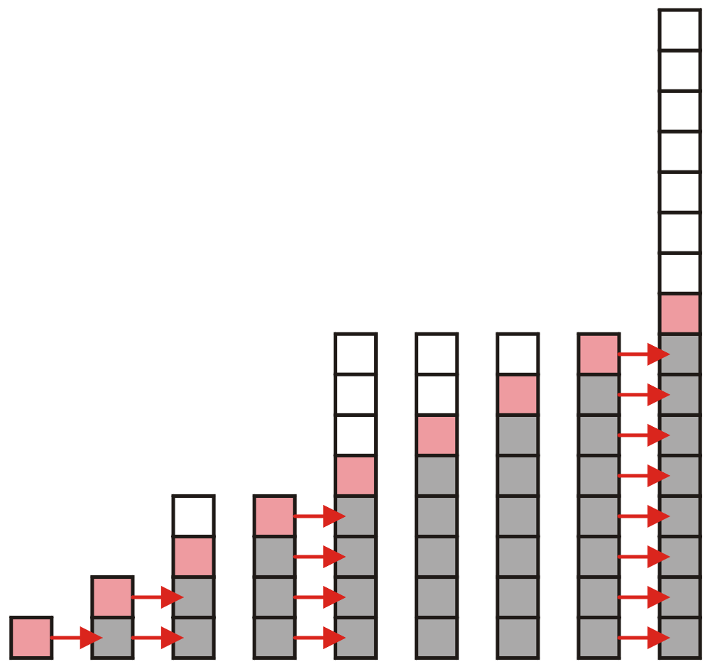
Array Capacity
Suppose we double the number of entries each time
the array is full
  Now the number of copies appears to be significantly
  fewer

Slide 77
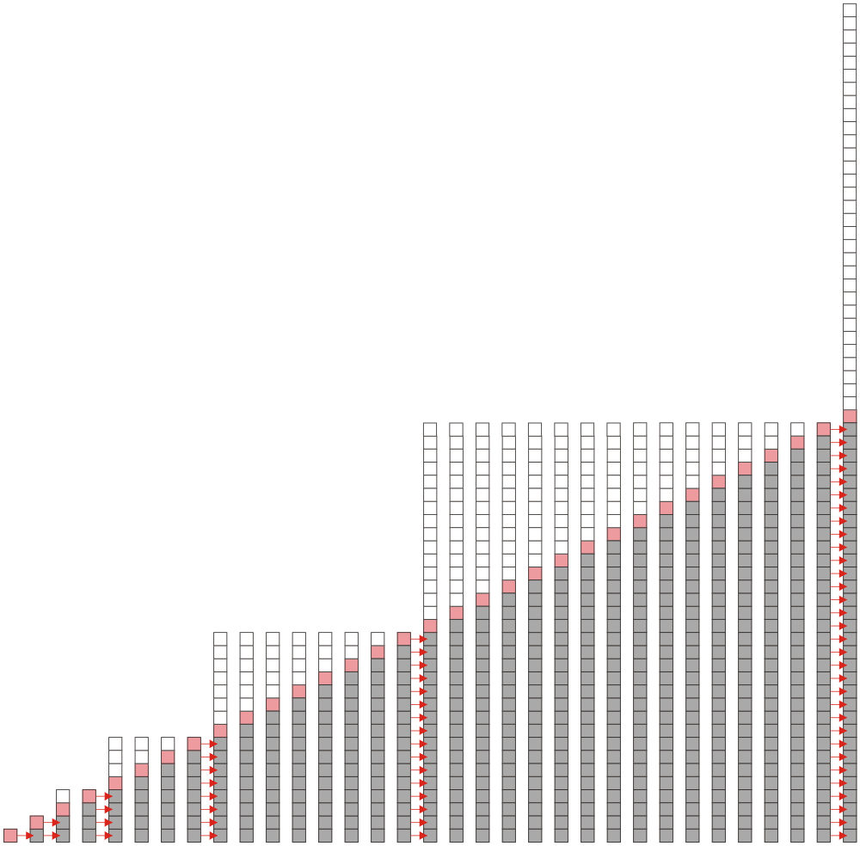
Array Capacity
Suppose we double the array size each time it is full:
  Inserting n objects would require 1, 2, 4, 8, ..., all the
  way up to the largest 2^{k} < n or
  Therefore, the amortized number of
  copies per insertion is Θ(1)
  The wasted space,
  however is O(n)

Slide 78
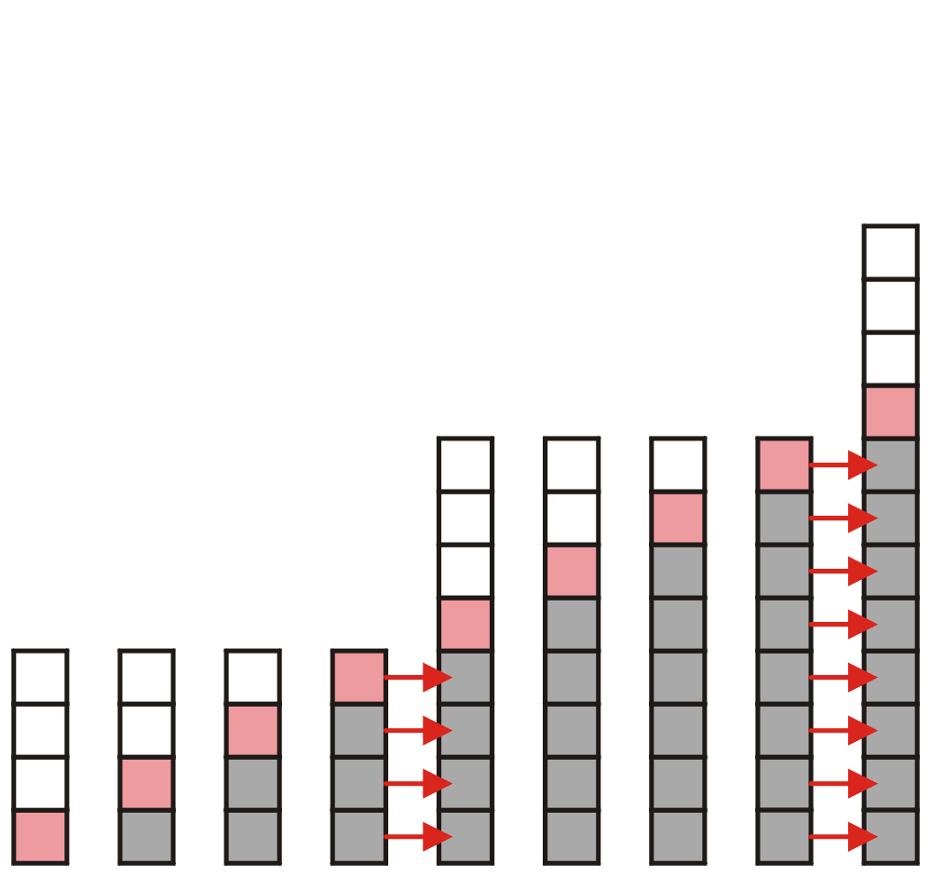
Array Capacity
What if we increase the array size by a larger constant?
  For example, increase the array size by 4, 8, or 100?

Slide 79
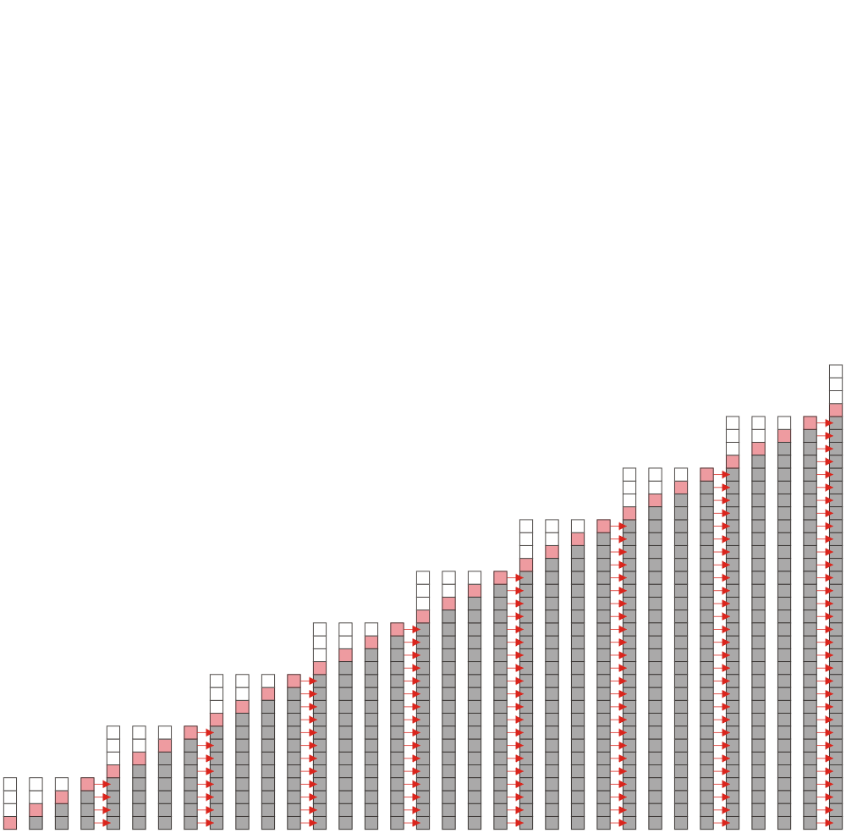
Array Capacity
Suppose we increase it by a constant value m
Therefore, the amortized run time per
insertion is Θ(n)

Slide 80
Array Capacity
 | Copies per Insertion | Unused Memory
Increase by 1 | n – 1 | 0
Increase by m | n/m | m – 1
Increase by a factor of 2 | 1 | n
Increase by a factor of r > 1 | 1/(r – 1) | (r – 1)n
Note the difference in worst-case amortized scenarios:

Slide 81
Outline
Stack ADT
Implementation
Example applications

Slide 82

Example：Maze Routing
Objective：
One path from the entrance to the exit
Directions：
Up(N), Down(S), Left(W), Right(E)
Entrance
1
2
3
4
5
6
7
8
Up
1
2
Left
Right
3
Down
4
5
Rules：
Go down first. If possible, the man can further explore. Otherwise, the man explores the possible next steps in a counterclockwise direction.
6
7
8
Exit
Notes:
例子：迷宫寻路问题，探索一条从入口到出口的通路。规则如下：首先向下探索，可行则前进一步并继续探索，否则按照逆时针方向依次探索下一步可能前进的位置

Slide 83
Example：Maze Routing
1
2
3
4
5
6
7
8
1
i
2
i
3
i
(7,1)
4
i
(6,1)
5
i
(5,1)
6
i
(4,1)
7
(3,1)
8
(2,1)
(1,1)
Stack

Slide 84
Example：Maze Routing
(8,8)
…
1
2
3
4
5
6
7
8
1
i
2
i
(6,4)
3
i
(6,3)
(5,3)
4
i
(7,1)
5
i
i
(5,2)
i
i
(6,1)
(5,1)
6
i
i
i
#
i
(4,1)
7
#
i
(3,1)
8
i
i
i
(2,1)
(1,1)
Stack

Slide 85
Application: Parsing
Most parsing uses stacks
Examples includes:
  Matching tags in XHTML
  In C++, matching
    parentheses ( ... )
    brackets, and [ ... ]
    braces { ... }

Slide 86
Parsing XHTML
A markup language is a means of annotating a document to given context to the text
  The annotations give information about the structure or presentation of the text
The best known example is HTML, or HyperText Markup Language
  We will look at XHTML

Slide 87
Parsing XHTML
XHTML is made of nested
  opening tags, e.g., <some_identifier>, and
  matching closing tags, e.g., </some_identifier>
    <html>
    <head><title>Hello</title></head>
    <body><p>This appears in the <i>browser</i>.</p></body>
    </html>
Nesting indicates that any closing tag must match the most recent opening tag

Slide 88
Parsing XHTML
Strategy for parsing XHTML:
  read though the XHTML linearly
  place the opening tags in a stack
  when a closing tag is encountered, check that it matches what is on top of the stack

Slide 89
Parsing XHTML
<html>
<head><title>Hello</title></head>
<body><p>This appears in the <i>browser</i>.</p></body>
</html>
<html>

Slide 90
Parsing XHTML
<html>
<head><title>Hello</title></head>
<body><p>This appears in the <i>browser</i>.</p></body>
</html>
<html> | <head>

Slide 91
Parsing XHTML
<html>
<head><title>Hello</title></head>
<body><p>This appears in the <i>browser</i>.</p></body>
</html>
<html> | <head> | <title>

Slide 92
Parsing XHTML
<html>
<head><title>Hello</title></head>
<body><p>This appears in the <i>browser</i>.</p></body>
</html>
<html> | <head> | <title>

Slide 93
Parsing XHTML
<html>
<head><title>Hello</title></head>
<body><p>This appears in the <i>browser</i>.</p></body>
</html>
<html> | <head>

Slide 94
Parsing XHTML
<html>
<head><title>Hello</title></head>
<body><p>This appears in the <i>browser</i>.</p></body>
</html>
<html> | <body>

Slide 95
Parsing XHTML
<html>
<head><title>Hello</title></head>
<body><p>This appears in the <i>browser</i>.</p></body>
</html>
<html> | <body> | <p>

Slide 96
Parsing XHTML
<html>
<head><title>Hello</title></head>
<body><p>This appears in the <i>browser</i>.</p></body>
</html>
<html> | <body> | <p> | <i>

Slide 97
Parsing XHTML
<html>
<head><title>Hello</title></head>
<body><p>This appears in the <i>browser</i>.</p></body>
</html>
<html> | <body> | <p> | <i>

Slide 98
Parsing XHTML
<html>
<head><title>Hello</title></head>
<body><p>This appears in the <i>browser</i>.</p></body>
</html>
<html> | <body> | <p>

Slide 99
Parsing XHTML
<html>
<head><title>Hello</title></head>
<body><p>This appears in the <i>browser</i>.</p></body>
</html>
<html> | <body>

Slide 100
Parsing XHTML
<html>
<head><title>Hello</title></head>
<body><p>This appears in the <i>browser</i>.</p></body>
</html>
<html>

Slide 101
Parsing XHTML
We are finished parsing, and the stack is empty
Possible errors:
  a closing tag which does not match the opening tag on top of the stack
  a closing tag when the stack is empty
  the stack is not empty at the end of the document

Slide 102
Parsing C++
Like opening and closing tags, C++ parentheses, brackets, and braces must be similarly nested:
    void initialize( int *array, int n ) {
    for ( int i = 0; i < n; ++i ) {
    array[i] = 0;
    }
    }

Slide 103
Function calls
int a(){
b();
c();
return 0;
}
int b(){ return 0; }
int c(){ return 0; }
int main(){
a();
return 0;
}

Slide 104
Function calls
main
main() calls a()
main | a
a() calls b()
main | a | b
b() returns
main | a
a() calls c()
main | a | c
c() returns
main | a
a() returns
main

Slide 105
Function calls
int a(){
return a();
}

Slide 106
Function calls
calls a()
a
a() calls a()
a | a
a() calls a()
a | a | a
a() calls a()
a | a | a | a
a | a | a | a
a() calls a()
?
Stack Overflow!

Slide 107

StackOverflow

Slide 108
Summary
Stack ADT
  Push, pop, LIFO
Implementation
  Linked list
  Array
    How to increase the array capacity
Example Applications
  Reverse-Polish Notation
  Maze Routing

Slide 109

Standard Template Library
The Standard Template Library (STL) has a wrapper class stack with the following declaration:
    template <typename T>
    class stack {
    public:
    stack(); // not quite true...
    bool empty() const;
    int size() const;
    const T & top() const;
    void push( const T & );
    void pop();
    };

Slide 110
Standard Template Library
    #include <iostream>
    #include <stack>
    using namespace std;
    int main() {
    stack<int> istack;
    istack.push( 13 );
    istack.push( 42 );
    cout << "Top: " << istack.top() << endl;
    istack.pop(); // no return value
    cout << "Top: " << istack.top() << endl;
    cout << "Size: " << istack.size() << endl;
    return 0;
    }

Slide 111
Standard Template Library
The reason that the stack class is termed a wrapper is because it uses a different container class to actually store the elements
The stack class simply presents the stack interface with appropriately named member functions:
  push, pop , and top

