Slide 1
Text Classification
Natural Language Processing

Slide 2
Applications
Sentimental Analysis 情感分析
Spam Check 垃圾郵件偵測
Violating Posts Detection 違規文章偵測
Fake News Detection 假新聞辨識
...etc

Slide 3
Outline
1
Data Collection
2
Data Pre-processing
3
Text Vectorization
4
Model Selection

Slide 4
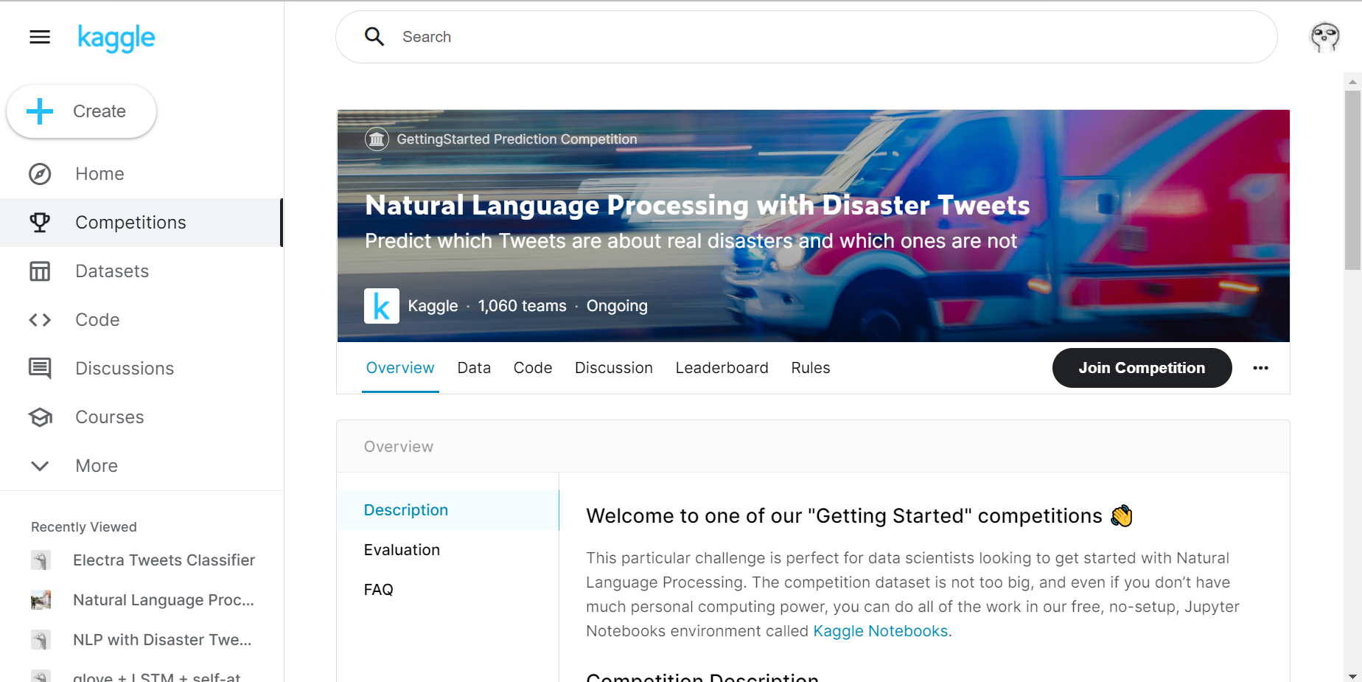
Data Collection

Slide 5
Data Pre-processing
Coffee is life, bitter and sweet are included.
Tea is love, Tea is life.
Tea is bitter but calming and healthy.

Slide 6
Tokenization
Coffee is life, bitter and sweet are included.
Tea is love, tea is life.
Tea is bitter but calming and healthy.

Slide 7
Stopwords Filter
Coffee is life, bitter and sweet are included.
Tea is love, tea is life.
Tea is bitter but calming and healthy.

Slide 8
Vocabulary
0
1
2
3
4
Coffee is life, bitter and sweet are included.
5
6
5
1
Tea is love, tea is life.
5
2
7
8
Tea is bitter but calming and healthy.

Slide 9
Text Vectorization
Bag of Words (1D arrays)
Tea is love, tea is life. -> [0, 1, 0, 0, 0, 3, 1, 0, 0]
Word Embedding (2D arrays)
Pre-trained Word2Vec (GloVe, FastText, …)
Pre-trained Embedding Model (ELMo, BERT, …)
From Scratch

Slide 10
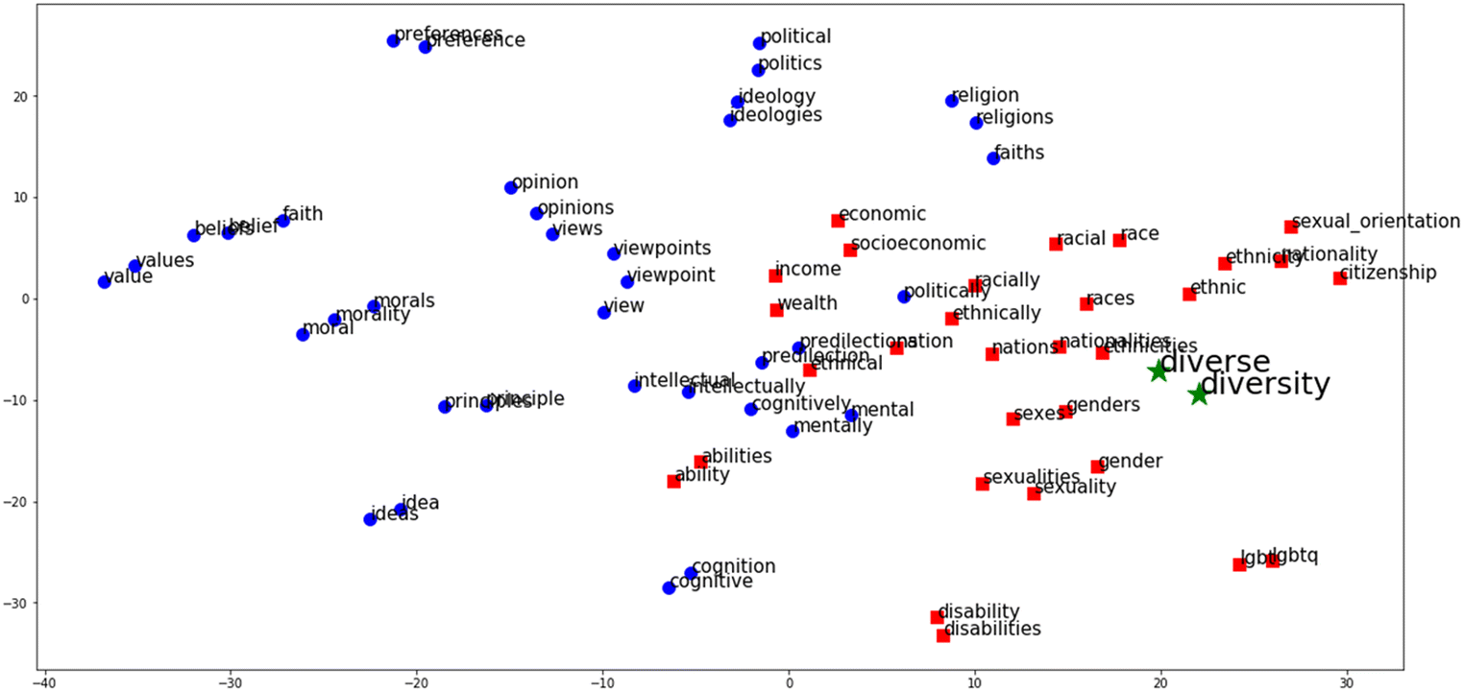
Word2Vec Visualization

Slide 11
Model Selection
Neural Network
Embedding Layer
LSTM layer (Downstream)
LSTM layer (Upstream)
Linear

Slide 12
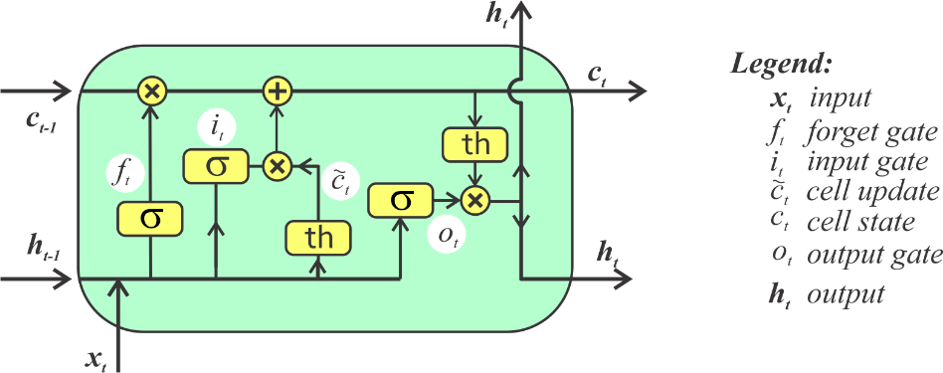
Model Selection
LSTM (Long-Short-Term Memory)

Slide 13
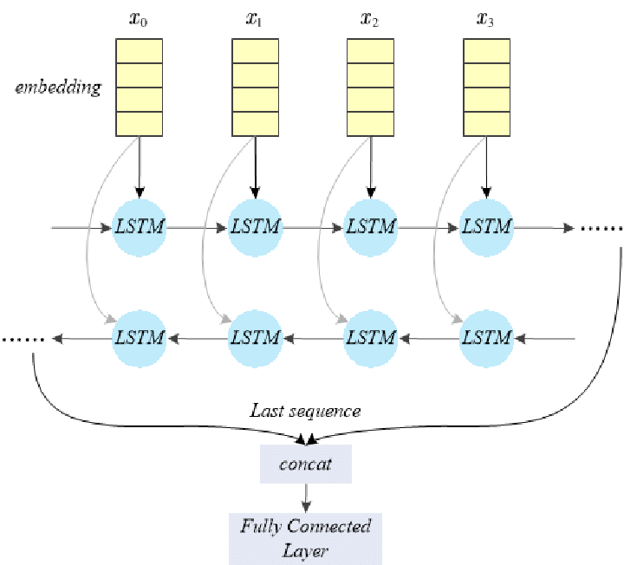
Model Selection
Bidirectional LSTM

